Slide 1

Population Health M3
An introduction to evidence based medicine for patient care
Michael Joyce, MD, FACEP
Associate Professor of Emergency Medicine and Radiology
VCU School of Medicine

Slide 2
Housekeeping:
Quiz will be open immediately after this lecture, and open until Wednesday end of day (11:59pm)
The quiz is short questions that you will be able to answer easily if paid attention to and participated with the presentation
Please remember to take the quiz!

Slide 3
Recap of what we have covered so far
Session 1: Intro to EBM, Resources for finding the best evidence
Session 2: How to ask a good question, refining the ask to get an answer
Session 3: Applying diagnostic studies to your everyday practice – likelihood ratios are your friend
Session 4: Therapy studies - interpreting new data – should I do this for my patient(s)?
Session 5: Harm - understanding the importance of observational studies
Session 6: Prognosis - knowing what is likely to happen to my patient

Slide 4
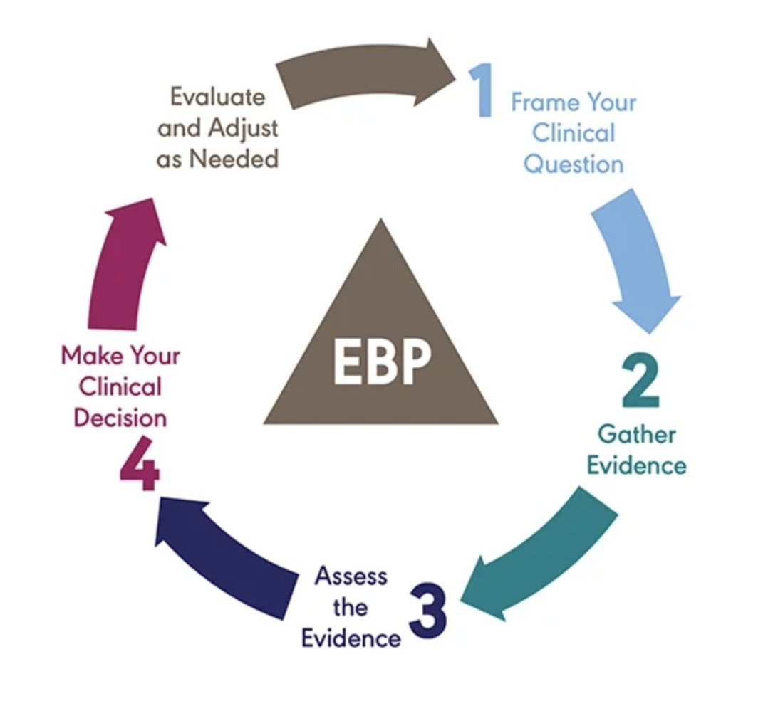
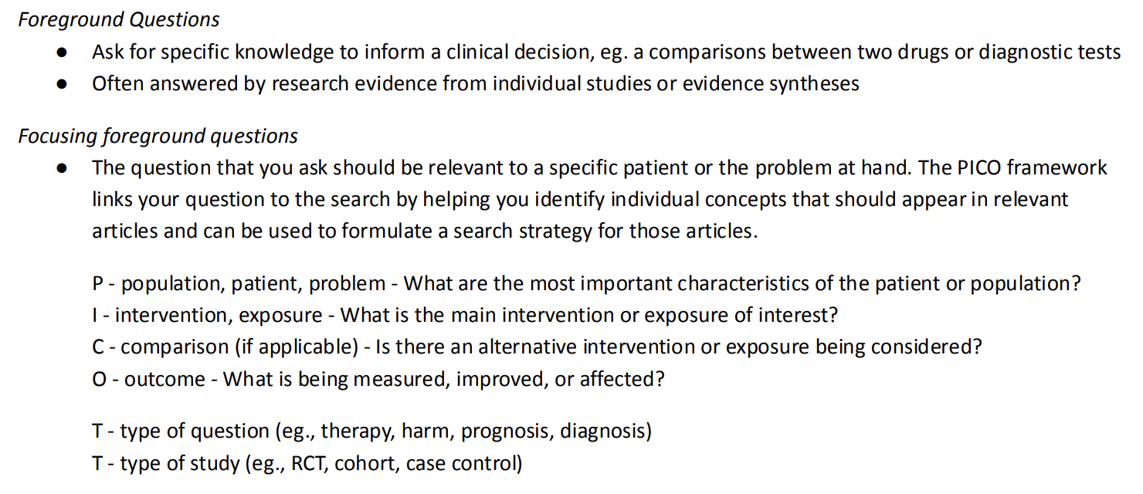
The Evidence Cycle
EBM

Slide 5
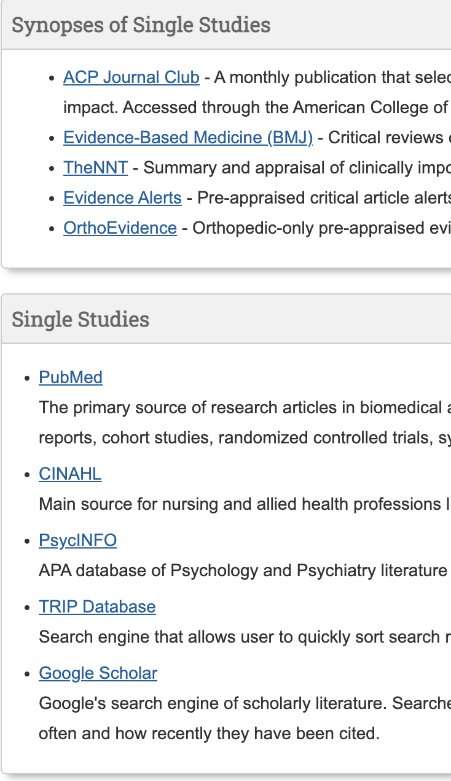
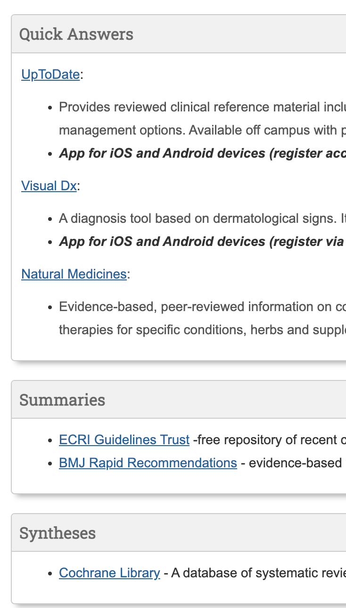
The Evidence Cycle
https://guides.library.vcu.edu/clerkships
EBM

Slide 6
The Evidence Cycle
Takes continued practice – more practice today
EBM

Slide 7
The Evidence Cycle
What decision am I making?
Diagnosis
Therapy
Harm
Prognosis
EBM
Today:
Recap
Prognosis
Intro to SDM
Review Questions

Slide 8
Goals and Objectives
Today’s goals:
  Review some of the concepts we have covered
  Discuss prognosis studies
  Identify what prognostic factors are
  Understand risk, odds, RR, OR, HR
  Reinforce the importance of patient centered outcomes
  Intro to shared decision making

Slide 9
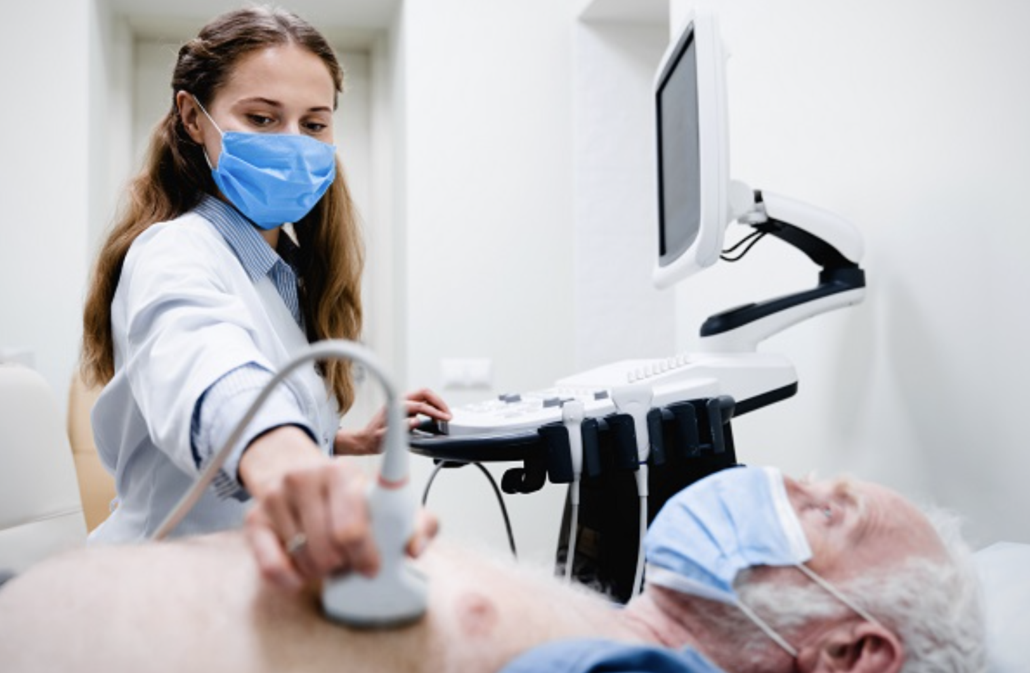
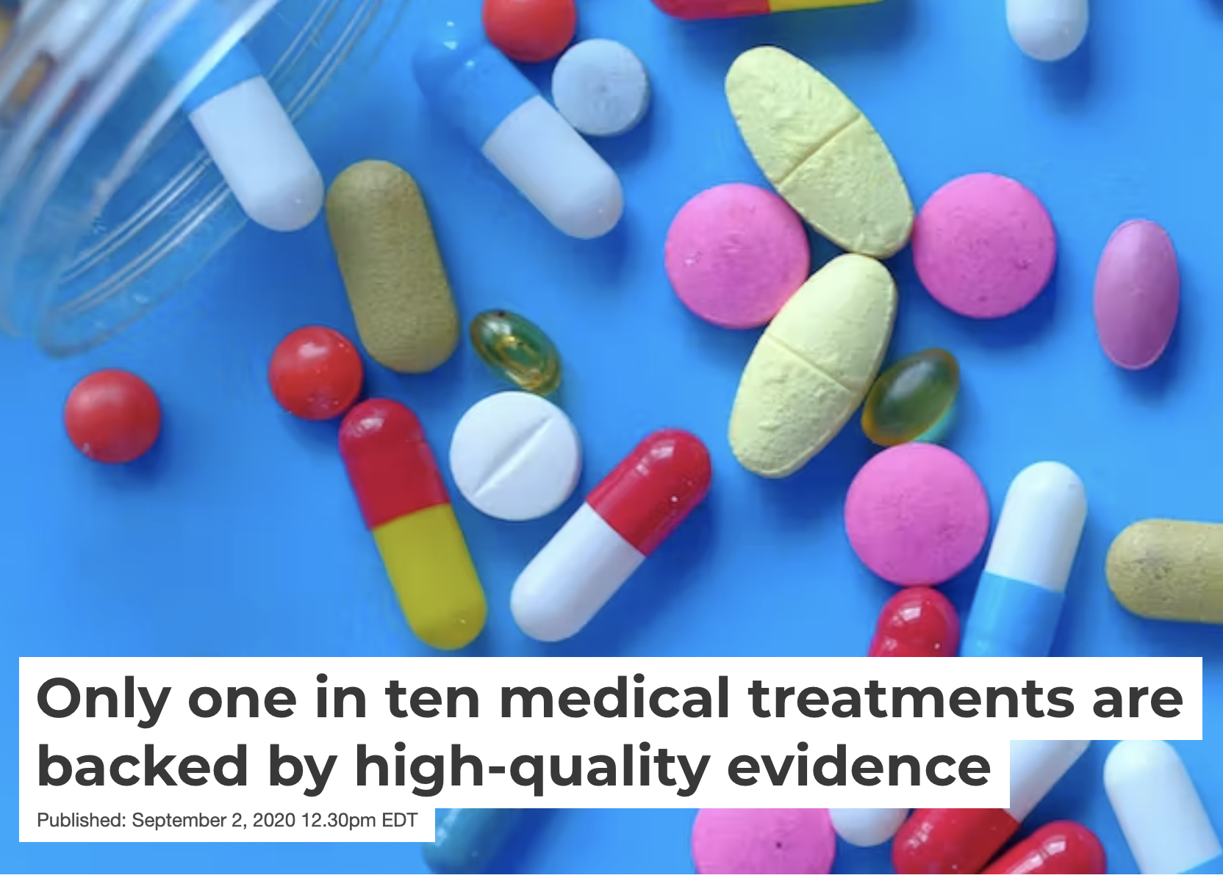
How do doctors actually help patients?
Diagnosing
Treating

Slide 10
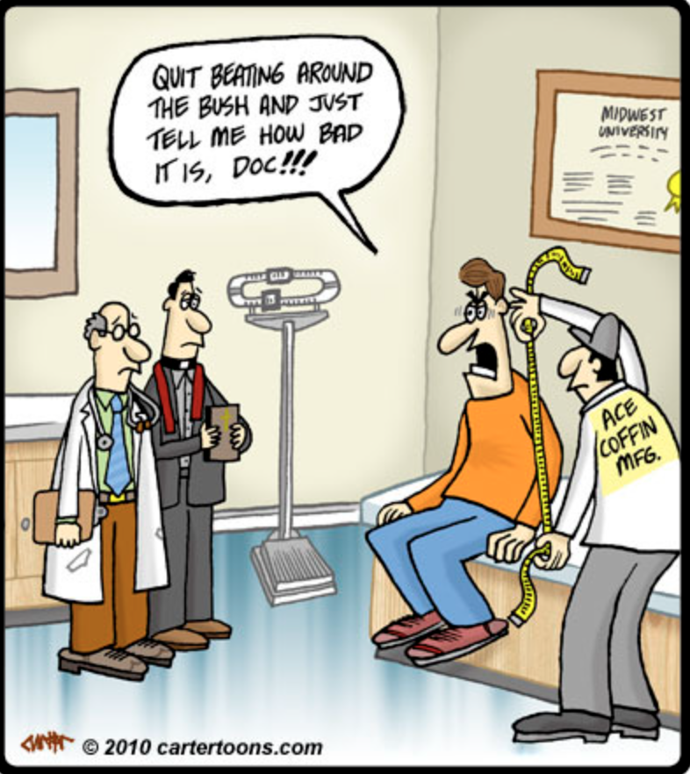
How do doctors actually help patients?
Prognosis

Slide 11
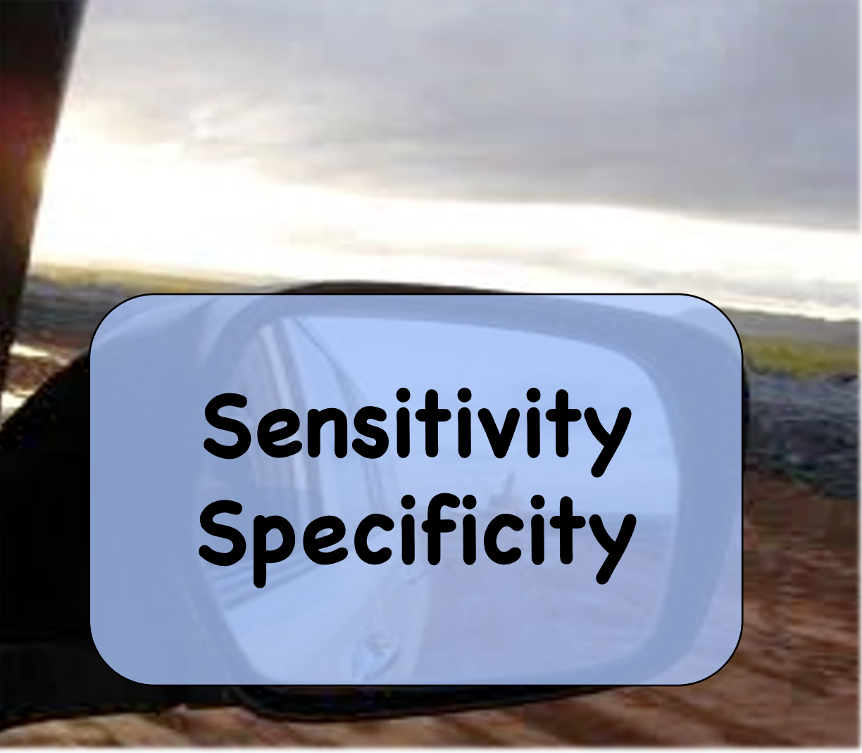
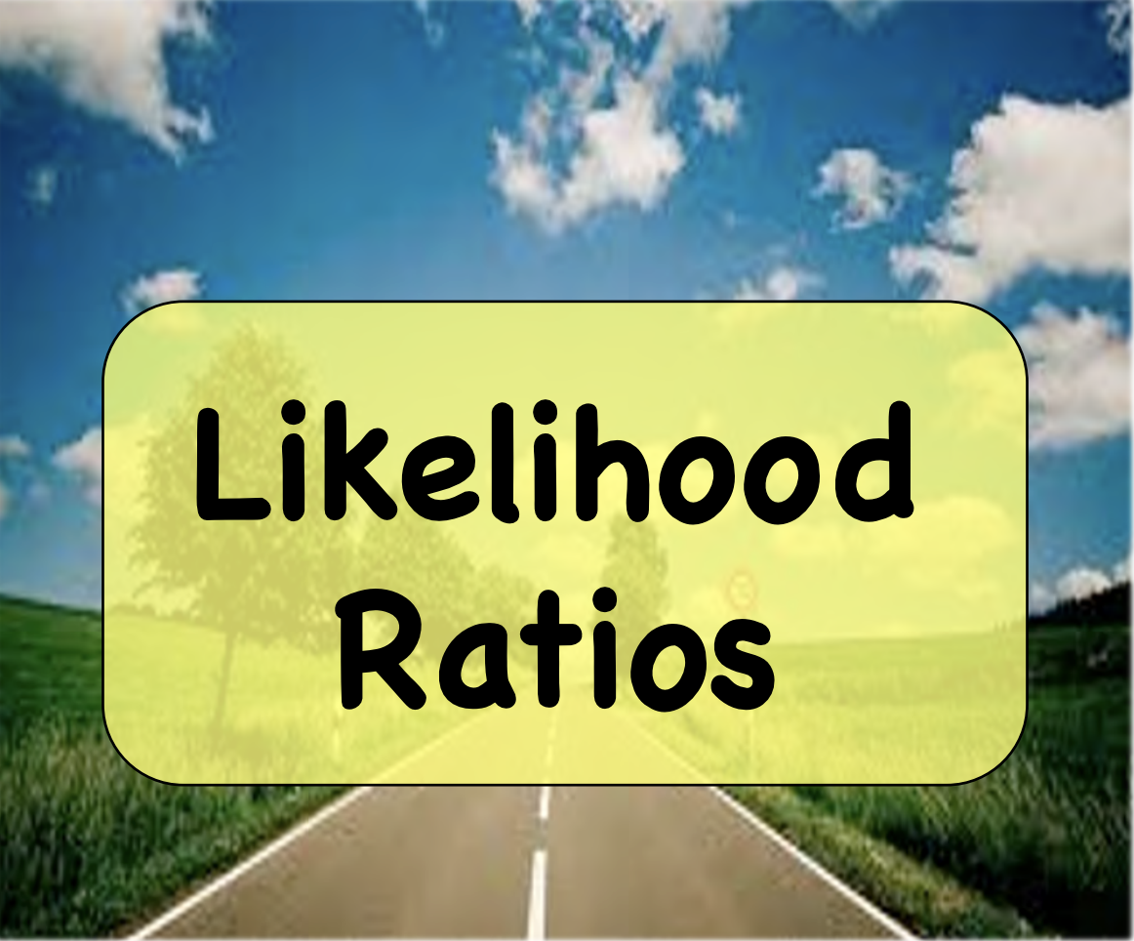
Diagnosing: using tests

Slide 12
Diagnosing: using tests
Sensitivity: the ability of a test to correctly identify patients with a disease
Specificity: the ability of a test to correctly identify people without the disease
LR+ Likelihood of the test being correct when it is positive
LR – Likelihood of the test being correct when it is negative

Slide 13
Diagnosing:
Don’t forget about likelihood ratios!
LR+ Likelihood of the test being correct when it is positive
LR – Likelihood of the test being correct when it is negative
> 10
< 0.1
Likelihood ratios have a number of useful properties:
  because they are based on a ratio of sensitivity and specificity, they do not vary in different populations or settings
  they can be used directly at the individual patient level
  they allow the clinician to quantitate the probability of disease for any individual patient.

Slide 14
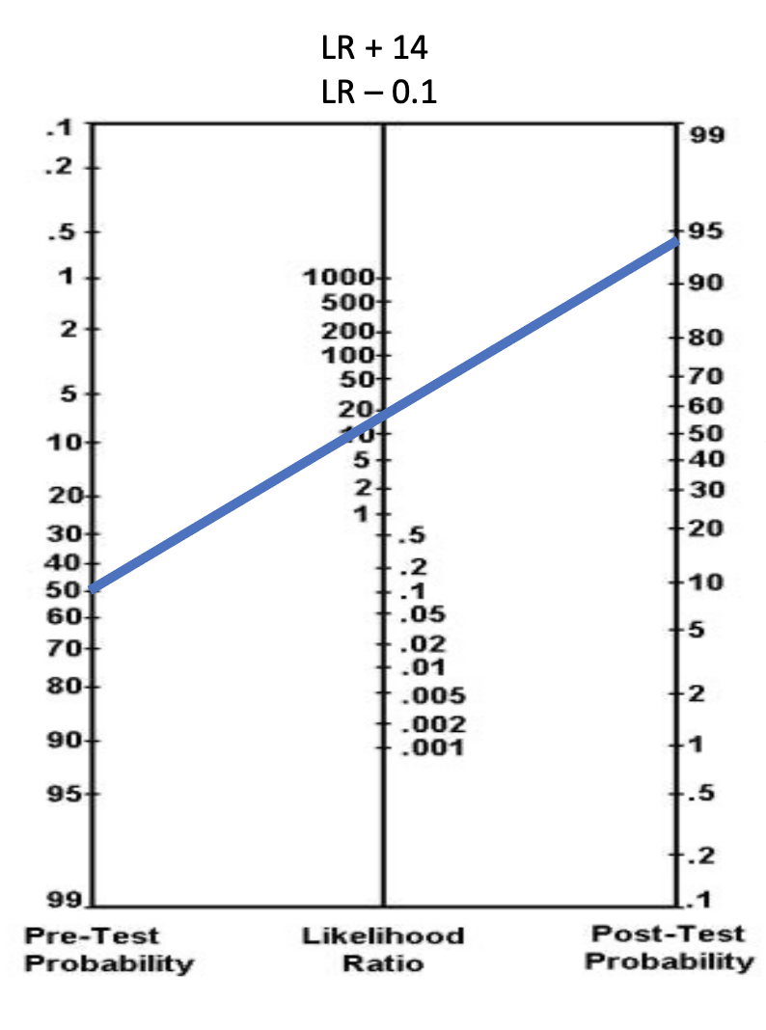
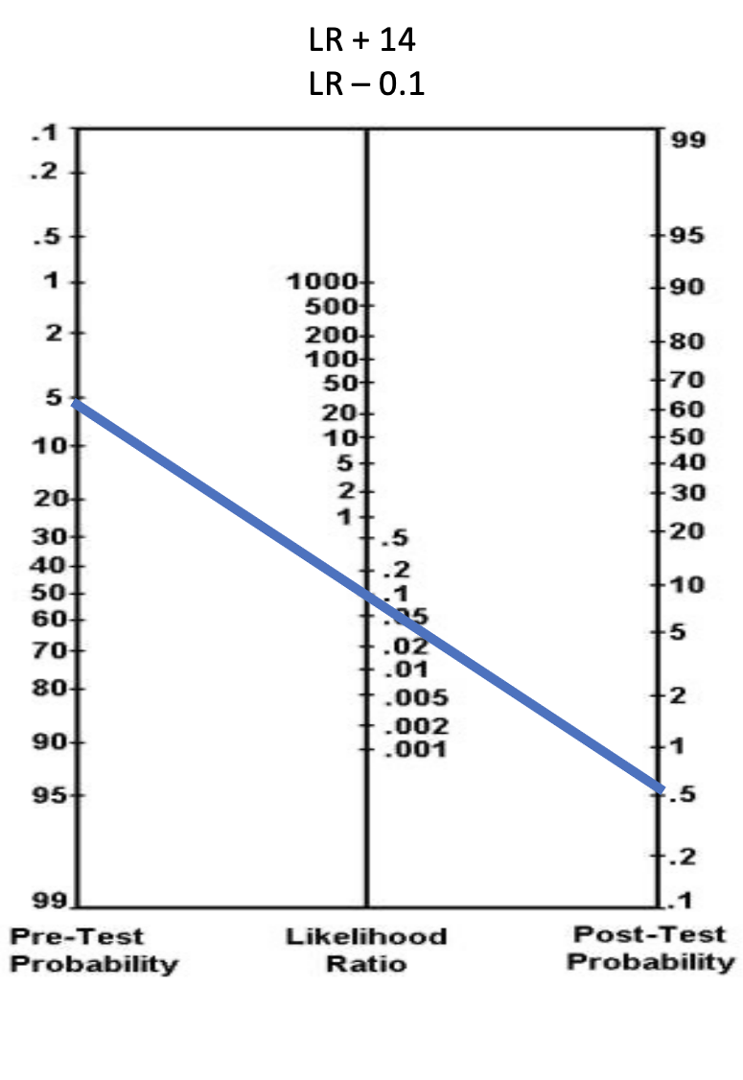

Slide 15
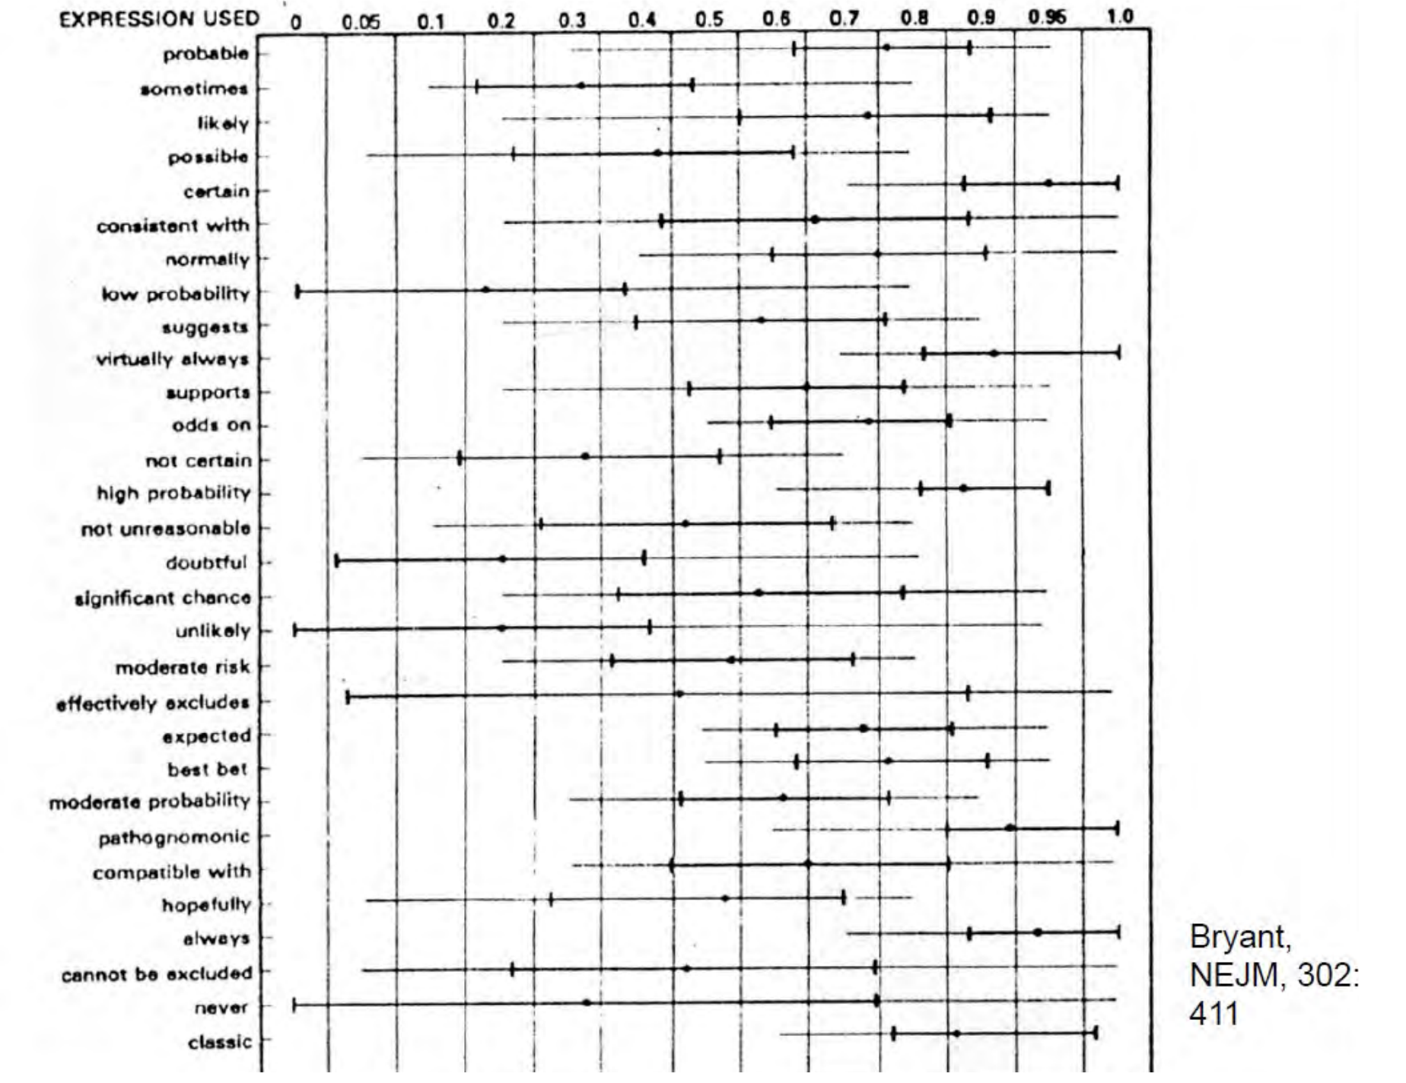
Expressions of Probability: Words and Numbers

Slide 16
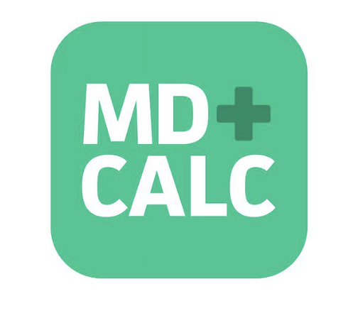
Use clinical decision-making tools to get pre-test probability
Cognitively unload us:
PE – Wells Criteria, PERC rule
Appendicitis- Alvarodo, pARC
Necrotizing fasciitis – LIRNEC
C-Spine Fracture – NEXUS
ICH – Canadian head CT
NIH Stroke scale

Slide 17
Diagnosing
Likelihood ratios:
  Affect real time decision making
  Integrate specificity and sensitivity (they use the whole 2x2 table!)
  Should be applied in all diagnostic work ups!
  Used appropriately, can prevent unnecessary testing or incorrect testing
  As you continue to rotate through M3 year, continue to think in terms of probability expressed as a percentage, not “pathognomonic, classic presentation, etc”. What does that mean for that disease ?
  The data is out there!

Slide 18
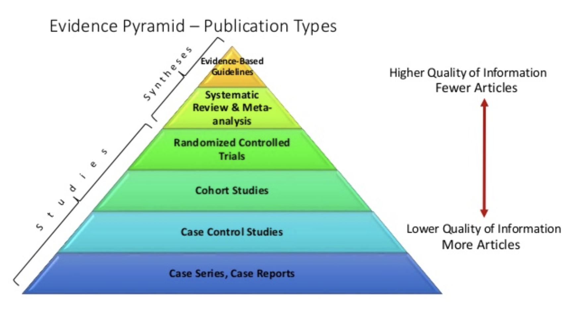
Treatment

Slide 19

Randomized Control Trial
Treatment

Slide 20
Evolution of evidence
New therapy developed
Physiologically makes sense, or bench trials/animal trials/small trials
Ideal next step: RCT with patient centered outcomes (takes long time)
Real world – observational studies with surrogate outcomes (quicker) or: controlled trials with surrogate outcomes (smaller, quicker)
Therapy approved, put into use
RCTs get started… take years to evaluate for patient centered outcomes
Study concludes - Therapy rejected and or/treatment not as effective as once thought
Long term observational studies completed

Slide 21
Treatment
Always re-evaluate new evidence
Avoid the noise – read Table 1, Look at results table, calculate numbers that make sense to patients (ARR, NNT), use those to help you guide clinical decisions
Randomized is the gold standard, but still requires very high methodological adherence
Intention to treat vs Per protocol – both have their benefits but ITT will simulate real world whether we like the result or not
Watch out for surrogate outcomes causing authors to over conclude

Slide 22

How do doctors actually help patients?
Diagnosing
Treating
Prognosing?
-LR+, LR –
-Pre-test, post test probabilities
- Avoid unnecessary testing
-RCTs
-Always re-evaluate with new evidence
-Observational trials have merit, especially when determining HARM

Slide 23
Prognosing
In simple acute cases, taken for granted, perhaps understated
  UTI, Fracture, Kidney stone, etc
In complex chronic cases, often overlooked
  HTN
  DM
  AFIB
  Joint arthritis
  CHF
  Crohn’s
In cancer cases – usually the first thing that is asked

Slide 24
Looking into the future:
Requires studies of prognosis
Allows doctors to help patients make the right decisions to line up with their values
Prognostic research has many important purposes
  (i) describing the natural history and clinical course of health conditions
  (ii) investigating variables associated with health outcomes of interest,
  (iii) estimating an individual’s probability of developing different outcomes
  (iv) investigating the clinical application of prediction models

Slide 25
Why is it so important?
If a patient is likely to improve without intervention, doctors should not recommend treatments, particularly those that are expensive or potentially toxic.
If a patient is at low risk of adverse outcomes, even beneficial treatments may not be worthwhile.
Some patients will experience poor outcomes regardless of which treatments are offered by the clinician.
When a patient better understands the long term outlook of a disease, they are MUCH more likely to take an active role in managing it.
  Cannot feel high cholesterol, but there are many adverse outcomes that patients may actually care about

Slide 26


What is the best type of study for prognosis?
Cross Sectional Study
Case Control Study
Randomized Control Trial
Prospective Cohort Study
Retrospective Cohort Study
Descriptive / Association
https://www.polleverywhere.com/multiple_choice_polls/Ts2dLEyKUfG2R0aDL1GjW?preview=true&controls=none

Slide 27


Slide 28
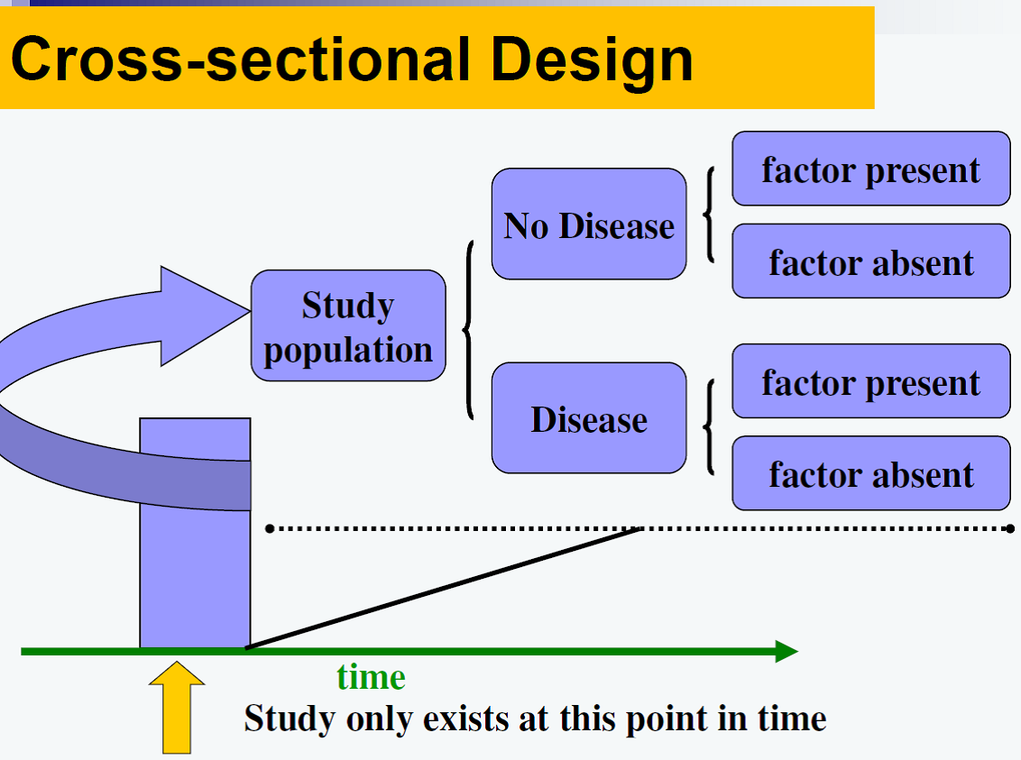

Slide 29
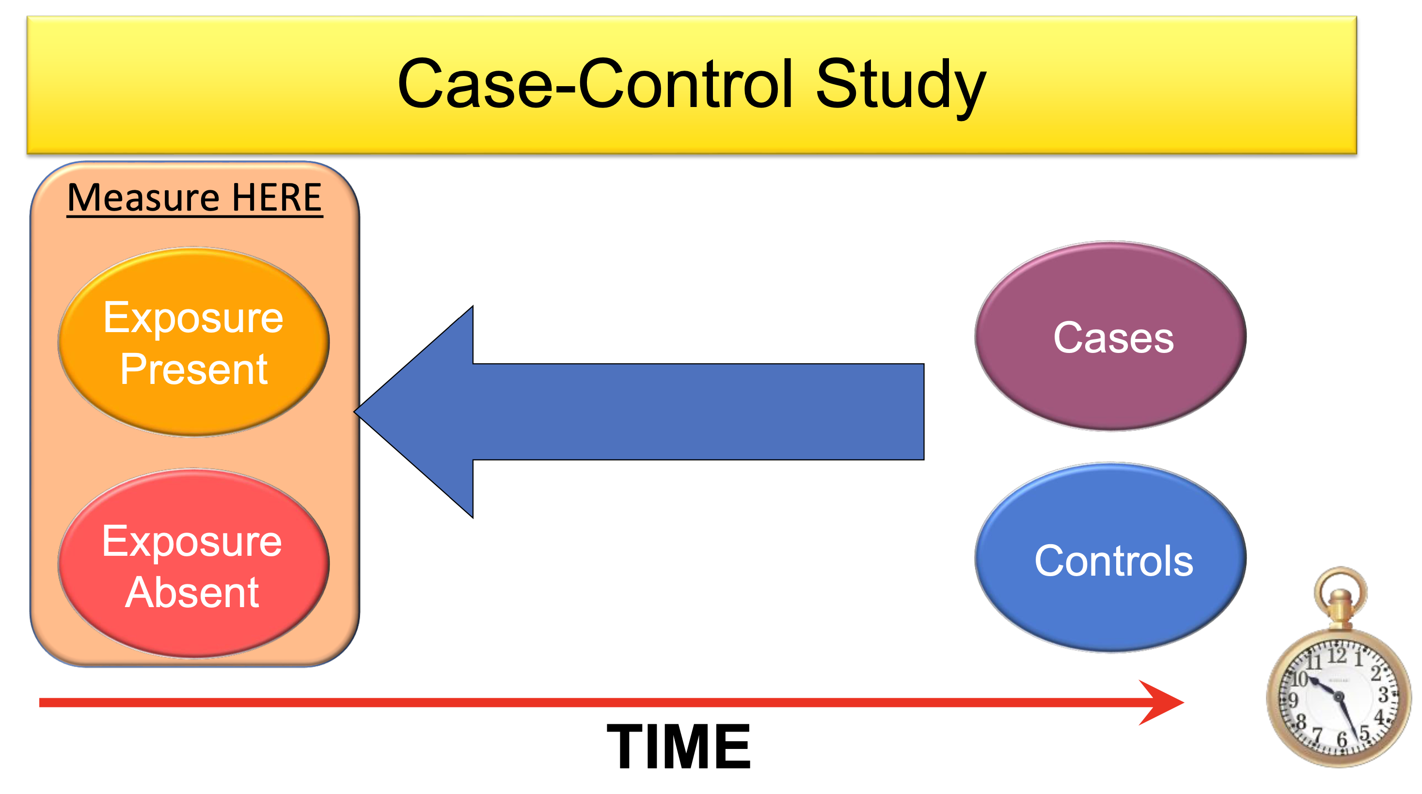

Slide 30
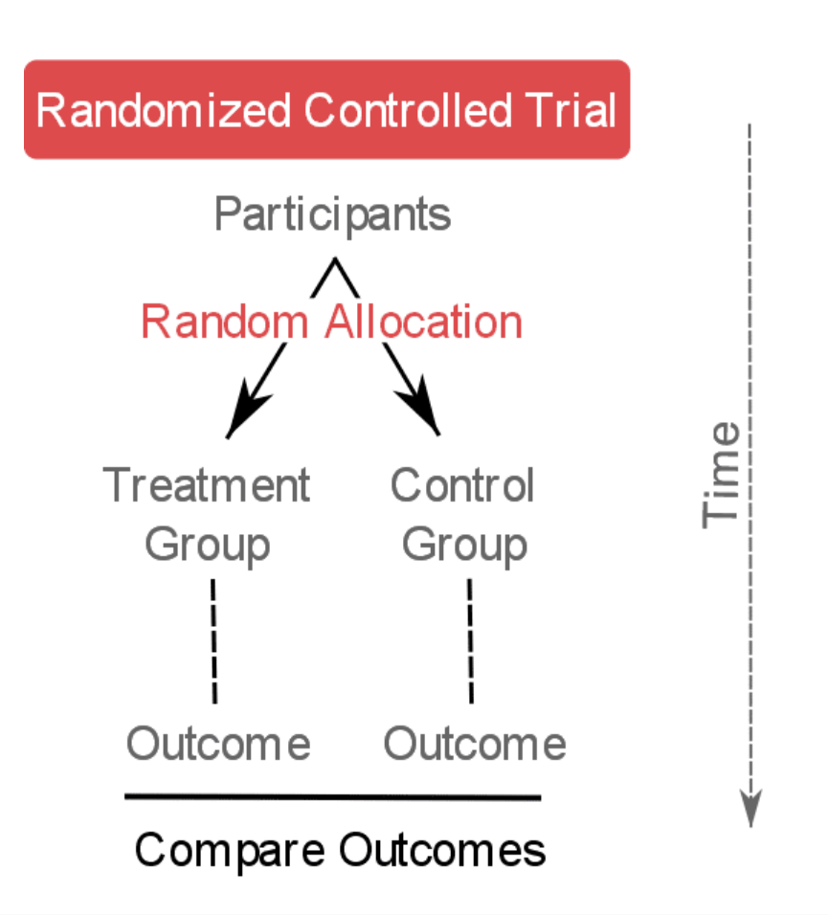

Slide 31
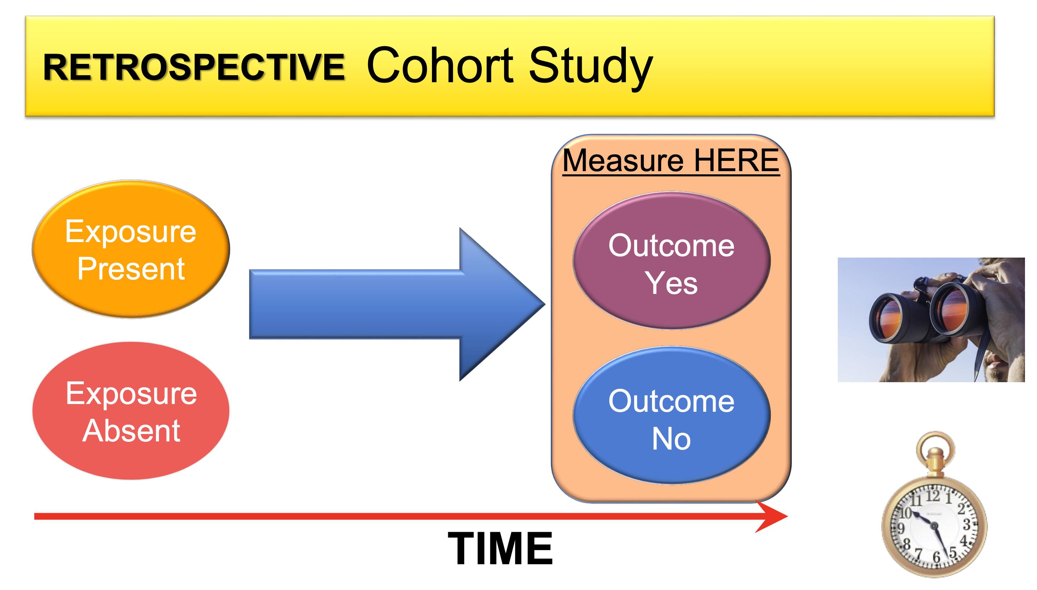

Slide 32
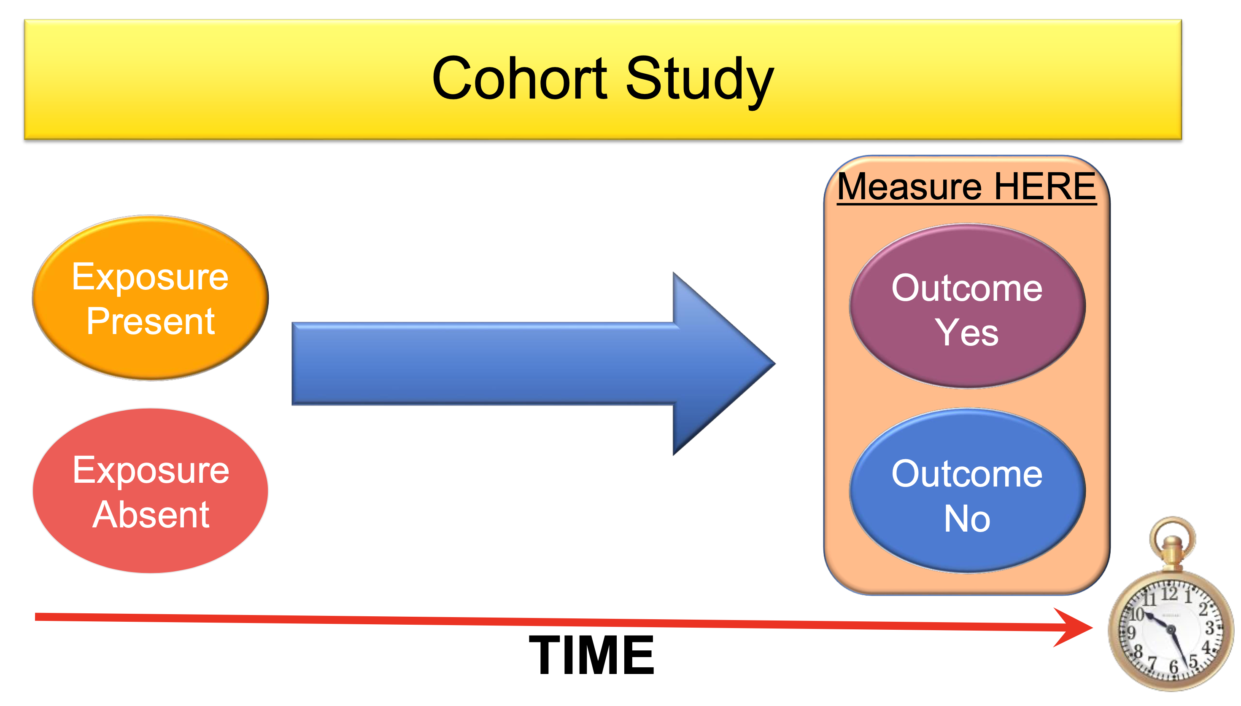

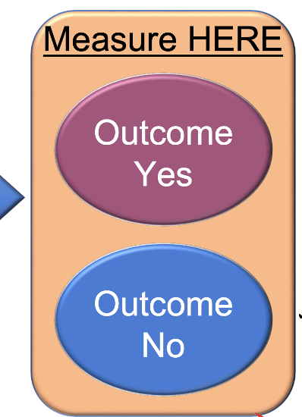
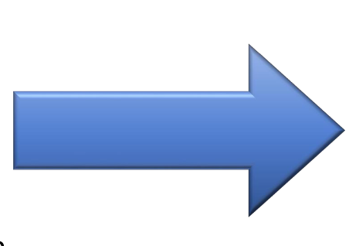

Prognosis study
Record potential differences in the patients (Prognostic factors)

Slide 33
So what do prognostic studies look for?
Age
Sex
Co-morbidities (HTN, DM, etc)
As opposed to studies where you are applying an intervention, in prognostic studies, you are looking at either the natural course of the disease, or the expected course of the disease with standard care

Slide 34
What is the best type of study for prognosis?
Cross Sectional Study
Case Control Study
Randomized Control Trial
Prospective Cohort Study
Retrospective Cohort Study
Descriptive / Association
https://www.polleverywhere.com/multiple_choice_polls/Ts2dLEyKUfG2R0aDL1GjW?preview=true&controls=none

Slide 35
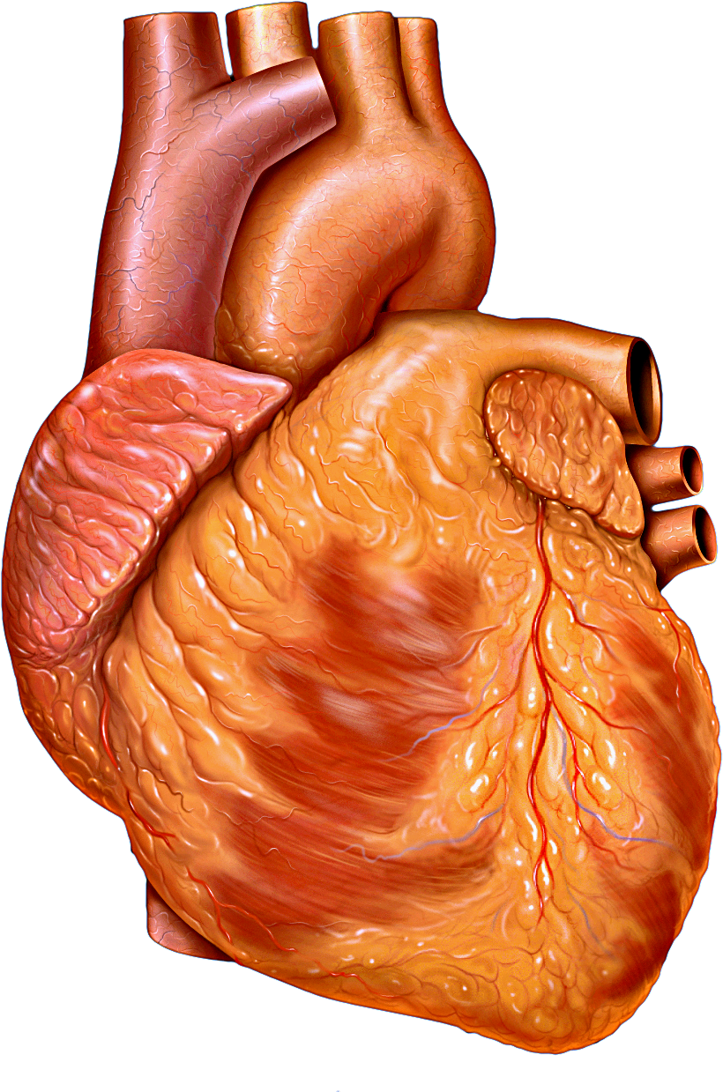
Let’s look at a case
A 50 yo male with a history of well controlled hypertension comes into your clinic stating that he has been experiencing on and off palpitations for the past month. His apple watch has noticed his HR is sometimes fast at a rate of around 110, but goes away when the palpitations stop. He denies any other symptoms. He noticed it once while snowboarding, and another time while rock climbing. He figured it could be related to his activities.

Slide 36
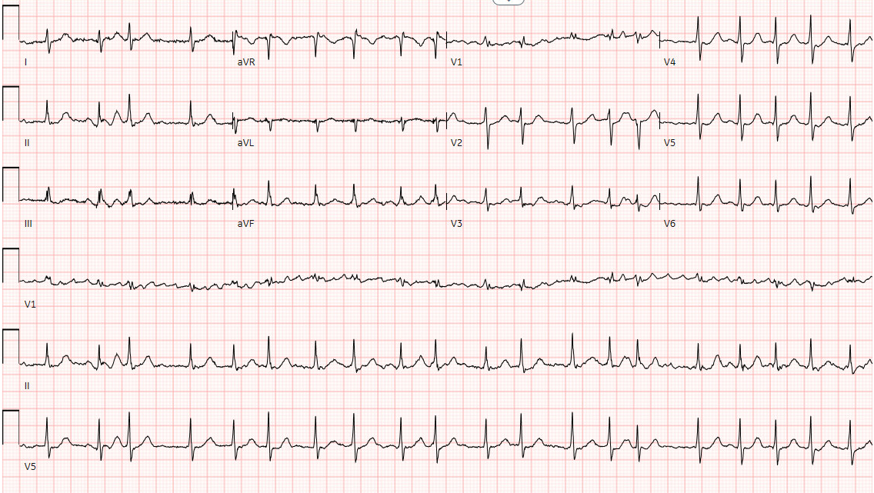
EKG:

Slide 37
Let’s look at a case
You appropriately refer the patient for an echocardiogram which returns normal. The patient is asking what this new diagnosis means for them? What is the treatment?
You discuss whether anticoagulation would be beneficial, given his stroke risk. But the patient states that he is concerned about taking these given his lifestyle. He does not want to stop participating in extreme sports.
“What would happen if I didn’t take the blood thinners!?”

Slide 38

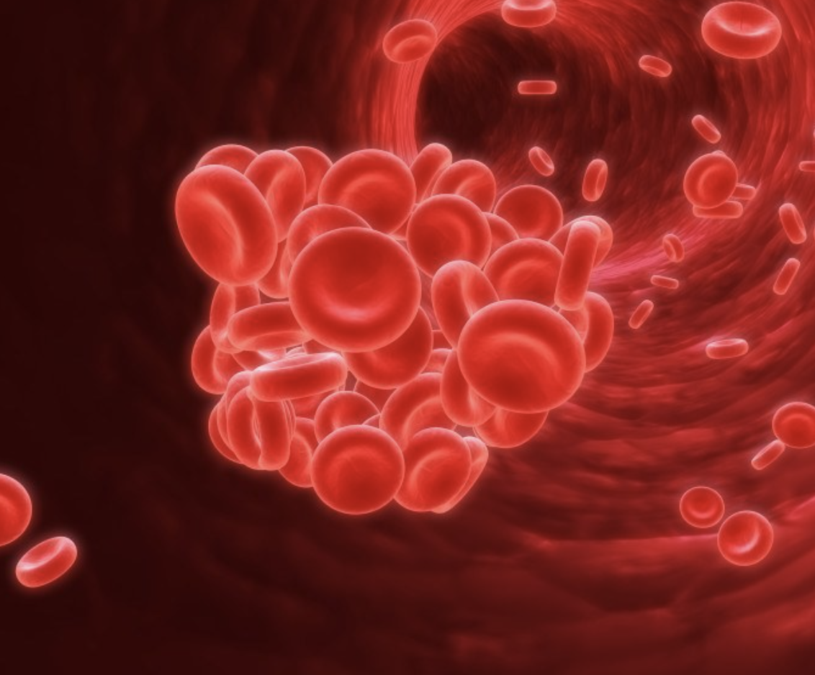

Slide 39

So… what is the first step?

Slide 40
Step one: what is the question?
P -
I -
C -
O -
T -

Slide 41
Step one: what is the question?
P – Adult patients with new diagnosis AFIB
I – Anticoagulation
C – No anticoagulation
O – Stroke
T – prognosis

Slide 42
Step one: what is the question?
P – Adult patients with new diagnosis AFIB
I – Time
C –
O – Stroke
T – Prognosis

Slide 43
Step 2, where should I start looking?

Slide 44
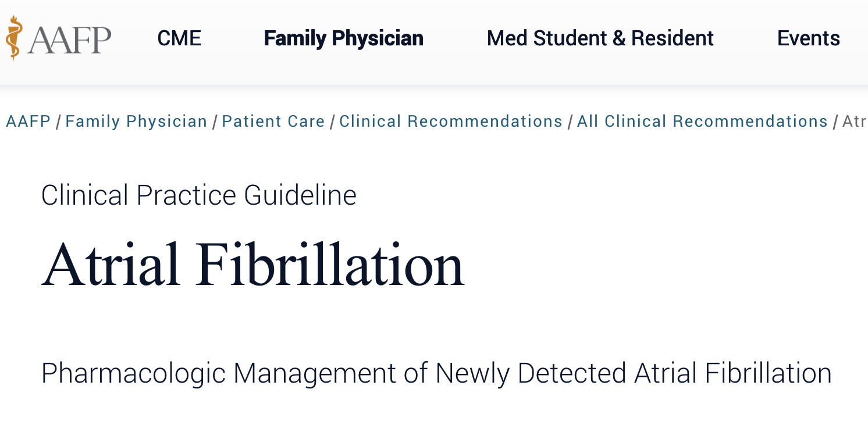
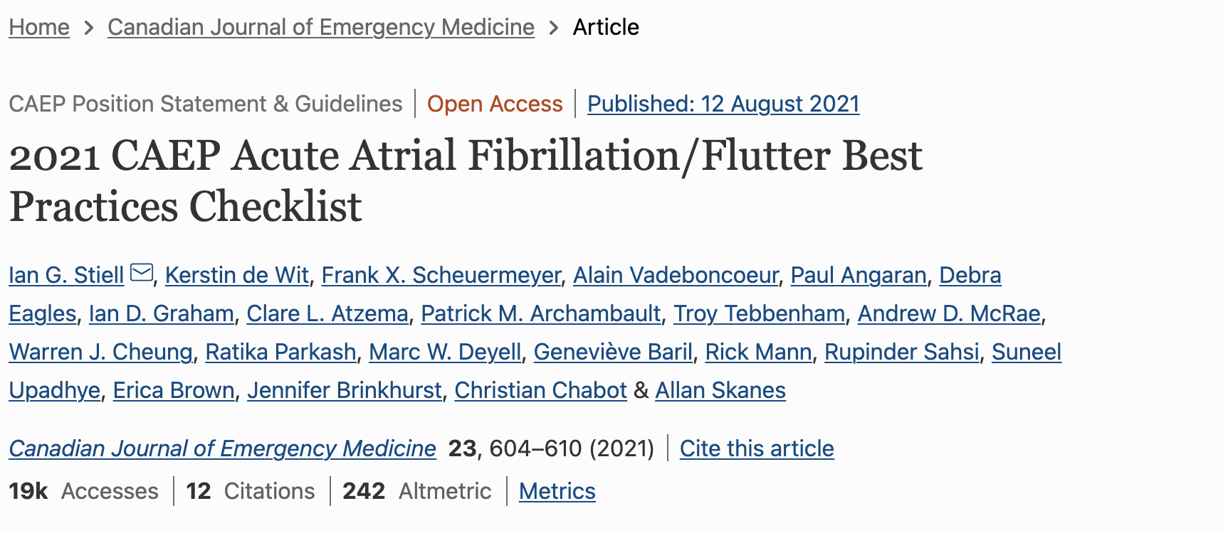
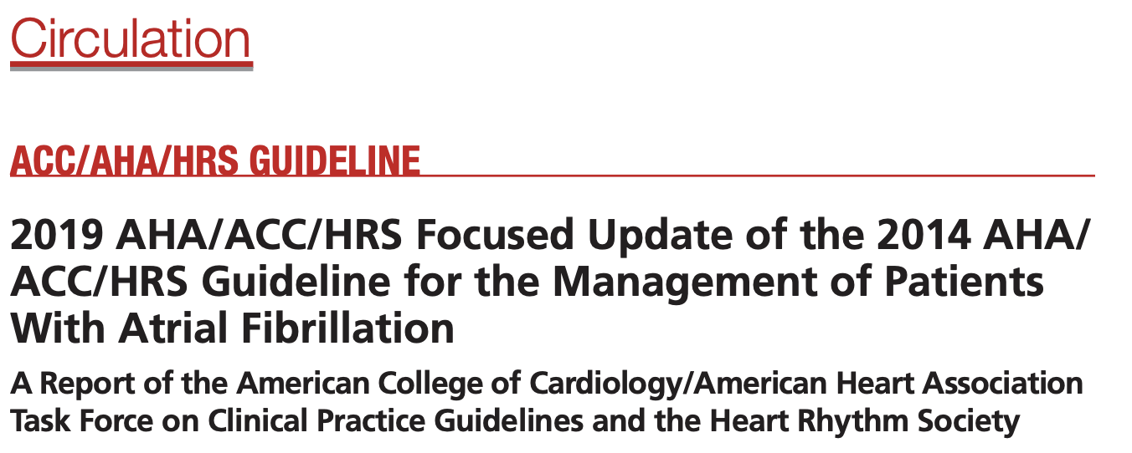
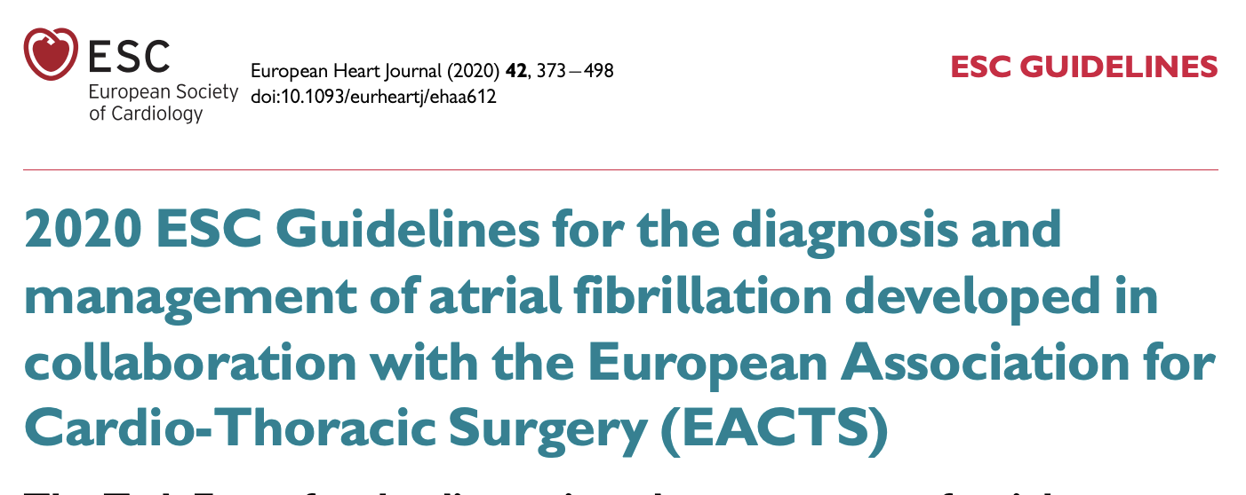
Look for clinical EBM guidelines:

Slide 45
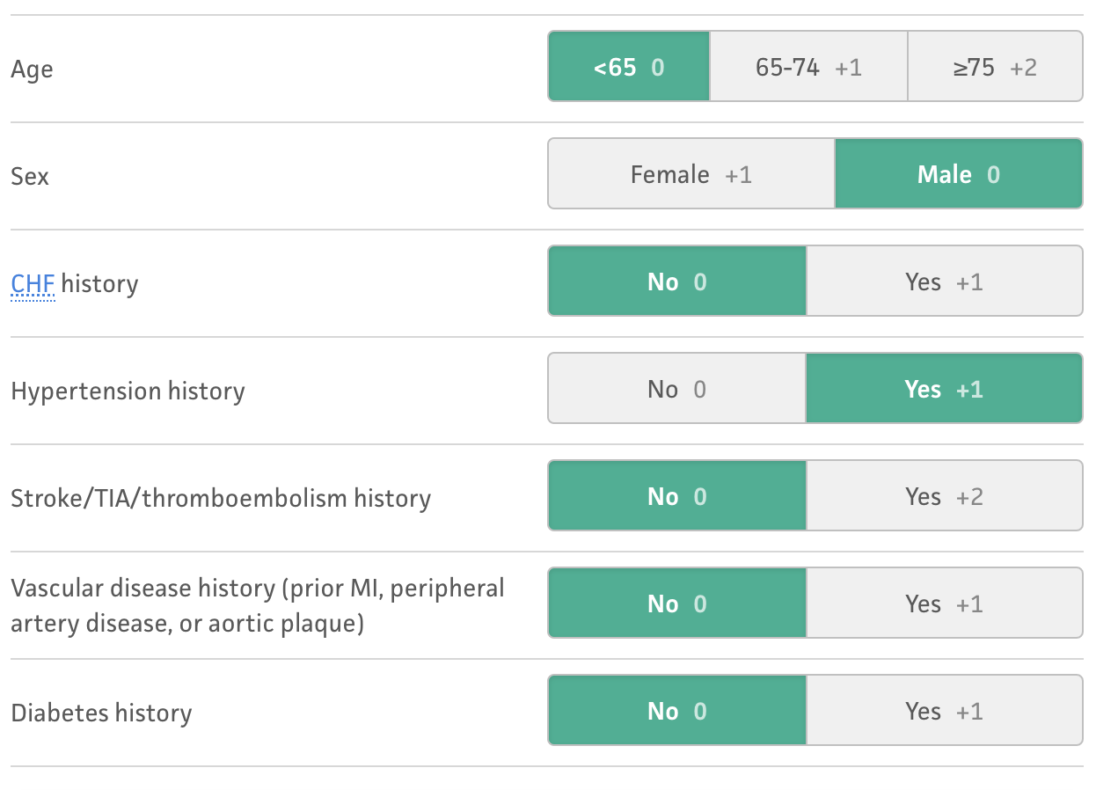

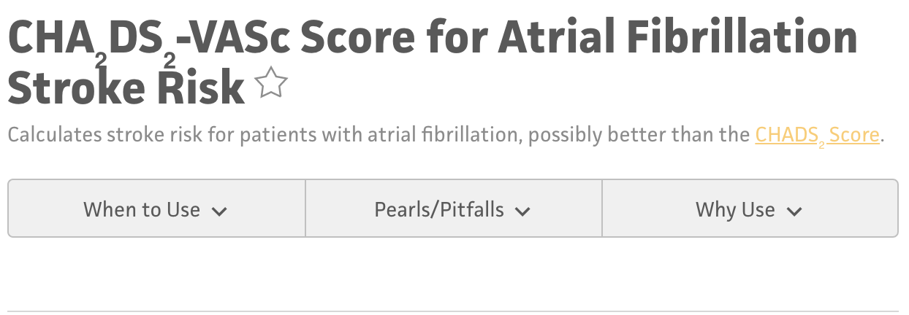
Look for clinical EBM decision making tools:

Slide 46
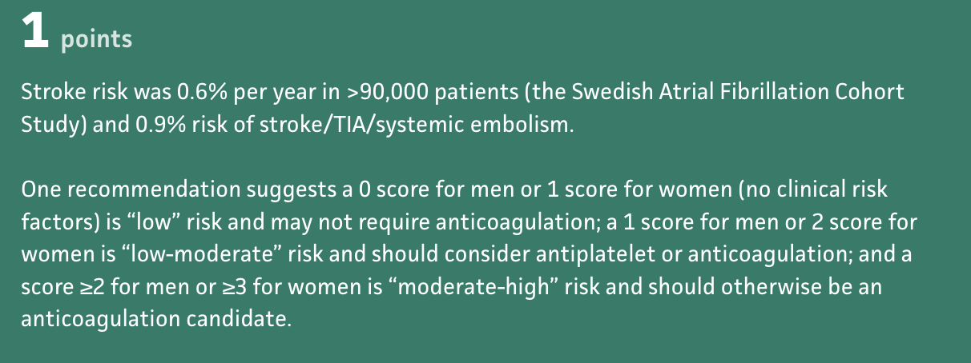
Look for clinical EBM decision making tools:

Slide 47
Where do these scoring systems come from??
Prognostic studies!

Slide 48
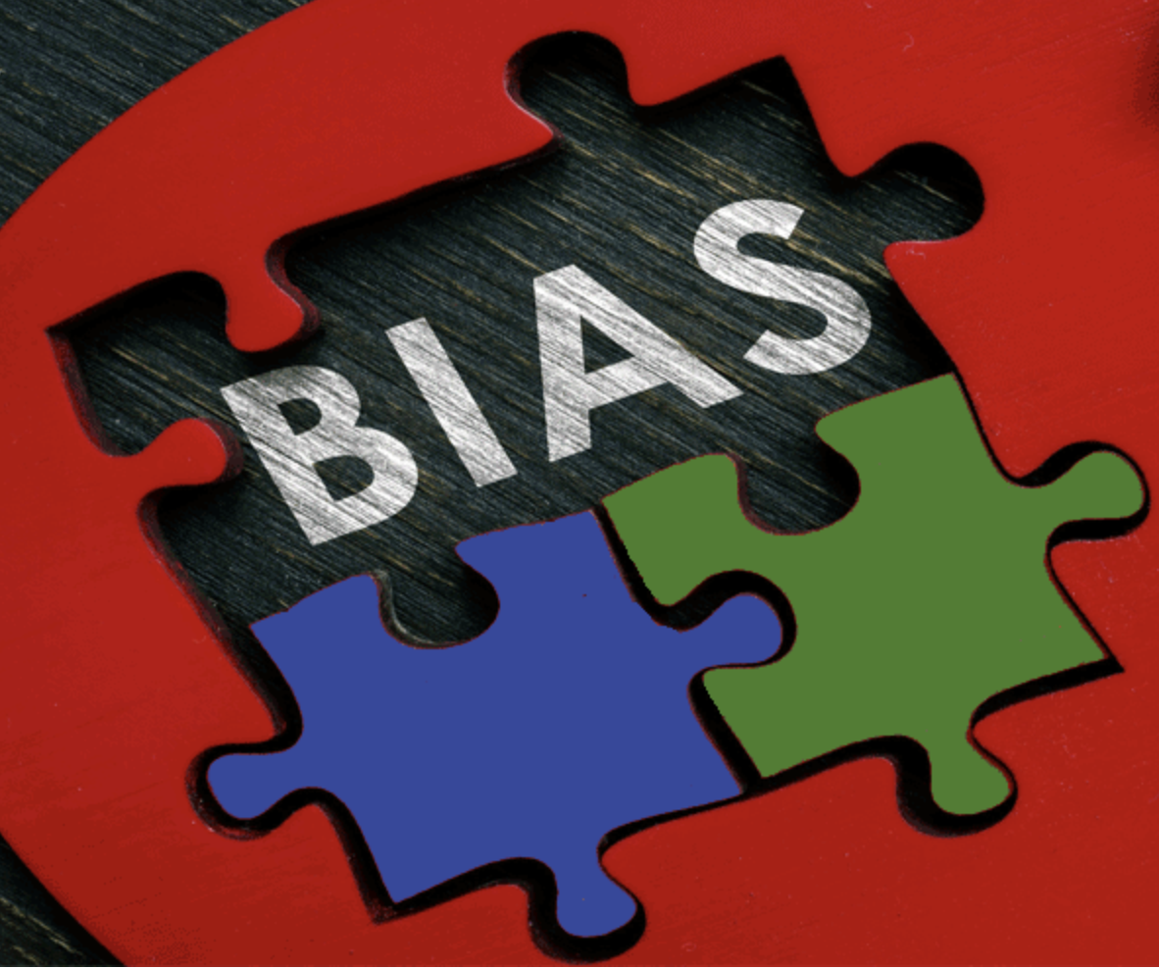

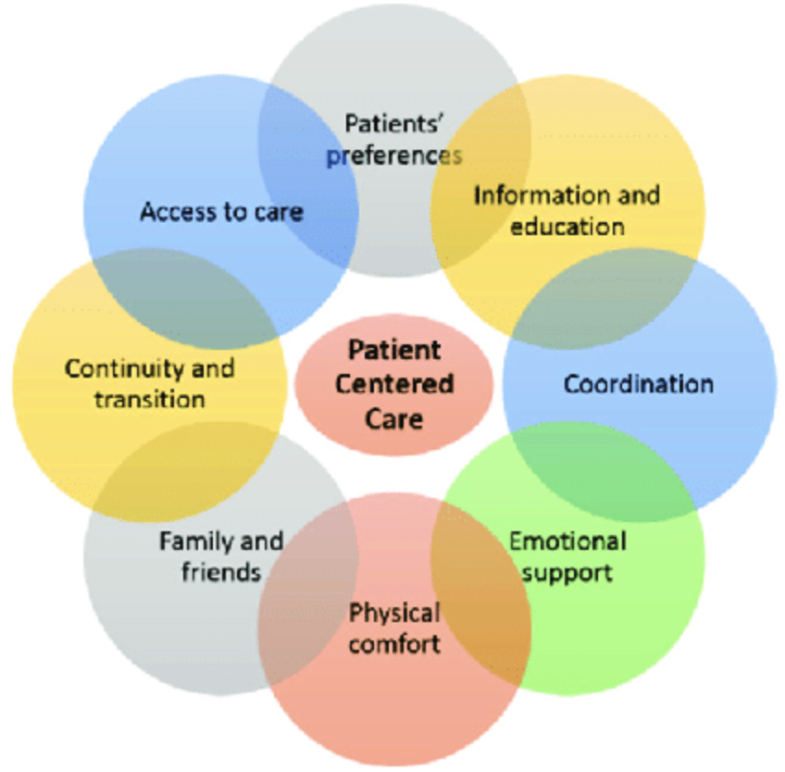
What makes a good prognosis study?

Slide 49
What makes a good prognosis study?
Was the Sample of Patients in a Study Representative?
Was Study follow up Sufficiently Complete?
Were Study Outcome Criteria Objective and patient centered?

Slide 50
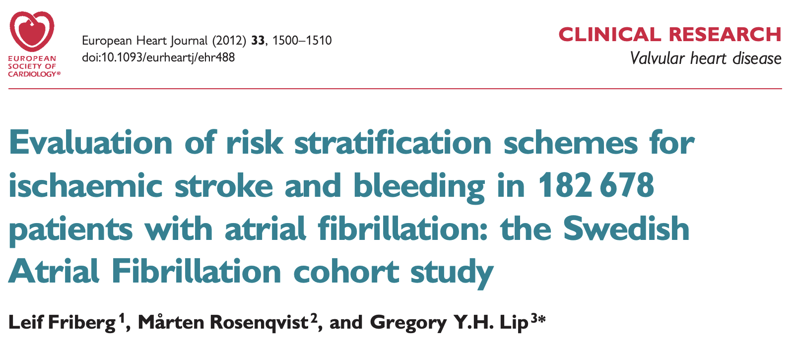

Slide 51
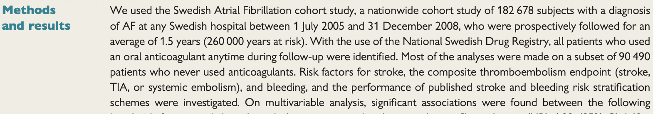

Slide 52
So what did they do?
Enrolled 180,000 patients with new diagnosis of Afib
Looked at the COHORT of patients that did not take OAC
Recorded suspected prognostic factors
Followed them over time
Found out which ones were related
Performed multivariate regression analysis to determine independent prognostic factors as predictors

Slide 53
What makes a good prognosis study?
Was the Sample of Patients in a Study Representative?
Was Study follow up Sufficiently Complete?
Were Study Outcome Criteria Objective and patient centered?

Slide 54
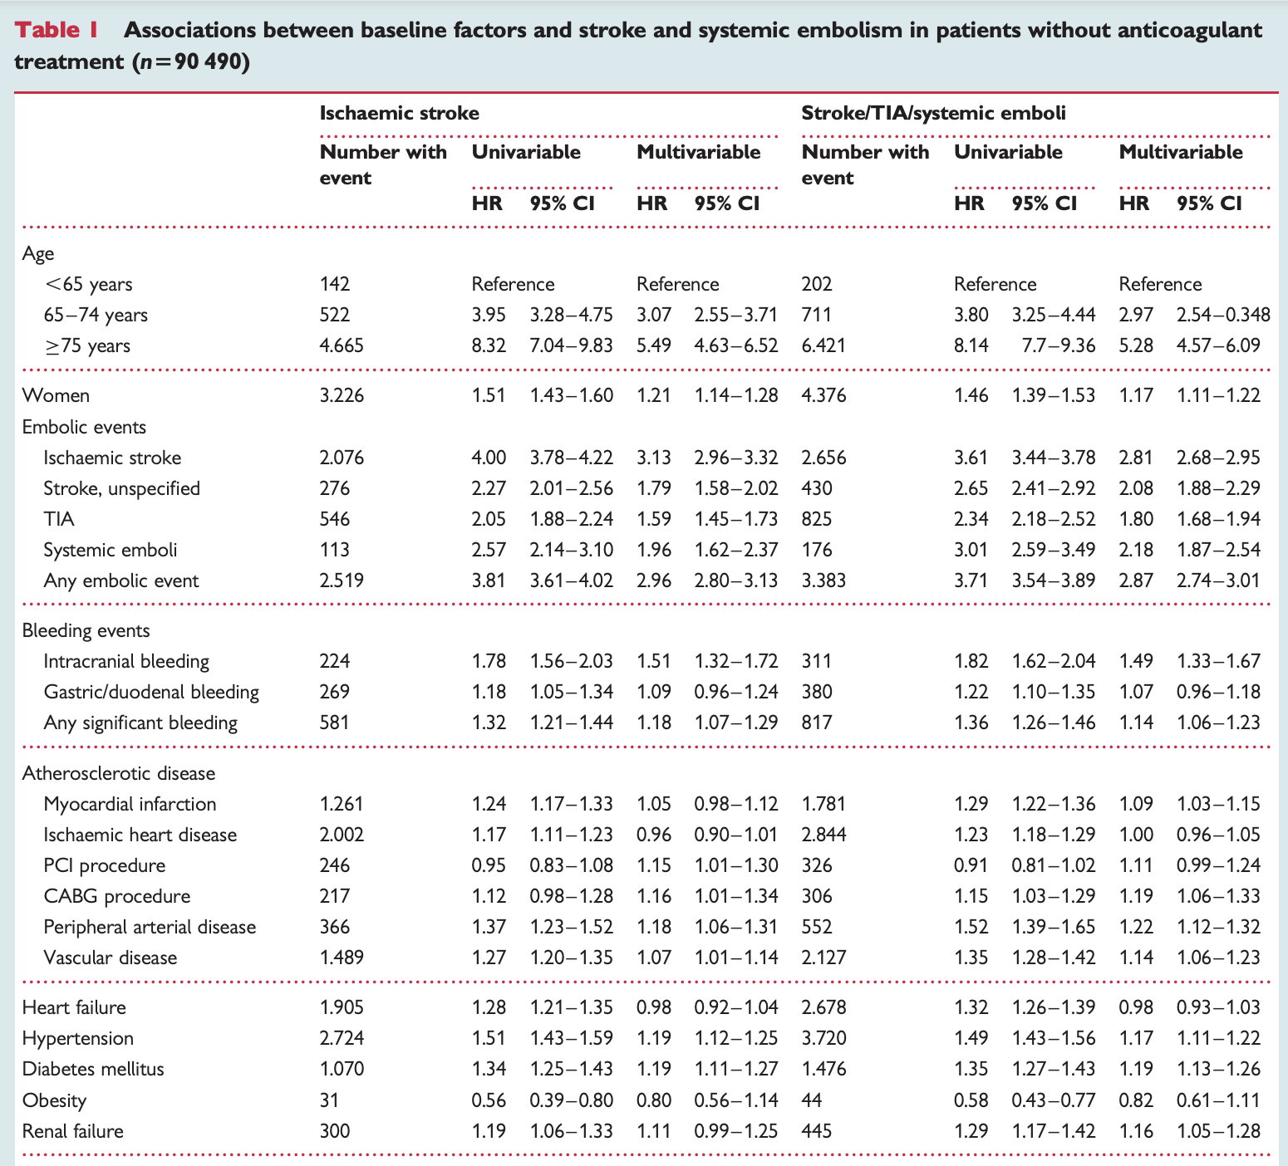
Was the Sample of Patients in the Study Representative?

Slide 55


What makes a good prognosis study?
Was the Sample of Patients in a Study Representative?
Was Study follow up Sufficiently Complete?
Were Study Outcome Criteria Objective and patient centered?

Slide 56
How do observational studies report findings?
Odds vs Risk
  This is very confusing, and often mis-stated in summaries of studies, or from clinicians to patients
  RISK
    Simply put is a probability
    The probability of something happening, compared to all the outcomes.
    Best for looking at multiple outcomes
  ODDS
    A ratio of occurring vs not occurring
    Best for looking at binary outcomes
Relative Risk
Odds Ratio

Slide 57
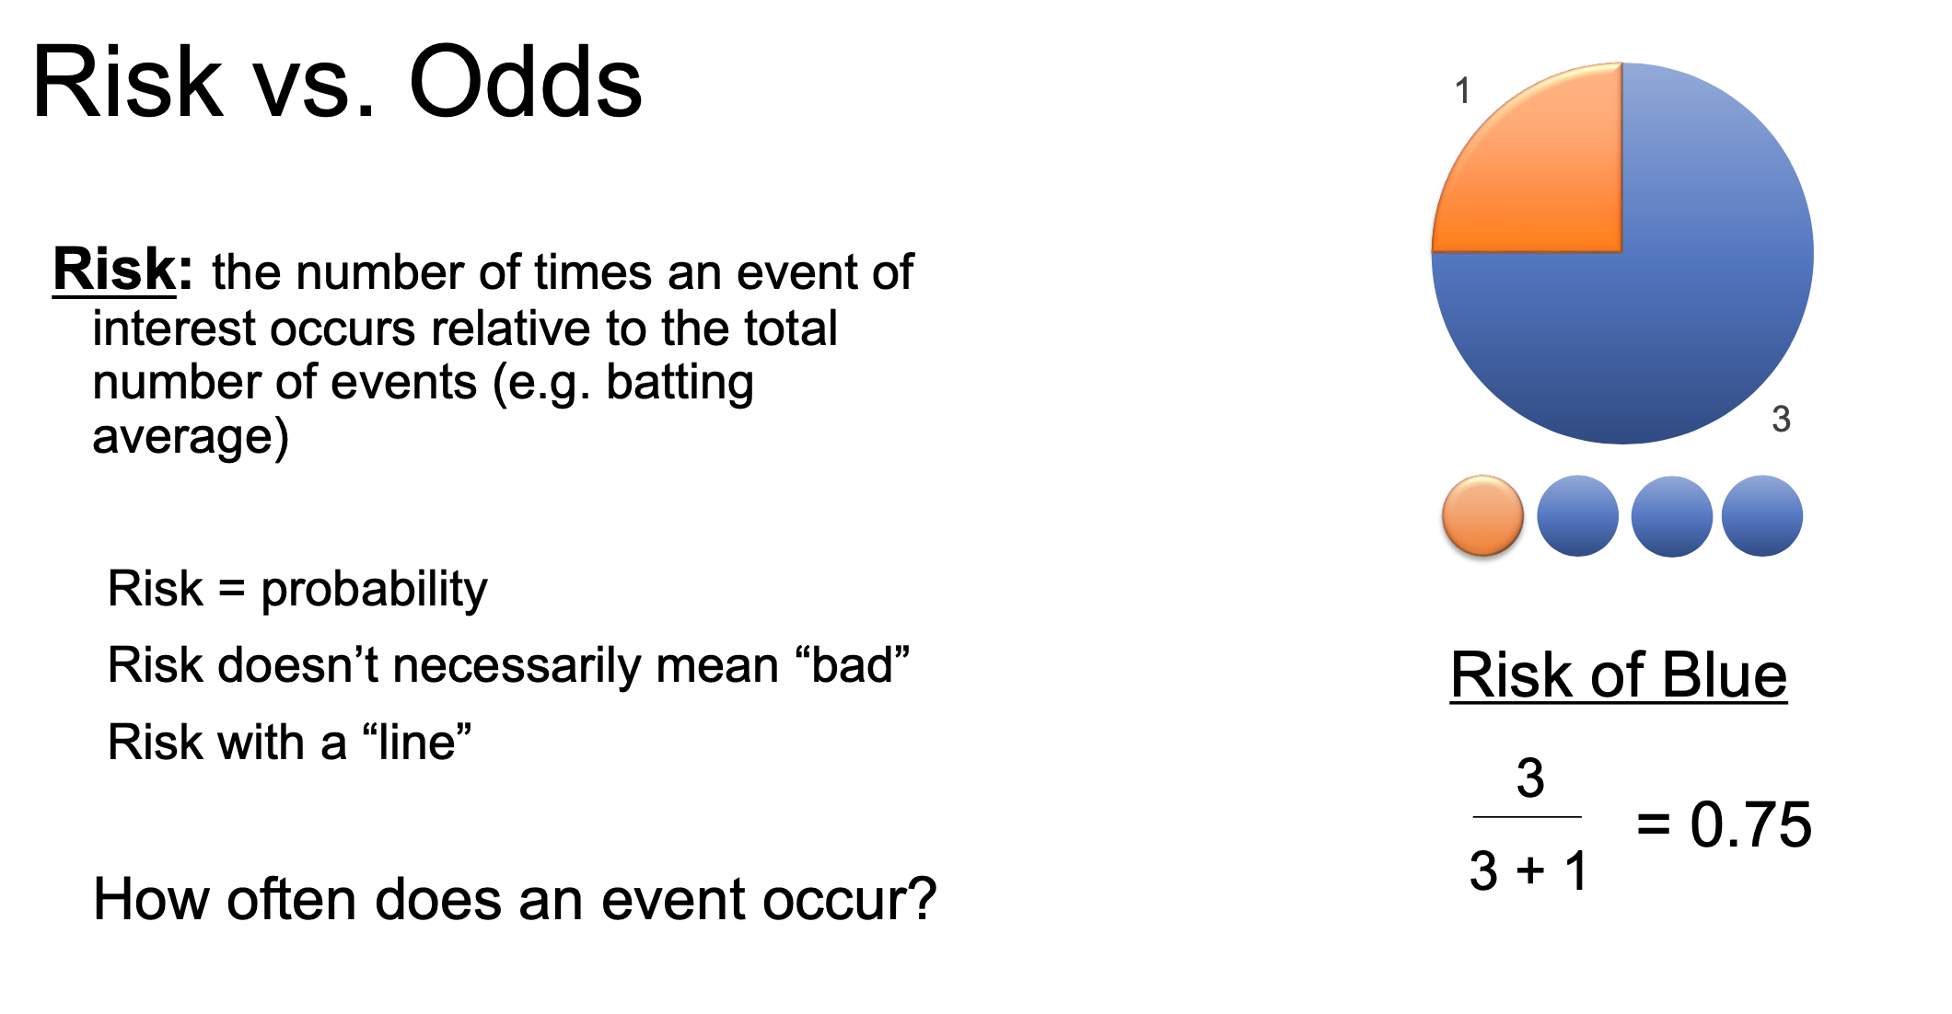

Slide 58
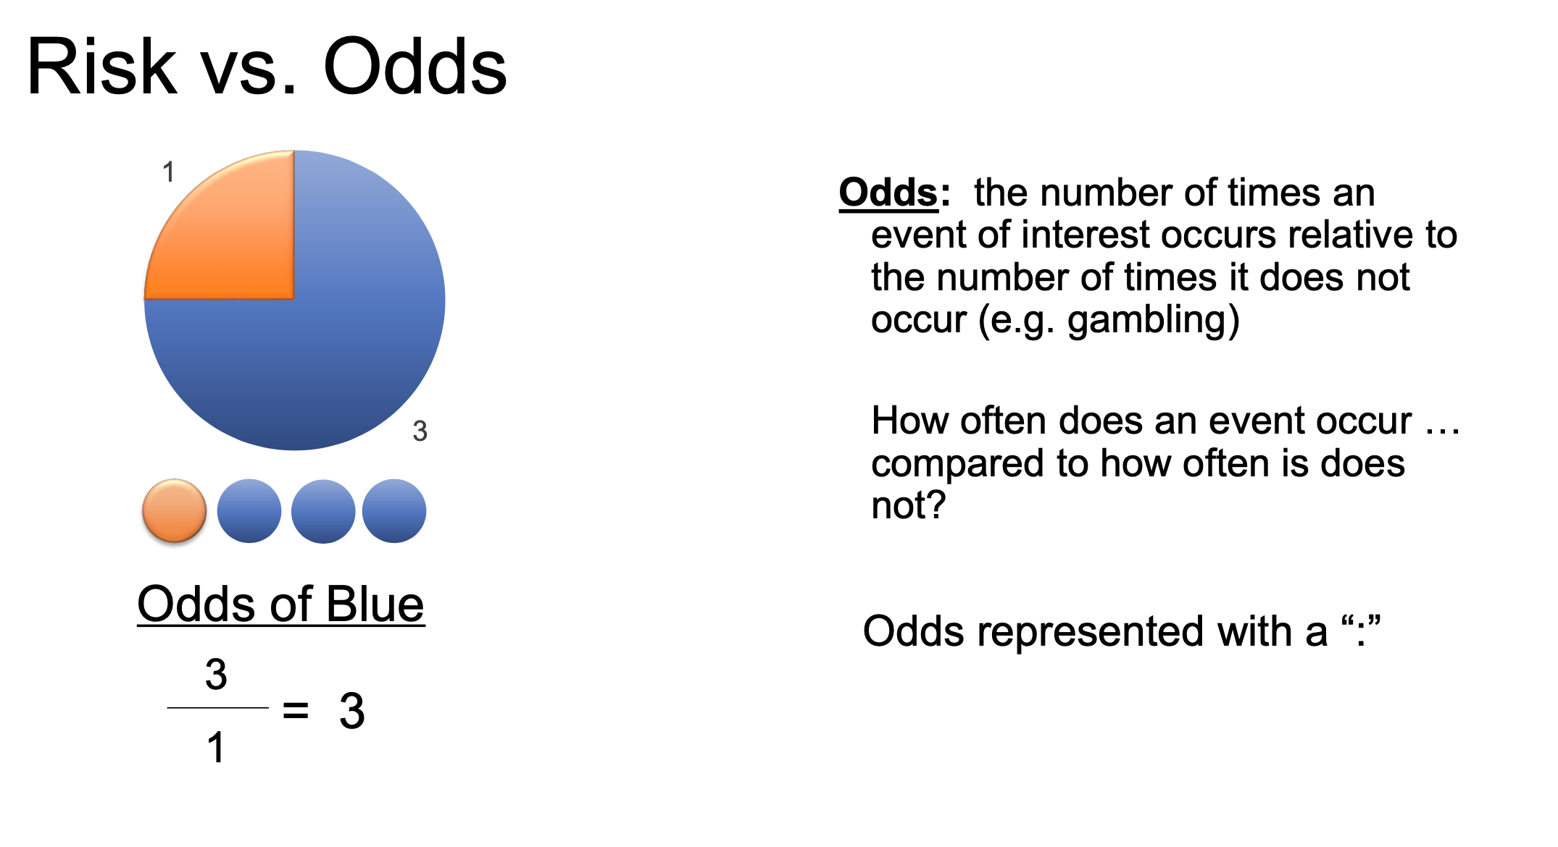

Slide 59
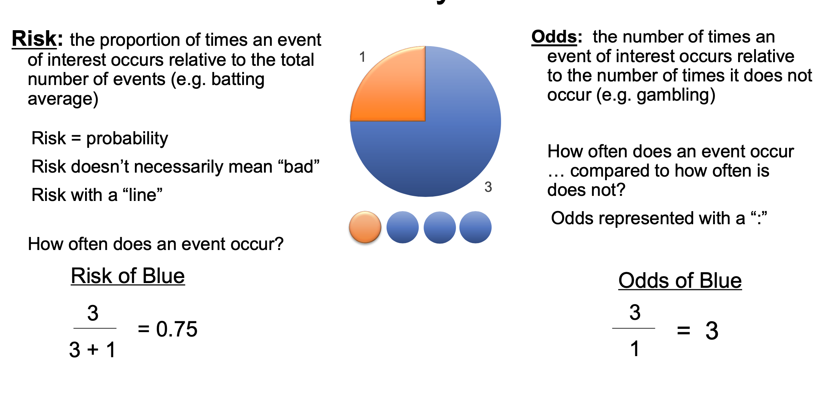

Slide 60
Lets use an example: RISK
Group
Lung disease
No disease
Smokers
40
60
Nonsmokers
20
80
What is the risk of developing lung disease, if you are a smoker vs not a smoker?
Smoker: 40/100 = 40%
Non Smoker 20/100 = 20%

Slide 61
Lets use an example: RELATIVE RISK
Group
Lung disease
No disease
Smokers
40
60
Nonsmokers
20
80
What is the risk of developing lung disease, if you are a smoker vs not a smoker?
Smoker: 40/100 = 40%
Non Smoker 20/100 = 20%
What is the relative risk of developing lung disease, if you are a smoker vs not a smoker?
RR = Risk in exposed group / Risk in non exposed group
= 40% / 20 %
= 2.0
"Smokers have twice the risk of developing lung disease."

Slide 62
Lets use an example: ODDS
Group
Lung disease
No disease
Smokers
40
60
Nonsmokers
20
80
What is the odds of developing lung disease, if you are a smoker vs not a smoker?
Smoker: 40:60 = 0.67 (2:3)
Non Smoker 20:80 = 0.25 (1:4)

Slide 63
Lets use an example: ODDS RATIO
Group
Lung disease
No disease
Smokers
40
60
Nonsmokers
20
80
What is the odds of developing lung disease, if you are a smoker vs not a smoker?
Smoker: 40:60 = 0.67
Non Smoker 20:80 = 0.25
What is the odds ratio of developing lung disease, if you are a smoker vs not a smoker?
OR = odds in exposed group / odds in the unexposed group
= (40/60) / (20/80)
= 2.67

Slide 64
Comparing the Two Groups
Example: 200 patients followed for development of lung disease
Group
Lung disease
No disease
Smokers
40
60
Nonsmokers
20
80
RISK = Events / All patients
ODDS = Events / Non-events
Smokers: 40/100 = 40%
Smokers: 40/60 = 0.67
Nonsmokers: 20/100 = 20%
Nonsmokers: 20/80 = 0.25
RELATIVE RISK (RR)
ODDS RATIO (OR)
2.0
Twice the probability of disease
2.67
2.67 times the odds of disease

Slide 65
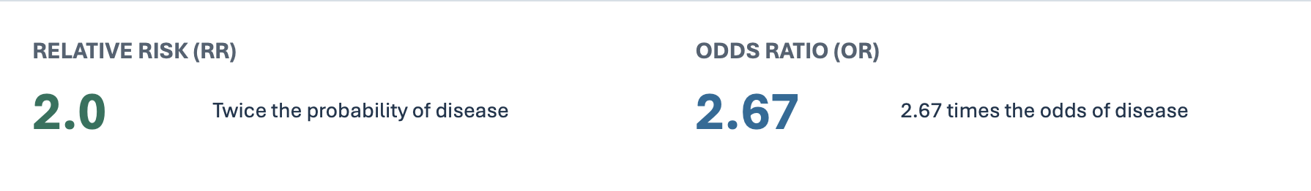
Which one makes more sense to you?
So why even have odds ratios?
  Case control studies
  Logistic Regression
Notes:
So why even have odds ratios?
If you can calculate relative risk (RR), it's generally easier to interpret and more clinically useful than an odds ratio (OR)
But what about case-control studies?
In a prospective cohort study, you start with 1,000 smokers and 1,000 nonsmokers, follow them for 20 years, and see who develops cancer.
You can calculate:
Risk of lung cancer among smokers.
Risk of lung cancer among nonsmokers.
Relative risk comparing the two.
But in a case-control study, you do something different.
You identify:
100 patients who already have lung cancer (cases).
100 patients who don't (controls).
Then you look backward to see how many smoked.
You can't calculate the actual risk of lung cancer from those data.
But you can calculate an odds ratio comparing smoking exposure between cases and controls.

Slide 66

But wait

Slide 67
WHEN an event occurs matters
Same smoking study • 10 years of follow-up
AT 10 YEARS
DURING FOLLOW-UP
RR = 2.0
40% vs 20% developed disease
Hazard ratio (HR)
Compares instantaneous event rates
HR incorporates when events occur—not just whether they occur.

Slide 68
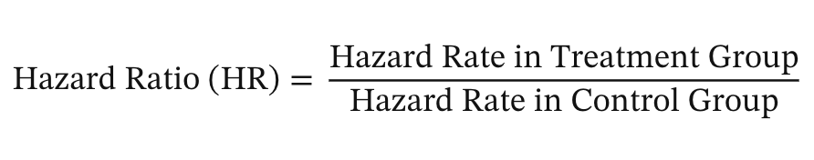
Hazard Ratio – now adds in time
Researchers follow patients and record when each event occurs. At each event time, they compare who experienced the event with everyone who was still at risk. Cox regression combines those comparisons to estimate a hazard ratio

Slide 69
HR vs OR
HR – “At what rate does the event occur”
OR – “How likely is the event to occur at all”
A higher HR, indicates a quicker rate of event. Not just whether it occurred or not.

Slide 70
RR vs. OR vs. HR
Three ways to compare outcomes between groups
RR
RELATIVE RISK
Compares the probability of an event between groups over a specified period.
OR
ODDS RATIO
Compares the odds of an event between groups.
HR
HAZARD RATIO
Compares instantaneous event rates between groups over time.
For all three: 1 = no difference >1 = higher relative measure <1 = lower relative measure

Slide 71
What are the results?

Slide 72
Don’t forget about confidence intervals!
Confidence intervals are intervals in which the population statistic could lie. They are constructed based on the sample statistic and certain features of the sample that gauge how likely it is to be representative and are reported to a certain threshold.
  A 95% confidence interval is an interval constructed such that, on average, 95% of random samples would contain the true population statistic within their 95% confidence interval
  If the confidence interval cross over 1 in a hazard ratio, it means that there is no statistical association between prognostic factor and the outcome

Slide 73
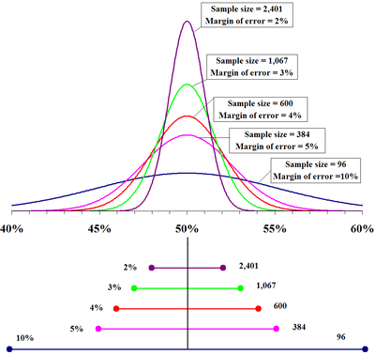
As you increase sample size, Confidence interval becomes smaller

Slide 75
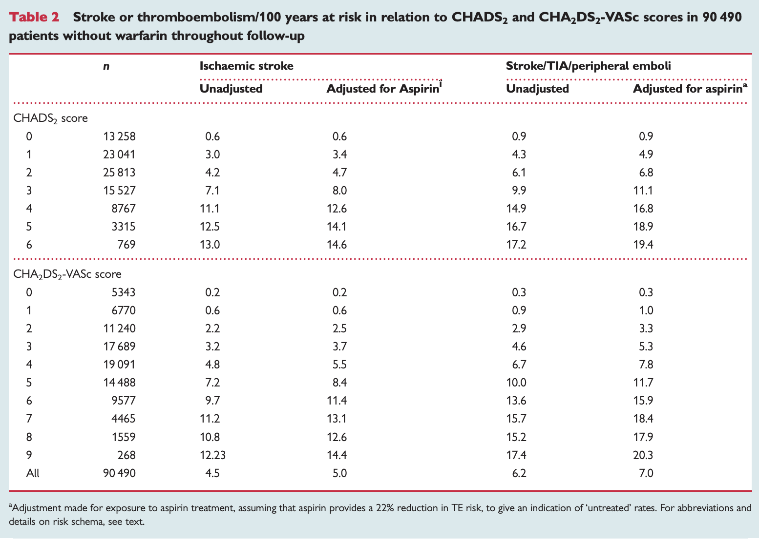

Slide 76
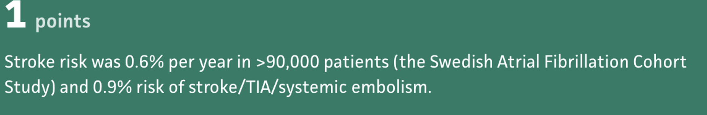
PROGNOSIS / INTERPRETING ABSOLUTE RISK
What Does 0.6 per 100 Person-Years Mean?
0.6 strokes per 100 person-years
↓
≈ 0.6% annual stroke risk
100 patients × 1 year
50 patients × 2 years
= 100 person-years
= 100 person-years
Clinical interpretation: About 6 strokes per 1,000 patients followed for one year.

Slide 77

How else are prognosis statistics presented?
The most common way is a Kaplan-Meier Curve (Survival curve)
This can be for survival to death, or survival to a major outcome (need for total joint revision, survival until a stroke, etc)

Slide 78
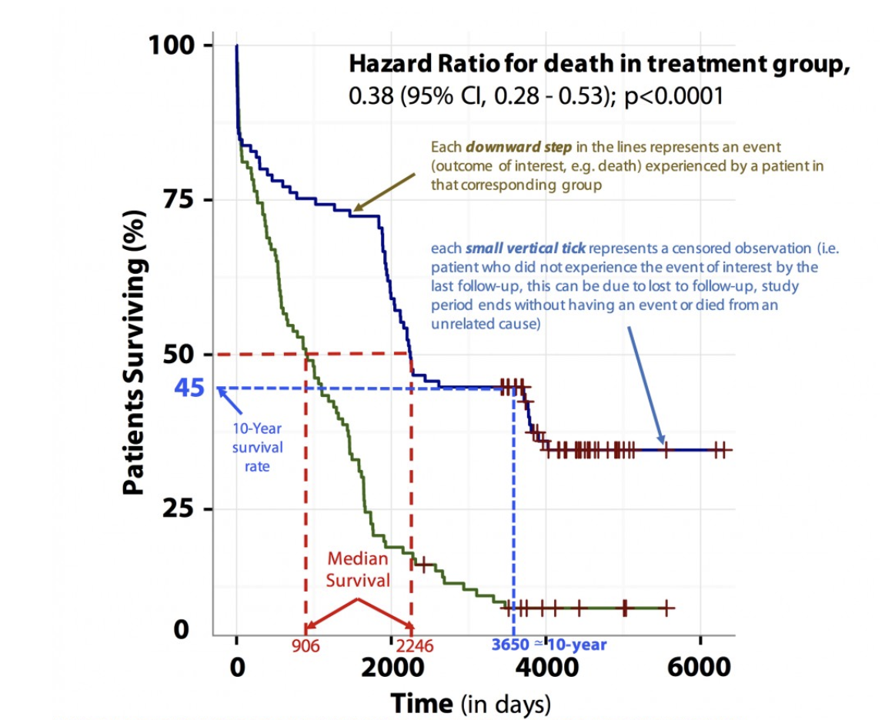
Kaplan-meier curve

Slide 79
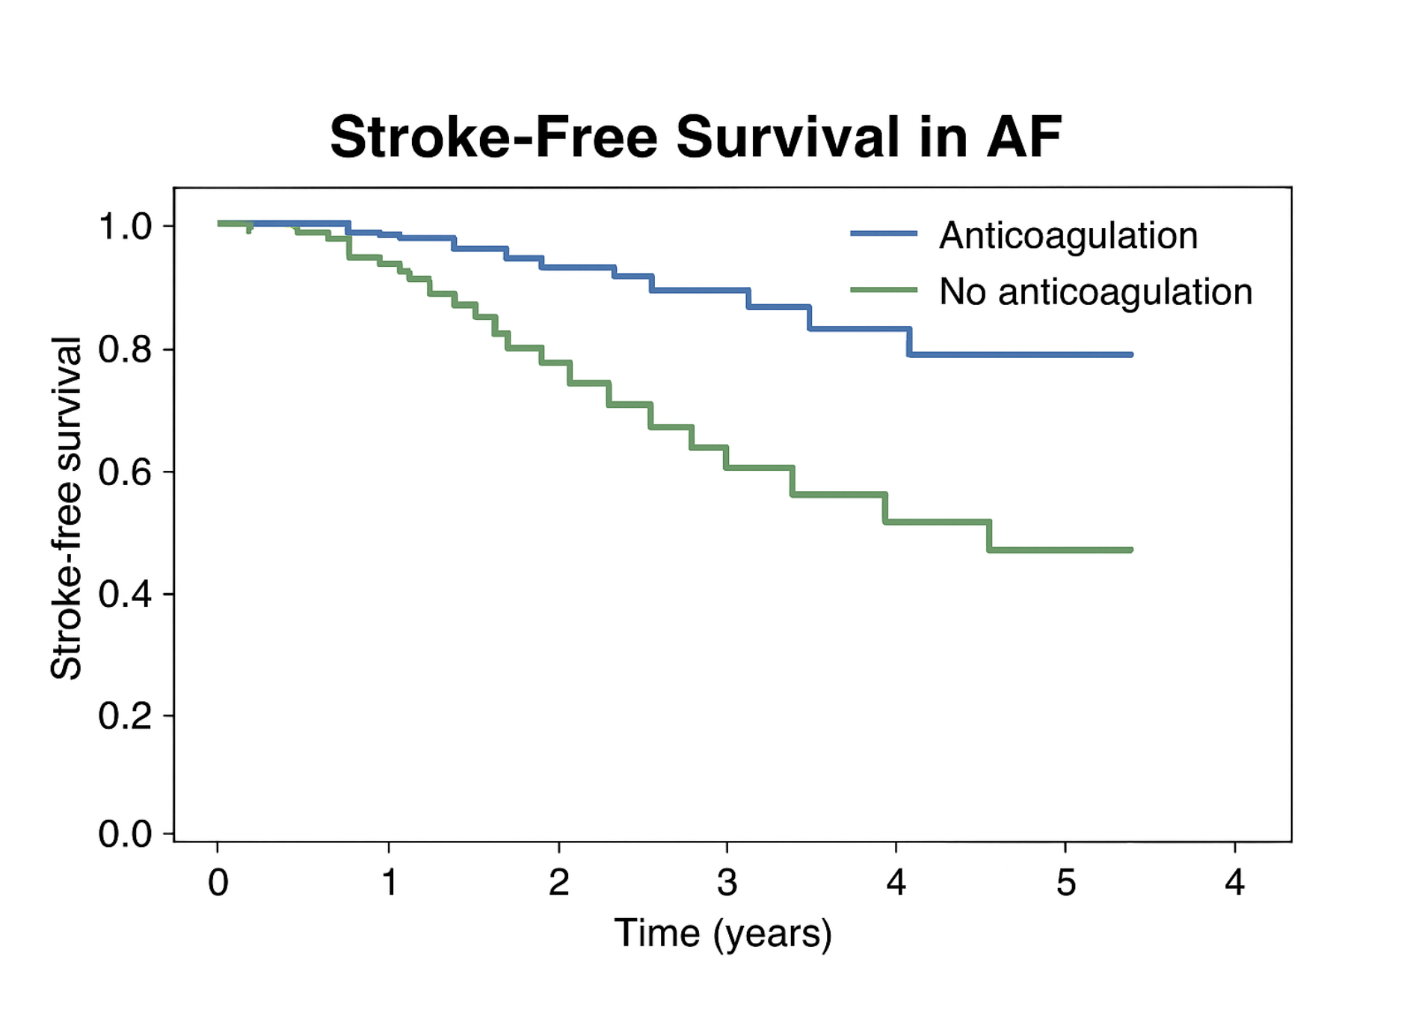

Slide 80
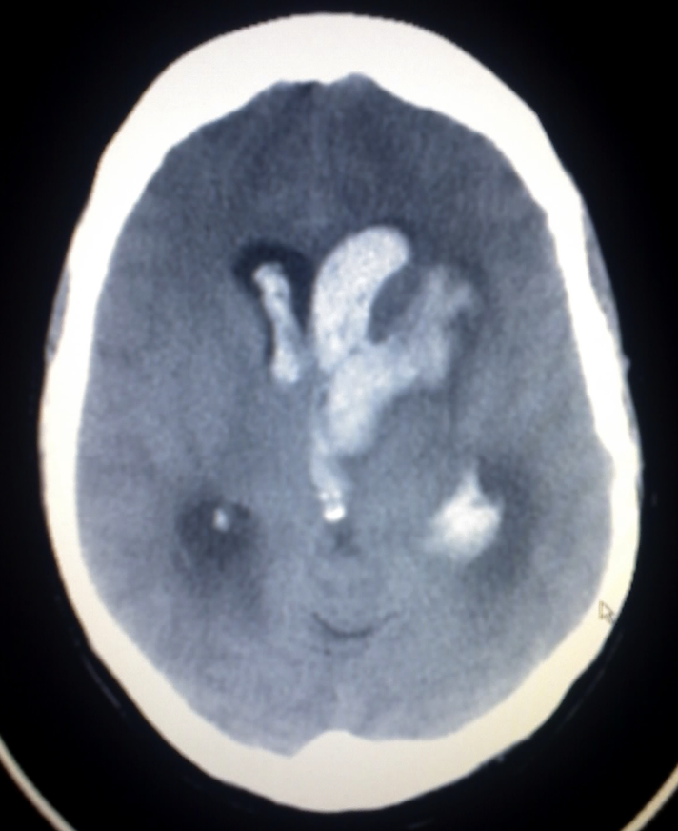
What about adverse events if taking the medication?

Slide 81
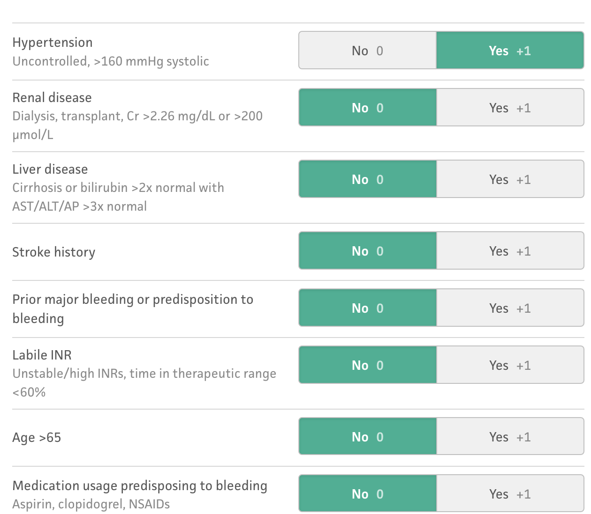
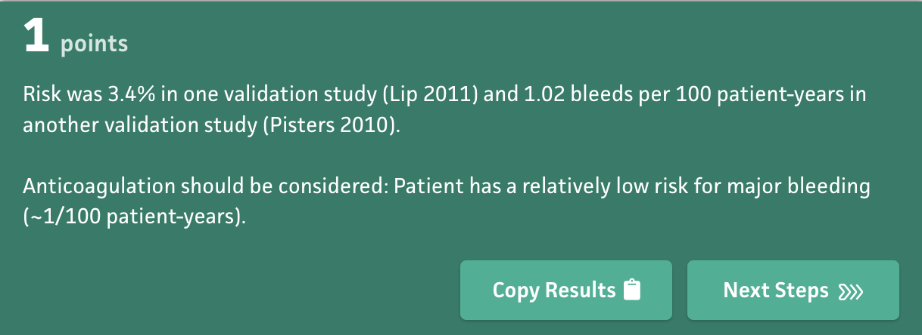
HAS-BLED

Slide 82
Finally – back to treatment briefly:
How much would anticoagulation reduce that 0.6% risk, and at what cost in bleeding risk?
  If anticoagulation decreased stroke risk by 60% (~published rate), his annual stroke incidence would decrease from
    0.6% x 0.6 = 0.36%
    Final stroke risk: 0.24%
    What is the ARR? 0.36%
    What is the NNT? 1/0.36% = 288
  And the bleed risk: 1%
    Significant bleed, etc, etc.

Slide 83
So what do we tell our patient?

Slide 84
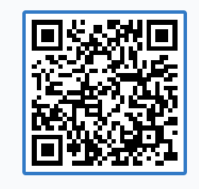

Vote:
Take the blood thinner
Don’t take the blood thinner
https://www.polleverywhere.com/multiple_choice_polls/QQixqPe5cqchhtZrw1zj4?preview=true&controls=none

Slide 85


Shared Decision making

Slide 86
Shared Decision making
Shared decision making occurs when a health care provider and a patient work together to make a health care decision that is best for the patient.
The optimal decision takes into account evidence-based information about available options, the provider’s knowledge and experience, and the patient’s values and preferences.
You will need to utilize motivational interviewing to ascertain values and preferences – most of the time

Slide 87
Shared Decision making - What matters to your patient?
Outcomes that matter to patients may include:
  Quality of life
  Mobility
  Ability to carry out certain tasks
  Ability to focus
  Ability to return to work
  Side effects/risks of treatment
  Symptoms (e.g., pain, nausea)
  Survival
Consider that outcomes might be different for each patient.

Slide 88
Shared Decision making
Sharing decision with patients:
  Improves patient knowledge regarding their options
  Reduces patients’ decisional conflict
  Increases patients’ active role in decision making
  Improves accurate risk perceptions of possible benefits and harms among patients
  Increases the likelihood that patients’ choices are more consistent with their informed values
  Enhances communication between patients and their clinicians

Slide 89

How about for our patient? The SHARE Approach
Step 1: Seek your patient’s participation
Step 2: Help your patient explore and compare treatment options
Step 3: Assess your patient’s values and preferences
Step 4: Reach a decision with your patient
Step 5: Evaluate your patient’s decision

Slide 90

Case conclusion
The patient decides that he is going to defer OAC for now. He understands that as he ages, and if he develops any other comorbidities, his risk might increase for developing thromboembolism, and will re-consider at that time.
You feel confident the patient made a decision that both fits with the evidence, AND aligns with his values.

Slide 91
How do doctors actually help patients?
Diagnosing
Treating
Prognosing?
-RCTs
-Always re-evaluate with new evidence
-Observational trials have merit, especially when determining HARM
-Don’t overlook this part
-Allows the patient to understand what the diagnosis and treatment mean for them
-Strive for SDM when able
-LR+, LR –
-Pre-test, post test probabilities
- Avoid unnecessary testing

Slide 92
Take home points
Prospective cohort studies allow for the most unbiased determination of prognostic factors
Hazard ratios are interpreted similar to odds ratios (>1, <1 or crosses 1) but refer to an outcome happening over time (doesn’t tell you when though)
Helping patients understand what will happen with their disease can foster a much better, mutualistic treatment plan (think, increased adherence for one)
Shared decision making is your friend, we already suffer from decision fatigue, so don’t be afraid to share this load with the person it is affecting the most!
Our values, even though they seem rational, are not the same as everyone else

Slide 93
Step 2 review type questions

Slide 94
A study finds a relative risk (RR) of 0.7 (95% CI: 0.4–1.3) for myocardial infarction with a new drug vs placebo.
Which conclusion is most accurate?
A. The new drug significantly reduces MI risk
B. The new drug significantly increases MI risk
C. The new drug has no statistically significant effect on MI risk
D. The study has a Type I error

Slide 95
A 75-year-old woman with multiple comorbidities is considering whether to undergo screening colonoscopy. What is the most appropriate physician action?
A. Recommend screening based on national guidelines
B. Discuss risks and benefits in the context of her health goals
C. Decide against screening because of age
D. Defer the decision to family members

Slide 96
In an RCT, some participants in the intervention arm fail to adhere to the protocol. Investigators analyze all participants according to the group to which they were randomized.
This analytic approach primarily preserves which study feature?
A. Power
B. External validity
C. Randomization
D. Blinding

Slide 97
An RCT for a new antiplatelet drug shows an annual incidence of stroke of 10% in the control group and 8% in the treatment group.
What is the number needed to treat (NNT) to prevent one stroke?
A. 10
B. 20
C. 25
D. 50

Slide 98
A test for myocardial infarction has 95% sensitivity but 60% specificity.
Raising the troponin cutoff will most likely:
A. Increase sensitivity, decrease specificity
B. Decrease sensitivity, increase specificity
C. Increase both sensitivity and specificity
D. Decrease both sensitivity and specificity

Slide 99
A 60-year-old man with newly diagnosed prostate cancer is considering active surveillance versus surgery.
What is the most appropriate next step?
A. Recommend surgery because it improves mortality
B. Ask the patient what outcome is most important to him
C. Order PET scan to determine staging
D. Defer to the patient’s family for decision-making

Slide 100
Remember - take the quiz!
Read the primary literature! It really does make a difference
Questions? Email me – john.joyce@vcuhealth.org

