Slide 1

Cardiac Risk stratification
Michael Joyce, MD
One troponin, two troponin, home?

Slide 2
Goals
Discuss cardiac biomarkers and their application in the Emergency Department
Discuss medical/legal considerations
Determine where the real risk is
Discuss utility of stress tests
Proper shared decision making

Slide 3





Disclosures

Slide 4
Disclosures
The views and opinions expressed in this presentation are those of the authors and do not necessarily reflect the official policy or position of VCU Health.

Slide 5
Cardiac “enzyme(S)!”
Why do you order CK?
Background
  Relatively non-specific markers of myocardial damage, such as creatine kinase (CK), creatine kinase-MB (CK-MB), and myoglobin (MYO), were used in diagnostic laboratories prior to the commercial release of the troponin assays.
  Numerous clinical studies on troponin have indicated its superior cardiac specificity in comparison to CK, CK-MB, or MYO.
  Troponin levels remain elevated in the blood longer than CK-MB or MYO, providing an extended diagnostic window for MI.
Notes:
Roughly 98% of chest pain is not STEMI

Slide 6
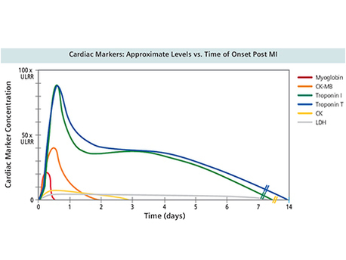

Slide 7
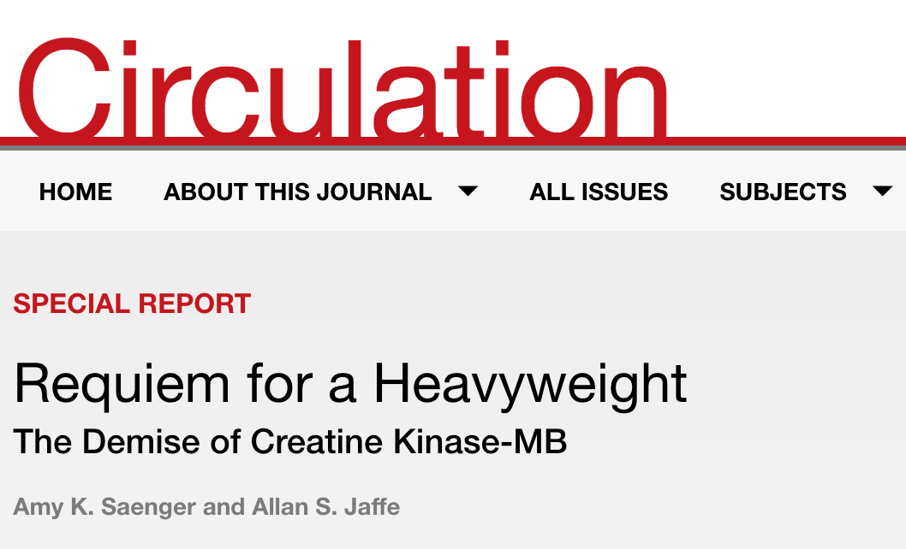
CK is dead!
Conclusion: It adds only cost and, from our perspective, confusion. Accordingly, after >10 years of experience using troponin in the clinical arena, it is time for clinicians to learn how to use cardiac troponin properly and, in doing so, let our old friend CK-MB rest.

Slide 8

What do you think the national missed rate for MI is?
Pollev.com/usvcu
Results
Notes:
What do you think the national missed rate for MI is?
https://www.polleverywhere.com/multiple_choice_polls/Qhy9Qp6X8UqXrgL

Slide 9

Results
Notes:
When you finish residency, what do you want your miss rate to be?
https://www.polleverywhere.com/multiple_choice_polls/9xTn6QqmbXJvydU

Slide 10
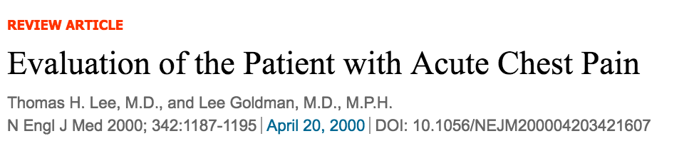
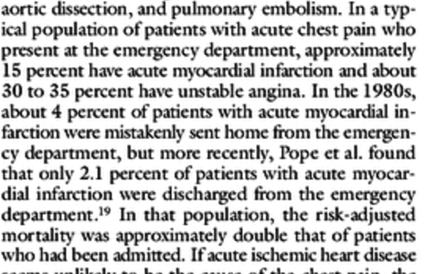
Risk of Missed MI?

Slide 11
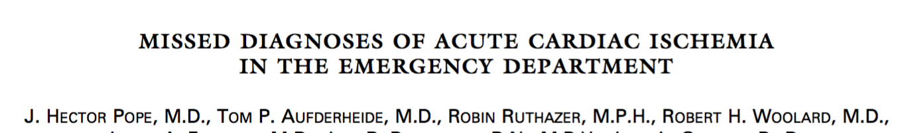
Risk of Missed MI?
  11 different centers, midwest and east coast, 11,000 patients, trop, EKG, h/p, admitted vs not, every patient there with CP and ACS as primary concern were enrolled, every patient who was sent home was followed up in 48-72 hours. Brought them back for the study, another H/P, another EKG, another Trop. 99.1% follow up.
  19/894 = 2.1%
  19/11000 = 0.2%
  Can you think of a chief complaint where we are that accurate??
NEJM, 2000
Notes:
11 different centers, midwest and east coast, 11,000 patients, trop, EKG, h/p, admitted vs not, ievery patient there for CP enrolled, every patient who was sent home was followed up in 48-72 hours. Brought them back for the study, another H/P, another EKG, another Trop. 99.1% follow up.

Slide 12
Risk of Missed MI?

Slide 13
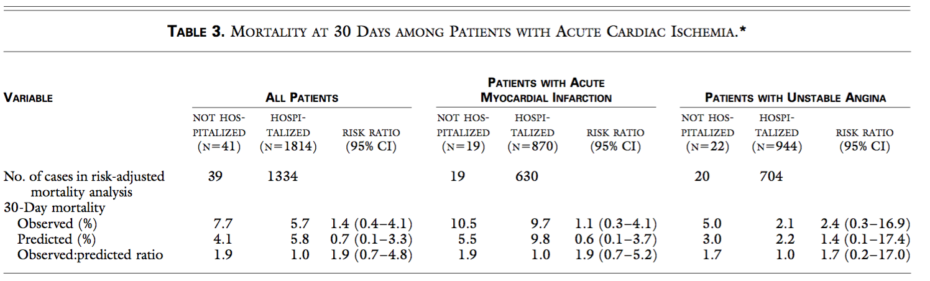
Risk of Missed MI?
Notes:
Prospective study with perfect follow up – why a prediction?? They said if you adjust for the EKG, and hypotension. What the hell?
But what about those that are interested in stats? Moffett? Whats the problem here. The odds ratio (CI) crosses 1.
This is not to say there is 0 difference. There probably is some difference. Maybe it would take us 50,000 patients? But if it takes 50,000 patients to find the difference, is it a really important intervention? Not sure – we don’t know.

Slide 14
Risk of missed MI for patients
Risk of missed MI for doctors

Slide 15
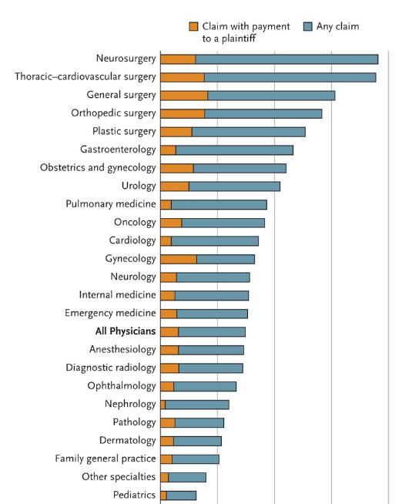
Malpractice risk

Slide 16
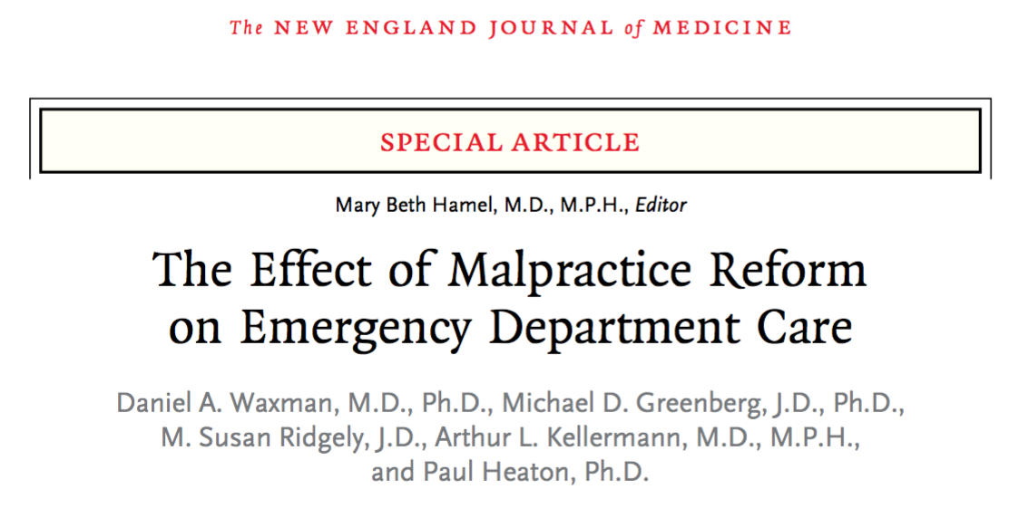
Notes:
What they did was looked at ED practice in states where there was tort reform.

Slide 17
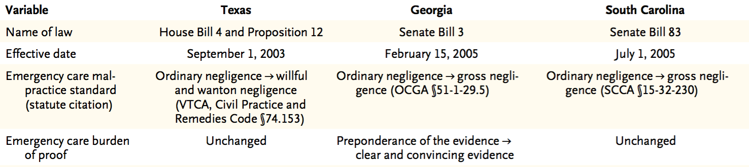
The effect of malpractice reform
Texas (2003)
Georgia (2005)
South Carolina (2005)
What did they change?
  Deviation from standard of care → gross negligence
Did it have an effect on?
  Cost? Admissions? CT/MRI’s?
  This is what doctors say they get a lot of to avoid being sued
Notes:
Question

Slide 18
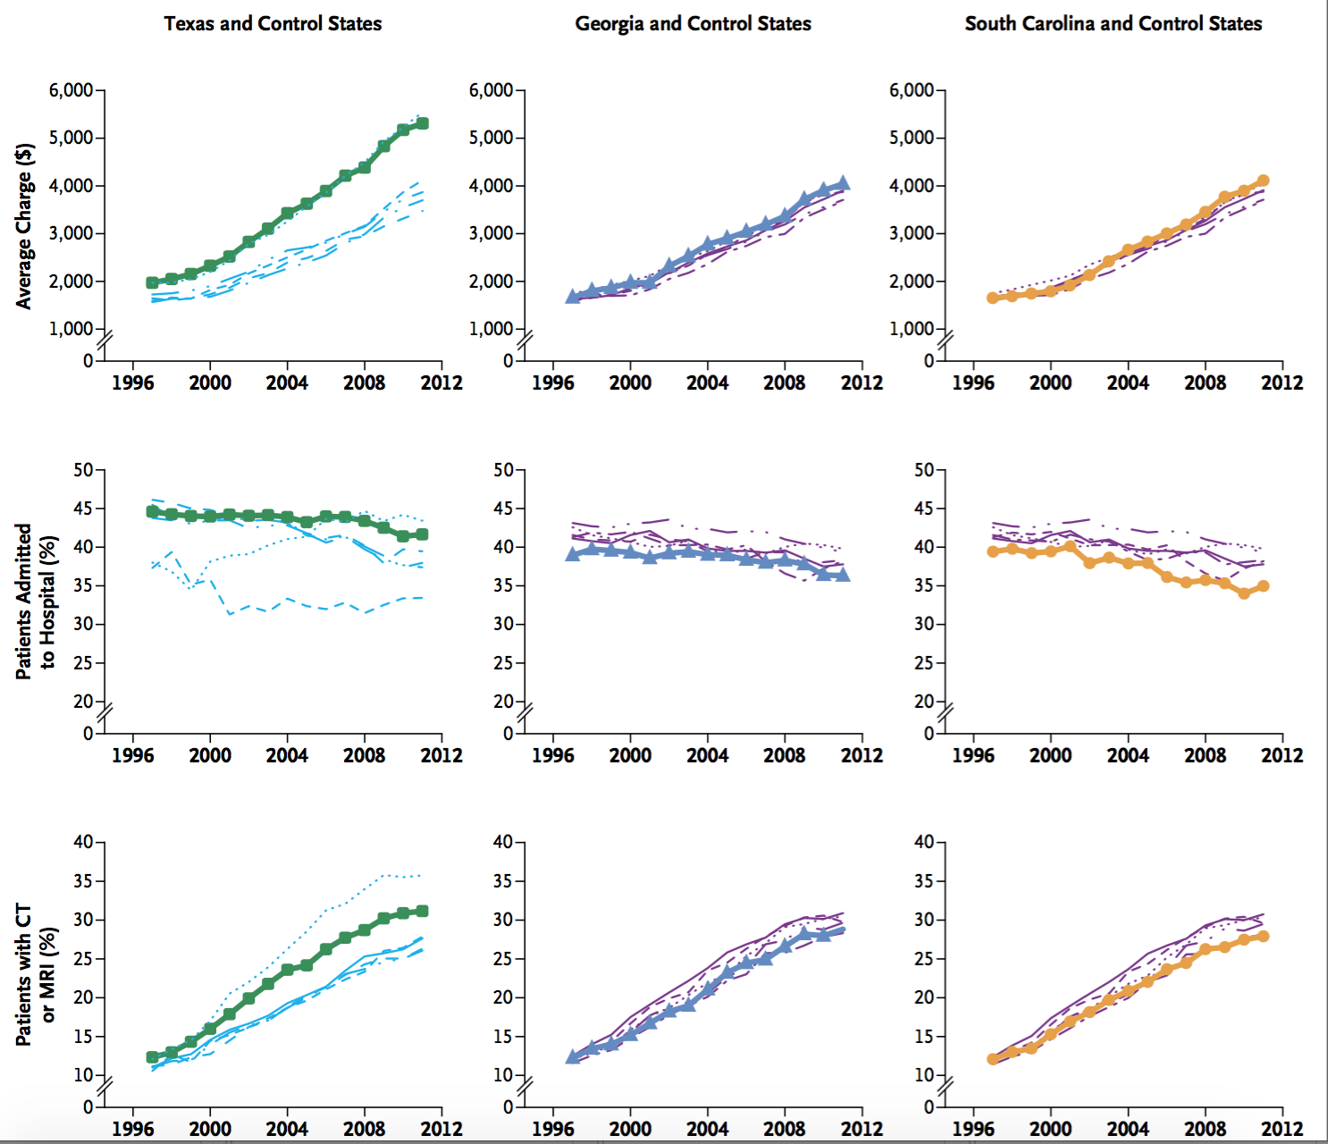
Overall – it DID NOT change the way physicians practice

Slide 19
The effect of malpractice reform
Claims: decreased 60%
Payouts: decreased 70%

Slide 20
So what is the risk of ?
Never miss culture
System pressure
  Finger pointing
Satisfaction pressure
Embarrassment (M&M)
Notes:
Should it be lower then 2%?

Slide 21
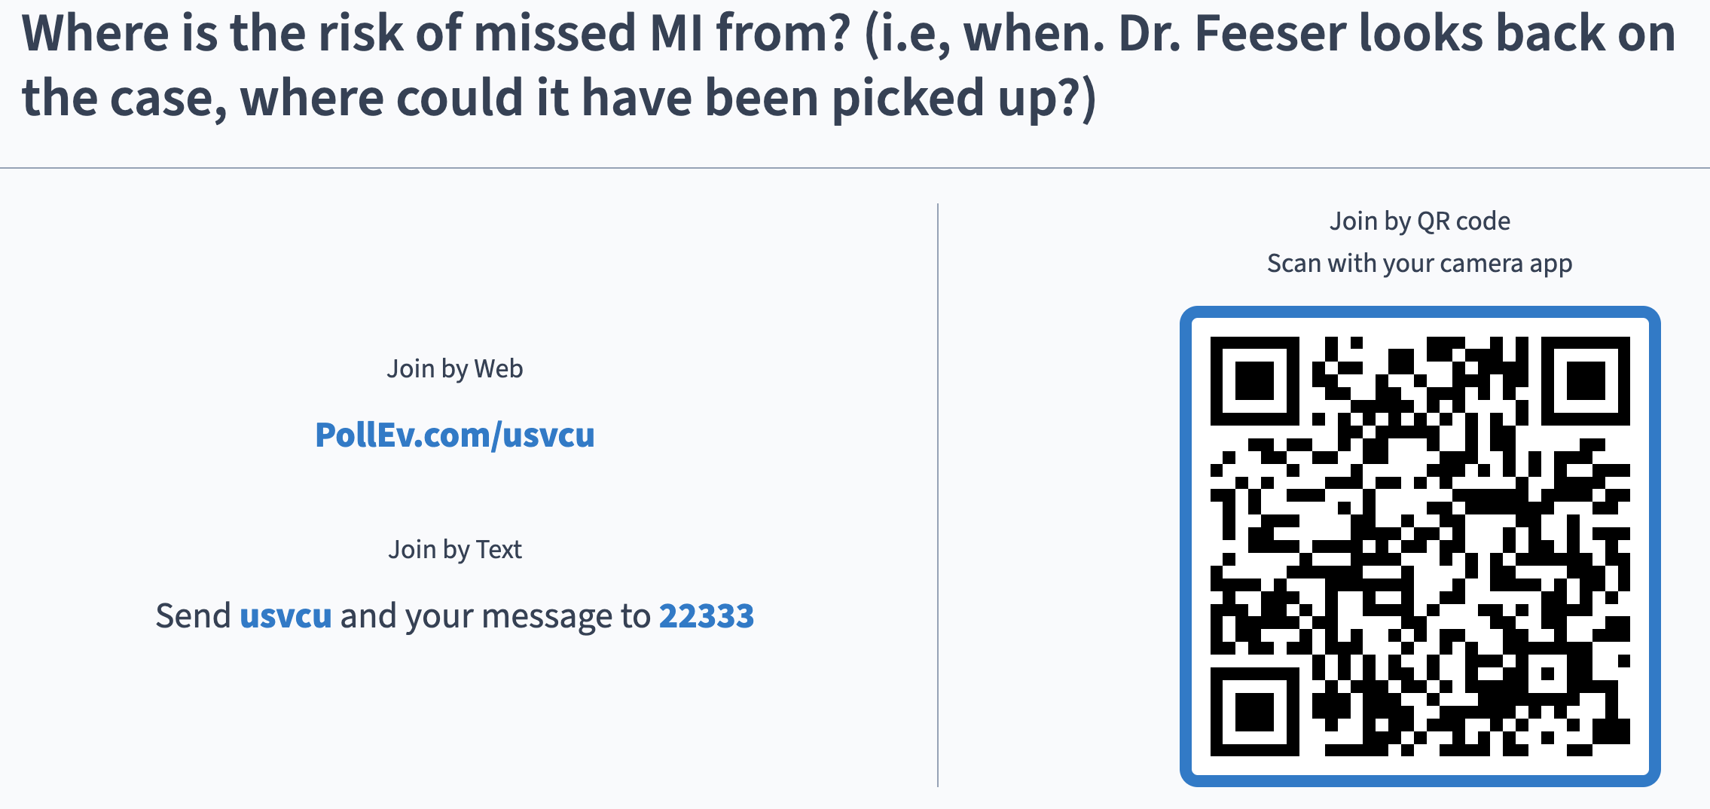
results
Notes:
Where is the risk of missed MI from?
https://www.polleverywhere.com/multiple_choice_polls/zlGCic8HAf5were

Slide 22
ECG + Hx
Pope et al: “It appears that the incidence of missed diagnoses of acute cardiac ischemia in the emergency department may be reduced by interpreting the electrocardiogram more accurately and addressing clinical factors or preconceptions that obscure the recognition of acute myocardial infarction and unstable angina”

Slide 23
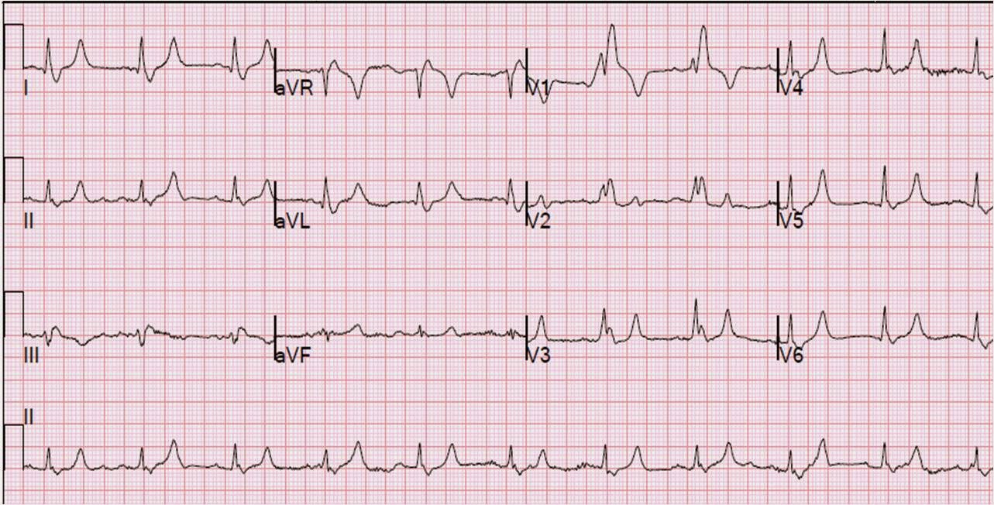
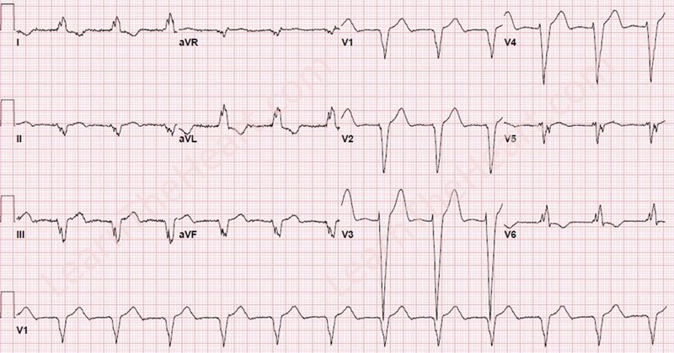
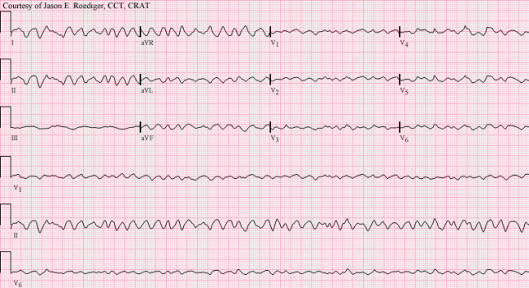
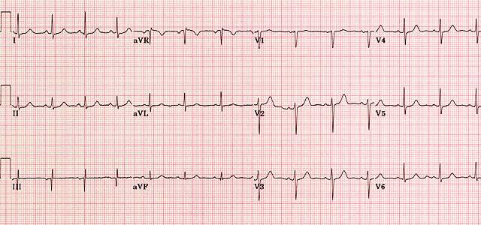
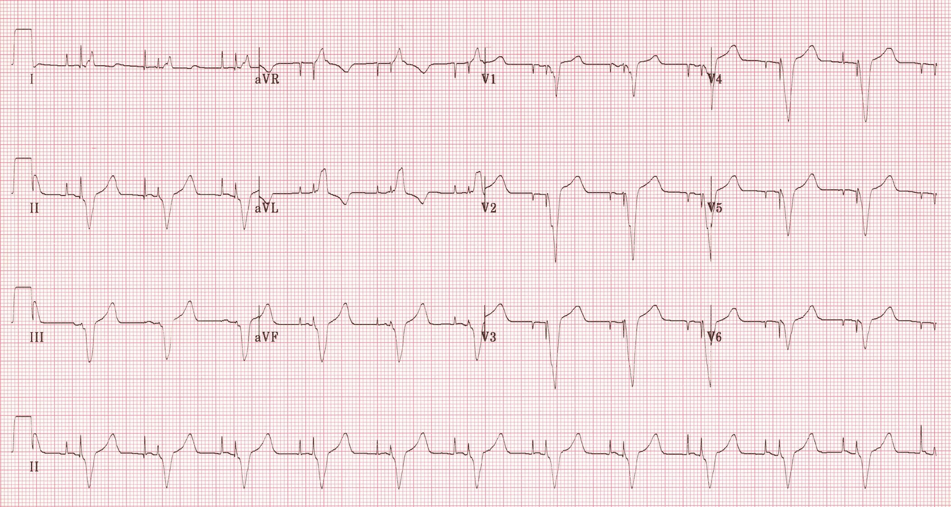
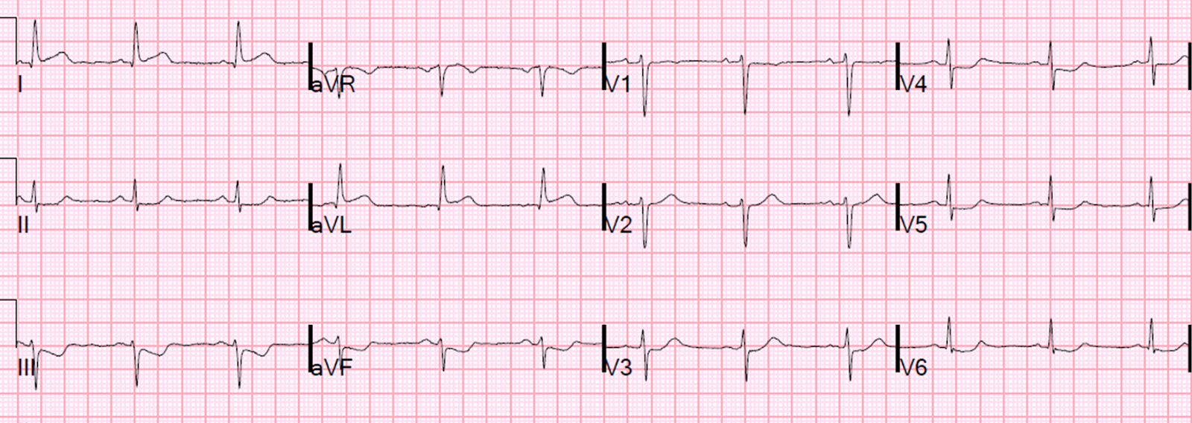

Slide 24
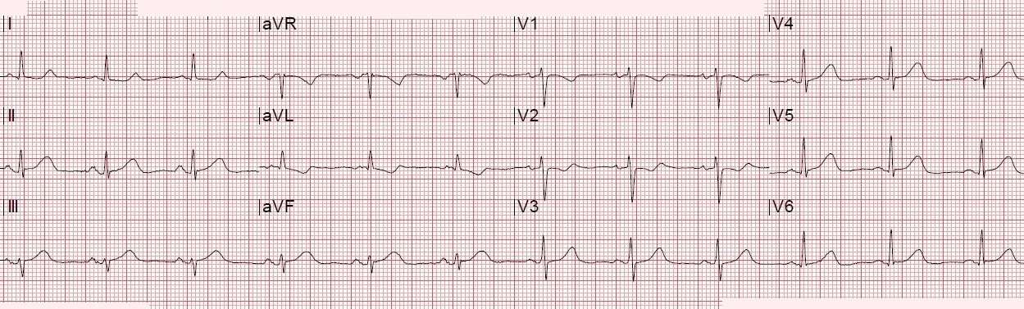

Slide 25
So what can we do about it?
Stop doing EKGs
Scrutinize EKGs
REPEAT them
Perform a good chest pain history

Slide 26
What is typical chest pain?

Slide 27
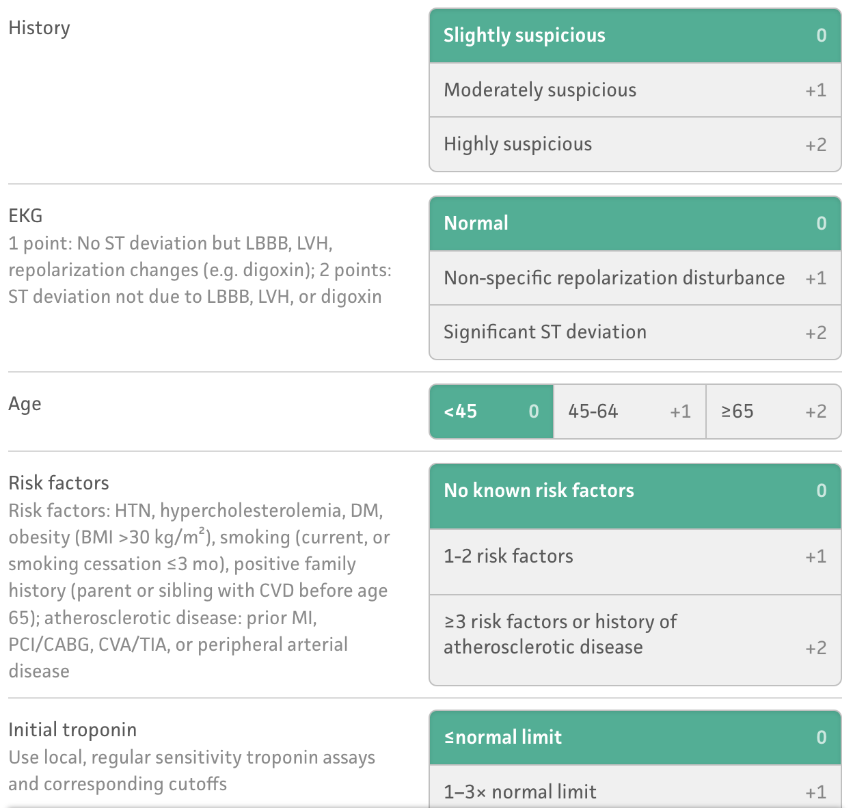

Slide 28
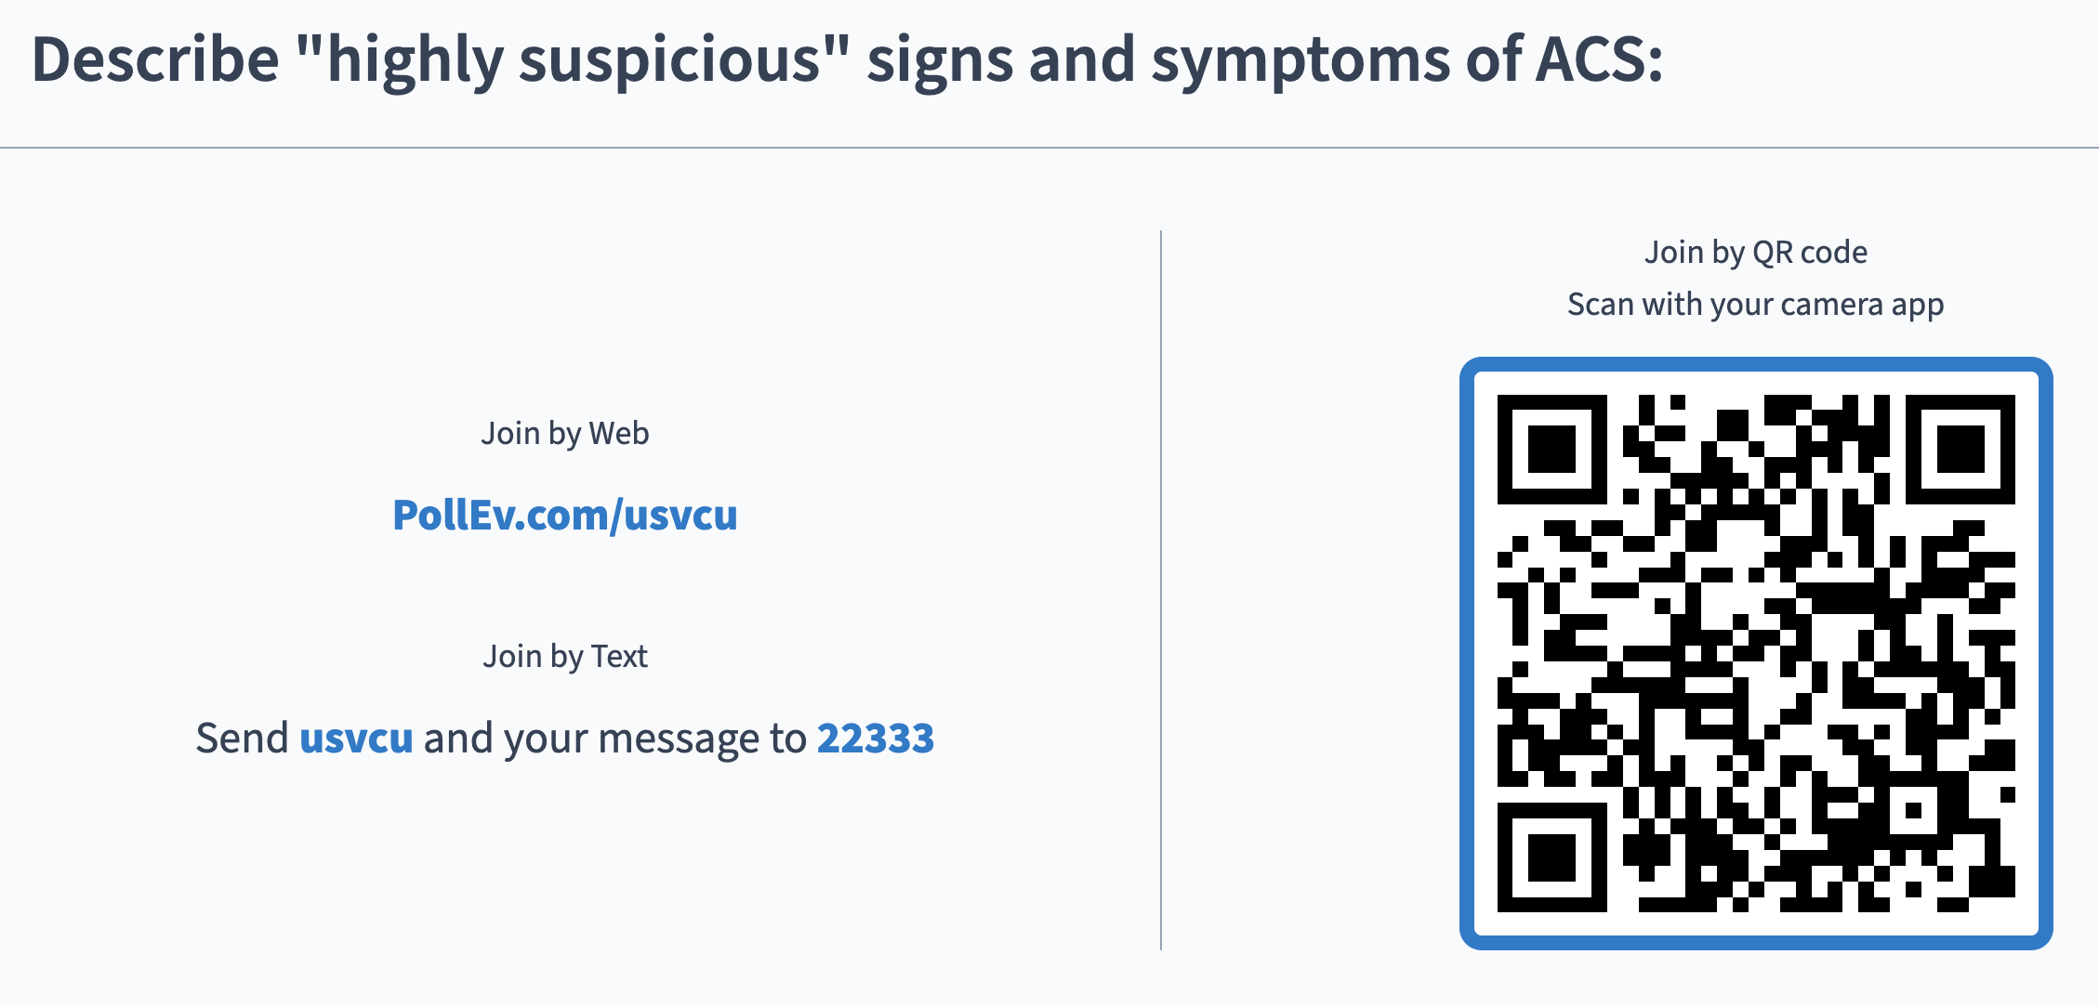
Results
Notes:
Describe "highly suspicious" signs and symptoms of ACS:
https://www.polleverywhere.com/free_text_polls/ixl5jKb4GYf4JdD

Slide 29

What is ”typical” chest pain?
Heberden in 1768: A painful sensation in the breast accompanied by a strangling sensation, anxiety, and occasional radiation of pain to the left arm.
He also observed an association with exertion and relief with rest.

Slide 30
What does the evidence show?
Increased Liklihood | LR
Radiation to right arm or shoulder | 4.7
Radiation to both arms or shoulders | 4.1
Associated with exertion | 2.4
Radiation to left arm | 2.3
Associated with diaphoresis | 2.0
Associated with nausea or vomiting | 1.9
Worse than previous angina or similar to previous MI | 1.8
Described as pressure | 1.3
Swap, Nagurney. Value and Limitations of Chest Pain History in the Evaluation of Patients With Suspected Acute Coronary Syndromes. JAMA, November 23/30, 2005—Vol 294, No. 20

Slide 31
What does the evidence show?
Decreased Liklihood | LR
Described as pleuritic | 0.2
Described as positional | 0.3
Described as sharp | 0.3
Reproducible with palpation | 0.3
Not associated with exertion | 0.8
Swap, Nagurney. Value and Limitations of Chest Pain History in the Evaluation of Patients With Suspected Acute Coronary Syndromes. JAMA, November 23/30, 2005—Vol 294, No. 20

Slide 32
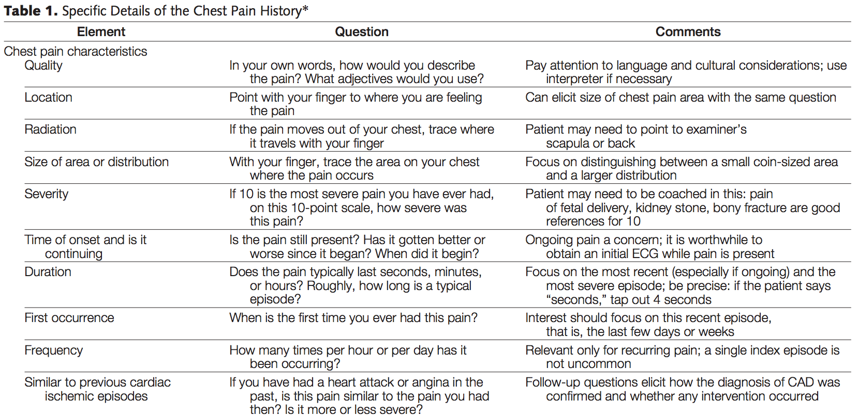
What are the important questions?
Swap, Nagurney. Value and Limitations of Chest Pain History in the Evaluation of Patients With Suspected Acute Coronary Syndromes. JAMA, November 23/30, 2005—Vol 294, No. 20

Slide 33
Risk Stratification by Hx:
Low Risk:
  Pain that is pleuritic, position or reproducible with palpation and described as stabbing
Probably Low Risk
  Pain not related to exertion or that occurs in small area of the chest wall
Possible High Risk
  Pain described as pressure, similar to that of prior MI, or worse than prior anginal pain, accompanied by nausea, vomitting or diaphoresis
High Risk
  Pain that radiates to one or both shoulders or arms and or is related to exertion

Slide 34
What else is at play?
Bias!
  Anchoring bias
    “That guy was here yesterday and we already ruled him out!”
  Confirmation bias
    “this hurts when I push here right?”
  Attribution errors
    “Are you going to give me something for my pain or not?”
  Representation error
    “But Joyce said if it is pleuritic that its not an MI!”

Slide 35
Hx is important…
The patient can tell you what is going on, but they can’t confirm it…

Slide 36
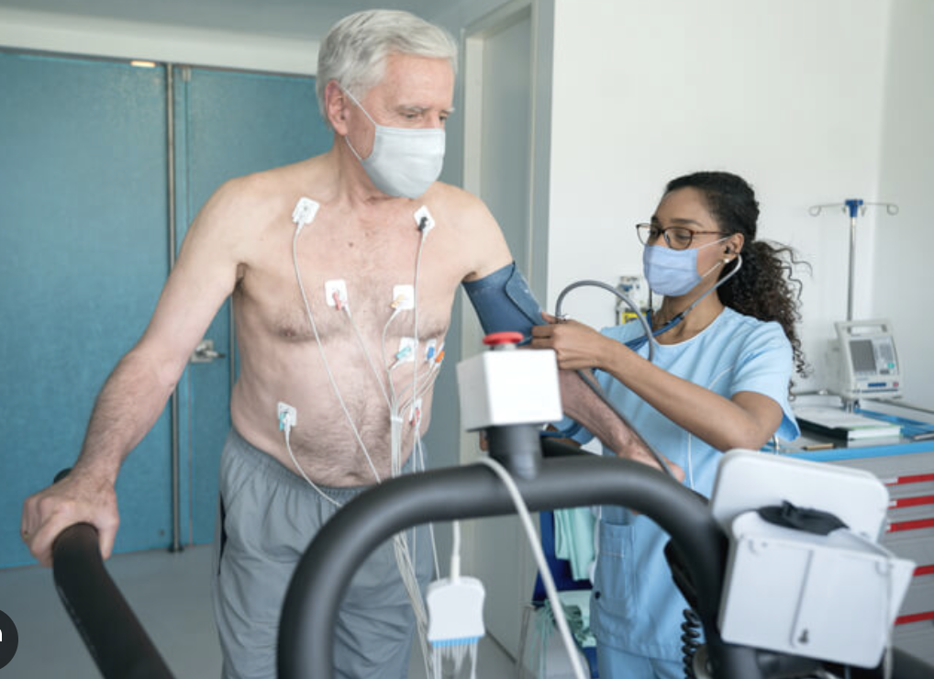
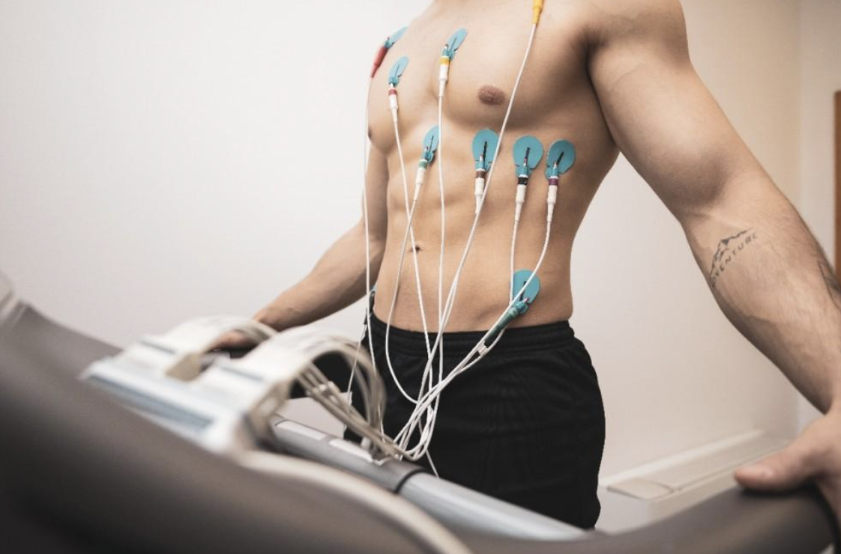
What next?
Ok, so I’ve done a good history, I’m slightly suspicious, I did two EKGs that had no ischemic changes, or dynamic changes, and the trop is negative, now what?

Slide 37
Why do we stress?

Slide 38
What is a stress test?
Stress Test: A test to determine whether a patient has reduced blood flow to an area during tachycardia
  Exercise stress: looking for ECG abnormalities while patient runs on a treadmill
  Stress Echo: echocardiography to look for wall motion abnormalities during tachycardia
  Perfusion imaging (‘nuclear stress’): radionucleoide tagged infusion with CT imaging to evaluate myocardium, looking for areas of poor perfusion – can be done at rest or during tachycardia

Slide 39
What are the AHA recommendations?
AHA (2015): For low to intermediate risk chest pain patients (normal ECG, negative enzymes) exercise stress testing increases sensitivity and negative predictive value for short term death or myocardial infarction. All such patients should therefore have this test performed within 72 hrs, and preferably ASAP.

Slide 40
What are the AHA recommendations?
AHA (2021):
Low-Risk Patients (30-day major adverse cardiac event rate <1%): Routine provocative or stress testing is not recommended. Clinical decision pathways (such as the HEART or EDACS scores) are prioritized to safely discharge these patients without urgent further testing

Slide 41
What are the AHA recommendations?
AHA (2021):
Intermediate-Risk Patients: If acute chest pain is possibly cardiac and the patient is at intermediate risk after negative serial high-sensitivity troponins and ECGs, functional stress testing (such as exercise ECG, stress echocardiography, or nuclear myocardial perfusion imaging) or coronary computed tomography angiography (CCTA) is recommended during the evaluation or selectively as an outpatient

Slide 42
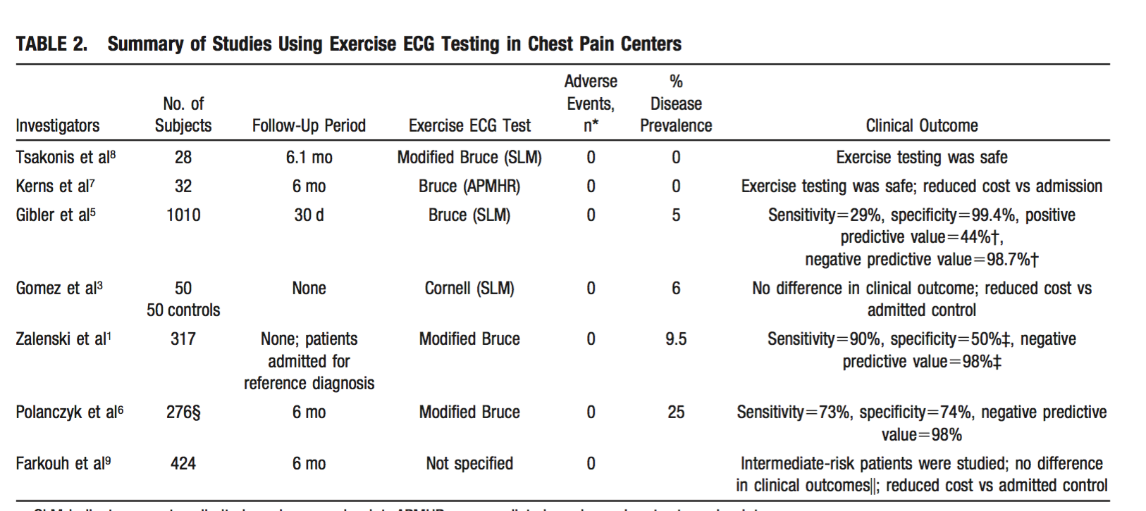
Guideline from the AHA
Notes:
Stress test on everybody, observation for everybody

Slide 43
Gibler – early ‘chest pain unit’ study of 1010 pt’s with nondiagnostic ECG. Included biomarkers, ST monitoring, echo and treadmill stress. 12 MIs, all biomarker positive. 1 pt with negative stress test had MI 3 days later.
Amsterdam : ~1000 stable pt’s w/ nonspecific ECG’s, immediate stress in ED. 5 MI’s, all had positive biomarkers in ED. 1 pt having an MI pt missed by stress, captured by biomarkers.
Biomarkers identify all contemporaneous MIs, and stress tests do not identify additional patients with short term risk that are missed by biomarkers.

Slide 44
But is there benefit for your patient?
Could revascularization benefit low risk chest pain patients with a positive stress?
1. Cochrane review (Honig, 2006): No difference in mortality, small MI benefit for invasive therapy among those with positive troponins. However INCREASED mortality if negative troponins.
2. JAMA meta-analysis (O’Donoghue, 2012) – no MI or death benefit, but again trend toward benefit if troponins positive, trend toward harm if troponin negative. Invasive vs medical treatment for ‘stable CAD’ may also be relevant, as it is possible that these are not true ACS patients but rather stable CAD patients:
3. COURAGE trial (Boden, 2017): significant ischemia or +stress –> if cath showed obstructive CAD, randomized to stent vs medical: no change in MI or mortality, mild symptom reduction

Slide 45
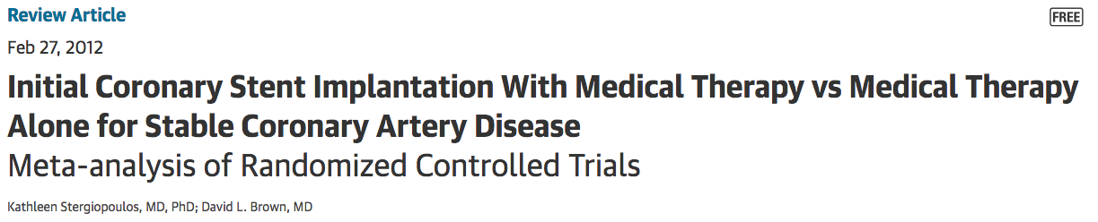
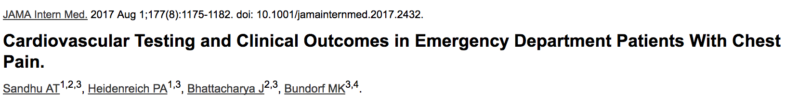
But is there benefit for your patient?
Could revascularization benefit low risk chest pain patients with a positive stress?
Conclusion: if people with proven obstructive CAD or proven ACS don’t benefit from PCI, then low risk chest pain patients are virtually certain not to benefit

Slide 46
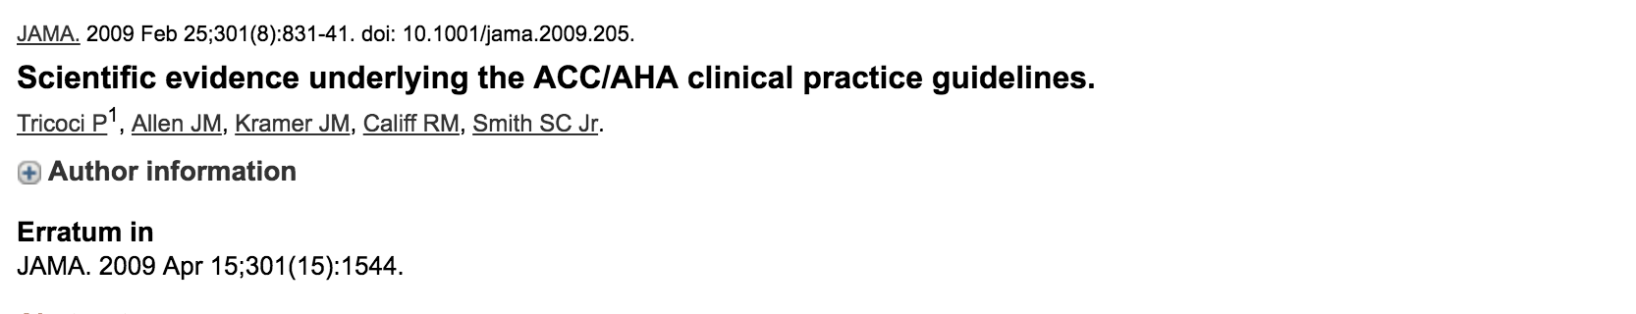
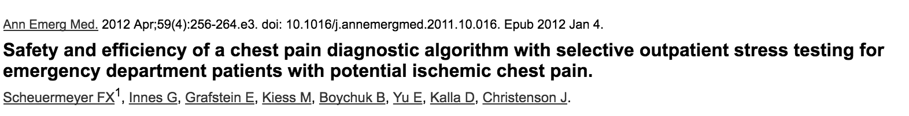
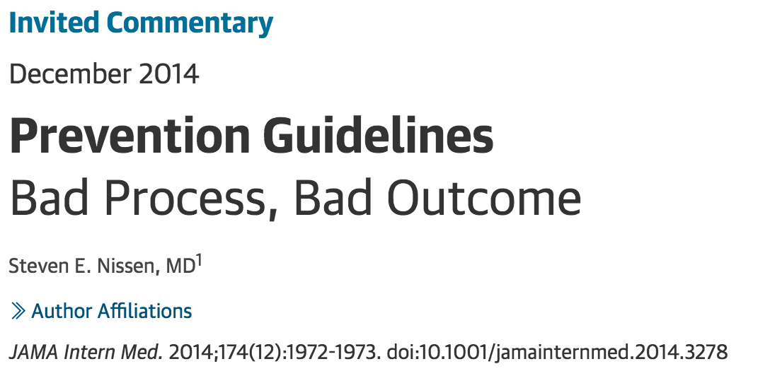
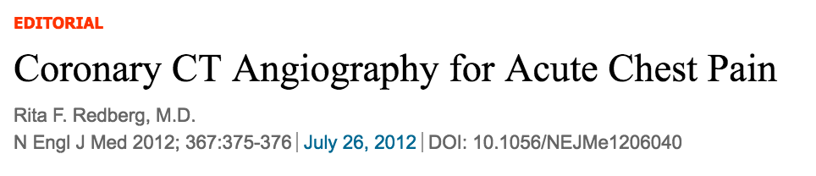

Slide 47
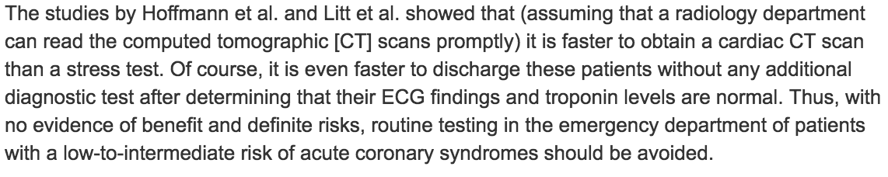
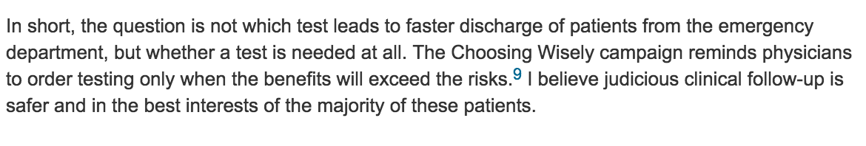
NEJM Editorial 2012 on further testing for low risk patients:

Slide 49
Standard of Care?
Negative biomarkers and negative ECGs
30d MI/death rate after 1 neg trop?

Slide 50
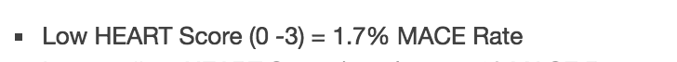
Risk in chest pain with “Standard of Care”
Low risk, <40 NNH = 1000
Low risk, >40 NNH = 100
= 0.1%
= 1%
Source: the NNT
Over 40 studies analyzed

Slide 51
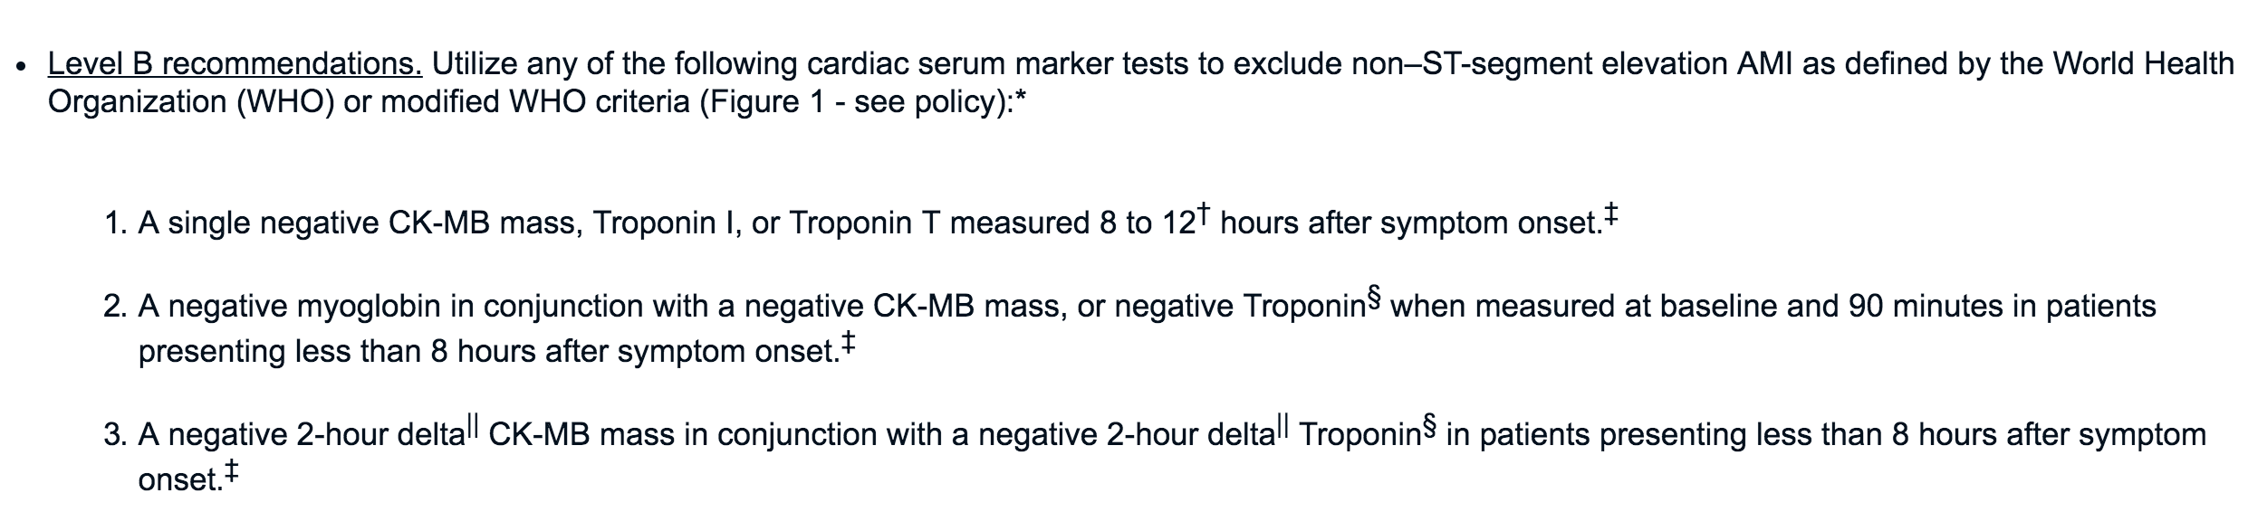
ACEP policy on one troponin

Slide 52
Clinical Judgment works!
This is why the heart score has shown to be useful and was externally validated
We are still TOO conservative admitting all CP pt’s with Heart Score > 4 and negative biomarkers

Slide 53
Shared Decision Making
Auto text similar to:
  “The patient and I discussed going home vs staying for a period of observation and possible further testing. I explained the risk of MI was likely less than 1% but could be higher. They felt comfortable going home and following up with their PCP or returning if worse. They appeared competent and reasonable and verbalized an understanding of these risks to me.”

Slide 54
Shared Decision Making
You must sit with the patient and discuss the real risks that you have determined
It is not SHARED if you don’t SHARE
The patients LIKE when you do this
If you are really worried about legal issues, this is the best thing you can do

Slide 55

Summary
Do serial ECGs
Stop stressing
Zero Risk
One troponin: SDM or 8h

Slide 56
Questions?

