Slide 1
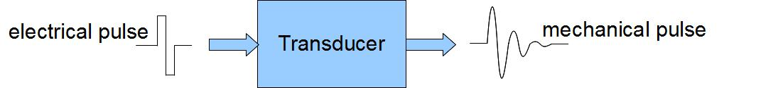
Sonographic Principals

Slide 2
Goals and Objectives
Why Does Advanced Ultrasound Physics Matter?
Acquire better images faster in challenging patients (obesity, edema, subcutaneous emphysema, etc)
Recognize and troubleshoot artifacts instead of mistaking them for pathology
Optimize machine settings (gain, frequency, harmonics, focus, Doppler settings) rather than relying on presets.
Know the limitations of ultrasound and avoid overcalling or missing disease
Teach others effectively by explaining the principles behind image acquisition
Evaluate new technologies (AI guidance, advanced beamforming, contrast, elastography) with an informed perspective
Become a better clinician, not just a better sonographer

Slide 3


Learn by questions

Slide 4
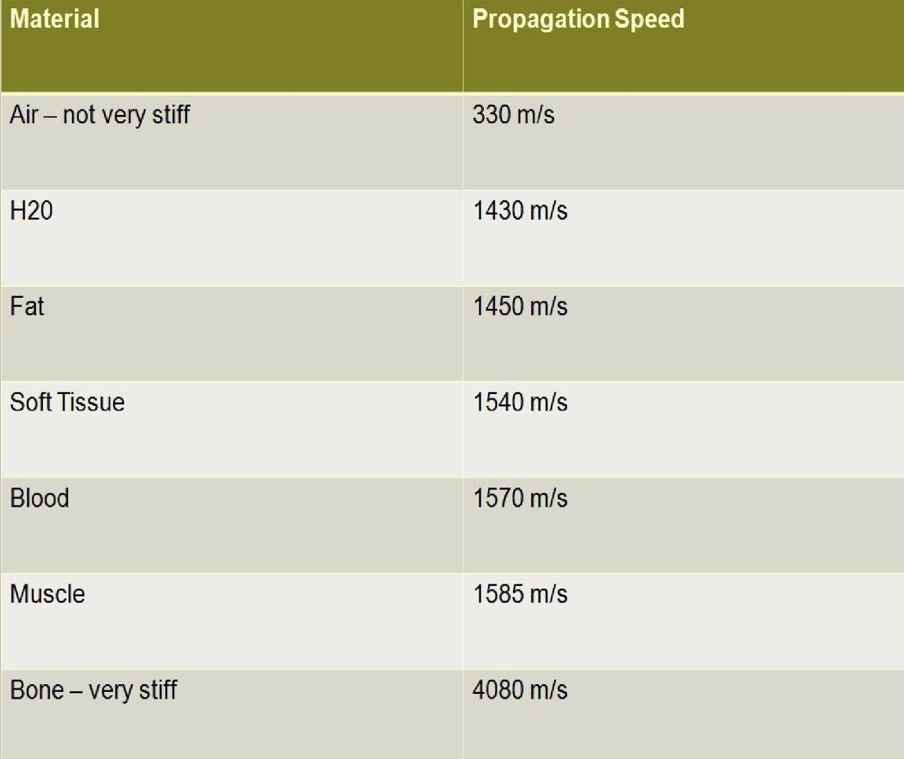
Speed is not constant

Slide 5
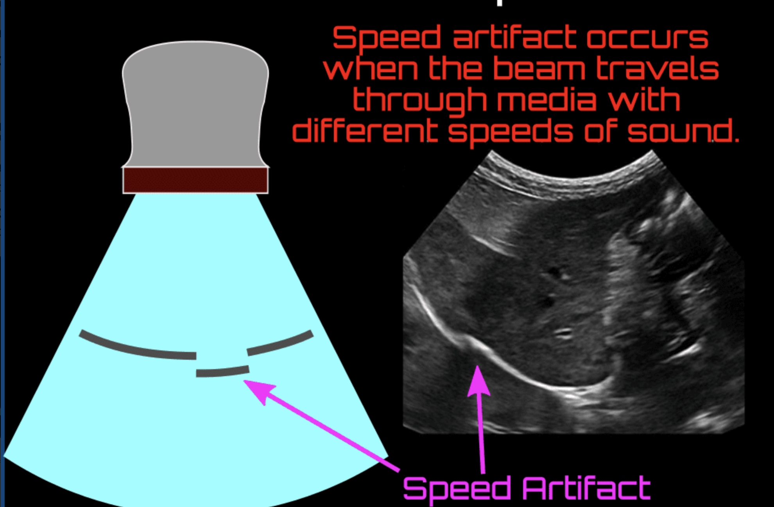
Speed displacement artifact

Slide 6
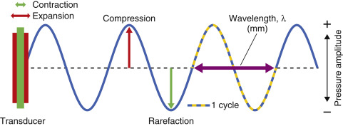
Ultra-sound

Slide 7
Beam width artifact
Ultrasound beam width artifact occurs when a reflective object located beyond the widened ultrasound beam, after the focal zone, creates false detectable echoes that are displayed as overlapping the structure of interest.
To understand this artifact, it is important to remember that the ultrasound beam is not uniform with depth, the main beam leaves the transducer with the same width as it, then narrows as it approaches the focal zone and widens again distal to this zone ¹.
Usually, it occurs when scanning an anechoic structure and some peripheral echoes are identified, i.e. gas bubbles in the duodenum simulating small gallstones and peripheric echoes in the bladder.
It is possible to avoid this artifact adjusting the focal zone to the depth level of interest and by placing the transducer at the center of the object being studied.

Slide 8
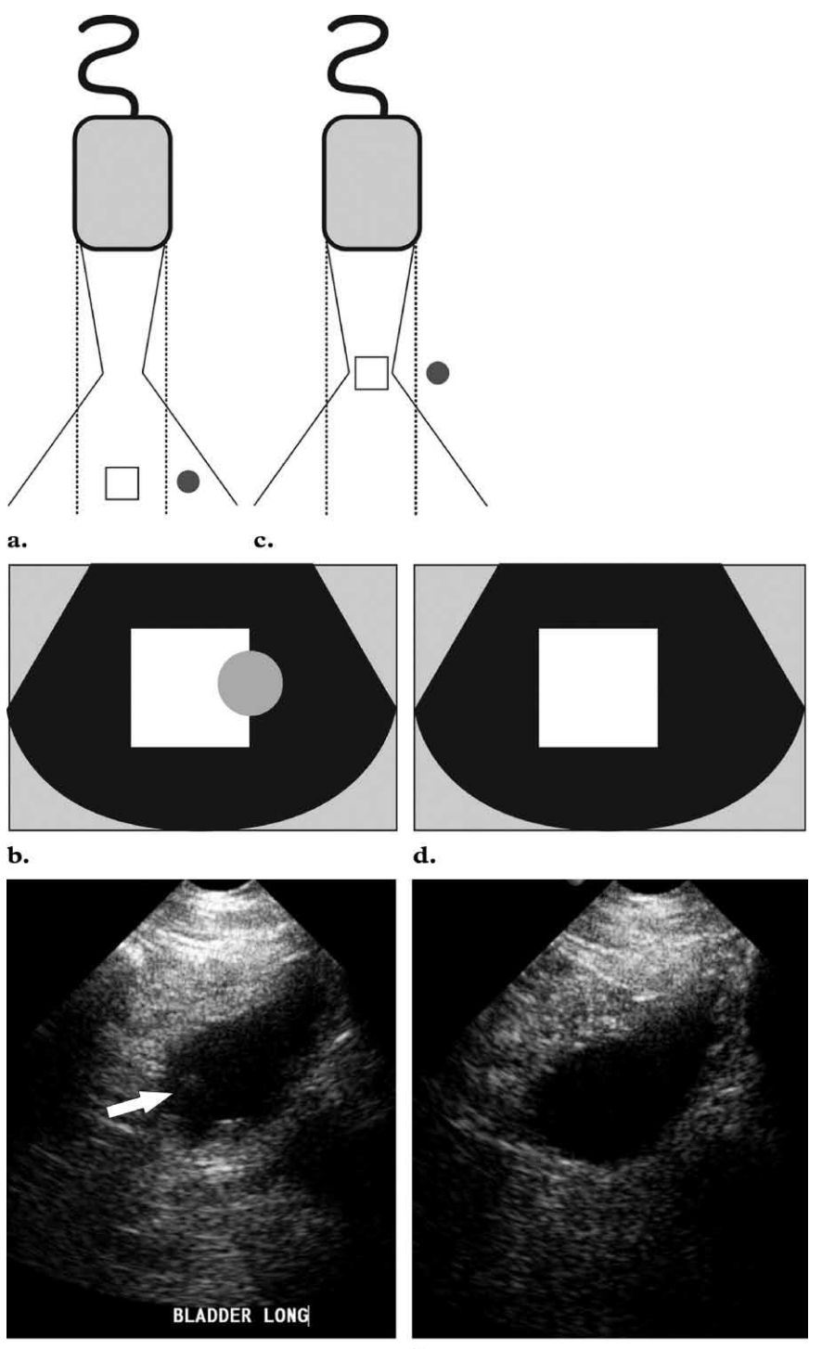

Slide 9
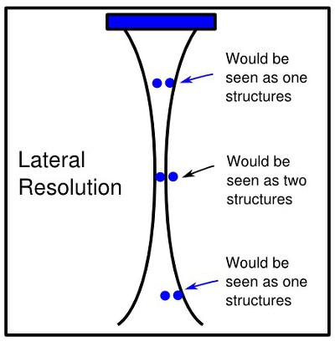

Slide 10
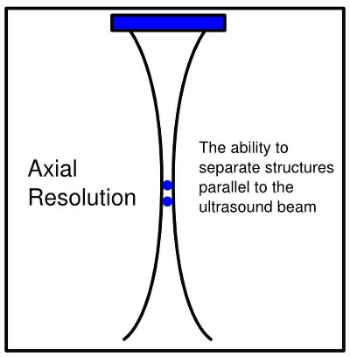

Slide 11
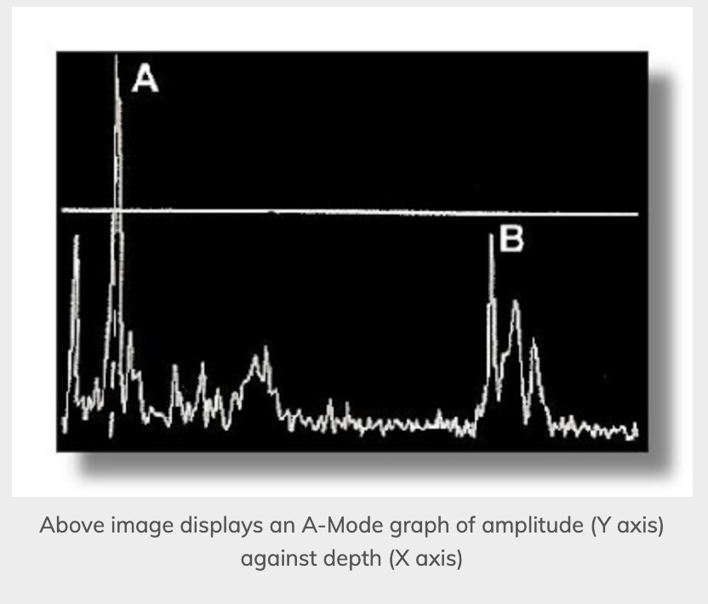
A- mode – the OG
Amplitude mode ultrasound can be used to create graphs of amplitude against depth. It is the simplest type of ultrasound. A single transducer produces ultrasound waves in a straight line. Destructive therapeutic ultrasound is also A-Mode.

Slide 12
Spectral Broadening
Caused by turbulence in blood flow
Results in a "fill-in" of the area between a curve and the baseline due to varying velocity of reflectors in the sampling area
How to fix:
  Artifactual spectral broadening is dependent on the angle of insonation and will increase as the angle approaches 90
  Maintaining a proper orientation (<60°)
  use an appropriately sized sample volume

Slide 13
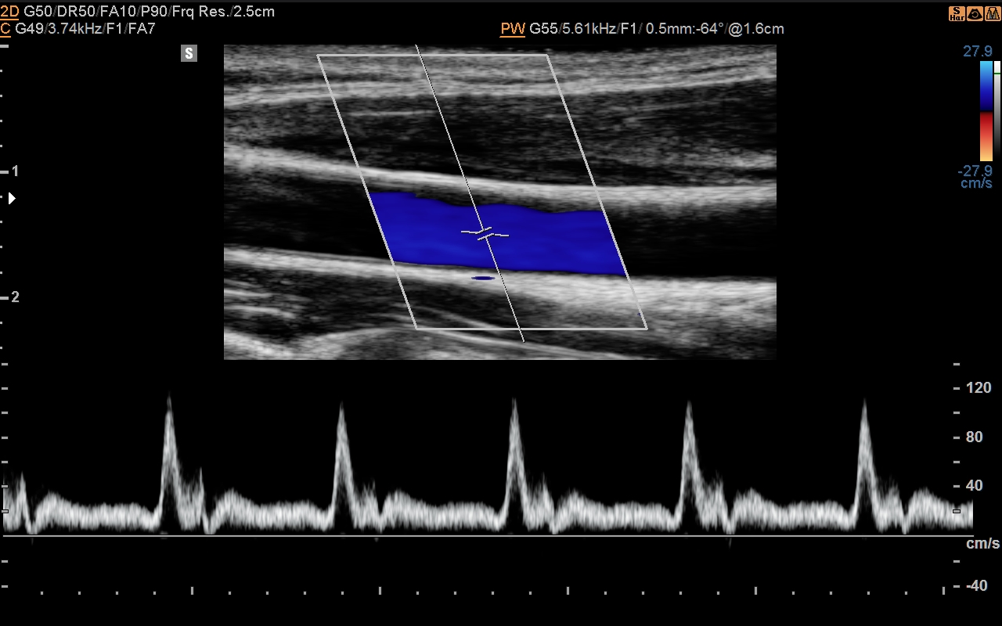
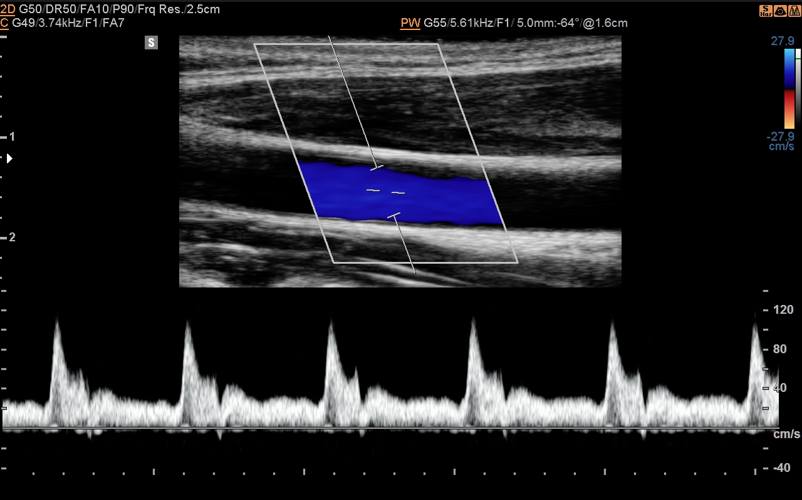
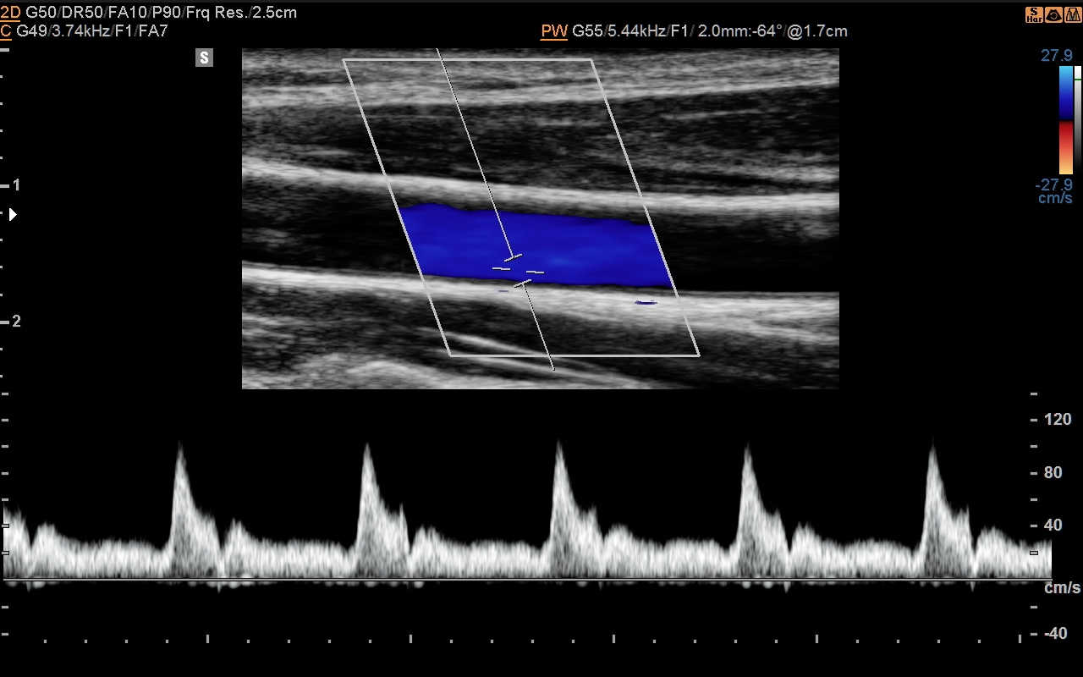

Slide 14
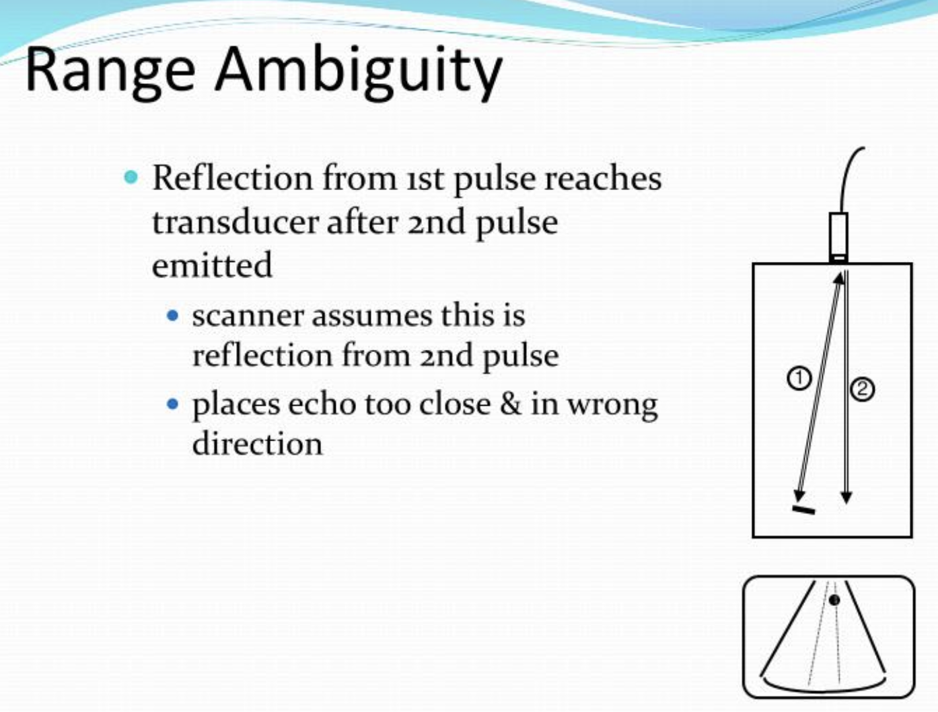

Slide 15
Two main parameters you need to know
Thermal Index
  Directly related to power output
  Color and spectral doppler increase output power, and thus increase TI
Mechanical Index
  Mechanical index is proportional to an ultrasound beam's peak negative pressure (or peak rarefaction pressure).
  It is also inversely proportional to the frequency of the beam. Therefore, higher frequencies have a lower mechanical index.

Slide 16
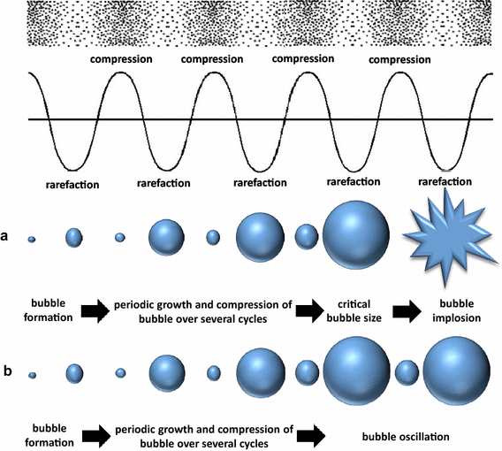

Slide 17
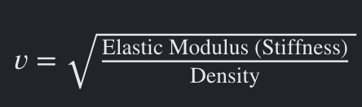

Slide 18
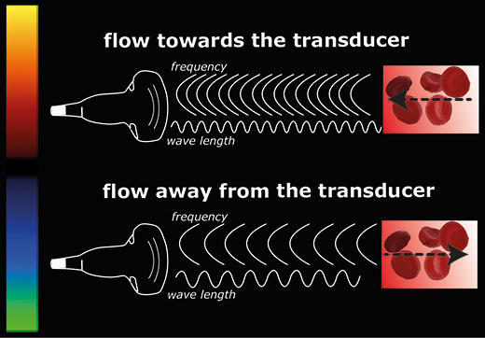
Doppler shift

Slide 19
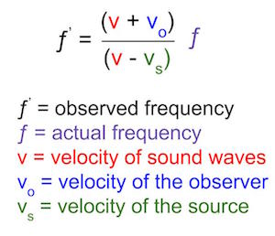
Doppler shift equation

Slide 20
Adjusted doppler equation
Adjusted (magnitude) Doppler equation
F = 2f_{o}(v/c)cos(Q)
where:
  F is Doppler frequency shift
  f_{o} is transmitted frequency from ultrasound probe
  v is the velocity of moving reflector
  c is the velocity of sound in the medium
  Q is the angle between ultrasound beam and axis of flow

Slide 21
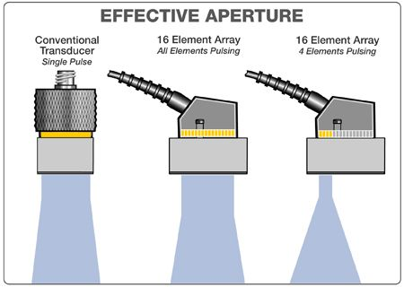
Beam steering

Slide 22
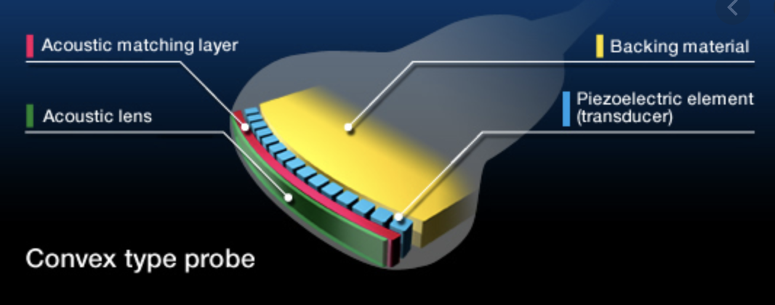

Slide 23
Tissue Harmonics
Ultrasound is sent out at the fundamental frequency – but it actually returns in integer multiples of this frequency
Filtering for only the harmonic waves decreases artifacts, improves lateral resolution and contrast resolution
Reduced slice thickeness

Slide 24
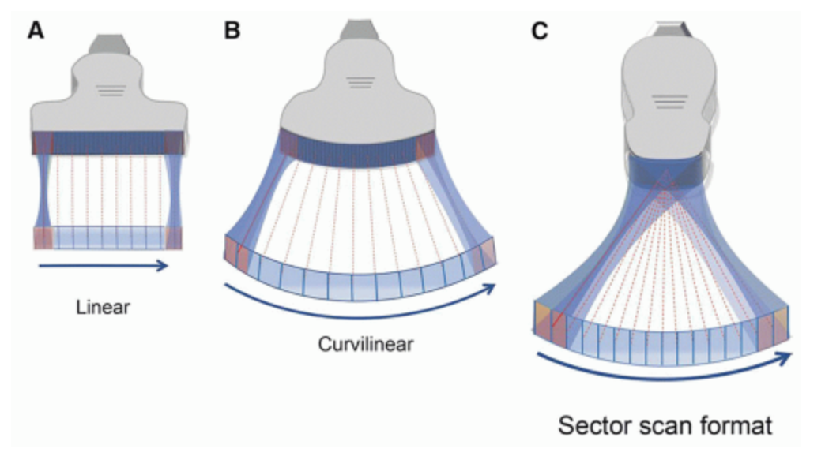
Scan line density
Scan line density refers to the number of sampling beams an imaging system transmits per frame.
higher densities improve lateral resolution, but require more time to process, which reduces your frame rate and temporal resolution

Slide 25
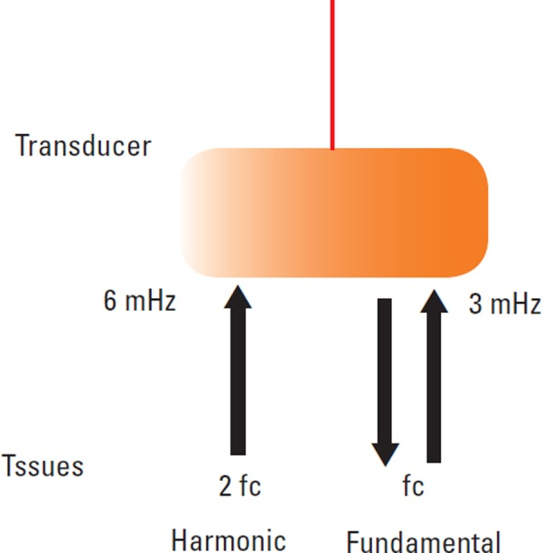

Slide 26
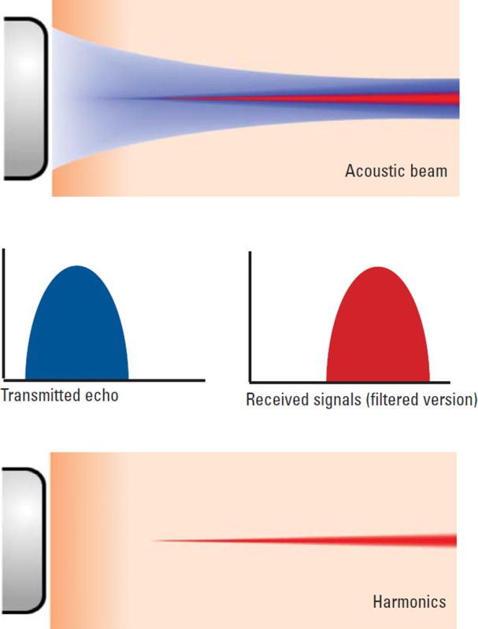
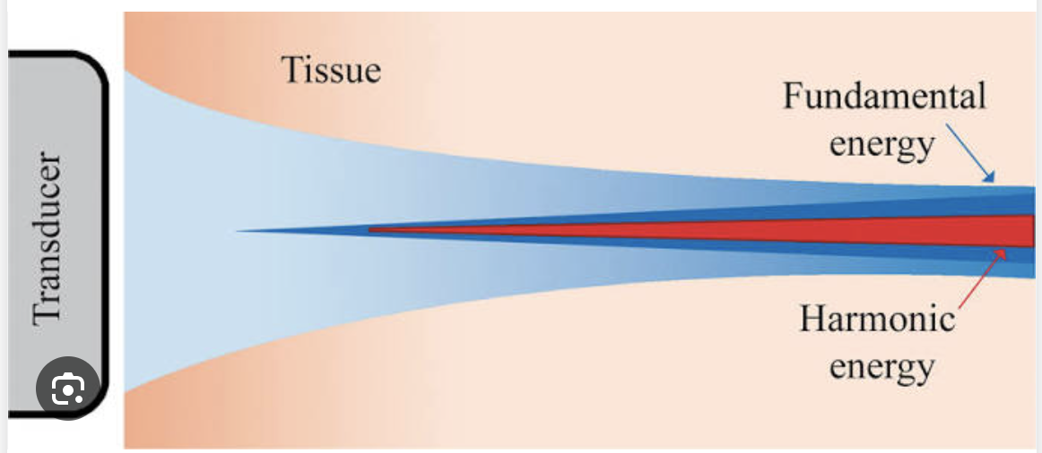

Slide 27
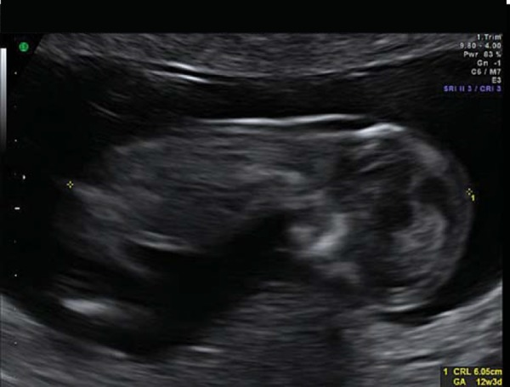
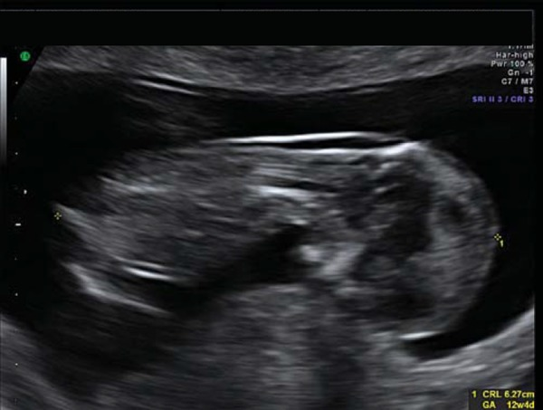

Slide 28
Tissue Harmonics also:
Improved axial resolution: Due to higher frequencies
Improved signal-to-noise ratio: Reduced side lobes decrease noise, which can improve signal-to-noise ratios and reduce artifacts
Improved contrast resolution: The higher-order signal can provide better contrast-to-noise ratios
Improved range penetration: Can be useful for imaging cystic lesions and those containing echogenic tissues such as fat, calcium, or air

Slide 29
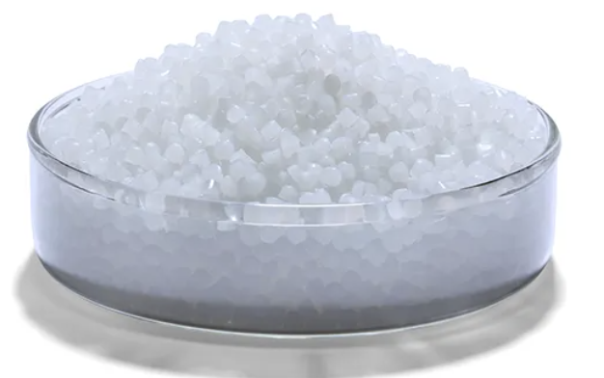
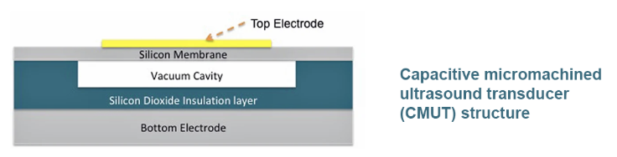
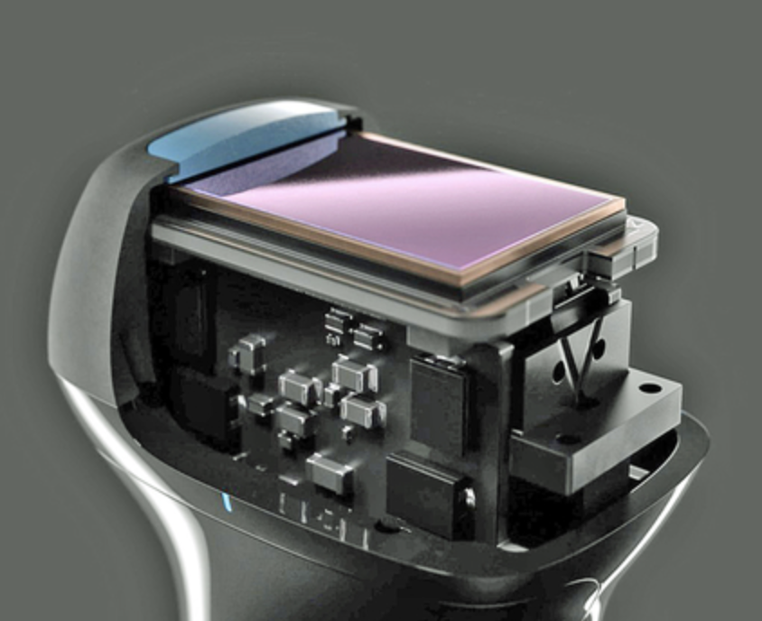
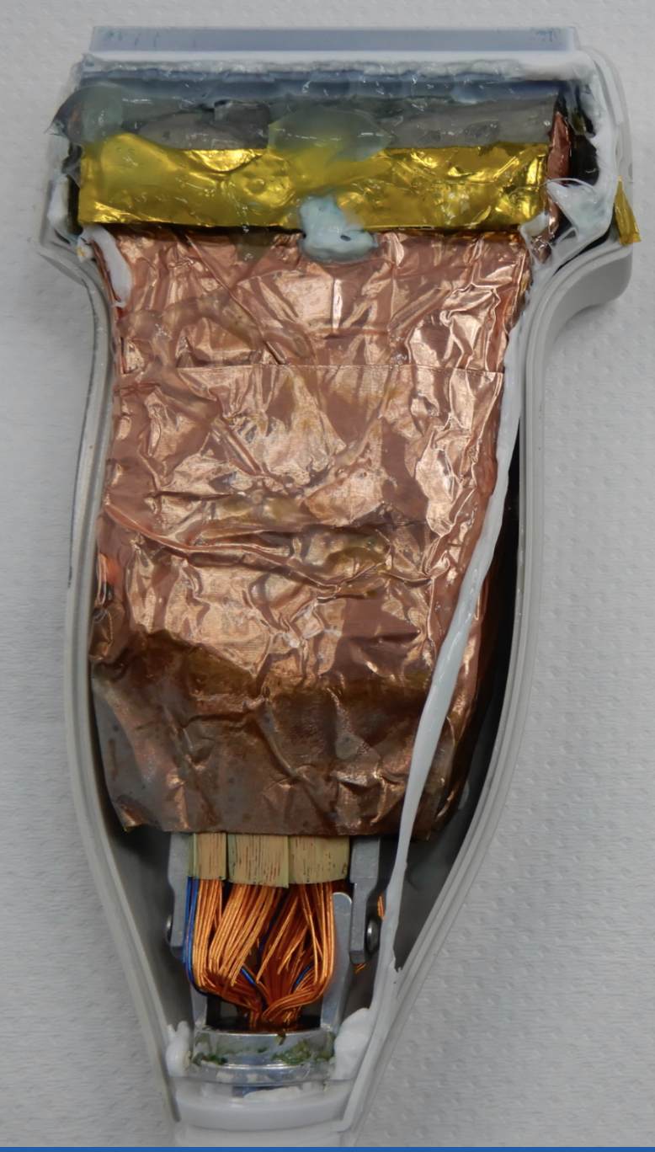
Crystals vs Chips

Slide 30
Chips vs Crystals
Traditional Piezoelectric Crystal Ultrasound
Uses piezoelectric ceramics (e.g., PZT) that deform with electric current to generate sound waves
Proven, reliable technology for decades
Limitations:
  Bulkier probes
  Limited frequency range per probe
  Requires complex manufacturing
  Less flexible in beam steering without mechanical motion
Microchip-Based (CMUT/PMUT) Ultrasound
Uses capacitive micromachined ultrasonic transducers (CMUTs) or piezoelectric micromachined ultrasonic transducers (PMUTs) built with semiconductor fabrication
Advantages:
  Potential for miniaturization → handheld and wearable ultrasound devices
  Broad frequency bandwidth in a single probe
  Easier integration with digital electronics and AI
  Lower cost, scalable production
  Electronic beam steering without moving parts
Challenges:
  Still emerging in clinical adoption
  Durability and image quality optimization ongoing

