Slide 1

Population Health M3
An introduction to evidence based medicine for patient care
Michael Joyce, MD, FACEP
Associate Professor of Emergency Medicine and Radiology
VCU School of Medicine

Slide 2
Housekeeping:
Quiz will be open immediately after this lecture, and open until Wednesday end of day (11:59pm)
The quiz is short questions that you will be able to answer easily if paid attention to and participated with the presentation
Please remember to take the quiz!

Slide 3
Recap of what we have covered so far
Session 1: Resources for finding the best evidence
Session 2: How to ask a good question, refining the ask to get an answer
Session 3: Applying diagnostic studies to your everyday practice – likelihood ratios are your friend
Session 4: Therapy studies - interpreting new data – should I do this for my patient(s)?
Session 5: Harm - understanding the importance of observational studies

Slide 4
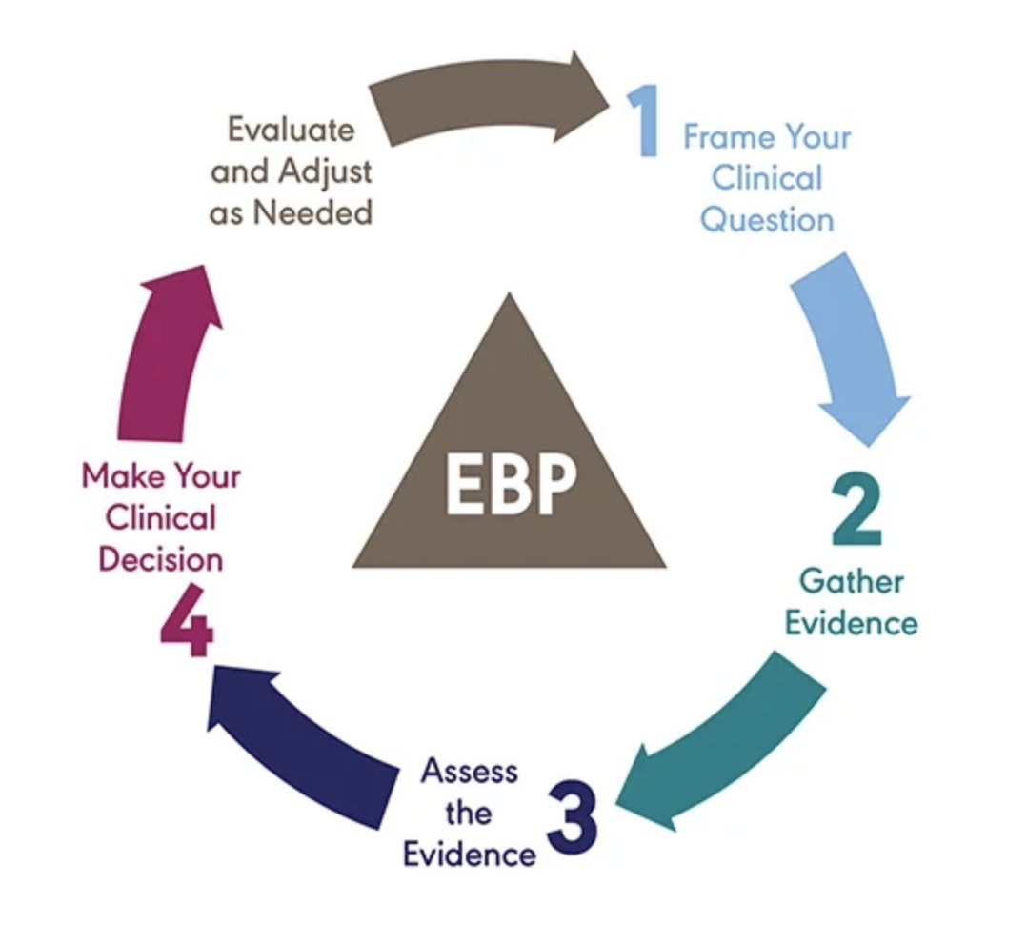
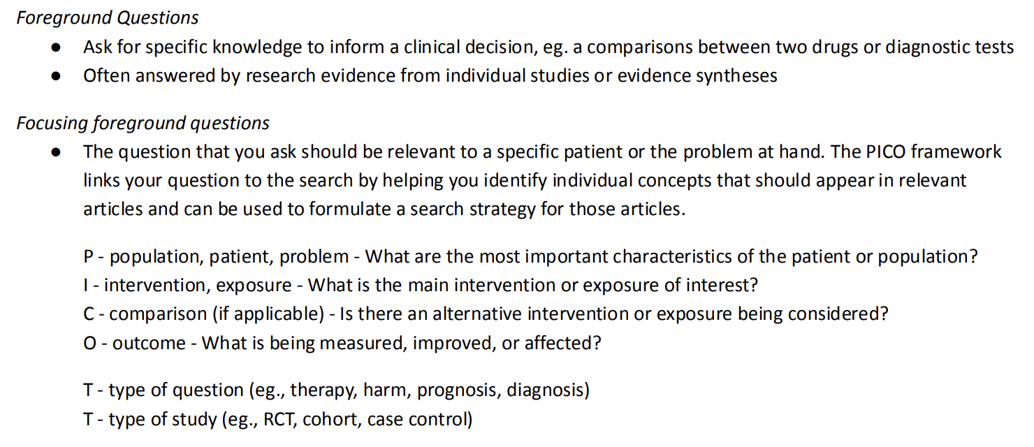
The Evidence Cycle
EBM

Slide 5
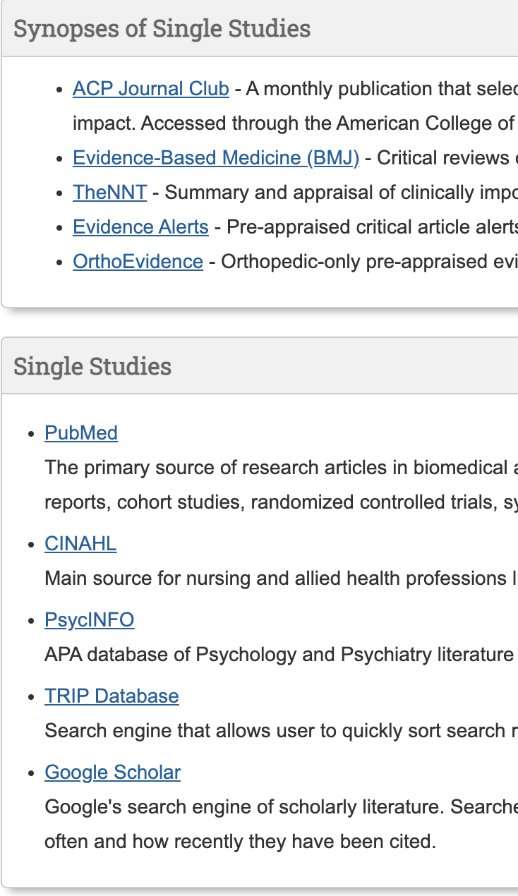
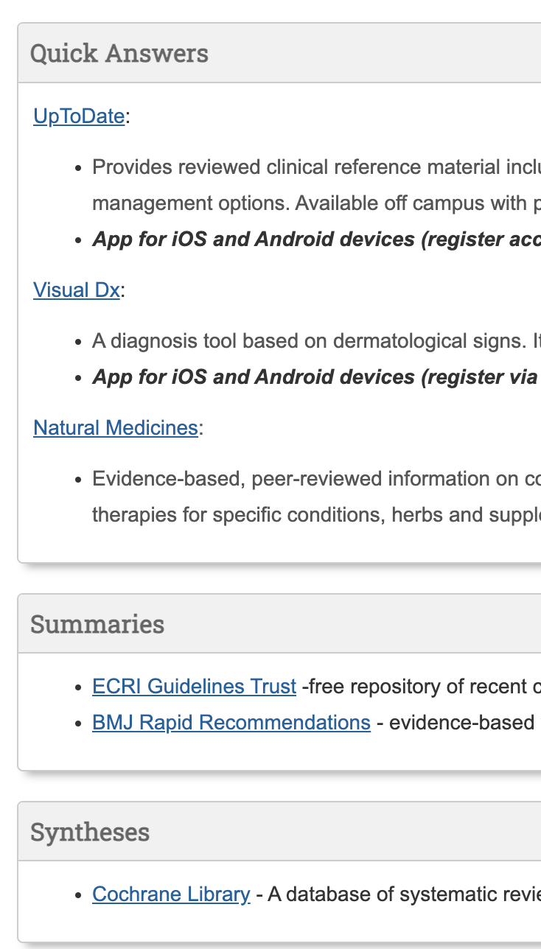
The Evidence Cycle
https://guides.library.vcu.edu/clerkships
EBM

Slide 6
The Evidence Cycle
Takes continued practice – more practice today
EBM

Slide 7
The Evidence Cycle
What decision am I making?
Diagnosis
Therapy
Harm
Prognosis
EBM
Today:
Harm

Slide 8
Goals and Objectives
Today’s goals:
  Discuss harm studies
  Understand the importance of observational studies
  Learn how to interpret the math of an observational study
    Quickly read the stats!
  RCTs aren’t always the best?

Slide 9

Let’s walk through a case
A mom and her 2-year-old daughter come in for a well child check. During the visit, the mom asks about pets in the house. They do not have a dog, but they are considering adopting a rescue dog. The mom heard through her friends that this would increase her child's risk of developing asthma and it was a bad idea. There is no family history of asthma, but the mom suffers from eczema.
You do know that having a dog does increase the symptoms from asthma, but you aren’t sure about the risk of developing the disease. You tell mom you will check some evidence and get back to her!

Slide 10
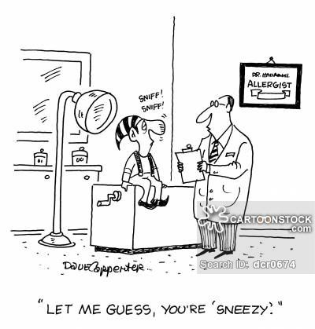
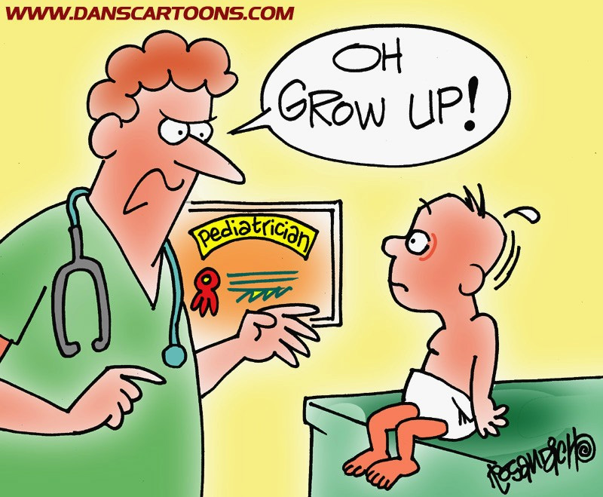
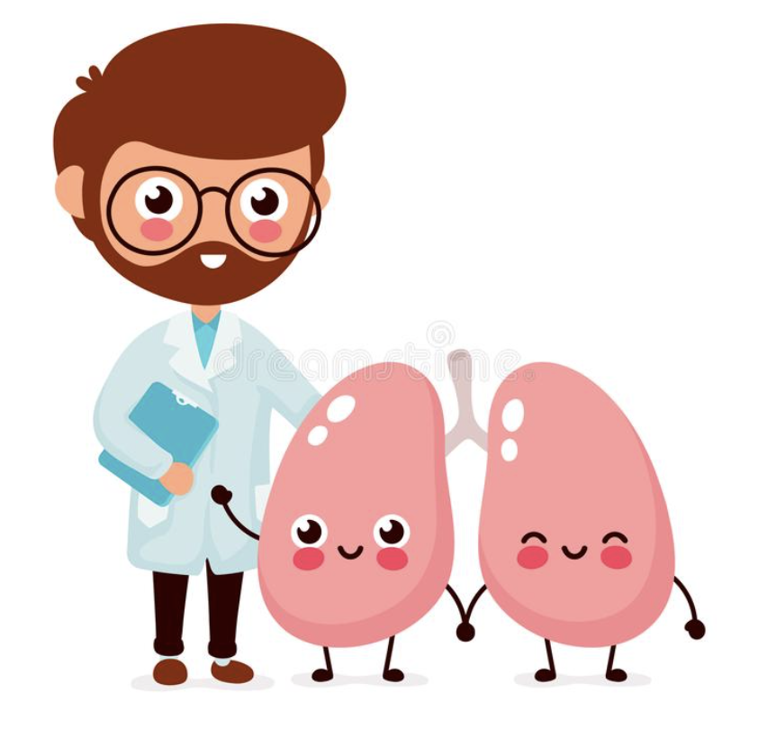
Disclosures

Slide 11

So… what is the first step?

Slide 12
Step one: what is the question?
P -
I -
C -
O -
T -
Responses

Slide 13
Step one: what is the question?
P – Adolescents/Adults
I – living with a dog in the house during childhood
C – not living with a dog during childhood
O – development of asthma
T – harm

Slide 14
Step one: what is the question?
P – Adolescents
I – Parents with atopy
C – Parents without atopy
O – development of asthma
T – harm

Slide 15
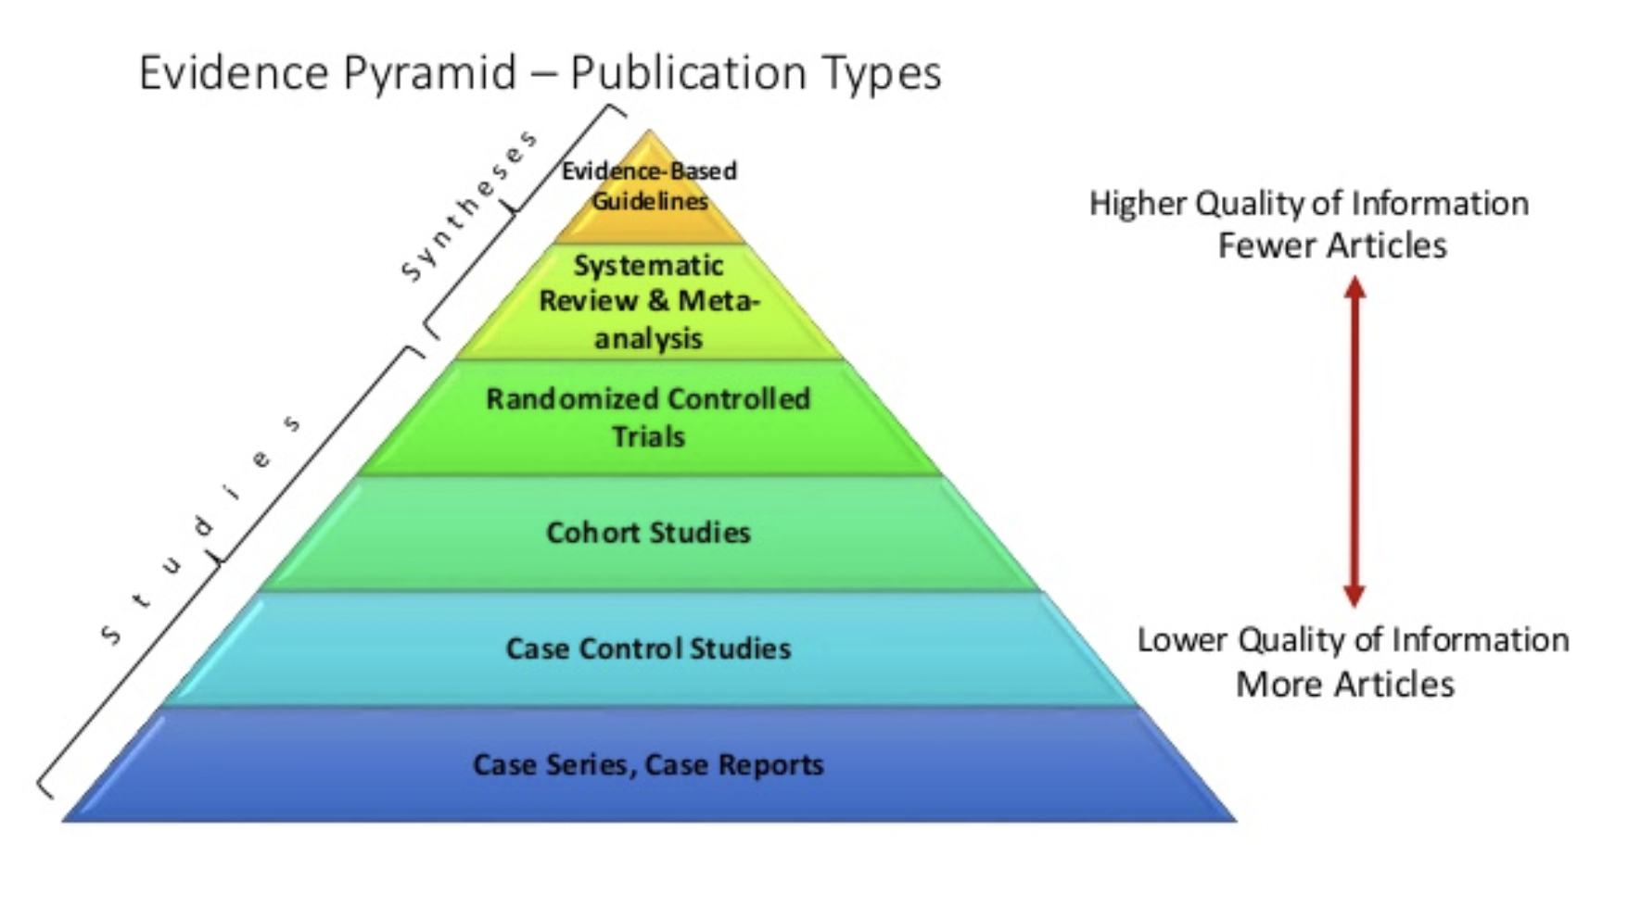
Step 2, where should I start looking?

Slide 16

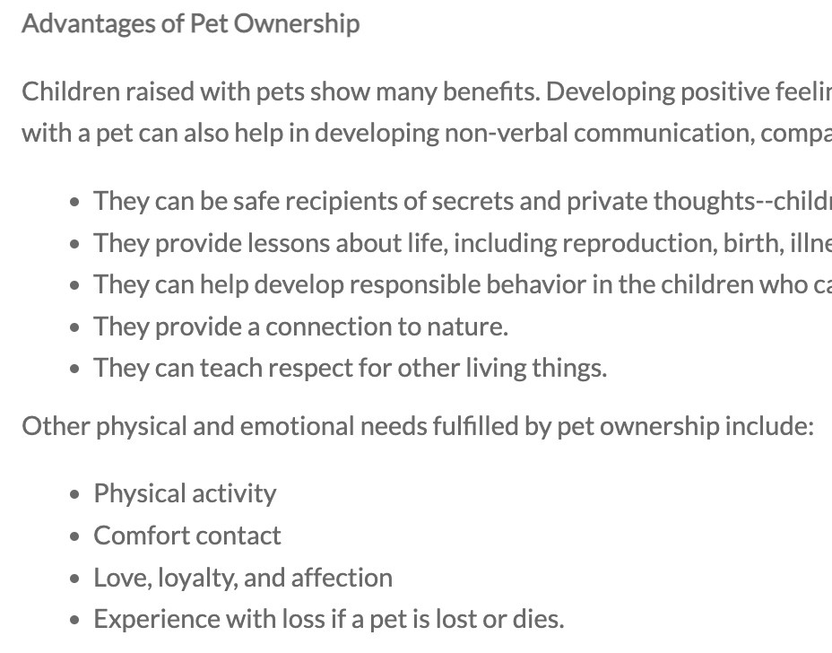
Look for clinical EBM guidelines:

Slide 17
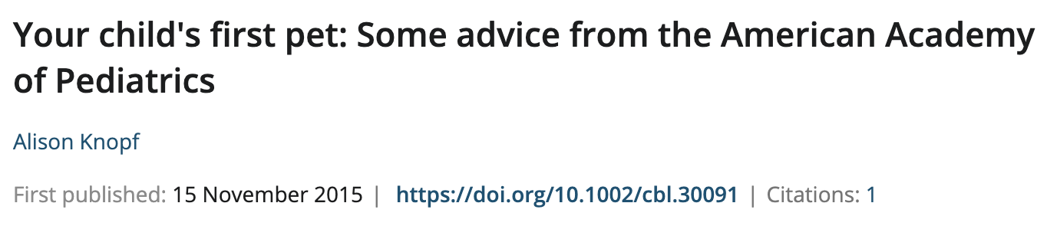
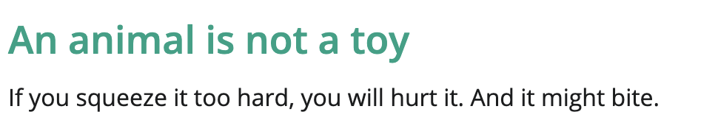
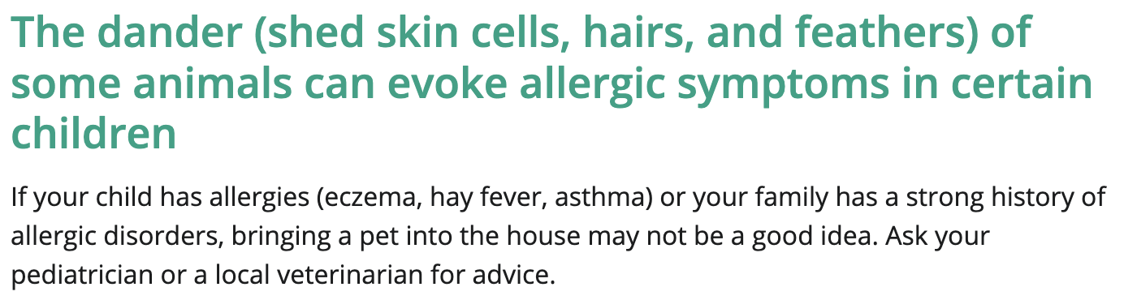
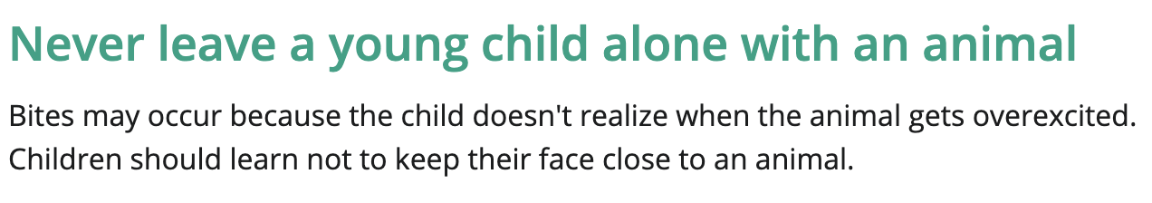
Look for clinical EBM guidelines:

Slide 19
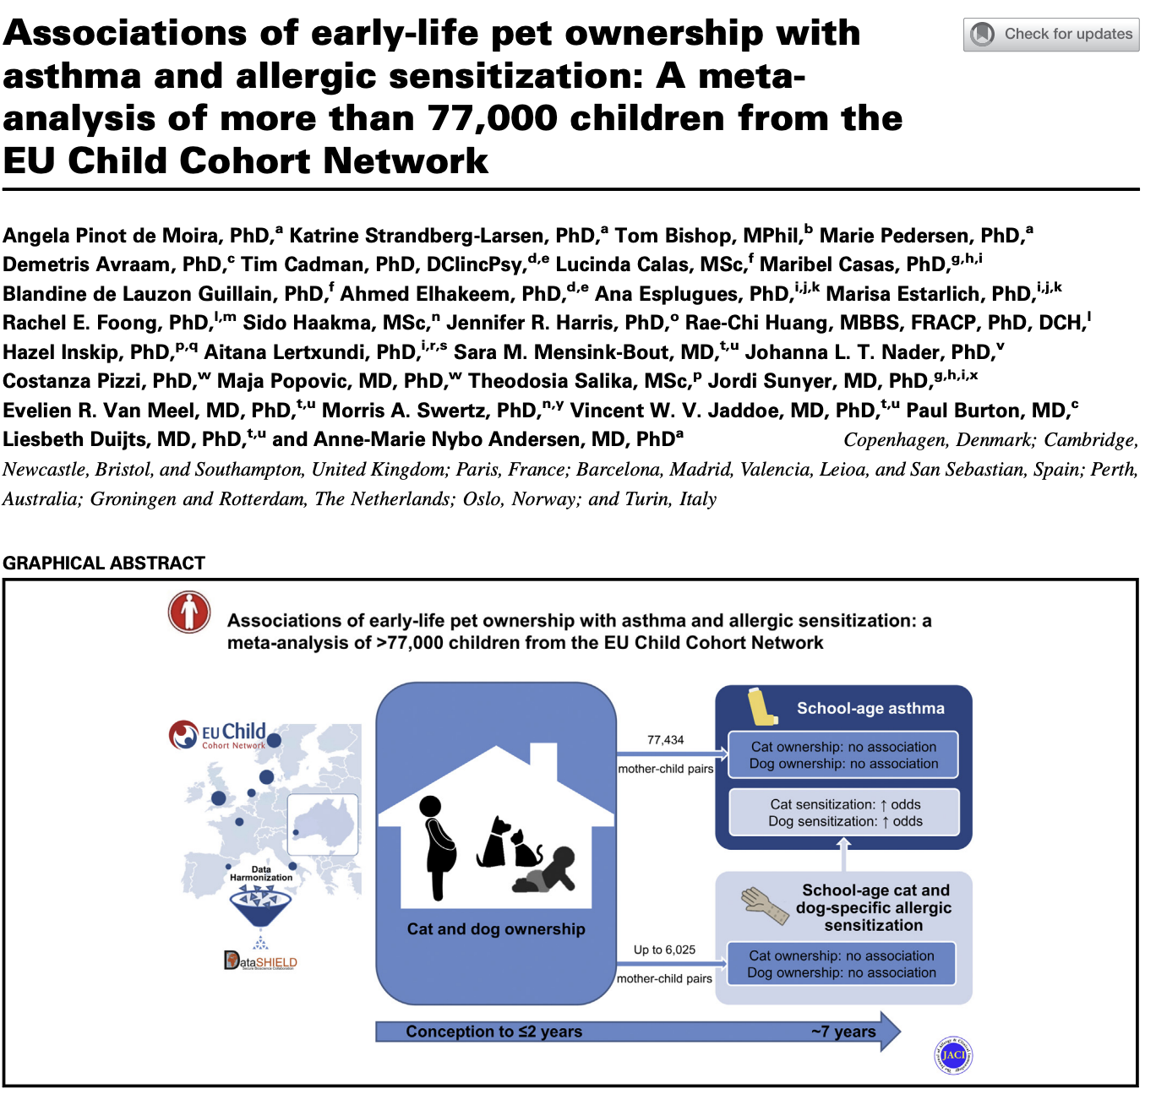
Find a systematic review:

Slide 20
Find a systematic review:

Slide 21
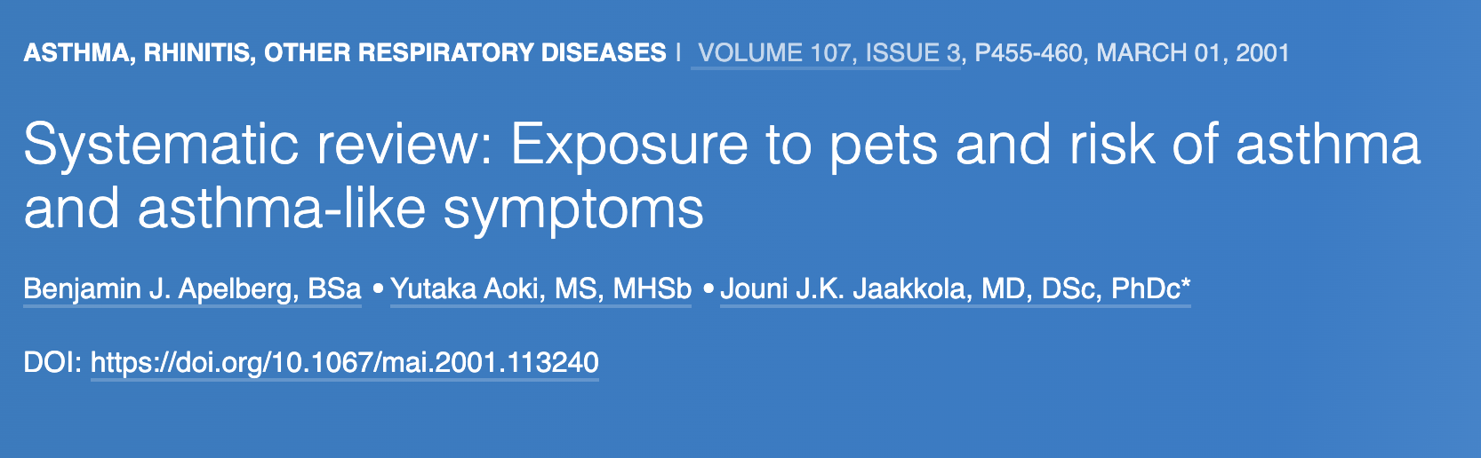
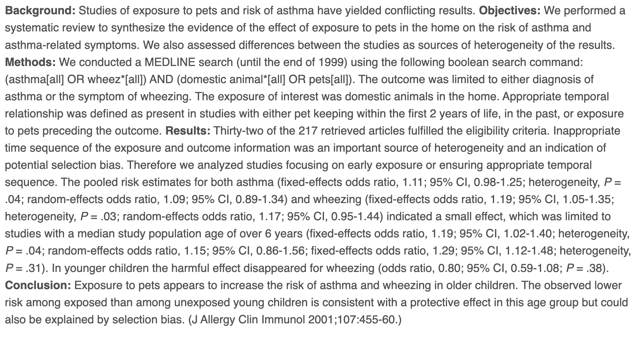
Find a systematic review:

Slide 22
Find a systematic review:

Slide 24
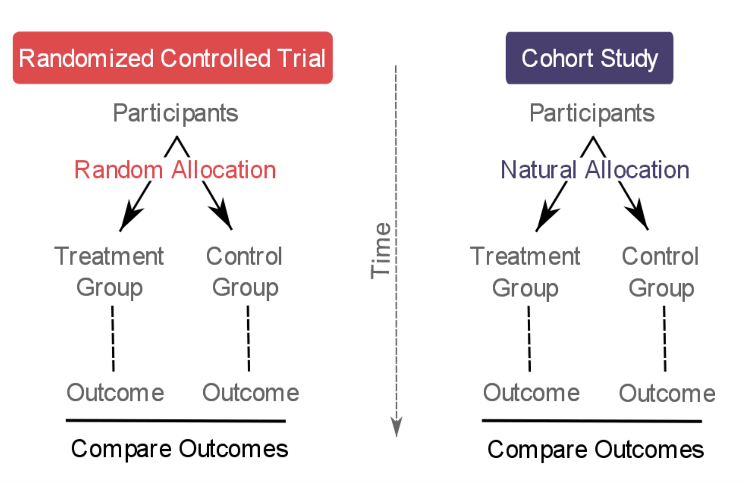
What is so special about RCTs?
Randomization = equal groups
Only difference should be the intervention
Can attribute differences in outcome to the intervention (exposure) alone!

Slide 25
Why not an RCT then?
Often unethical
  Cannot randomize kids to things that could be harmful, IE cigarette smoke
  Often not feasible
    How do you randomize to having a pet vs not having a pet? Free puppies!?
    Timeline is usually much longer
      Unlike obvious harm exposures, usually takes a long time for the disease or outcome to generate
      Takes a LOT of patients if the risk is small
      Would be very expensive

Slide 26
So then what is the biggest risk of bias?
Did exposed and control groups (or cases and controls) began and complete the study with sufficient similarities that we can obtain a minimally biased assessment of the influence of exposure on outcome
Therefore, the researcher must:
  Document the important characteristics of each group
  Control for differences using statistical methods

Slide 27

Name that study design!

Slide 28

In a study of risk factors for the development of asthma, investigators enrolled consecutive children during their first newborn well child check. Each child’s caretaker was asked whether or not there were pets in the household. The children were followed for 5 years and the frequency of asthma in children with and without pets in the home was assessed.
A) Randomized Control Trial
B) Prospective Cohort Study
C) Retrospective Cohort Study
D) Case Control Study
E) Cross Sectional Study
Responses

Slide 29
In a study of risk factors for the development of asthma, investigators accessed records from the electronic medical record. They identified all children with a diagnosis of asthma. They also identified children of similar age and sex who did not have asthma. The investigators then looked to see how many children in each group had pets in the home before they were diagnosed with asthma.
A) Randomized Control Trial
B) Prospective Cohort Study
C) Retrospective Cohort Study
D) Case Control Study
E) Cross Sectional Study
Responses

Slide 30
In a study of risk factors for the development of asthma, investigators looked at all their patients in their health system who had asthma. They identified those that had asthma and owned pets and those that had asthma and did not own pets. The investigators calculated the risk of asthma based on owning a pet.
A) Randomized Control Trial
B) Prospective Cohort Study
C) Retrospective Cohort Study
D) Case Control Study
E) Cross Sectional Study
Responses

Slide 31
In a study of risk factors for the development of asthma, last month investigators accessed records from the electronic medical record from 2000 through 2020. The investigators determined which children had pets in the home at the time of their birth. They then looked to see which children developed asthma by their 5th birthday.
A) Randomized Control Trial
B) Prospective Cohort Study
C) Retrospective Cohort Study
D) Case Control Study
E) Cross Sectional Study
Responses

Slide 32
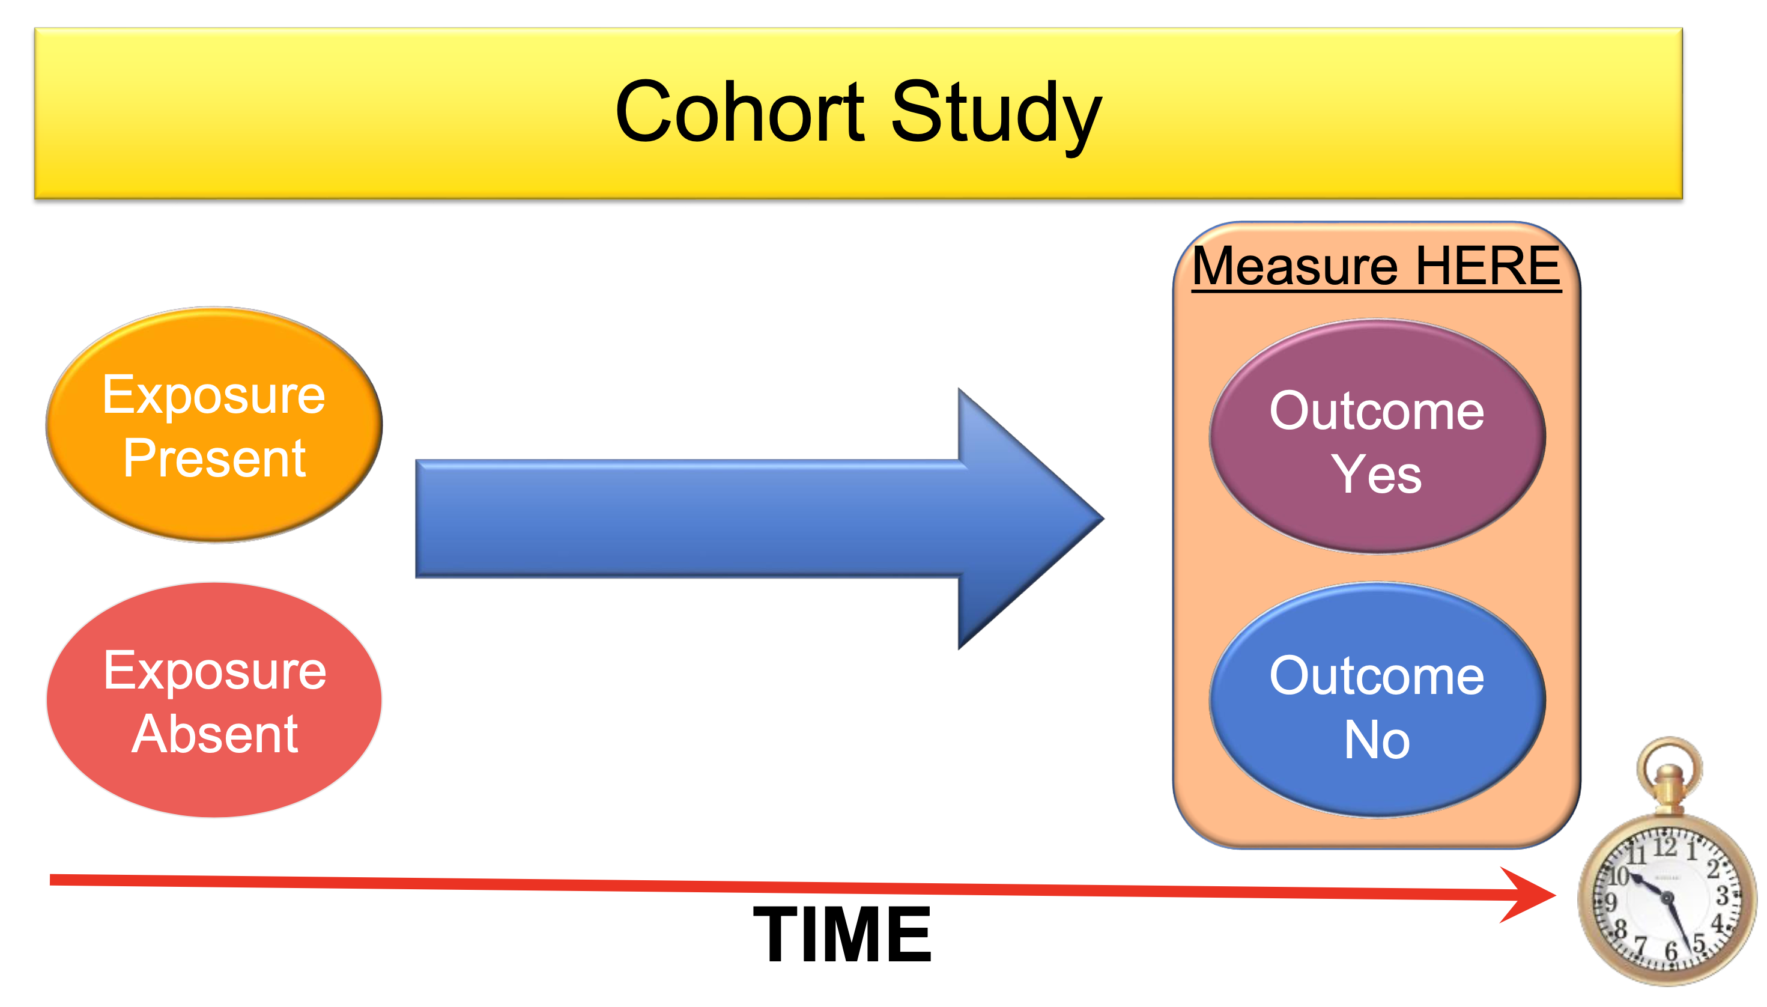
Observational studies
ENROLL HERE

Slide 33
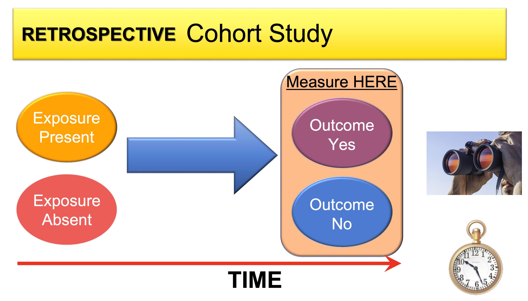
Observational studies
ENROLL HERE

Slide 34
Looking forward vs Looking back
Retrospective
  Can do it quickly *
  Recall bias
  Selection bias
  Might not have all the data you want
Prospective
  Less chance of bias, can consecutively enroll
  Can collect all the data needed to reduce confounders *
  Takes a long time – I want to know the answer now!

Slide 35
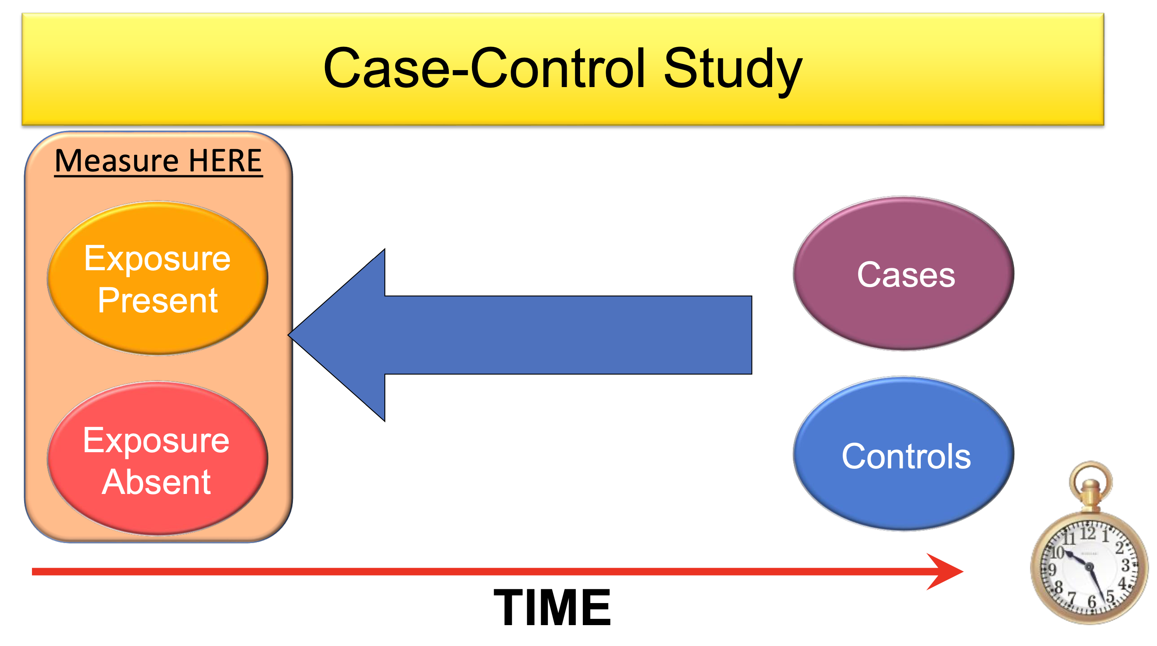
Observational studies

Slide 36
Case Control
Benefits:
  Can target a known outcome
  Can be done relatively quickly
  Able to control for confounders by matching the controls
Cons
  May not have all the data you want
  Selection bias still plays a role
  Can be hard to match

Slide 37
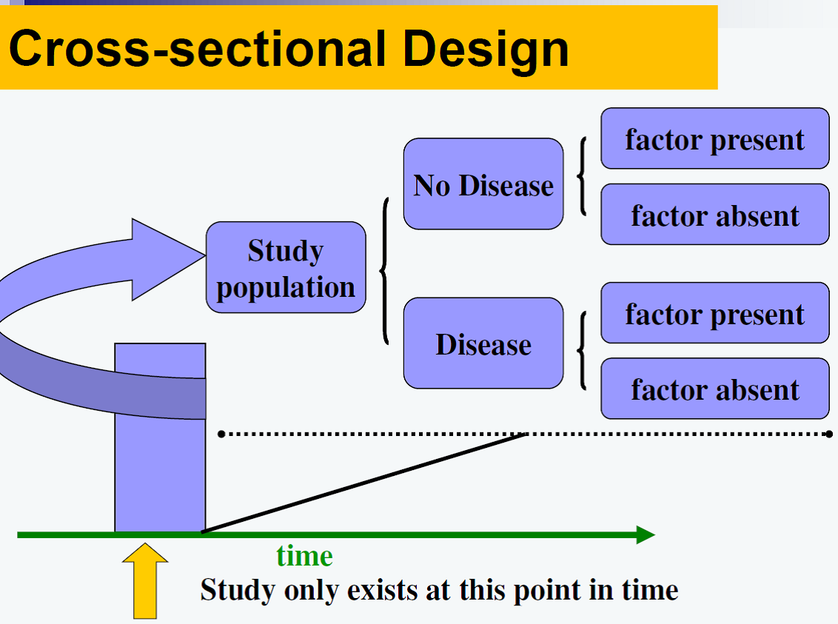

Slide 38
Back to the case

Slide 39
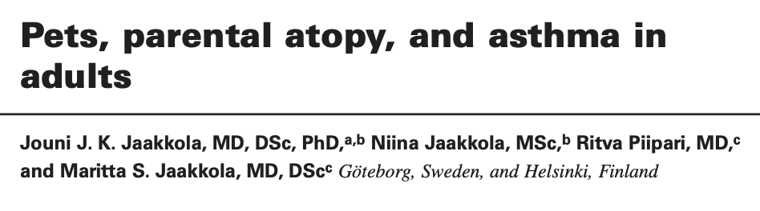
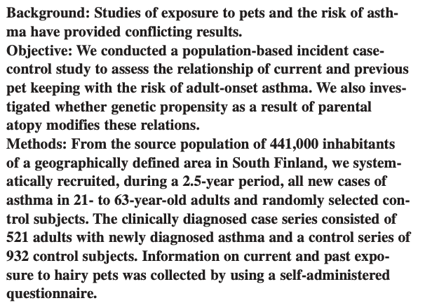
(Retrospective) Case-Control Study

Slide 40

What is the first step in interpreting this article?
What is the first step in critically looking at any article?
  We already said the biggest risk in observational trials of bias is unequal groups (selection bias)
  Let’s determine how patients were enrolled
  Compare the groups by looking at table 1

Slide 41
How did they enroll?
Cases
  We systematically recruited all new cases of asthma, first in the city of Tampere beginning on September 15, 1997, and then from March 10, 1998, to March 31, 2000, in the whole Pirkanmaa Hospital District
Controls:
  The control subjects were randomly drawn from the source population by using the national population registry, which has a full coverage of the population

Slide 42
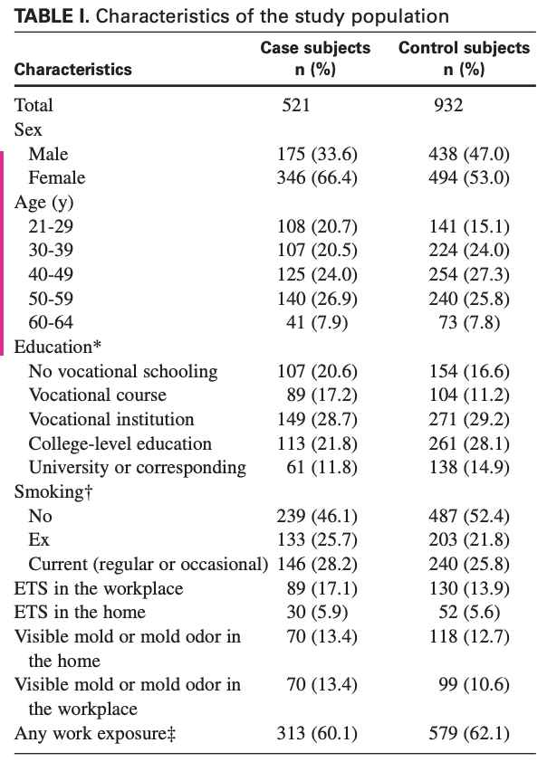
Table 1

Slide 43
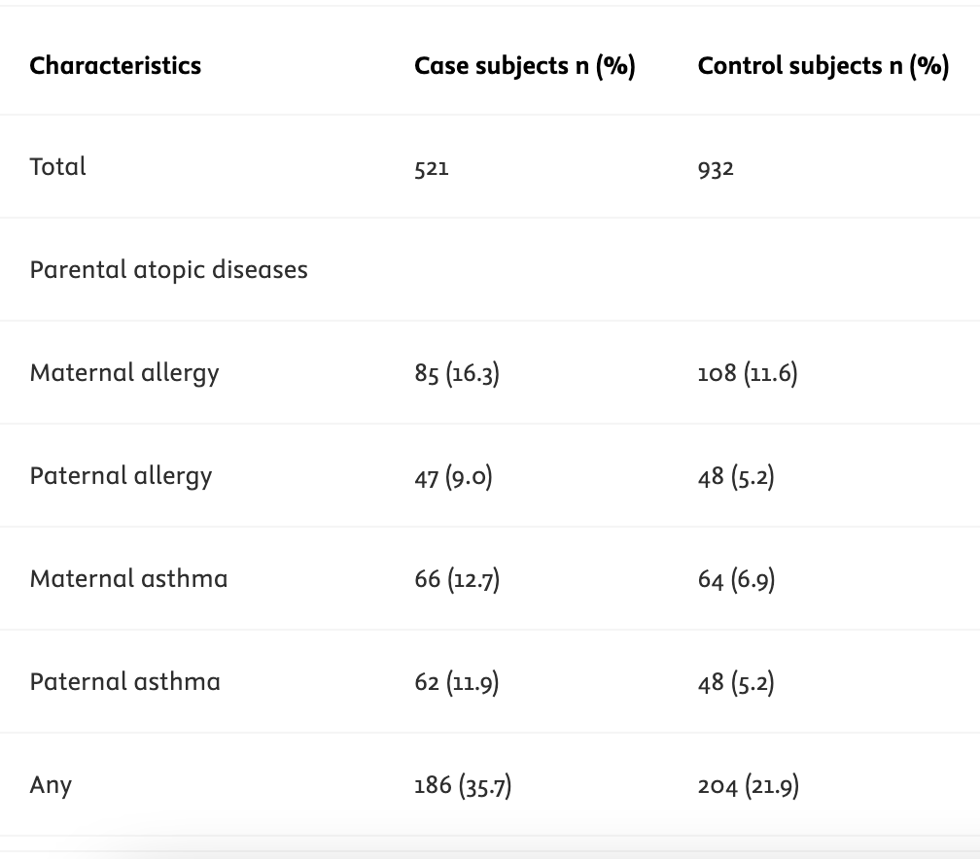
Table 1

Slide 44
What is another big form of bias in retrospective studies?
  Recall bias:
    If asked to self identify exposure, how reliable is it
    Were they actually exposed?!

Slide 45



What is our assessment of the bias?
Enrolled all patients with the disease?
Matched controls ?
Table 1 shows equal demographics?
Low chance of recall or reporting bias?

Slide 46
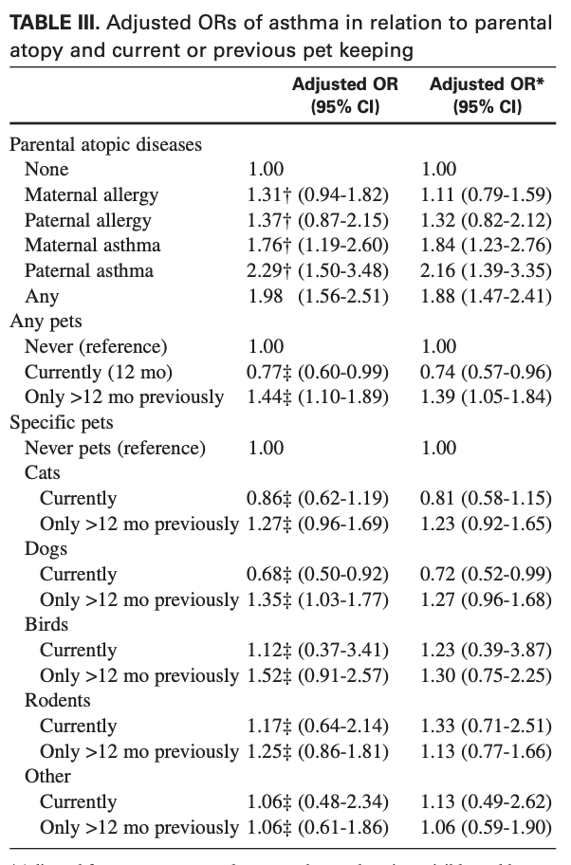
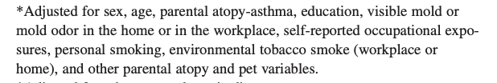
Interpreting the results

Slide 47
How do observational studies report findings?
Odds vs Risk-
  This can be confusing, and often misused
  Even by researchers, editors and final published work!
  RISK
    Simply put is a probability
    The probability of something happening, compared to all the outcomes.
    Best for looking at multiple outcomes
  ODDS
    A ratio of occurring vs not occurring
    Best for looking at binary outcomes

Slide 48
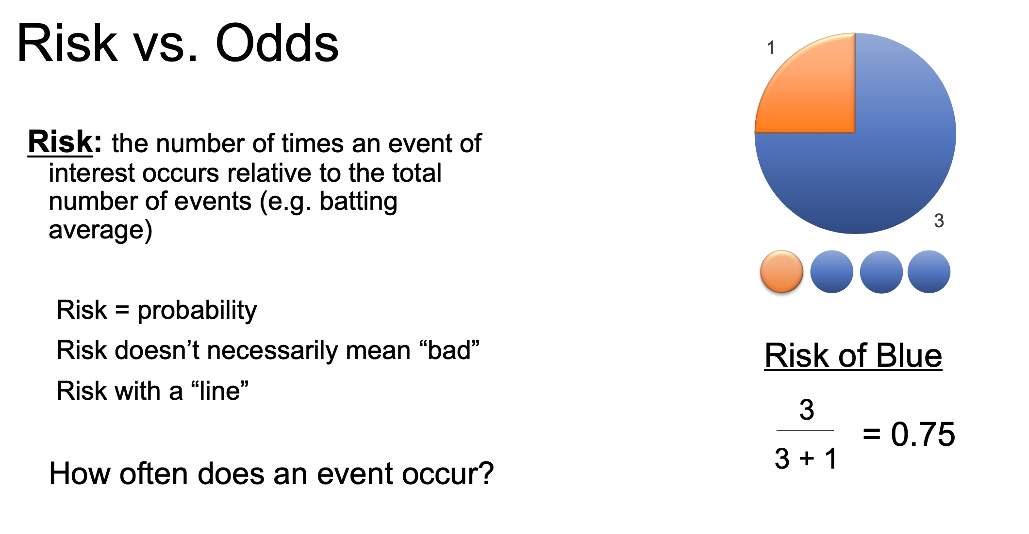

Slide 49
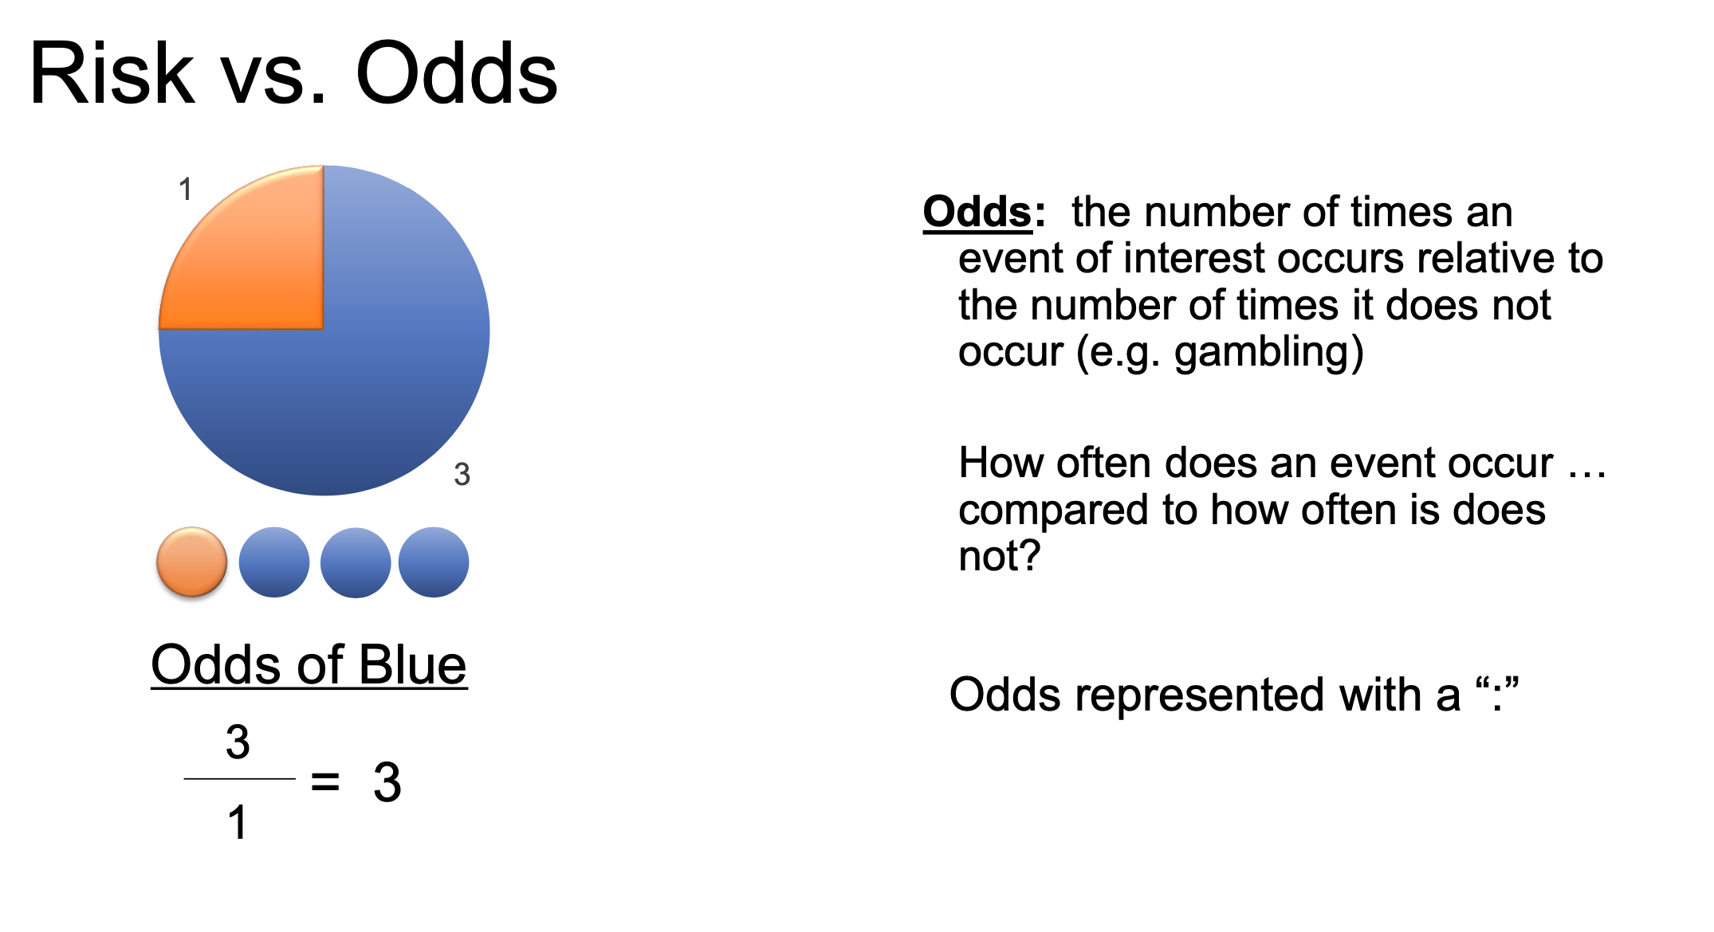

Slide 50
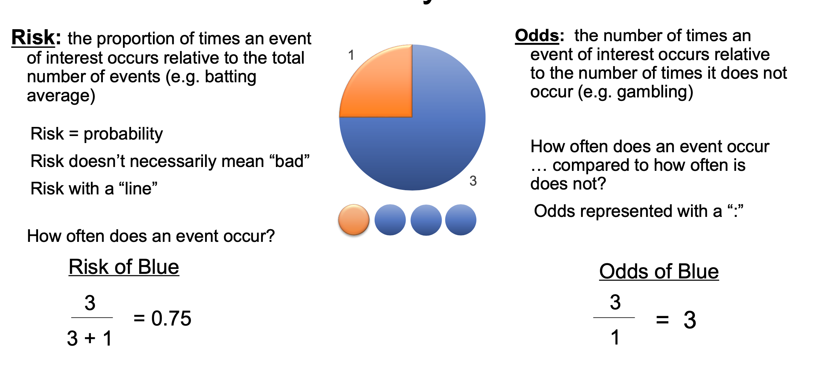

Slide 51
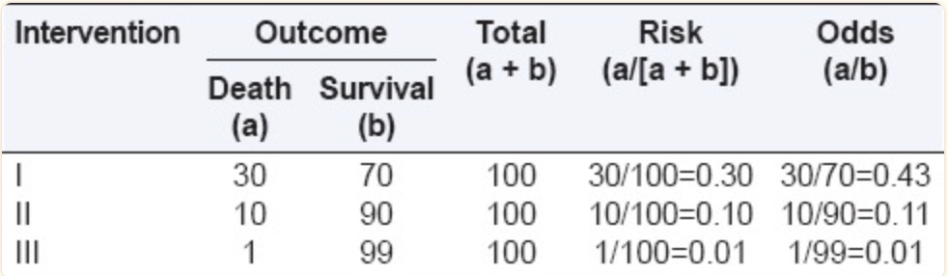
Risk v Odds

Slide 52
So why do we need to know the difference?
Risk answers:
"What is the probability that this happens?"
Odds answers:
"How many times does it happen compared with not happening?"
When outcomes are rare (<10%), odds and risk are very similar. As outcomes become more common, odds increasingly exaggerate the magnitude compared with risk.

Slide 53
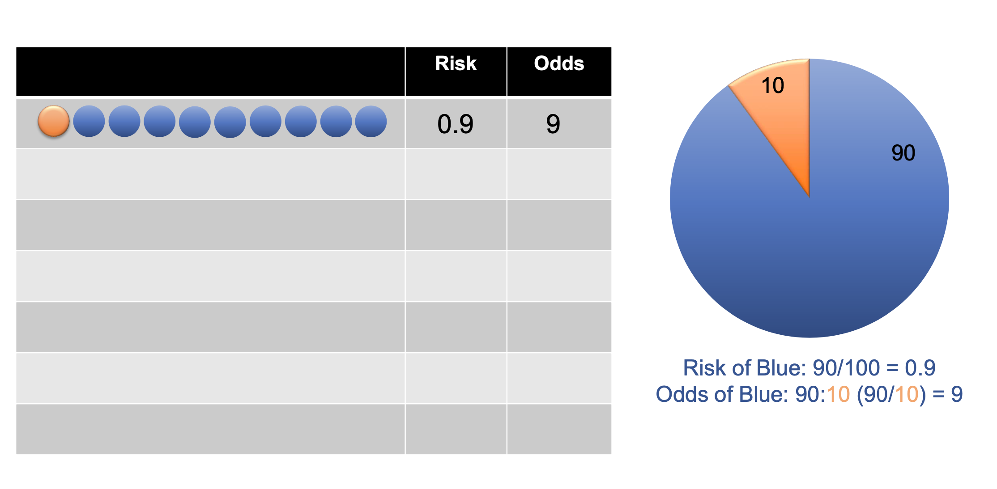

Slide 54
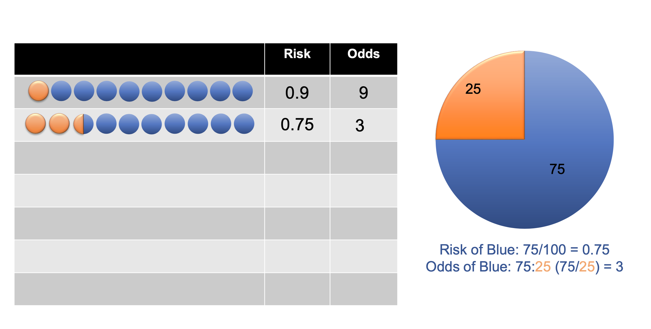

Slide 55
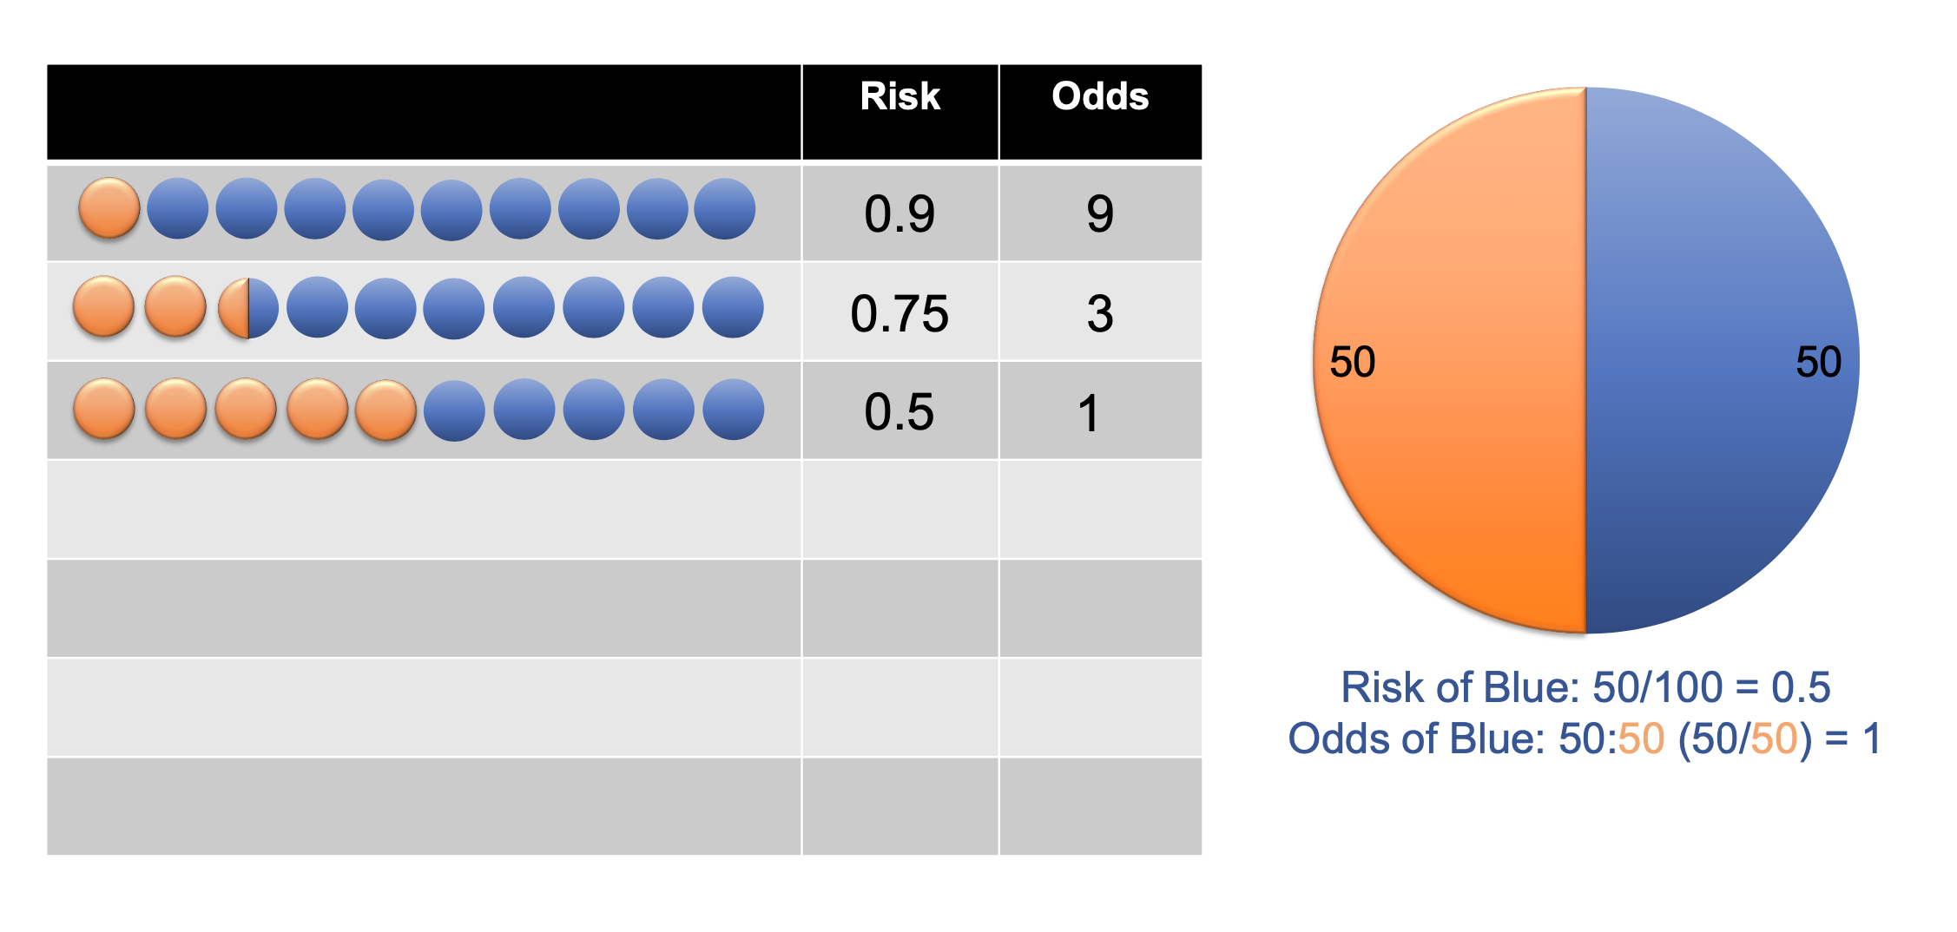

Slide 56
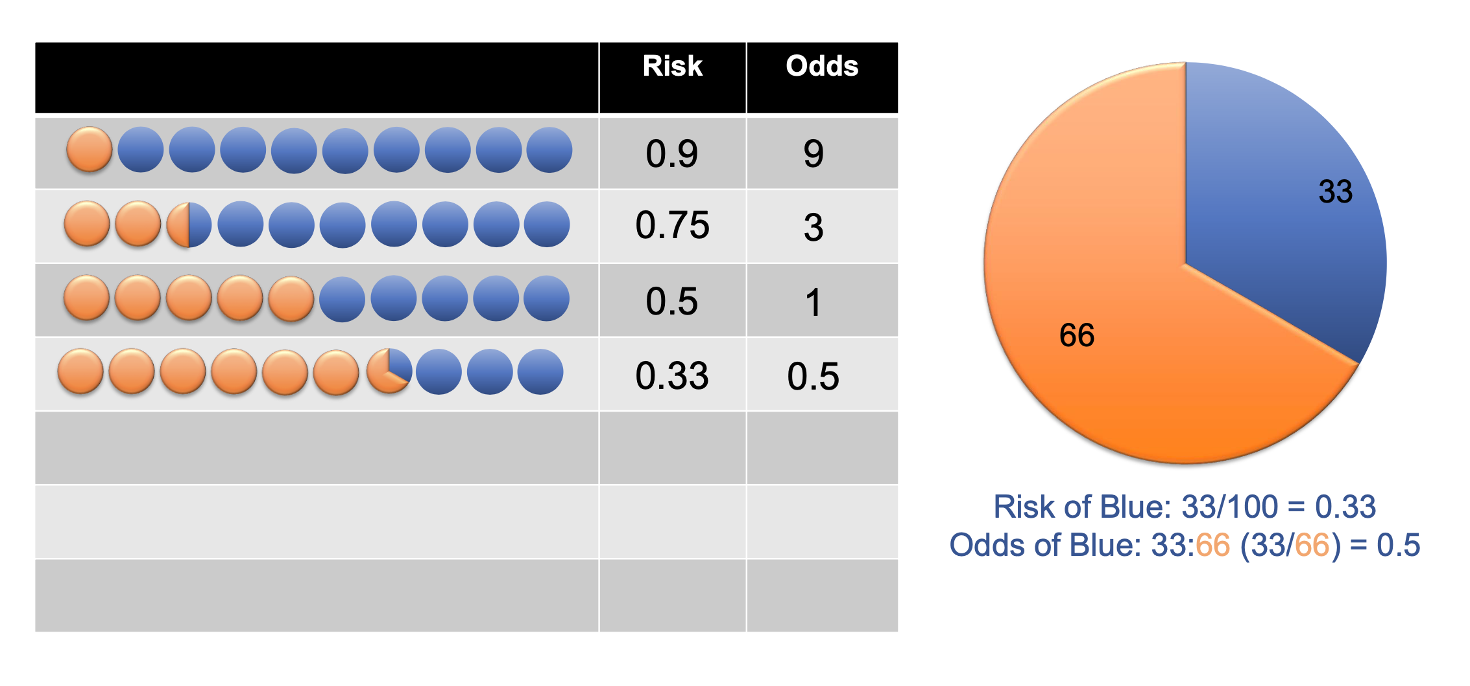

Slide 57
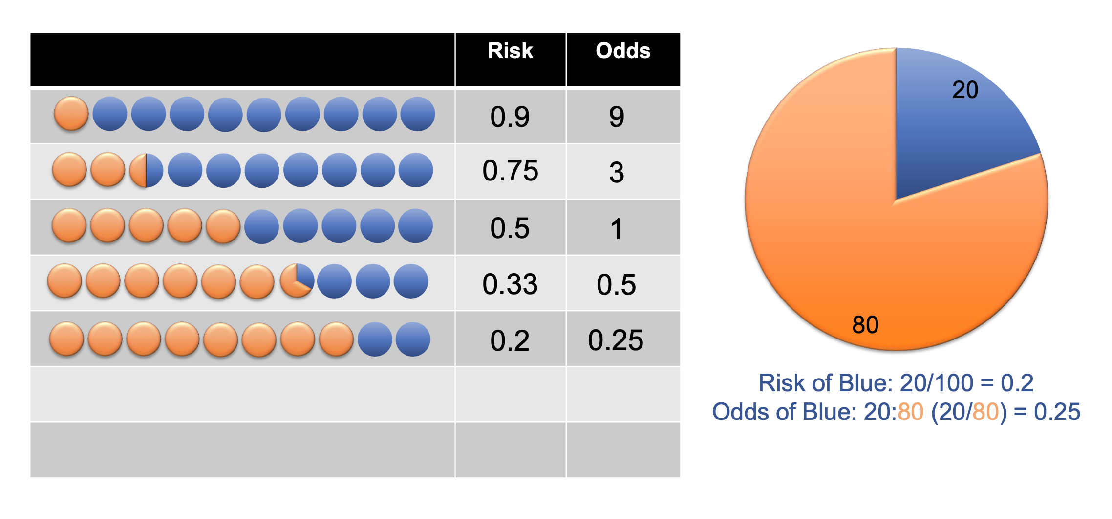

Slide 58
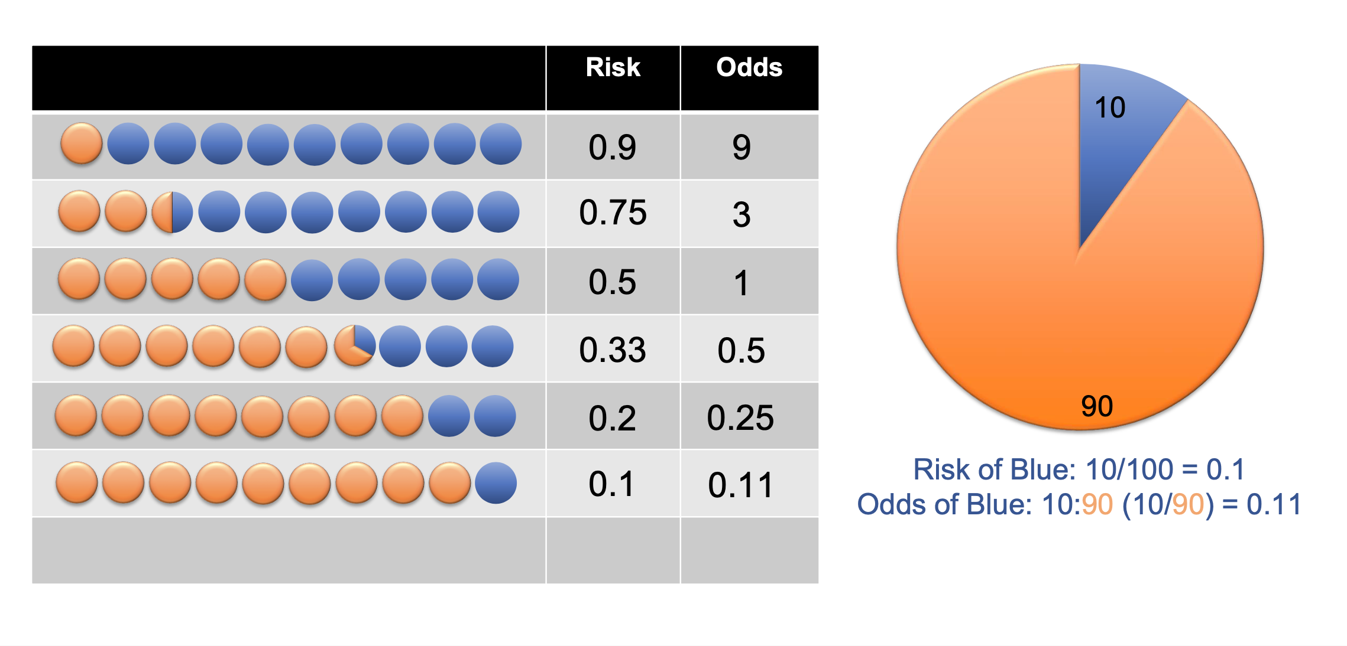

Slide 59
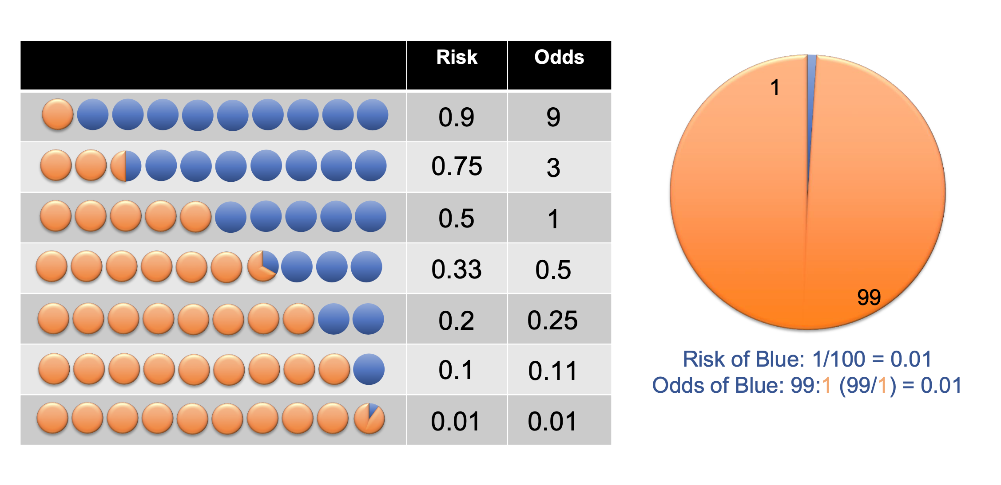

Slide 60
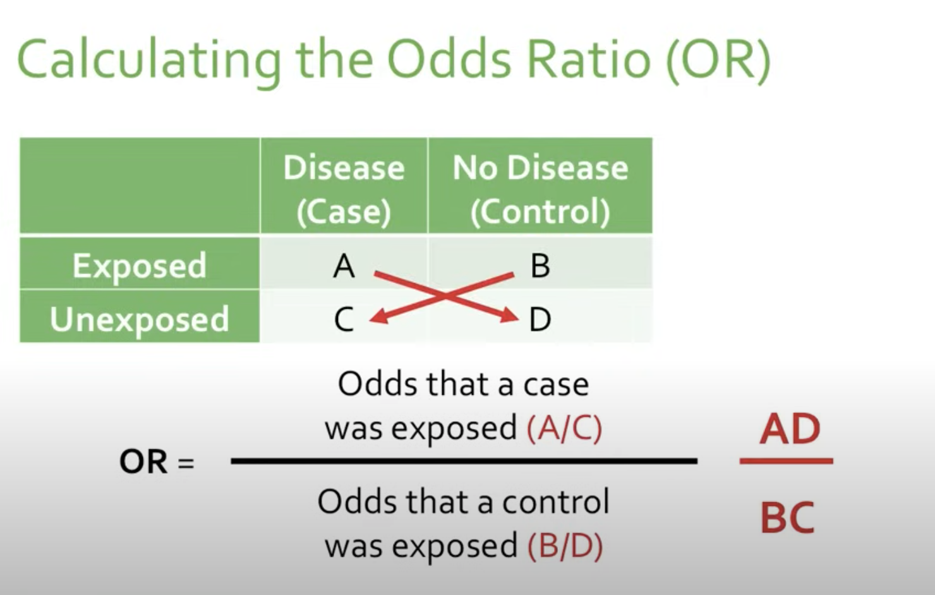
OR = (Odds of event in Group A) / (Odds of event in Group B)

Slide 61
OR = (Odds of event in Group A) / (Odds of event in Group B)

Slide 62
What does the OR mean?
OR = (Odds of event in Group A) / (Odds of event in Group B)
Odds of it happening case
10
Odds ratio:
2
Odds of it happening control
5

Slide 63
What does the OR mean?
OR = (Odds of event in Group A) / (Odds of event in Group B)
Odds of it happening case
3
Odds ratio:
1.5
Odds of it happening control
2

Slide 64
What does the OR mean?
OR = (Odds of event in Group A) / (Odds of event in Group B)
Odds of it happening case
.6
Odds ratio:
1.2
Odds of it happening control
.5

Slide 65
What does the OR mean?
OR = (Odds of event in Group A) / (Odds of event in Group B)
Odds of it happening case
2
Odds ratio:
1
Odds of it happening control
2

Slide 66
What does the OR mean?
OR = (Odds of event in Group A) / (Odds of event in Group B)
Odds of it happening case
2
Odds ratio:
0.28
Odds of it happening control
7

Slide 67
What does the OR mean?
OR = (Odds of event in Group A) / (Odds of event in Group B)
An odds ratio of
  1.0 (or close to 1.0) indicates that the odds of exposure among case-patients are the same as the odds of exposure among controls. The exposure is not associated with the disease.
  Greater than 1.0 indicates that the odds of exposure among case-patients are greater than the odds of exposure among controls. The exposure might be a risk factor for the disease.
  Less than 1.0 indicates that the odds of exposure among case-patients are lower than the odds of exposure among controls. The exposure might be a protective factor against the disease.

Slide 68
Which one do should be used?
Odds ratio should be used in case control studies
  Cannot calculate risk – because you don’t know all the outcomes!
Relative risk , or relative risk reduction should be used in cohort studies (next lecture)
  A more accurate representation of the entire population – if other bias is controlled for

Slide 69
Bias in observational trials
So we have determined the biggest risk of bias is unequal groups. So you construct a study that has exactly equal groups…

Slide 70
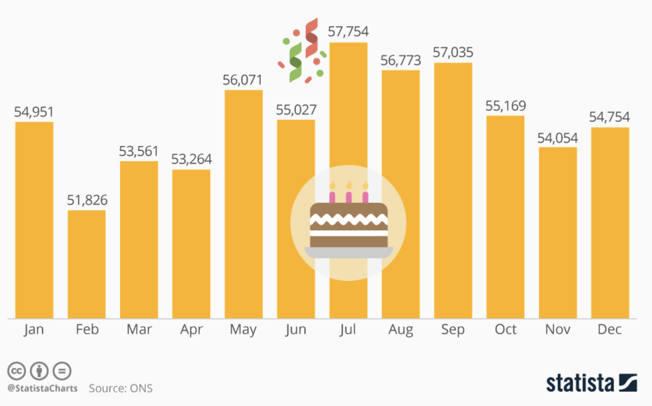
But wait - what is the chance it was just random?
What percentage of the class has a birthday in October?
If I sample ten people right now in this room, I might find 4 people with a birthday in October.
If I extrapolate this to the class, would you think 40% of the class has a birthday in October?
My confidence would be LOW.
But if I sampled all of Richmond – how would that affect my confidence?
Confidence that it was a true representation would be much higher!
Notes:
Notes for next year – make this slide better – extrapolate to entire class, then city, different population sizes. Maybe some pictures, etc.

Slide 71
Confidence intervals to the rescue!
Confidence intervals are intervals in which the population statistic could lie. They are constructed based on the sample statistic and certain features of the sample that gauge how likely it is to be representative and are reported to a certain threshold.
  A 95% confidence interval is an interval constructed such that, on average, 95% of random samples would contain the true population statistic within their 95% confidence interval
  If the confidence interval cross over 1, it means that there is NO ASSOCIATION between the exposure and the outcome

Slide 72
Three main things that affect confidence interval:
Sample size
Percentage / Accuracy of the measurement
Population size
    Confidence interval calculations assume you have a genuine random sample of the relevant population. If your sample is not truly random, you cannot rely on the intervals. Non-random samples usually result from a flaw in the sampling procedure.
        An example of such a flaw is to only call people during the day, and miss almost everyone who works days. For most purposes, the non-working population cannot be assumed to accurately represent the entire (working and non-working) population.

Slide 73
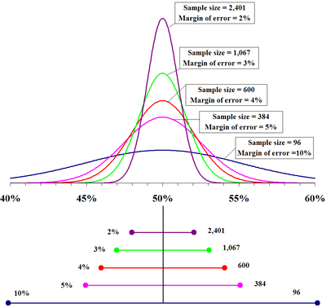
As you increase sample size, Confidence interval becomes smaller

Slide 74
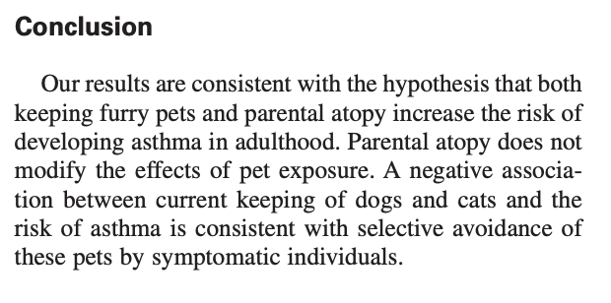
Back to the case:
So what are we going to tell mom?
Authors conclusion:

Slide 75
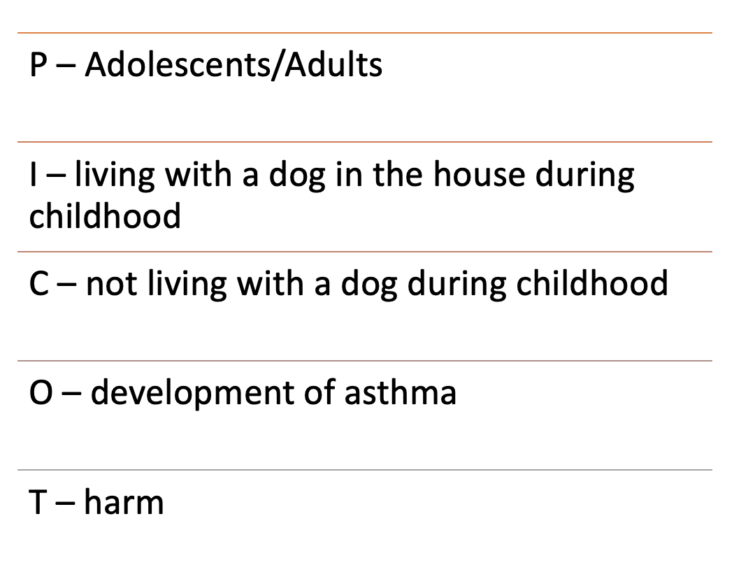
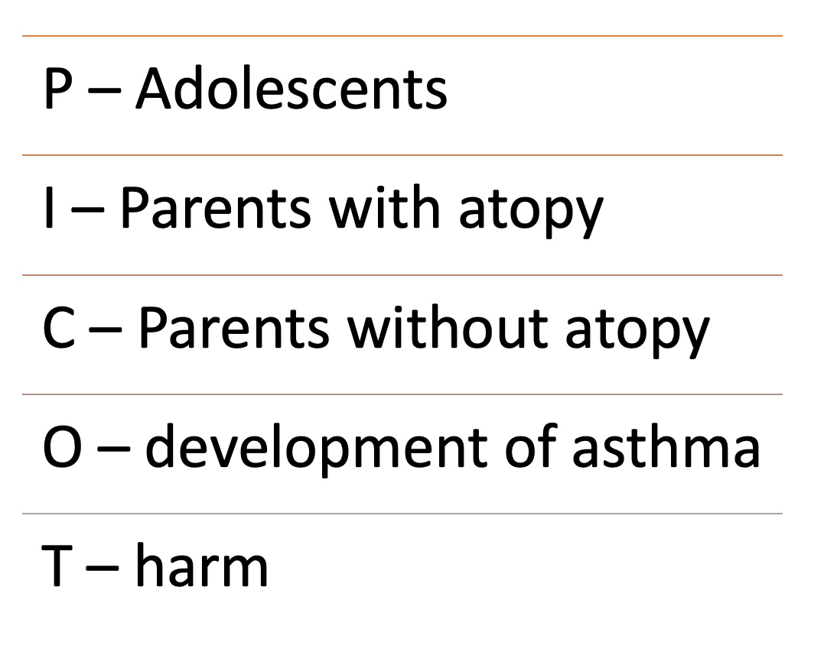
Interpreting the results

Slide 76
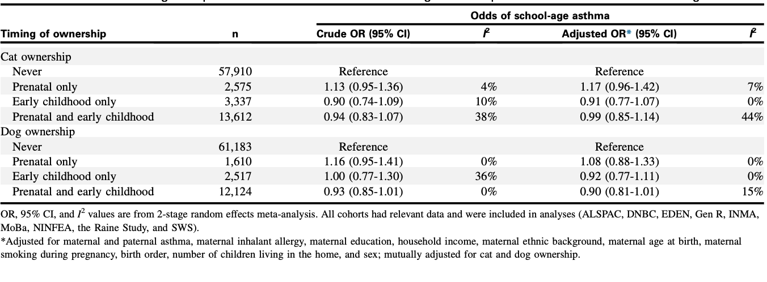
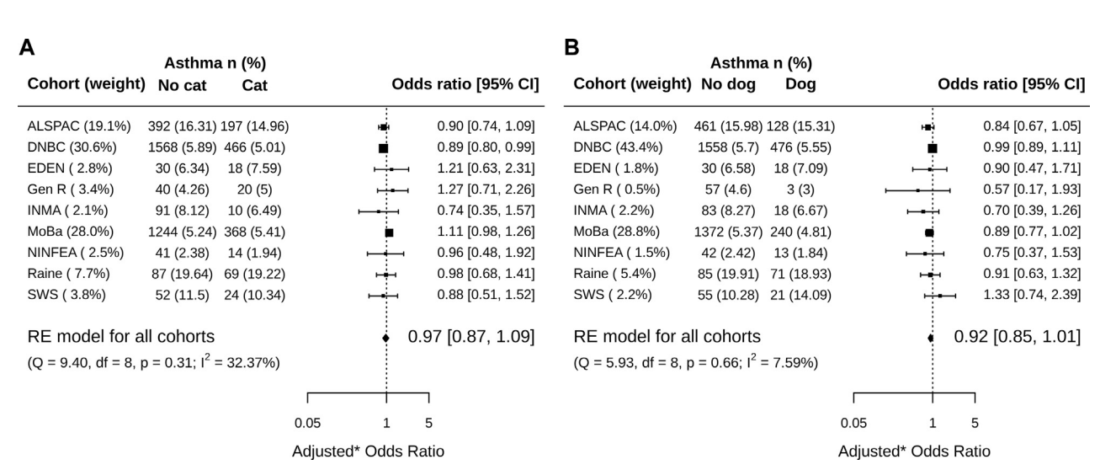
So what are we going to tell mom?
Lets take a quick look at the 2022 systematic review

Slide 77
So what are we going to tell mom?
“Most trials show that the odds of developing asthma from simply having a pet does not happen”
“The odds of developing asthma seem to be the same whether you have a dog or not”
“Stronger predictor might be family history of asthma (can’t control) “
“Get the dog!”

Slide 78
When observational trials contradict RCTs…what should we think?
It is not uncommon for a new therapy to show promise in RCTs, to later be found to have more potential harm then benefit
This is almost always attributed to TIME.
Remember surrogate endpoints?
  Observational trials rarely have surrogate endpoints, because we have the benefit of time.
  RCTs may not have that benefit, and choose a different outcome
  Can be misleading in the short term

Slide 79
When observational trials contradict RCTs…what should we think?
Examples:
RCT showing tight glucose control in ICU = better outcomes
  Observational trials showed worse outcomes!
RCT showing steroids beneficial in spinal cord injury
  Observational trials showed significant harm with no benefit
RCT showing benefit of antiarrhythmic 1C drugs – normal rhythm
  Observational trials showed large increase in cardiac related death!
RCT showing TPA works for stroke
  Many observational trials show no difference in functional outcome
  Many more examples, likely things we are doing right now that will no longer be recommended by the time you finish residency!

Slide 80
Take home points
Observational trials have a lot of value, but must be critically analyzed for application to your question
Selection bias (unequal groups) is the biggest threat to validity of an observational trial
Odds ratios show if there is association, and both the strength and direction of that association
  Do not forget the confidence interval! The truth lies somewhere in that range, and all values in that range are equally possible.

Slide 81
Remember - take the quiz!
Questions? Email me – john.joyce@vcuhealth.org

