Slide 1
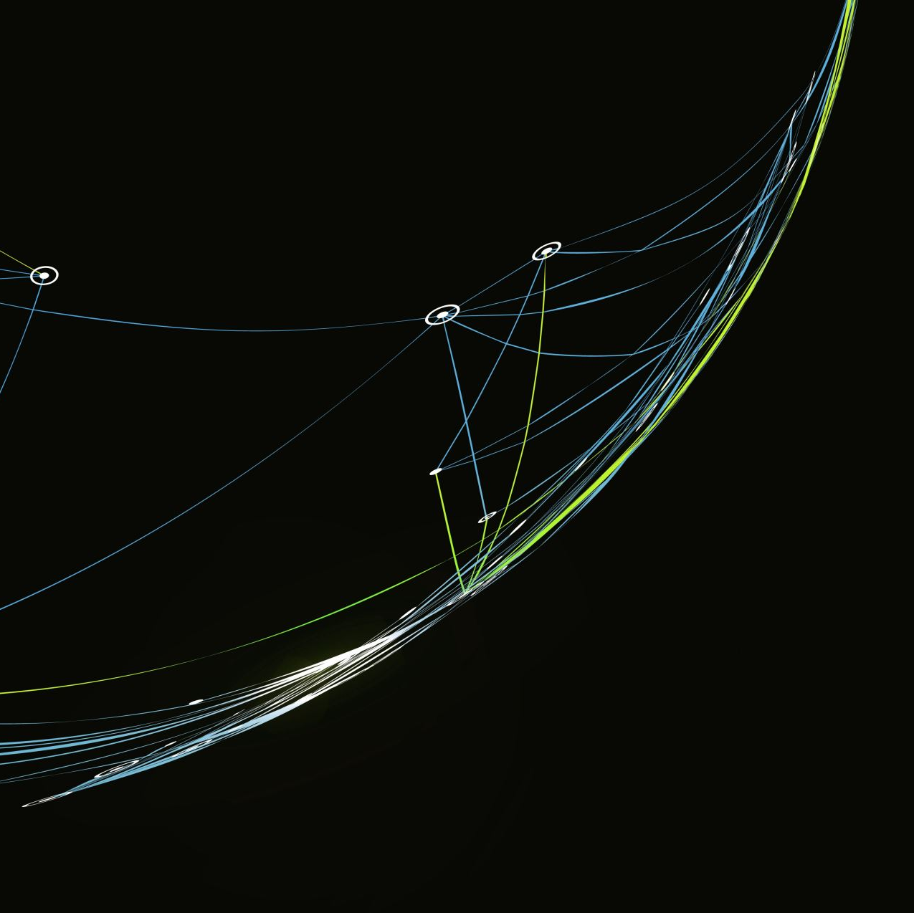
Point of Care Ultrasound in the 3rd year
Michael Joyce, MD

Slide 2
Learning Objectives
By the end of the session, students should be able to:
Recognize key pathology on common POCUS exams.
Integrate ultrasound findings into clinical reasoning.
Understand how POCUS changes management decisions.

Slide 3
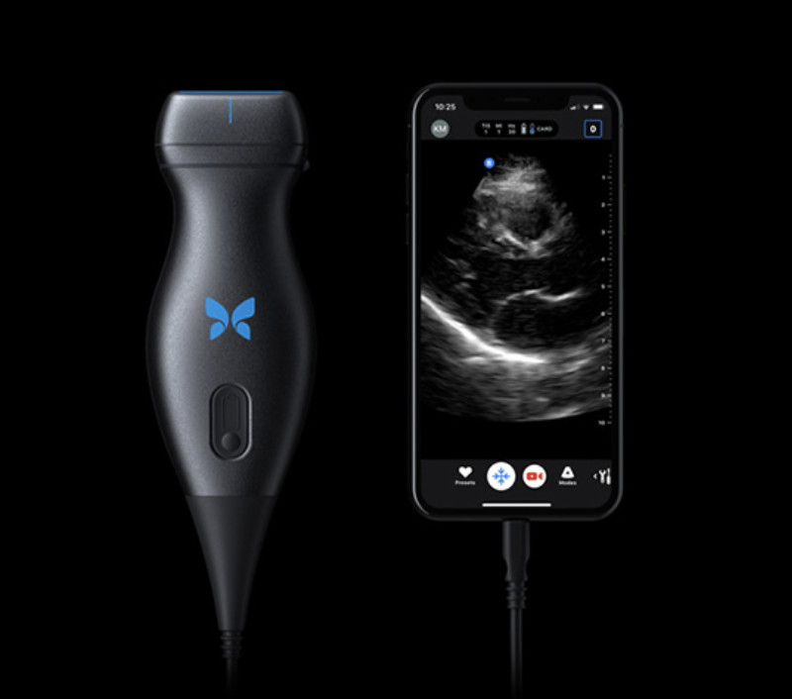

Slide 4
Cased based POCUS review
For each clip – identify:
  1. what are we scanning
  2. normal or abnormal
  3. what would you do next

Slide 5
Case 1 - SOB
72 year old woman presents with chief complaint of shortness of breath for 2 days. It has been progressively worsening. She has tried her albuterol rescue inhaler without relief.
PMH: HTN, COPD, DM
Vitals: HR 105, BP 150/90, RR 22, O2 91%

Slide 6
What is on your differential?

Slide 7
What is on your differential?
COPD exacerbation
CHF – new onset
Pneumonia
PE
Pleural Effusion
PTX
MI

Slide 8
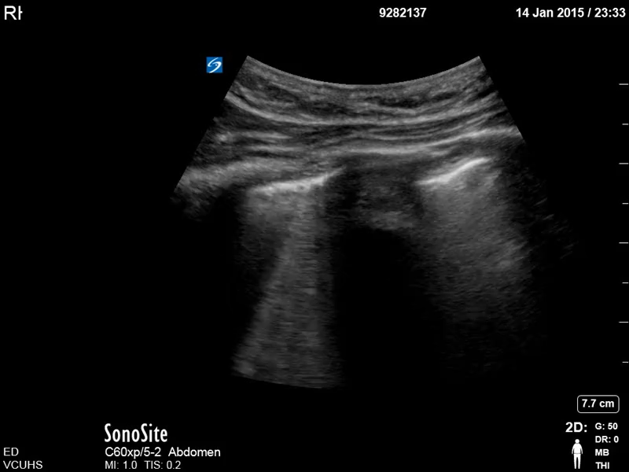

Slide 9
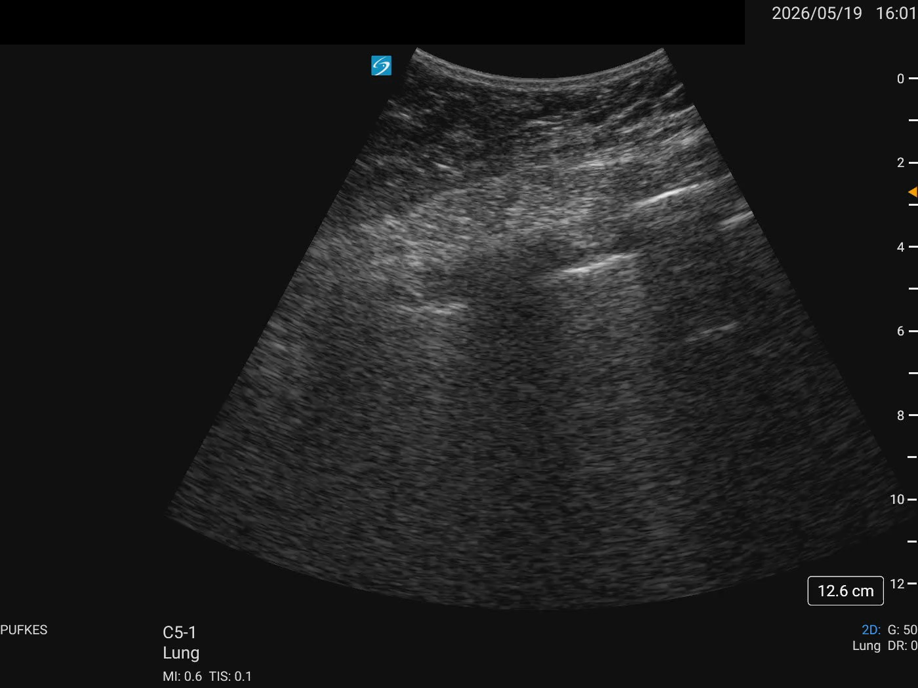

Slide 10
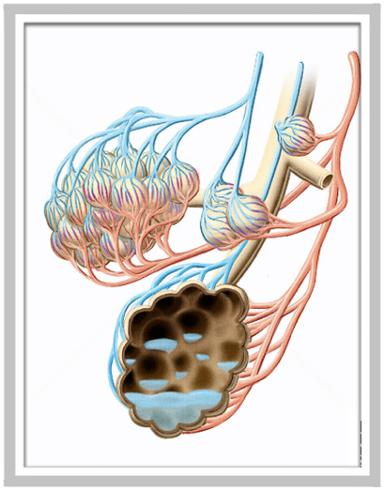
Pulmonary Edema
fluid at the alveolar - interstitial membrane

Slide 11
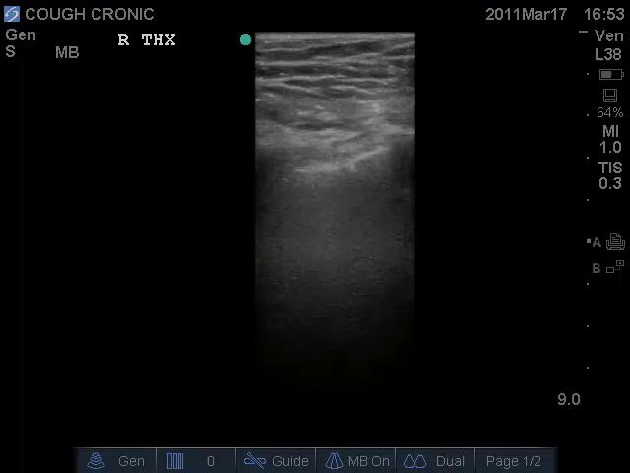
pulmonay edema
>3 B-lines per intercostal space

Slide 12
Teaching pearls – Lung Ultrasound
Diffuse B lines – diffuse problem - pulmonary edema
Focal B lines – focal problem (i.e. Pneumonia, contusion)
Ultrasound is more sensitive for pulmonary edema than xray
Combine it with cardiac ultrasound!

Slide 13
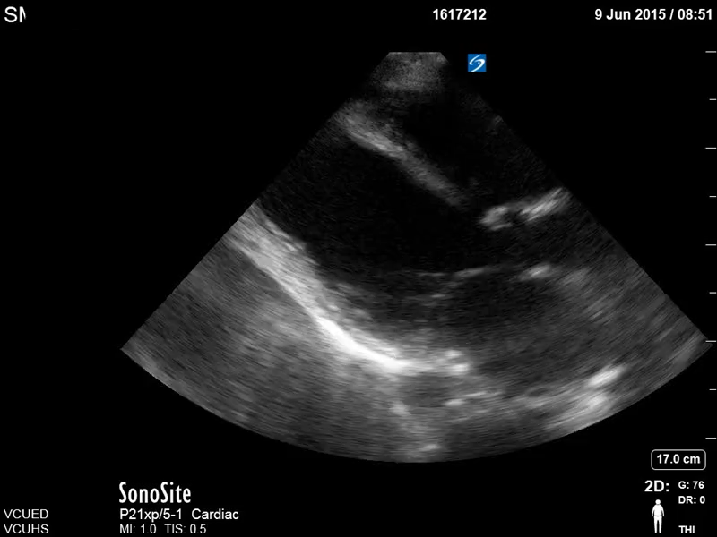

Slide 14
So how did POCUS change what we did?
Did the ultrasound narrow the differential?
Did the ultrasound change what test you order next?
Did the ultrasound change treatment?
Did the ultrasound change disposition?

Slide 15
Case 2 – Back pain
70 yo male presents to your primary care clinic with chief complaint of off and on back pain. The pain does not relate to any specific movements. Does not recall any injury. No new medications. No urinary bowel or bladder symptoms. Has been working on trying to quit smoking, currently smoking 1.5ppd.
PMH: HTN
Vitals: WNL

Slide 16
What is on your differential?

Slide 17
What is on your differential?
MSK related
  Herniated disk
  Muscle strain
  Arthritis
Urinary system
  UTI
  Prostatitis
Vascular
  AAA

Slide 18
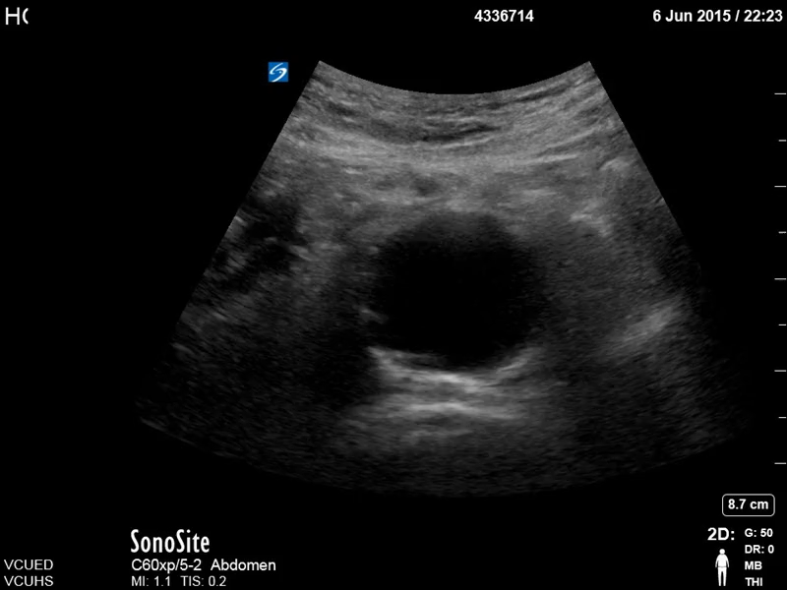

Slide 19
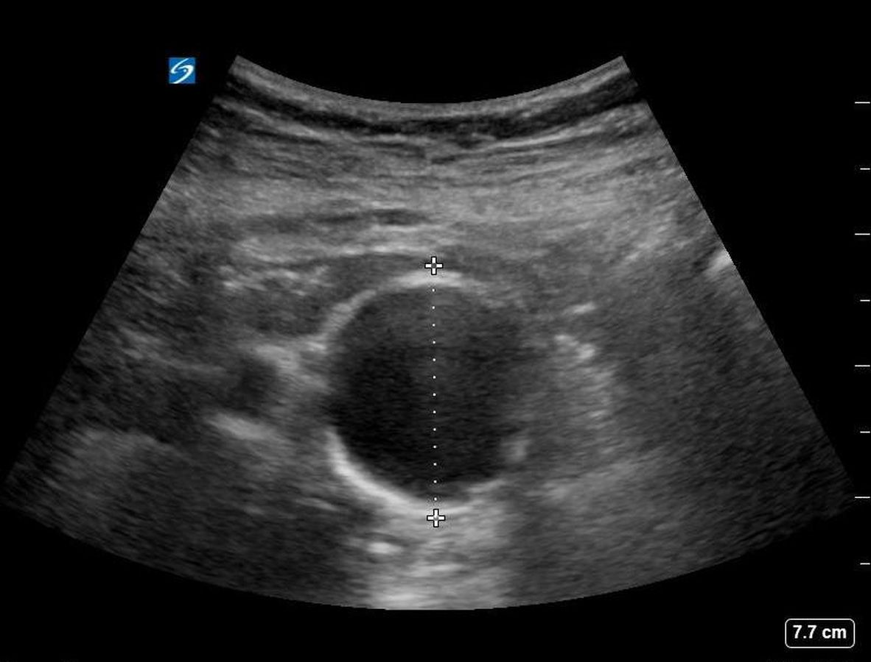
5.4cm

Slide 20
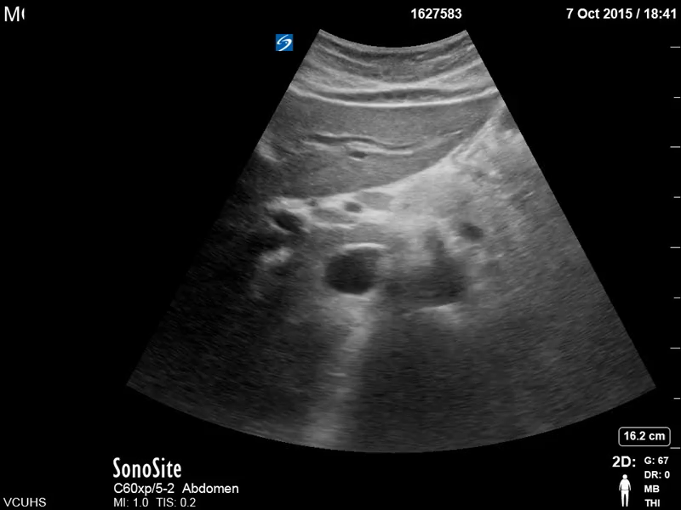

Slide 21
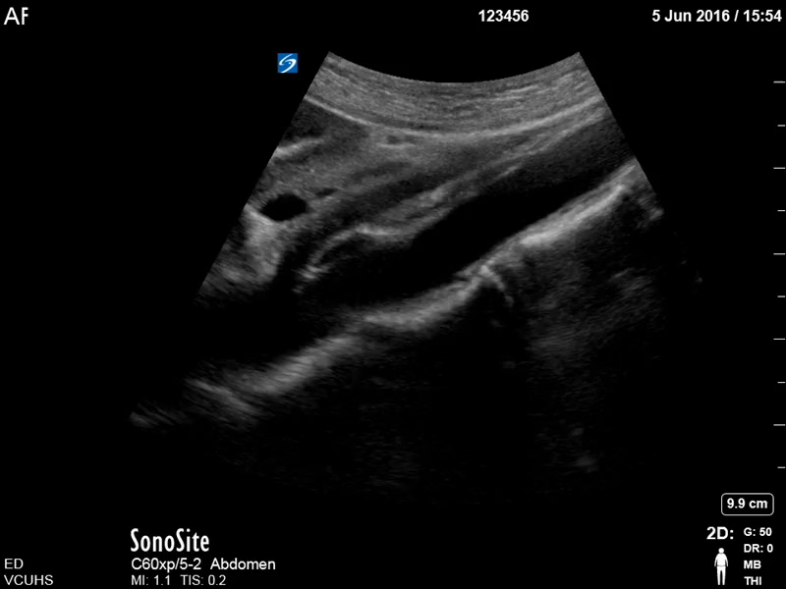

Slide 22
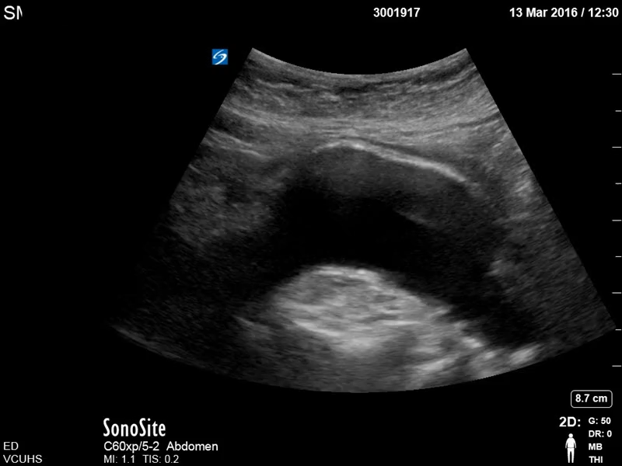

Slide 23
Teaching pearls
Very easy screening test to do, if can visualize, has very high LR+ (16.8) and low LR- (0.03)
Takes very little time
When difficult to visualize, reposition patient, or sweep bowel gas
Measure outside wall to outside wall

Slide 24
So how did POCUS change what we did?
Did the ultrasound change the differential?
Did the ultrasound change what test you order next?
Did the ultrasound change treatment?
Did the ultrasound change disposition?

Slide 25
Case 3 – RUQ pain
32 y.o. female presents with abdominal pain that comes and goes. Has been happening for about a month, but has become unbearable over the last couple days. Seems to happen every time she eats. Is located epigastric to the right side of her abdomen. No fevers, chills, n/v/d. No CP or SOB.
PMH: none
Exam: tenderness in the RUQ

Slide 26
What is on your differential?

Slide 27
What is on your differential?
Cholelithiasis
Cholecystitis
Pancreatitis
Hepatitis
Gastritis
Ureteral colic

Slide 28
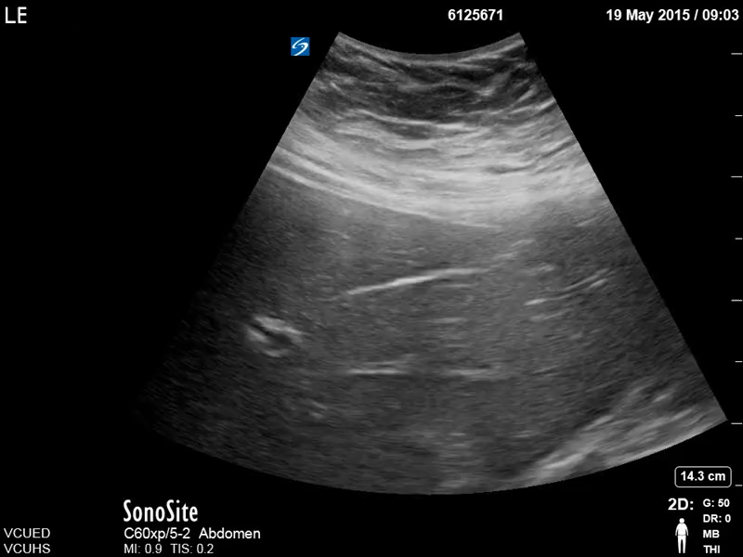

Slide 29
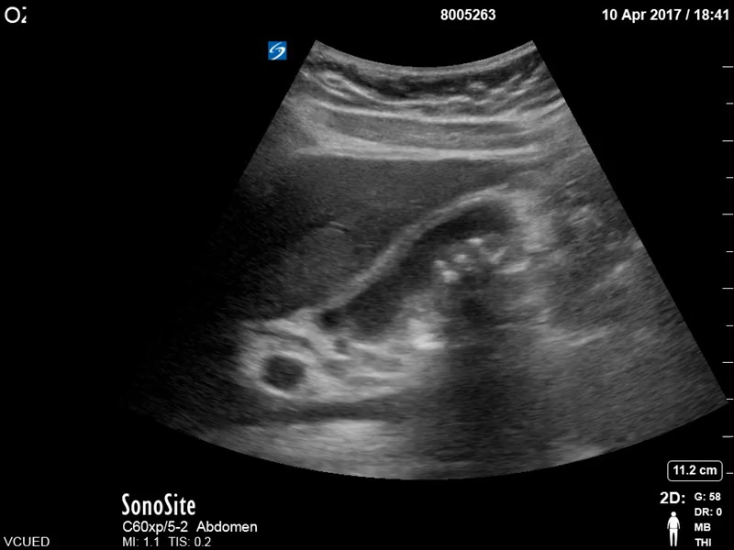

Slide 30
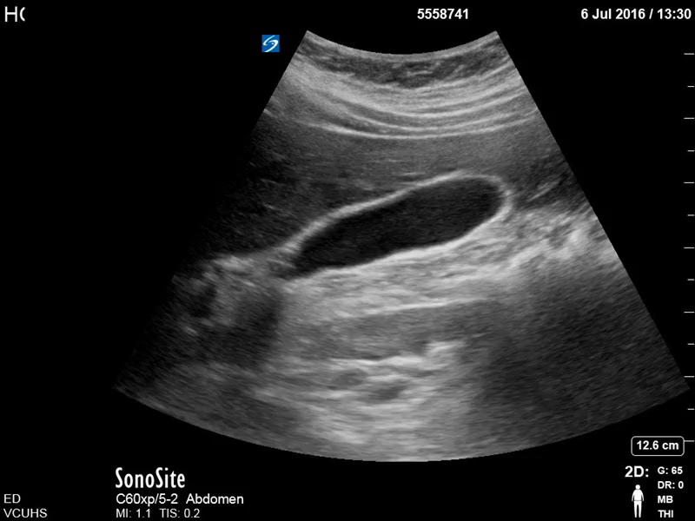

Slide 31
Teaching pearls
Very easy screening exam that can be done in the clinic, in the ED, on the floor, in a tent
Does not need to be “diagnostic quality”, if positive, can get confirmatory testing
If negative, LR- (0.08) is low enough exclude GB as the problem

Slide 32
So how did POCUS change what we did?
Did the ultrasound narrow the differential?
Did the ultrasound change what test you order next?
Did the ultrasound change treatment?
Did the ultrasound change disposition?

Slide 33
Case 4 – Leg swelling
56 yo male presents to clinic with chief complaint of right leg swelling and pain. States he noticed it about 5 days ago, but has continued to bother him despite elevating the leg at night time. Never had this problem before. Denies any swelling to other extremities. Recently had an inguinal hernia repair.
PMH: HTN, DM, obesity
Vitals

Slide 34
What is on your differential?

Slide 35
What is on your differential?
DVT
Celluitis
Injury
Muscle strain
Arterial insufficiency

Slide 36
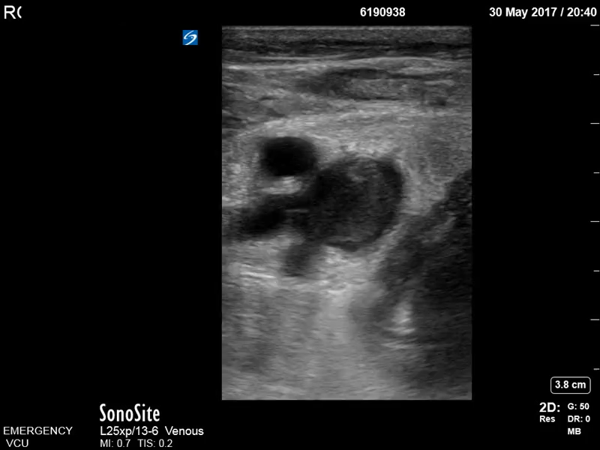

Slide 37
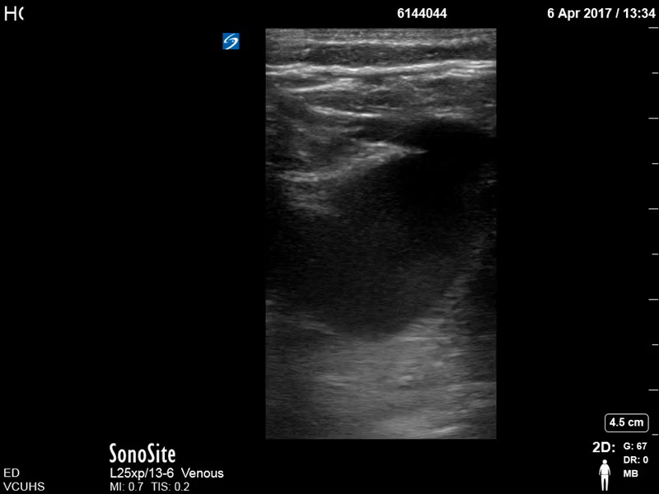

Slide 38
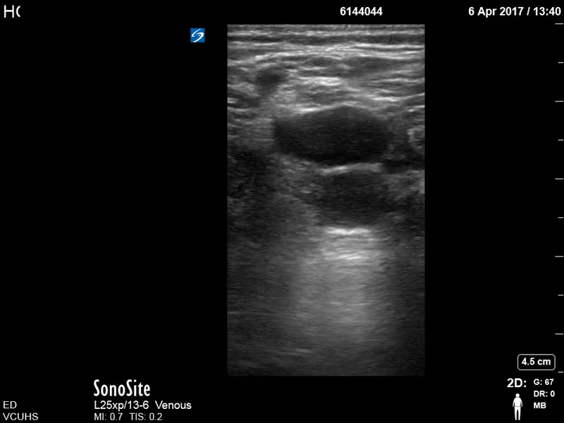

Slide 39
Teaching pearls
Technically very easy study, but often logistically very hard to get a “formal done”
High LR+ (18-30), and LR – (0.04-0.19)
If negative, and still concerned, can send for repeat scan
Can save your patients a lot of time and expense, and make the diagnosis much quicker

Slide 40
So how did POCUS change what we did?
Did the ultrasound change the differential?
Did the ultrasound change what test you order next?
Did the ultrasound change treatment?
Did the ultrasound change disposition?

Slide 41
Case 5 – Vision loss
67 yo male presents with chief complaint of decreased vision in his left eye. States he had flashers and then it felt like a curtain was over his vision. He can still see light, and make out large objects in front of him. Uses reading glasses, but otherwise has not had issues with his vision before.
PMH: DM, TIA
Vitals: 20/40 vision in R eye, LP only in left.

Slide 42
What is on your differential?

Slide 43
What is on your differential?
Retinal detachment
Vitreous hemmorage
Vitreous detachment
Diabetic retinopathy

Slide 44
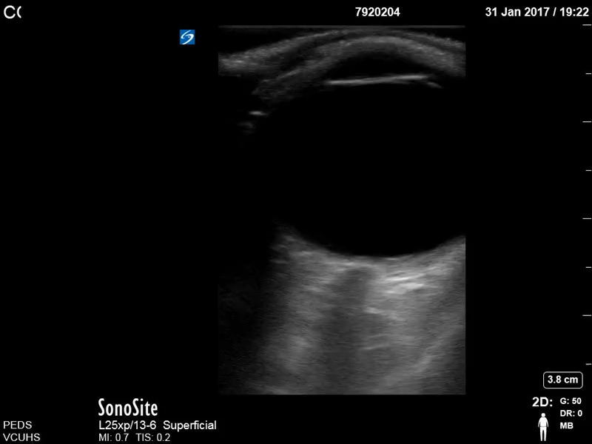
Right Eye
(normal vision)

Slide 45
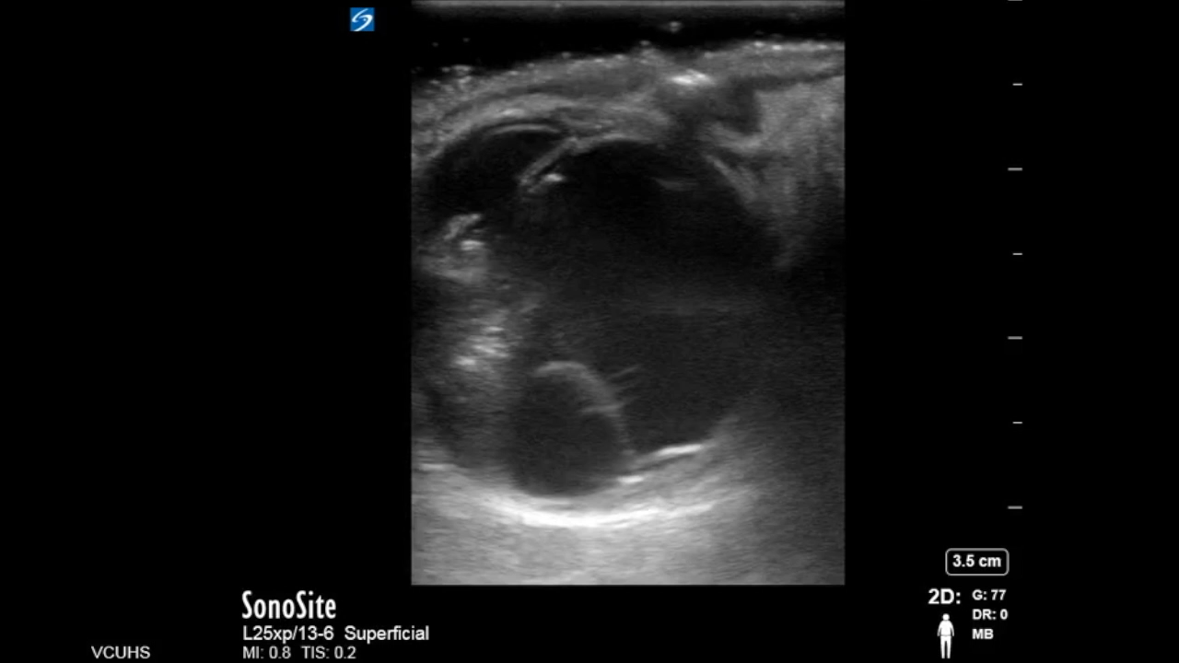
Left Eye

Slide 46
Teaching pearls
The eye is a big ball of fluid, great for US!
Again, just a screening exam, but can be very useful in narrowing and/or making the diagnosis
Not as uncomfortable for the patient as it seems
Way easier to look at the retina then a non dilated fundoscopic exam

Slide 47
So how did POCUS change what we did?
Did the ultrasound change the differential?
Did the ultrasound change what test you order next?
Did the ultrasound change treatment?
Did the ultrasound change disposition?

Slide 48
Case 6 - difficulty urinating
70 yo male presents to the urgent care with chief complaint of difficulty voiding. States that he has trouble urinating, never feeling like he can empty his bladder. He has pain before and after he urinates in his lower abdomen that is dull in nature. Never had this problem before. Did notice blood in his urine one time but not in the last couple days.
PMH: HTN, DM
Vitals: normal
PE: dull suprapubic pain to deep palpation

Slide 49
What is on your differential?

Slide 50
What is on your differential?
UTI / Prostatitis
BPH
Bladder mass
Medications

Slide 51
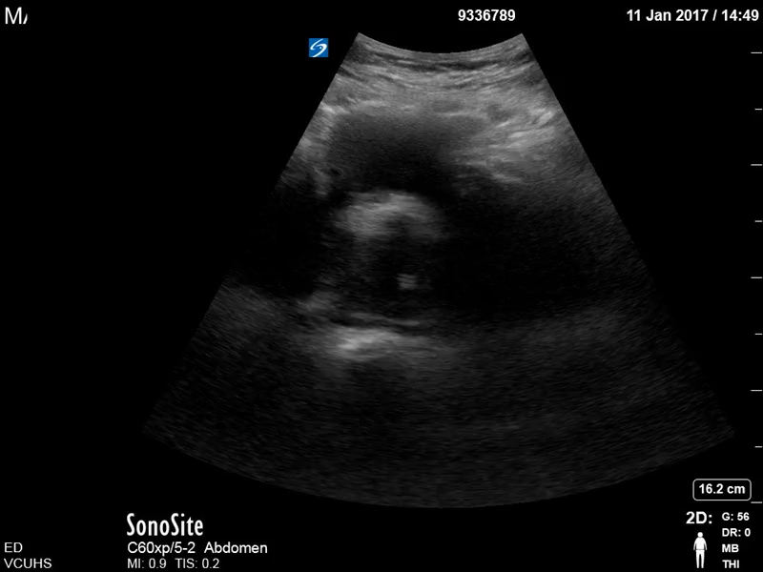

Slide 52
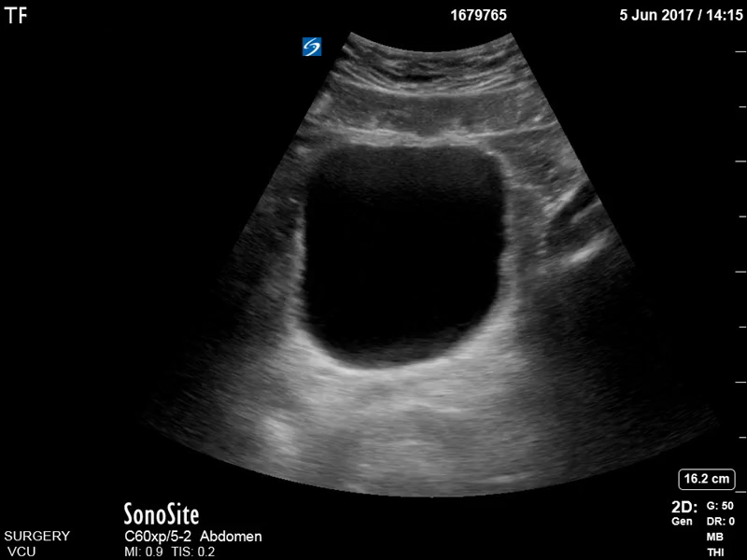

Slide 53
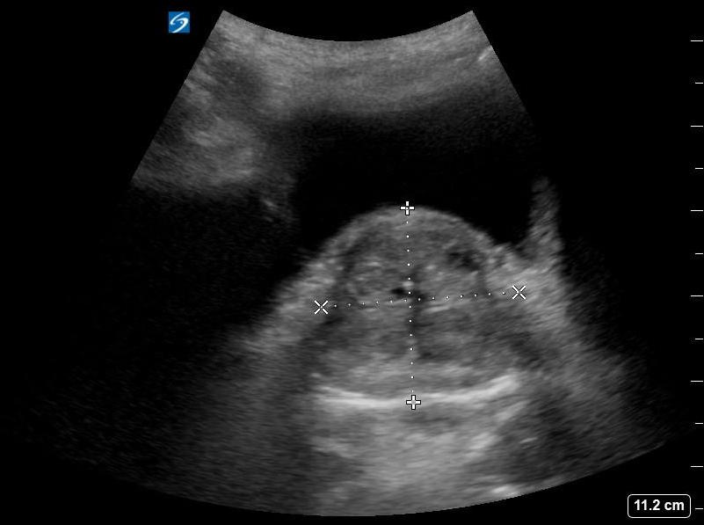

Slide 54
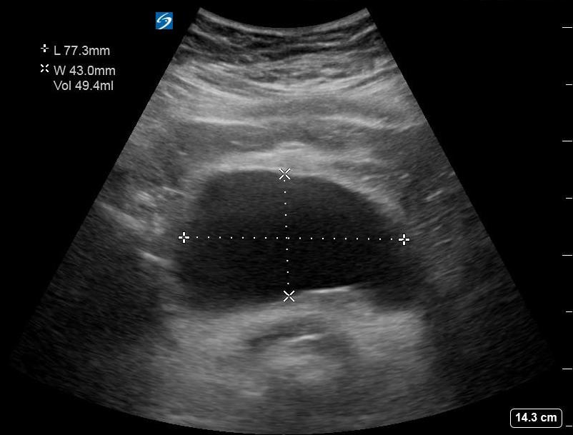
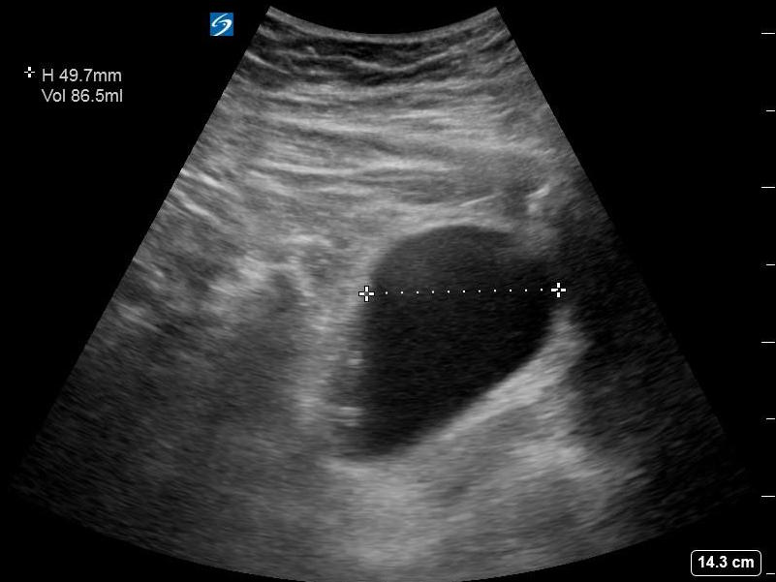

Slide 55
Teaching pearls
The bladder is a pelvic organ (except when obstructed), need to look low in the pelvis, especially when measuring PVR
More dynamic than a bladder scanner, can see the foley, clots, other issues
Combine with renal scan to look for hydro
Can also evaluate the prostate very easily for enlargement
All patients with urinary complaints would benefit from a quick ultrasound screening!

Slide 56
So how did POCUS change what we did?
Did the ultrasound change the differential?
Did the ultrasound change what test you order next?
Did the ultrasound change treatment?
Did the ultrasound change disposition?

Slide 57
Case 7 – IV access issue
Your are the on call intern for the internal medicine wards. You get a page that your patient lost IV access. The nurse has tried and failed. The patient needs multiple medications overnight including IV antibiotics. The nurse is asking if you can come place a central line.

Slide 58
What is on your differential?

Slide 59
What is on your differential?
Difficult IV access!
Central line?
IO?
US PIV?

Slide 60
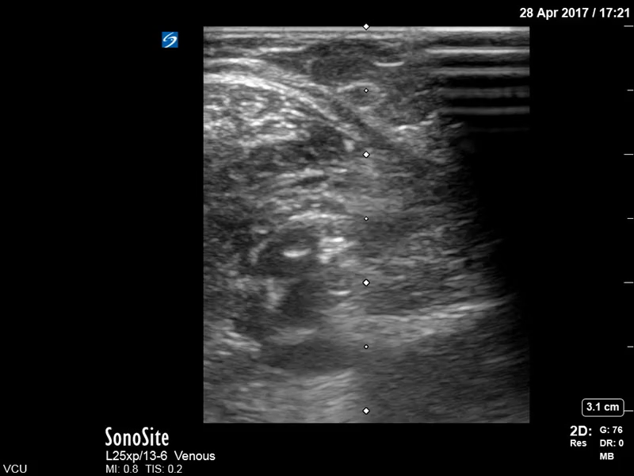

Slide 61
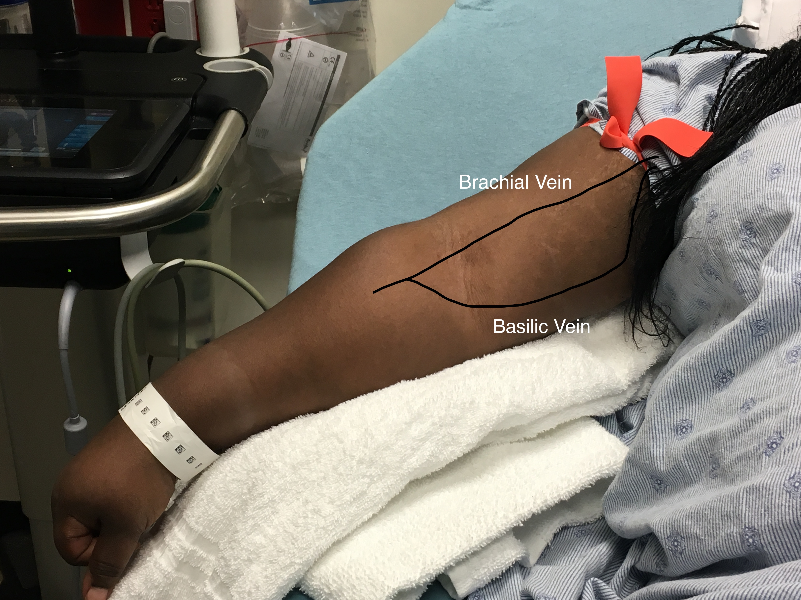
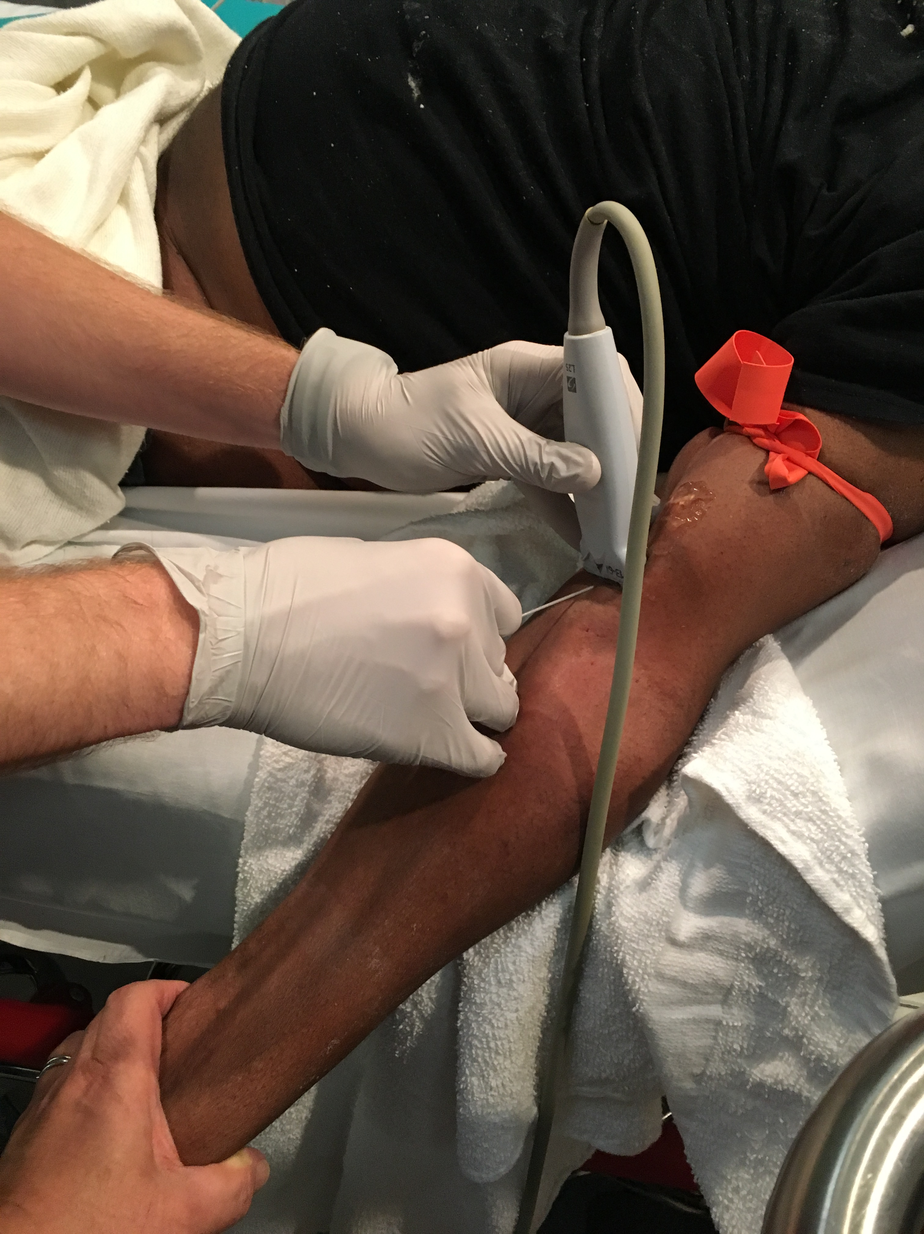

Slide 62
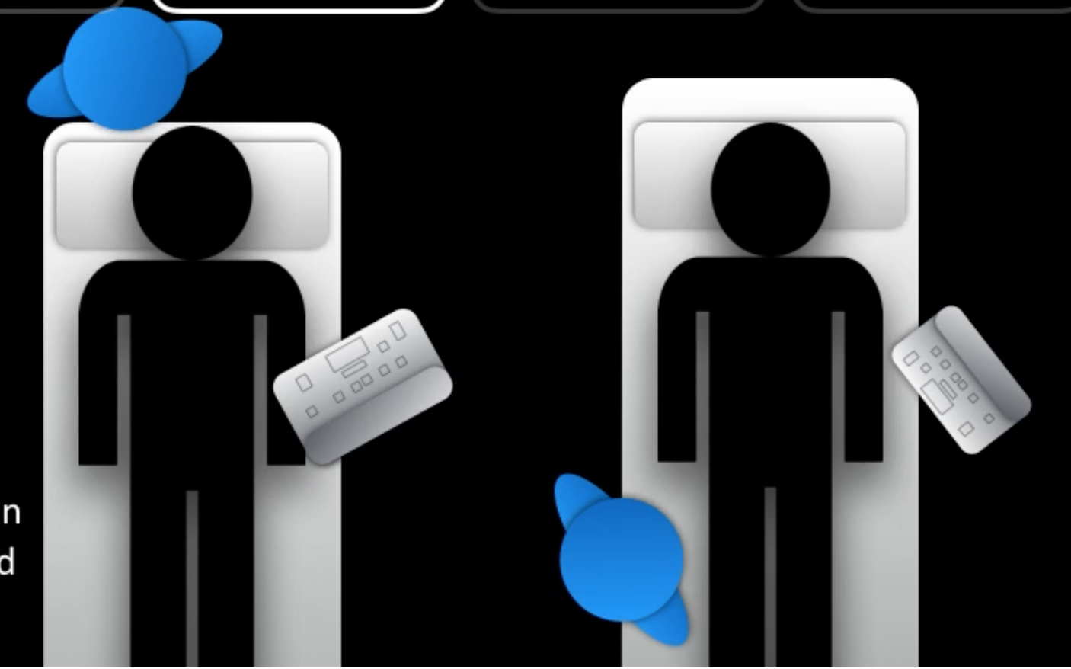
Proper position will dramatically increase your success rate!

Slide 63
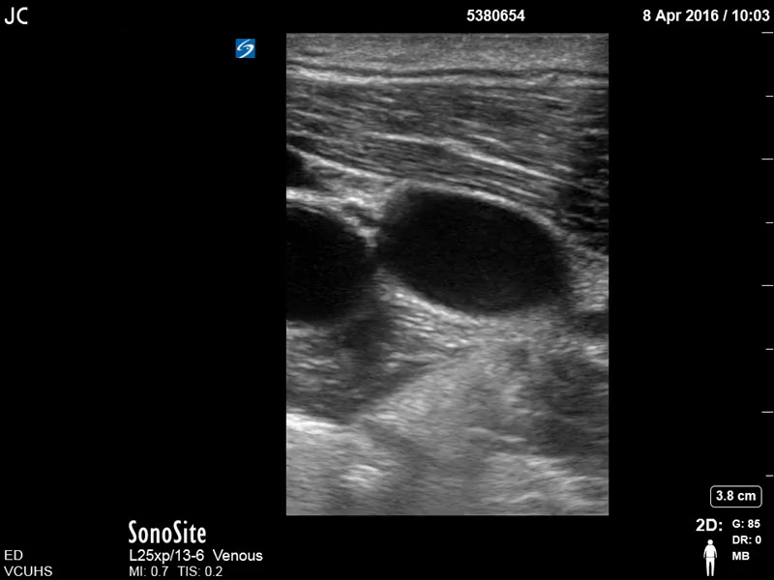

Slide 64
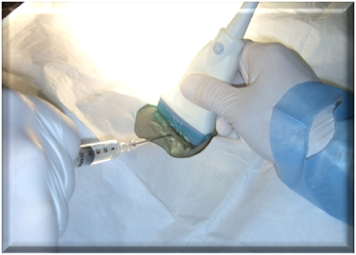

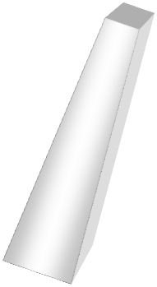








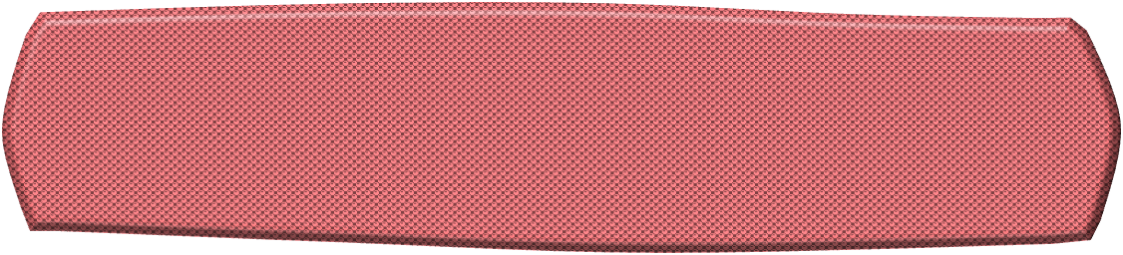




Short Axis Approach

Slide 65










Slide 69










Slide 70










Slide 72

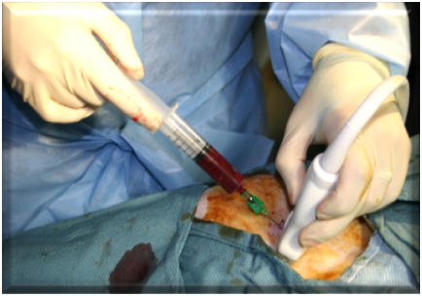










Slide 73
So how did POCUS change what we did?
Did the ultrasound narrow the differential?
Did the ultrasound change what test you order next?
Did the ultrasound change treatment?
Did the ultrasound change disposition?

Slide 74
Case 8 – Hypotension
55 yo female is admitted to the ICU for fever, tachycardia, hypotension. She is started on empiric antibiotics. She was resuscitated with 3L of IV fluids in the ED and her blood pressure improved from 75/42 to 90/55 on admission. Overnight, her blood pressure has slowly continued to drop. Additional IV fluids have not changed her BP. The nurse is asking if you want to start pressors.

Slide 75
What is on your differential?

Slide 76
What is on your differential?
Hypovolemic shock
Cardiogenic shock
Obstructive shock
Distributive shock

Slide 77
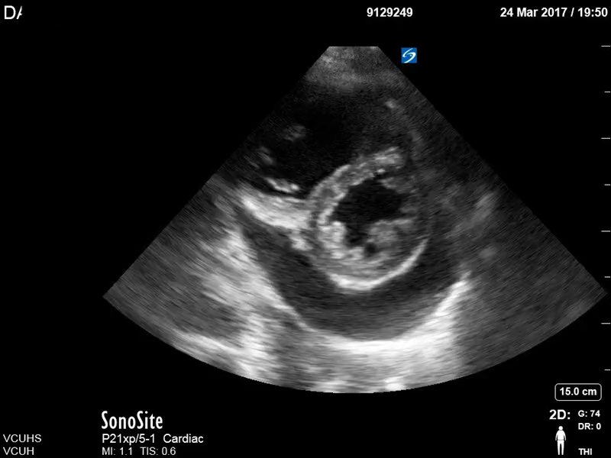

Slide 78
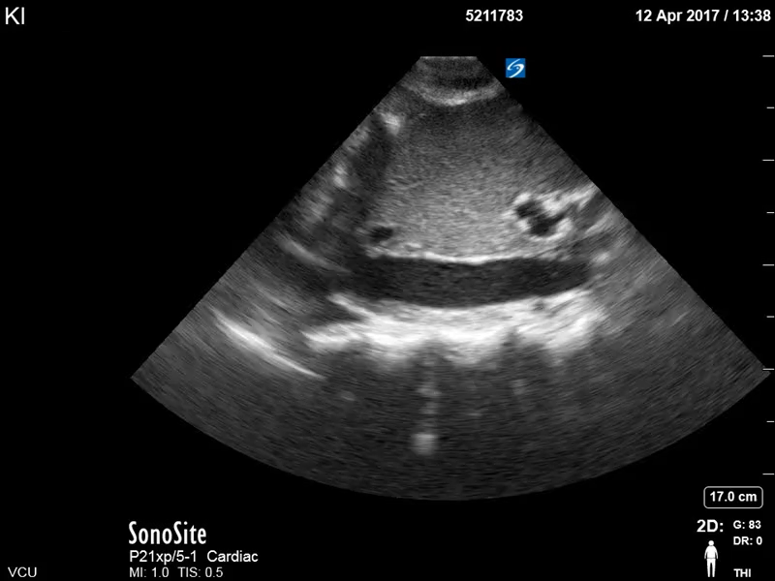

Slide 79
Teaching pearls
You do not need a complete cardiac exam to make the diagnosis. Getting all 5 views can be tough, but finding one good window on a patient can give a lot of information
Effusion is very easy to see – again – fluid!
The diagnosis of tamponade can be more nuanced, but in the right clinical setting is easier
Persistent hypotension – large effusion… tamponade !
Use IVC with caution, it is part of the whole system

Slide 80
So how did POCUS change what we did?
Did the ultrasound narrow the differential?
Did the ultrasound change what test you order next?
Did the ultrasound change treatment?
Did the ultrasound change disposition?

Slide 81
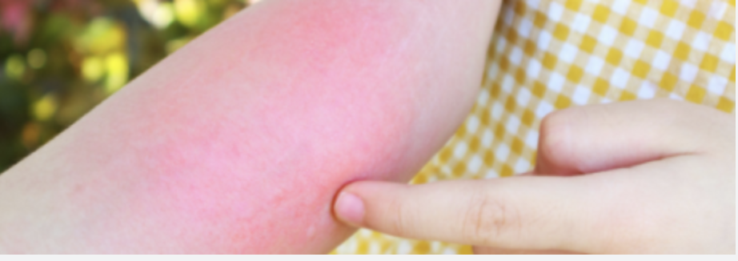
Case 9 – James river
34 yo male presents with tender swollen right forearm. States he was recently swimming in the James river, and now his R arm has become red and painful. Thought it was a sunburn at first but the pain has persisted. No other complaints.
PMH: none

Slide 82
What is on your differential?

Slide 83
What is on your differential?
Cellulitis
Abscess
Sunburn
Occult injury

Slide 84
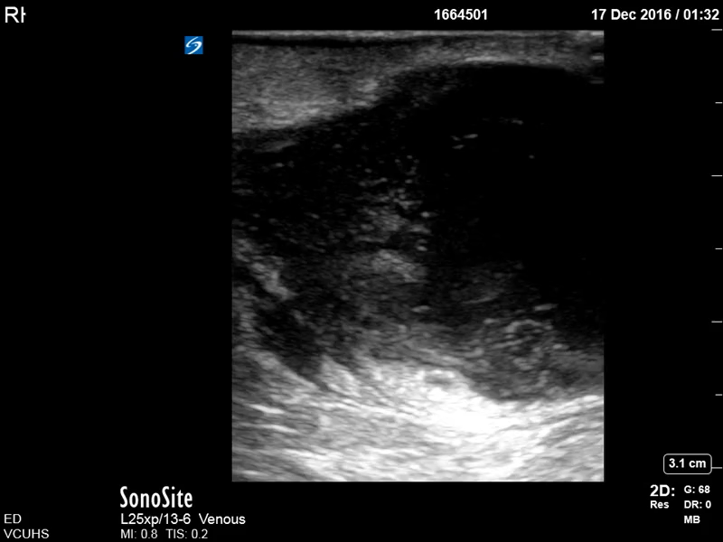

Slide 85
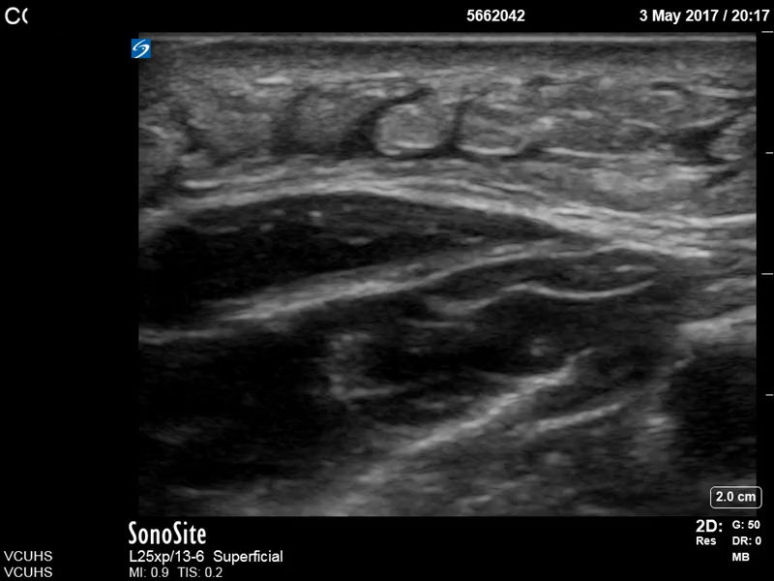

Slide 86
Teaching pearls
Scanning ”obvious” cellulitis, or “obvious” abscess seems unneccsary, until you start doing it
Takes less than 30 seconds, changes management 20-30% of the time
Prevents repeat visits, failed therapy and…. does better for your patient!

Slide 87
So how did POCUS change what we did?
Did the ultrasound change the differential?
Did the ultrasound change what test you order next?
Did the ultrasound change treatment?
Did the ultrasound change disposition?

Slide 88
Case 10 – Flank pain
44 yo male presents to the ED with chief complaint of right sided flank pain. States it feels like his prior kidney stone. He states the pain is 9/10. Has not noticed any blood in his urine but has not been paying attention to that due to the pain. No fevers or chills. No other complaints

Slide 89
What is on your differential?

Slide 90
What is on your differential?
Renal stone
UTI
Pyelonephritis
Appendicitis
Obstruction

Slide 91
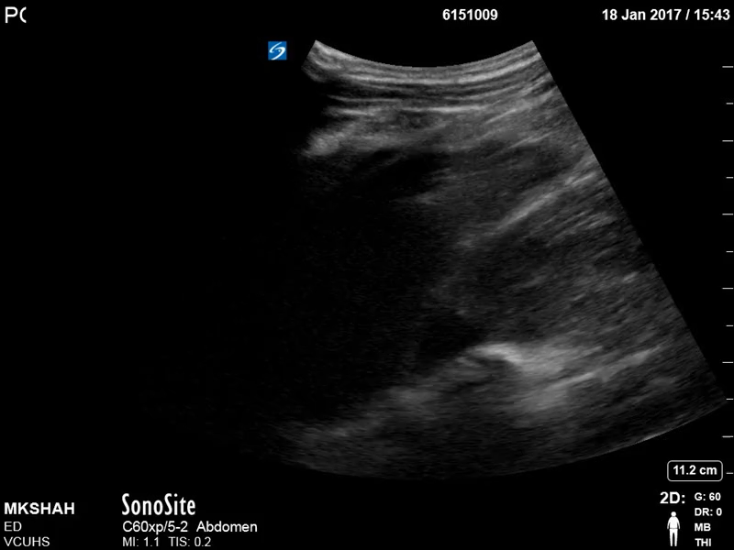

Slide 92
Teaching pearls
Not every stone needs a CT!
Reserve advanced imaging for cases where there are complications, or the stone is not passing.
Renal ultrasound is quick and easy and can confirm your diagnosis, or..

Slide 93
So how did POCUS change what we did?
Did the ultrasound narrow the differential?
Did the ultrasound change what test you order next?
Did the ultrasound change treatment?
Did the ultrasound change disposition?

Slide 94
Conclusions
Take POCUS With You
As you move through your clerkships:
✓ Ask yourself, "Would ultrasound help answer my question?"
✓ Use POCUS to support your clinical reasoning.
✓ Integrate ultrasound findings with the patient's history, exam, and other data.
✓ Remember that even a focused exam can have a major impact on patient care.
POCUS enhances your medical decision making !

