Slide 1

Population Health M3
An introduction to evidence based medicine for patient care
Michael Joyce, MD, FACEP
Associate Professor of Emergency Medicine and Radiology
VCU School of Medicine

Slide 2
Housekeeping:
Quiz will be open immediately after this lecture, and open until Thursday end of day (11:59pm)
The quiz is short questions that you will be able to answer easily if paid attention to and participated with the presentation
Please remember to take the quiz!

Slide 3
Recap of what we have covered so far
Session 1: Resources for finding the best evidence
Session 2: How to ask a good question, refining the ask to get an answer
Session 3: Applying diagnostic studies to your everyday practice – likelihood ratios are your friend
Session 4: Therapy studies - interpreting new data – should I do this for my patient(s)?

Slide 4


The Evidence Cycle
EBM

Slide 5


The Evidence Cycle
https://guides.library.vcu.edu/clerkships
EBM

Slide 6
The Evidence Cycle
Takes continued practice – more practice today
EBM

Slide 7
The Evidence Cycle
What decision am I making?
Diagnosis
Therapy
Harm
Prognosis
EBM
Today:
Therapy

Slide 8
Goals and Objectives
Today’s goals:
  Develop a question and try to answer it
  Look at how to interpret therapy trials
  Review a large randomized trial that may change practice
  Compare observational vs controlled trials
  Discuss NNT, ARR, RR, OR, CIs and more fun stats

Slide 9

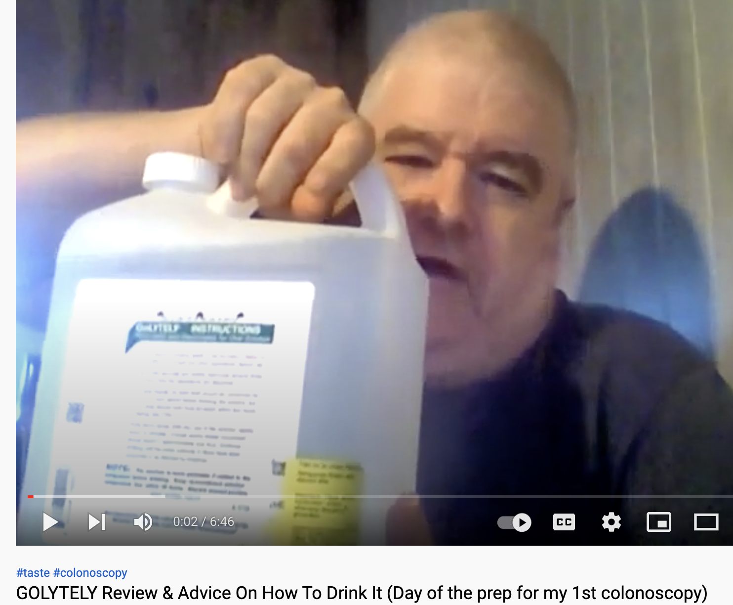
Case:
You are a family physician. You are undergoing a new patient intake visit, for a 55 yo male. He only has a history of HTN on lisinopril. He has been getting his prescription from urgent care facilities and has no established primary care doctor. He states he would like to get caught up on age-appropriate screening. He doesn’t smoke, and has no family history of cancer. He asks: “Do I really need to get a colonoscopy?? I hear it is uncomfortable, hard to schedule and requires a lot of preparation. I watched a youtube video on it and the reviews were not favorable!”

Slide 10
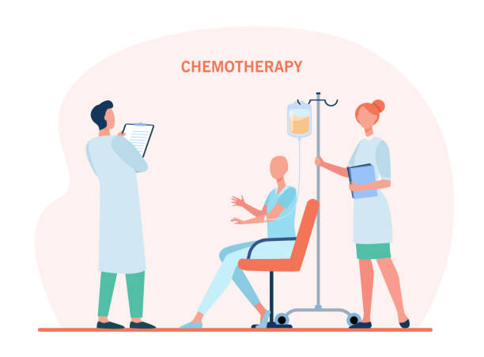
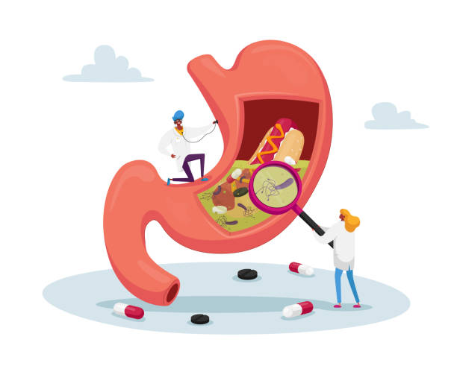
Disclaimer:
Notes:
I am not an oncologist or a GI doc. Goal is not to make a decision about colorectal cancer screening. Goal is to see how new evidence plays into established guidelines, and answer a question for our particular patient. Which leads us to… who is our population for this question

Slide 11
Step one: what is the question?
P -
I -
C -
O -
T -

Slide 12
Step one: what is the question?
P - Patients over the age of 50 with no prior hx of colon cancer
I - screening for colon cancer with colonoscopy
C - no screening, or "usual care"
O - early detection of colon cancer while it is treatable, or death from cancer
T – therapy

Slide 13

Step 2, where should I start looking?

Slide 14
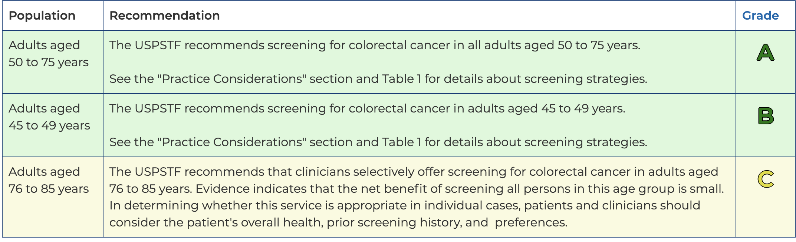
Guidelines – Colon cancer screening

Slide 15
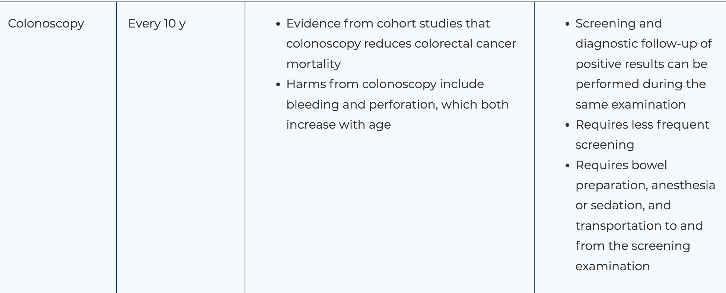
Guidelines – Colon cancer screening

Slide 16
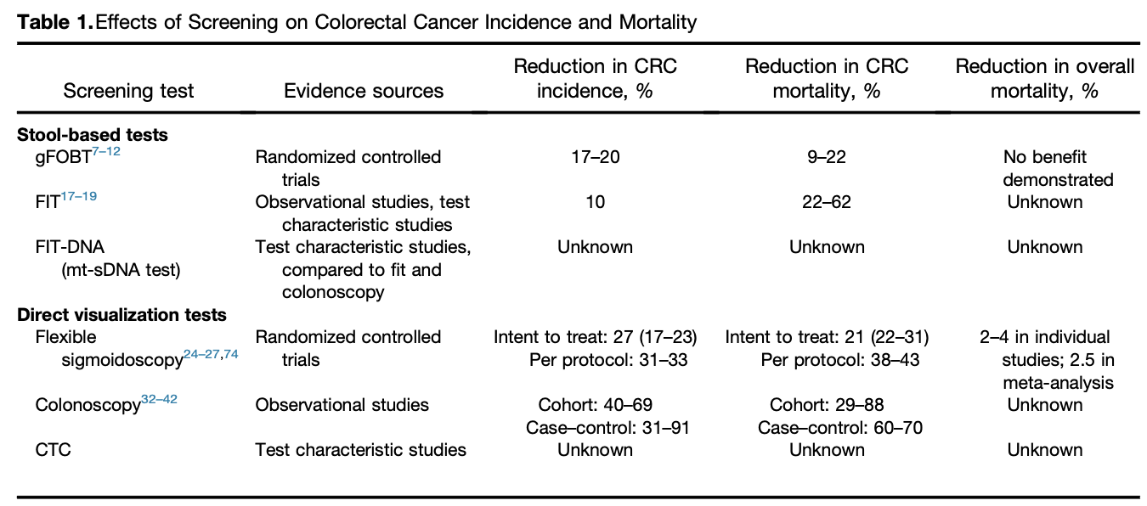

Slide 17
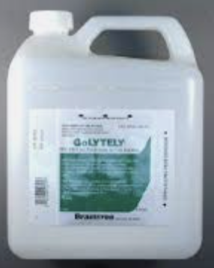
Ok back to the case
We formed a question, went to the evidence pyramid, found a recommendation. Great!
We tell the patient:
Since you are 55 years old, the current recommendation is for you to get a screening colonoscopy now and if it is normal, repeat it in 10 years. This will decrease your chance of developing colon cancer by detecting early polyps and pre-cancerous lesions by 40-60%, and reduce your chance of death from colon cancer from the range for 30-80%! You would be silly not to get it.

Slide 18
Case:
“But Doc – I saw some headlines that colonoscopies aren’t all they are cracked up to be? Don’t you read the recent literature!? "

Slide 19
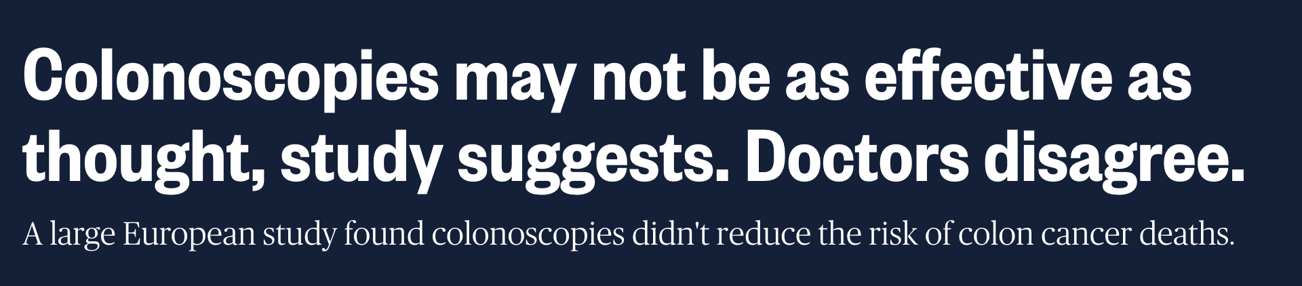
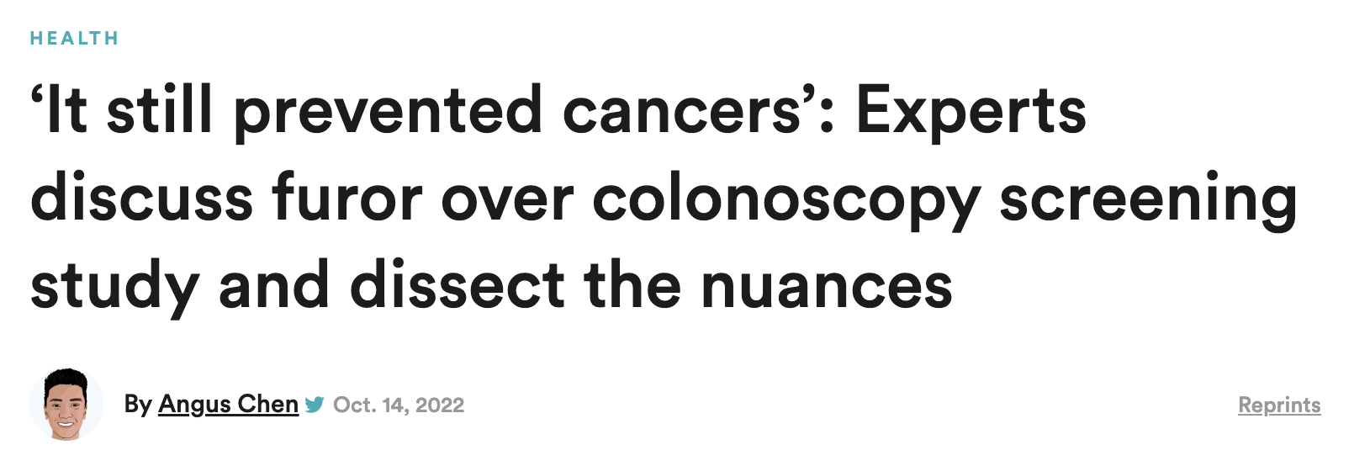
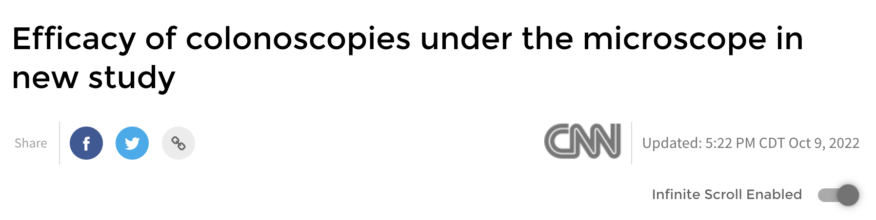


Slide 20
Alright hold on…
What is the best type of study to answer this question?

Slide 21

Therapy - Randomized Trial

Slide 23
Evolution of evidence
New therapy developed
Physiologically makes sense, or bench trials/animal trials/small trials
Ideal next step: RCT with patient centered outcomes (takes long time)
Real world – observational studies with surrogate outcomes (quicker) or: controlled trials with surrogate outcomes (smaller, quicker)
Therapy approved, put into use
RCTs get started… take years to evaluate for patient centered outcomes
Study concludes - Therapy rejected and or/treatment not as effective as once thought

Slide 24

What is so special about RCTs?
Randomization = equal groups
Only difference should be the intervention
Can attribute differences in outcome to the treatment alone!

Slide 25
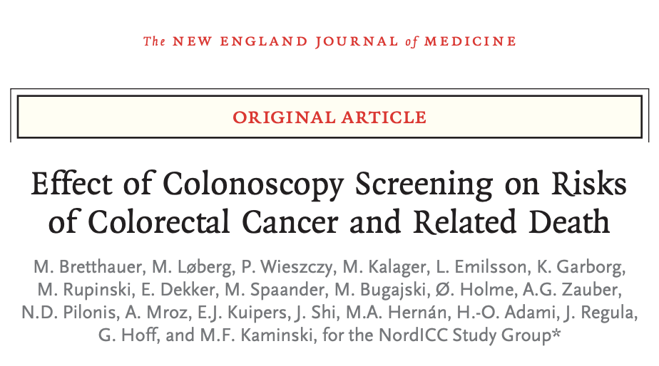
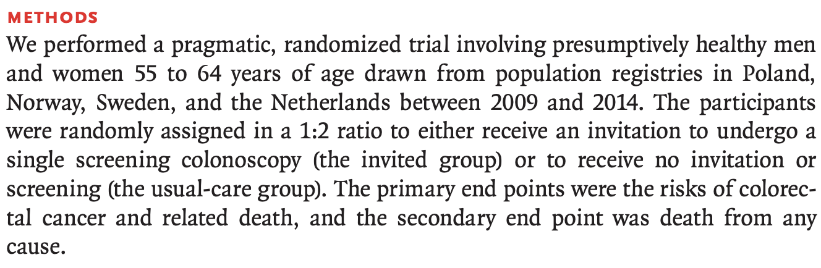

Slide 26
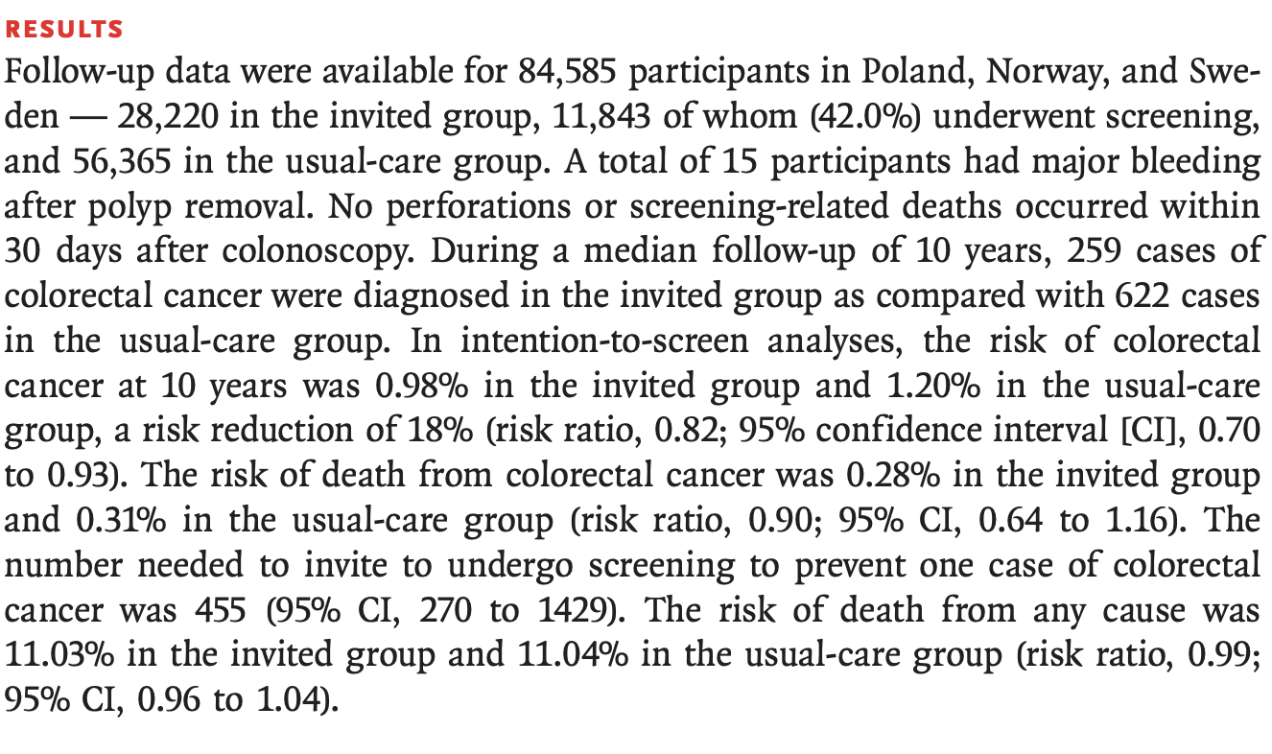
Previously thought: 30-60% Risk reduction
This trial: 7-30% Risk Reduction

Slide 27

What makes a good RCT?
1. Addresses the clinical question directly
2. Has a low risk of bias making the results trustworthy
3. The result is significant and generalizable

Slide 28
Critical questions to ask about an RCT
How serious was the risk of bias?
  Did intervention and control groups start with the same prognosis?
  Were patients randomized?
  Was randomization concealed?
  Were patients in the study groups similar with respect to known prognostic factors?
  To what extent was the study blinded?
  Was follow-up complete?
  Were patients analyzed in the groups to which they were randomized?
  Was the trial stopped early?
What are the results?
  How large was the treatment effect?
  How precise was the estimate of the treatment effect?
How can I apply the results to patient care?
  Were the study patients similar to my patient?
  Were all patient-important outcomes considered?
  Are the likely treatment benefits worth the potential harm and costs?

Slide 29
Work in your table groups:
Write out the PICOT for this study
A. What was the primary outcome? Was it patient centered?
B. Was the method of randomization truly random? Was it concealed?
C. Were groups comparable at the start?
D. Were patients and practitioners providing care blinded?
E. Was outcome assessment blinded or were outcomes objective?
F. Was there minimal loss to follow-up & losses explained?
G. Was an intention-to-treat analysis conducted?
H. Was a a-priori power analysis conducted?

Slide 30
PICOT?
P –
I –
C -
O –
T –

Slide 31
PICOT?
P – Healthy patients between age 55-64 in Poland, Norway and Sweden
I – invited for screening for colon cancer with colonoscopy
C - no invitation, or "usual care"
O – risk of developing colon cancer, death
T – therapy, RCT trial

Slide 32
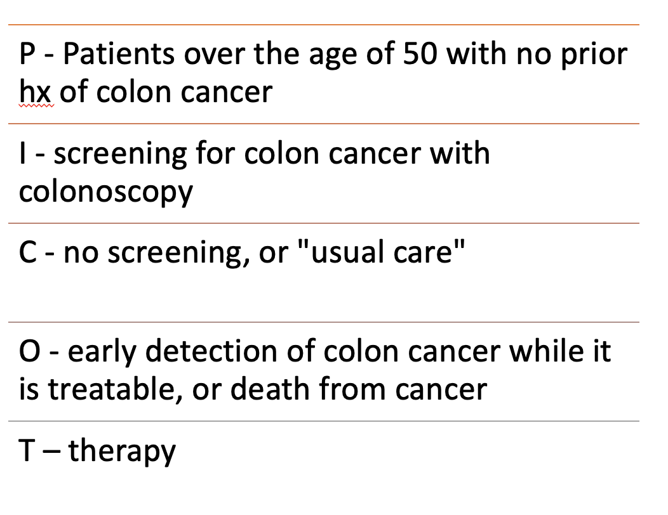
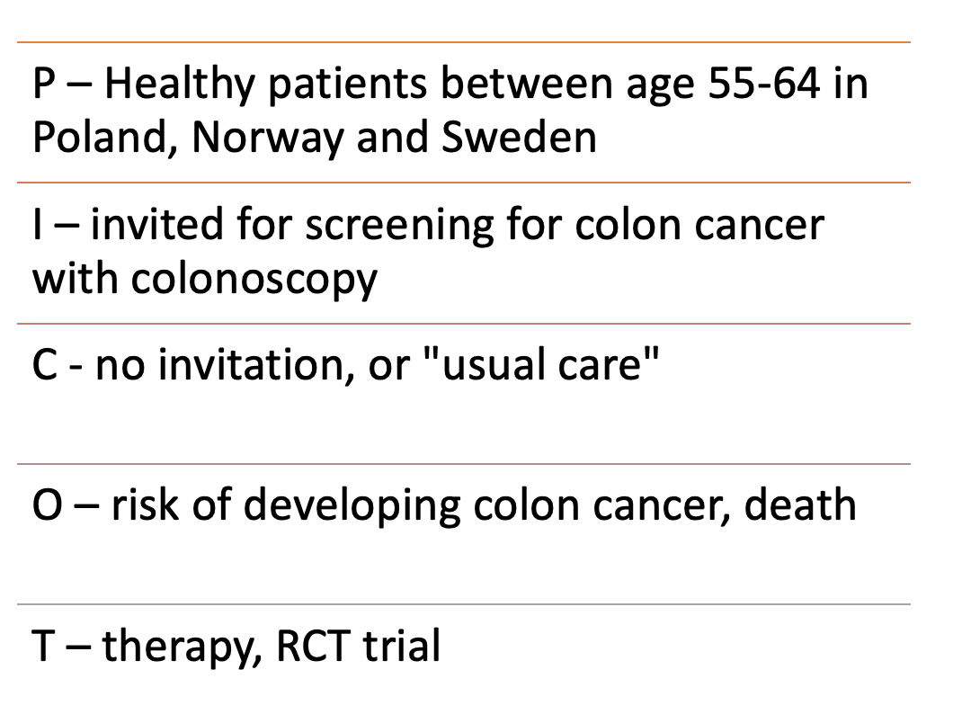
Our Question The article

Slide 33

What makes a good RCT?
1. Addresses the clinical question directly
2. Has a low risk of bias making the results trustworthy
3. The results are significant and generalizable

Slide 34
What are we even studying?
A. What was the primary outcome? Was this patient centered?
Primary outcome:
  Risk of colorectal cancer
  Risk of death from colorectal cancer
Secondary outcome:
  Death

Slide 35
Surrogate endpoints
True patient centered outcomes are harder studies to perform (take more time, more money and more patients)
Be careful of surrogate outcomes:
  A surrogate endpoint does not measure the clinical benefit of primary interest in and of itself, but rather is expected to predict that clinical benefit.
Examples:
- Trial on therapy for sepsis, uses surrogate outcome of renal failure. Renal failure is known to predict worse outcomes
- Early trials on antiarrhythmic drugs (90’s) – surrogate endpoint was normalization of heart rhythm. Normal rhythm – better! When time passed (years!), it was found mortality with the drugs had drastically increased! Thus, we were doing a lot of harm

Slide 36

Seems obvious but
Studies are better when they study what you want to answer!

Slide 37
How we randomize- does it matter?
B. What was the method of randomization? Was randomization concealed?
Independent organizations in each country randomly assigned participants with the use of a computer-generated allocation algorithm, stratified according to age, sex, and municipality.

Slide 38
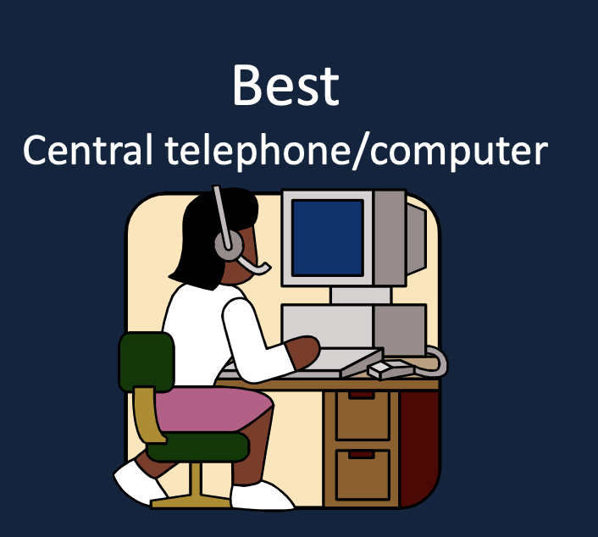
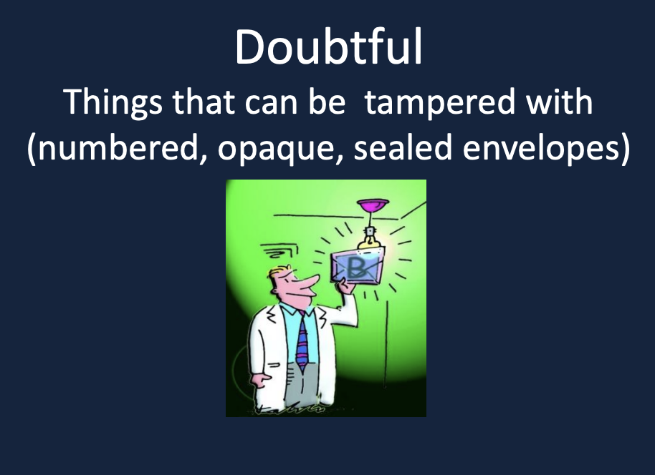
Concealment – does it matter?
Patients and investigators enrolling patients should not know which group the next patient is going to. They can not know the sequence!
Bias is introduced if participant’s decision to provide consent or a recruiter’s decision to enroll a participant is influenced by knowledge of which group a patient might be in if they participated

Slide 39
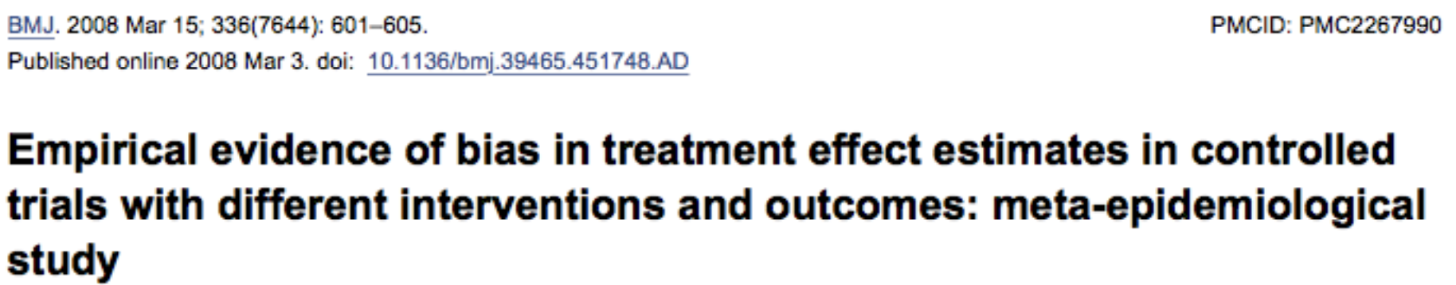
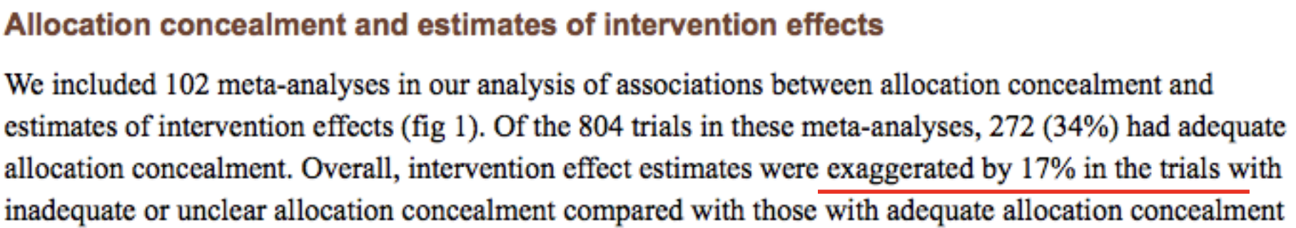
Concealment – does it matter?

Slide 40
We randomized for a reason…
C. Were the groups comparable at the start?
  Always look at Table 1
  Occasionally you will find significant discrepancies here that will preclude you from applying it to your population
  The larger the sample size, the less likely this is to happen
  Studies don’t always collect data that you might be interested in

Slide 41
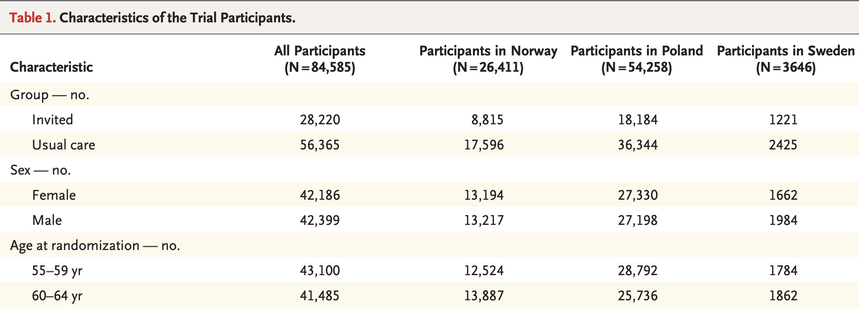
Table 1

Slide 42
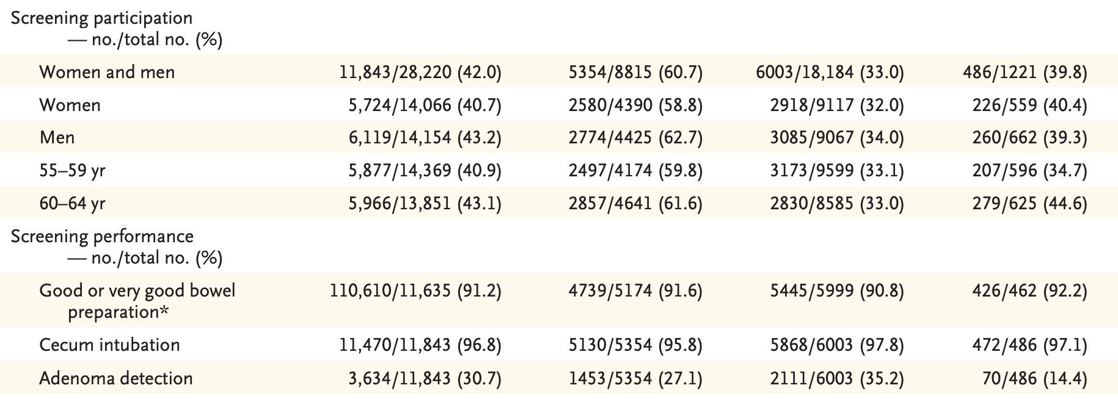
Table 1

Slide 43
Are they truly equal?
What about family history of colon cancer
What about smoking history
What about weight/BMI (what kind of diet?)
What about other medical problems?
None of those were reported – possible the sample size was large enough, but – maybe the ones who chose to participate knew their risk was lower…!? Or higher? Opted out as they didn’t want to roll the dice on getting offered screening…

Slide 44
You can’t see me….
D. Were patients and practitioners blinded?
  No

Slide 45
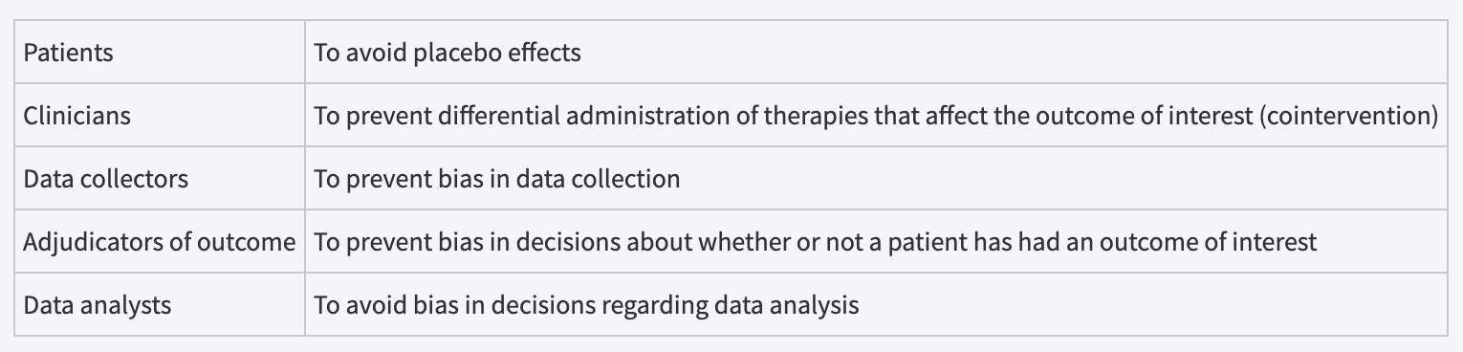
Blinding
In therapy trials where you can’t have a placebo, blinding can become essentially impossible. Usually the case for surgery, or intervention based trials
Should still blind other parts of the study, specifically the outcome data.

Slide 46
Now we can’t see
E. Was outcome assessment blinded or were outcomes objective?
Three outcomes:
diagnosed with colon cancer - Colon cancer was defined explicitly as adenocarcinoma only, unlikely to have bias
death from colon cancer – potential bias, however cause of death was not decided by the researchers
death – dichotomous, no bias (but… must be able to follow everyone up!)

Slide 47
Where did you go?
F. Was there minimal loss to follow up and losses explained?
No lost to follow up!?

Slide 48
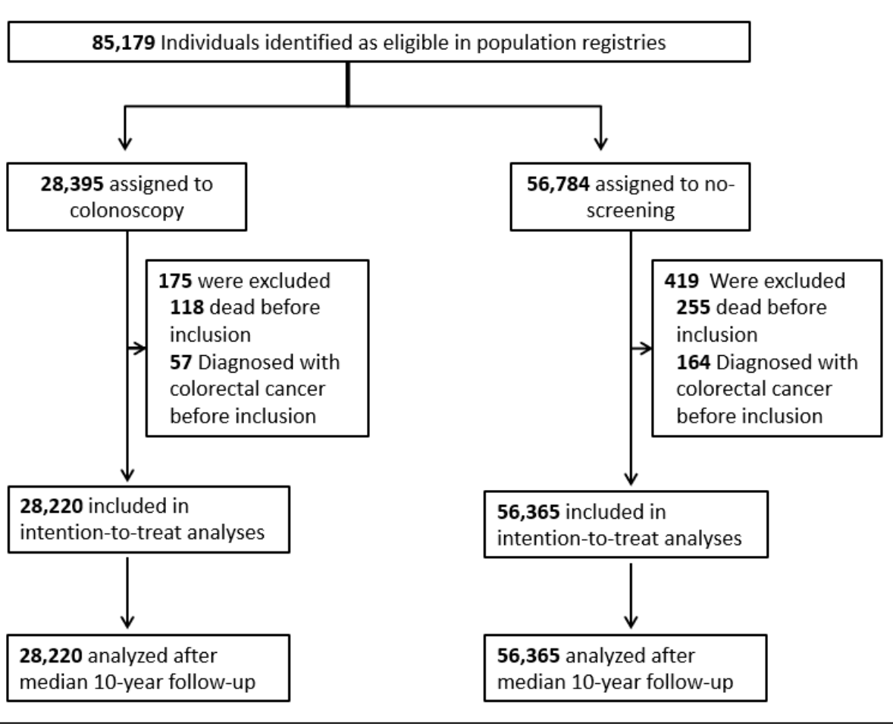
Lost to Follow up
All participants who underwent randomization were followed for all end-point events through these registries, regardless of whether they underwent screening.
5-and-20 rule for follow up:
<5% unlikely bias
5-20% - potential bias
>20% - serious threat

Slide 49
Is this the real world?
G. Was an intention to treat analysis conducted?
Yes – all stats reported are from ITT

Slide 50
What is intention to treat?
Once a patient is randomized, he/she is analyzed in their assigned group
  • Regardless of status: lost to follow-up, never received treatment, or crossed over
Benefit: groups stay equal, maintain power, estimates real world effectiveness
- if a treatment is particularly risky, costly or involved, ITT is much more important. We could develop a 15 day hospital stay to detect colon cancer, but this is not feasible or possible to actually implement. It may detect 100% of cancers…. But nobody will get or use the therapy. ITT controls for this.

Slide 51
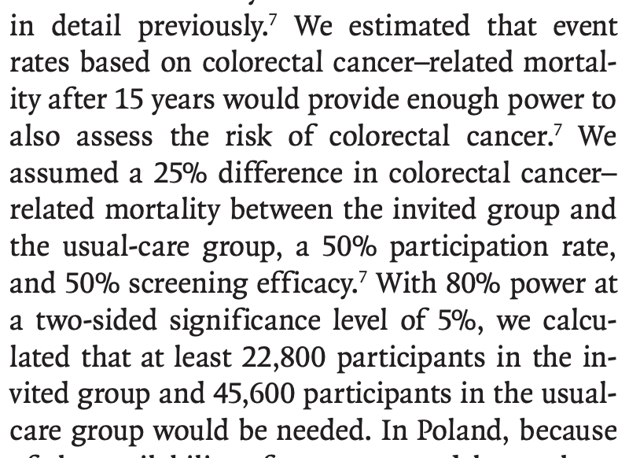
Do you have the power?
H. Was an a-priori power analysis conducted?
An a priori analysis is a sample size calculation performed before conducting the study and before the design and planning stage of the study; thus, it is used to calculate the sample size N, which is necessary to determine the effect size, desired α level, and power level

Slide 52
Do you have the power?
Very important to determine beforehand how many patients you need to find your effect size
Will give you statistically significant results – IE, not just random chance
Power analysis must be completed before you start the study – cannot use your own data to determine significance numbers
Uses incidence, and prior data to determine how many patients it will take to power so that a difference is detected IF THERE IS ONE
If you don’t do this, could be just random chance that where you stopped showed a difference

Slide 53


Risk of Bias – Our assessment
A. What was the primary outcome? Was it patient centered?
B. Was the method of randomization truly random? Was it concealed?
C. Were groups comparable at the start?
D. Were patients and practitioners providing care blinded?
E. Was outcome assessment blinded or were outcomes objective?
F. Was there minimal loss to follow-up & losses explained?
G. Was an intention-to-treat analysis conducted?
H. Was a a-priori power analysis conducted?

Slide 54
What makes a good RCT?
1. Addresses the clinical question directly
2. Has a low risk of bias making the results trustworthy
3. The results are significant and generalizable

Slide 55
Does Treatment Lower Risk? Understanding the Results
The way stats are reported can be very confusing:
Risk (absolute risk) - probability of a bad outcome - straightforward
Relative Risk Reduction – percentage of reduction between the two groups (50% less chance) – doesn’t tell the whole story (0.5 → 0.25)
Absolute risk reduction – difference between baseline risk and after treatment risk (30% baseline, 10% after treatment – 20% ARR)
Odds Ratio – odds of it happening vs it not happening
Risk Ratio – The risk of it happening vs not happening
NNT – (1/ARR) - the number needed to treat to avoid 1 bad outcome

Slide 56
Does Treatment Lower Risk? Understanding the Results
The way stats are reported can be very confusing:
Risk (absolute risk) - probability of a bad outcome - straightforward
Relative Risk Reduction – percentage of reduction between the two groups (50% less chance) – doesn’t tell the whole story (0.5 → 0.25)
Absolute risk reduction – difference between baseline risk and after treatment risk (30% baseline, 10% after treatment – 20% ARR)
Odds Ratio – odds of it happening vs it not happening
Risk Ratio – The risk of it happening vs not happening
NNT – (1/ARR) - the number needed to treat to avoid 1 bad outcome

Slide 57
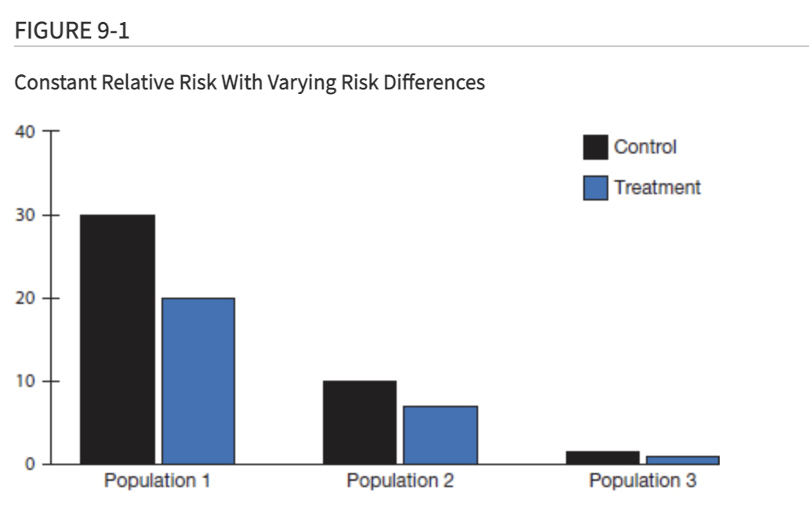
RR (relative risk, risk ratio) vs ARR (Absolute Risk reduction)

Slide 58
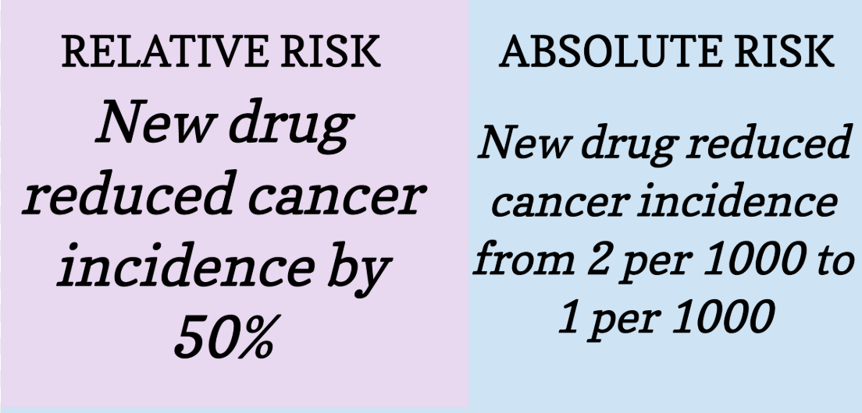
Absolute risk reduction
Absolute risk reductions give the actual difference in risk between one group and another.
These are usually a lot less headline worthy, but give a more realistic picture of how likely someone is to benefit from a given treatment.

Slide 59
Number Needed to Treat (NNT)
Intuitively a very simple concept
The number of times you need to give an intervention to prevent the bad outcome you are trying to prevent (disease progression, death, MI, cancer, etc, etc)
Can help relay the stats to a patient much easier
Think of a drug to stop a heart attack: if you needed to give it to 10 people to stop one heart attack, that would be great! If you needed to give it to 100,000 people to stop one heart attack…maybe not so good.
NNH – number needed to harm. If the above drug had a NNH of 500, then the drug would only be beneficial with a NNT <500

Slide 60
Confidence Intervals
Show you the range the TRUE value lies between
Similar to a p value, they give you the 95% confidence of where the true value likely is
Must know the top and bottom of this range, and be comfortable using the result if it was at either extreme
When confidence intervals of two groups cross – the results are NOT significant
If the confidence interval crosses 1 in ratios – then the value is of no significance

Slide 61
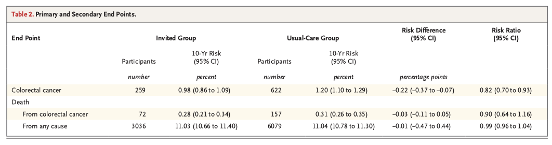
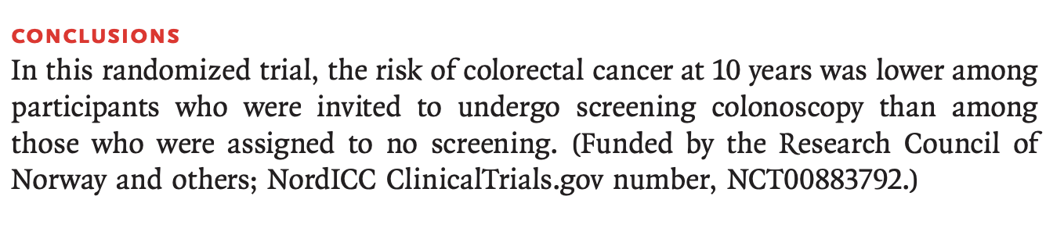
Are the results statistically significant?
Absolute Risk Reduction
Relative RR
NNT: 1/ARR
455
3333
10,000

Slide 62
ITT vs Per Protocol
Both have their advantages
ITT should ALWAYS be reported, accounts for things that we cannot predict
  IE in drug trials – the drug may kill the cancer cells, but the side effects are so miserable that nobody can finish the treatment
  The treatment might be so cost prohibitive, only the wealthy can do it
  The treatment might involve taking golyetly!
  Etc
Per protocol will give a better estimate of the “effectiveness” of the intervention itself

Slide 63
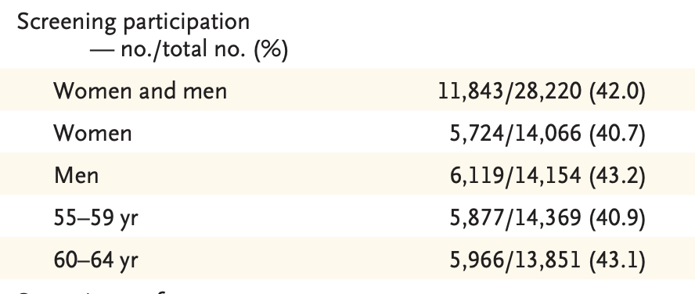
A test only works if you get the test!

Slide 64
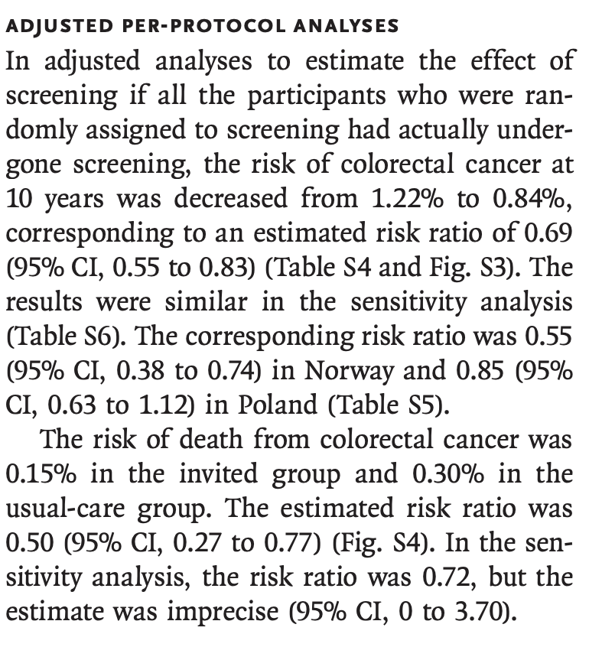
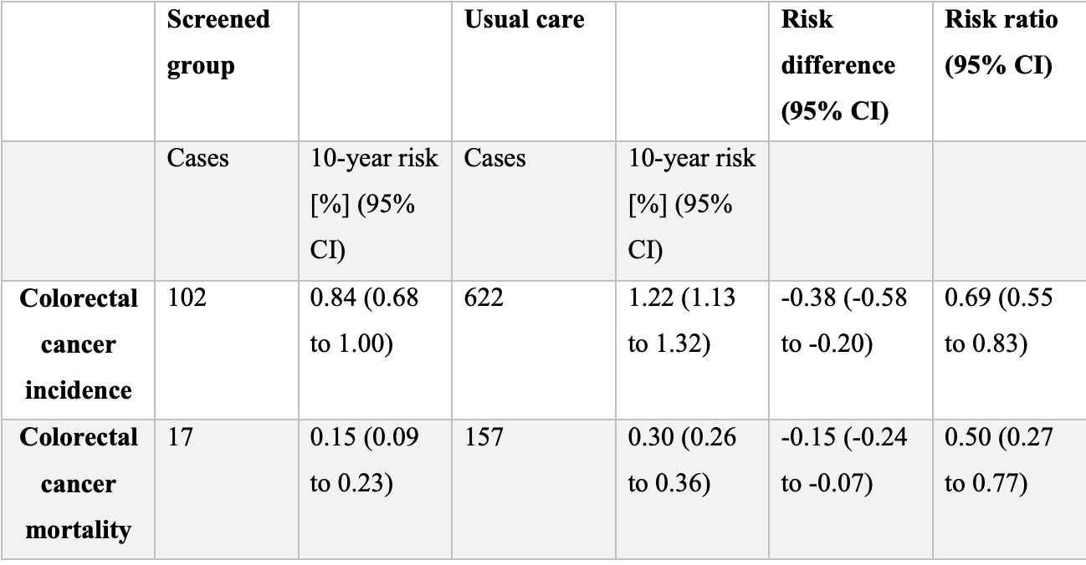
ITT vs Per Protocol
NNT: 263
666

Slide 65
Can we apply this to our population?
Why was the ITT so different than per protocol, was it because …
  Nordic countries saw the golytely review?
  Since it is not standard of care, did people opt out based on fear of the unknown or deviating from what others are doing?
  Was it really hard to get a colonoscopy in Sweden?
  If they are doing less colonoscopies, are they as good?
Does this apply to high risk colon cancer patients?
Does this apply to 50 year olds? 70 year olds?
Lots of questions remain

Slide 66
17-45%
23-73%

Slide 67
What makes a good RCT?
1. Addresses the clinical question directly
2. Has a low risk of bias making the results trustworthy
3. The results are significant and generalizable

Slide 68
Back to the case…
What should you tell your patient now?
He saw the headlines!

Slide 69
Case:
Shared decision making
Explain the study results so he can understand it, not just be confused by headlines
There is likely some benefit, but the benefit could be small. It is reasonable to use some other screening, and if any of those come back positive we could re-evaluate
Or – he could say “any risk over 0.1% is just too much, sign me up doc! “

Slide 70
Don’t discount it just because it is observational
Some authors have studied the results from RCTs, compared with similar observational studies. Concato et al. published an evaluation of meta-analyses that compared outcomes between RCTs and observational studies and reached the following conclusion: "The results from well-designed observational studies (with either a cohort or a case-control design) do not systematically overestimate the magnitude of the effects of treatment, as compared with those in randomized, controlled trials on the same topic".⁶ In other words, if the observational study has good methodological quality, the results are quite similar.
advanced statistical tools may enable good and reliable control over many confounders

Slide 71
Just because it is randomized…
One should be particularly skeptical of very large treatment effects that arise from very small studies, even randomized ones. An evaluation of more than 85 000 meta-analyses of RCTs revealed that it is common to see odds ratios that exceed 5 in small trials, but when additional trials are performed on the same question, the effects almost always become much smaller and may even disappear
Always determine if the study 1. answers the question 2. was well performed 3. applies to your patients

Slide 72
A note on AI
Did anyone drop this article in an AI platform and ask for summary?

Slide 73
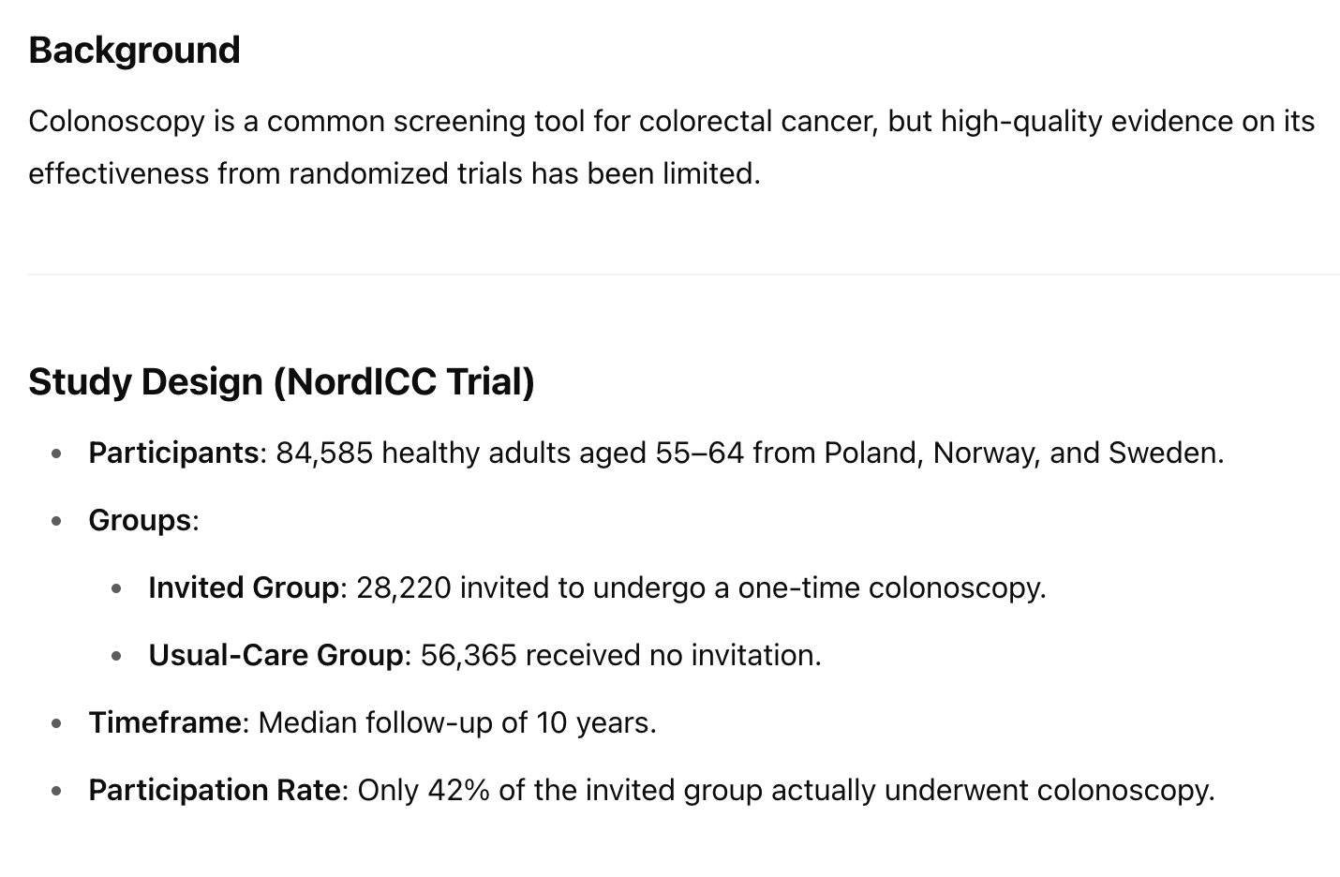

Slide 74
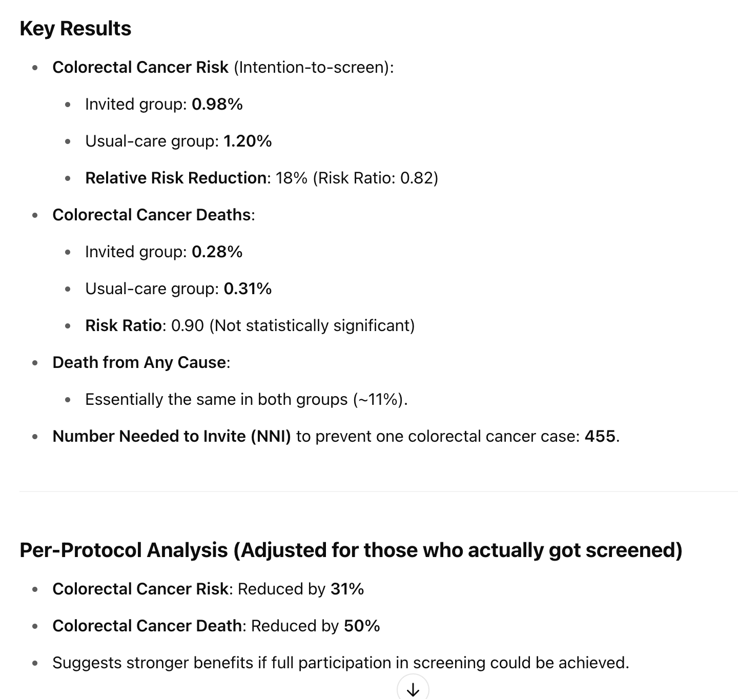

Slide 75
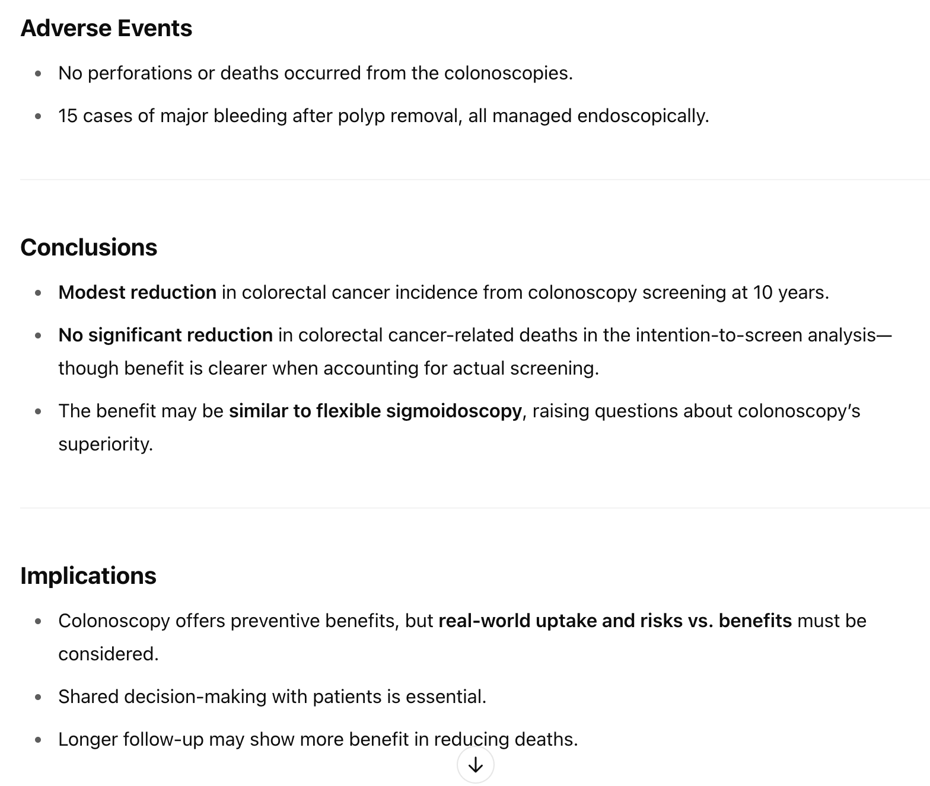

Slide 76
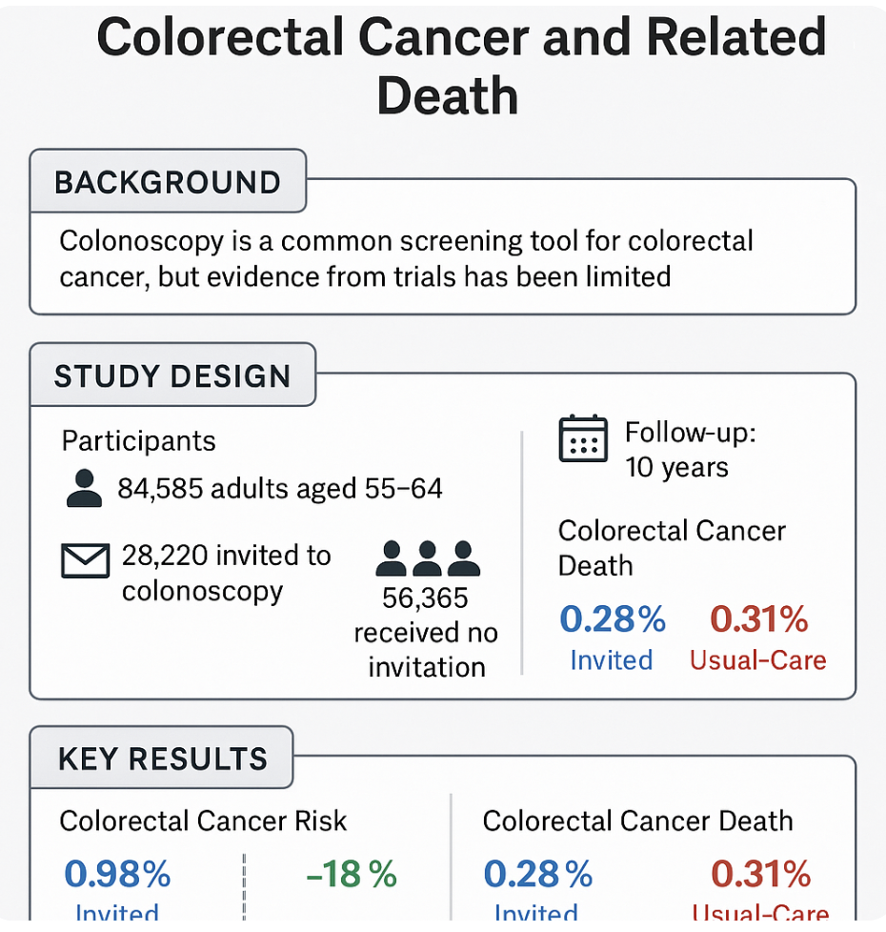

Slide 77
AI the future?
Probably
Still have some hesitations, but it is improving at a rapid rate
More info to come

Slide 78
Take home points
Always re-evaluate new evidence
Avoid the noise – read Table 1, Look at results table, calculate numbers that make sense to patients (ARR, NNT), use those to guide clinical decisions
Randomized is the gold standard, but still requires very high methodological adherence
Intention to treat vs Per protocol – both have their benefits but ITT will simulate real world whether we like the result or not
Watch out for surrogate outcomes causing authors to over conclude

Slide 79
Remember - take the quiz!
Questions? Email me – john.joyce@vcuhealth.org

