Slide 1


Stop ordering low value tests a series of rants (teaching rounds) by Michael Joyce

Slide 2
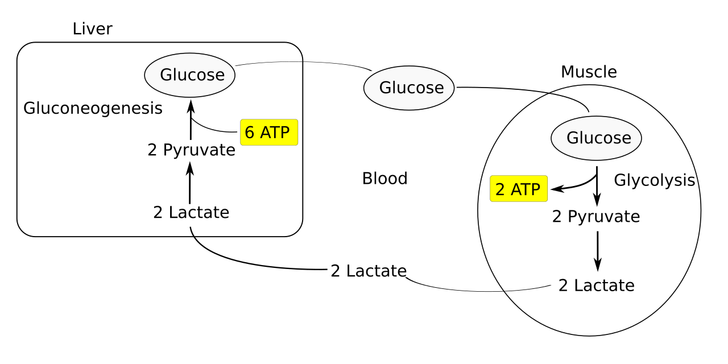
Session 1:
Lactate
  Produced from pyruvate during glycolysis
  Happens even with adequate oxygen
  Cleared mainly by liver (some kidney)
  Lactate ≠ hypoxia
  Lactate ≠ dehydration
  Lactate = marker of metabolic stress
  Common causes beyond shock:
  Sepsis (catecholamine surge)
  Beta-agonists
  Seizures
  Exercise
  Liver disease
  Epinephrine
  Any adrenergic state
Notes:
Lactate = stress, not shock Not all elevated lactate needs fluids Always ask: production vs clearance vs perfusion Treat the patient, not the number
Produced from pyruvate during glycolysis
Happens even with adequate oxygen
Cleared mainly by liver (also kidney)
Common causes beyond shock:
Sepsis (catecholamine surge)
Beta-agonists (albuterol!)
Seizures
Exercise
Liver disease
Epinephrine

Slide 3
Session 1:
Lactate
  = stress, not shock
  Not all elevated lactate needs fluids
  Always ask: production vs clearance vs perfusion
  Treat the patient, not the number
Notes:
Lactate = stress, not shock Not all elevated lactate needs fluids Always ask: production vs clearance vs perfusion Treat the patient, not the number
Produced from pyruvate during glycolysis
Happens even with adequate oxygen
Cleared mainly by liver (also kidney)
Common causes beyond shock:
Sepsis (catecholamine surge)
Beta-agonists (albuterol!)
Seizures
Exercise
Liver disease
Epinephrine

Slide 4
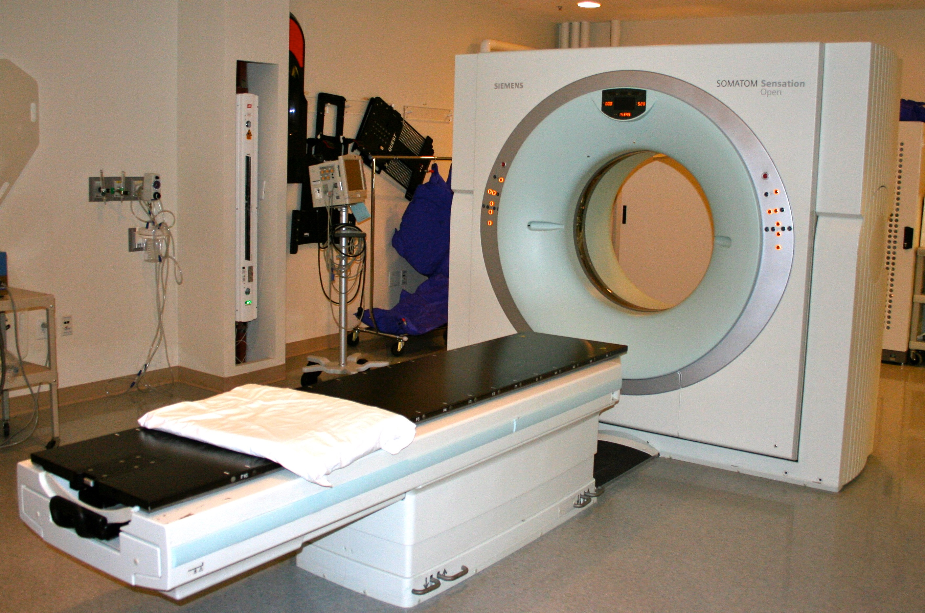

Session 2
CTA in GI bleeds
  CTA is a localization tool for active, significant bleeding
What decision are you trying to make with a CTA?
If the answer isn’t: “Do I need IR now?”
- then CTA is not the right test.
Upper GI bleed
First test - endoscopy
CTA only if:
  Massive + endoscopy not possible or failed
Lower GI bleed
Stable → colonoscopy
Unstable→ CTA → IR

Slide 5
So….. It got me thinking. What IS a low value test?
What does that mean to you?

Slide 6
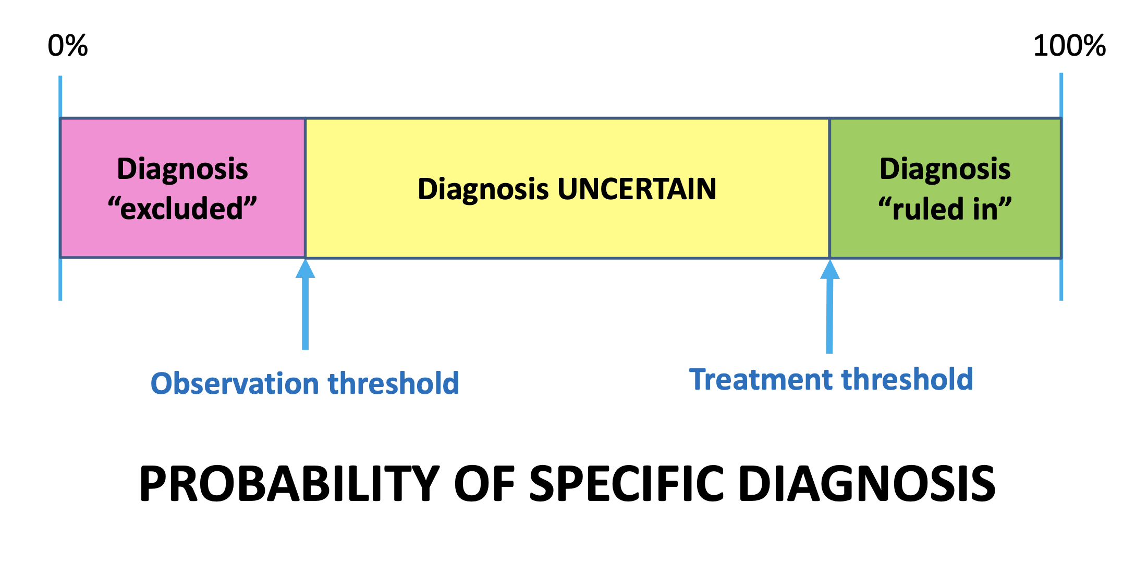

Slide 7
Treatment threshold
How certain you’d like to be of a diagnosis before proceeding with treatment
Depends on:
Prognosis of the disease under consideration
Effectiveness, safety, availability of treatment(s)
Safety and costs of next test(s)

Slide 8
Observation threshold
How certain you’d like to be that a patient does NOT have a diagnosis before you would not pursue further testing
Depends on:
Prognosis of the disease under consideration
Effectiveness and availability of treatment
Test accuracy, safety, acceptability to the patient

Slide 9
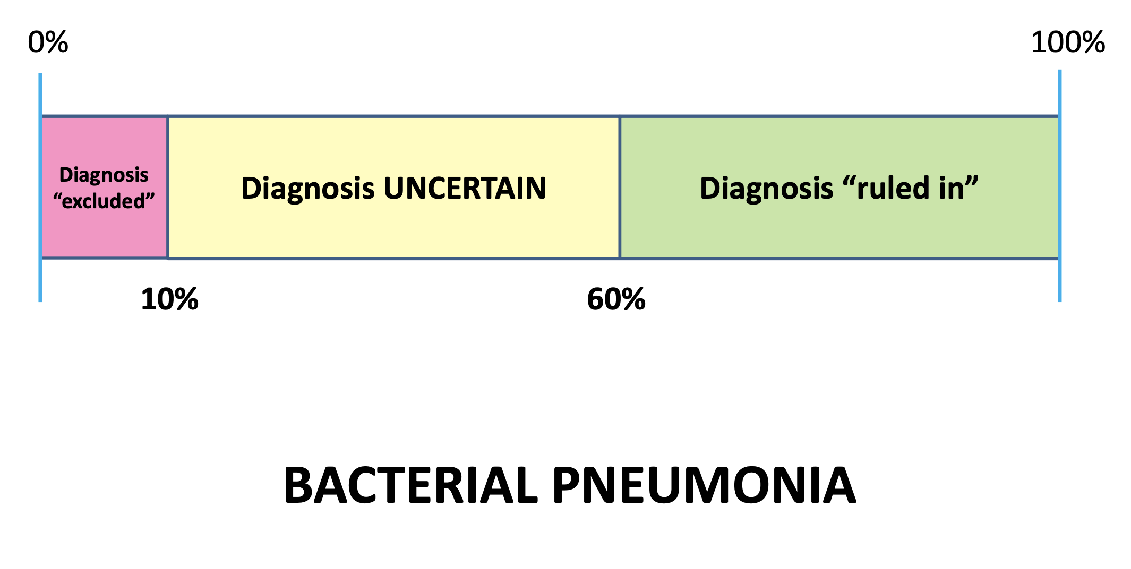

Slide 10
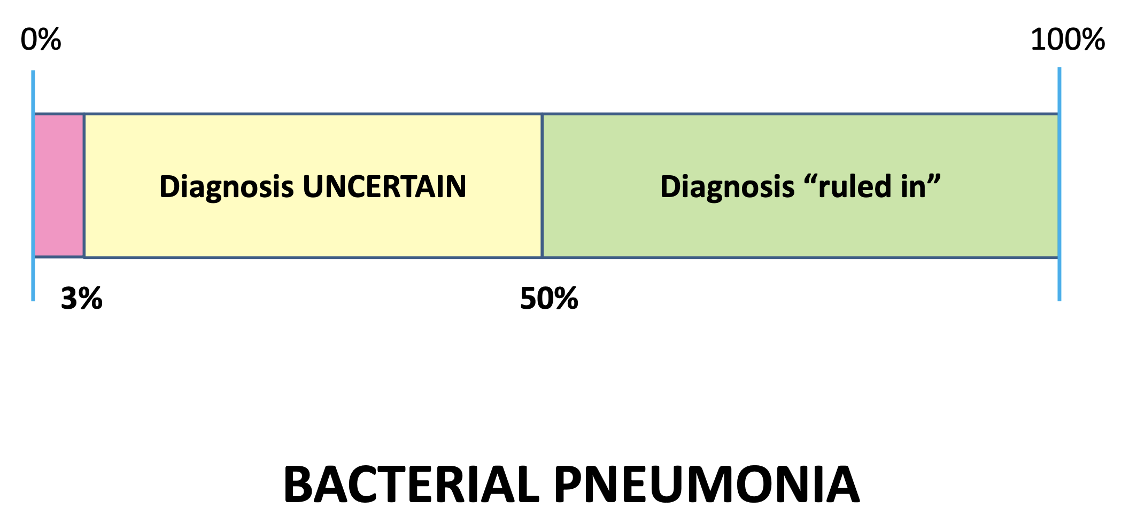
82 yo with HTN, DM and COPD

Slide 11
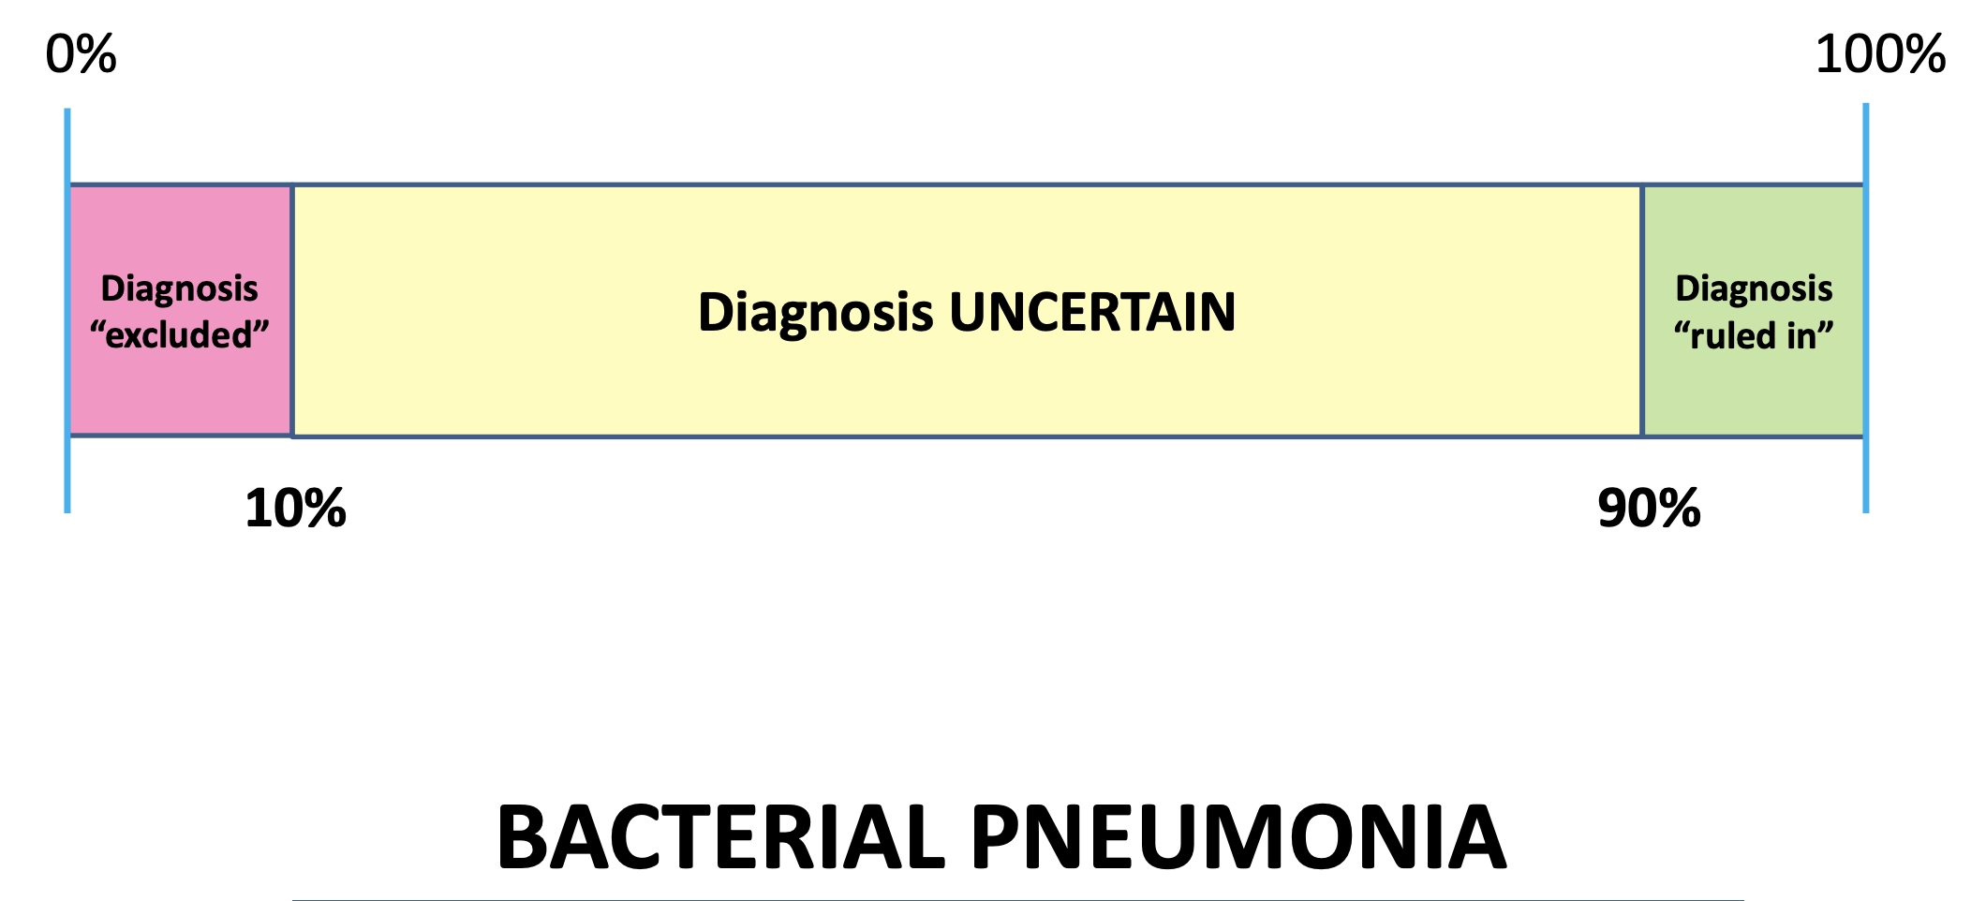
Healthy 20 yo with no medical problems

Slide 12
How do you assess how good a test is?

Slide 13
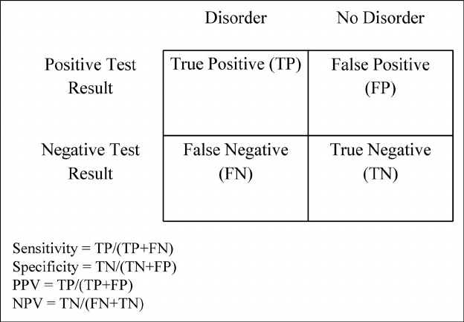
Ways that we can assess test performance:
  Sensitivity - ability of a test to yield a positive result for a subject that has that disease
  Specificity- ability of the test to obtain normal range or negative results for a person who does not have a disease
  Positive predictive value - proportion of patients with positive test who actually have the disease,
  Negative predictive value - proportion of patients with negative test who are actually free of the disease
  These values are useful for telling us when we have a result, how good is that result.
  Limitations:
  Sensitivity – ignores false positives
  Specificity – ignores false negatives
  PPV / NPV – perform different based on the prevalence of disease
  But the major limitation of these values, is they do not tell us WHEN to use a test!
  If only there were a better way?!
Notes:
This is not enough information!

Slide 14
Who uses sensitivity/specificity?
Who actually changes management with them?

Slide 15
Likelihood ratios to the rescue!
What is a likelihood ratio?
Allows us to decide if performing a test usefully increases or decreases the chance of making the diagnosis
Takes into consideration pre-test probability, and helps us convert into a post-test probability
Two forms of likelihood ratio exist, positive and negative, known as LR+ and LR-

Slide 16
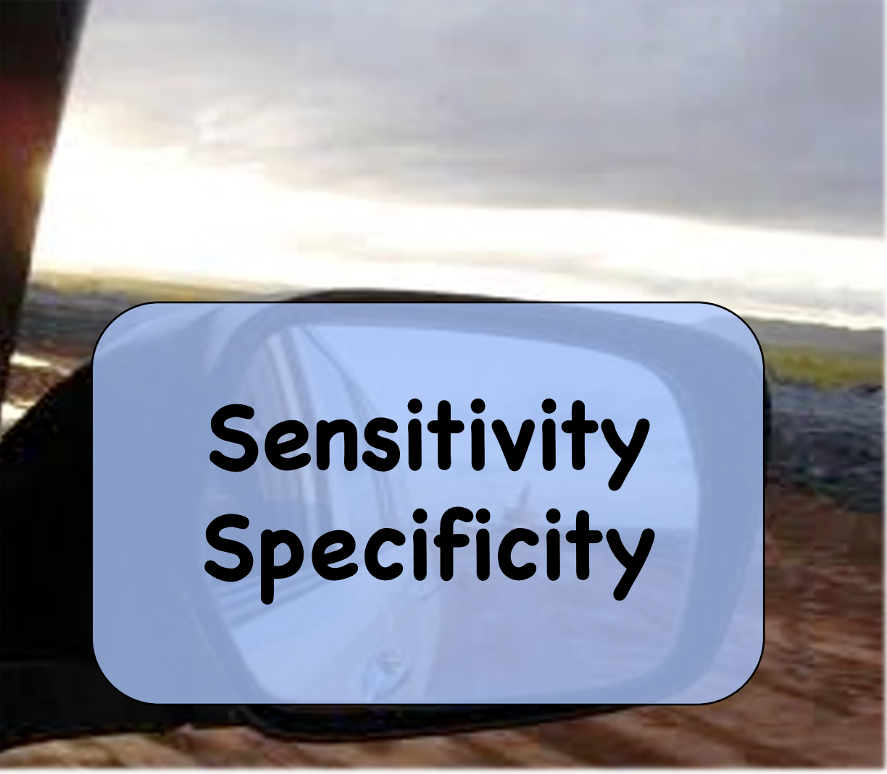
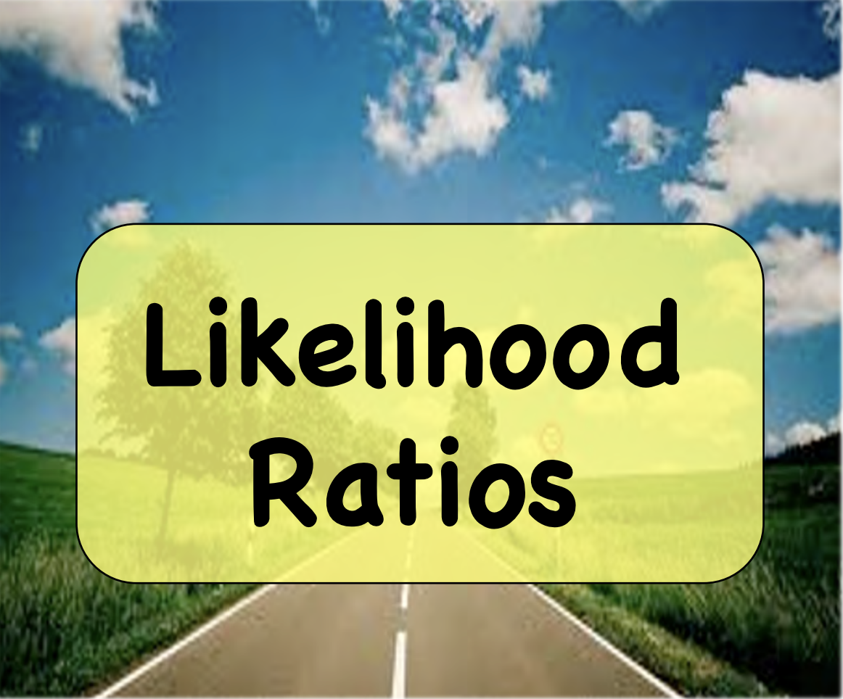

Slide 17
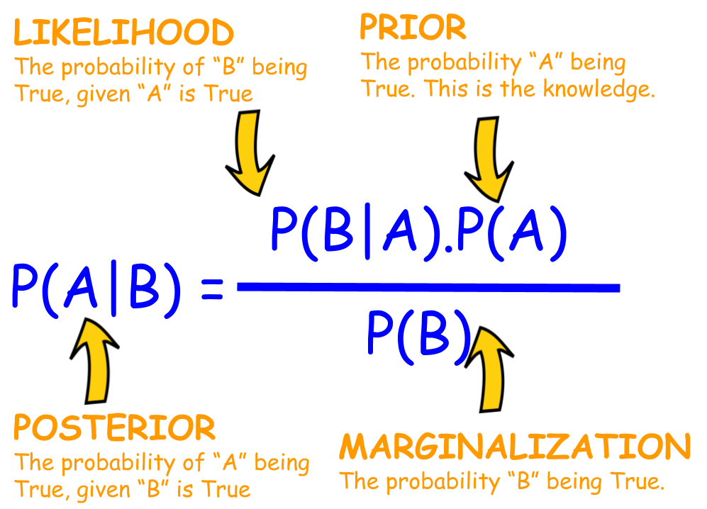
Bayes Theorem

Slide 18
Bayes Theorem Explained – statistics are fluid!
- A mathematical formula for determining conditional probability
Bayes theorem allows us to use context in statistics
Let’s take a simple yes/no test: the UPT
What if I were to tell you a UPT pregnancy test is 99% sensitive and 99% specific?
That is a great test! (but not perfect)
So you order and get a pregnancy test result back, and it is positive!
What is the chance this was a false positive?

Slide 19
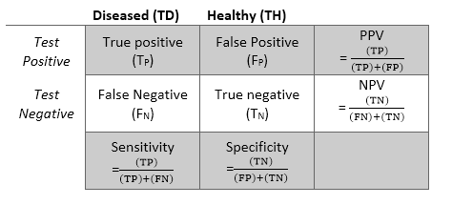
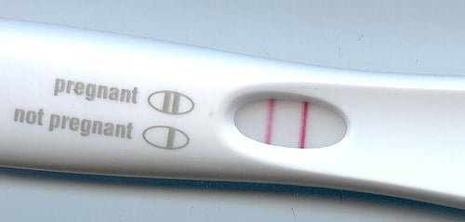
99%
99%
99
1
1
99
What is the chance this was a false positive?

Slide 20


1%
99%
false positive

Slide 21

What is the chance it was FP now?
100%!
1% up to 100%!

Slide 22

This is because our pre-test probability was zero

Slide 23
This is because our pre-test probability was zero
Biological male patient: pre-test – 0%
Biological female, but has had tubal ligation – 1%
Biological female, reports not currently sexually active and normal menstrual cycle last week – 5%
Biological female trying to conceive but hasn’t missed a menstrual cycle – 20%
Biological female trying to conceive, missed menstrual cycle – 50%
Biological female, fetus present on ultrasound – 100%

Slide 24
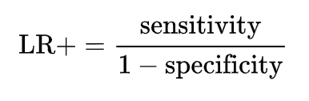
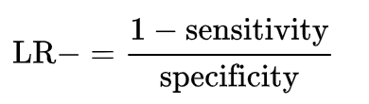
Back to the 2x2 table
Lets take the sensitivity and specificity, and convert it to a LR + and LR -
Positive likelihood ratio: ratio between the probability of a positive test result given the presence of the disease and the probability of a positive test result given the absence of the disease
Negative likelihood ratio: ratio between the probability of a negative test result given the presence of the disease and the probability of a negative test result given the absence of the disease

Slide 25
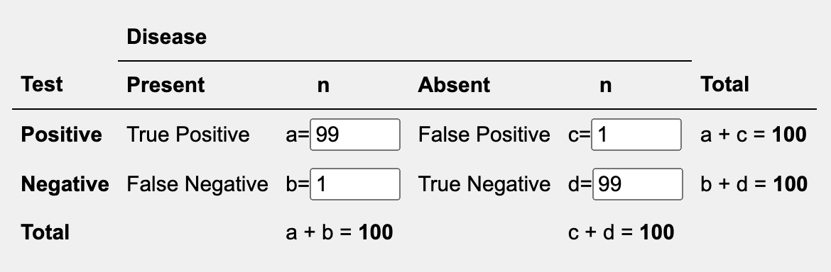
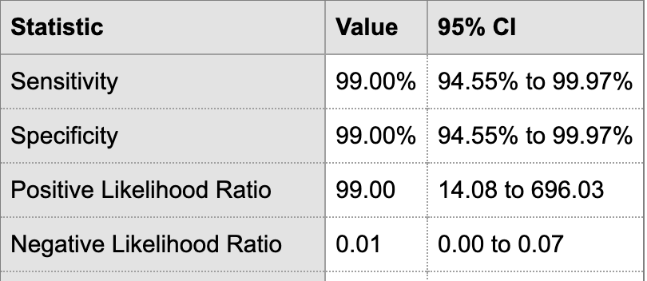
LR + 14
LR – 0.01

Slide 26
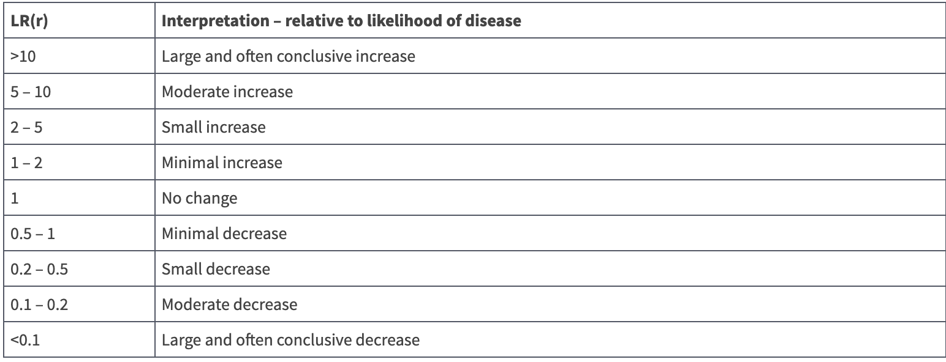
A word on ratios:
You can use them in succession
Multiply by 1 - no change!
Really high is good – changes the answer significantly
Or really low is good – also changes the answer significantly

Slide 27
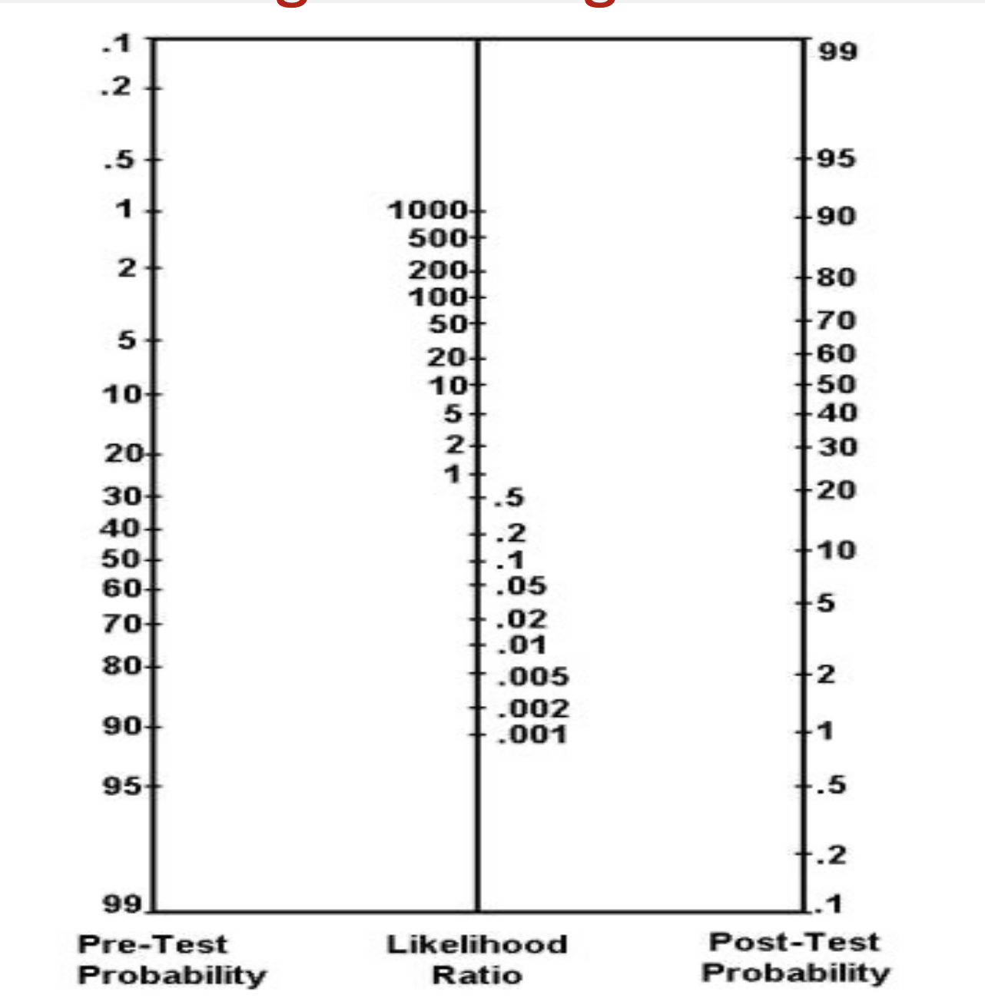
Fagen nomogram

Slide 28
LR + 14
LR – 0.1
Biological female, but has had tubal ligation
Pre test: 1%
Post test: 10%

Slide 29
LR + 14
LR – 0.1
Biological female, reports not sexually active and normal menstrual cycle last week
Pre test: 5%
Post test:
40%

Slide 30
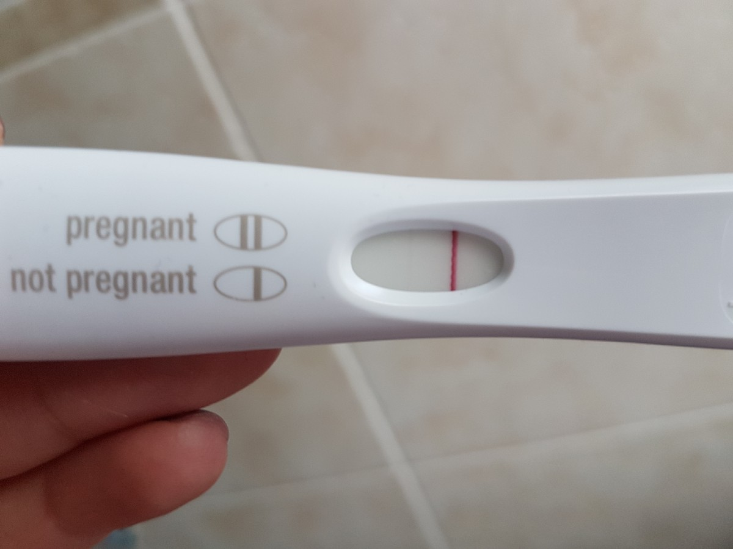
LR + 14
LR – 0.1
Biological female, reports not sexually active and normal menstrual cycle last week
Pre test: 5%
Post test: 0.5%

Slide 31
LR + 14
LR – 0.1
Biological female trying to conceive but hasn’t missed a menstrual cycle
Pre test: 20%
Post test: 80%

Slide 32
LR + 14
LR – 0.1
Biological female trying to conceive, missed menstrual cycle
Pre test: 50%
Post test: 95%

Slide 33
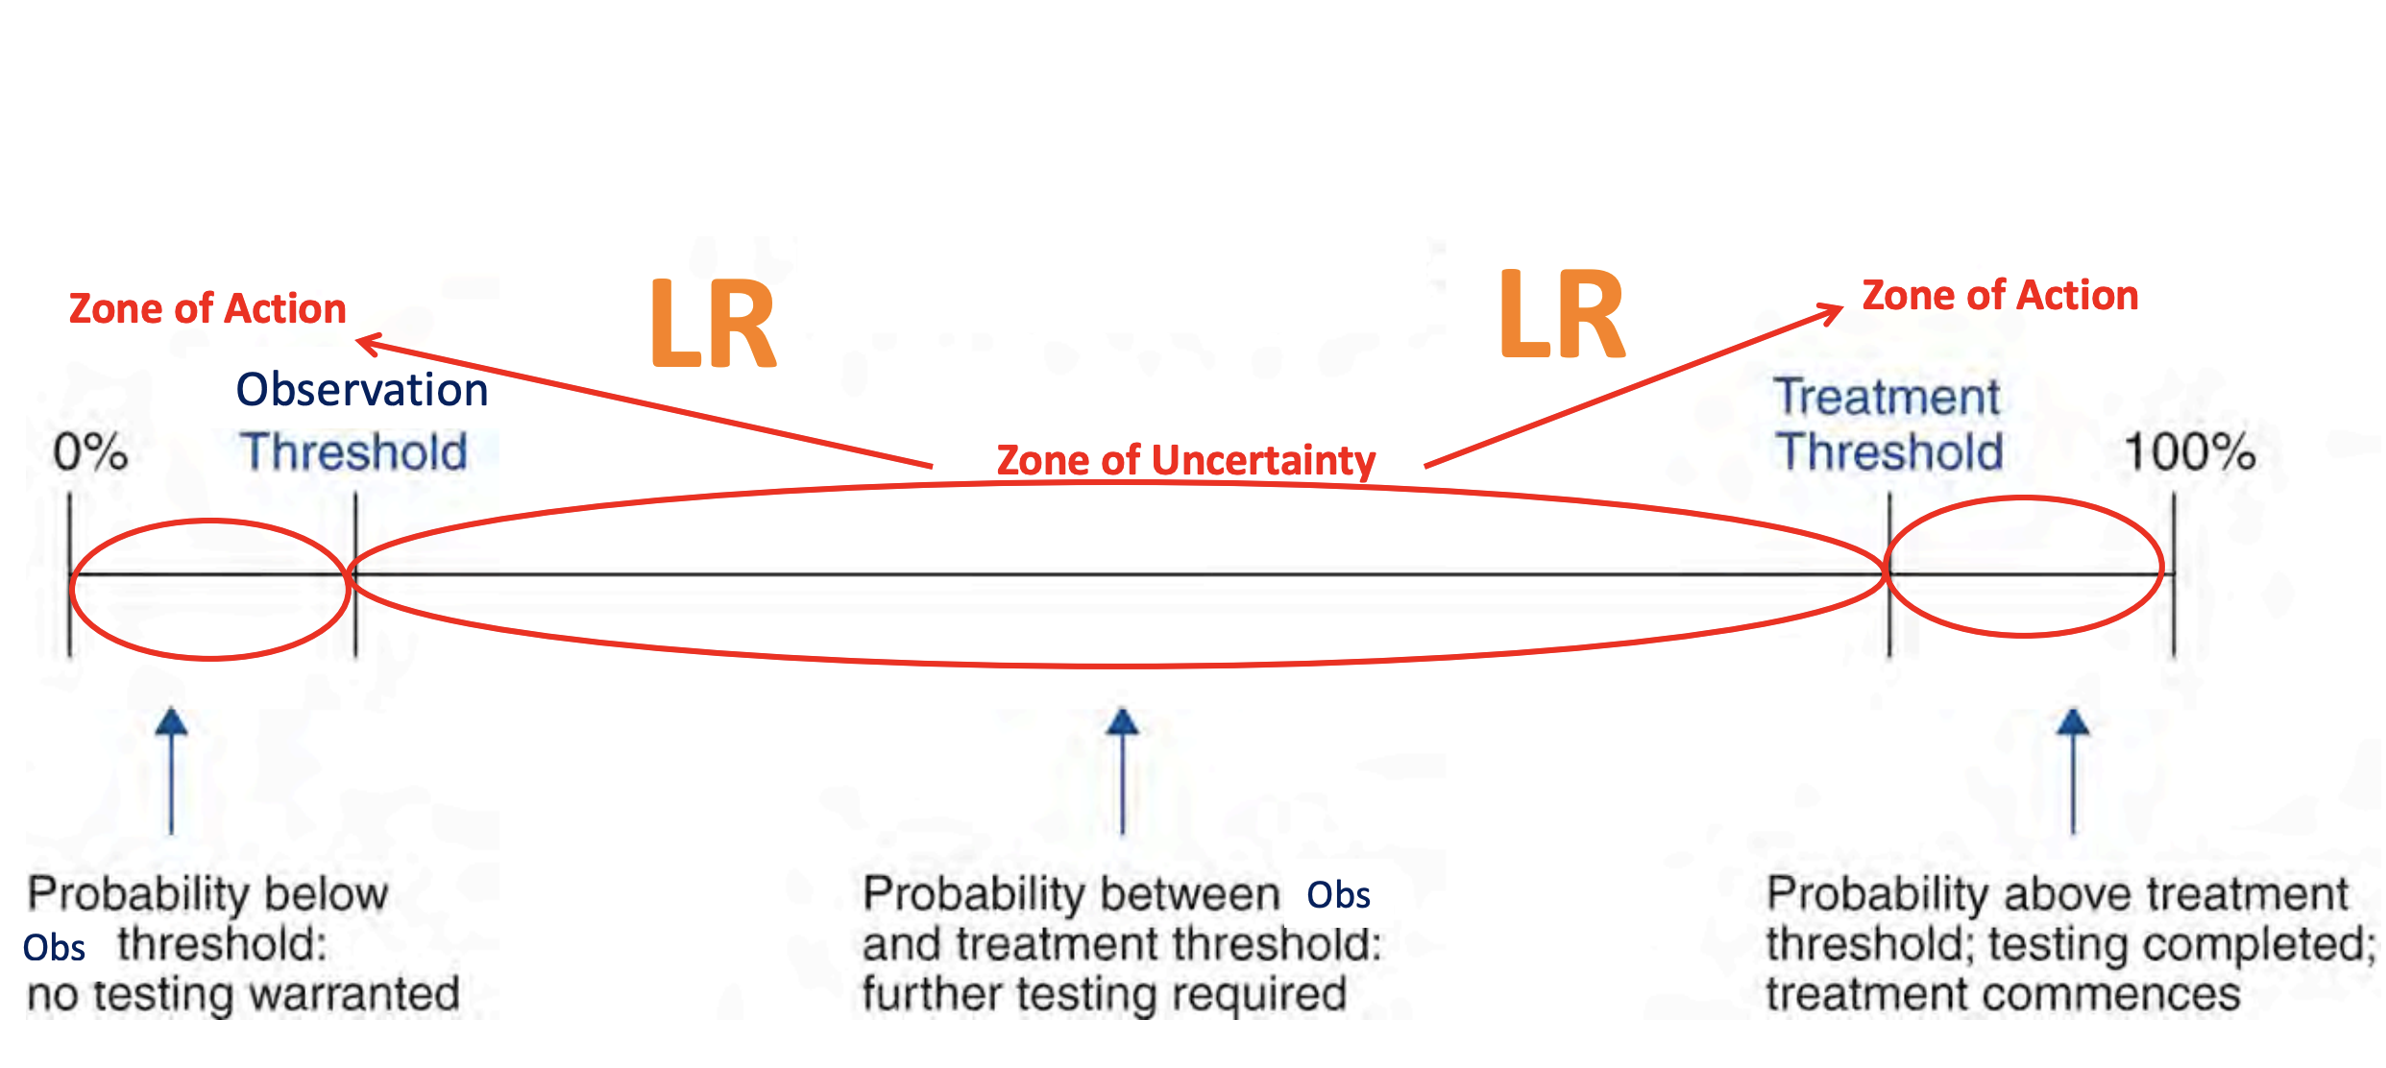
Tests force action – one direction or the other

Slide 34
Guess the LR

Slide 35
Answers
Ottawa ankle rules: 0.02
ECG normal: 0.7
ECG w stemi: 18.5
Rebound tenderness: 2
Chest pain to both arms: 7
Reproducible chest pain: 0.3
Sonographic murphys: 5
POCUS stones + wall thick: 11
BNP positive: 5-8
?Stone – hematuria: 3
Worst headache: 2
POCUS with normal lung slide: 0.05
KUB for obstruction LR+: 1.5
KUB for obstruction LR- : 0.5
CTA to rule out GI bleed: 0.5

Slide 36
Summary
Before you order a test, ask yourself
  1. how good is this test
  2. Will it move me from a zone of inaction to a zone of action
  3. Is there a better / more appropriate test, or, is no test a reasonable option

Slide 37
A recent case:
Resident sees a patient with chief complaint of leg swelling.
  PMH: HTN, COPD, DM, hyperlipidemia, VTE
Patient denies trauma, redness, fevers, rash or any other complaints.
On physical exam, there is unilateral left lower extremity swelling, 1+ pitting edema to mid shin, no deformities, normal sensation and motor. Skin exam is unremarkable.

Slide 38
DDx?
DVT
Cellluitis
Abscess
Fracture
Contusion
Renal failure
Heart failure
Lymphedema

Slide 39
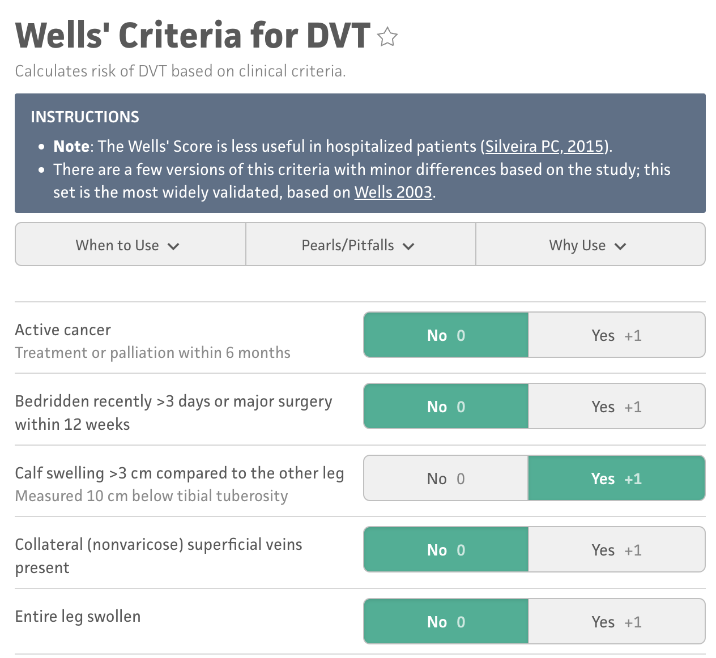
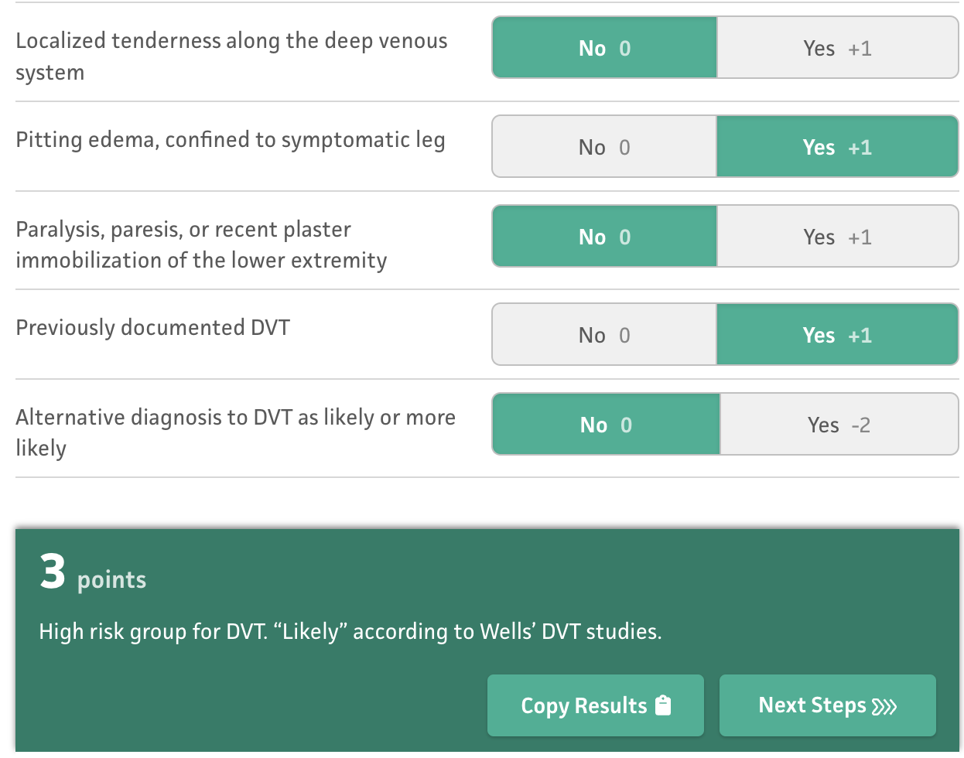
Pre test probability?

Slide 40
Ultrasound obtained
Negative for DVT

Slide 41
Ultrasound obtained
Negative for DVT
How good is the test?
LR+ 64
LR- 0.06

Slide 42
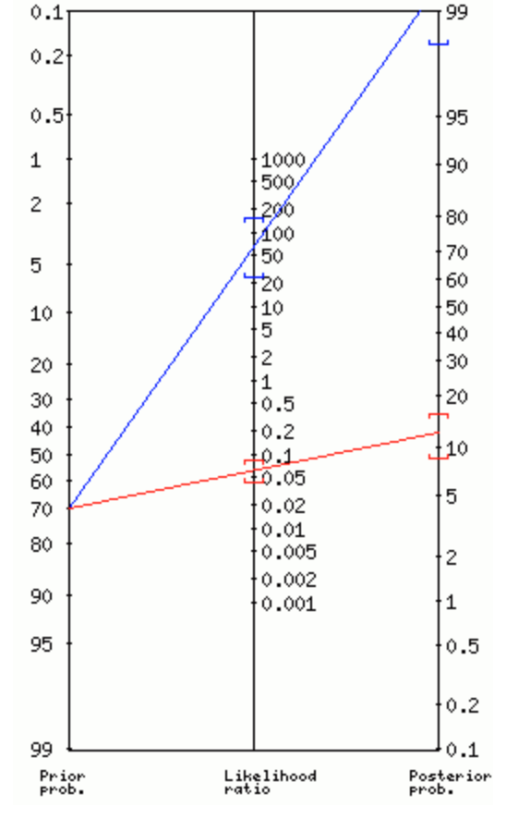
Ultrasound obtained
Negative for DVT
How good is the test?
LR+ 64
LR- 0.06

Slide 44
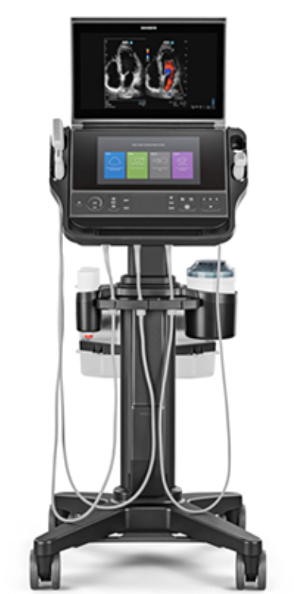
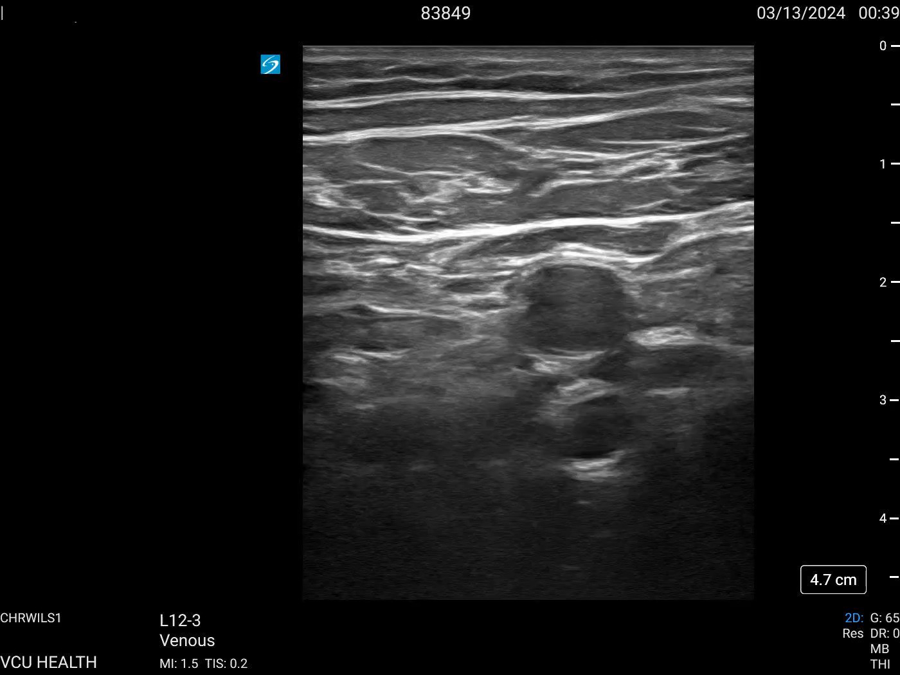

Slide 45
Case conclusion
Started patient on DOAC
Followed up with PCP, had a repeat study done which again confirmed the diagnosis
Used likelihood ratios to appropriately determine the likelihood that the test was correct!
This can be you !

Slide 46
Post lecture thoughts:
A little bit short, finished 15 early.
Could make it a bit more interactive
The pregnancy changing stats hits well
Transitions into some of the slides threw me off didn’t know what was coming
- pre reading from BMJ didn’t go through, perhaps do a different pre reading that we can break down in class. Maybe even send the appendicitis article

