Slide 1

Population Health M3
An introduction to evidence based medicine for patient care
Michael Joyce, MD, FACEP

Slide 2
Goals and Objectives
Goal
The goal of this course is for students to learn the necessary knowledge and skills to acquire, appraise, and apply evidence-based medicine to the care of their patients. By the end of this course, third year medical students will be to make patient care decisions using the principles of EBM.
Objectives
By the end of this course the M3 student will be able to:
  formulate a clinical question based on a patient scenario in the format of PICO (Population/disease, Intervention/exposure, Comparator, and Outcome);
  Perform a refined search of the medical literature to answer a clinical question using both primary sources and pre-appraised literature
  Select appropriate types of articles based on the type of clinical question (therapy, harm, diagnosis, prognosis)
  Evaluate articles for study methodology, effectiveness, and generalizability using criteria such as GRADE or other scoring systems
  Summarize the available evidence and present summarized evidence as a recommendation to a patient

Slide 3

Today’s outline
Discuss the importance of how to formulate a question
1
Overview of the main types of questions doctors ask on a daily basis
2
Practice refining clinical questions so that we can get to an answer
3
Provide resources for searching for evidence
4

Slide 4

Reminder of EBM Principles
Evidence-Based Medicine
The practice of using research evidence in decision-making about the care of an individual patient
  Involves the integration of your own clinical knowledge, research, and patient preferences
  There is no one right answer!
EBM Process:
  Ask a question > Acquire evidence > critically Appraise evidence > Apply evidence > Assess EBM process

Slide 5
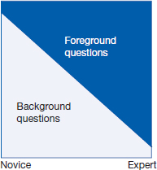
What Is the Question?
On average, clinicians have 5 to 8 questions about individual patients per daily shift.
Some now even consider that “the use of search engines is as essential as the stethoscope.”
Background vs Foreground
Ultrasound.
Citation: Chapter 4 What Is the Question?, Guyatt G, Rennie D, Meade MO, Cook DJ. Users' Guides to the Medical Literature: A Manual for Evidence-Based Clinical Practice, 3rd ed; 2015. Available at: https://jamaevidence.mhmedical.com/content.aspx?bookid=847&sectionid=69031460 Accessed: July 06, 2022
Copyright © 2022 American Medical Association. All rights reserved

Slide 6
Clarifying the question
Clinical questions often spring to mind in a form that makes finding answers in the medical literature a challenge.
Dissecting the question into its component parts to facilitate finding the best evidence is a fundamental skill.
This is what separates you from your patients with google and AI searches

Slide 7

What about AI?

Slide 8
What about AI?
EBM Process:
  Ask a question > Acquire evidence > critically Appraise evidence > Apply evidence
  AI fits into all of the above, but can be hard to apply if misleads at early steps
  Over reliance on AI while training and learning can lead to a decrease in critical appraisal skills – for real world, real time situations

Slide 9
AI
Strengths
Speed
Summarization
Translation of dense literature
Weaknesses
Hallucination
Lack of source transparency (sometimes)
Outdated training data
Confident tone ≠ correctness

Slide 10
Clarifying the question
Consider the following patient scenario:
A 53 year old male presents with chest pain that has been going on for 1 day. The pain is mid sternal with no radiation. There is no associated shortness of breath. The pain is relieved with Tylenol. He has never had pain like this before. He has a history of diabetes and high cholesterol for which he takes medications. He smokes cigarettes, but does not drink or use any illicit drugs. His father died from a heart attack at age 64.
Work up today reveals a normal ECG, normal troponins and chest xray, and his pain has now resolved.
What is the next step? Should I get a stress test on this patient?

Slide 11
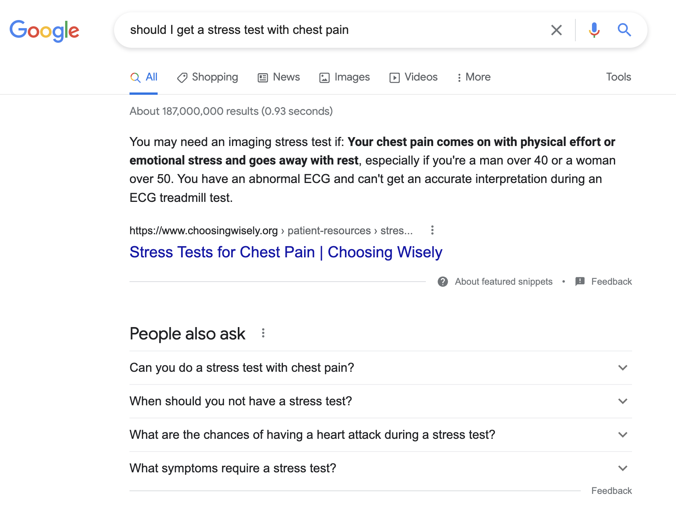
Google

Slide 12
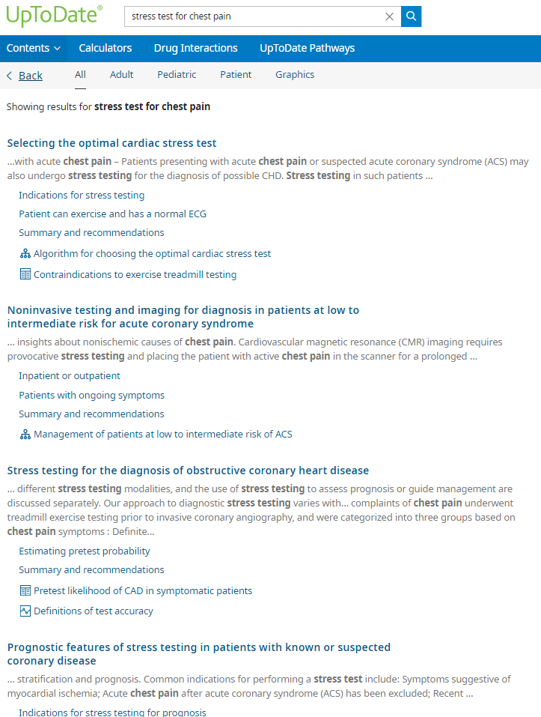
Uptodate

Slide 13
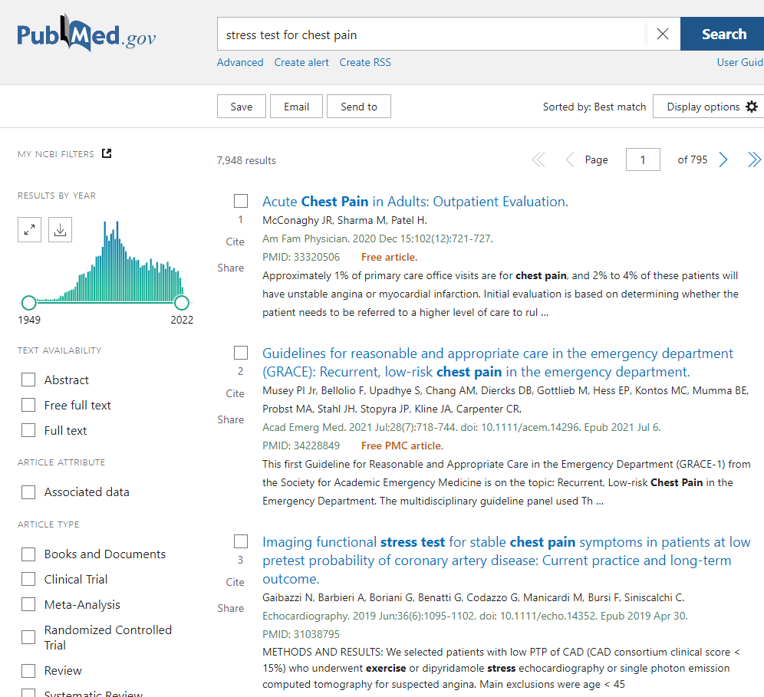
Pubmed

Slide 14
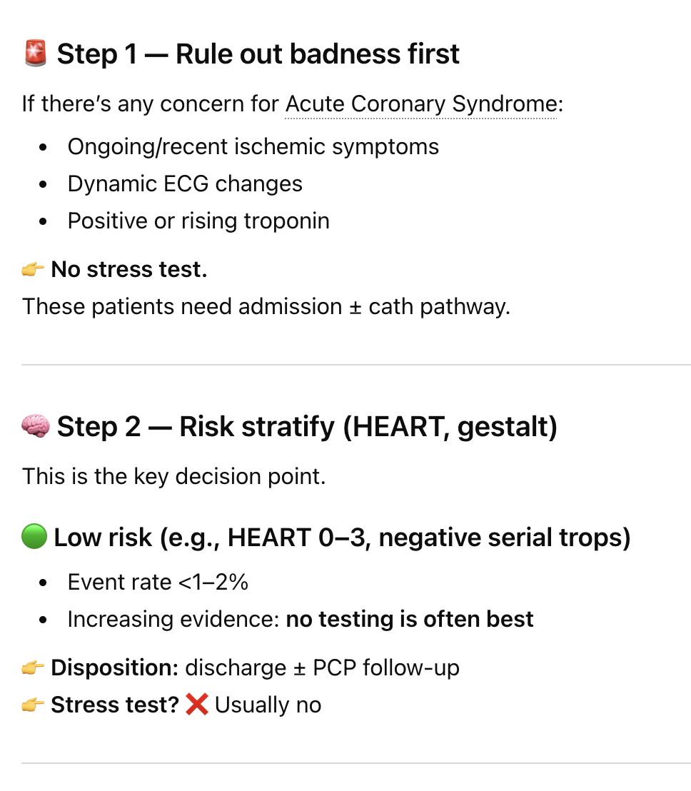
ChatGPT

Slide 15
ChatGPT

Slide 16
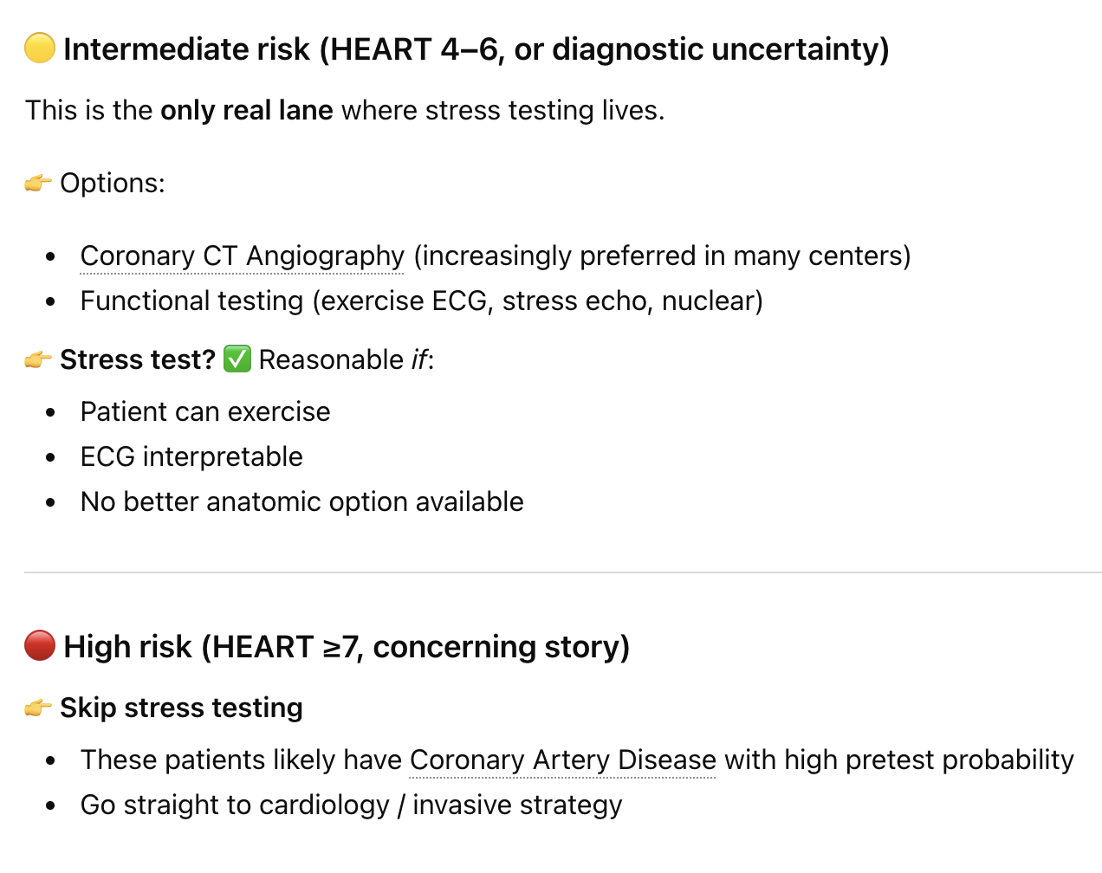
ChatGPT

Slide 17
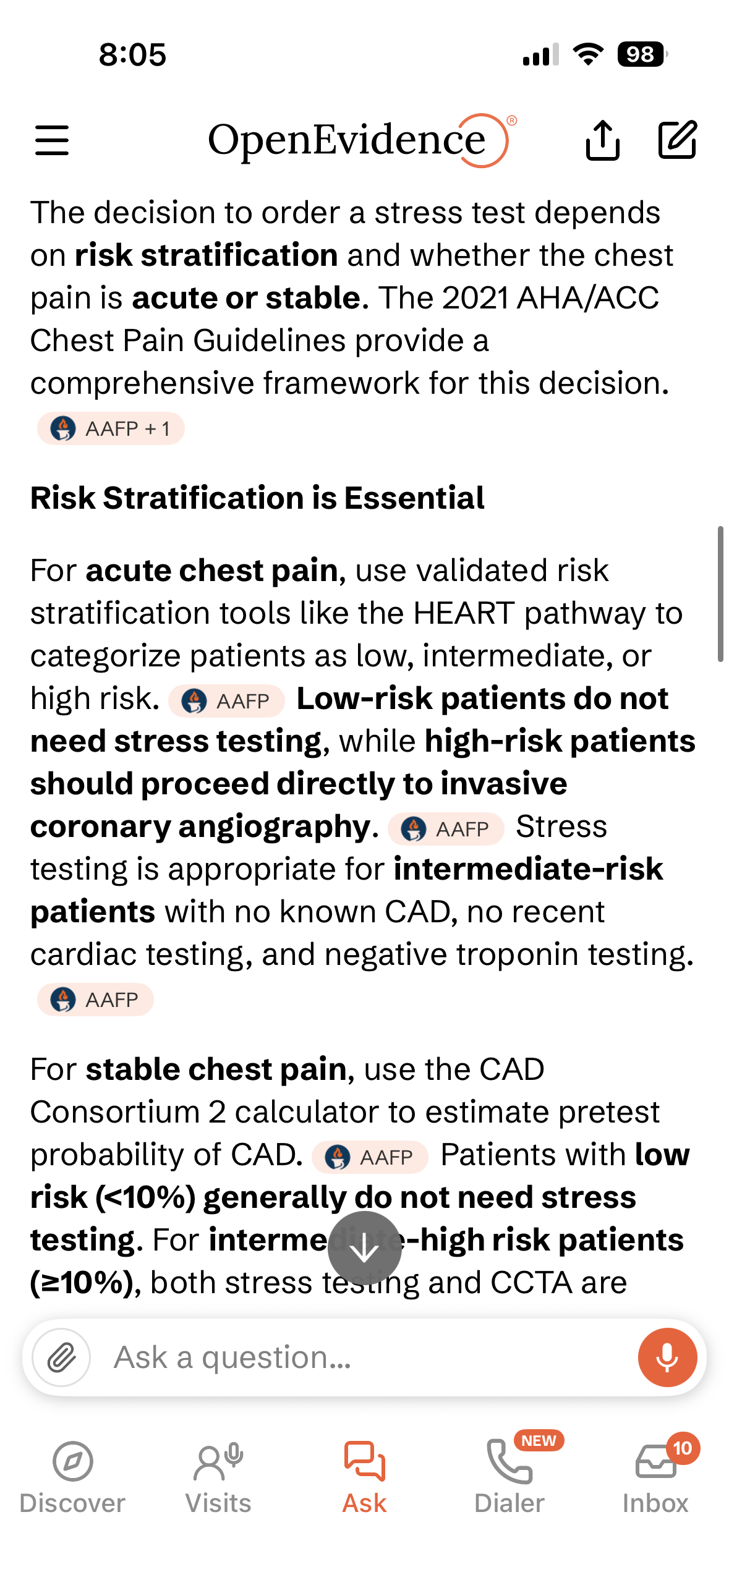
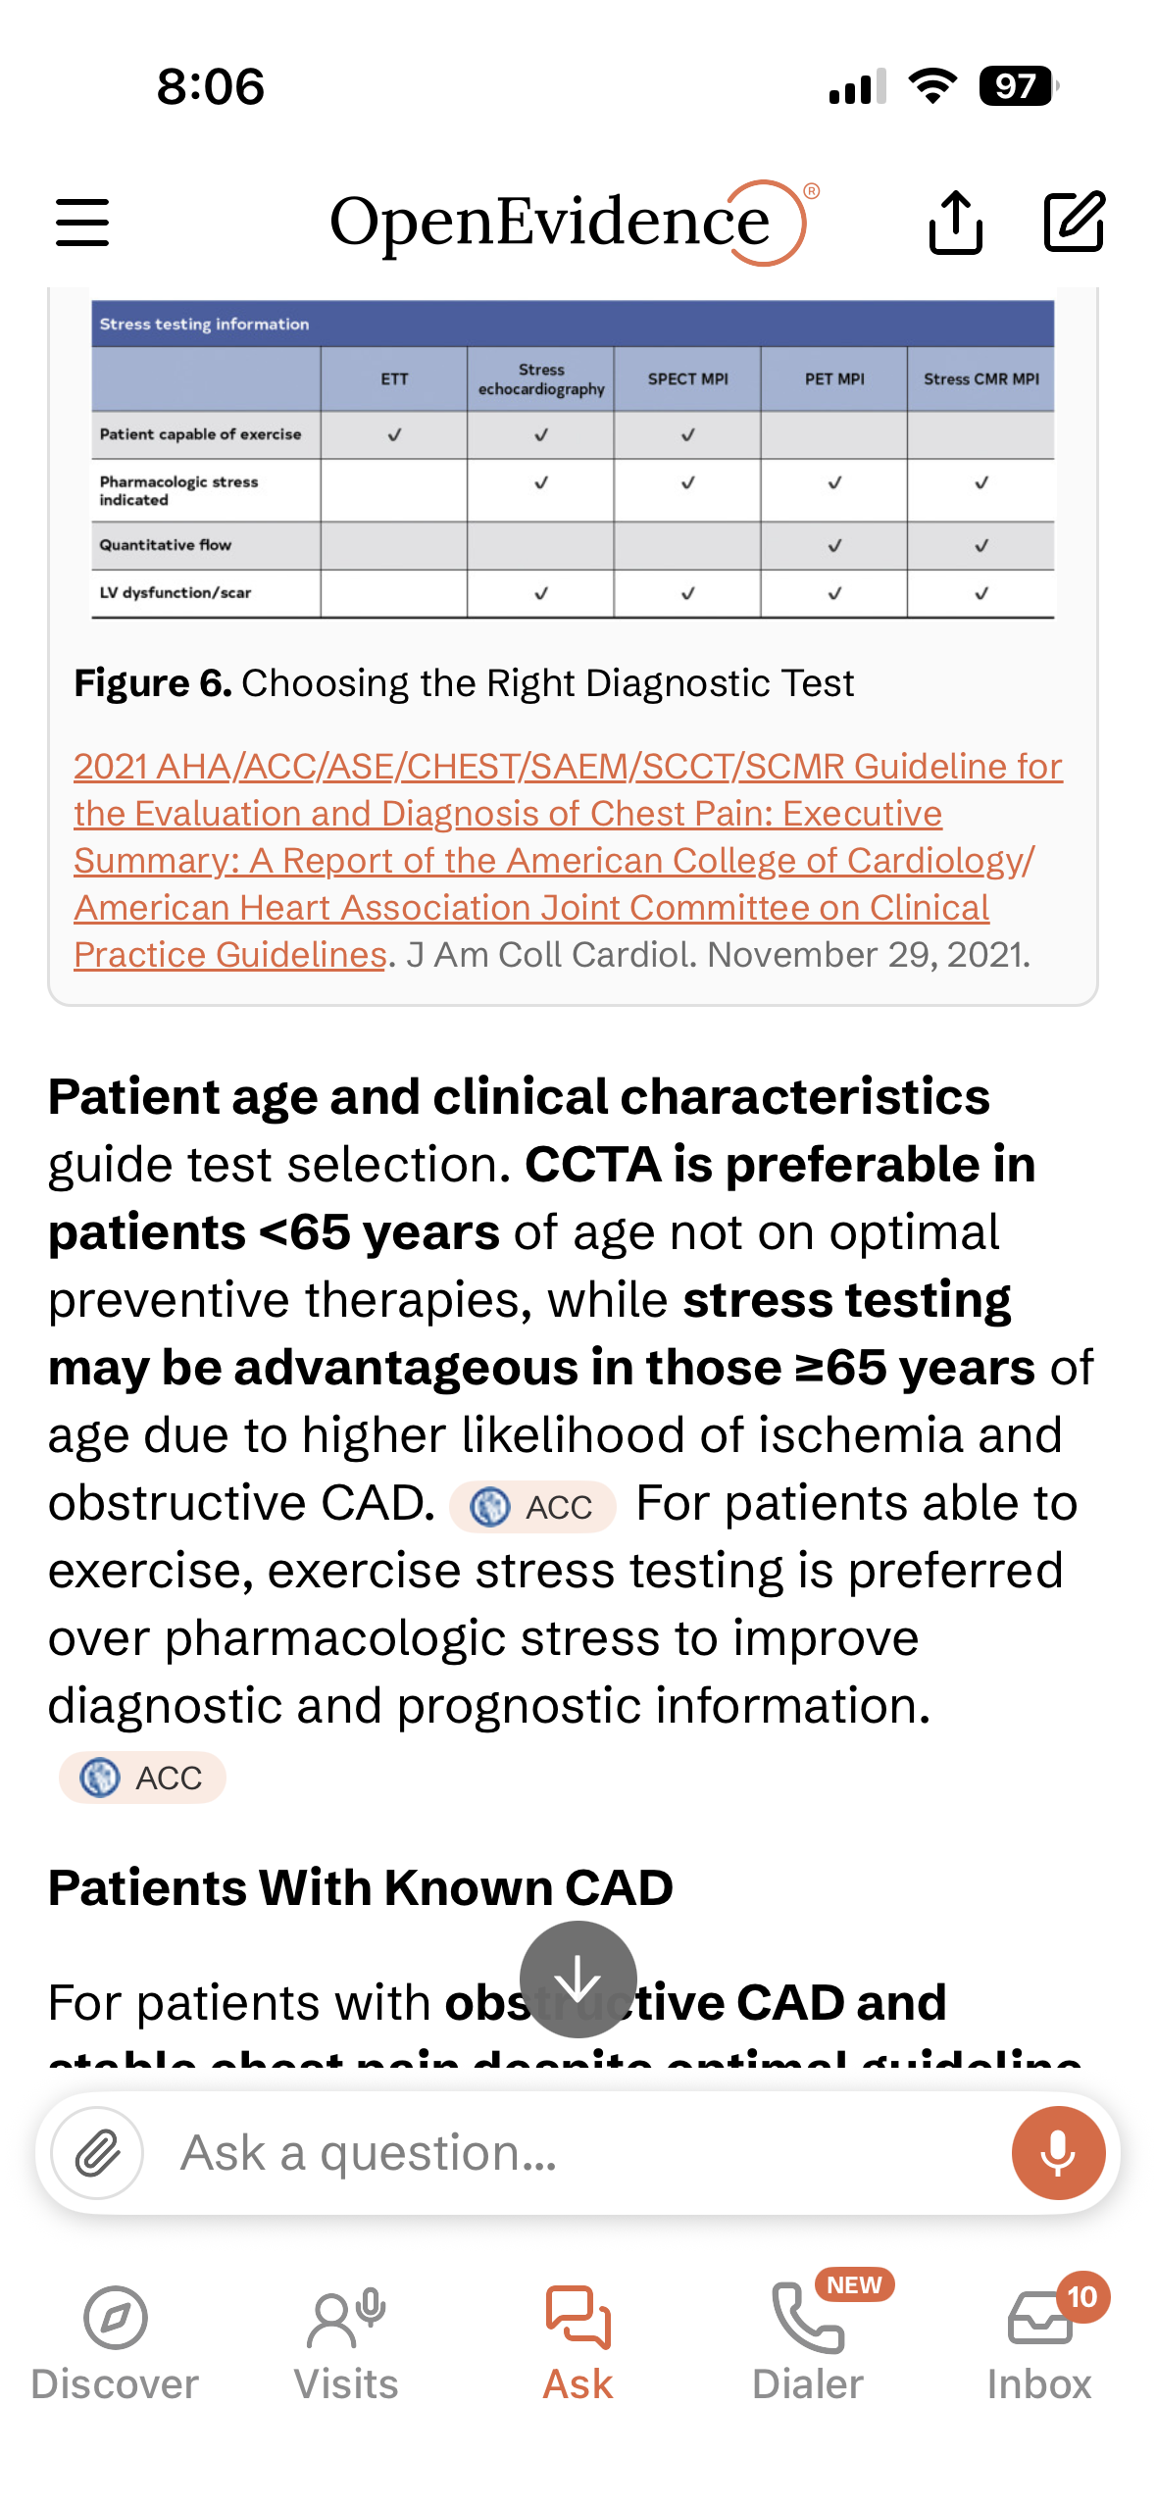
Open Evidence

Slide 18
What is the question?
What question are we trying to answer? Cause of chest pain?
What is the outcome we are interested in?
What risk does the test have to the patient?
What benefit does the test have to the patient?
Is there evidence to suggest this is the next best step?
Does the outcome of the test benefit the patient?
Does the outcome of the test benefit what the patient wants?
How good is the test at answering the question compared to another test?
If we do the test, when should we do it?
Admit to the hospital for stress test or follow up for one?
What do we do with the results of the test?
……

Slide 19
The Structure: PICO (TT)
The question that you ask should be relevant to a specific patient or the problem at hand. The PICO framework links your question to the search by helping you identify individual concepts that should appear in relevant articles and can be used to formulate a search strategy for those articles.
P - population, patient, problem - What are the most important characteristics of the patient or population?
I - intervention, exposure - What is the main intervention or exposure of interest?
C - comparison (if applicable) - Is there an alternative intervention or exposure being considered?
O - outcome - What is being measured, improved, or affected?
T - type of question (eg., therapy, harm, prognosis, diagnosis)
T - type of study (eg., RCT, cohort, case control)

Slide 20
Types of Foreground Clinical Questions
Therapy: determining the effect of interventions on patient-important outcomes (symptoms, function, morbidity, mortality, and costs)
Harm: ascertaining the effects of potentially harmful agents (including therapies from the first type of question) on patient-important outcomes
Differential diagnosis: in patients with a particular clinical presentation, establishing the frequency of the underlying disorders
Diagnosis: establishing the power of a test to differentiate between those with and without a target condition or disease
Prognosis: estimating a patient's future course
Prevention: determining if an intervention prevents a specific outcome

Slide 21
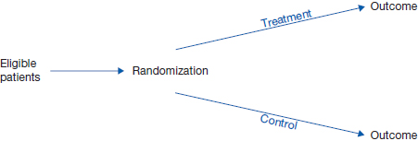
Finding a Suitably Designed Study for Your Question Type
Randomized Clinical Trial
Therapy
Citation: Chapter 4 What Is the Question?, Guyatt G, Rennie D, Meade MO, Cook DJ. Users' Guides to the Medical Literature: A Manual for Evidence-Based Clinical Practice, 3rd ed; 2015. Available at: https://jamaevidence.mhmedical.com/content.aspx?bookid=847&sectionid=69031460 Accessed: July 06, 2022
Copyright © 2022 American Medical Association. All rights reserved

Slide 22
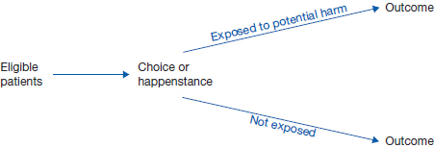
Finding a Suitably Designed Study for Your Question Type
Observational Cohort
Harm
Citation: Chapter 4 What Is the Question?, Guyatt G, Rennie D, Meade MO, Cook DJ. Users' Guides to the Medical Literature: A Manual for Evidence-Based Clinical Practice, 3rd ed; 2015. Available at: https://jamaevidence.mhmedical.com/content.aspx?bookid=847&sectionid=69031460 Accessed: July 06, 2022
Copyright © 2022 American Medical Association. All rights reserved

Slide 23

Finding a Suitably Designed Study for Your Question Type
Differential Diagnosis
Prospective Cohort
Citation: Chapter 4 What Is the Question?, Guyatt G, Rennie D, Meade MO, Cook DJ. Users' Guides to the Medical Literature: A Manual for Evidence-Based Clinical Practice, 3rd ed; 2015. Available at: https://jamaevidence.mhmedical.com/content.aspx?bookid=847&sectionid=69031460 Accessed: July 06, 2022
Copyright © 2022 American Medical Association. All rights reserved

Slide 24
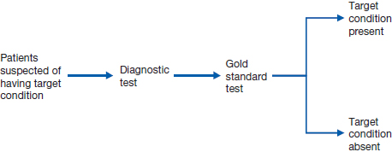
Finding a Suitably Designed Study for Your Question Type
Prospective blind comparison to gold standard
Diagnostic Test
Citation: Chapter 4 What Is the Question?, Guyatt G, Rennie D, Meade MO, Cook DJ. Users' Guides to the Medical Literature: A Manual for Evidence-Based Clinical Practice, 3rd ed; 2015. Available at: https://jamaevidence.mhmedical.com/content.aspx?bookid=847&sectionid=69031460 Accessed: July 06, 2022
Copyright © 2022 American Medical Association. All rights reserved

Slide 25
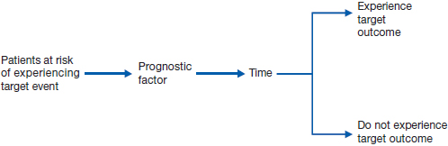
Finding a Suitably Designed Study for Your Question Type
Prognosis
Observational Cohort
Citation: Chapter 4 What Is the Question?, Guyatt G, Rennie D, Meade MO, Cook DJ. Users' Guides to the Medical Literature: A Manual for Evidence-Based Clinical Practice, 3rd ed; 2015. Available at: https://jamaevidence.mhmedical.com/content.aspx?bookid=847&sectionid=69031460 Accessed: July 06, 2022
Copyright © 2022 American Medical Association. All rights reserved

Slide 26
Revisit our chest pain question?
Break it down into components that can be answered
Diagnosis
Prognosis
Diagnostic test
Harm

Slide 27
Diagnosis
In patients with significant risk factors for acute coronary syndrome, does obtaining a stress test help establish the diagnosis compared to serial troponin testing?
P: patients with risk factors for ACS
I: stress test
C: serial troponin testing
O: correct diagnosis

Slide 28
Diagnostic Test
In patients with significant risk factors for coronary artery disease, does a stress test have a higher sensitivity for making the diagnosis compared to a coronary CTA?
P: patients with risk factors for CAD
I: stress test
C: coronary CTA
O: sensitivity of the test compared to gold standard

Slide 29
Prognosis
In patients with significant risk factors for coronary artery disease, does obtaining an inpatient stress test decrease the risk of 30 day mortality from cardiac causes compared to an outpatient stress test.
P: patients with risk factors for ACS
I: stress test in the hospital
C: outpatient follow up stress test
O: mortality

Slide 30
Harm
In patients with significant risk factors for coronary artery disease, does obtaining an stress test increase unnecessary downstream testing causing patient harm
P: patients with risk factors for ACS
I: stress test
C: no stress test
O: complications from procedures

Slide 31
Refining the question
Work in your table groups
Take the initial question, and refine it into a question that is answerable
Use the PICO format
Think about Therapy, Harm, DDx, Diagnostic Testing, Prognosis

Slide 32
www.vcuultrasound.com/question

Slide 33
Refining the question
A 55-year-old white woman presents with type 2 diabetes mellitus and hypertension. Her glycemic control is excellent with metformin, and she has no history of complications. To manage her hypertension, she takes a small daily dose of a thiazide diuretic. During a 6-month period, her blood pressure is 155/88 mm Hg.
Initial Question: When treating hypertension, at what target blood pressure should we aim?

Slide 34
Refining the question
A previously well although heavy drinker, 55-year-old man presents to the emergency department with an episode of transient loss of consciousness. On the evening of presentation, he had his usual 5 beers and started to climb the stairs at bedtime. The next thing he remembers is being woken by his son, who found him lying near the bottom of the stairs. The patient took about a minute to regain consciousness and remained confused for another 2 minutes. His son did not witness any shaking, and there had not been any incontinence. Physical examination findings were unremarkable; the electrocardiogram revealed a sinus rhythm with a rate of 80/min and no abnormalities. Glucose, sodium, and other laboratory results were normal.
Initial Question: How extensively should I investigate this patient?

Slide 35
Refining the question
A 60-year-old man with a 40-pack-year smoking history presents with hemoptysis. A chest radiograph shows a parenchymal mass with a normal mediastinum, and a fine-needle aspiration and biopsy of the mass reveals non–small cell carcinoma. Aside from hemoptysis, the patient is asymptomatic, and the physical examination results are normal.
Initial Question: What investigations should we undertake before deciding whether to offer this patient surgery?

Slide 36
www.vcuultrasound.com/question

Slide 37
Refining the question
A 55-year-old white woman presents with type 2 diabetes mellitus and hypertension. Her glycemic control is excellent with metformin, and she has no history of complications. To manage her hypertension, she takes a small daily dose of a thiazide diuretic. During a 6-month period, her blood pressure is near 155/88 mm Hg.
Initial Question: When treating hypertension, at what target blood pressure should we aim?
Improved (Searchable) Question: Therapy
P
I
C
O
T

Slide 38
Refining the question
A 55-year-old white woman presents with type 2 diabetes mellitus and hypertension. Her glycemic control is excellent with metformin, and she has no history of complications. To manage her hypertension, she takes a small daily dose of a thiazide diuretic. During a 6-month period, her blood pressure is near 155/88 mm Hg.
Initial Question: When treating hypertension, at what target blood pressure should we aim?
Improved (Searchable) Question: Therapy
Patients: Patients with hypertension and type 2 diabetes without diabetic complications.
Intervention/Exposure: Any antihypertensive agent that aims at a target diastolic blood pressure of 90 mm Hg.
Comparator: Target diastolic blood pressure of 80 mm Hg.
Outcomes: stroke, myocardial infarction, cardiovascular death, and total mortality.

Slide 39
Refining the question
A previously well, although a heavy drinker, 55-year-old man presents to the emergency department with an episode of transient loss of consciousness. On the evening of presentation, he had his usual 5 beers and started to climb the stairs at bedtime. The next thing he remembers is being woken by his son, who found him lying near the bottom of the stairs. The patient took about a minute to regain consciousness and remained confused for another 2 minutes. His son did not witness any shaking, and there had not been any incontinence. Physical examination findings were unremarkable; the electrocardiogram revealed a sinus rhythm with a rate of 80/min and no abnormalities. Glucose, sodium, and other laboratory results were normal, and a blood alcohol test result was negative.
Initial Question: How extensively should I investigate this patient?
Differential Diagnosis Improved Question
P
I
C
O

Slide 40
Refining the question
Initial Question: How extensively should I investigate this patient?
Differential Diagnosis Improved Question
Patients: Middle-aged patients presenting with transient loss of consciousness.
Intervention: Thorough investigation and follow up for common and less common diagnoses.
Comparator: Minimal investigation and close follow up
Outcomes: Frequency of underlying disorders, such as vasovagal syncope, seizure, and transient ischemic attack.

Slide 41
Refining the question
Initial Question: How extensively should I investigate this patient?
Prognosis: Improved question
P
I
C
O

Slide 42
Refining the question
Initial Question: How extensively should I investigate this patient?
Prognosis: Improved question
Patients: Middle-aged patients presenting with transient loss of consciousness.
Exposure/Comparison: Time.
Outcomes: Morbidity (complicated arrhythmias or seizures, strokes, or serious accidents) and mortality in the year after presentation.

Slide 43
Refining the question
Initial Question: How extensively should I investigate this patient?
Diagnostic test: Improved question
P
I
C
O

Slide 44
Refining the question
Initial Question: How extensively should I investigate this patient?
Diagnostic test: Improved question
Patients: Middle-aged patients presenting with loss of consciousness with concern for underlying arrhythmia
Intervention: admission for telemetry
Comparator: outpatient event monitor
Outcomes: Cardiac event 90 days after presentation

Slide 45
Refining the question
A 60-year-old man with a 40-pack-year smoking history presents with hemoptysis. A chest radiograph shows a parenchymal mass with a normal mediastinum, and a fine-needle aspiration and biopsy of the mass reveals non–small cell carcinoma. Aside from hemoptysis, the patient is asymptomatic, and the physical examination results are normal.
Initial Question: What investigations should we undertake before deciding whether to offer this patient surgery?
Therapy:
P
I
C
O

Slide 46
Refining the question
Therapy:
Patients: Newly diagnosed non–small cell lung cancer with no evidence of extrapulmonary metastases
Intervention: surgery for excision
Comparator: chemo and radiation
Outcome: 5-year survival, quality of life, complications

Slide 47
Refining the question
Diagnosis:
Patients: Newly diagnosed non–small cell lung cancer with no evidence of extrapulmonary metastases
Intervention: PET-CT
Comparator: Alternative diagnostic strategies
Outcome: Unnecessary thoracotomy

Slide 48
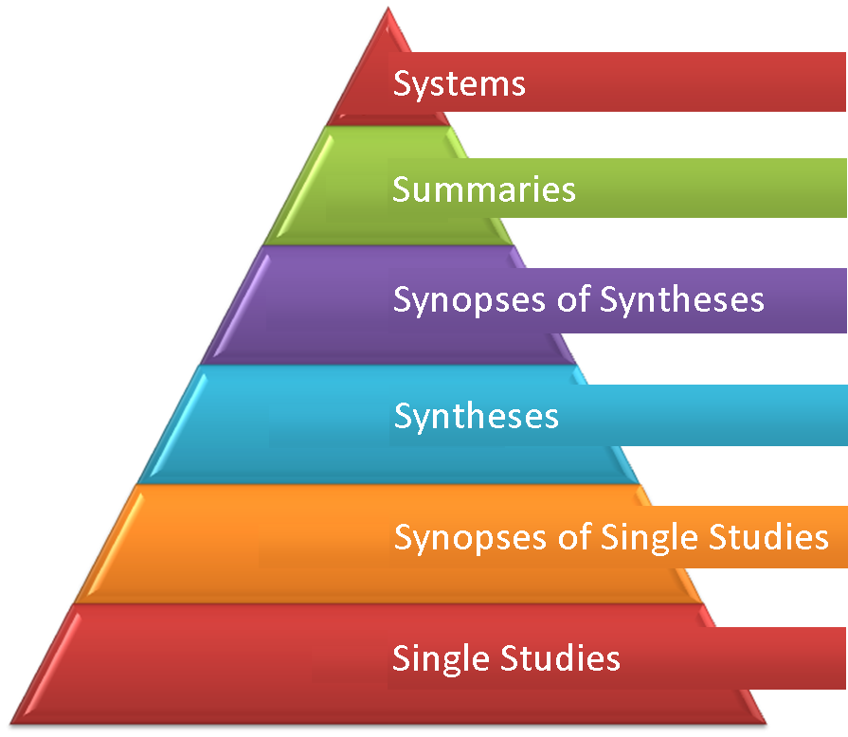
Where do I find the evidence?
After you have clarified your question, where should you search for the answer?
Start with the evidence pyramid
[Adapted from DiCenso, Bayley and Haynes (2009). ACP Journal Club. Editorial: Accessing pre-appraised evidence: Fine-tuning the 5S model into a 6S model. Annals of Internal Medicine, 151(6):JC3-2, JC3-3.]
Notes:
A single study examines a specific question in a limited population and results may not be relevant to other groups.
A synopsis summarizes evidence from a high-quality study or set of studies; synopses of multiple studies provide stronger evidence than synopses of a single study.
A synthesis, or systematic review is a comprehensive summary of all the evidence for a specific question.
Summaries are clinical guidelines or textbooks that are updated routinely to reflect complete and updated information about clinical issues.
Systems populated by many, many individual patient records represent the ideal source of evidence.

Slide 49
Use pre-appraised evidence first
The M3 clerkship guide can help you find resources:
https://guides.library.vcu.edu/clerkships
Resources like UpToDate provide access to evidence-based summaries of clinical topics that can answer background and provide a starting place for foreground questions.
Meta-analyses, RCTs, cohort studies, case control studies, case reports, and reviews can all be found in databases like Pubmed

Slide 50
Future sessions:
Ask a question
Acquire evidence
critically Appraise evidence
Apply evidence
Assess EBM process

Slide 51
Big take home points
It is VERY important that you understand what question to ask
This is an essential skill that separates you as a doctor from the rest of the care team and allows you to make the decisions and lead the care for your patients
Remember to think in terms of therapy, diagnosis, testing, prognosis, and harm.
There is no one right answer for any patient scenario, always remember the importance of patient preference and patient centered outcomes, not just the outcomes of specific trials

Slide 52
Logistics
Take the quiz by Sunday at midnight in VidaNova
5 questions – could do it now!
Enjoy M3 year, ask lots of questions, remain skeptical

