Slide 1

Crossword
ITE Image Review Crossword
Notes:
https://crosswordlabs.com/embed/em-17779
https://crosswordlabs.com/view/em-17779

Slide 2
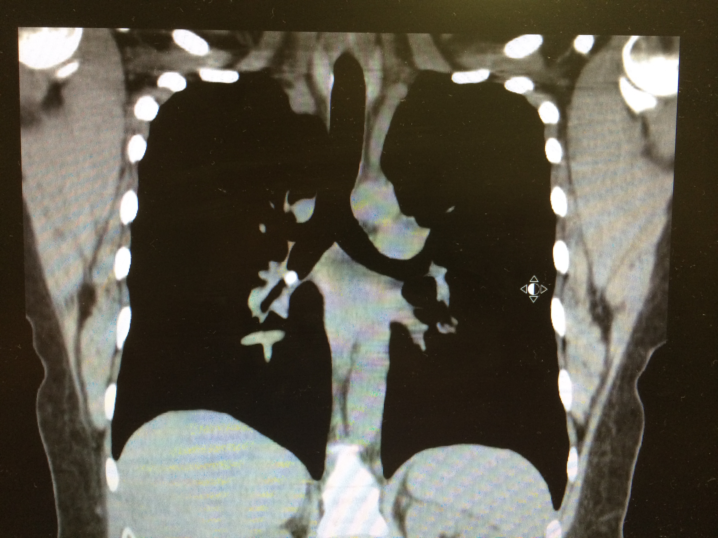
1 DOWN
How do you manage me
Notes:
Can I go home and finish my M&M’s? What is the management?

Slide 3
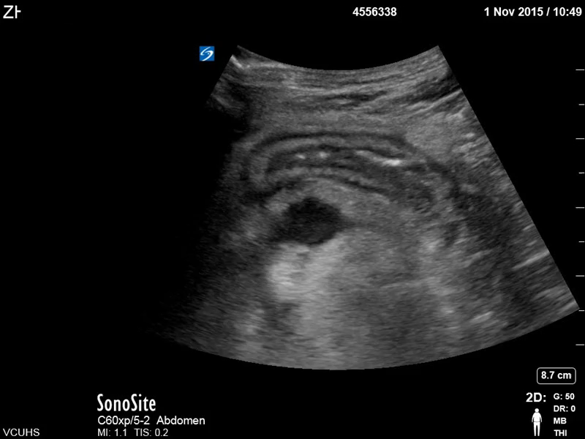
The condition seen here is classically mimicked by what infectious bacteria?
2 Down
Notes:
Asnwer: Yersinia enterocolitica
50

Slide 4
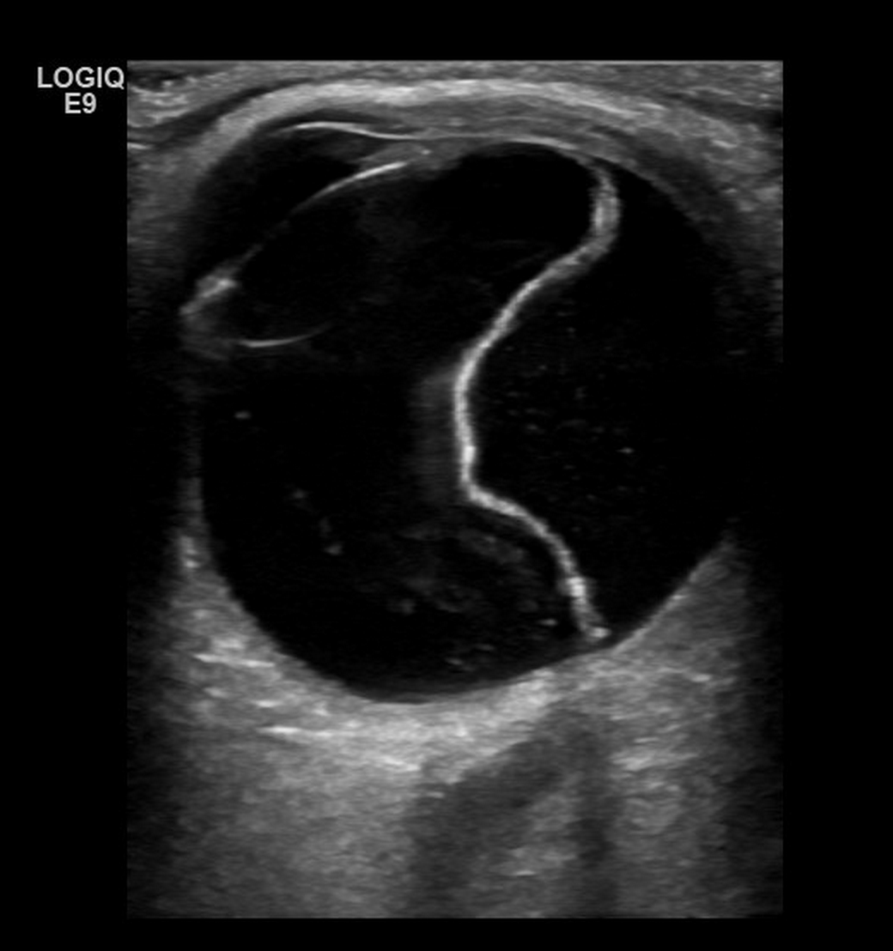
3 Down
When the ______ is spared. This is considered an ophthalmologic emergency.
Notes:
Echogenic band posteriorly
Usually associated with vitreous hemorrhage
Still visible with low gain
Can’t see on still image
Retina – whole membrane → peeling away from the choroid
Tetherated at optic nerve and ora serrata
Must be able to see optic nerve sheath to diagnosis the difference between PVD and RD
Thick Echogenic band posteriorly
Usually associated with vitreous hemorrhage
Attaches to the optic disc and the ora serrata
Still visible with low gain
Dynamic Scan → retina has little movement and is fixed at either the optic nerve or ora serrata
A 31yo male presents to the ED after being punched in the left eye during a bar fight. On exam, EOMI, cornea is normal. You do an ocular ultrasound, what is the most likely diagnosis?
When there is ______ involvement it becomes a ophthalmology emergency?

Slide 5
4 Down
C2 > 6mm and C6 > 22mm
Notes:
C2 = 6mm
C6 = 22mm

Slide 6
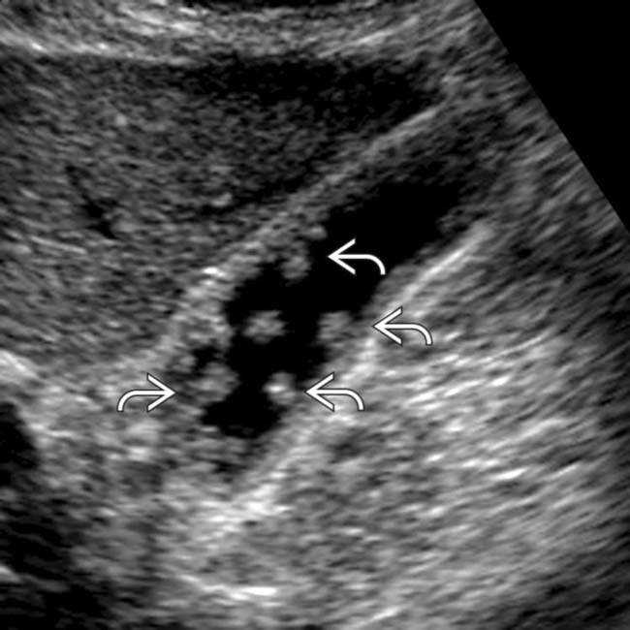
5 Down
No rolling here
Notes:
POLYPS

Slide 7
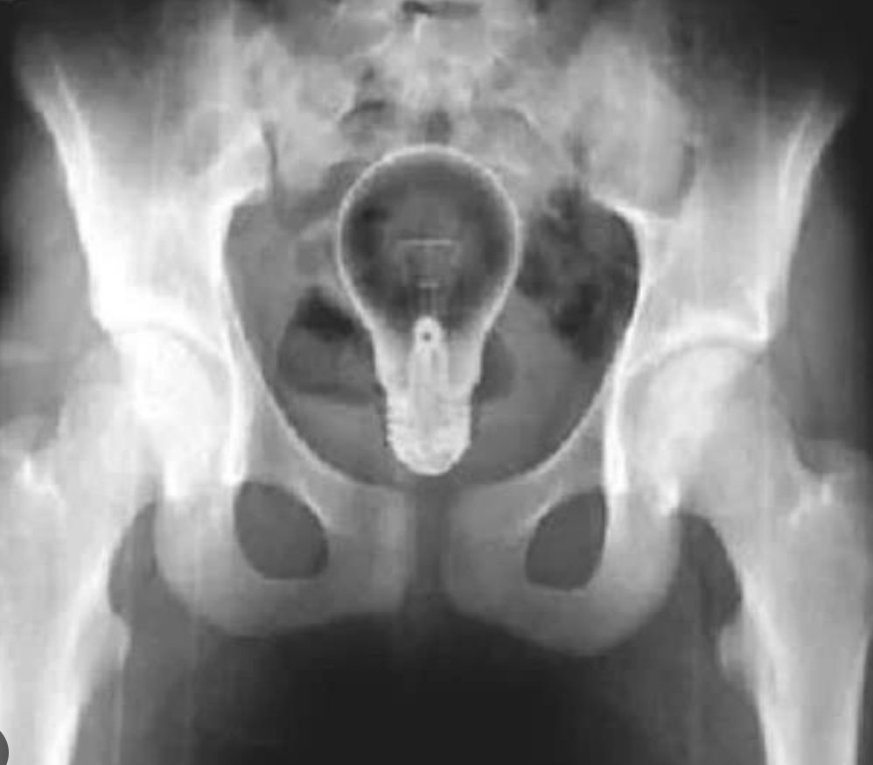
What did this patient “fall” onto?
6 Down
WHAT DID THIS PATIENT “FALL” ONTO?

Slide 8
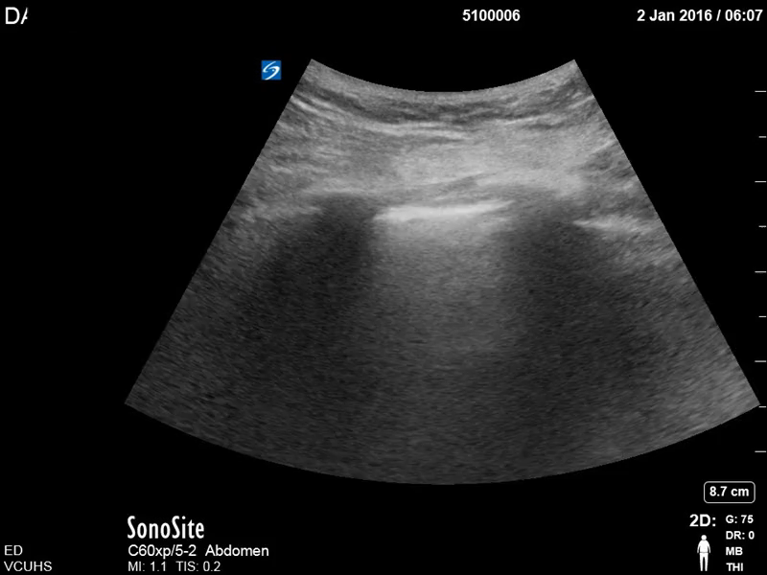
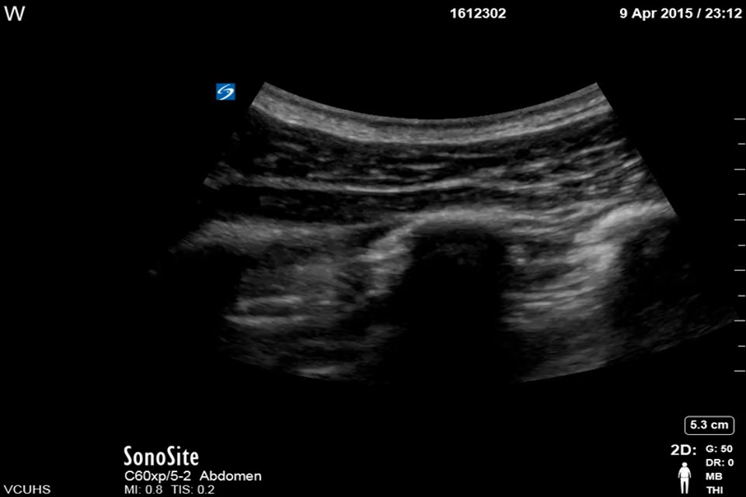
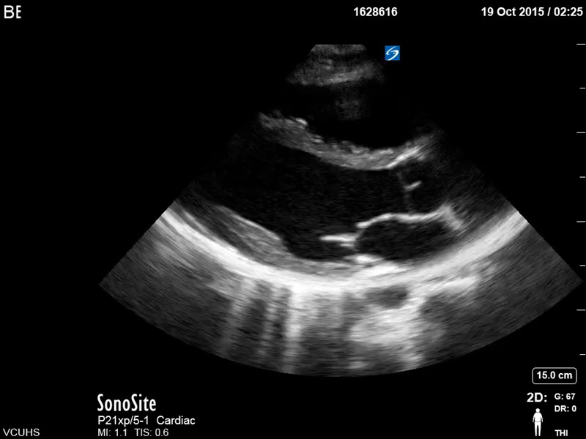
DYSPNEA
7 Across
Notes:
PTX

Slide 9
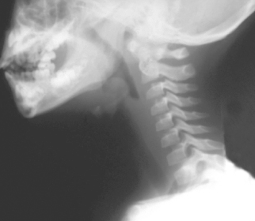
8 Across
(USED) TO BE THE MOST COMMON CAUSE
Notes:
Drooling, What bacteria used to be the most common cause?
Hib
Haemophilus influenza type b

Slide 10
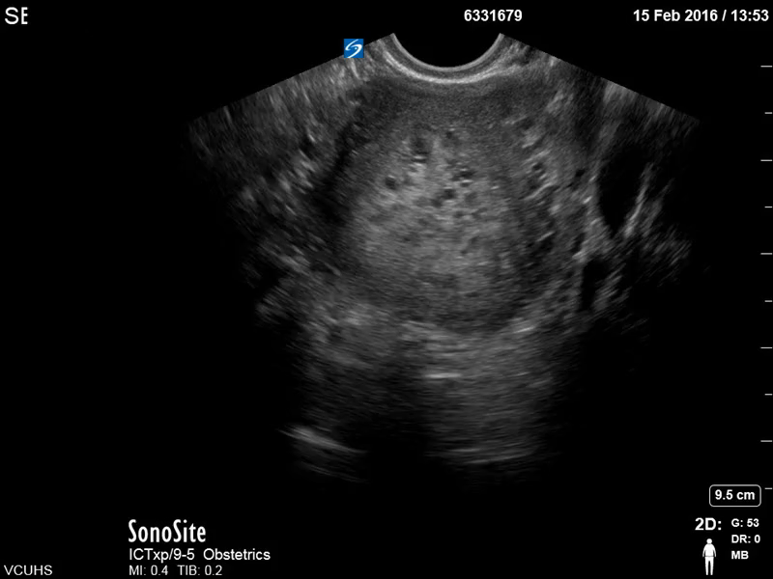
9 Down
Notes:
Molar Pregnancy

Slide 11
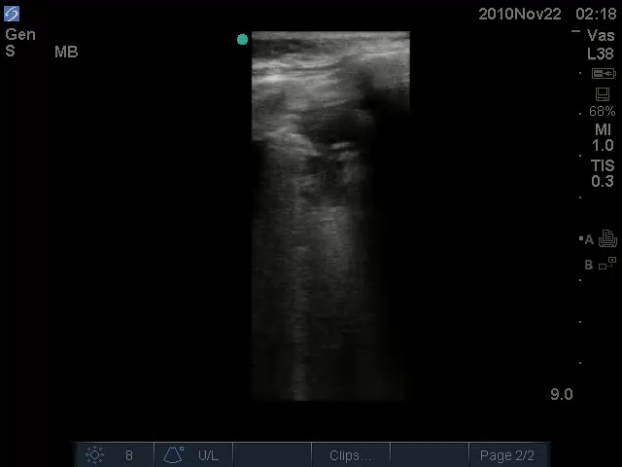
Abbreviation for this disease
10 Down
Notes:
PNA

Slide 12
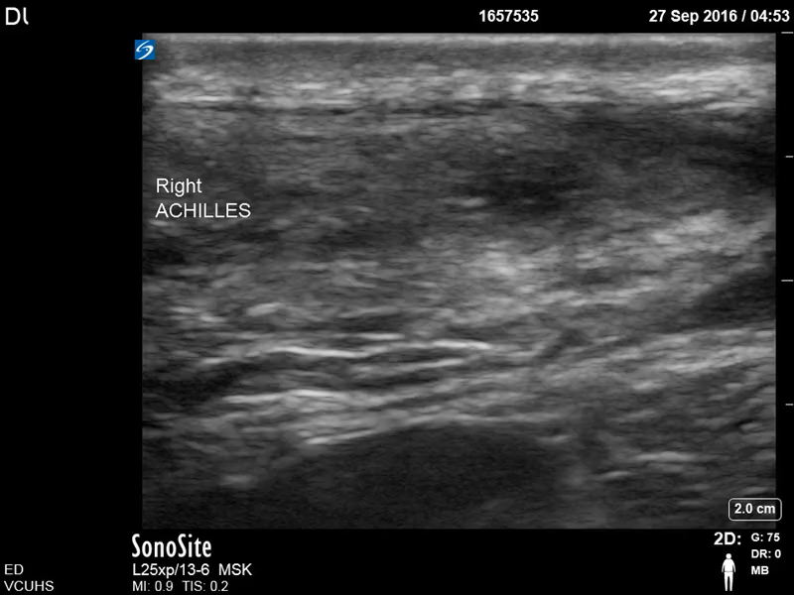
11 Down
PHYSICAL EXAM NAME
Notes:
Splint 20° Plantar Flexion

Slide 13
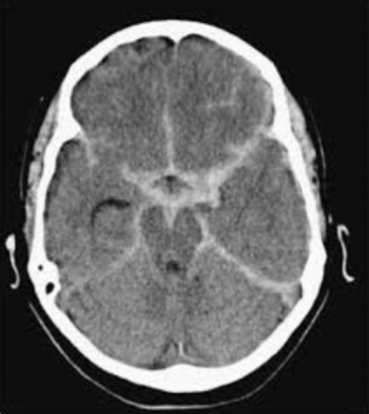
12 Across
Notes:
Thunderclap
CT within 6 hours + LP

Slide 14
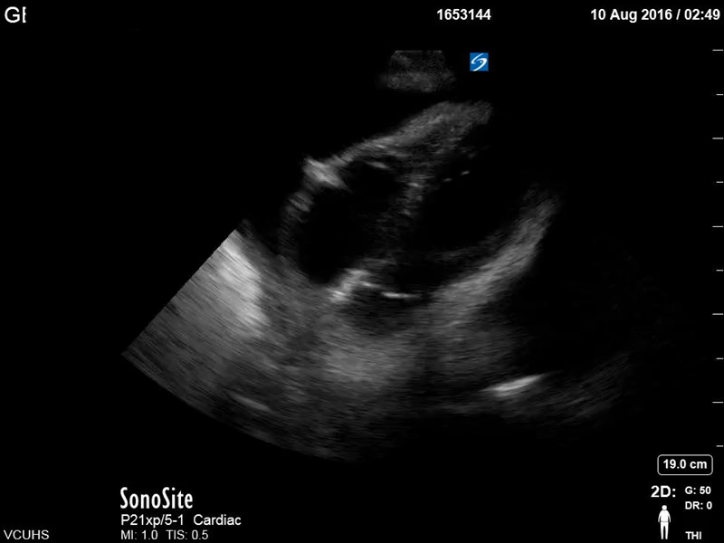
Save me!
13 Down
Notes:
Pericadrial tamponade – needs pericardiocentesis
Most sen
Most sensitive for the detection of tamponade:RA collapse during systole
RV collapse during diastole

Slide 15
Rubbing his thigh will not raise This ball!
14 Down
Notes:
Rubbing his thigh will not raise this roof…
What is the reflex called? Cremasteric

Slide 16
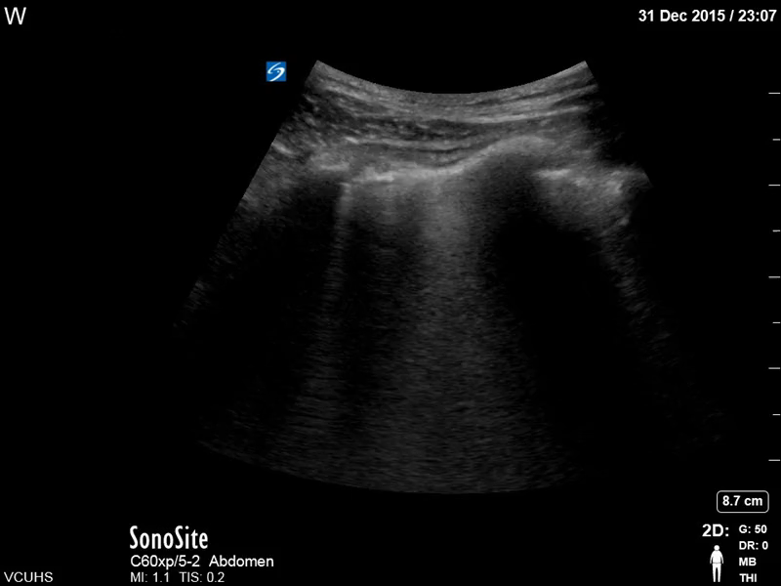
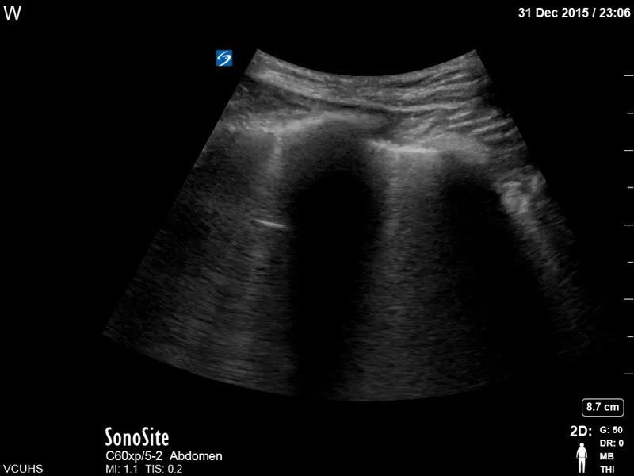
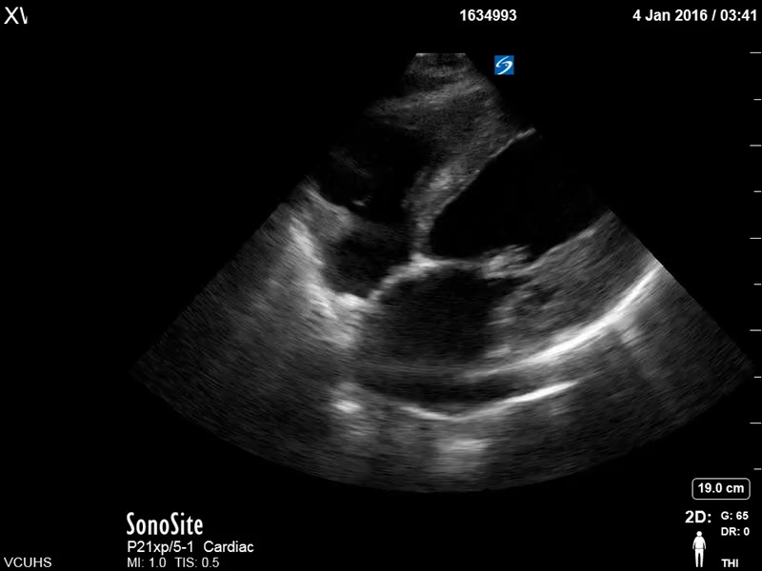
Abbreviation for this disease
15 Down
Notes:
CHF

Slide 17
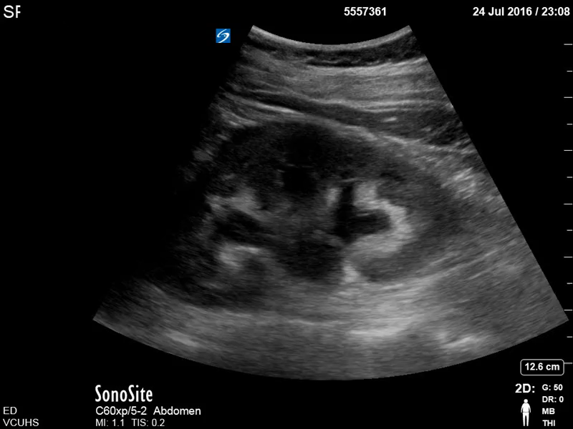
16 Across
Notes:
Mild Hydronephrosis
A 46yo man presents with right flank pain and a history of confirmed nephrolithiasis

Slide 18
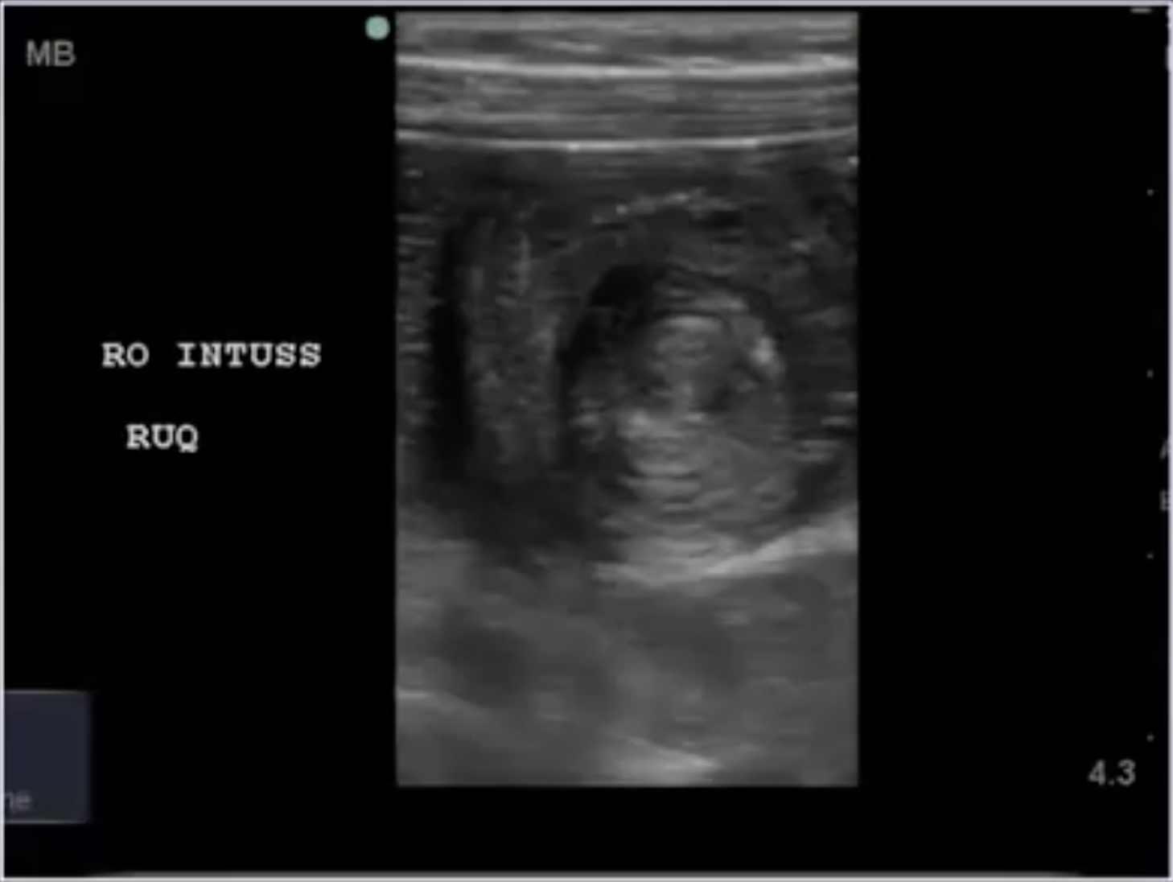
17 down
What procedure can alleviate this pathology?
Notes:
Donut or target sign
Invaginated bowels
Contrast enema

Slide 19
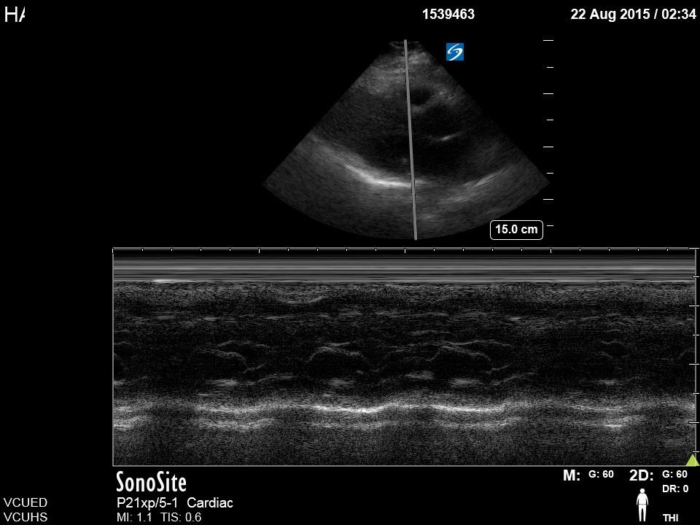
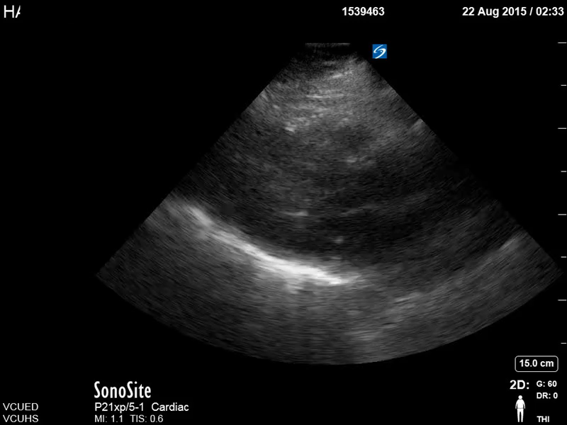

A maneuver to accentuate the murmur
18 Down
Notes:
The answer is Valsalva maneuever. This ultrasounds demonstrate HOCM. The image on the RIGHT demonstrates atrial septal hypertrophy (ASH) with systolic anterior motion (SAM) of the anterior mitral valve leaflet

Slide 20
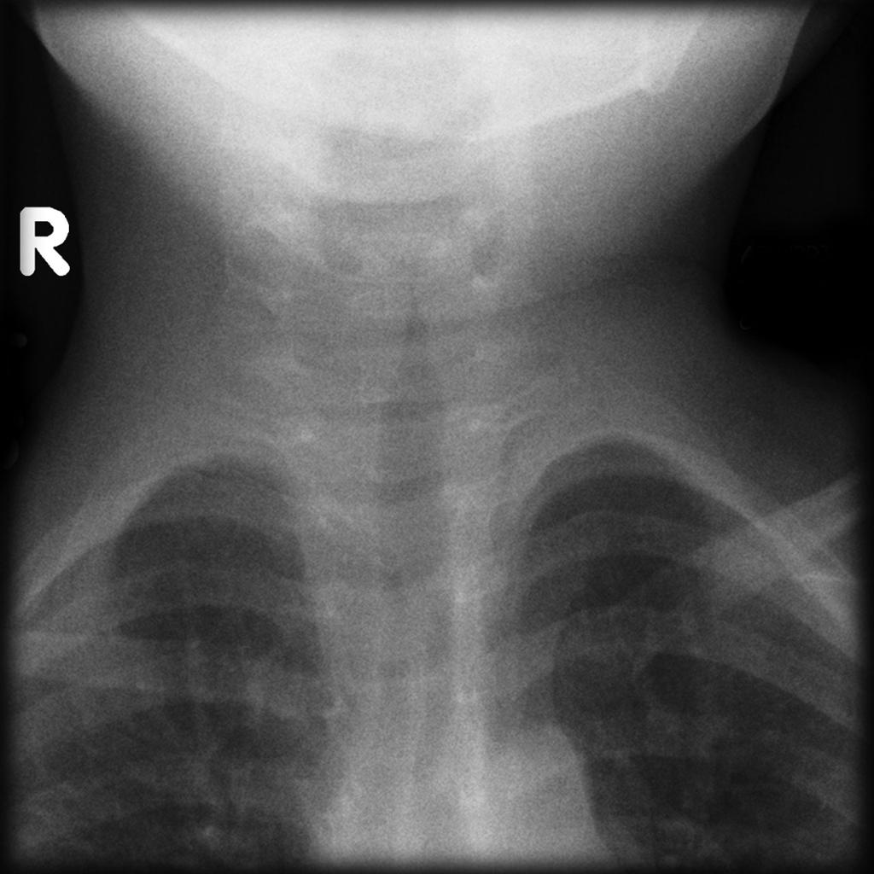
19 Down
_____ Sign
Notes:
Take me to church: Croup
What is the virus?

Slide 21
20 Down
Notes:
Old and twisted

Slide 22
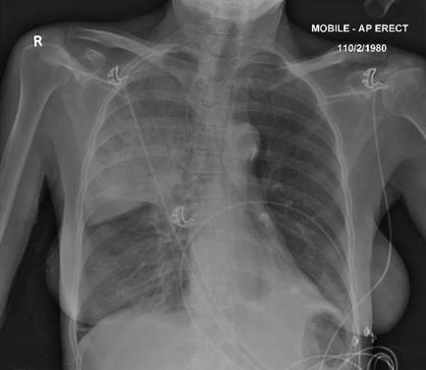
21 Across
I DRINK A 5TH OF VODKA DAILY

Slide 23
Definitive management?
22 Across
Notes:
Blood: compartment syndrome on the eye
Treatment?
Lateral Canthotomy and Inferior (+/- Superior) Cantholysis

Slide 24
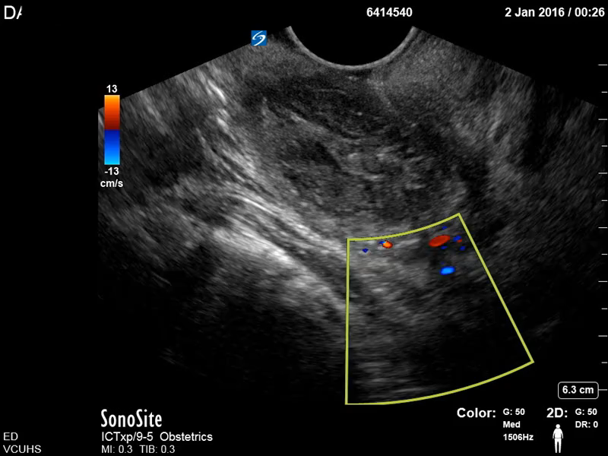
Avoid this
23 Across
Notes:
When performing this procedure what structure are you trying to avoid?
Carotid Artery

Slide 25
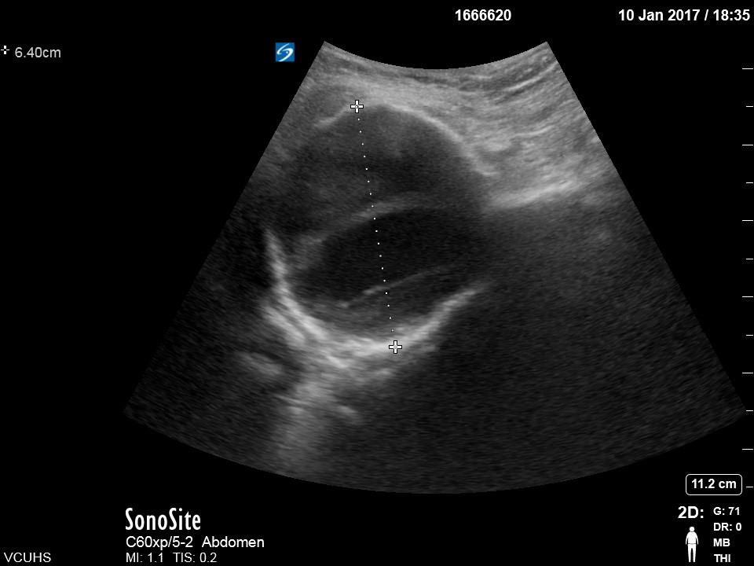
24 Down
What is the most common location of this pathology?
Notes:
What is the most common location of this pathology?
Short-acting IV beta-blockers such as labetalol or esmolol are ideal, with esmolol preferred if the subject is potentially intolerant of beta-blockers (chronic obstructive pulmonary disease, bradycardia, congestive heart failure). The goal heart rate is 60-80 bpm. No data for calcium-channel blockers exists, but IV dihydropyridines such as nicardipine may be used to reduce blood pressure. Vasodilators such as nitroprusside may be necessary to decrease systolic blood pressure to 100-120 mm Hg once heart rate is controlled.⁵

Slide 26
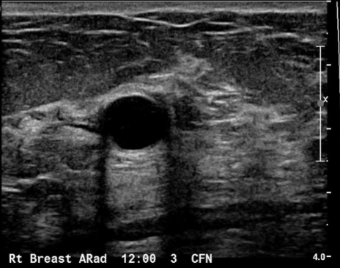
What is this artifact called?
25 Across
Notes:
What artifact is present on this image? EDGE
Refraction artifact
usually occurs at the interface of reflective medium to an anechoic medium
image the object in different planes

Slide 27
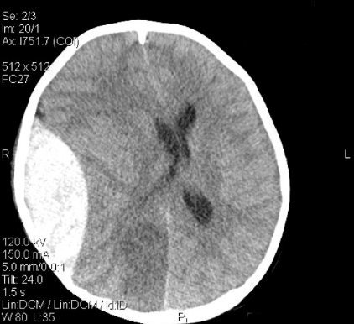
Definitive management?
26 Across
Notes:
Definitive management in the ED?
Burr Hole

Slide 28
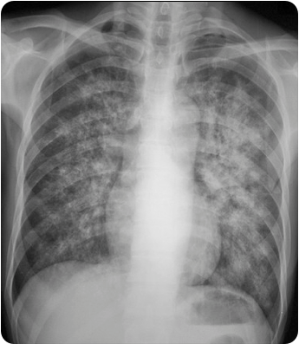
27 Across
Not the kind you smoke…
Notes:
Not the kind you smoke: PCP
What is the CD 4 count? <200

Slide 29
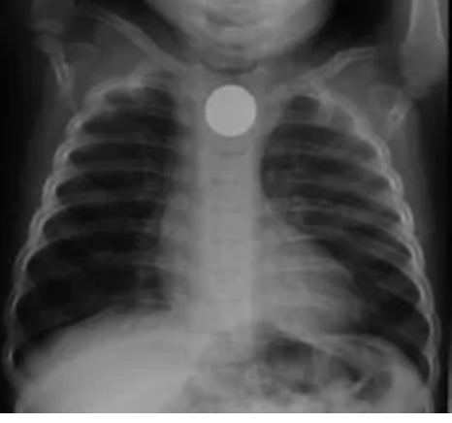
28 Down
LOCATION
Notes:
Wrong Pipe

Slide 30
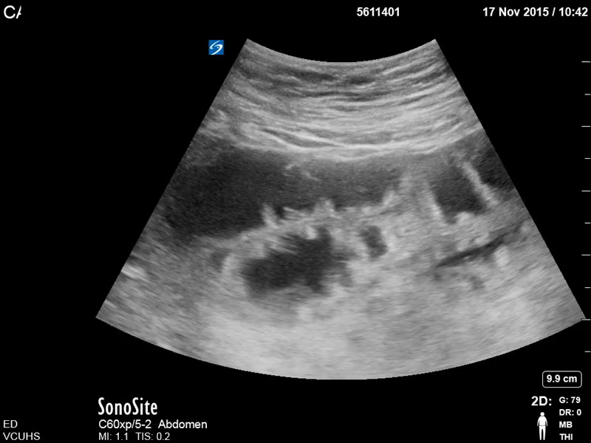
WHAT IS THE MOST COMMON CAUSE OF THE CONDITION?
29 Across
Notes:
Adhesions > Hernia

