Slide 1
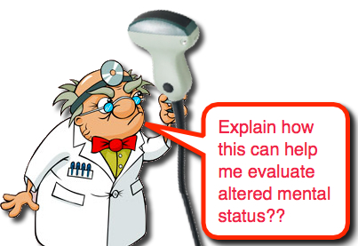
CPC - AMS

Slide 2
HPI
68 yo gentleman who was in his usual state of health until last night when his wife noticed he was acting funny, apparently he was walking around with a gun, stating he was hearing voices and that there were intruders. There were no intruders. His wife called police, who called psych crisis response, who then took him to chesterfield stabilization unit. She denied any drug or alcohol use or prior psychiatric disease. He was there overnight on a TDO with no improvement. The TDO was expiring this morning and they sent him here for further evaluation. On route, he kept screaming for help and was very combative. EMS administered Geodon to help with this. On arrival, he was saying “help me”, but then as the Geodon kicked in he became sedated and no further history was obtained.

Slide 3
Vitals
HR 101
BP 129/76
86% RA, 98% NRB
22 bbp
36.7
No PMH

Slide 4
PE
Skin: Warm, diaphoretic.
Head: Normocephalic, atraumatic.
Neck: Supple, trachea midline.
Eye: Normal conjunctiva, L pupil is 4mm and reactive, R pupil is 2mm and reactive, pupilar defect
Cardiovascular: Regular rate and rhythm, No edema.
Respiratory: Respirations are non-labored, expiratory wheezing bilaterally .
Gastrointestinal: Soft, Nontender, Guarding: Negative, Rebound: Negative.
Musculoskeletal: Normal ROM, no deformity.
Neurological: alert/oriented. pt fell asleep shortly after arrival , Not Alert and oriented to person, place, time, and situation, minimally responsive to sternal rub

Slide 5
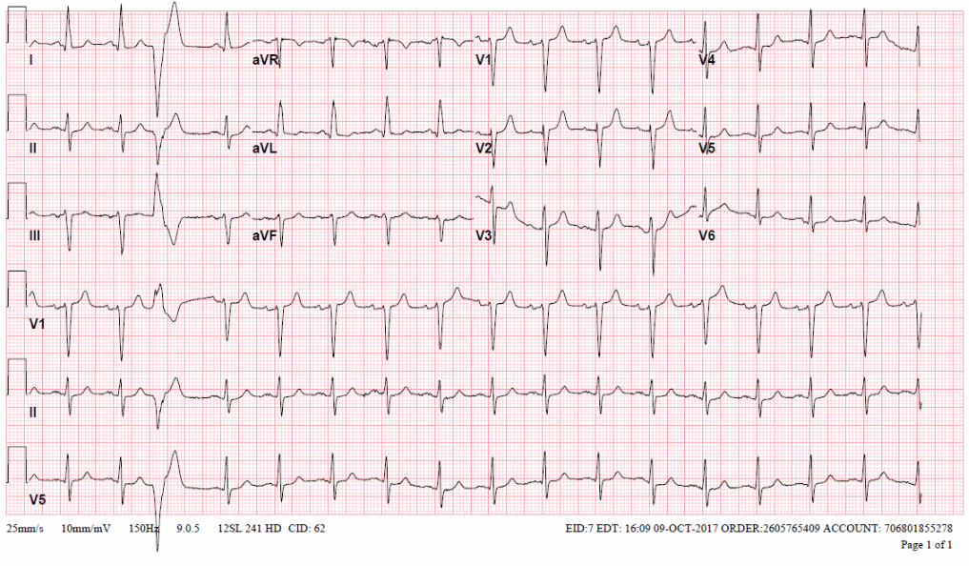

Slide 6
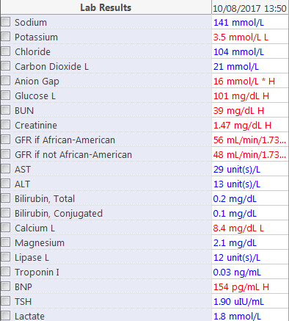
Labs

Slide 7
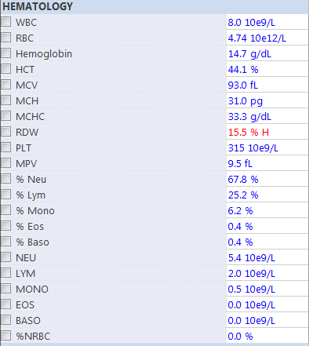
Labs

Slide 8
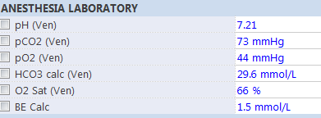
Labs

Slide 9
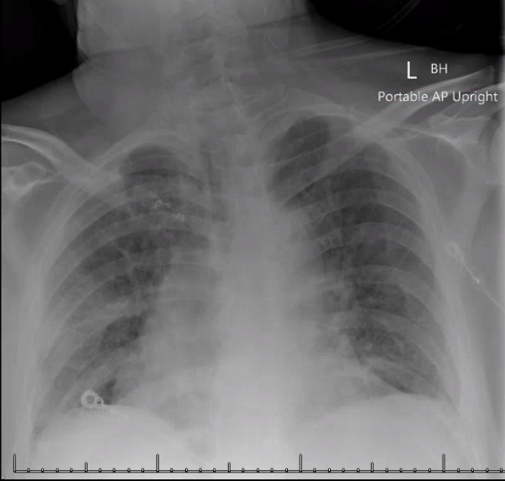
Imaging

Slide 10
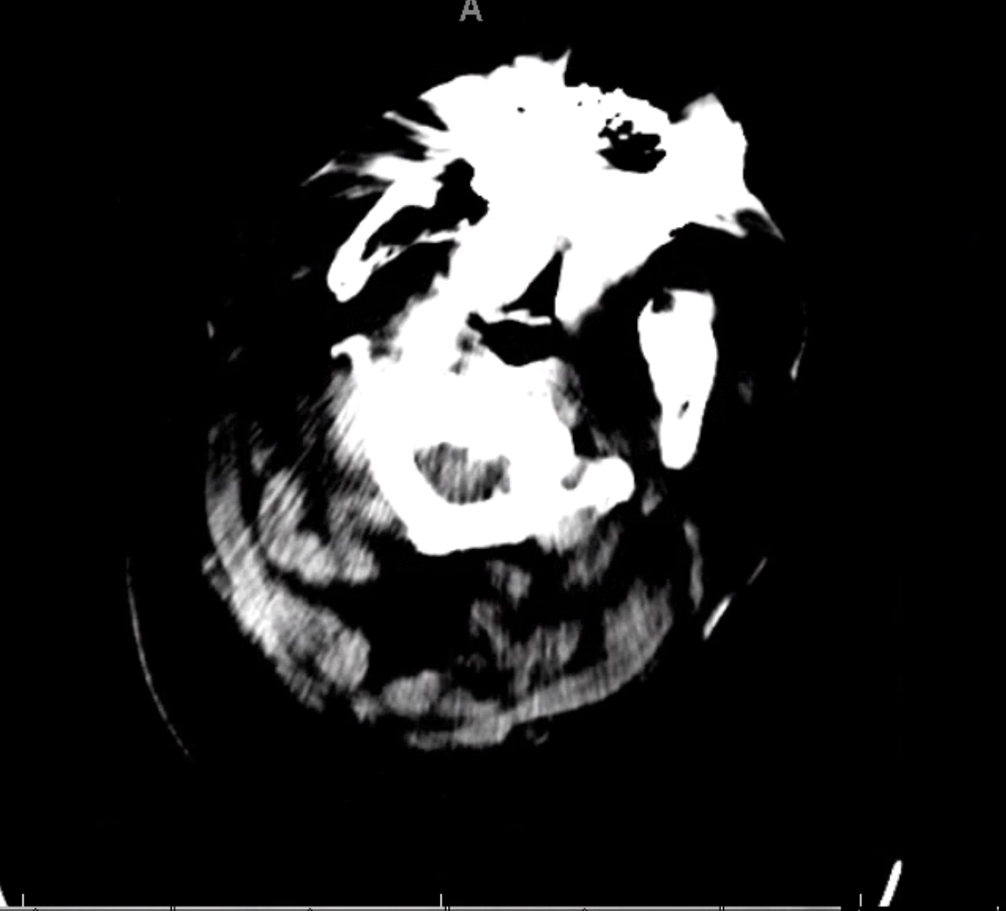
Imaging

Slide 11

Who can solve this?

Slide 12
DDx: ACS
+ Altered, tachycardic, diaphoretic, hypoxic
+ Wheezing on lung exam could be related to pulmonary edema
No ischemia on EKG
Negative troponin

Slide 13
DDx: New onset heart failure
+ Altered, tachycardic, diaphoretic, hypoxic
+ Wheezing on lung exam could be related to pulmonary edema
BNP only minimally elevated
No edema on physical exam
No past medical history

Slide 14
DDx: Pneumonia
+ Altered, tachycardic, diaphoretic, hypoxic
+ Wheezing on lung exam
Afebrile, no cough reported
No obvious consolidation on CXR
Doesn’t quite explain bilateral wheeze

Slide 15
DDx: PE
+ Altered, tachycardic, diaphoretic, hypoxic
+ Could be altered from hypoxia
Doesn’t explain bilateral wheeze or hypercarbia
No signs of DVT on physical exam
No stated risk factors

Slide 16
DDx: SAH
+ Altered, old
+ Pupillary defect
Doesn’t explain wheezing, acidosis
No other neurologic deficits
No obvious bleed on head CT

Slide 17
DDx: Carotid artery dissection
+ Old, altered
+ Anisocoria
Doesn’t explain wheezing, acidosis
No other neurologic deficits
No reports of neck pain

Slide 18
DDx: Uremia
+ Altered
+ AKI
+ Acidotic
Only minor AKI
Acidosis appears to be a respiratory acidosis
Doesn’t explain other symptoms

Slide 19
DDx: ethylene glycol toxicity
+ Altered
+ Acidotic
+ AKI
+ Ethylene glycol can cause cranial nerve palsies
Doesn’t explain wheeze
Acidosis appears to be a respiratory acidosis
Why is gramps drinking antifreeze?

Slide 20
DDx: Bronchiolitis
+ Altered, tachycardic, diaphoretic, hypoxic
+ Bilateral wheezing on lung exam
+ CXR looks diffusely fluffy
+ Hypercarbia from air trapping → acidemia
Afebrile
No cough reported
Doesn’t explain anisocoria
Notes:
Other stuff:
Hyperglycemia/hypoglycemia
UTI
Drugs or other tox
Psych

Slide 21
Final answer:
Flu/COVID/RSV swab
Altered mental status secondary to hypoxic/hypercarbic respiratory failure from RSV infection
(and his eyes are weird and he has an AKI from dehydration)

Slide 22

And the answer is….?

Slide 23



Slide 24
Aspirin Toxicity
Basics
  Aspirin is rapidly converted to salicylic acid
  The therapeutic range of salicylate concentration for anti-inflammatory effects is between 15 and 30 mg/dL. (150-300mg/L)
  Concentrations higher than 30mg/dL (300mg/L) can be associated with signs and symptoms of toxicity

Slide 25
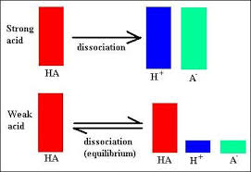
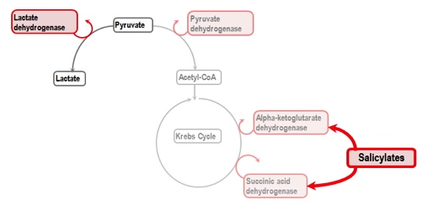
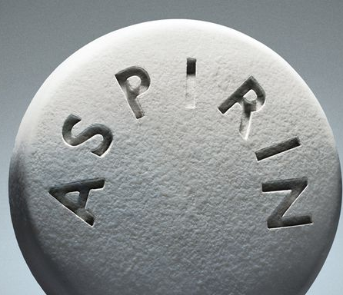
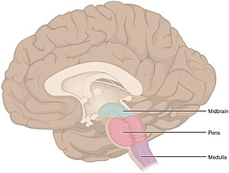
Aspirin Toxicity
Notes:
Salicylic acid → uncouple oxidative phosphorylation → increase in lactic acid/pyruvic acid → AG acidosis
Salicylic acid →respiratory drive in the medulla → leading to a primary respiratory alkalosis
Salicylic acid is a weak acid: exists mostly in charged/ionized state at physiologic pH. As pH decreases, shifts more towards uncharged/ non-ionzed state and can cross blood-brain barrier to worsen neurotoxicity

Slide 26


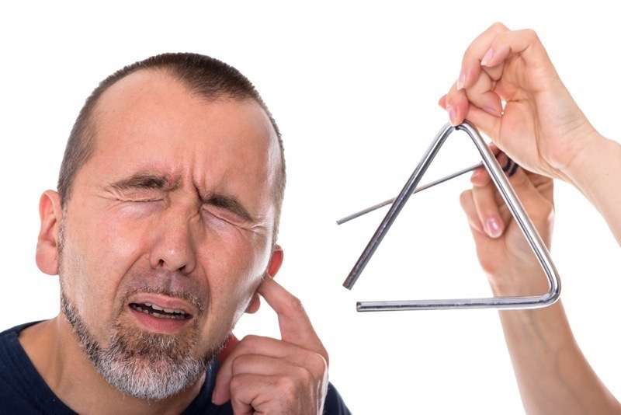

Aspirin Toxicity
Signs and Symptoms
Our Patient:
RR: 22
Tinnitus: ?
AMS:

Slide 27

Aspirin Toxicity
Diagnostics
Blood Gas:
  Classical finding: primary metabolic acidosis with primary respiratory alkalosis
  Patients will often present with normal pH to slightly alkalemic
  Patients who are acidemic on presentation are more likely to be critically ill

Slide 28
Aspirin Toxicity
Diagnostics
BMP:
  Look for elevated anion gap metabolic acidosis
  Acute kidney injury
  Hypokalemia secondary to acidemia

Slide 29

Aspirin Toxicity
Diagnostics
Toxicology
  Serum salicylate concentration
  Acetaminophen concentration

Slide 30

Aspirin Toxicity
Management
  ABC’s, IV, O2
  GI decontamination (awake, alert)
  Alkalinization with Sodium Bicarbonate
pH

Slide 31
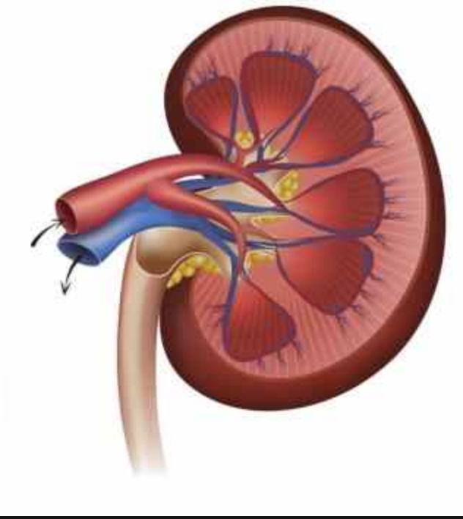
Aspirin Toxicity
Management
  ABC’s, IV, O2
  GI decontamination (awake, alert)
  Alkalinization with Sodium Bicarbonate
pH

Slide 32
Aspirin Toxicity
Management
Bicarbonate:
    Start with 1-2 mEq/kg bolus followed by a drip
      1 AMP is equal to 50mL of 8.4% sodium bicarbonate 1mEq/mL, or 50mEq of NaHCO3–
    Bicarb drip can be made with 3 ampules of NaHCO3– (150 mEq) in one liter of D5W
    Do not make bicarb drip with normal saline because this will be hypertonic solution due to sodium in sodium bicarbonate
    Run bicarb drip at 1.5-2X maintenance.
    Goal serum pH around 7.55, urine pH 8.0

Slide 33
Aspirin Toxicity
Management
Airway
  Tachynpnea alone not indication – it is protective
    In our case potentially got worse with the geodon
  Avoid intubation if possible – even more acidic
  Indications: hypoxia, pulmonary edema, hypoventilation/tiring out, worsening acidosis
      Ventilator settings very important post-intubation
        Need to match minute ventilation of patient pre-intubation to prevent respiratory acidosis
        High tidal volumes and high rate needed

Slide 34
Aspirin Toxicity
HD?
  If unable to appropriately alkalinize and eliminate salicylate with bicarbonate, HD may be indicated
  Consult nephrology early to be able to ensure prompt HD
  Indications: persistent altered mental status, renal/hepatic/cardiac failure, persistent acidemia, requiring intubation
  No definite cutoff for salicylate concentration requiring HD, however acute toxicity patients with concentrations greater than 80(0) or 100(0) mg/dL will likely require HD
  In chronic salicylate toxicity, may require HD at much lower levels

Slide 35
Case completion
Tox consult in the ED, recommened bicarb 2 AMP push, 40meq K, then 3 AMPs sodium bicarb with 1 liter D5W at 150/hr, careful not to fluid overload given CXR findings. Consult HD for dialysis.
Pt went to ICU, renal was consulted, ASA started clearing rapidly on bicarb drip and mental status improved, so held off on HD.
Since it was powder and not pills, no concern for delayed absorption and clears relatively quickly

