Slide 1

Population Health M3
An introduction to evidence based medicine for patient care
Michael Joyce, MD, FACEP

Slide 2
Housekeeping:
Quiz will be open immediately after this lecture, and open until Wednesday at 11:59pm
The quiz is short 4 questions that you will be able to answer easily if paid attention to presentation
Please remember to take the quiz!

Slide 3


The Evidence Cycle
EBM

Slide 4


The Evidence Cycle
https://guides.library.vcu.edu/clerkships
EBM

Slide 5
The Evidence Cycle
Takes continued practice and makes you a life long learner!
Remember basics from M1/M2 Pop heath on dissecting the medical literature
We will go through some articles together
EBM

Slide 6
The Evidence Cycle
What decision am I making?
Diagnosis
Therapy
Harm
Prognosis
EBM
Today:
Making the Diagnosis!

Slide 7
Goals and Objectives
Today’s goals:
  Stress the importance of applying testing appropriately
  Remember that NO TEST IS PERFECT and all tests need to be interpreted with stats (sounds miserable, but I’ll show you it is not!)
  Remove the words ruled out from our vocabulary
  Understand the concept of LR + and LR -
  Practice applying to a patient case
  Remember that memorizing equations wastes brain space, better to understand how to apply them, we all have smart phones

Slide 8
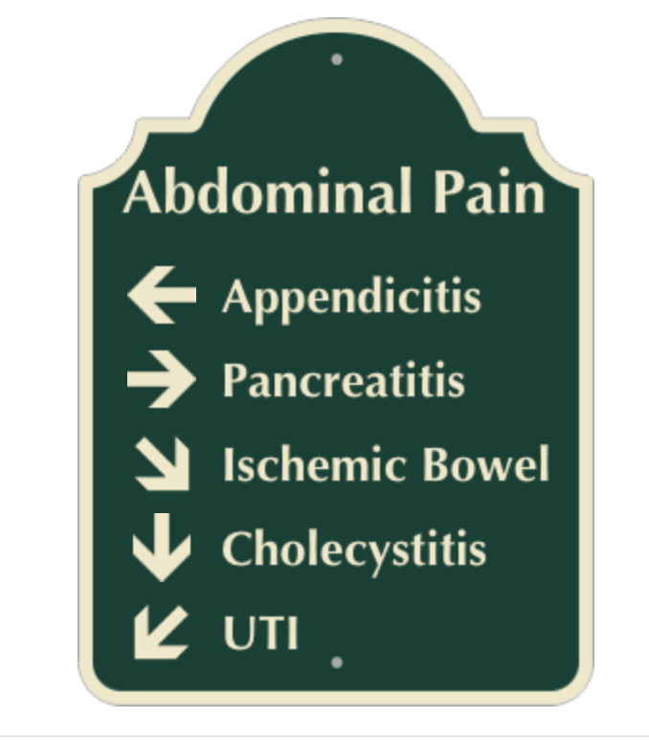
Today’s Road Map: making the diagnosis

Slide 9
Today’s Road Map: making the diagnosis
Ultrasound, CT
HPI, Labs, CT
Labs, CTA, laproscopy
Ultrasound, HIDA, MRCP
POCT UA, Urinalysis, Urine culture

Slide 10
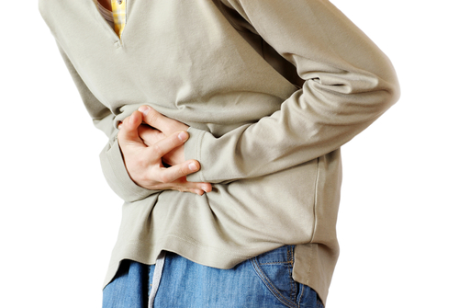
Consider the case:
You are a physician working in the ED and you’ve just evaluated a 16yoM brought in by his parents for abdominal pain which began yesterday. It’s gradually worsening. Pain began 36hrs ago and is located near his belly button. He developed a fever of 38.2 and feels nauseated with loss of appetite. No trauma. He’s vomited twice and had 1 loose stool today. Says abdomen hurts when he’s walking.
Physical exam: No fever, normal vital signs. Appears ill and moves w/o discomfort.
Lungs are clear
Normal bowel sounds, tender everywhere including right lower area
Rest of exam is unremarkable.
Labs:
WBC 14,000
60% neutrophils
Urine normal

Slide 11

How likely is it that he has appendicitis?

Slide 12
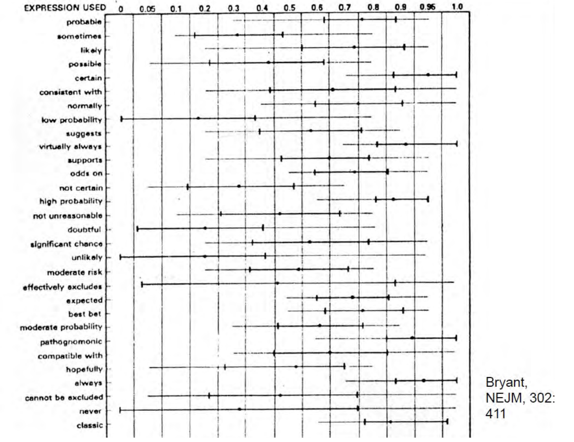
Expressions of Probability: Words and Numbers

Slide 13
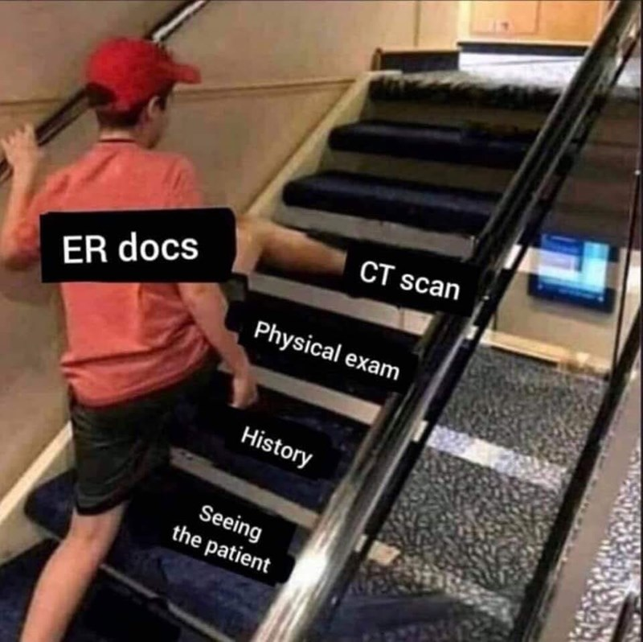

So what test should I order?!

Slide 14
Before you order any test, you need to know - how good is the test??
Sensitivity
Specificity
Positive Predictive Value
Negative Predictive Value
NO TEST IS PERFECT
Notes:
This is not enough information!

Slide 15
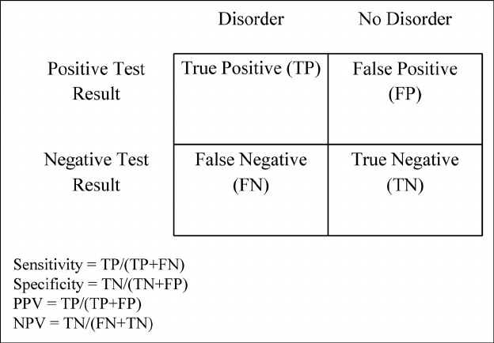
Ways that we can assess test performance:
  Sensitivity - ability of a test to yield a positive result for a subject that has that disease
  Specificity- ability of the test to obtain normal range or negative results for a person who does not have a disease
  Positive predictive value - proportion of patients with positive test who actually have the disease,
  Negative predictive value - proportion of patients with negative test who are actually free of the disease
  These values are useful for telling us when we have a result, how good is that result.
  Limitations:
  Sensitivity – ignores false positives
  Specificity – ignores false negatives
  PPV / NPV – perform different based on the prevalence of disease
  But the major limitation of these values, is they do not tell us WHEN to use a test!
  If only there were a better way?!
Notes:
This is not enough information!

Slide 16
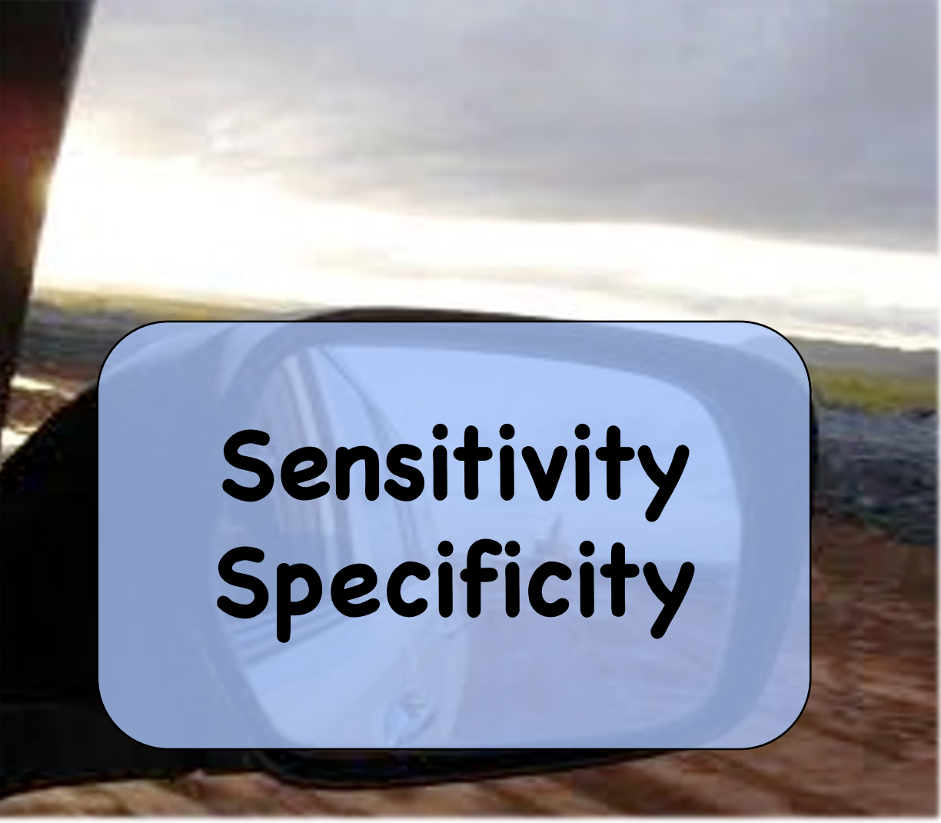


Slide 17
Likelihood ratios to the rescue!
What is a likelihood ratio?
Allows us to decide if performing a test usefully increases or decreases the chance of making the diagnosis
Takes into consideration pre-test probability, and helps us convert into a post-test probability
Two forms of likelihood ratio exist, positive and negative, known as LR+ and LR-

Slide 18
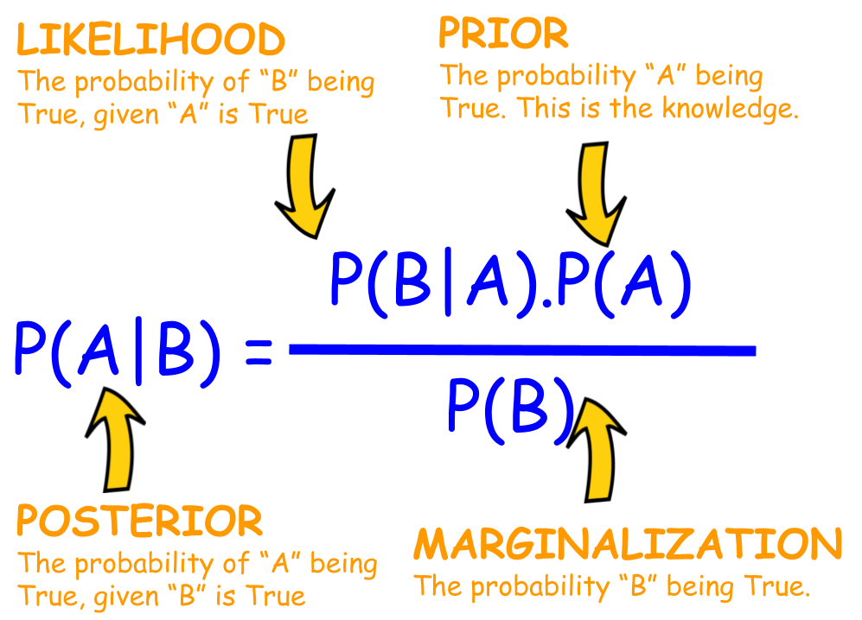
Bayes Theorem

Slide 19
Bayes Theorem Explained – statistics are fluid!
Bayes theorem allows us to use context in statistics
Let’s take a simple yes/no test: the UPT
What if I were to tell you a UPT pregnancy test is 99% sensitive and 99% specific?
That is a great test! (but not perfect)
So you order and get a pregnancy test result back, and it is positive!
What is the chance this was a false positive?

Slide 20
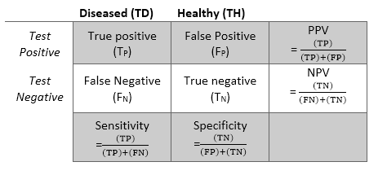
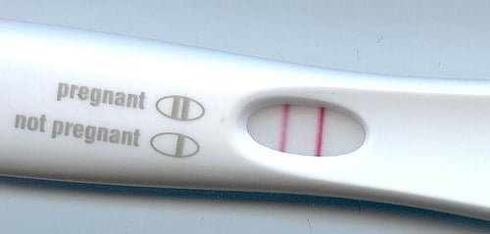
99%
99%
99
1
1
99
What is the chance this was a false positive?

Slide 21

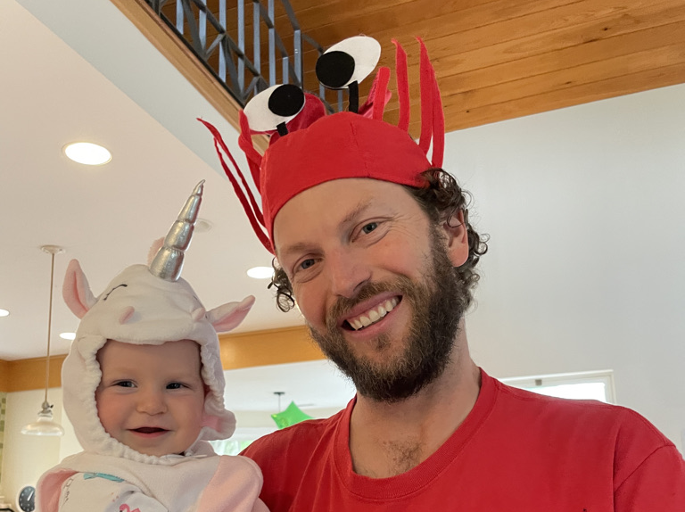
99%
1%
false positive

Slide 22

What is the chance it was FP now?
100%!
1% up to 100%!

Slide 23

This is because our pre-test probability was zero

Slide 24
This is because our pre-test probability was zero
Biological male patient: pre-test – 0%
Biological female, but has had tubal ligation – 1%
Biological female, reports not currently sexually active and normal menstrual cycle last week – 5%
Biological female trying to conceive but hasn’t missed a menstrual cycle – 20%
Biological female trying to conceive, missed menstrual cycle – 50%
Biological female, fetus present on ultrasound – 100%

Slide 25
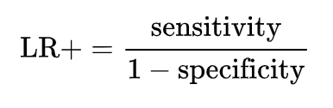
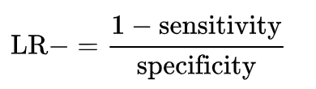
Back to the 2x2 table
Lets take the sensitivity and specificity, and convert it to a LR + and LR -
Positive likelihood ratio: ratio between the probability of a positive test result given the presence of the disease and the probability of a positive test result given the absence of the disease
Negative likelihood ratio: ratio between the probability of a negative test result given the presence of the disease and the probability of a negative test result given the absence of the disease

Slide 26

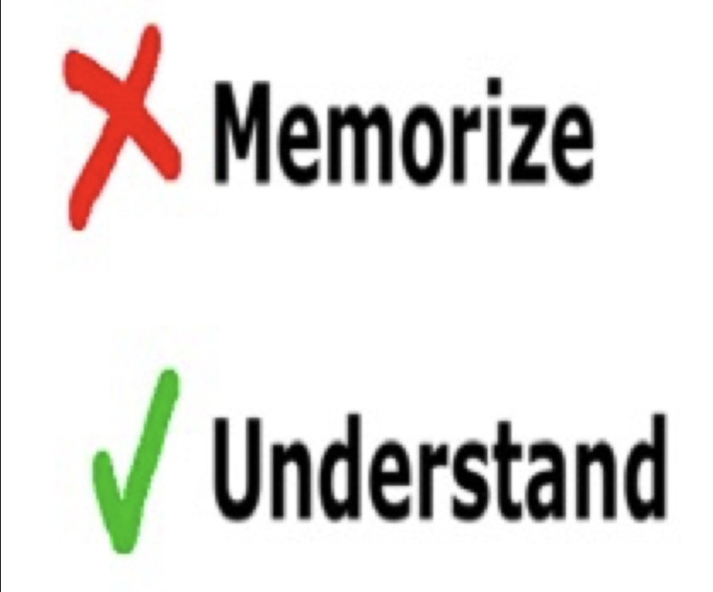
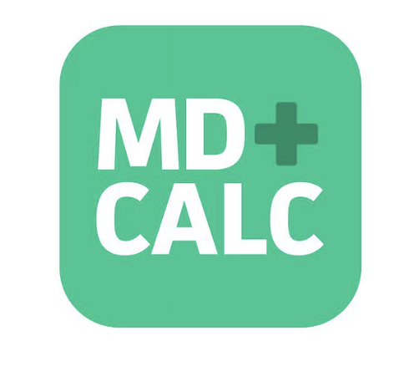

Slide 27
LR+ Likelihood of the test being correct when it is positive
LR – Likelihood of the test being correct when it is negative
Likelihood ratios have a number of useful properties:
  because they are based on a ratio of sensitivity and specificity, they do not vary in different populations or settings
  they can be used directly at the individual patient level
  they allow the clinician to quantitate the probability of disease for any individual patient.

Slide 28
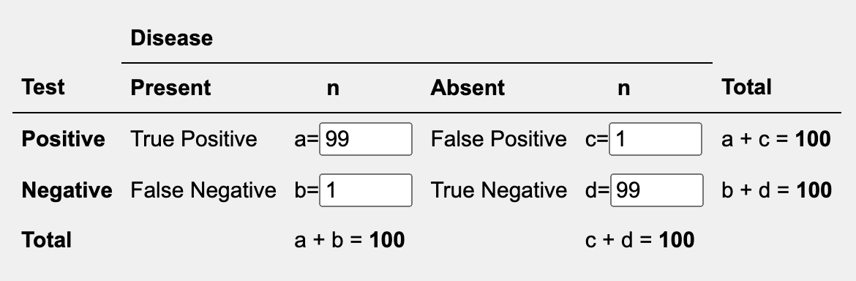
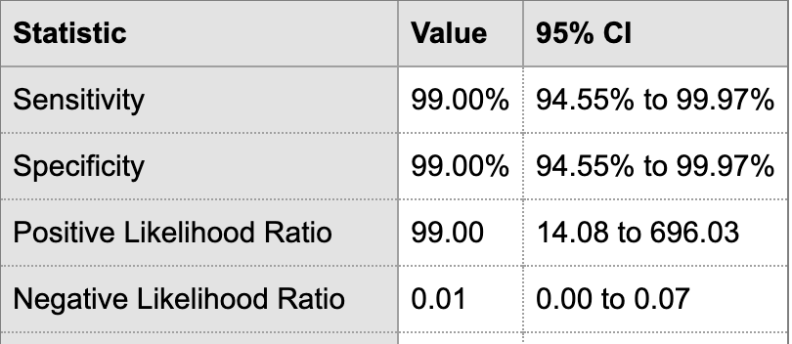
LR + 14
LR – 0.01

Slide 29
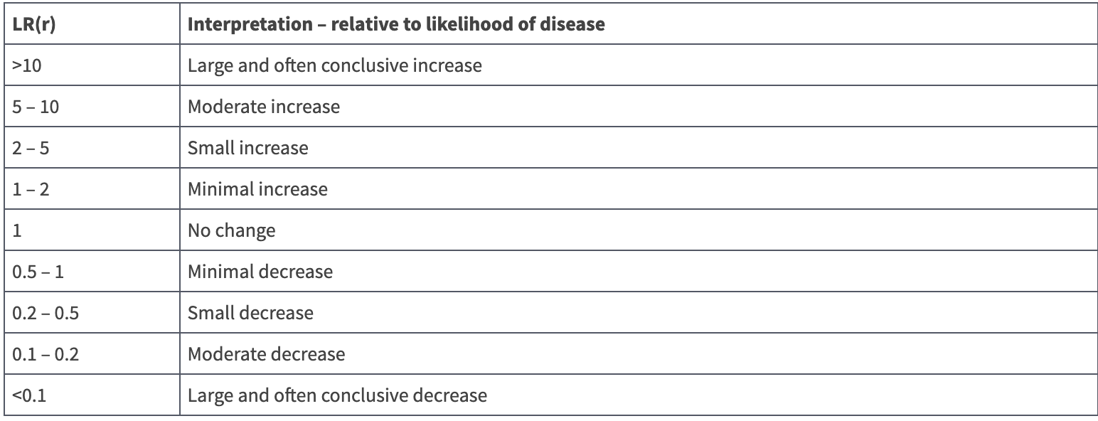
A word on ratios:
You can use them in succession
Multiply by 1 - no change!
Really high is good – changes the answer significantly
Or really low is good – also changes the answer significantly

Slide 30
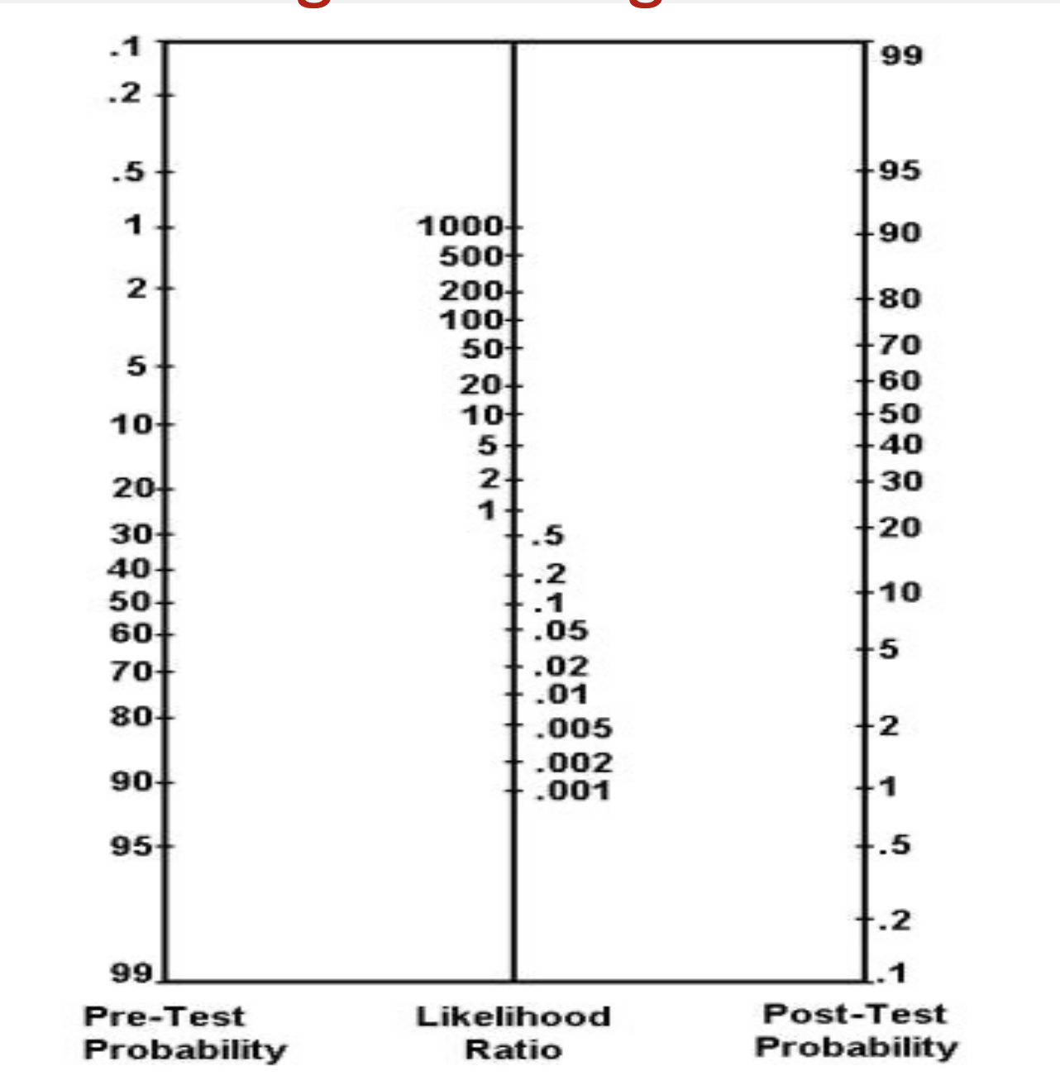
Fagen nomogram

Slide 31
LR + 14
LR – 0.1
Biological female, but has had tubal ligation
Pre test: 1%
Post test: 10%

Slide 32
LR + 14
LR – 0.1
Biological female, reports not sexually active and normal menstrual cycle last week
Pre test: 5%
Post test:
40%

Slide 33
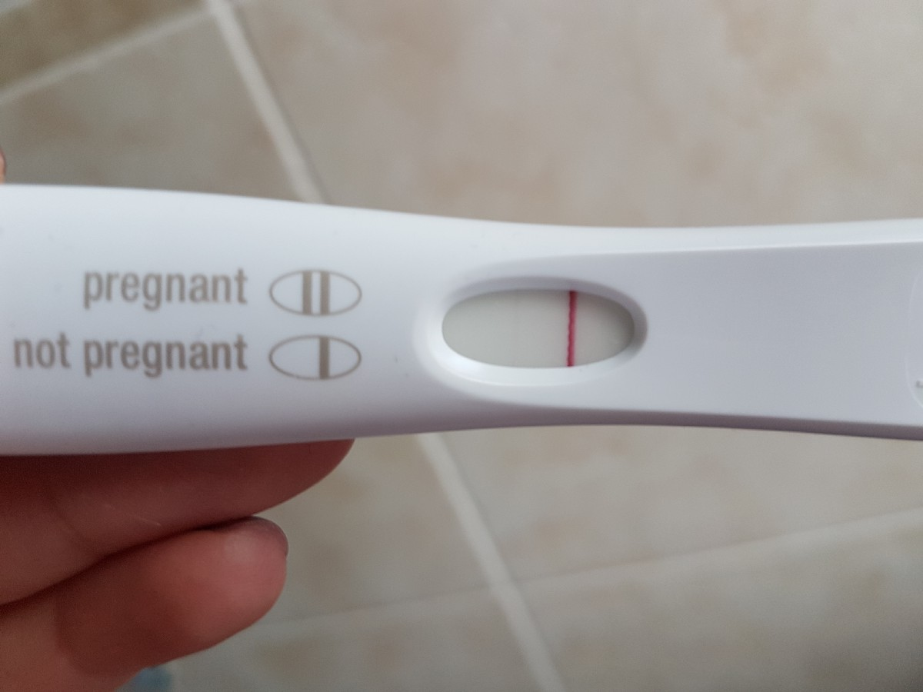
LR + 14
LR – 0.1
Biological female, reports not sexually active and normal menstrual cycle last week
Pre test: 5%
Post test: 0.5%

Slide 34
LR + 14
LR – 0.1
Biological female trying to conceive but hasn’t missed a menstrual cycle
Pre test: 20%
Post test: 80%

Slide 35
LR + 14
LR – 0.1
Biological female trying to conceive, missed menstrual cycle
Pre test: 50%
Post test: 95%

Slide 36
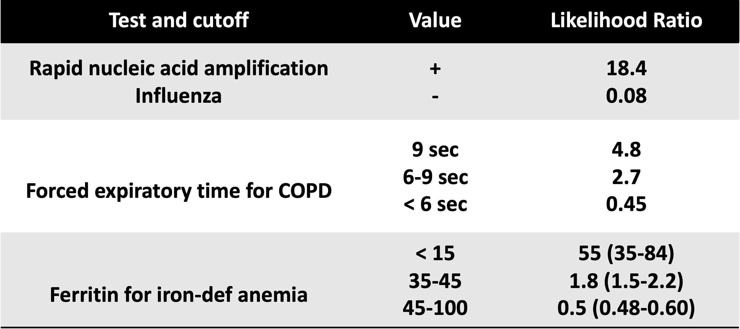
Let’s look at some other common tests

Slide 37
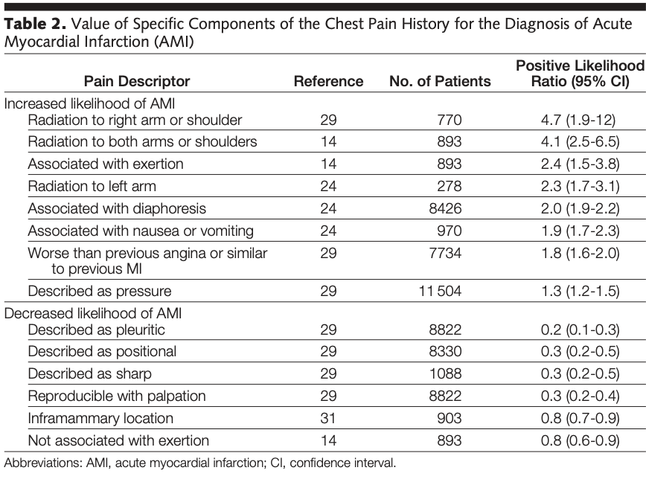
You can see if studies done, usually they are for common disease states:
For example, you can get LRs for HPI or Physical exam findings for Chest pain:

Slide 38
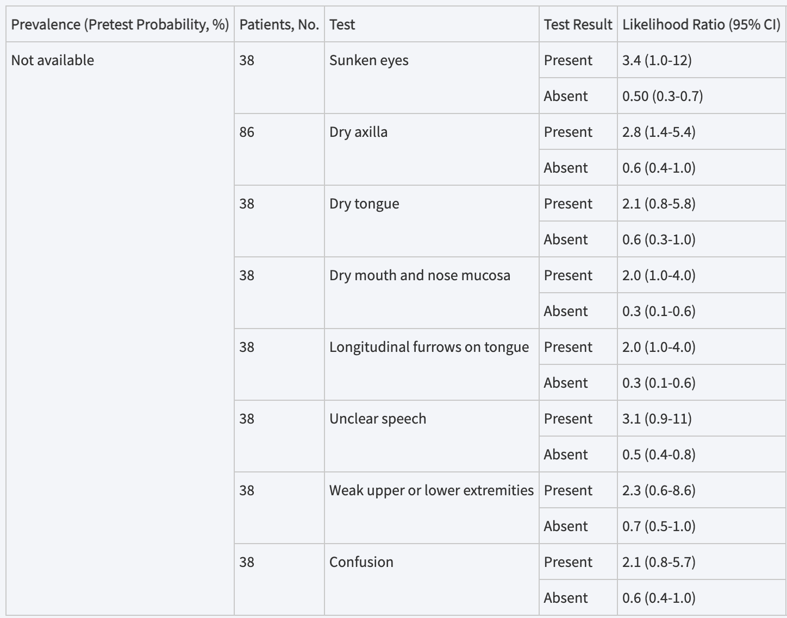
You can see if studies done, usually they are for common disease states:
Or for hypovolemia:

Slide 39
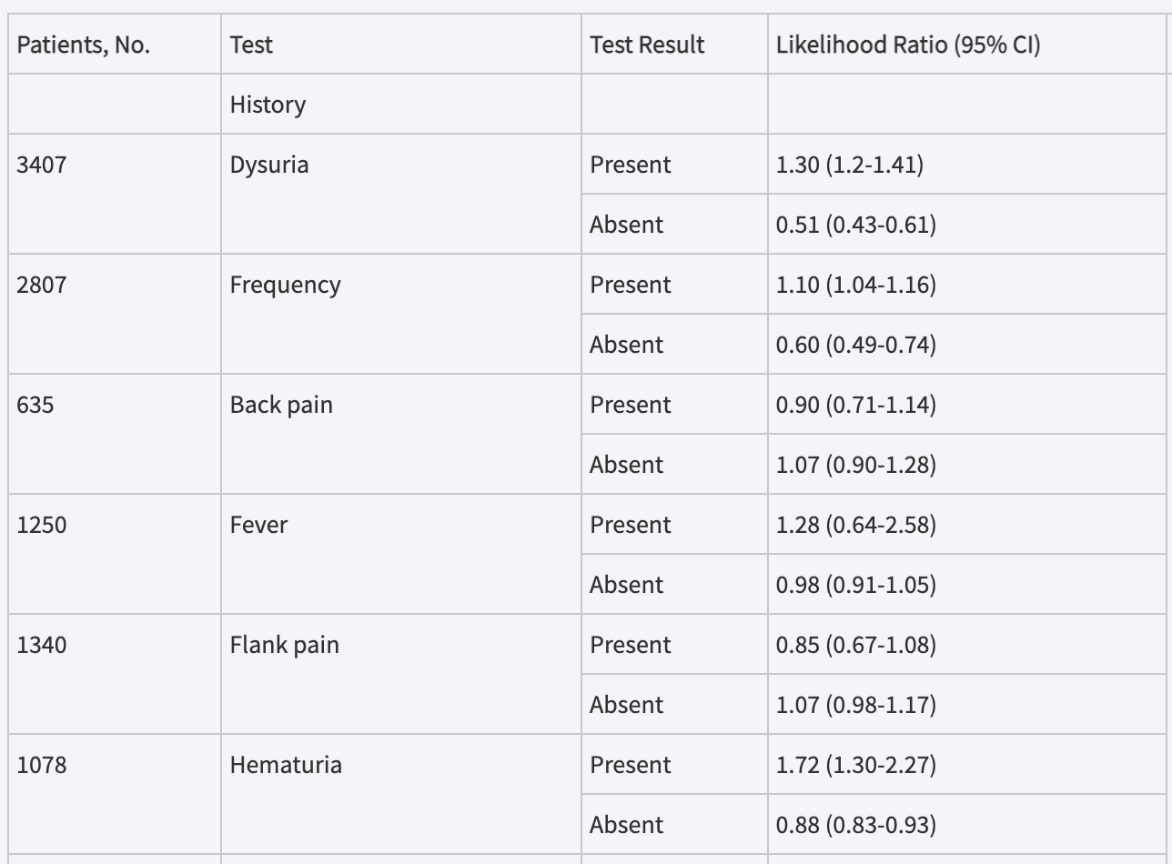
You can see if studies done, usually they are for common disease states:
Or UTI:

Slide 40
Ok so we now know – no test gives us 100 percent yes or no, so what do I do??
Lets revisit our case:
16yoM brought in by his parents for abdominal pain which began yesterday. It’s gradually worsening. Pain began 36hrs ago and is located near his belly button. He developed a fever of 38.2 and feels nauseated with loss of appetite. No trauma. He’s vomited twice and had 1 loose stool today. Says abdomen hurts when he’s walking.
Physical exam: No fever, normal vital signs. Appears ill and moves w/o discomfort.
Lungs are clear
Normal bowel sounds, tender everywhere including right lower area
Rest of exam is unremarkable.
Labs:
WBC 14,000
60% neutrophils
Urine normal

Slide 41

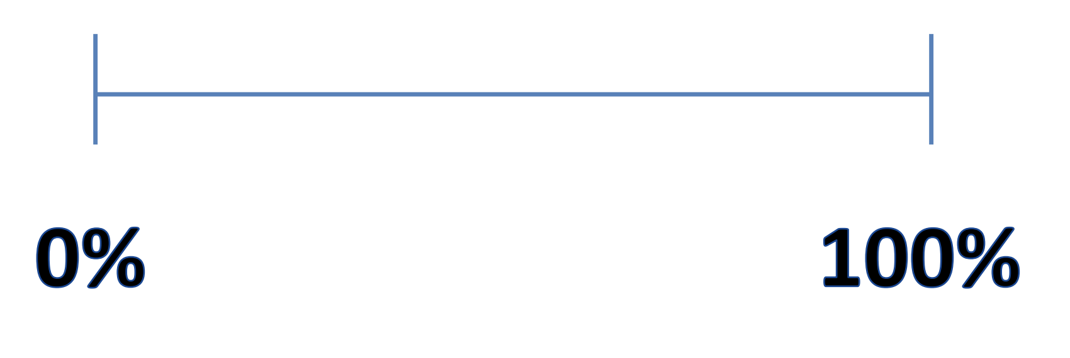
WHAT IS YOUR BEST ESTIMATE (PROBABILITY) THAT SHE has appendicitis?
Responses

Slide 42
How do we get pre-test probabilities
Just a fancy term for your initial impression, before you perform whatever test it is that you are going to use.
Clinical Judgement
Physical exam findings
HPI elements
Prevalence of disease
Clinical Decision Tools

Slide 43
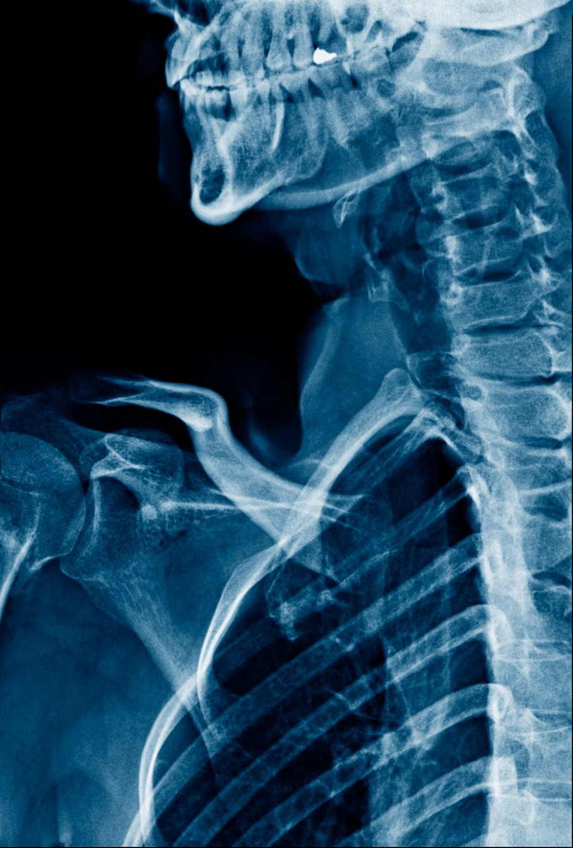
How do we get pre-test probabilities
Clinical experience
  ”Pathognomonic”
  “consistent with”
  “Classic presentation” (Fever, headache, neck pain)
Gestalt
This is the ART of medicine – and it is real

Slide 44
How do we get pre-test probabilities
Often, clinical decision making tools can help, and cognitively unload us:
PE – Wells Criteria, PERC rule
Appendicitis- Alvarodo, pARC
Necrotizing fasciitis – LIRNEC
C-Spine Fracture – NEXUS
ICH – Canadian head CT
NIH Stroke scale

Slide 45
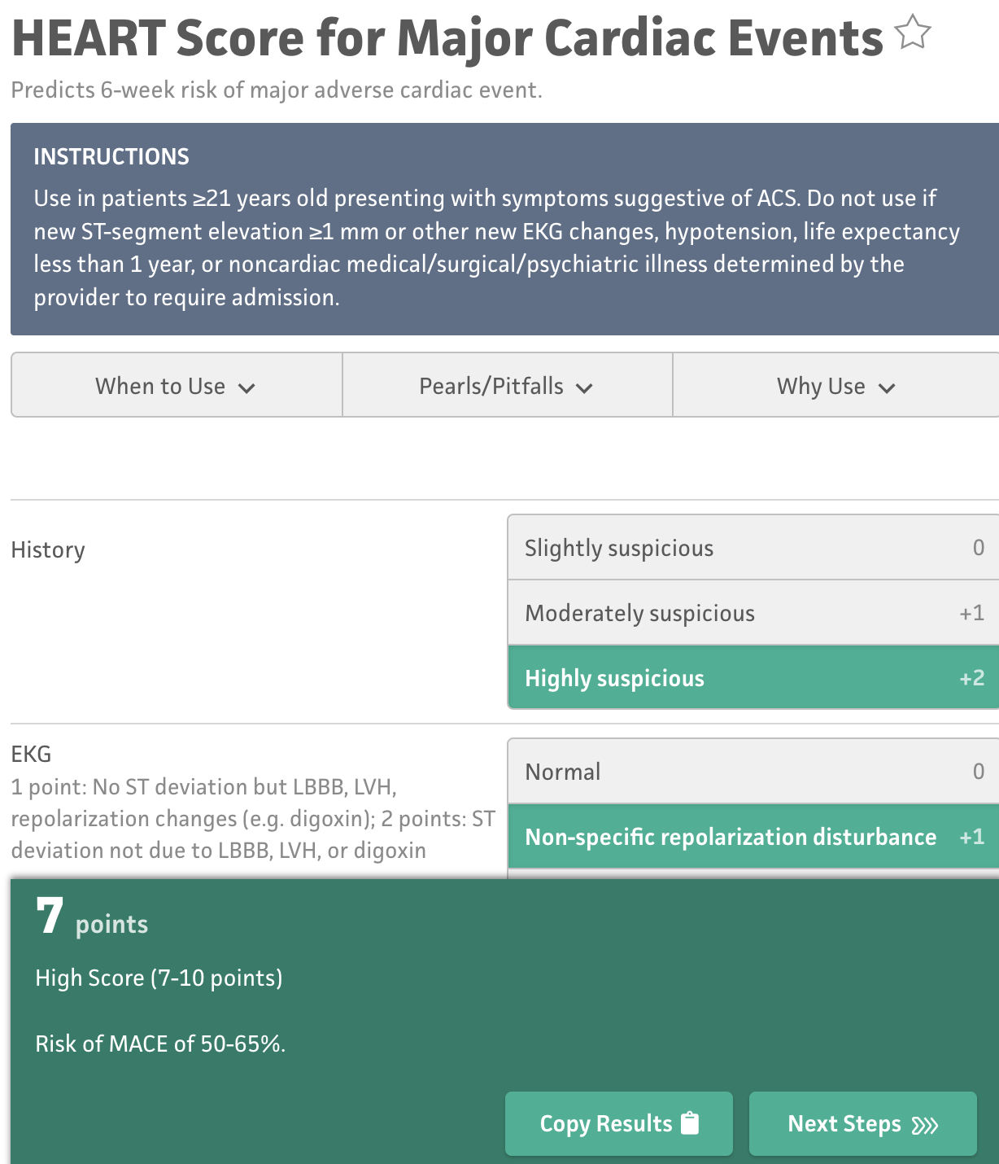
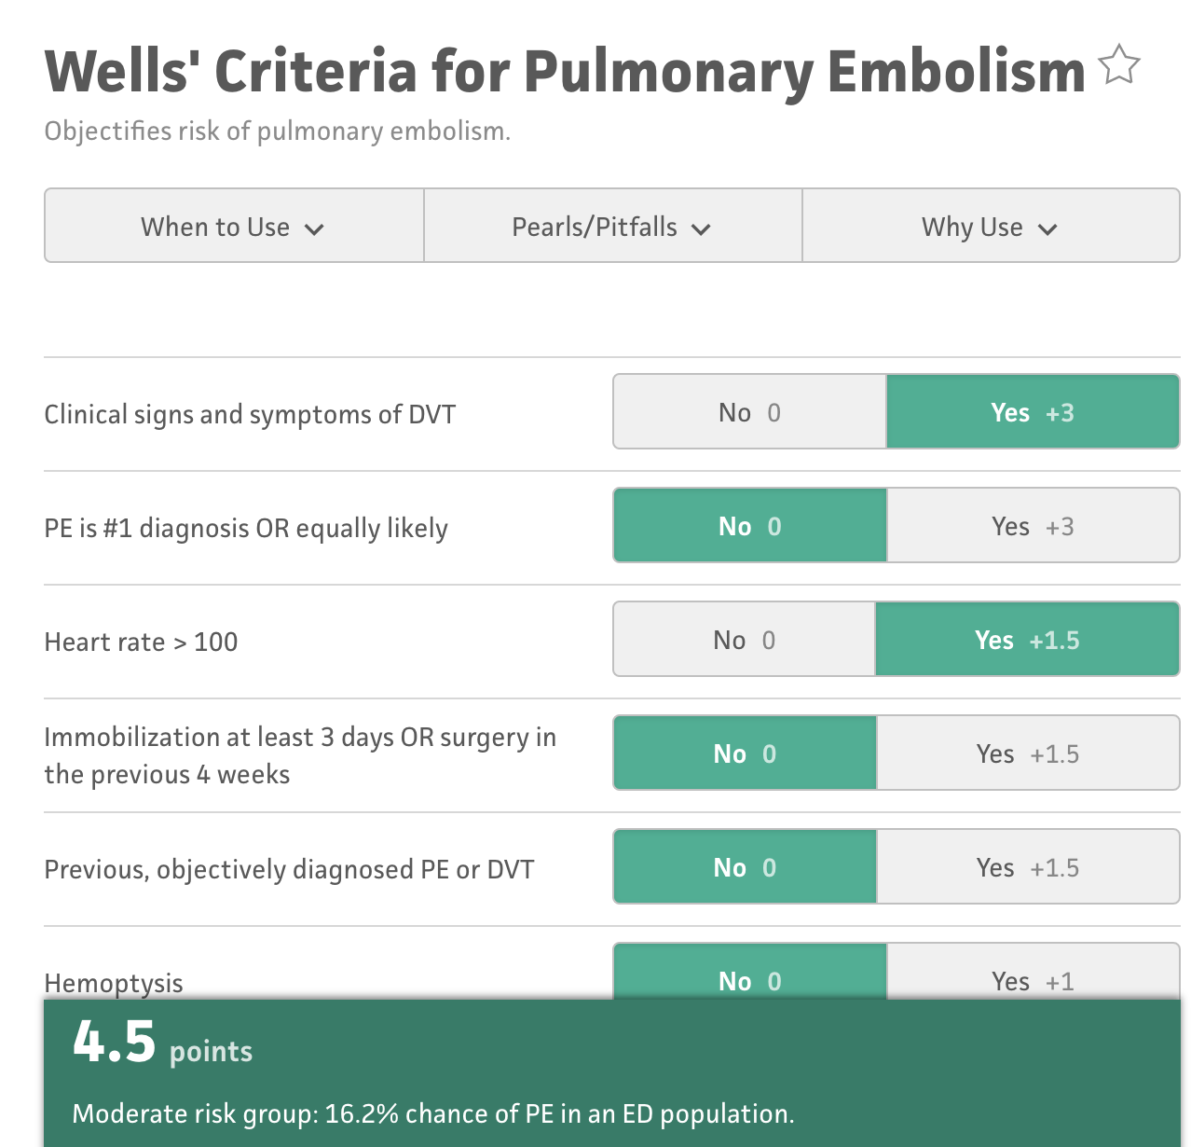

Slide 46
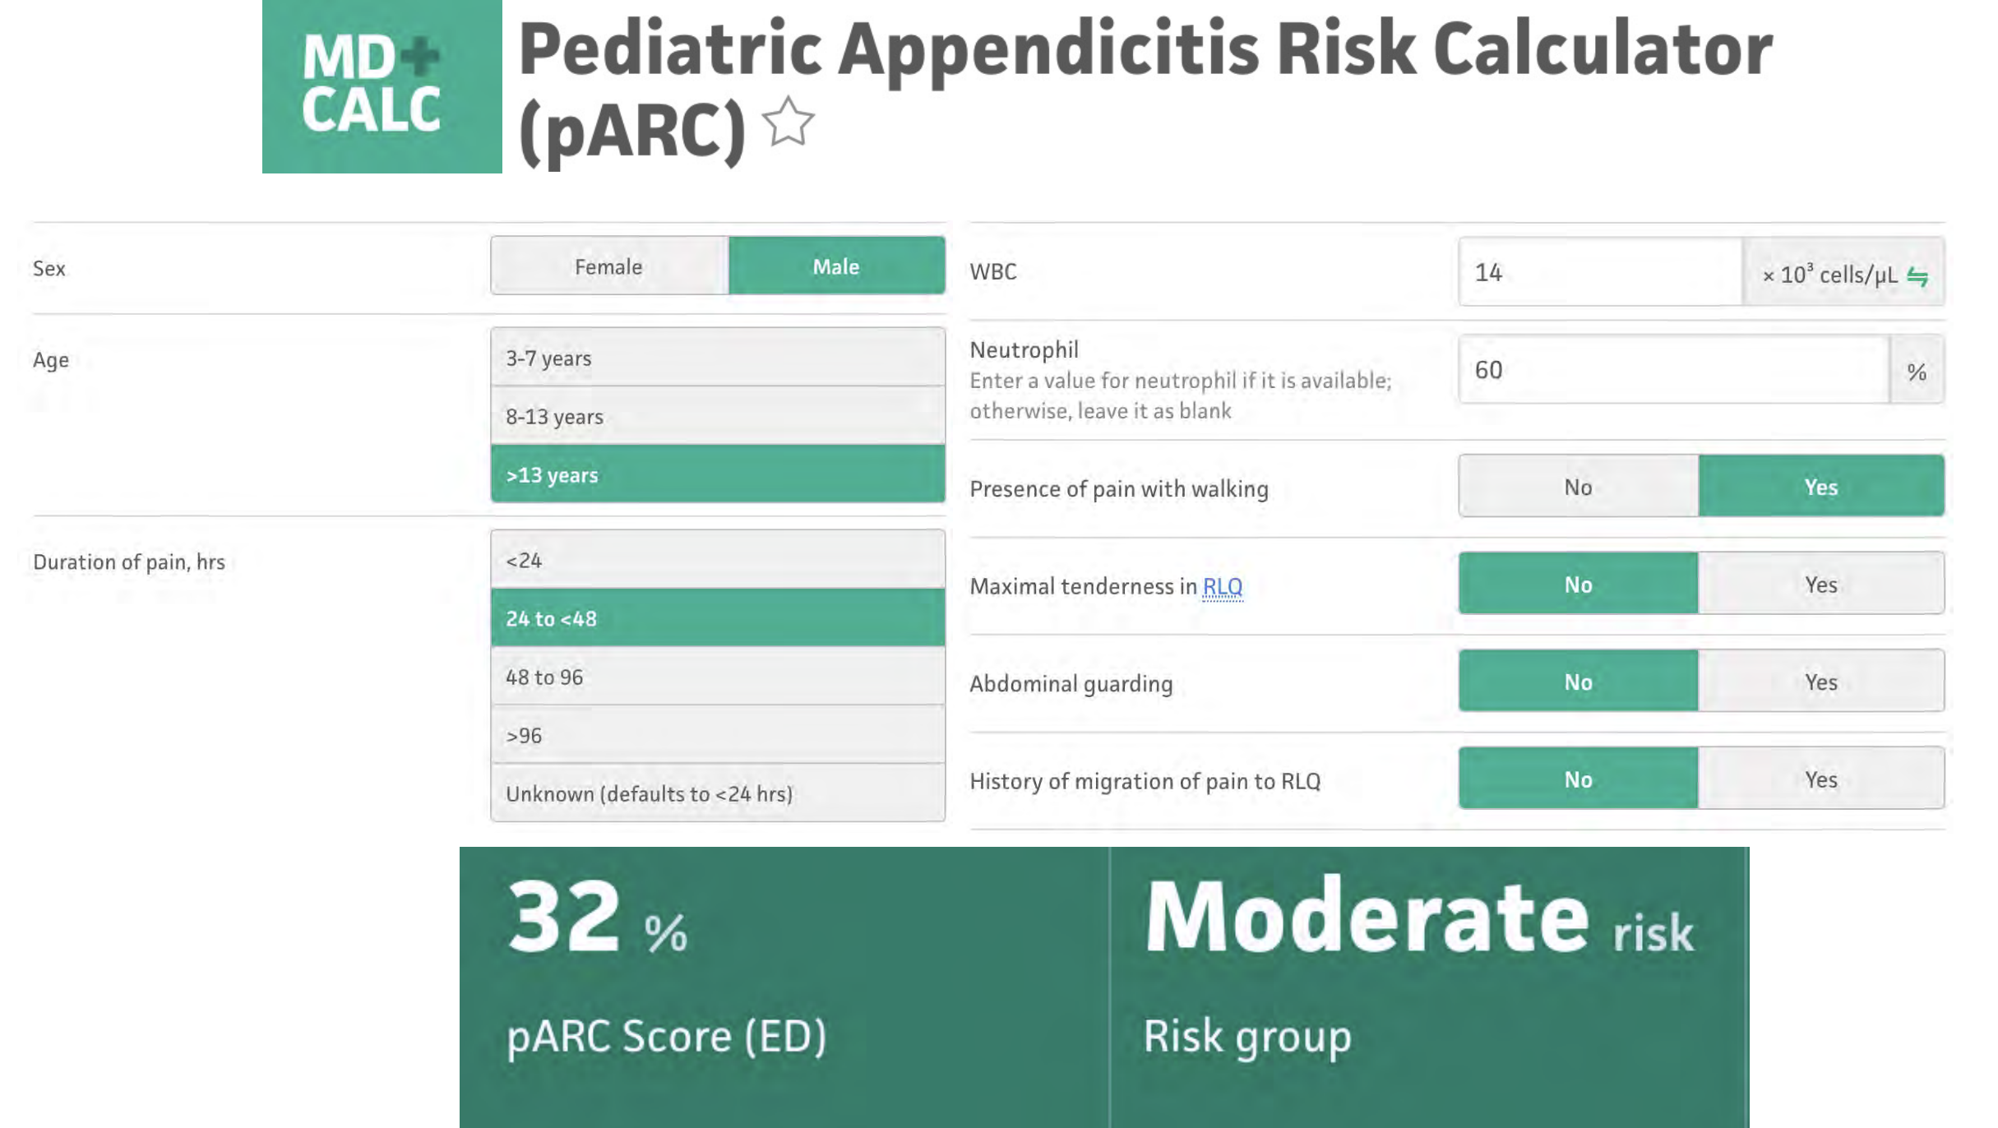
But let’s remember our patient

Slide 47

But how certain do I need to be?

Slide 48
How certain do you need to be that your patient has appendicitis to call the surgeon and recommend this child go to the OR?
50%
100%
NO TEST IS PERFECT
Responses

Slide 49
Treatment threshold
How certain you’d like to be of a diagnosis before proceeding with treatment
Depends on:
Prognosis of the disease under consideration
Effectiveness, safety, availability of treatment(s)
Safety and costs of next test(s)

Slide 50
How low would your suspicion of acute appendicitis need to be in order to send him home?
0%
50%
NO TEST IS PERFECT
Responses

Slide 51
Observation threshold
How certain you’d like to be that a patient does NOT have a diagnosis before you would not pursue further testing
Depends on:
Prognosis of the disease under consideration
Effectiveness and availability of treatment
Test accuracy, safety, acceptability to the patient

Slide 52
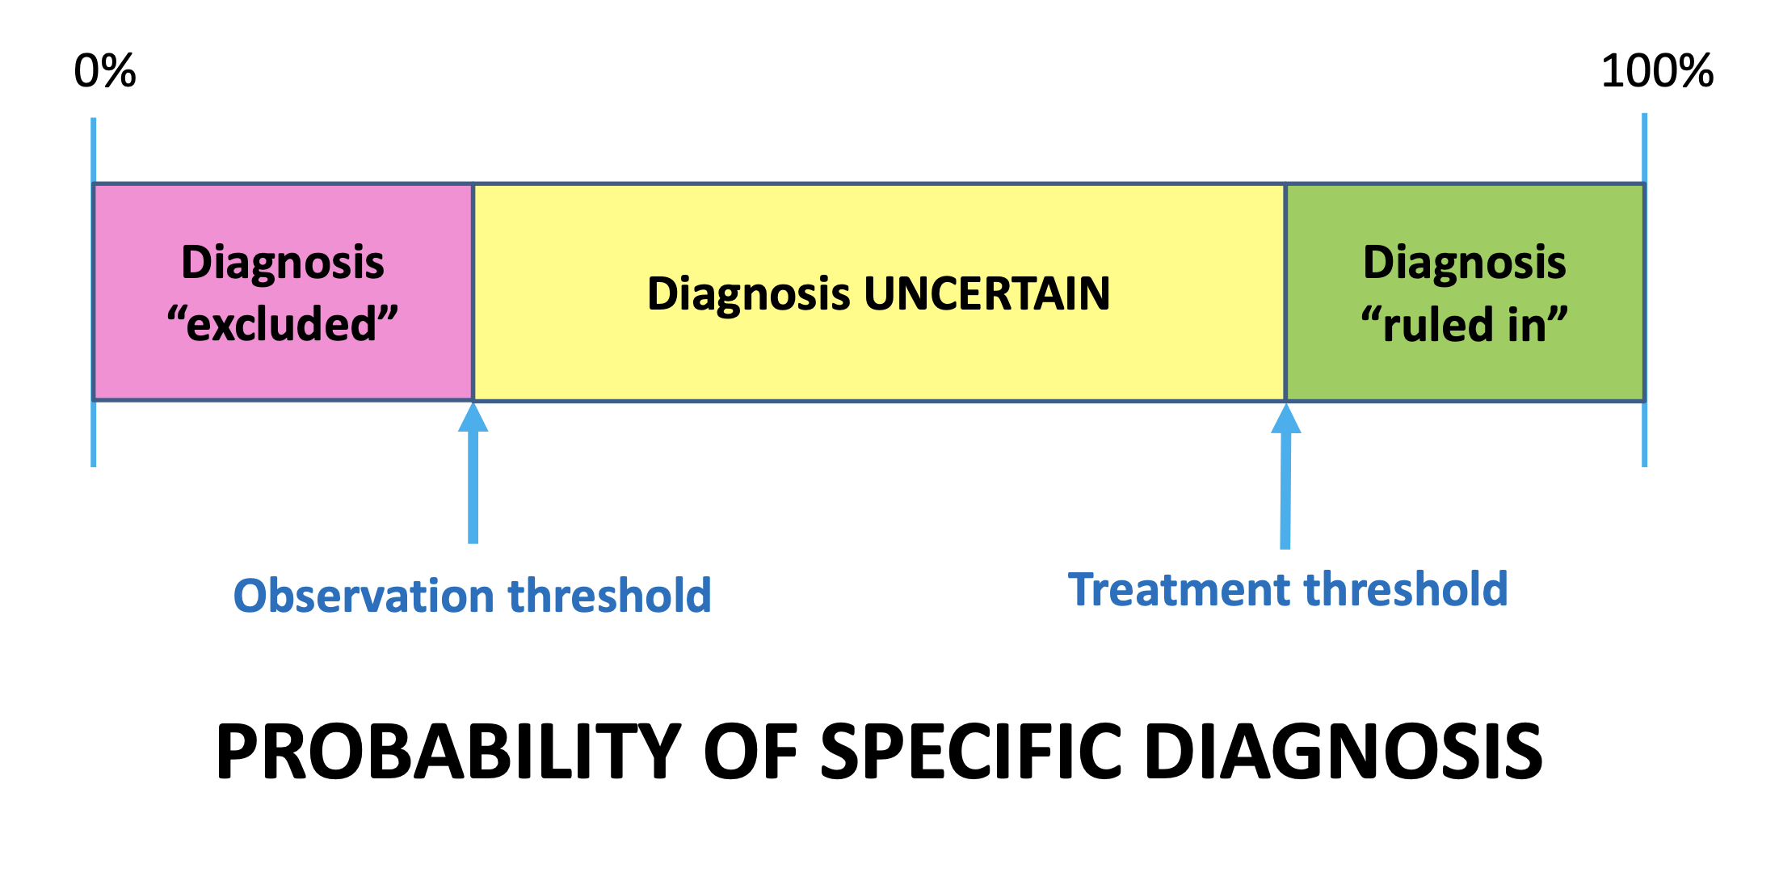

Slide 53
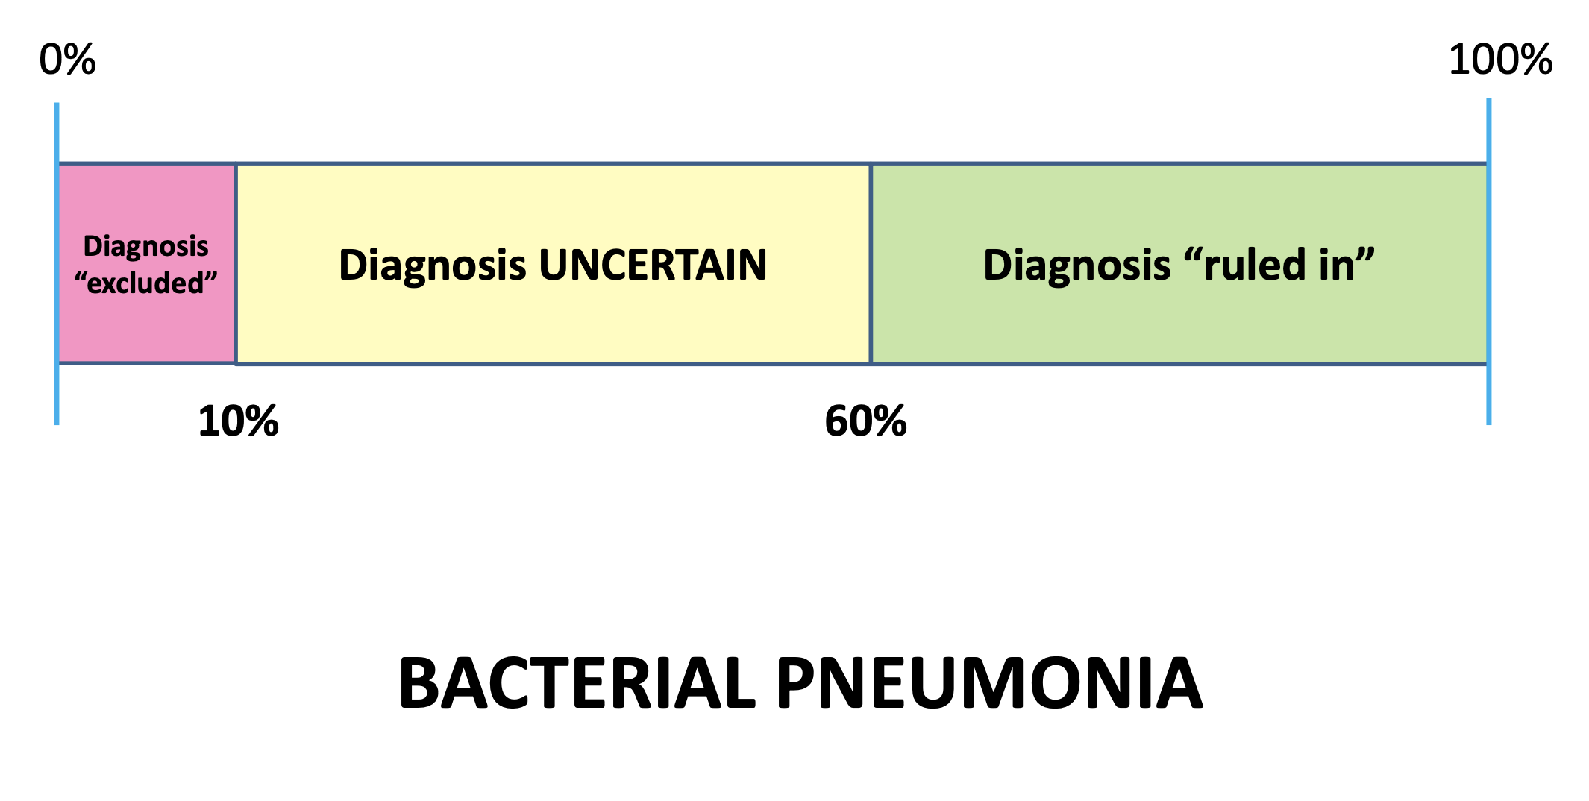

Slide 54
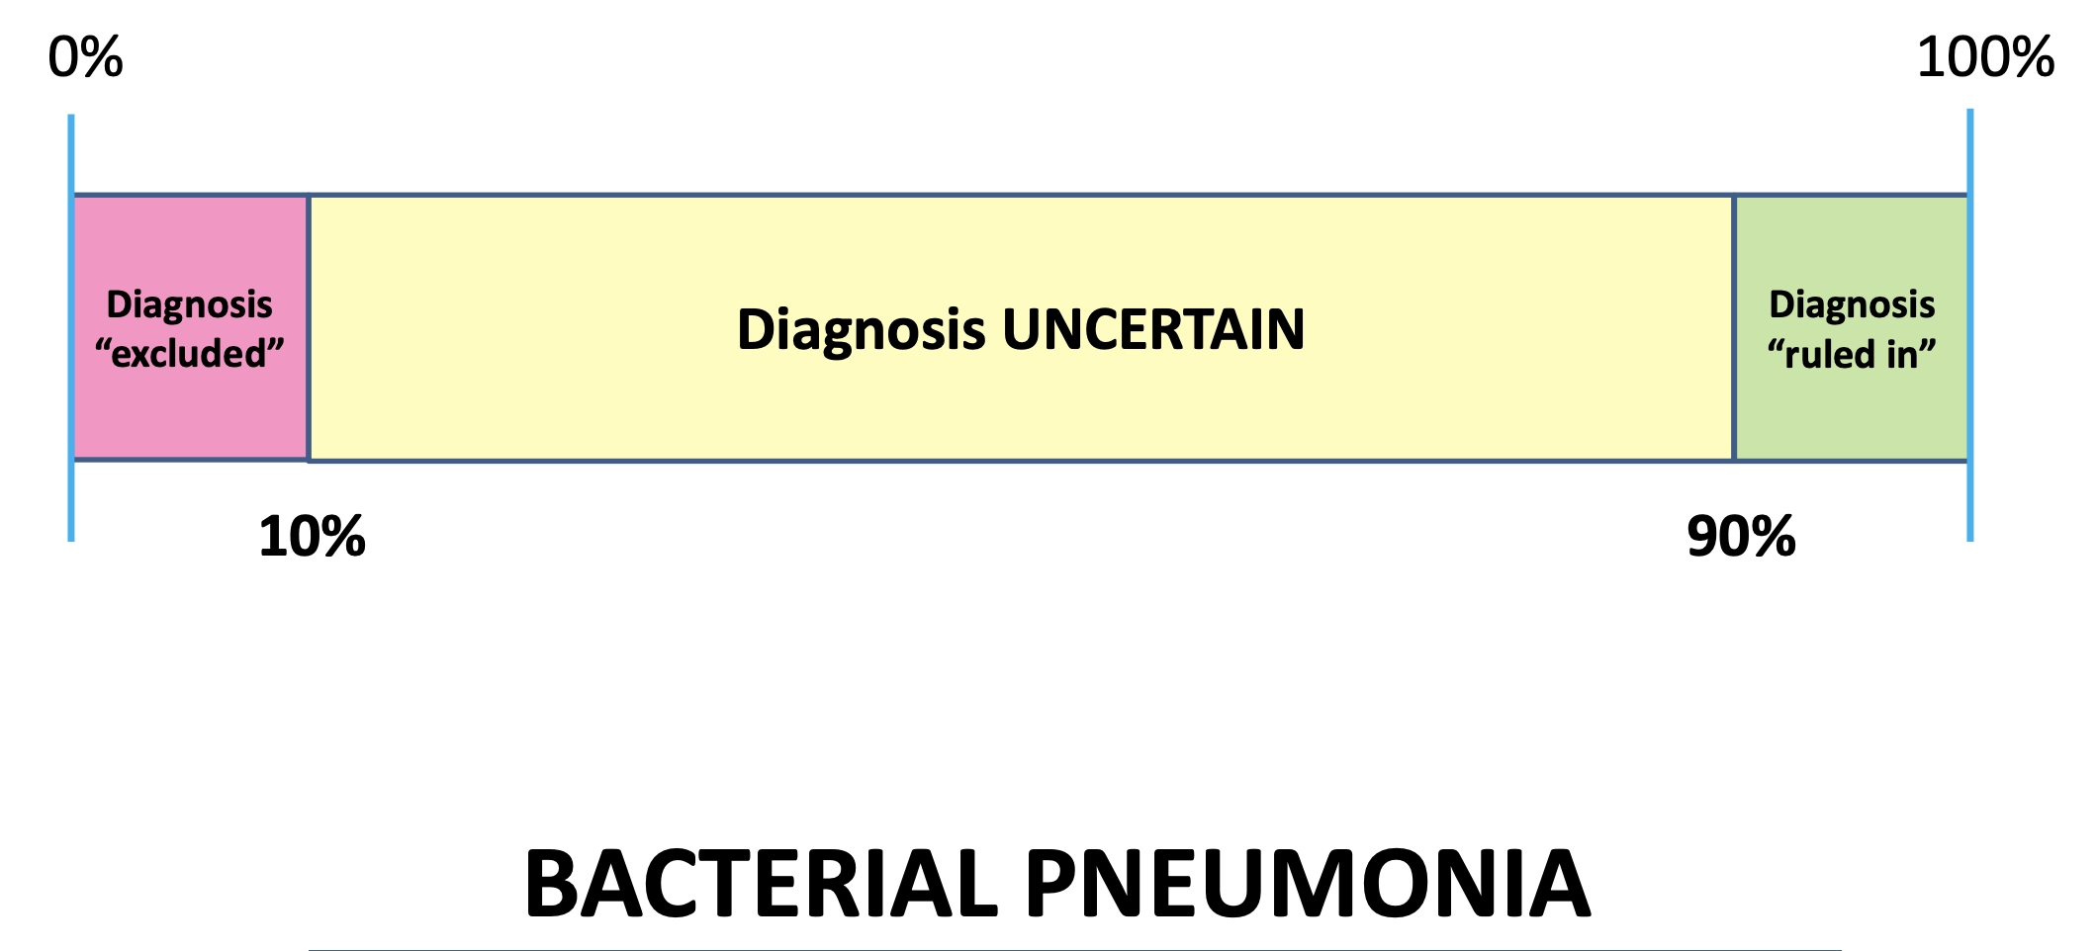
Healthy 20 yo with no medical problems

Slide 55
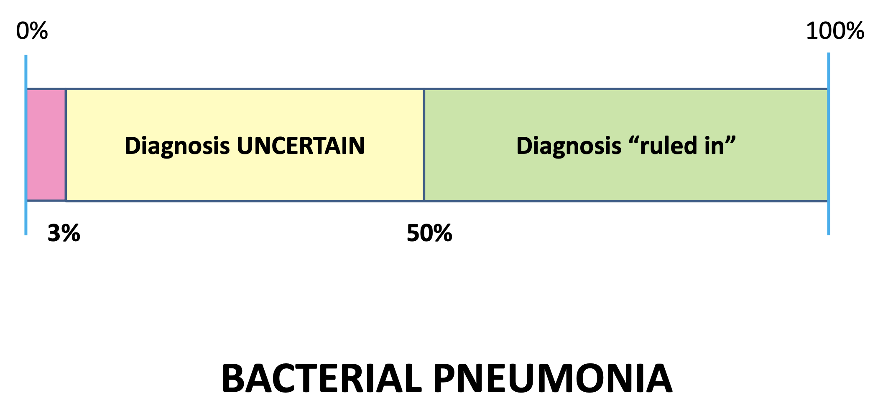
82 yo with HTN, DM and COPD

Slide 56
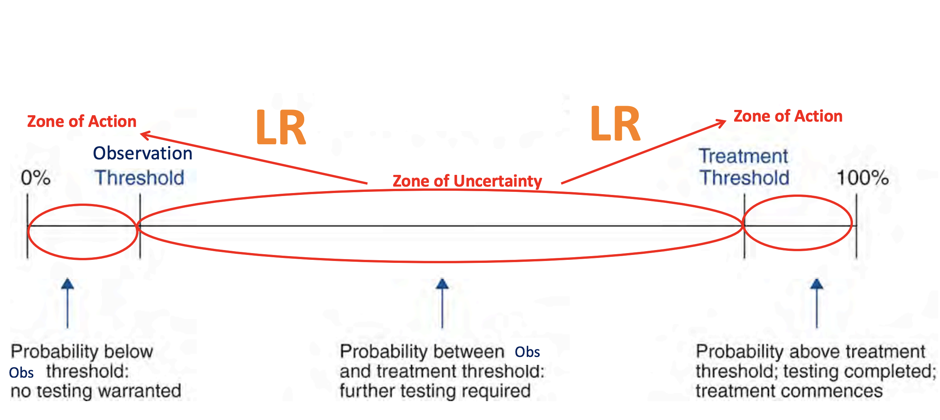
Tests force action – one direction or the other

Slide 57
Back to our case
We landed somewhere around 30%
So we are in the zone of uncertainty

Slide 58
Case continued
It is 2am. Turns out, you are in a rural clinic. You don’t have a CT scanner. You remember taking POCUS ultrasound at VCU SOM and feel confident about your US skills, and decide to throw the probe on yourself
But, how does this test perform?
Lets remember EBM process to answer our question

Slide 59
The Evidence Cycle
EBM
P: Patients
I: Intervention
C: Comparison
O: Outcome
P: Pediatric patients with abdominal pain
I: Ultrasound (POCUS)
C: Gold standard
O: Correct diagnosis or final outcome

Slide 60
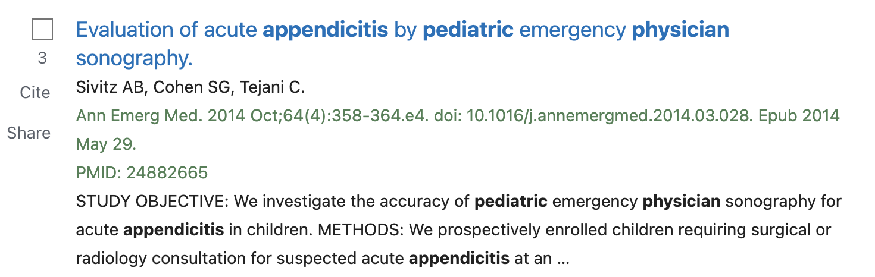
The Evidence Cycle
https://guides.library.vcu.edu/clerkships
EBM

Slide 61
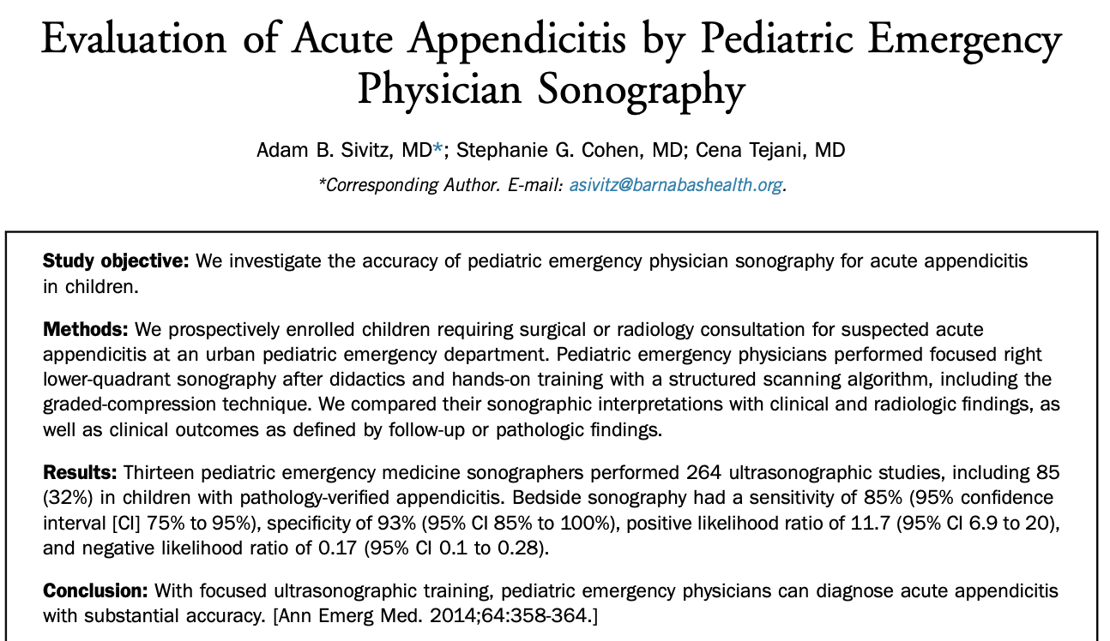

Slide 62
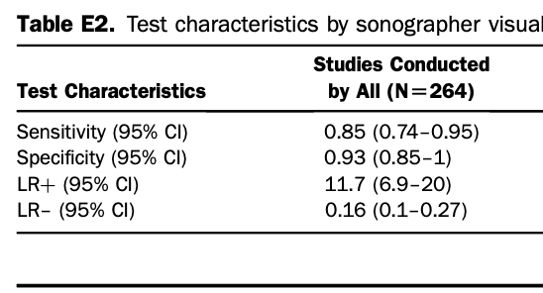

Slide 63
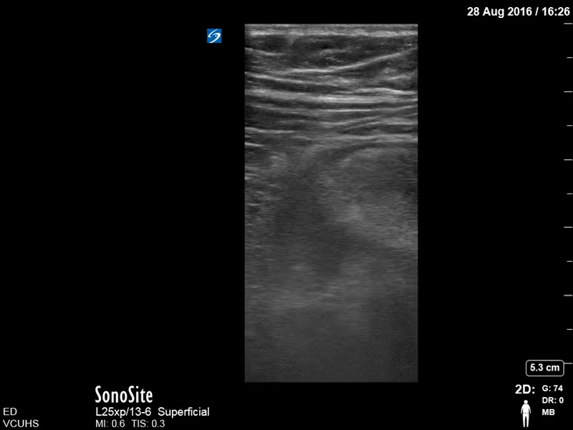
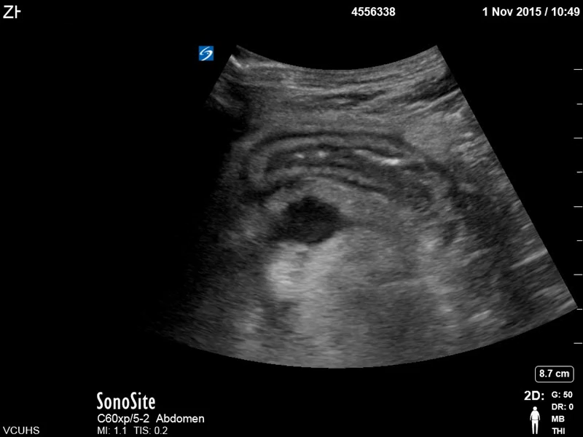
You perform your ultrasound and see:

Slide 64
Ultrasound Positive
LR+ 11
Pre test: 30%
Post test: 90%

Slide 65
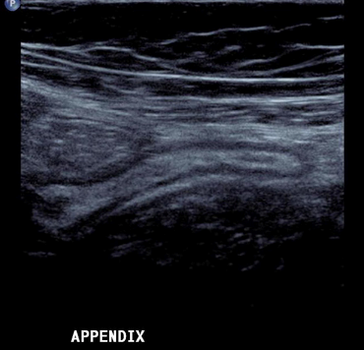
You perform your ultrasound and see:

Slide 66
Ultrasound Negative
LR 0.16
Pre test: 30%
Post test: 5%

Slide 67
What have we accomplished?
Took a patient from a zone of uncertainty
Found evidence on using a new test
Used the test, and appropriately determined what our true chance of the patient having the disease is
EBM!

Slide 68
But why does it matter?

Slide 69
But why does it matter?
Testing is not harm free
Testing costs money, time, resources (of both patient and health care system)
Using the incorrect test can lead to incorrect diagnosis and downstream harm
Using too many tests will make the diagnosis unclear
Interpreting the test incorrectly leads to over treatment
If we just order tests for our entire differential, we should let a computer practice medicine

Slide 70
Can we ”rule out” disease?
Almost never! Post test would have to be zero
We can risk stratify to low chance, low risk, low probability
Telling patients you have ruled out a disease is fraught with error

Slide 71
COVID
Remember when COVID tests came out, all of a sudden everyone seemed to understood false positive and false negative
But did they really?
The chance of it being FP or FN varied significantly on the pre-test probability
Fever, cough, chills, SOB --> high pre-test
Asymptomatic --> low pre-test
But --- we didn’t know the test characteristics! What was the gold standard??

Slide 72
A case from last month:
Dr. Wilson, resident physician sees a patient with chief complaint of leg swelling.
  PMH: HTN, COPD, DM, hyperlipidemia, VTE
Patient denies trauma, redness, fevers, rash or any other complaints.
On physical exam, there is unilateral left lower extremity swelling, 1+ pitting edema to mid shin, no deformities, normal sensation and motor. Skin exam is unremarkable.

Slide 73
DDx?
DVT
Cellluitis
Abscess
Fracture
Contusion
Renal failure
Heart failure
Lymphedema

Slide 74
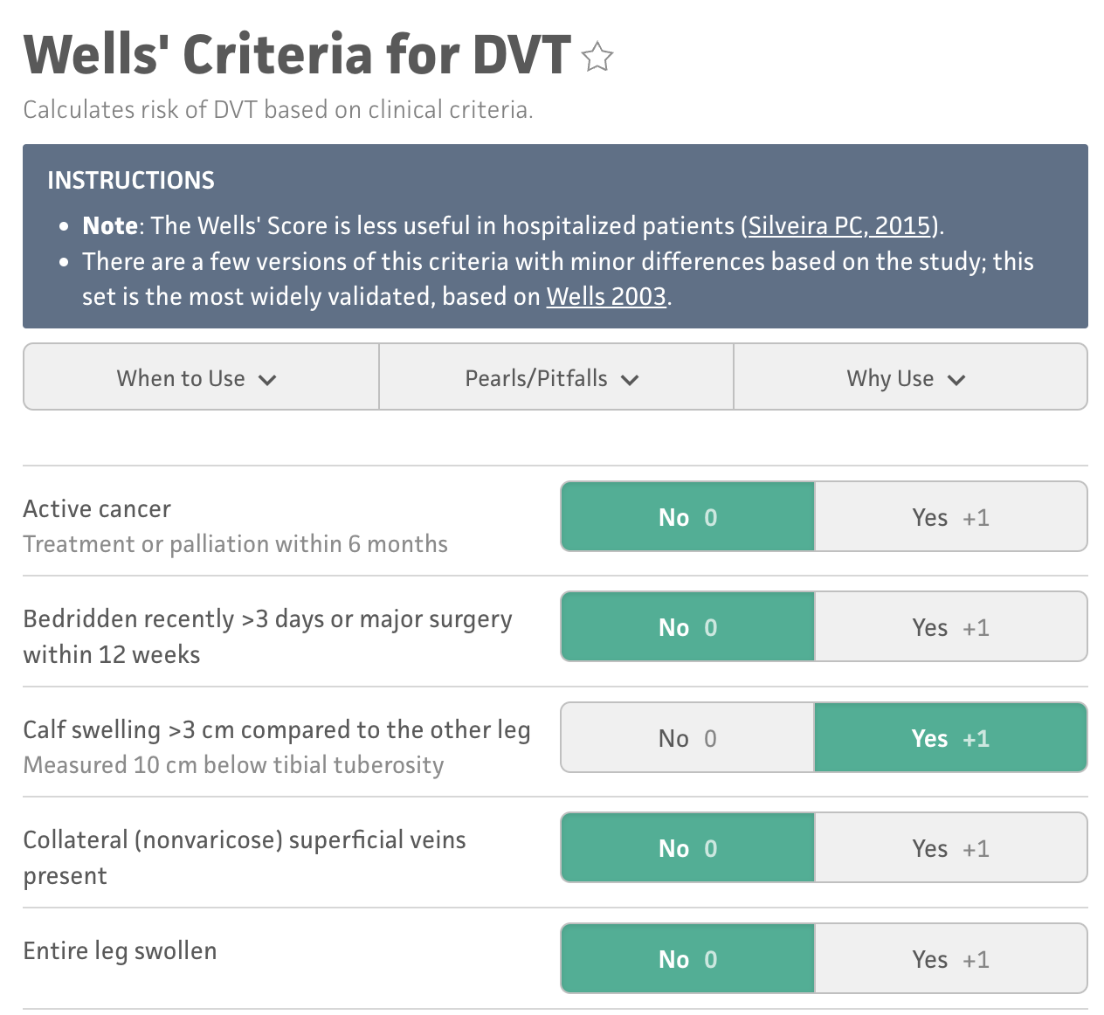
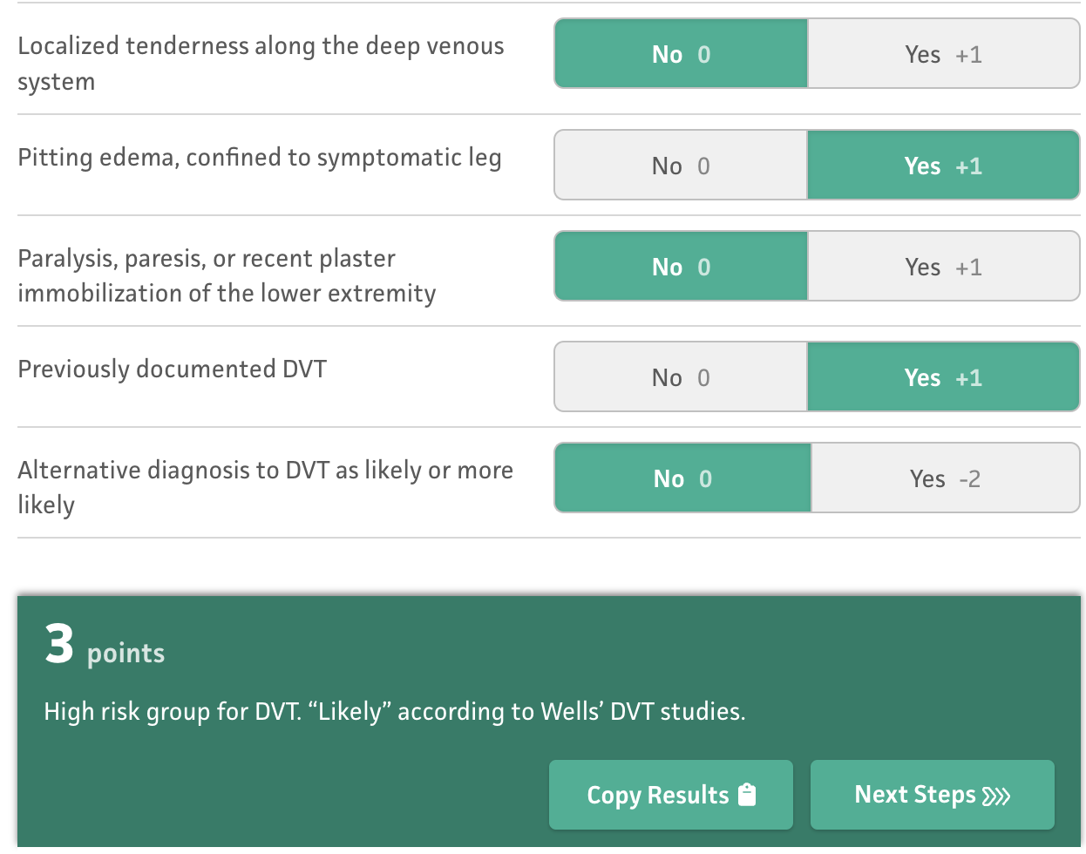
Pre test probability?

Slide 75
Ultrasound obtained
Negative for DVT

Slide 76
Ultrasound obtained
Negative for DVT
How good is the test?
LR+ 64
LR- 0.06

Slide 77
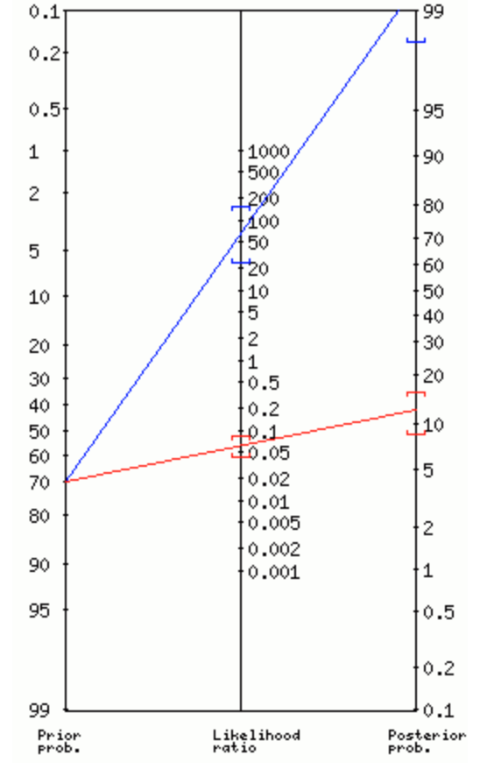
Ultrasound obtained
Negative for DVT
How good is the test?
LR+ 64
LR- 0.06

Slide 79
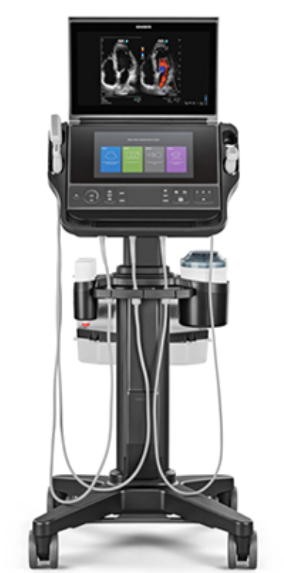
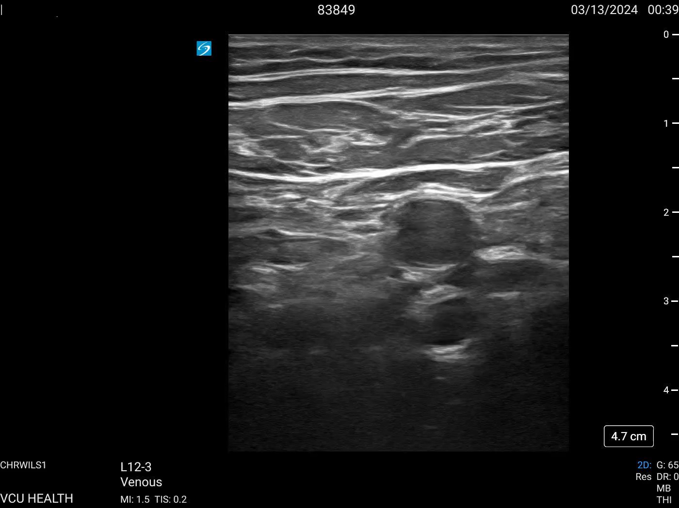

Slide 80
Case conclusion
Started patient on DOAC
Followed up with PCP, had a repeat study done which again confirmed the diagnosis
Used likelihood ratios to appropriately determine the likelihood that the test was correct!
This can be you !

Slide 81
Putting it together
Likelihood ratios:
  Affect real time decision making
  Integrate specificity and sensitivity (the whole 2x2 table!)
  Should be applied in all diagnostic work ups!
  Used appropriately, can prevent unnecessary testing or incorrect testing
  As you rotate through M3 year, start thinking in terms of probability expressed as a percentage, not “pathognomonic, classic presentation, etc”. What does that mean for that disease ?
  The data is out there!

Slide 82
Remember - take the quiz!
Questions? Email me – john.joyce@vcuhealth.org

