Slide 1



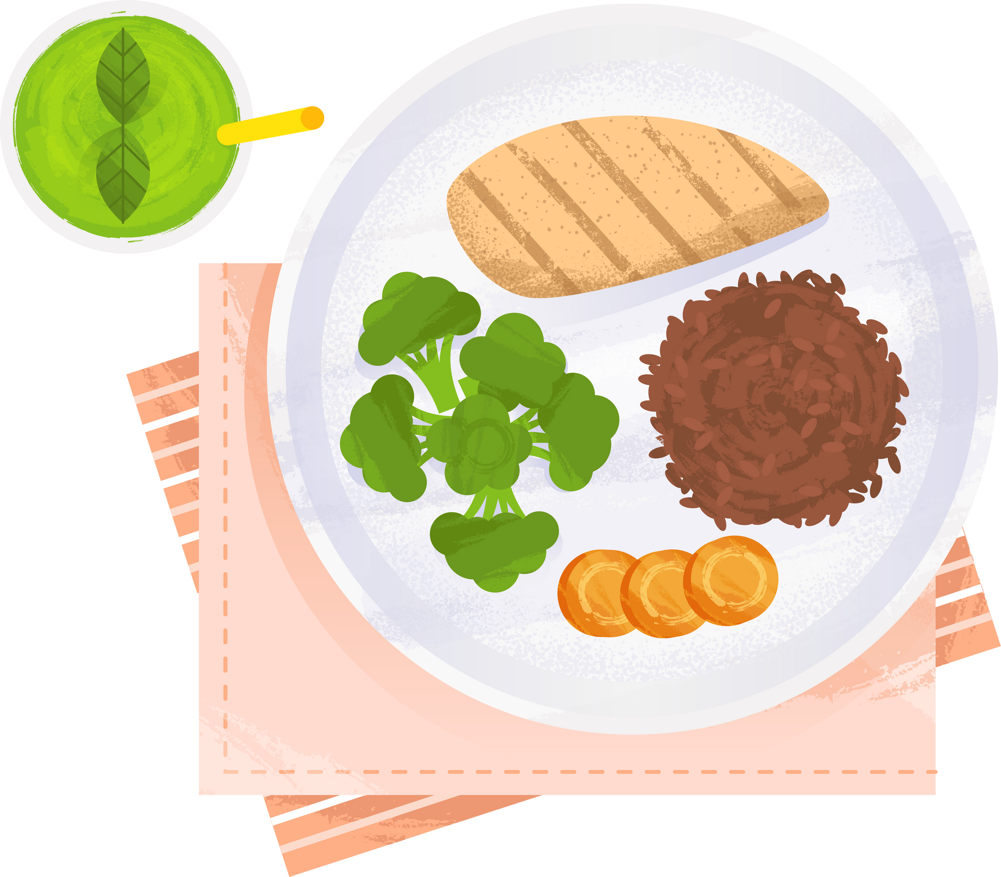
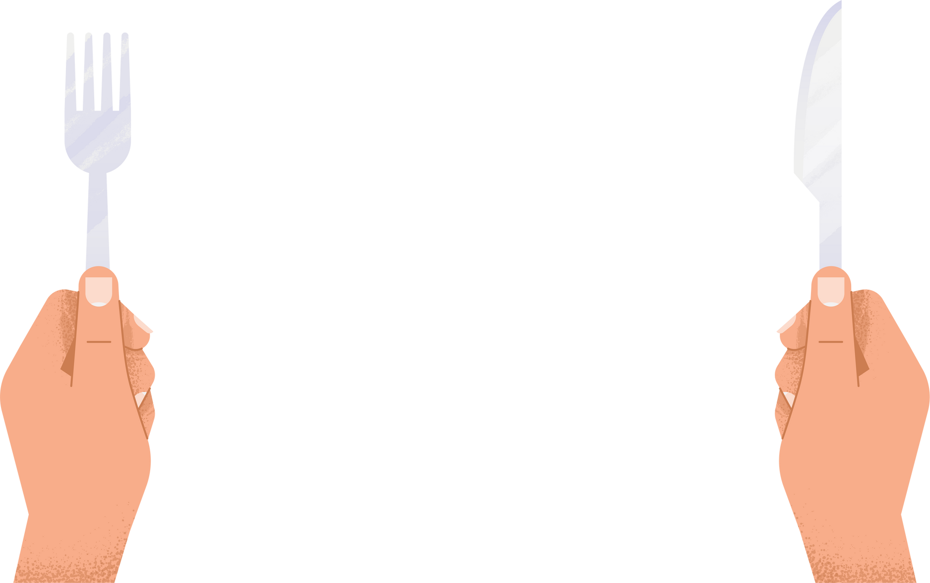

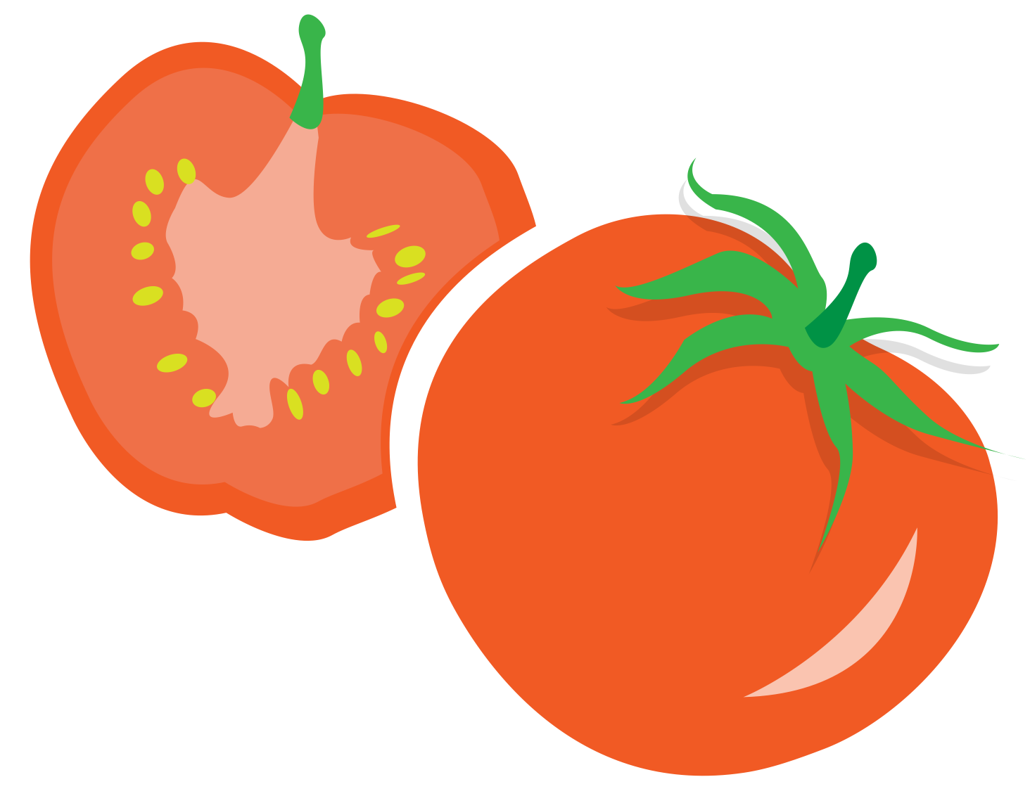





Interdisciplinary Recipe Creation Project to Guide Healthy Eating in Pediatrics
Stephanie Joyce, MSPAS, PA-C, MS, RD
In collaboration with Hannah Hollon, MD

Slide 2



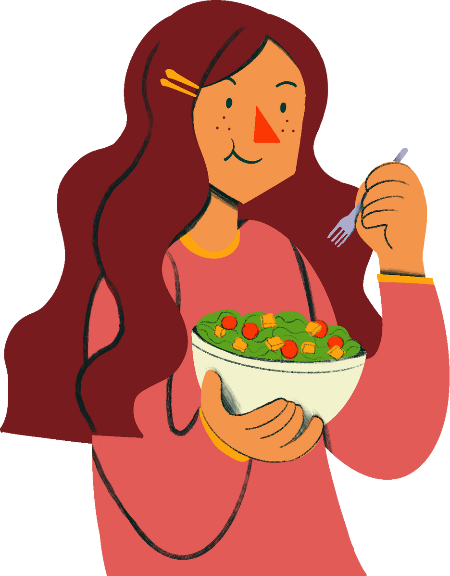

Dietary Recommendations for Pediatrics
Children should eat at least 3-5 servings of vegetables and fruits per day¹
Hamner and colleagues² found that for children between the age of 1 -5
•1 in 2 did not eat a daily vegetable
•1 in 3 did not eat a daily fruit

Slide 3




Childrens’ barriers to fruit and vegetable intake³
Caregivers’ barriers to making meals at home⁴
food preferences
food preferences
Perceived barriers
lack of time
lack of exposure
lack of interest, knowledge, and skills
cost of food
lack of cooking skills

Slide 4



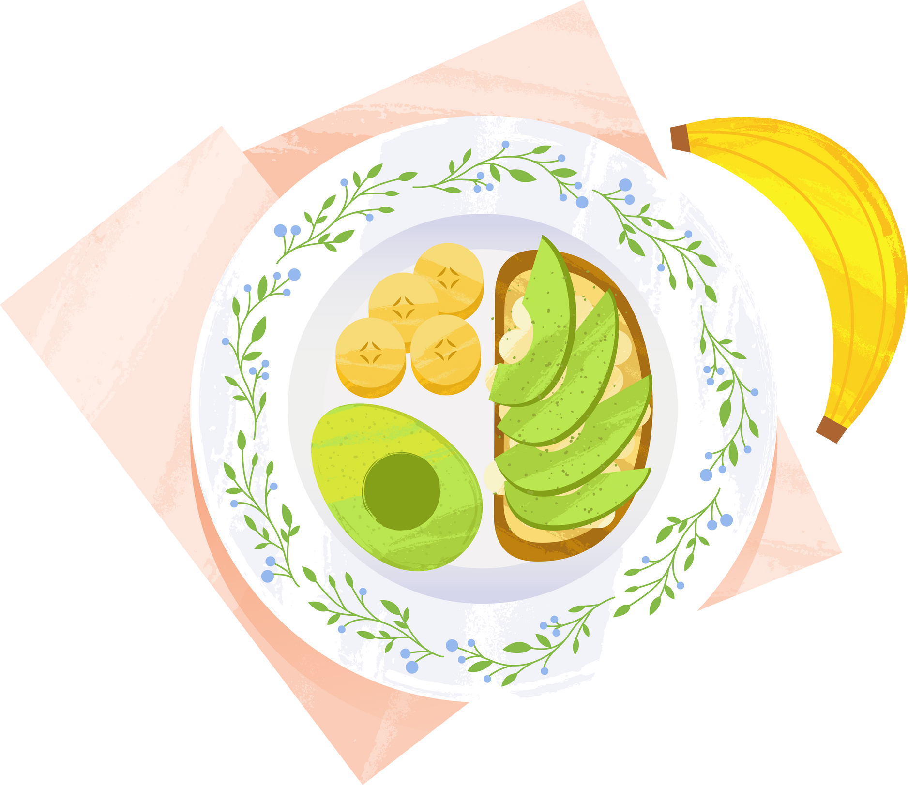
Pediatric Obesity
•19.7% of children in the United States have obesity⁵
•Pediatric obesity is a chronic medical condition and the treatment is complex given the socioeconomic and environmental factors⁶
•Pediatricians note lack of resources and time as top barriers to treating pediatric obesity⁷
•Bias and stigma associated with pediatric obesity are barriers to diagnosis and treatment⁶

Slide 5


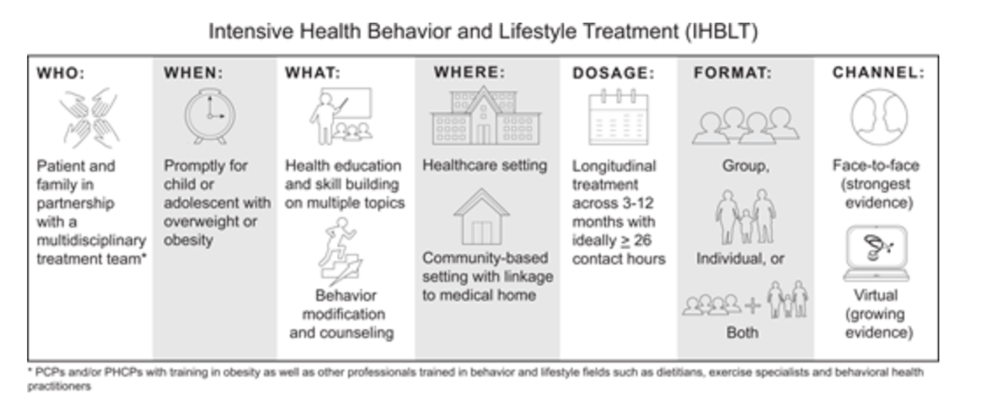


Intensive Health Behavior and Lifestyle Treatment⁶
  family based
  About 26 or more hours of counseling on nutrition and physical activity over a 3-12 month period

Slide 6
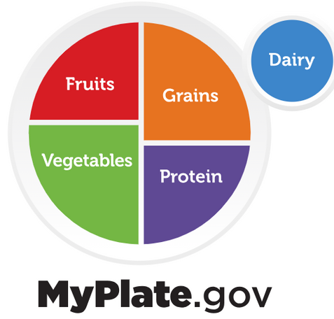




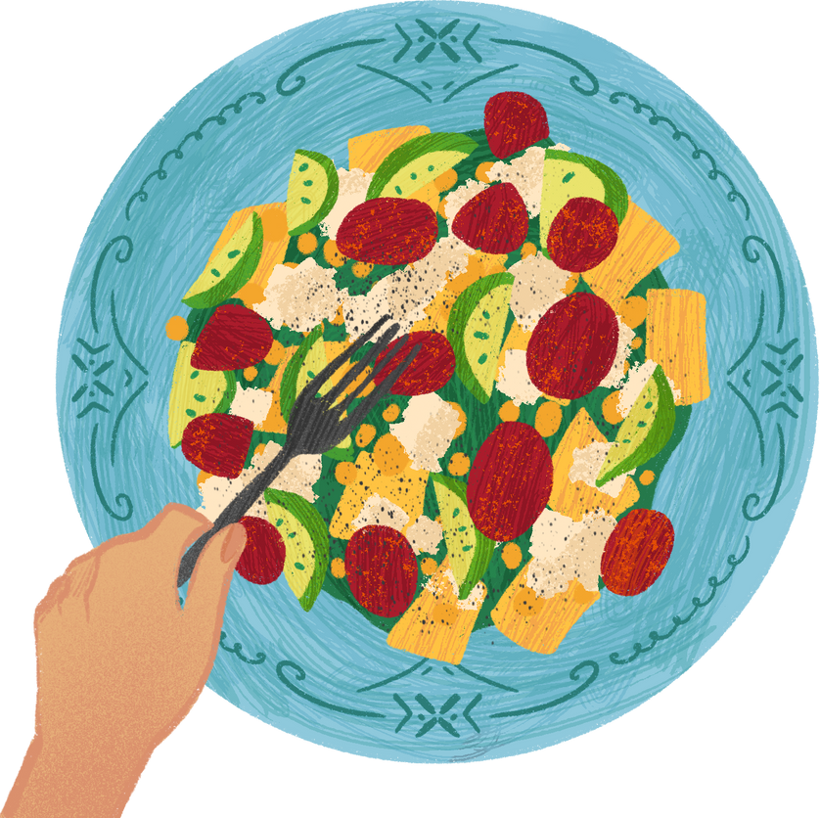
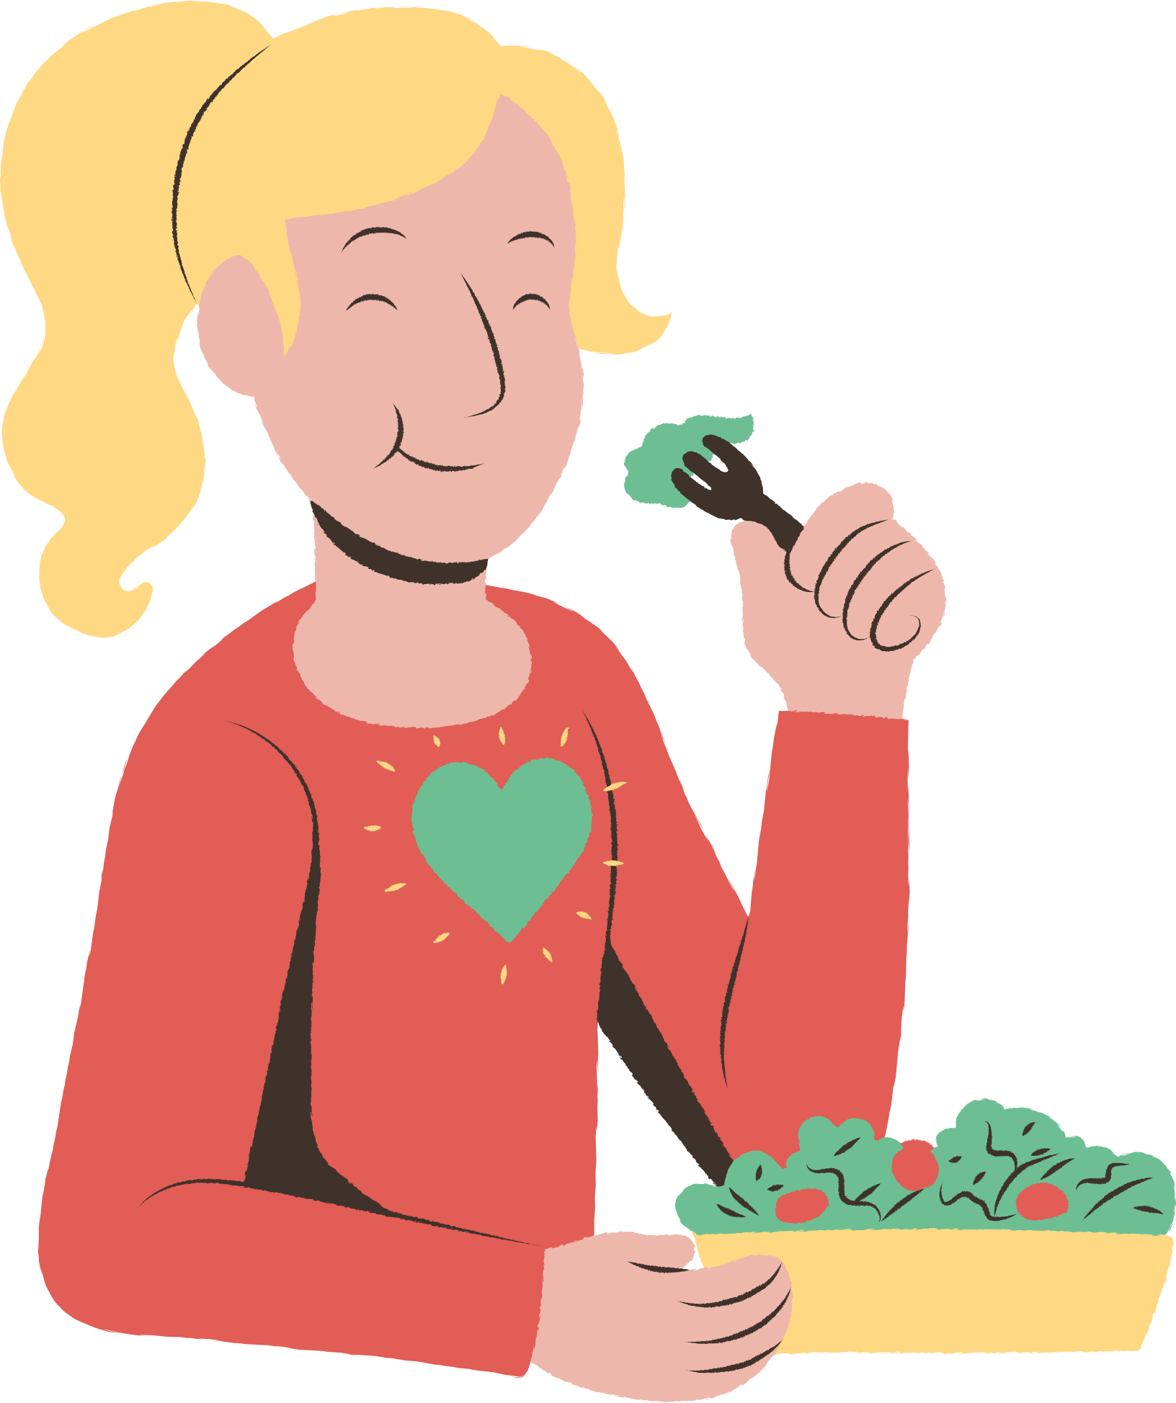
Recipe
Guidelines
  MyPlate as a guide for balanced meal
  Nutrient dense, appropriate for pediatric palate
  Less than $20/meal for 4 servings or more
  Minimal cooking skills and equipment necessary
Role of Dietetic Intern

Slide 7
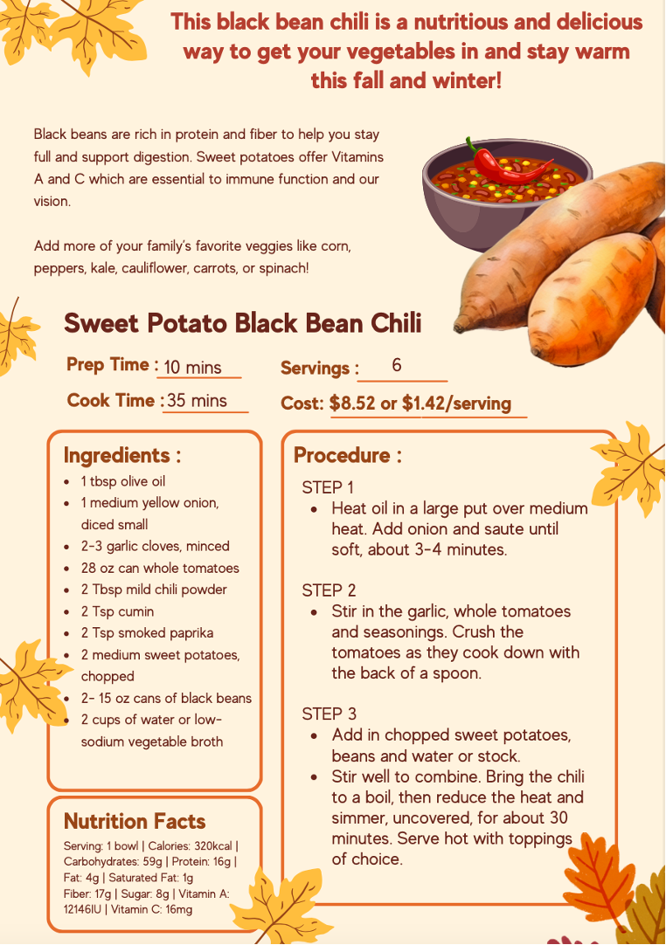
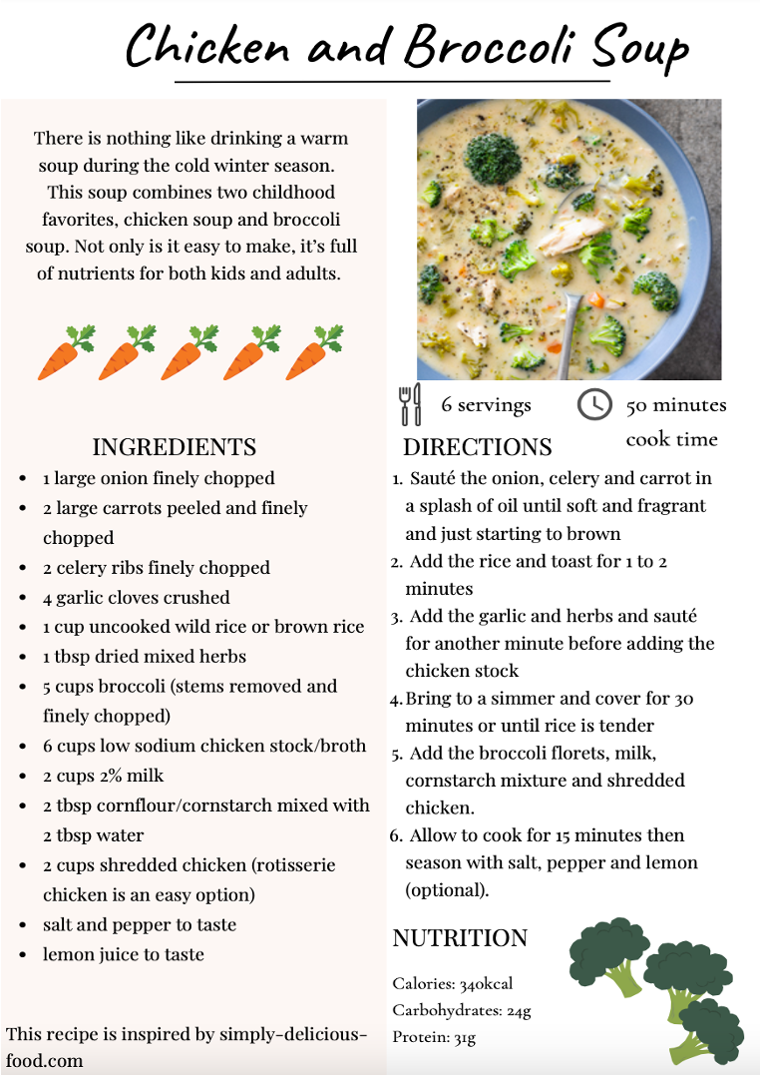

Slide 8
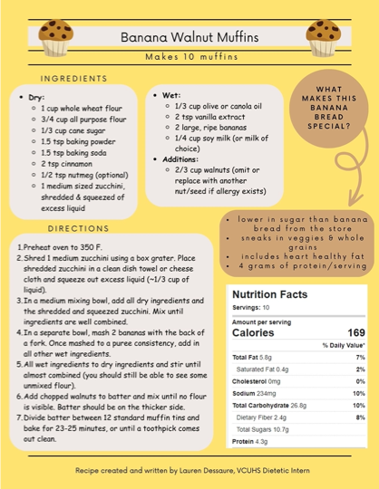
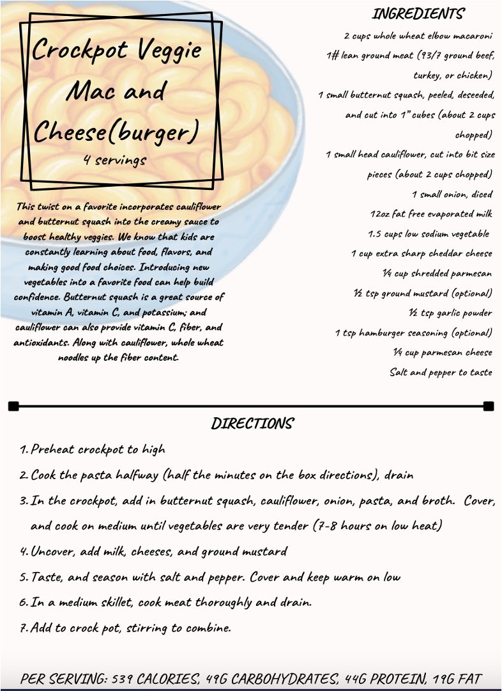

Slide 9
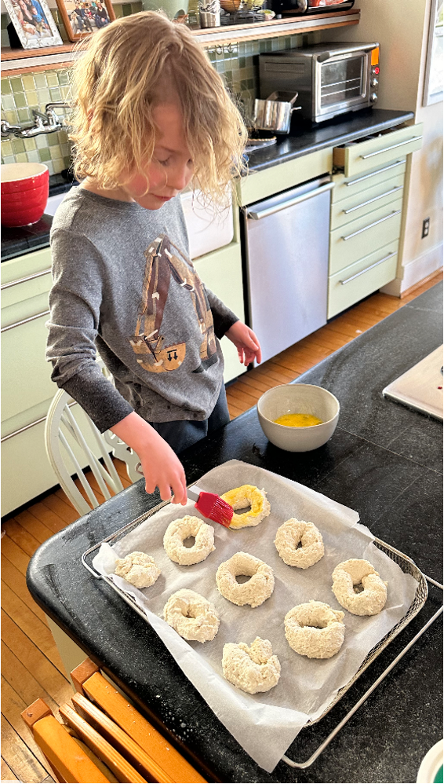
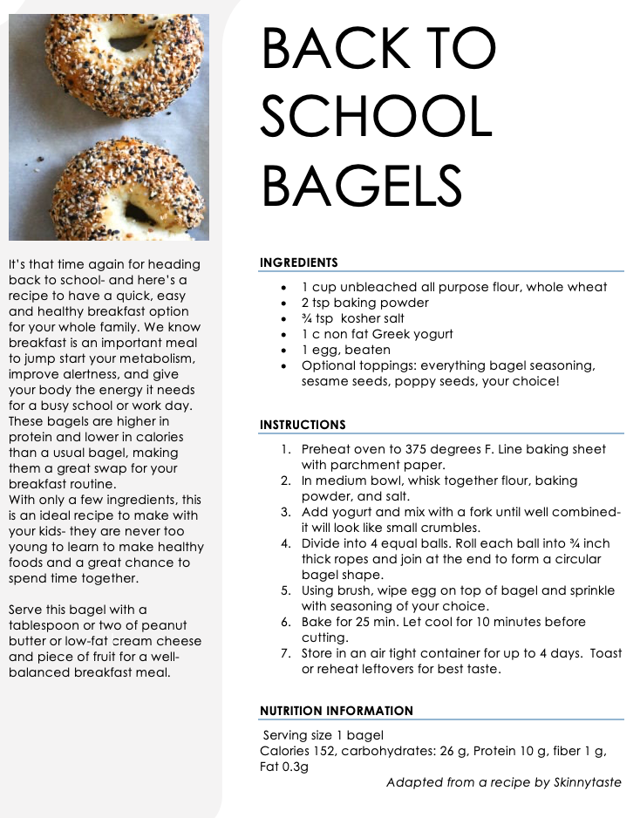

Slide 10




What’s next?
Data!
  What recipes do patients + families +
  Pediatricians like, dislike, acceptability
  Collaborate with Family Resource Center
    Give recipes along with non-perishable food items in FeedMore food boxes
    Potential for pediatric residency collaboration
  Community Advisory Board
  Cooking Classes
  Recipes + other materials available in Spanish

Slide 11
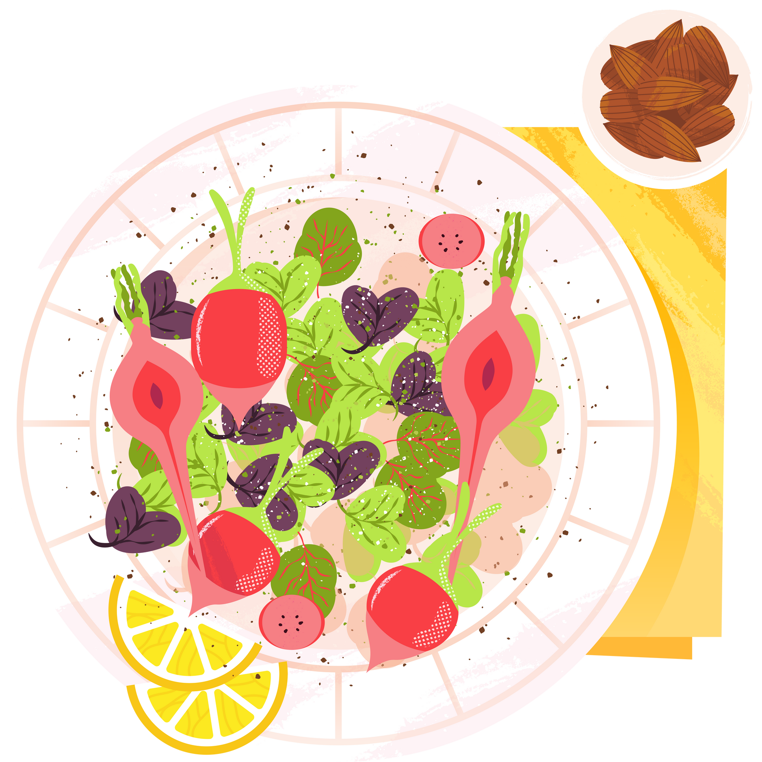


THANK YOU
Special Thanks to my collaborators:
•VCU Dietetic Interns: Jordan Folk, Maria Menjivar, Rachel Kauder, Arianna Sjamsu, Abby Caudle, Nicole Scott, Lauren Dessaure, Samantha Terry
•Dr. Susan Murray, Chair, VA Academy of Pediatrics Food Insecurity Practice Group
•Stephanie Stockslager, MS, RDN, VCU Health Dietetic Internship Program Director
•Dr. Hannah Hollon, Former Pediatric Obesity Medicine Fellow, now currently a Pediatric Cardiology Fellow at Children’s Hospital of Colorado

Slide 12




Sources
1. U.S. Department of Agriculture and U.S. Department of Health and Human Services. Dietary Guidelines for Americans, 2020-2025. 9th Edition. December 2020. Available at DietaryGuidelines.gov.
2. Hamner HC, Dooyema CA, Blanck HM, et al. Fruit, Vegetable, and Sugar-Sweetened Beverage Intake Among Young Children, by State — United States, 2021. MMWR Morb Mortal Wkly Rep 2023;72:165–170. DOI: http://dx.doi.org/10.15585/mmwr.mm7207a1.
3. Bel-Serrat S, Klingenstein P, Marques-Previ M, Hennessy E, Murrin C. Perceived barriers to vegetable intake amoung urban adolescents from socoioeconomically disadvantaged bacgrounds: a qualitiative study from the perspective of youth workers and teachers. Physiology and Behavior. 2023; 262
4. Wang X, Ouyang Y, Liu J, Zhu M, Zhao G, Bao W, Hu FB. Fruit and vegetable consumption and mortality from all causes, cardiovascular disease, and cancer: systematic review and dose-response meta-analysis of prospective cohort studies. BMJ. 2014 Jul 29;349:g4490. doi: 10.1136/bmj.g4490. Erratum in: BMJ. 2014;349:5472. PMID: 25073782; PMCID: PMC4115152
5. Centers for Disease Control and Prevention. Childhood Obesity Facts.Last Reviwed May 17 2022. Accessed February 2 2024. https://www.cdc.gov/obesity/data/childhood.html
6. Hampl SE, Hassink SG, Skinner AC, et al. Clinical Practice Guideline for the Evaluation and Treatment of Children and Adolescents With Obesity. Pediatrics. 2023;151(2): e2022060640
7. Rhee KE, Kessl S, Lindback S, Littman M, El-Kareh RE. Provider views on childhood obesity management in primary care settings: a mixed methods analysis. BMC Health Serv Res. 2018 Jan 30;18(1):55. doi: 10.1186/s12913-018-2870-y. PMID: 29378579; PMCID: PMC5789606.

Slide 13


Questions?
stephanie.joyce@vcuhealth.org
Healthy Lifestyles Center
Pediatric Endocrinology

