Slide 1
Population Health M3 Year
Michael Joyce, MD, FACEP
Associate Professor OF Emergency Medicine and radiology
VCU School of medicine

Slide 2
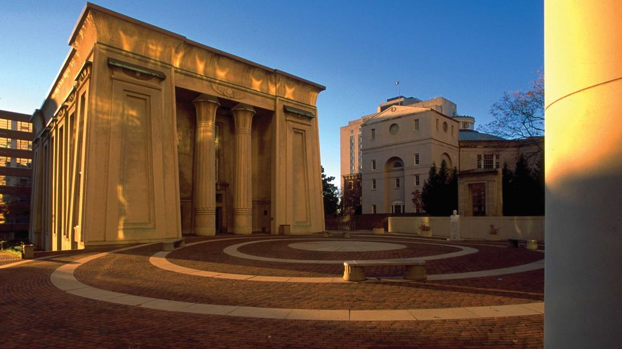
Who am I?
VCU SOM Class of 2012
VCU Emergency Medicine Residency 2012-2015
VCU Ultrasound Fellowship 2015-2016
Teaching in Medical Education 2015-2017
EM Faculty 2016-current
SOM US Course Director

Slide 3
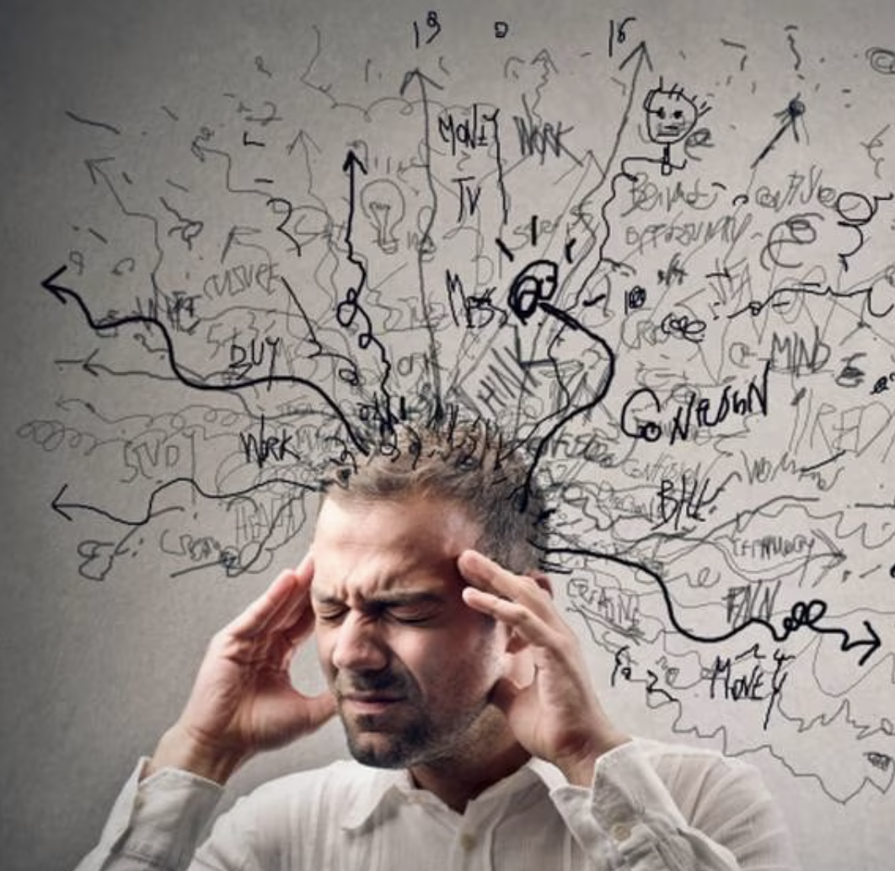
M3 Year

Slide 4

What is population health?
“The health outcomes of a group of individuals, including the distribution of such outcomes within the group”
Focuses on the collective outcome of a group, and not an individual
  This can be very tough to accept when it affects us and not the group

Slide 5

What is population health?
What controls outcomes?
  complex web of cultural, environmental, political, social, economic, behavioral, and genetic factors
How can we navigate this?
  Follow the evidence

Slide 6
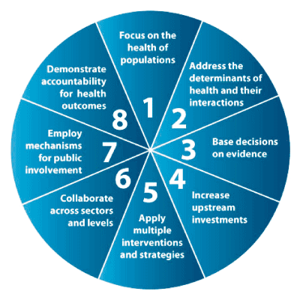
What is population health?
Evidence Based Medicine “EBM”
“EBM is a systematic approach to the acquisition, appraisal and application of research evidence to guide healthcare decision.” (Dans et al, Painless Evidence Based Medicine, page 4).

Slide 7
What is EBM
Evidence-Based Medicine (EBM) aims for the ideal that healthcare professionals should make "conscientious, explicit, and judicious use of current best evidence" in their everyday practice.
EBM practitioners engage in life-long learning and are committed to the continuing education of professionals and patient communities
EBM teaches us to distinguish between clinician viewpoints and scientifically supported statements
Medical knowledge rapidly changes, and is only accelerating
  Must be able to interpret what will help your patients

Slide 8
What got me interested in EBM?
Medical dogma and pseudoaxioms
Dogma is a belief generally held to be true by a group, organization or professional body that is put forth as authoritative without adequate grounds.
Pseudoaxioms, like pseudoscience, are “false principles or rules often handed down from generation to generation of medical providers and accepted without serious challenge or investigation” (Newman, 2007)

Slide 9
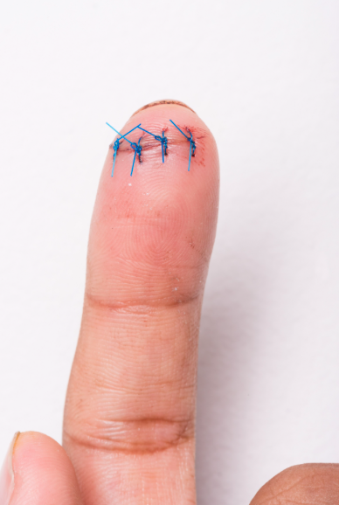
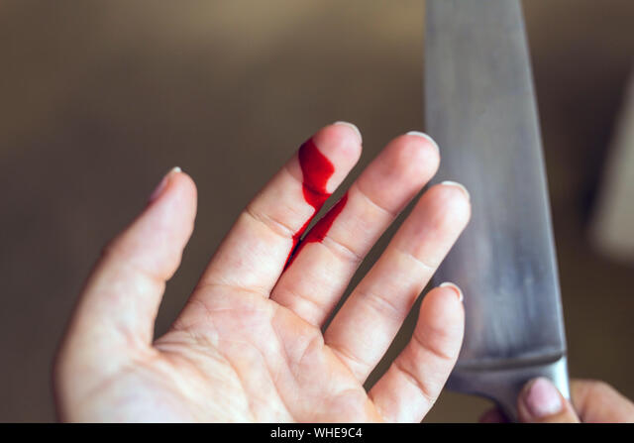
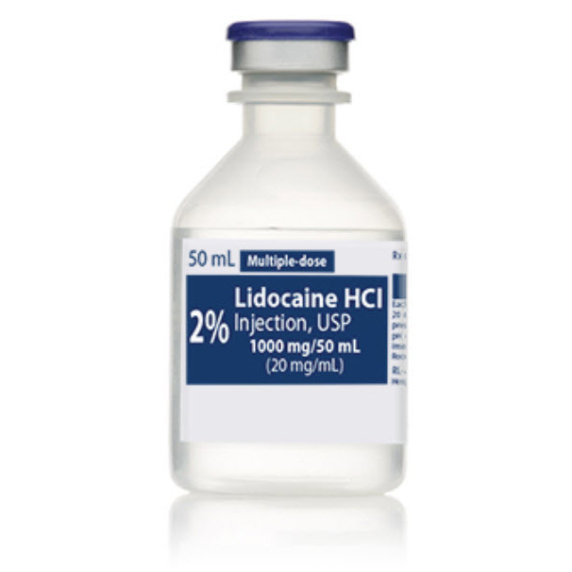
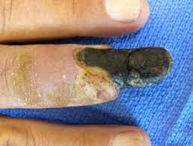
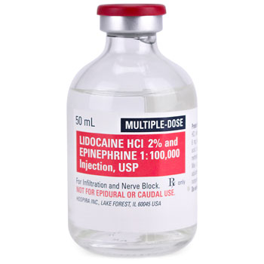
From Rosen's, THE textbook for Emergency Medicine:
“epinephrine-containing local anaesthetics in ring blocks must be avoided for digital anaesthesia due to the risk of gangrene”

Slide 10
More examples:
“avoid administration of opioids to the patient with undifferentiated abdominal pain because it interferes with diagnosis”
“calcium must be avoided in chronic digoxin toxicity due to the risk of causing a ‘stone heart'”
“septal haematoma causes necrosis of the septal cartilage unless urgently treated”
“early oral feeding after surgery is dangerous”
“immediate fluid resuscitation saves lives in penetrating torso injuries”
“shellfish allergy means you cannot get iodinated IV contrast”
“cricoid pressure is useful during rapid sequence intubation due to risk of aspiration”
“AMA discharges protect the physician”

Slide 11
WHY DOGMA AND PSEUDOAXIOMS PERSIST
A logical theory often trumps reality
Peer behaviours become a practice pattern, and these norms are difficult to break – in fact, there is a usually a benefit to preventing rogue behaviour
Current publication practices may distort science
Scientific facts have a ‘half-life’ — findings published in high impact, highly cited journals can be overturned by subsequent research (termed “medical reversal”) but not get the same traction
It is easier to stick to learned dogma in a field of permanent flux, humans are not good at “unlearning”

Slide 12
It is everyone’s responsibility to find out how to ask questions systematically, find answers from searching the literature, critically appraise the literature and apply the results to practice.

Slide 13
What I did about it
Took EMBRS (Emergency Medicine Basic Research Skills)
  Bootcamp on EBM for 2 weeks in Texas
Started the EBM curriculum for EM residency
Run a longitudinal track for residents interested in expanding their skills
Reformatted journal clubs for the residents to focus on answering a question
Committed to being a life-long learner
I still have to google information on statistics, study design, etc routinely!
The more you practice, the easier it becomes

Slide 14
The Course
Population Health M3
Evidence Based Medicine M3
7 Sessions – first today (required - grading based on attendance)
There will be pre-reading (mandatory!)
Discussion on the articles, one main learning theme per session
Quiz for each session (easy if you do the reading and come to class)

Slide 15
The Course: EBM M3
Evidence-based medicine is a systematic approach to using current research in determining management decisions about the care of a particular patient
Goal
The goal of this course is for students to learn the necessary knowledge and skills to acquire, appraise, and apply evidence-based medicine to the care of their patients. By the end of this course, third year medical students will be to make patient care decisions using the principles of EBM.
Objectives
Demonstrate the ability to formulate a specific clinical question which is based on a patient scenario and which is in the format of PICO (Population/disease, Intervention/exposure, Comparator, and Outcome);
Demonstrate proficiency in performing a search of the medical literature to answer a clinical question;
Demonstrate the ability to evaluate articles for study methodology, effectiveness, and generalizability;
Demonstrate the ability to succinctly summarize evidence in the context of patient preferences;
Present summarized evidence as a recommendation to a patient.

Slide 16
The Course
Grading:
  Competency Achieved / Not Achieved
  If you want to pass the course:
    Read the articles
    Come to class and participate
    Reach out if questions, have concerns or need help
    Pass!
  My goal is for you to feel confident to make clinical decisions based on medical literature using the skills introduced during this course
  I am not interested in anyone memorizing facts, stats equations or material from specific articles. I am not trying to develop researchers. We will focus on skills for every doctor to succeed regardless of specialty!

Slide 17
Step 1:
How do I find the literature!?
John Cyrus - Research and Education Librarian

Slide 18

Resume at 9a tomorrow

