Slide 1

Population Health M3
An introduction to evidence based medicine for patient care
Michael Joyce, MD, FACEP
Associate Professor of Emergency Medicine and Radiology
VCU School of Medicine

Slide 2
Housekeeping:
Quiz will be open immediately after this lecture, and open until Wednesday end of day (11:59pm)
The quiz is short questions that you will be able to answer easily if paid attention to and participated with the presentation
Please remember to take the quiz!

Slide 3
Recap of what we have covered so far
Session 1: Intro to EBM, Resources for finding the best evidence
Session 2: How to ask a good question, refining the ask to get an answer
Session 3: Applying diagnostic studies to your everyday practice – likelihood ratios are your friend
Session 4: Therapy studies - interpreting new data – should I do this for my patient(s)?
Session 5: Harm - understanding the importance of observational studies
Session 6: Prognosis - knowing what is likely to happen to my patient

Slide 4


The Evidence Cycle
EBM

Slide 5


The Evidence Cycle
https://guides.library.vcu.edu/clerkships
EBM

Slide 6
The Evidence Cycle
Takes continued practice – more practice today
EBM

Slide 7
The Evidence Cycle
What decision am I making?
Diagnosis
Therapy
Harm
Prognosis
EBM
Today:
Recap
Prognosis
Intro to SDM

Slide 8
Goals and Objectives
Today’s goals:
  Review some of the concepts we have covered
  Discuss prognosis studies
  Identify what prognostic factors are
  Reinforce the importance of patient centered outcomes
  Intro to shared decision making

Slide 9
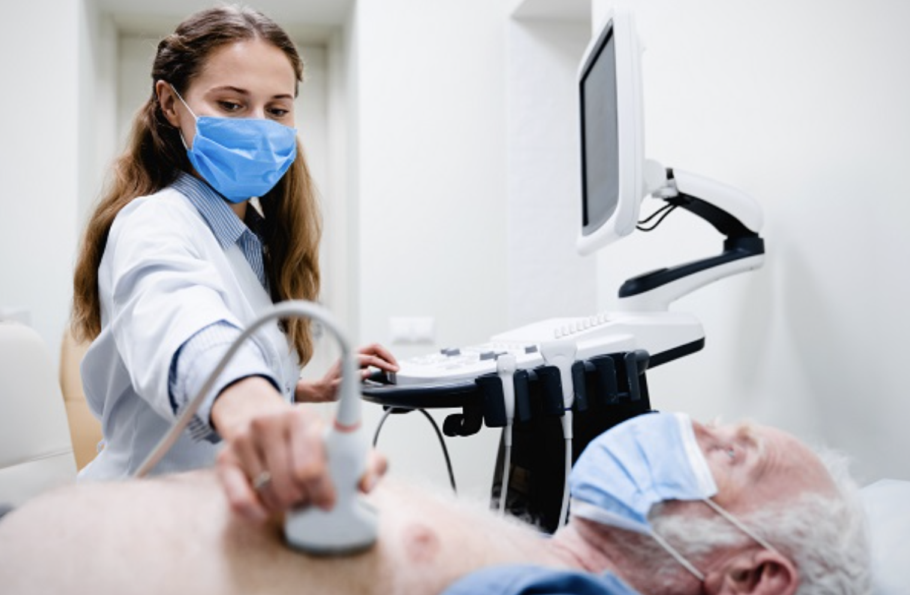
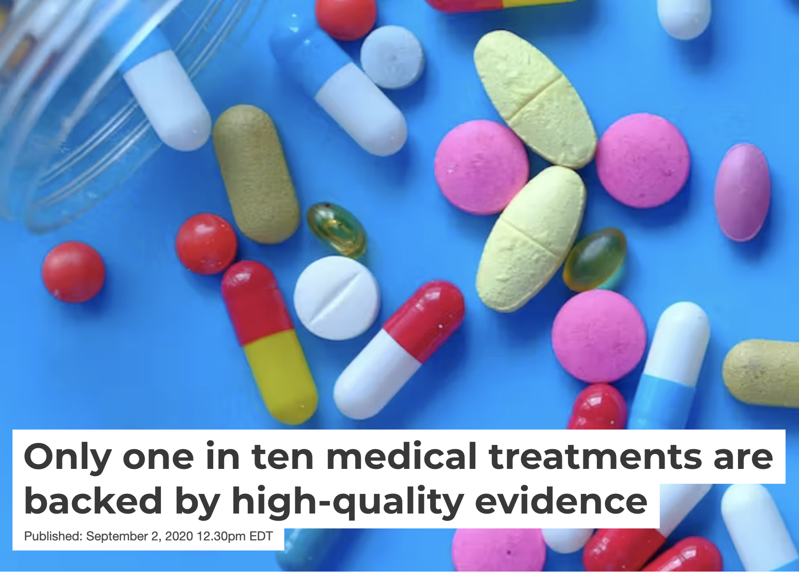
How do doctors actually help patients?
Diagnosing
Treating

Slide 10
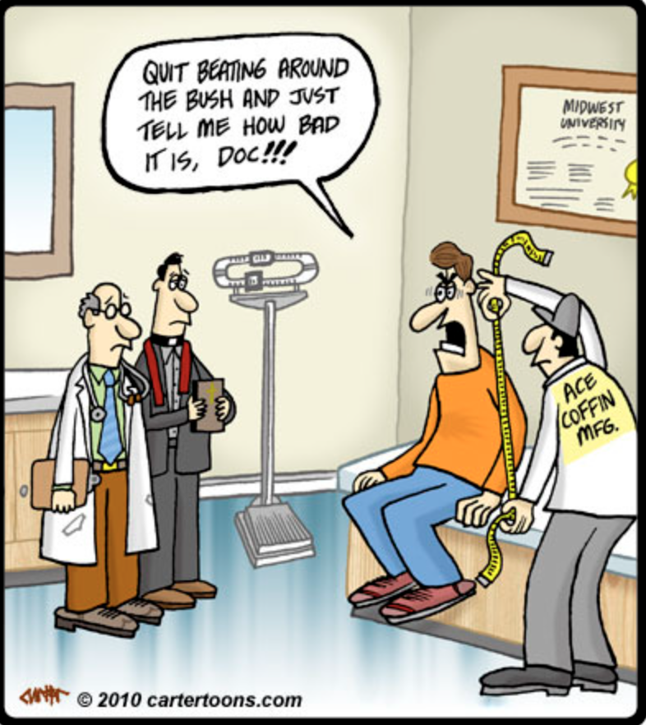
How do doctors actually help patients?
Prognosis

Slide 11
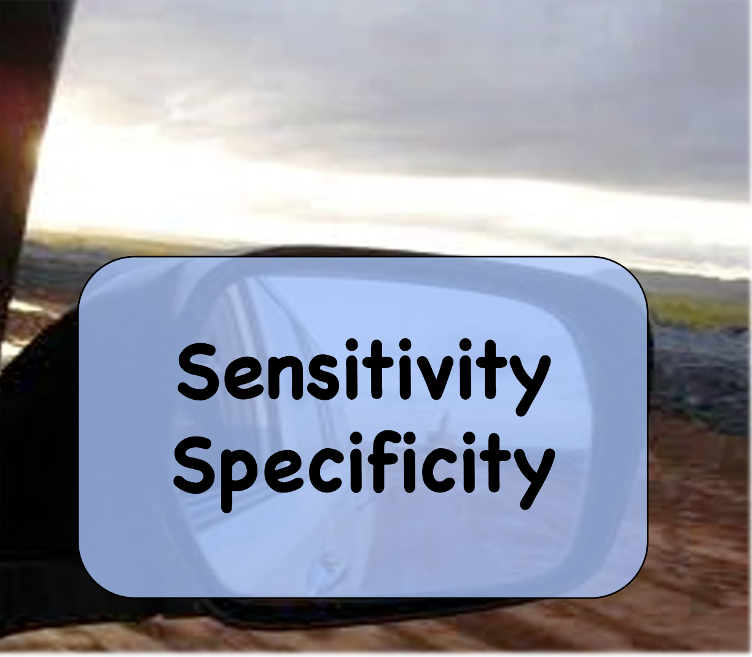
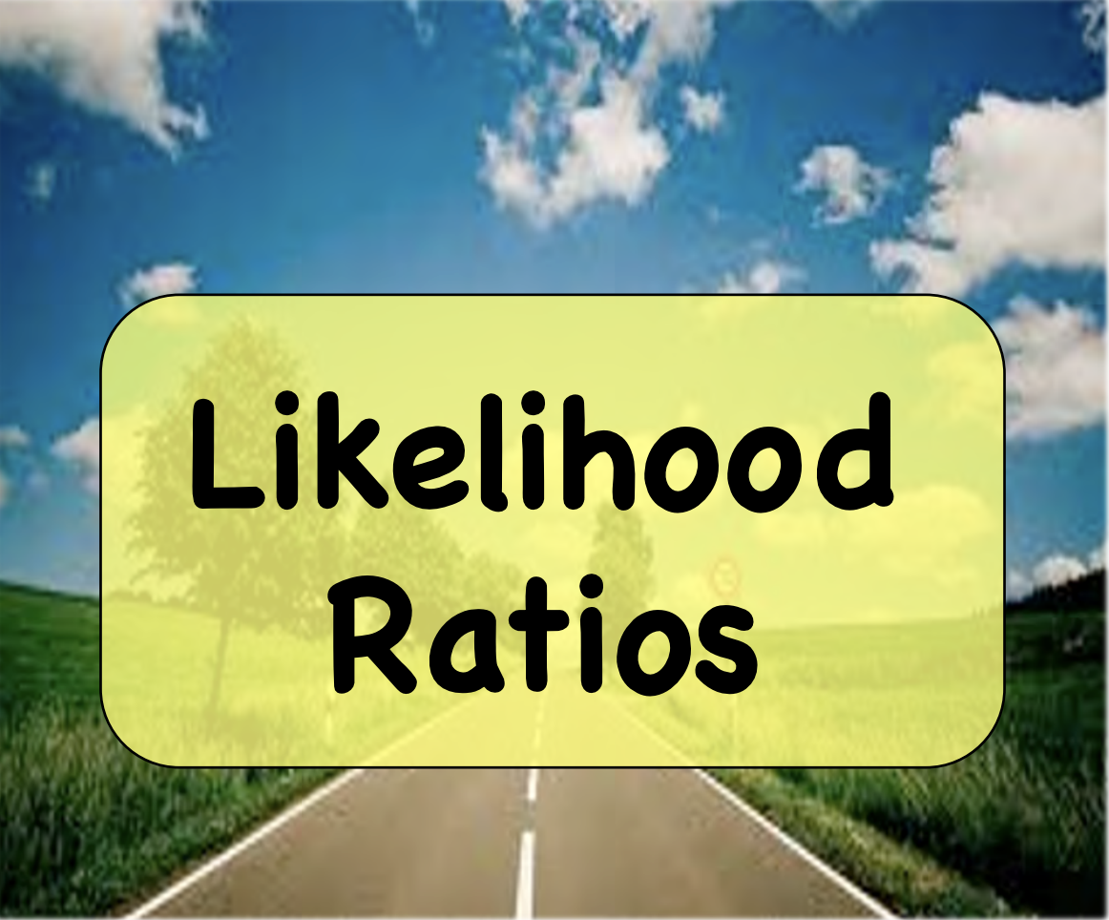
Diagnosing: using tests

Slide 12
Diagnosing: using tests
Sensitivity: the ability of a test to correctly identify patients with a disease
Specificity: the ability of a test to correctly identify people without the disease
LR+ Likelihood of the test being correct when it is positive
LR – Likelihood of the test being correct when it is negative

Slide 13
Diagnosing:
Don’t forget about likelihood ratios!
LR+ Likelihood of the test being correct when it is positive
LR – Likelihood of the test being correct when it is negative
> 10
< 0.1
Likelihood ratios have a number of useful properties:
  because they are based on a ratio of sensitivity and specificity, they do not vary in different populations or settings
  they can be used directly at the individual patient level
  they allow the clinician to quantitate the probability of disease for any individual patient.

Slide 14
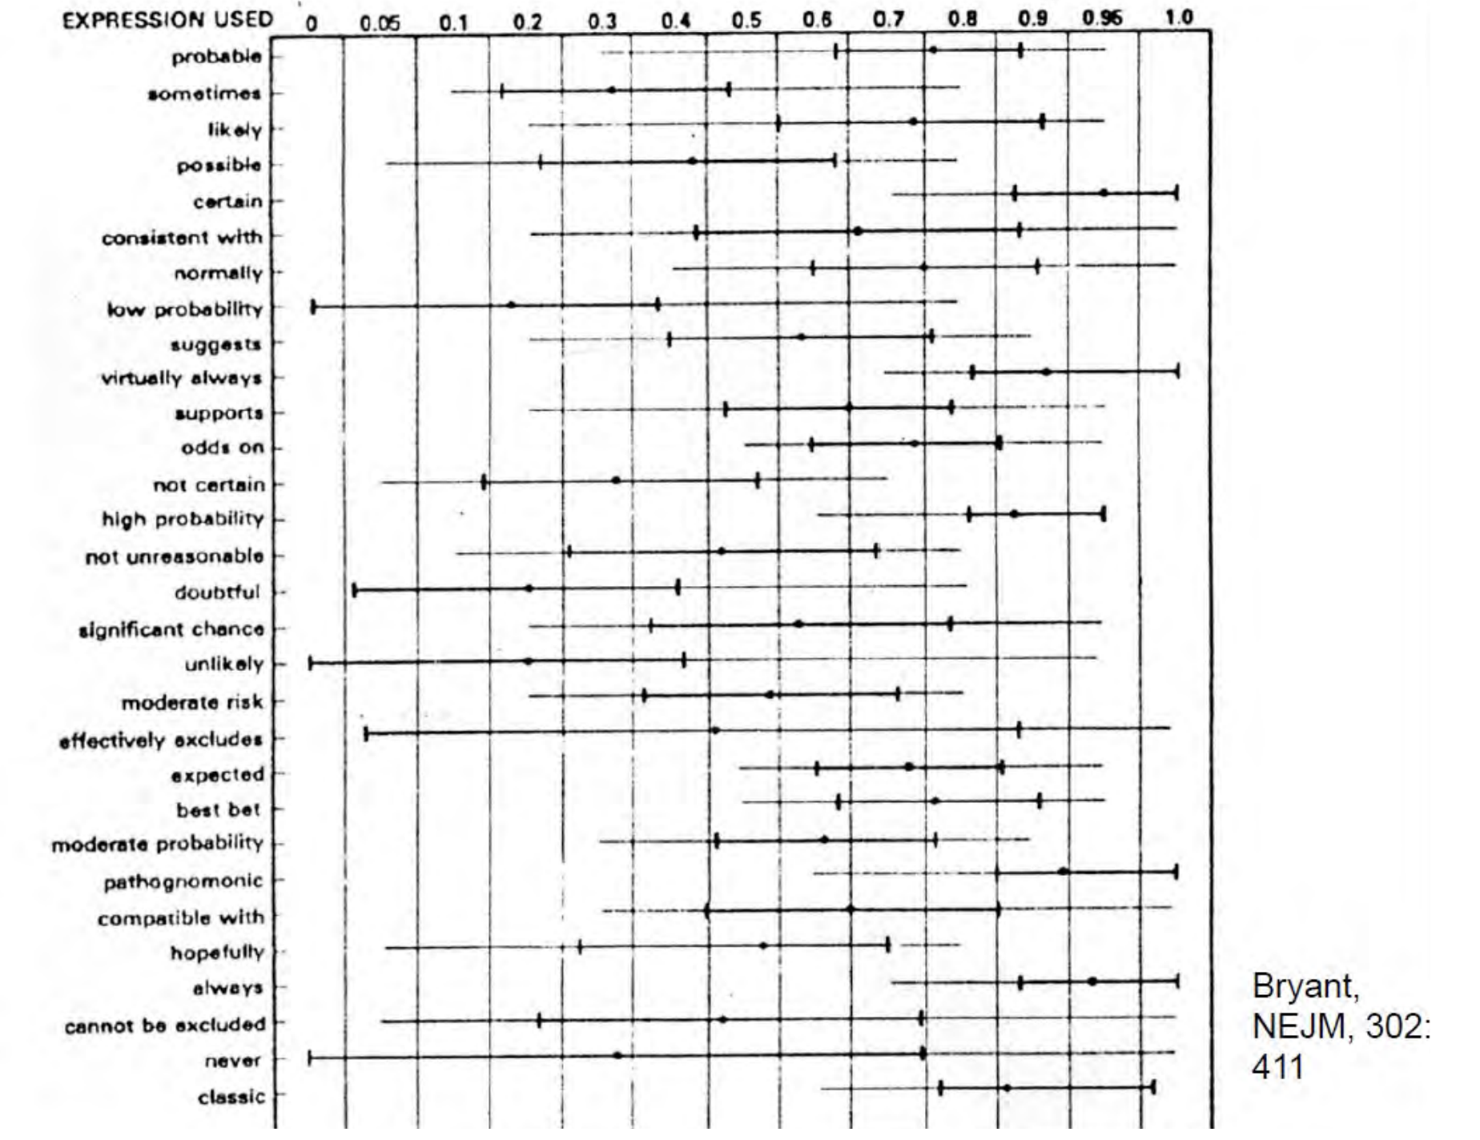
Expressions of Probability: Words and Numbers

Slide 15
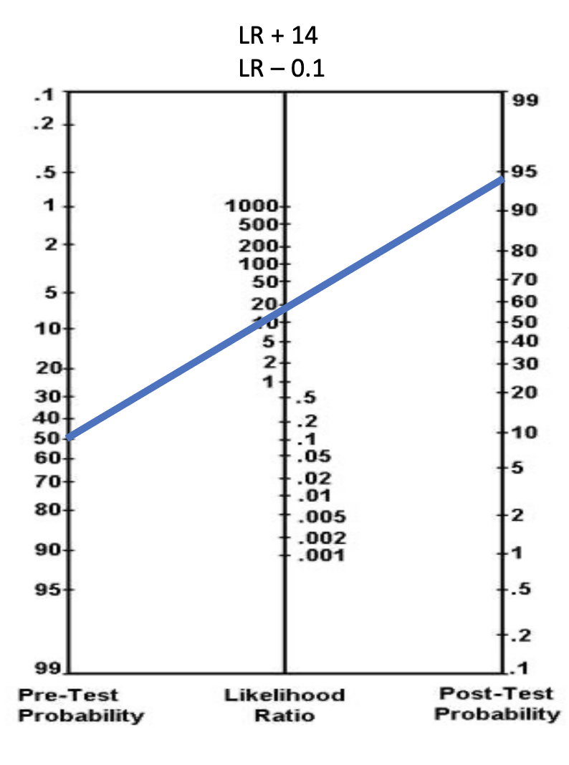
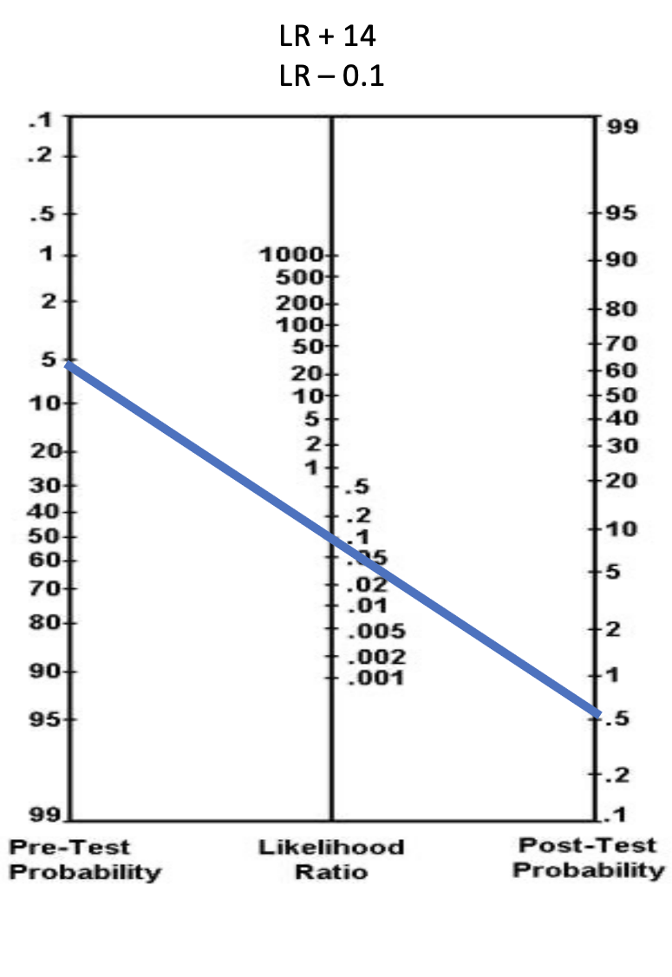

Slide 16
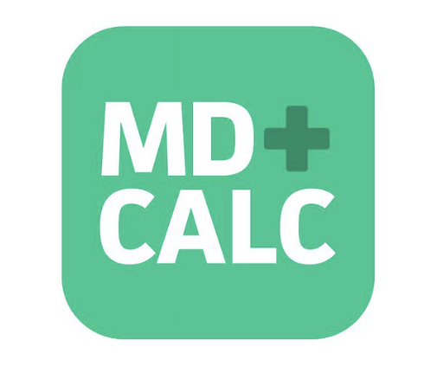
Use clinical decision-making tools to get pre-test probability
Cognitively unload us:
PE – Wells Criteria, PERC rule
Appendicitis- Alvarodo, pARC
Necrotizing fasciitis – LIRNEC
C-Spine Fracture – NEXUS
ICH – Canadian head CT
NIH Stroke scale

Slide 17
Diagnosing
Likelihood ratios:
  Affect real time decision making
  Integrate specificity and sensitivity (they use the whole 2x2 table!)
  Should be applied in all diagnostic work ups!
  Used appropriately, can prevent unnecessary testing or incorrect testing
  As you continue to rotate through M3 year, continue to think in terms of probability expressed as a percentage, not “pathognomonic, classic presentation, etc”. What does that mean for that disease ?
  The data is out there!

Slide 18

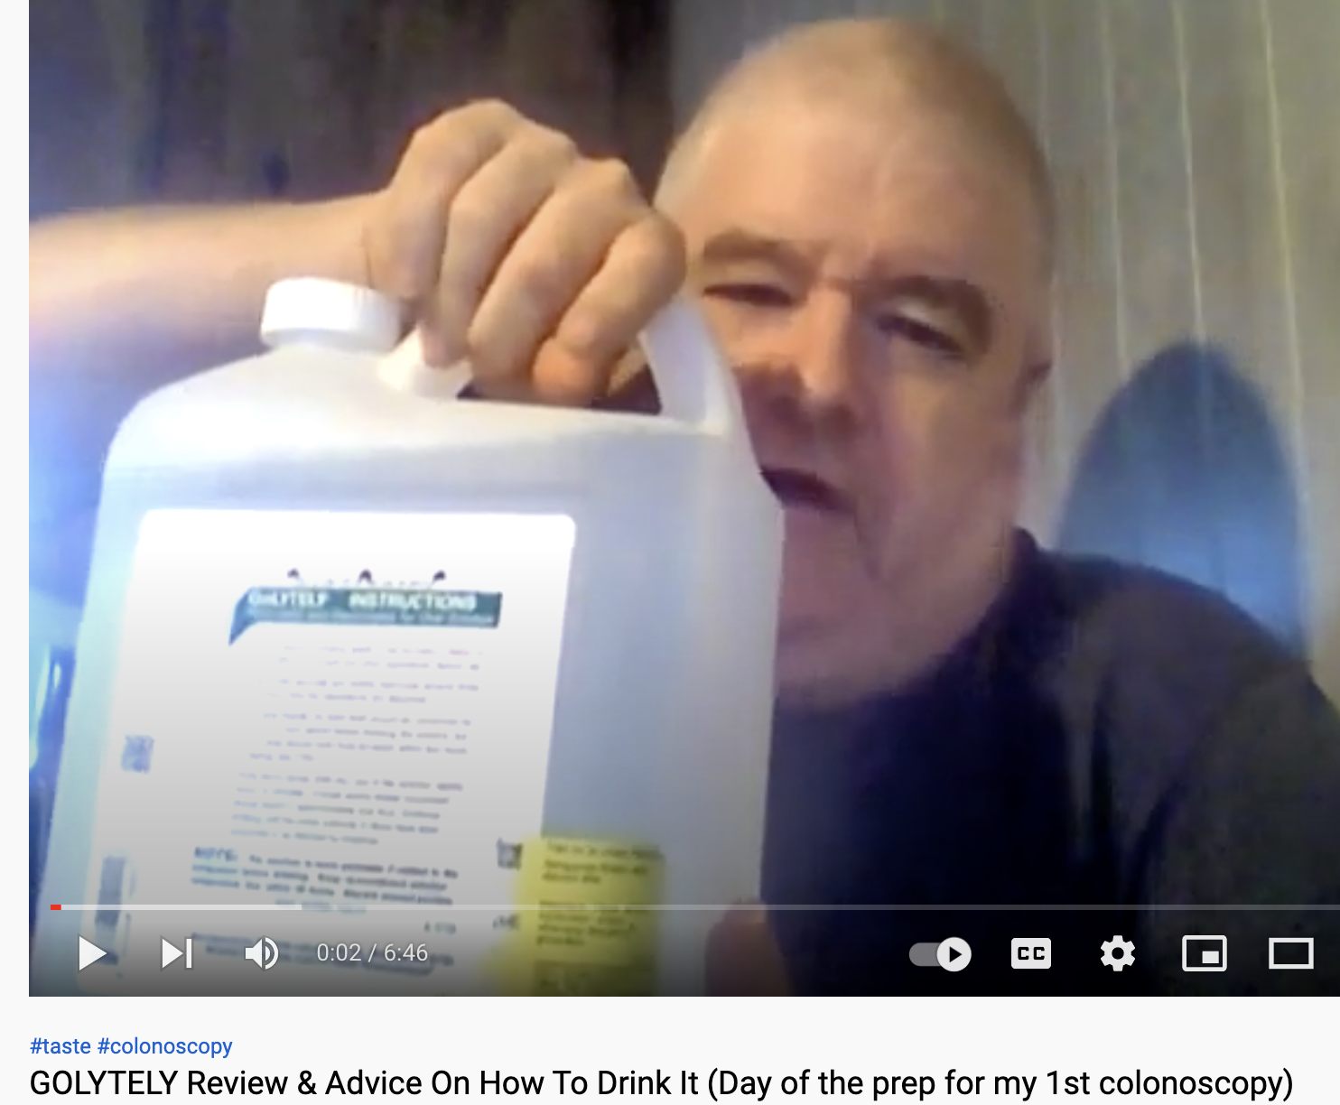
Case:
Treatment
You are a family physician. You are undergoing a new patient intake visit, for a 55 yo male. He only has a history of HTN on lisinopril. He has been getting his prescription from urgent care facilities and has no established primary care doctor. He states he would like to get caught up on age-appropriate screening. He doesn’t smoke, and has no family history of cancer. He asks: “Do I really need to get a colonoscopy?? I hear it is uncomfortable, hard to schedule and requires a lot of preparation. I watched a youtube video on it and the reviews were not favorable!”

Slide 19

Treatment

Slide 20

Therapy - Randomized Trial

Slide 21
Evolution of evidence
New therapy developed
Physiologically makes sense, or bench trials/animal trials/small trials
Ideal next step: RCT with patient centered outcomes (takes long time)
Real world – observational studies with surrogate outcomes (quicker) or: controlled trials with surrogate outcomes (smaller, quicker)
Therapy approved, put into use
RCTs get started… take years to evaluate for patient centered outcomes
Study concludes - Therapy rejected and or/treatment not as effective as once thought
Long term observational studies completed

Slide 22
Treatment
Always re-evaluate new evidence
Avoid the noise – read Table 1, Look at results table, calculate numbers that make sense to patients (ARR, NNT), use those to help you guide clinical decisions
Randomized is the gold standard, but still requires very high methodological adherence
Intention to treat vs Per protocol – both have their benefits but ITT will simulate real world whether we like the result or not
Watch out for surrogate outcomes causing authors to over conclude

Slide 23

How do doctors actually help patients?
Diagnosing
Treating
Prognosing?
-LR+, LR –
-Pre-test, post test probabilities
- Avoid unnecessary testing
-RCTs
-Always re-evaluate with new evidence
-Observational trials have merit, especially when determining HARM

Slide 24
Prognosing
In simple acute cases, taken for granted, perhaps understated
  UTI, Fracture, Kidney stone, etc
In complex chronic cases, often overlooked
  HTN
  DM
  AFIB
  Joint arthritis
  CHF
  Crohn’s
In cancer cases – usually the first thing that is asked

Slide 25
Looking into the future:
Requires studies of prognosis
Allows doctors to help patients make the right decisions to line up with their values
Prognostic research has many important purposes
  (i) describing the natural history and clinical course of health conditions
  (ii) investigating variables associated with health outcomes of interest,
  (iii) estimating an individual’s probability of developing different outcomes
  (iv) investigating the clinical application of prediction models

Slide 26
Why is it so important?
If a patient is likely to improve without intervention, doctors should not recommend treatments, particularly those that are expensive or potentially toxic.
If a patient is at low risk of adverse outcomes, even beneficial treatments may not be worthwhile.
Some patients will experience poor outcomes regardless of which treatments are offered by the clinician.
When a patient better understands the long term outlook of a disease, they are MUCH more likely to take an active role in managing it.
  Cannot feel high cholesterol, but there are many adverse outcomes that patients may actually care about

Slide 27


What is the best type of study for prognosis?
Cross Sectional Study
Case Control Study
Randomized Control Trial
Prospective Cohort Study
Retrospective Cohort Study
Descriptive / Association
https://www.polleverywhere.com/multiple_choice_polls/Ts2dLEyKUfG2R0aDL1GjW?preview=true&controls=none

Slide 28


Slide 29


Slide 30


Slide 31


Slide 32


Slide 33


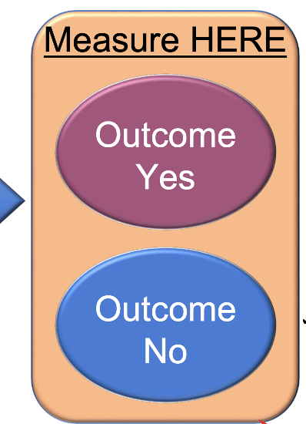
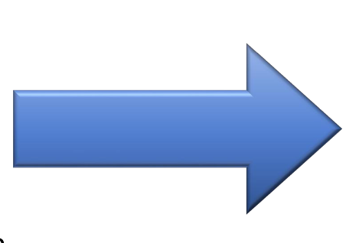

Prognosis study
Record potential differences in the groups

Slide 34
So what do prognostic studies look for?
Age
Sex
Co-morbidities (HTN, DM, etc)
As opposed to studies where you are applying an intervention, in prognostic studies, you are looking at either the natural course of the disease, or the expected course of the disease with standard care

Slide 35
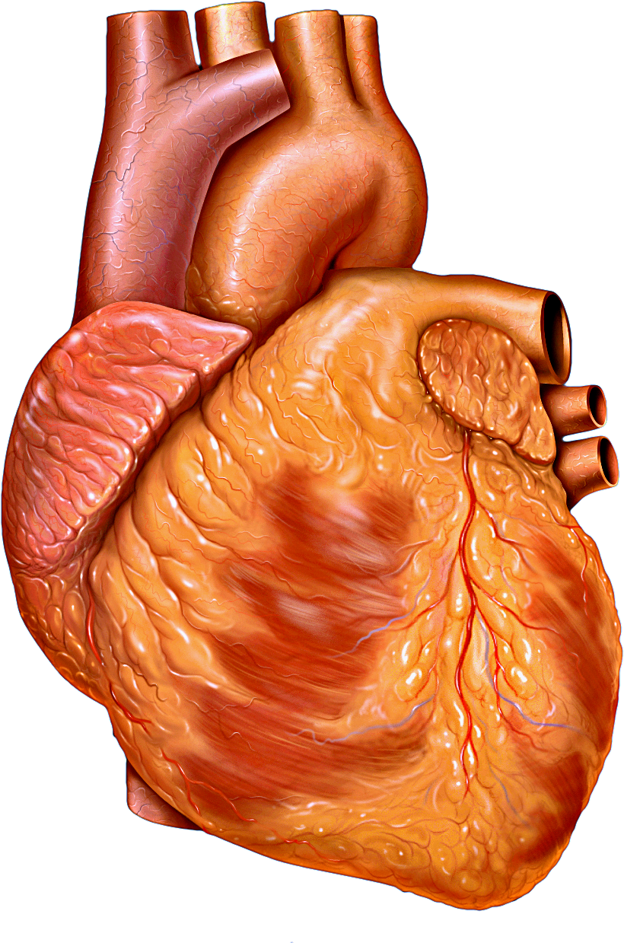
Let’s look at a case
A 50 yo male with a history of well controlled hypertension comes into your clinic stating that he has been experiencing on and off palpitations for the past month. His apple watch has noticed his HR is sometimes fast at a rate of around 110, but goes away when the palpitations stop. He denies any other symptoms. He noticed it once while snowboarding, and another time while rock climbing. He figured it could be related to his activities.

Slide 36
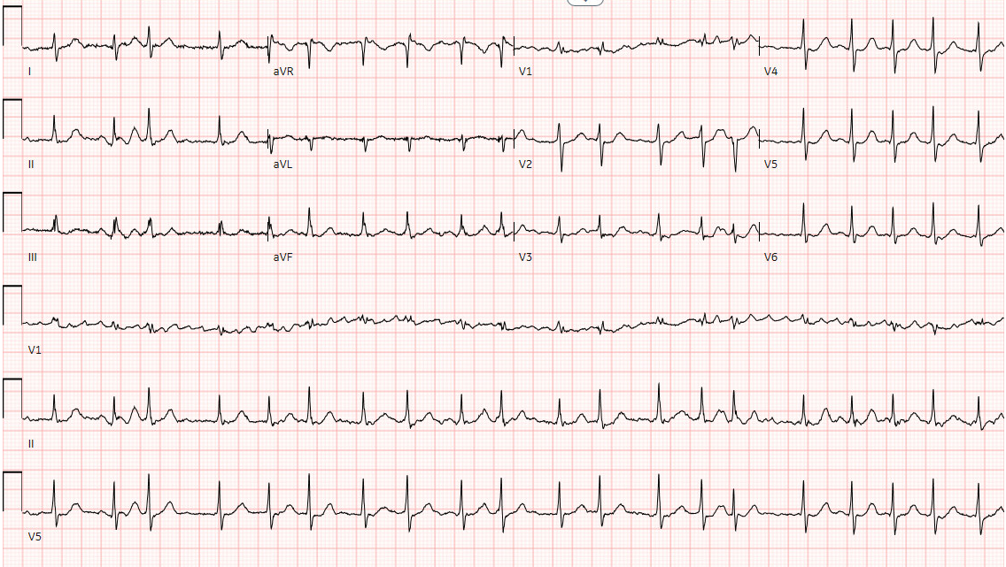
EKG:

Slide 37
Let’s look at a case
You appropriately refer the patient for an echocardiogram which returns normal. The patient is asking what this new diagnosis means for them? What is the treatment?
You recommend blood thinners. But the patient states that he is concerned about taking these given his lifestyle. He does not want to stop participating in extreme sports.
“What would happen if I didn’t take the blood thinners!?”

Slide 38

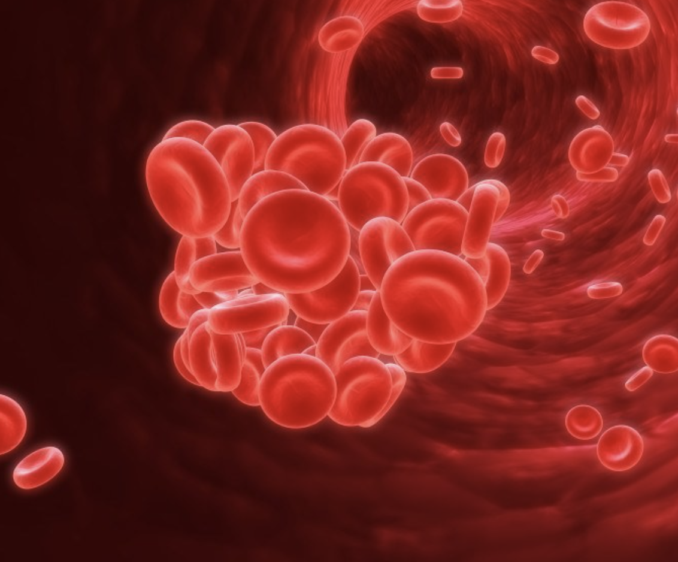

Slide 39

So… what is the first step?

Slide 40
Step one: what is the question?
P -
I -
C -
O -
T -

Slide 41
Step one: what is the question?
P – Adult patients with new diagnosis AFIB
I – Anticoagulation
C – No anticoagulation
O – Stroke
T – prognosis

Slide 42
Step one: what is the question?
P – Adult patients with new diagnosis AFIB
I – Time
C –
O – Stroke
T – Prognosis

Slide 43
Step 2, where should I start looking?

Slide 44
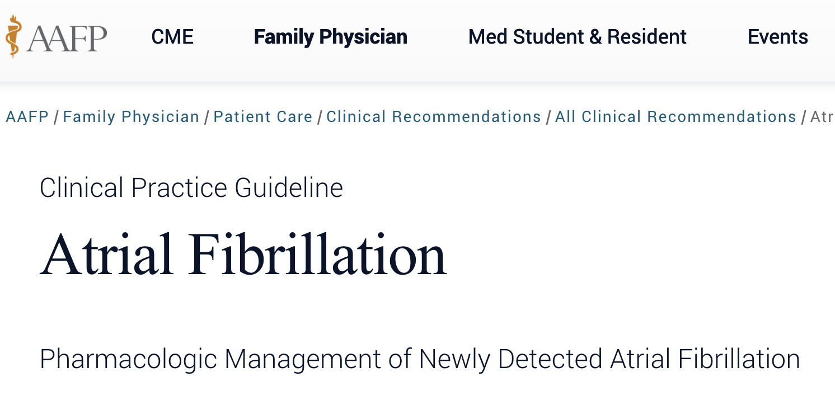
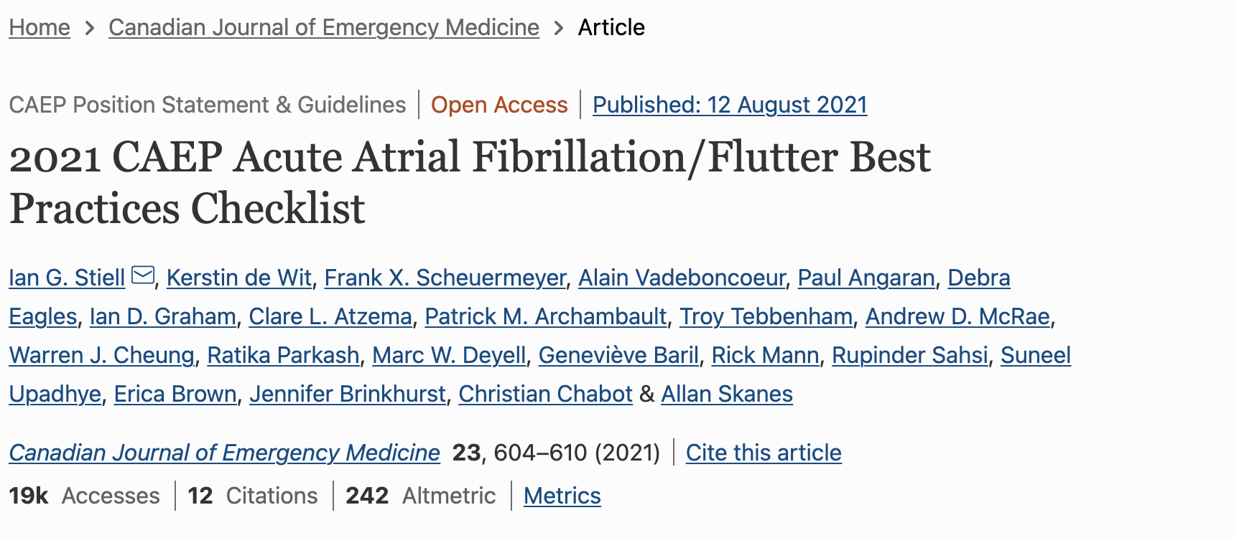
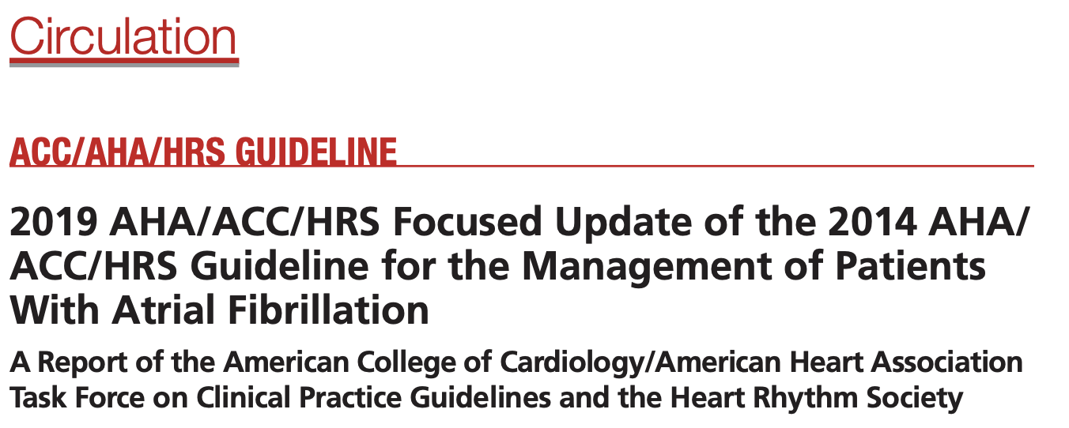
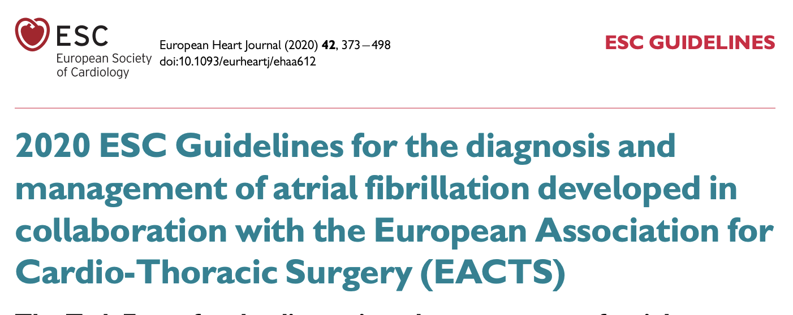
Look for clinical EBM guidelines:

Slide 45
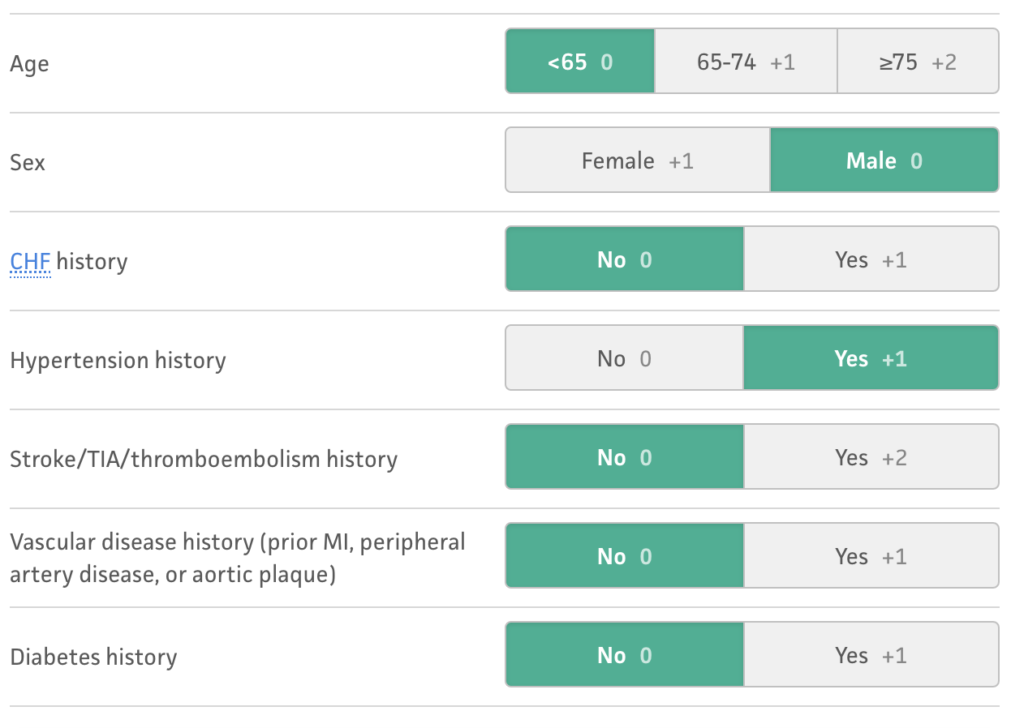

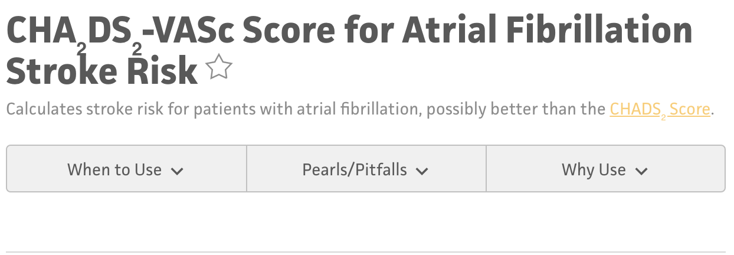
Look for clinical EBM decision making tools:

Slide 46
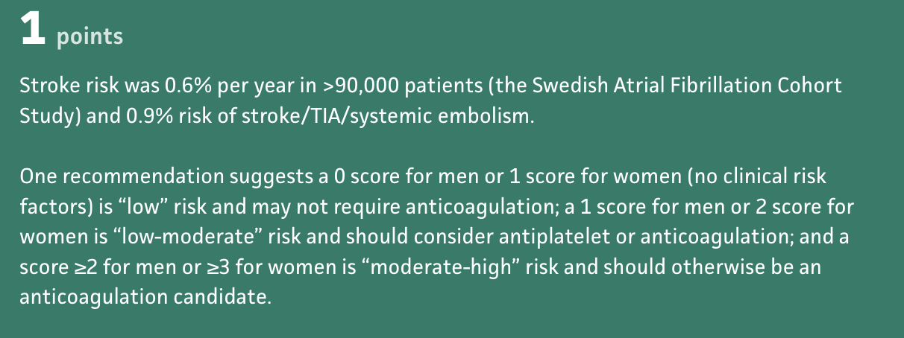
Look for clinical EBM decision making tools:

Slide 48
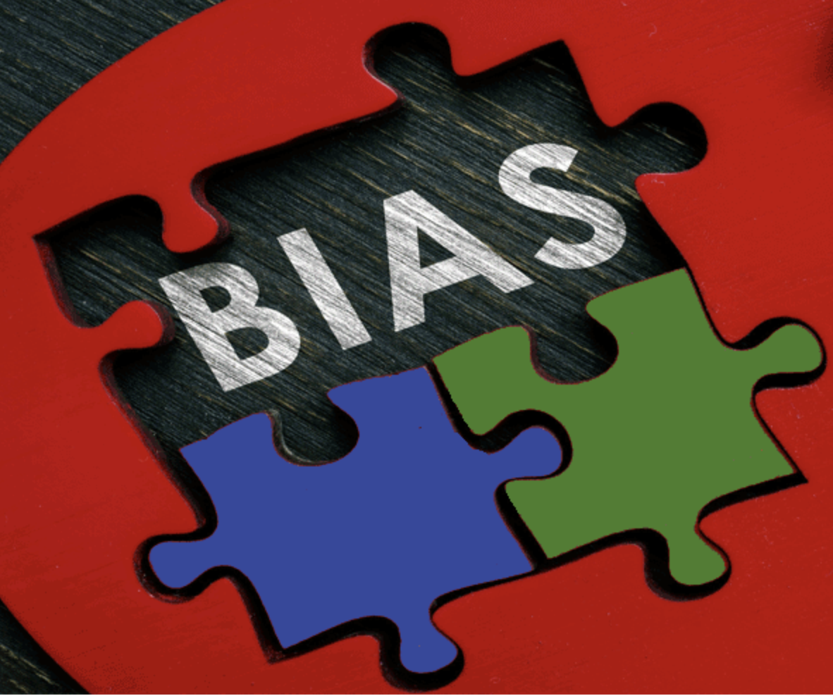

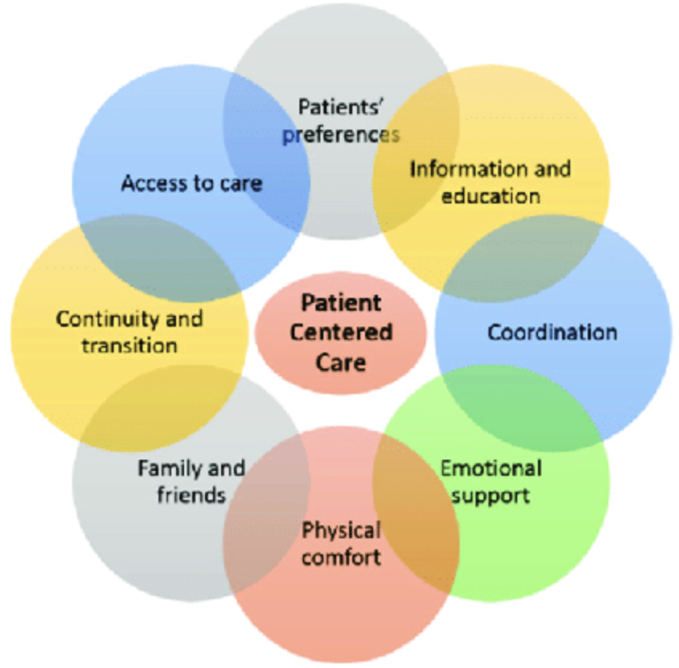
What makes a good prognosis study?

Slide 49
What makes a good prognosis study?
Was the Sample of Patients in a Study Representative?
Were the Patients Classified Into Similar Groups?
Was Study follow up Sufficiently Complete?
Were Study Outcome Criteria Objective and patient centered?

Slide 50
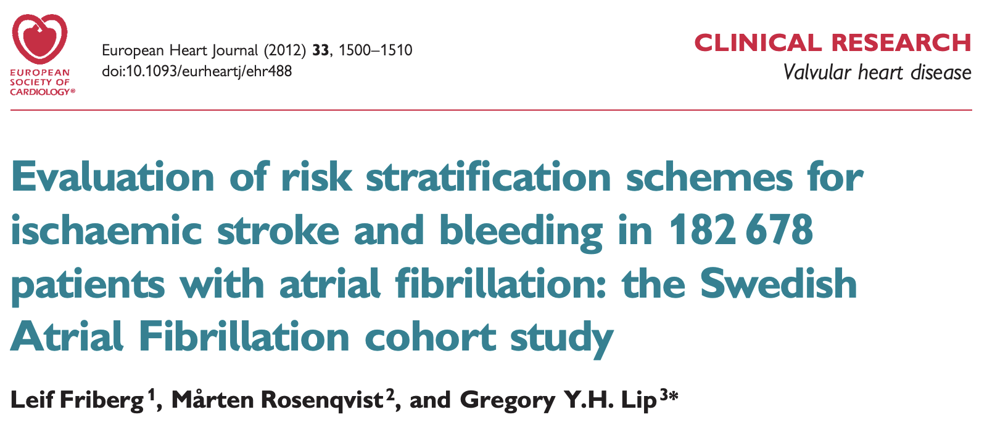

Slide 51
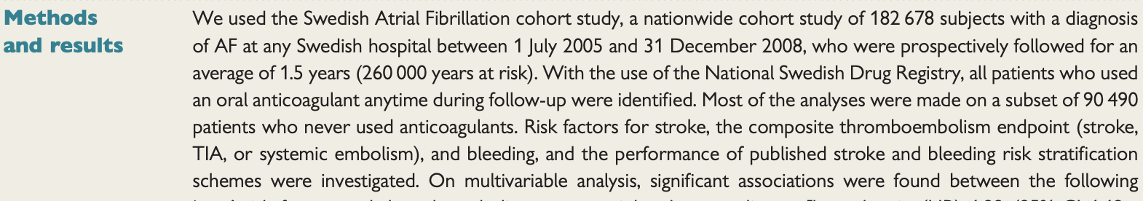

Slide 52
So what did they do?
Enrolled 180,000 patients with new diagnosis of Afib
Looked at the COHORT of patients that did not take OAC
Recorded suspected prognostic factors
Followed them over time
Found out which ones were related
Performed multivariate regression analysis to determine independent prognostic factors as predictors

Slide 53
What makes a good prognosis study?
Was the Sample of Patients in a Study Representative?

Slide 54
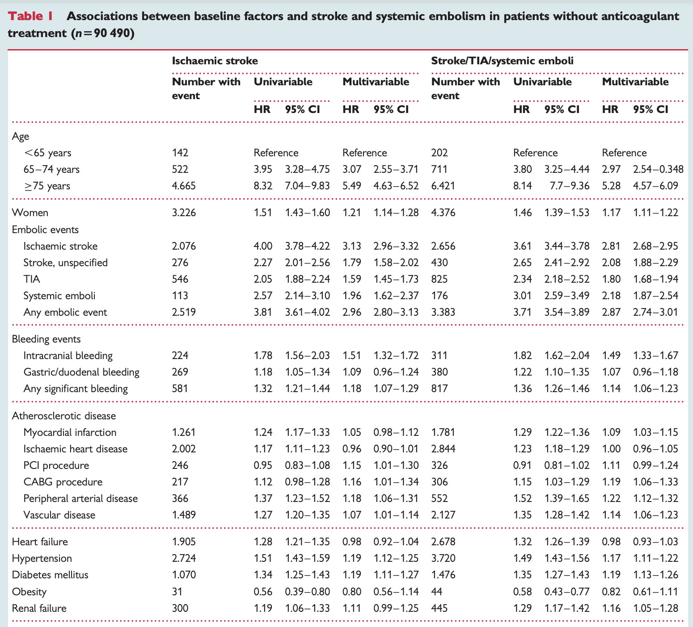
Was the Sample of Patients in the Study Representative?

Slide 55
What makes a good prognosis study?
Were the Patients Classified Into Similar Groups?
Was Study follow up Sufficiently Complete?

Slide 57
What makes a good prognosis study?
Were Study Outcome Criteria Objective and patient centered?

Slide 58
What are the results?

Slide 59


What makes a good prognosis study?
Was the Sample of Patients in a Study Representative?
Were the Patients Classified Into Similar Groups?
Was Study follow up Sufficiently Complete?
Were Study Outcome Criteria Objective and patient centered?

Slide 60
How do observational studies report findings?
Odds vs Risk-
  This is very confusing, and often misused
  Even by researchers, editors and final published work!
  RISK
    Simply put is a probability
    The probability of something happening, compared to all the outcomes.
    Best for looking at multiple outcomes
  ODDS
    A ratio of occurring vs not occurring
    Best for looking at binary outcomes

Slide 61


Slide 62


Slide 63


Slide 64
Prognosis study will report Hazard Ratio instead of Odds Ratio
An Odds ratio is the odds of one event happening compared to a DIFFERENT event happening
  Odds of Maple Leafs winning vs Tampa Bay winning
Hazard ratio looks at how often it happens in one group, vs how often it happens in another group over time
  How many times over 10 years do the Leafs win, with Austin Matthews vs without him. With a head coach, or without.
  Represents the RATE of difference between the two outcomes over time

Slide 65
Don’t forget about confidence intervals!
Confidence intervals are intervals in which the population statistic could lie. They are constructed based on the sample statistic and certain features of the sample that gauge how likely it is to be representative and are reported to a certain threshold.
  A 95% confidence interval is an interval constructed such that, on average, 95% of random samples would contain the true population statistic within their 95% confidence interval
  If the confidence interval cross over 1 in a hazard ratio, it means that there is NO ASSOCIATION between prognostic factor and the outcome

Slide 66

As you increase sample size, Confidence interval becomes smaller

Slide 68
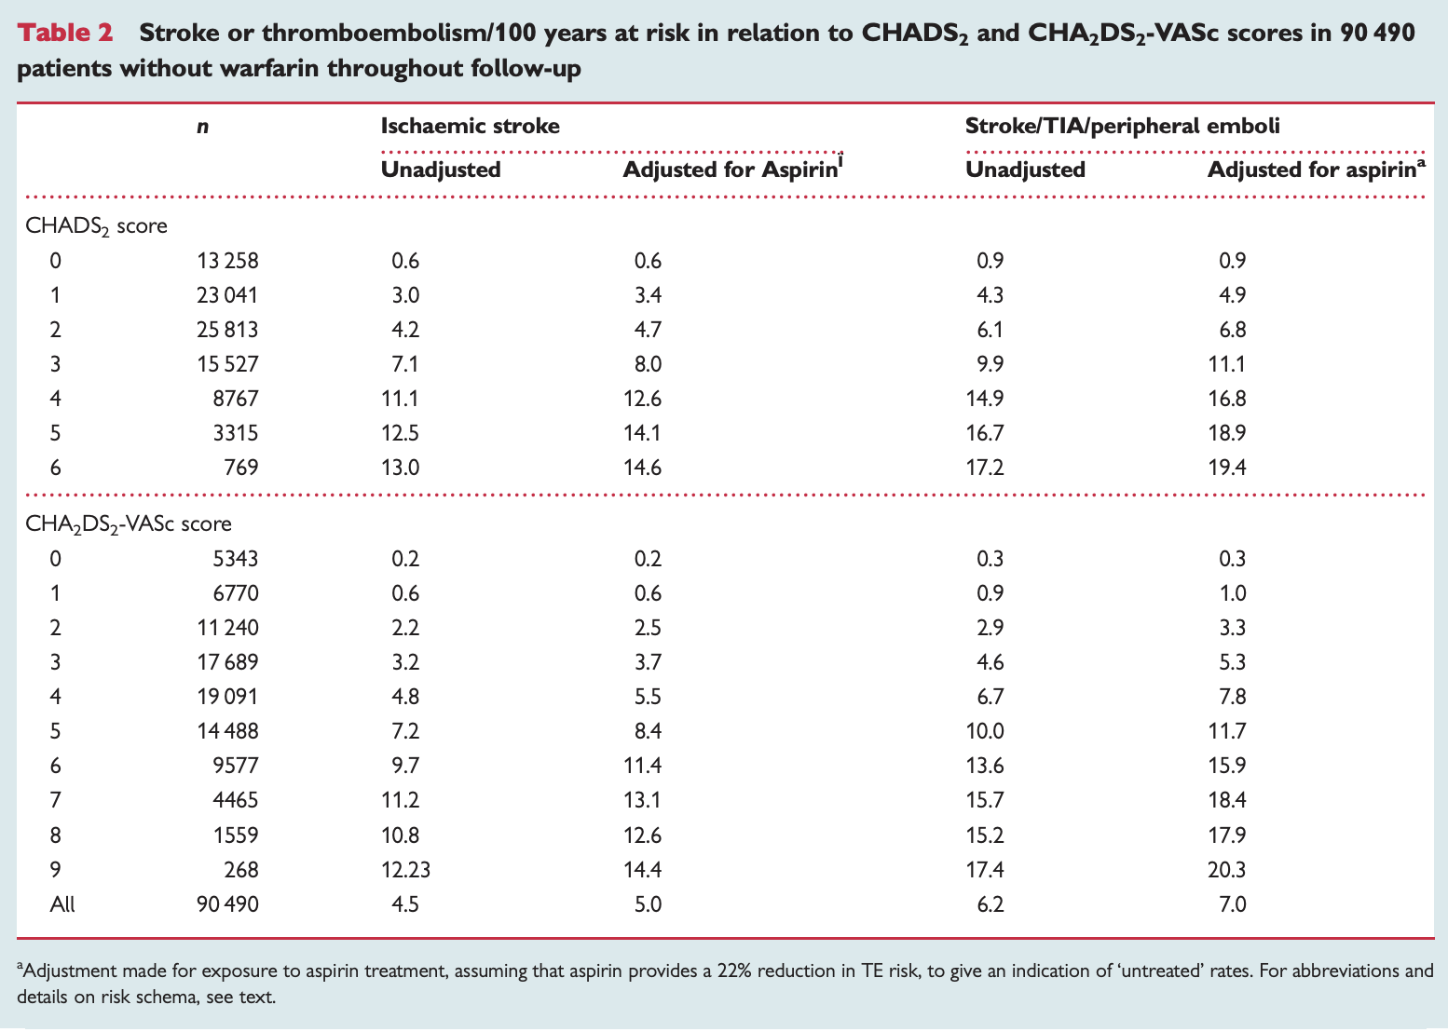

Slide 69

How else are prognosis statistics presented?
The most common way is a Kaplan-Meier Curve (Survival curve)
This can be for survival to death, or survival to a major outcome (need for total joint revision, etc)

Slide 70
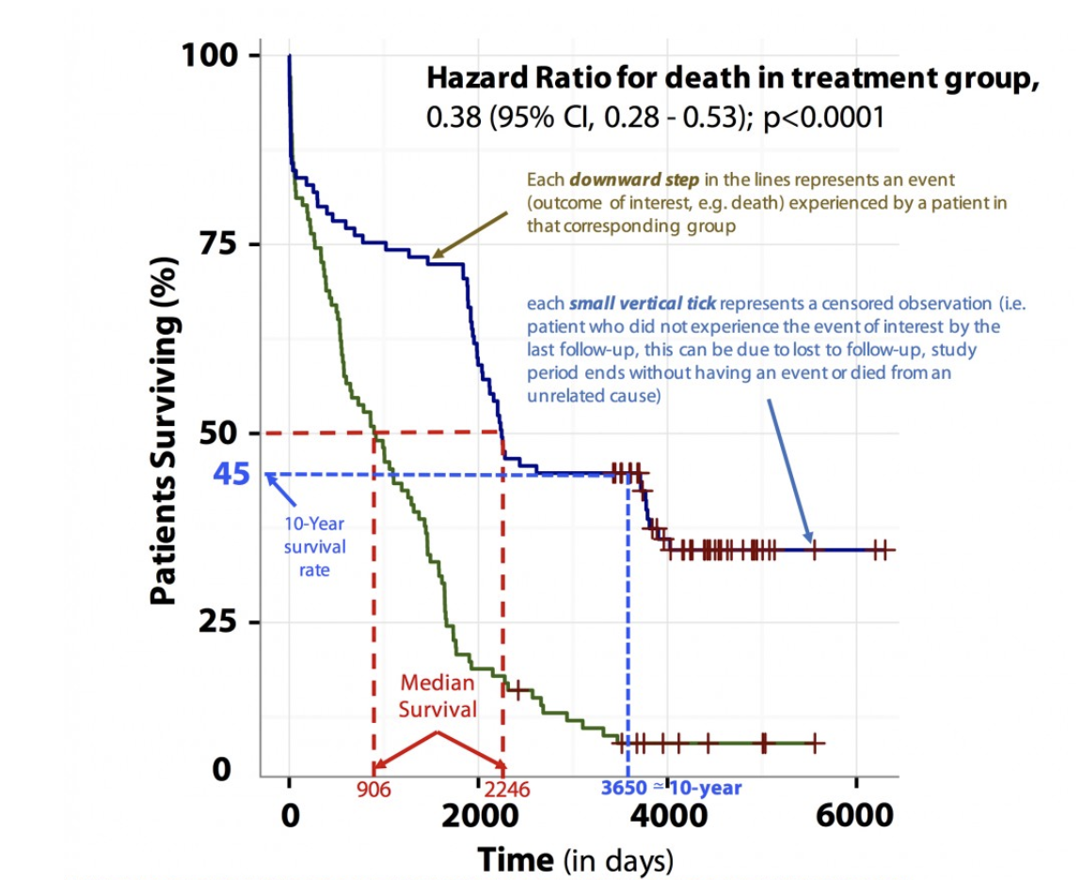
Kaplan-meier curve

Slide 71
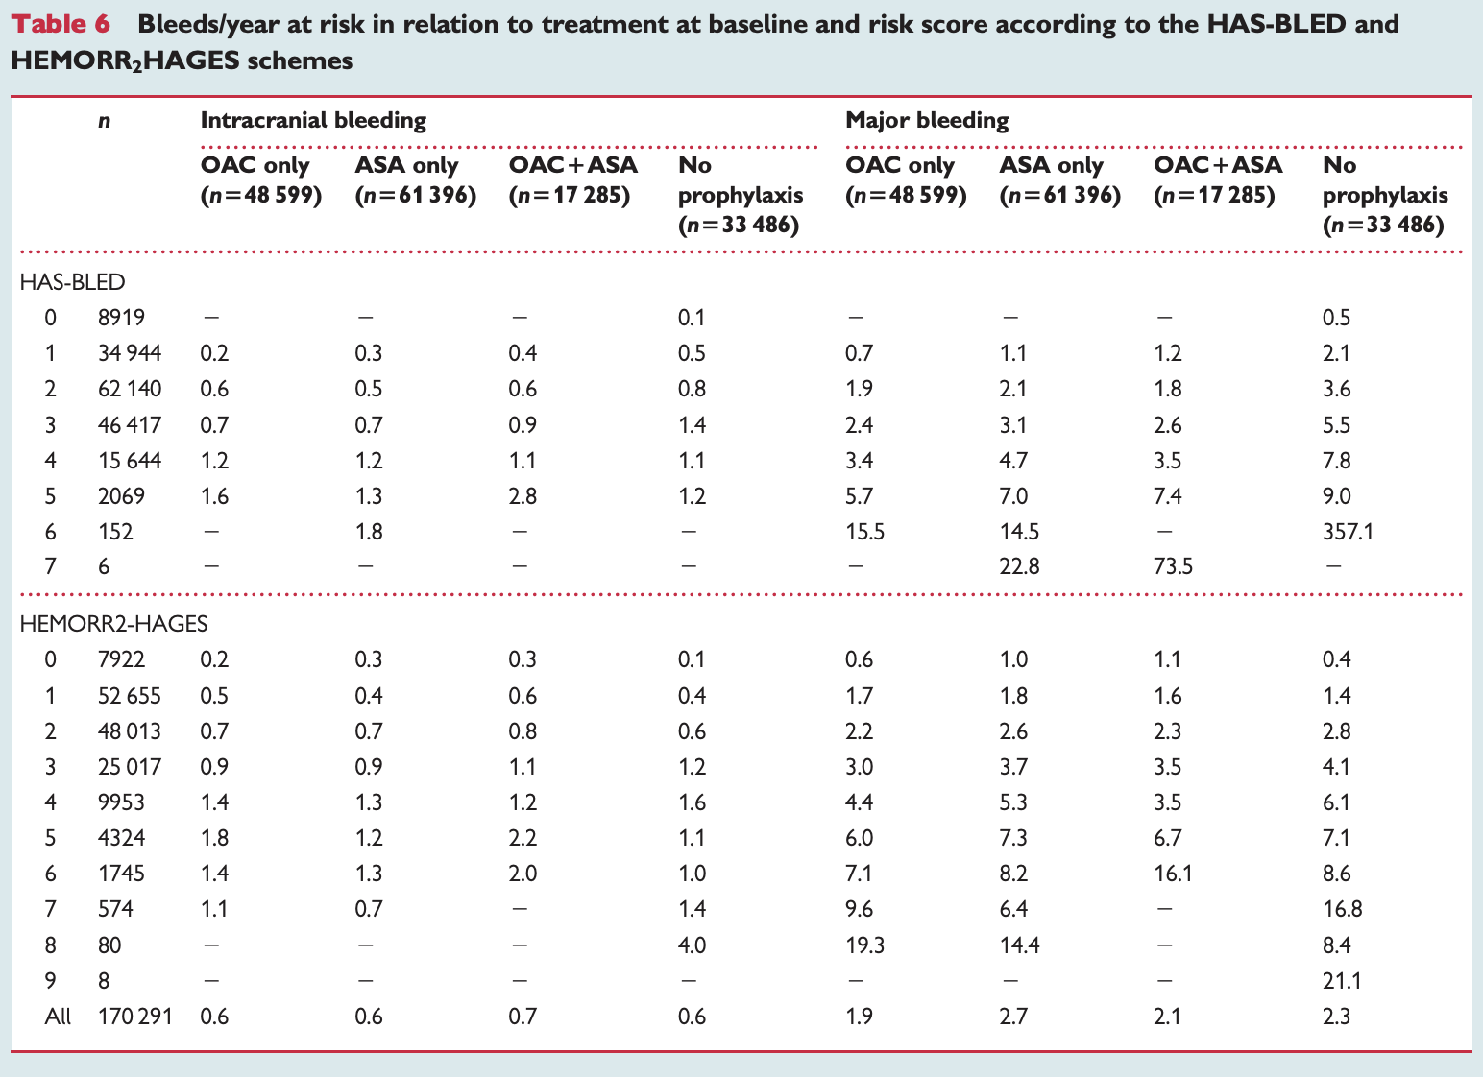
What about adverse events if taking the medication?

Slide 72
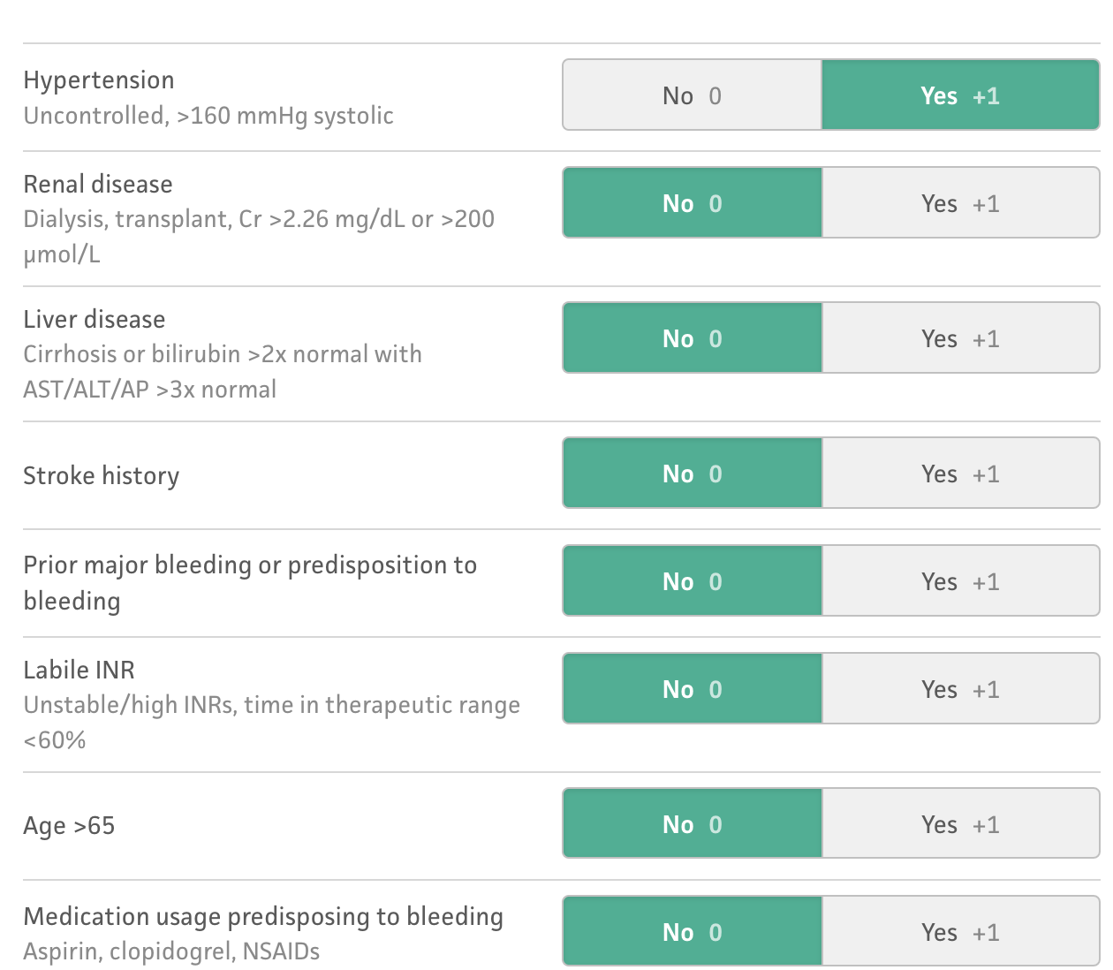
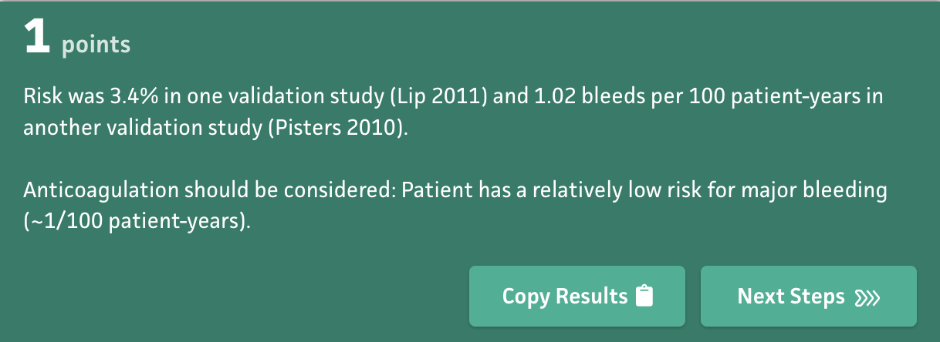
HAS-BLED

Slide 73
So what do we tell our patient?

Slide 74
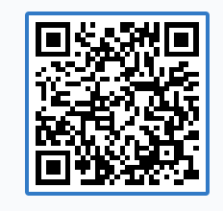
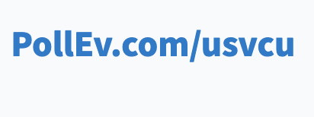
Vote:
Take the blood thinner
Don’t take the blood thinner
https://www.polleverywhere.com/multiple_choice_polls/QQixqPe5cqchhtZrw1zj4?preview=true&controls=none

Slide 75
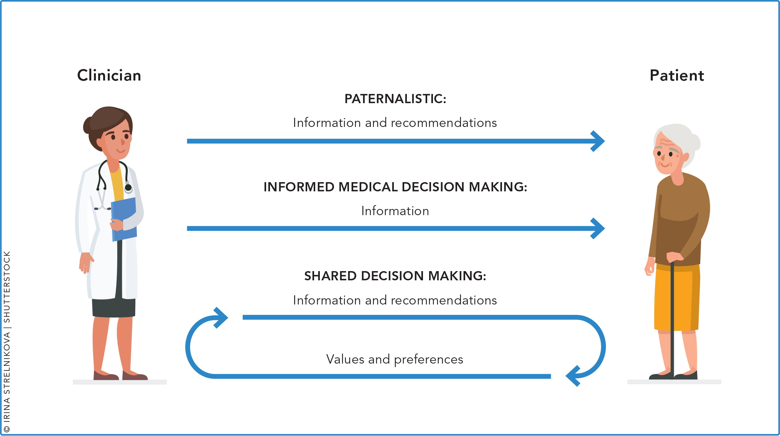
Shared Decision making

Slide 76
Shared Decision making
Shared decision making occurs when a health care provider and a patient work together to make a health care decision that is best for the patient.
The optimal decision takes into account evidence-based information about available options, the provider’s knowledge and experience, and the patient’s values and preferences.
You will need to utilize motivational interviewing to ascertain values and preferences – most of the time

Slide 77
Shared Decision making
Outcomes that matter to patients may include:
  Quality of life
  Mobility
  Ability to carry out certain tasks
  Ability to focus
  Ability to return to work
  Side effects/risks of treatment
  Symptoms (e.g., pain, nausea)
  Survival
Consider that outcomes might be different for each patient.

Slide 78
Shared Decision making
Define/explain problem.
Present options.
Discuss benefits/risks/costs
Clarify patient’s values/preferences.
Discuss patient ability/self-efficacy.
Discuss doctor knowledge/recommendations.
Check/clarify patient’s understanding.
Make or defer a decision.
Arrange follow-up.

Slide 79
Shared Decision making
Sharing decision with patients:
  Improves patient knowledge regarding their options
  Reduces patients’ decisional conflict
  Increases patients’ active role in decision making
  Improves accurate risk perceptions of possible benefits and harms among patients
  Increases the likelihood that patients’ choices are more consistent with their informed values
  Enhances communication between patients and their clinicians

Slide 80

How about for our patient? The SHARE Approach
Step 1: Seek your patient’s participation
Step 2: Help your patient explore and compare treatment options
Step 3: Assess your patient’s values and preferences
Step 4: Reach a decision with your patient
Step 5: Evaluate your patient’s decision for congruency

Slide 81

Case conclusion
The patient decides that he is going to defer OAC for now. He understands that as he ages, and if he develops any other comorbidities, his risk might increase for developing thromboembolism, and will re-consider at that time.
You feel confident the patient made a decision that both fits with the evidence, AND aligns with his values.

Slide 82
How do doctors actually help patients?
Diagnosing
Treating
Prognosing?
-RCTs
-Always re-evaluate with new evidence
-Observational trials have merit, especially when determining HARM
-Don’t overlook this part
-Allows the patient to understand what the diagnosis and treatment mean for them
-Strive for SDM when able
-LR+, LR –
-Pre-test, post test probabilities
- Avoid unnecessary testing

Slide 83
Take home points
Prospective cohort studies allow for the most unbiased determination of prognostic factors
Hazard ratios are interpreted similar to odds ratios (>1, <1 or crosses 1) but refer to an outcome happening over time (doesn’t tell you when though)
Helping patients understand what will happen with their disease can foster a much better, mutualistic treatment plan (think, increased adherence for one)
Shared decision making is your friend, we already suffer from decision fatigue, so don’t be afraid to share this load with the person it is affecting the most!
Our values, even though they seem rational, are not the same as everyone else's values

Slide 84
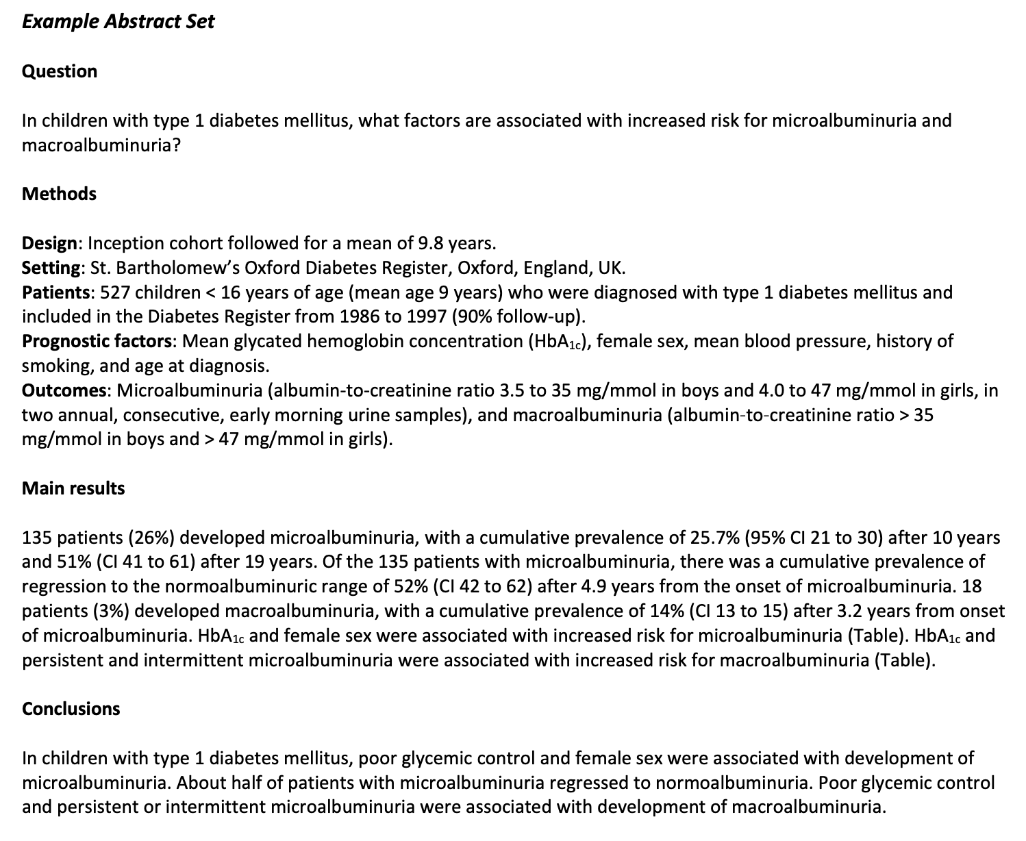
USMLE Step 2 Style Questions

Slide 85
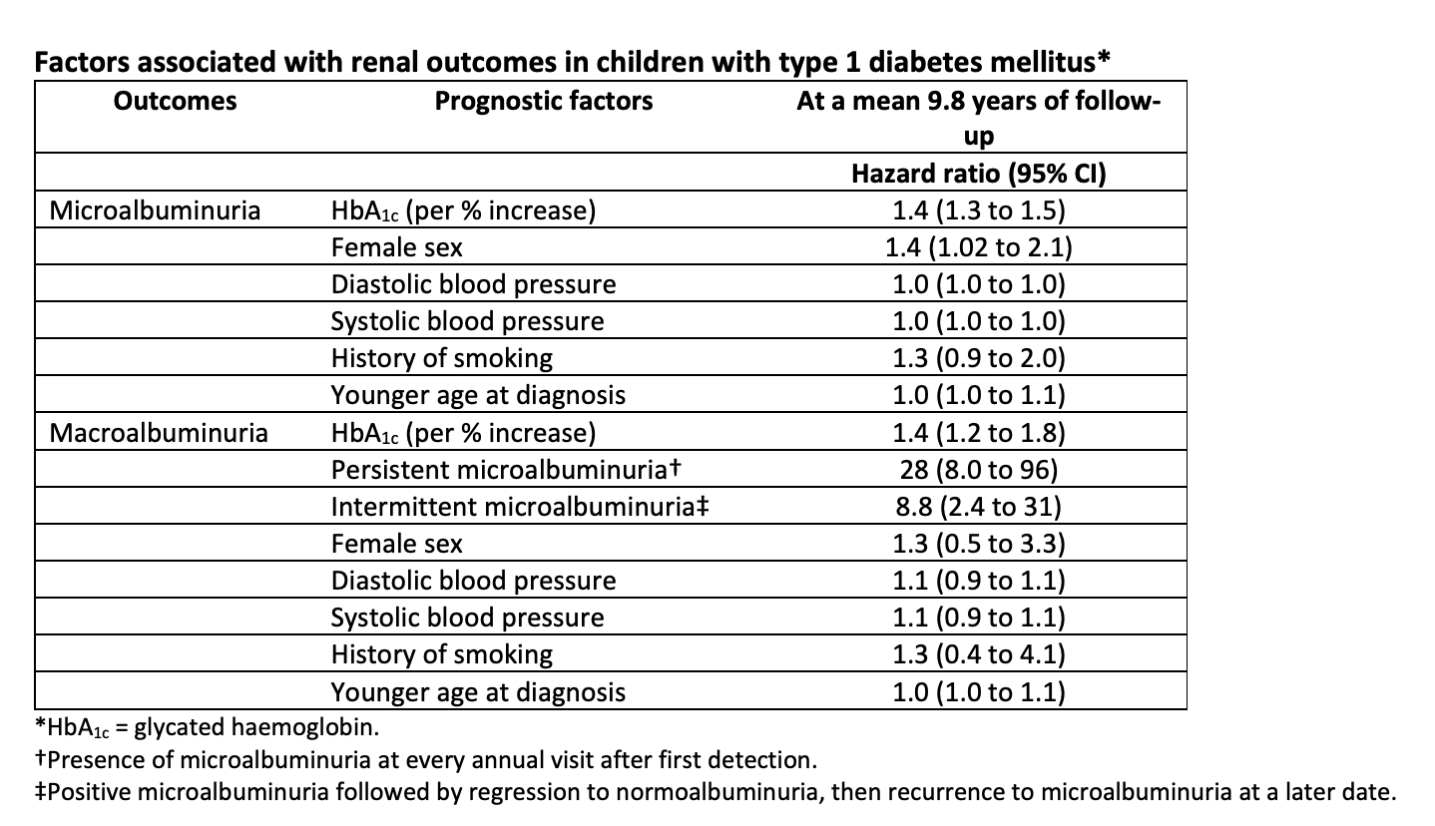

Slide 86
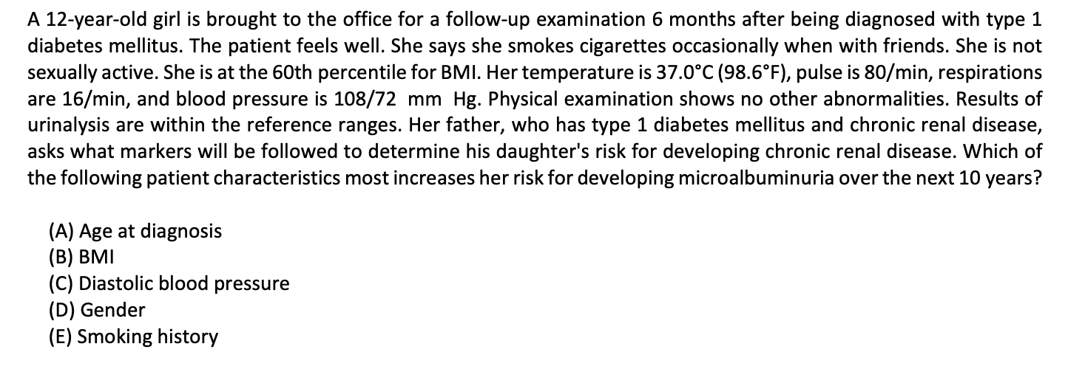

Slide 87
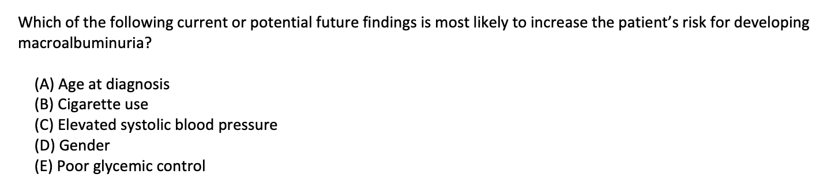

Slide 88
Remember - take the quiz!
Read the primary literature! It really does make a difference
Questions? Email me – john.joyce@vcuhealth.org

