Slide 1

Ultrasound IT
What could be more exciting!?

Slide 2
Objectives
Illustrate
Illustrate the importance of a workflow solution
Understand
Understand workflow infrastructure and associated terminology
Discuss
Discuss benefits to use of middleware in an ultrasound program
Compare
Compare current workflow products and highlight key features
Transfer
Transfer knowledge from VCU workflow and apply it to their future program

Slide 3
Why is workflow optimization so important?
Compliance
Patient safety
errors
Consultants
Revenue / Billing
pays for machines which continues high quality care
QA

Slide 4

Terminology

Slide 5
DICOM
Digital Imaging and Communications in Medicine (DICOM) is the standard for the communication and management of medical imaging information and related data
Lossless format
Important to make sure machines are DICOM compatible – not so much anymore there are essentially none that are not
BUT – machines often need to be turned on to DICOM, might be on jpeg or other export mode
Both a format and a method for transmitting images

Slide 6
PACS
Picture Archiving Communication System (PACs)
A system that electronically stores images and reports
Not a standard system, but usually standardized across a health care system
We use Intellispace , a Phillips product
This is the “Front End” – what the physician or end user sees

Slide 7
VNA
Vendor Neutral Archive (VNA)
Centralized vender neutral storage site
Long term storage, even if front end vendor changes
Permanent life management storage that is not accessible to end user

Slide 8
HL7
Health Level Seven or HL7 refers to a set of international standards for transfer of clinical and administrative data between software applications used by various healthcare providers
Almost all healthcare software utilizes this format
Fields are standardized so that usual things are found in usual spots : IE: field ORB.7.1 – indication for test

Slide 9
WiFi
Family of wireless network protocols, based on the IEEE 802.11 family of standards, which are commonly used for local area networking of devices and Internet access, allowing nearby digital devices to exchange data by radio waves
5Ghz vs 2.4Ghz

Slide 10
IP Address
Internet protocol address – usually identifies a device on a Local Network
How software knows to interact with hardware

Slide 11
AE Title
This is the name of the modality on the local network
So the IP tells you the address to locate things, but the AE title tells you what device it is!

Slide 12
Modality Worklist (MWL)
This is how the machine generates a list of studies to be performed
Can be generated multiple different ways:
  Encounter based
  Order based
  From EMR, from Middleware, From ADT (admission, discharge, transfer) feed
  “Order broker” – in our case Qpath is the order broker.

Slide 13
Server
Permanent storage of images from a single device type
Must follow life management rules (IE → peds images until they are 18)
Cloud vs on–premise
  Benefits?

Slide 14

What is a good workflow??

Slide 15
A good workflow:
1. Easy to execute
2. Minimizes human factors
3. Satisfies all billing and compliance factors

Slide 16

What is “middle management?"
Essentially a stopgap between obtaining the study and finalizing the report/images
Allows for mistakes to be corrected, before makes it into EMR
Given the nature of bedside ultrasound, IMO is essential
Programs that do not utilize have a lot of headache and problems with incorrect documentation
Home grown solutions – excel, etc. Not HIPPA compliant

Slide 17
VCU workflow
Physician places order
Selects order off machine
Completes study, hits end exam
Opens qpath, finds study and make sure has correct exam type
Fills out worksheet in qpath for resident to sign
Attending signs it which pushes study to EMR and Image Archival System

Slide 18
Emergent workflow
Physician performs exam on non registered patient due to critical nature (Trauma, critical medical alerts)
Physician must put identifying data in machine!
Completes study, hits end exam
Once patient registered, places order in cerner
Opens qpath, finds study and then enters in the correct MRN, matching it to the order
Fills out worksheet in qpath for resident to sign
Attending signs it which pushes study to EMR and Image Archival System

Slide 19
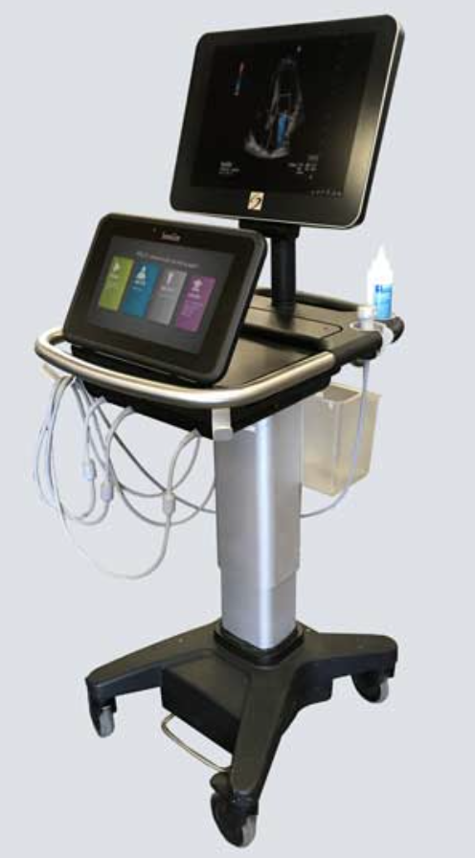


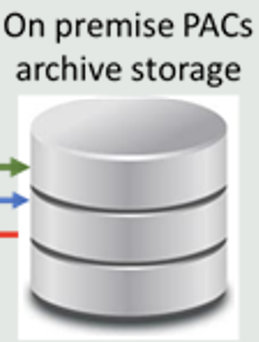
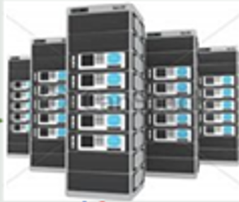
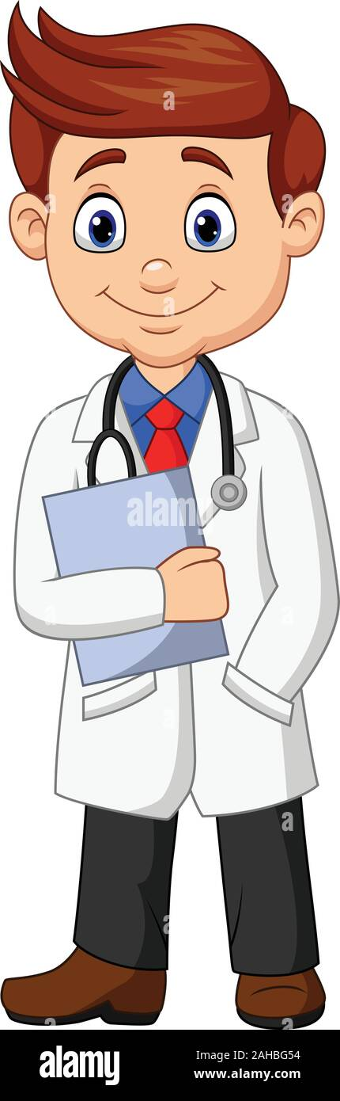



VNA
WIFI
End Exam: 4
DICOM
DICOM
MWL: HL7
6
3
5
2
Order
(HL7)
Report
(HL7)
7
1

Slide 20
How could this be better?
Barcode scanner
Eliminate need for order
        Is it backwards thinking – ordering yourself to do something?
      Reason is to add an accession number, but you can do this other ways
Fill out on machine?
Tablet/phone access
Cloud server

Slide 21

VNA
WIFI
DICOM
DICOM
MWL: HL7
Order
(HL7)
Report
(HL7)

Slide 22
WIFI
DICOM
DICOM
MWL: HL7
Order
(HL7)
Report
(HL7)

Slide 23
WIFI
DICOM
DICOM
MWL: HL7
Order
(HL7)
Report
(HL7)

Slide 24

MWL: HL7
WIFI
DICOM
DICOM
Order
(HL7)
Report
(HL7)

Slide 25
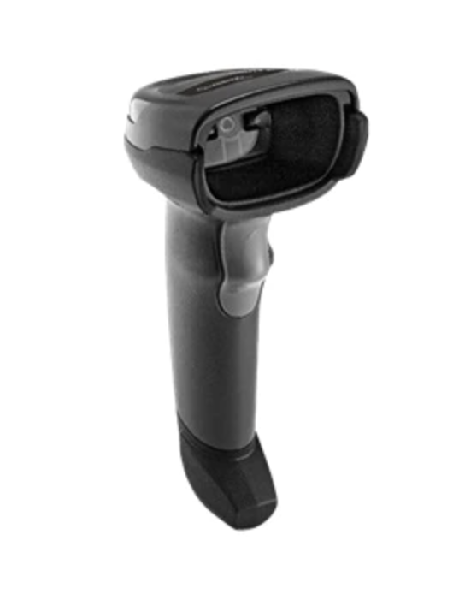
MWL: HL7
WIFI
DICOM
DICOM
Order
(HL7)
Report
(HL7)

Slide 26
MWL: HL7
WIFI
DICOM
VNA
DICOM
Order
(HL7)
Report
(HL7)

Slide 27
MWL: HL7
WIFI
DICOM
VNA
DICOM
Order
(HL7)
Report
(HL7)

Slide 28
3
MWL: HL7
WIFI
2: End Exam
DICOM
VNA
DICOM
1
Order
(HL7)
Report
(HL7)
4
Encounter Based Workflow

Slide 29
Qpath customization
Dynamic vs Static sheets
One worksheet per exam
Map probes to exam types
Default? Templates pros and cons
Default profile
Split into departments
Mapping machines
Mapping operators/attendings
Custom reminders
Reports
Etc… etc…

Slide 30
What does our IT look like?
EMR: Sends out HL7 order with accession number
Goes to QPATH – qpath then sends out worklist
Machine pulls the specific DMWL (dicom modality worklist) (some places use ADT feed)
Operator completes exam, DICOM image sent to PACS server for storage, HL7 tags sent back to EMR

Slide 31
Why utilize middle management?
Some places send images directly to PACS
Either fill out a template in EMR or on machine
Pros?
Cons?

Slide 32
What are the other options?
Qpath
Synchrocity
Butterfly
Viewpoint
PACS integrated system
Things to consider:
  Cost
  Support
  Customization
  Scalable? Enterprise use
  Ease

Slide 33
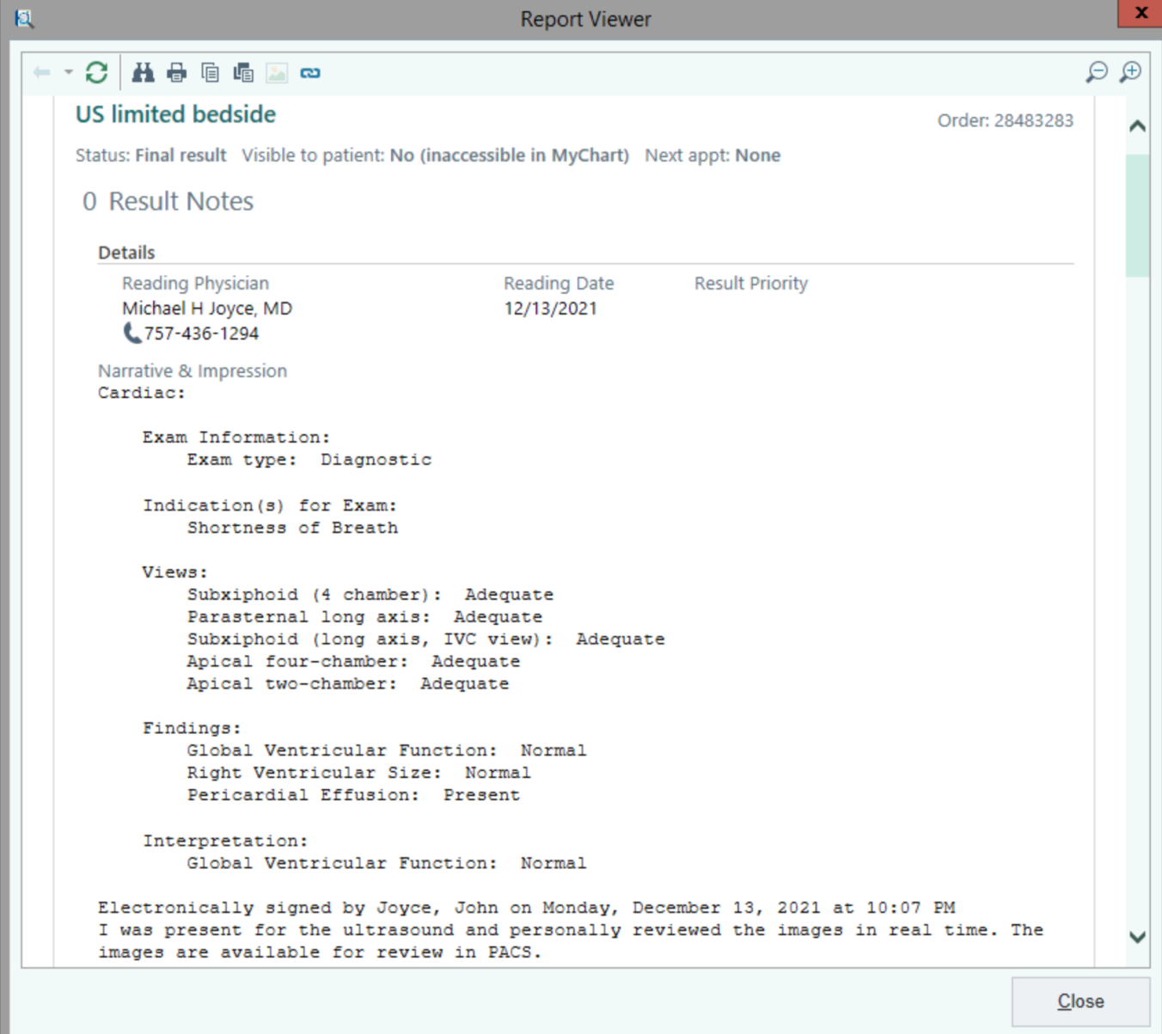
EPIC report
Things to consider
Procedure vs Image based result
Write a note?
Where should the report live?
What format should it be in?
Can it be updated?
How will you display corrections?

Slide 34
Enterprise Considerations
What does a clinic workflow look like?
What does an OR workflow look like?
EM is done in real time, a lot of specialties document entirely at end of shift

Slide 35
What makes successful program?
Easy to use workflow
Seamless integration
Easy access to support for when things go wrong
Education on the importance of the need for documenting and storing images!!

