Slide 1
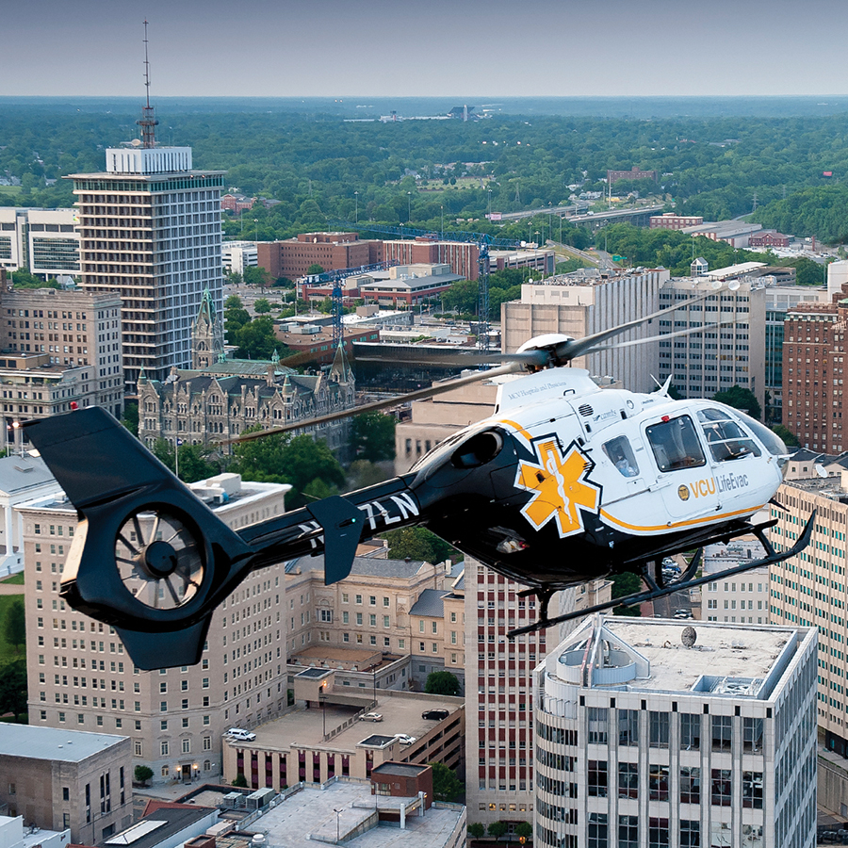
Enterprise Sonography Committee FY23 Annual Report
Radiologic Services Steering Committee
Sonya Echols, PhD
David Evans, MD
Uma Prasad, MD

Slide 2
Top Three Points
POCUS Business Plan – procuring equipment.
Ultrasound Compliance Plan - training providers and technologists, and installing compliance management software (QPath).
POCUS Data Review – establishing financial and compliance reports

Slide 3
#1 - POCUS Business Plan
  FY23 Capital Requests
      9 Replacement machine requisitions submitted for purchase.
        None approved for purchase.
      10 New machine requisitions submitted for purchase (Family Medicine, Tapp, IM, PM&R, Rheumo).
        2 machines procured September 2022 – Family Med and PM&R
        3 Lumify units procured. Negotiated lower price. Department purchases computer tablet.
  FY24 Capital Requests
      4 Replacement machine requisitions submitted for purchase
        None approved for purchase
        7 Lumify unit requests. Negotiated lower price. Department purchases computer tablet.

Slide 4
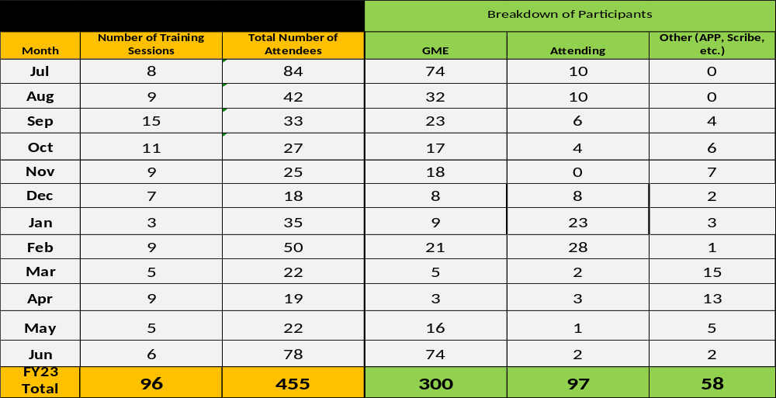
#2 - Compliance Plan
Training
* POCUS scanning training sessions added FY23.
Notes:
Totals by month on the left
Breakdown by Participant type on the right.
Total number of trainees FY23 is 455. 96 individual training sessions.
Residents trained in these departments:
Anesthesiology, cardiology, EM, FM, IM, Neurology, Neurosurgery, OB/Gyn, orthopedics, otolaryngology, pathology, pediatrics.

Slide 5
#2 – Compliance Plan
  All locations fully functioning with QPath.
      Approximately 1,800 team members in Qpath.
      QPath Cloud implementation in progress.
  Implemented a clinical compliance site visit process.
      70 individual units/departments.
      17 VCU Health locations enterprise wide.
      Completed 92 location surveys in FY23.
      Noncompliance areas:
          Damaged transducers – Workgroup established to identify transducer replacement plan.
          Infection control and cleaning – Workgroup established and new cleaning process for machines and transducers implemented.
          Nursing training – Working with nursing leadership to revise competencies for ultrasound guided PIV access and provide additional POCUS equipment cleaning and care.
      Developing the compliance report and notification process to be distributed to unit managers/department leadership.

Slide 6
#2 – Compliance Plan
Diagnostic Ultrasound Initiatives
Imaging Quality Assessment Program for Technologists
Technologist Scanning Competency Plan
Technologist Continuing Education Program
Radiology Resident Training
Notes:
One of our goals this year was to explore ways the Ultrasound Imaging Safety Educator could support Technologist education. We have made great progress in this area this year.

Slide 7
#3 – POCUS Data Review
Order, Image Storage, & Report Compliance Review
Emergency Medicine and Anesthesia are our heaviest users of POCUS and QPath.
OB/Gyn, EM, and Surgery have fairly high percentage of studies that have completed the full process and routed to EMR/PACS, but small opportunities remain.
IM, Pediatrics, and Anesthesia have opportunities for improvement related to signing off on final POCUS reports.
Overall, departments are now doing a great job with placing the correct order for POCUS exams.
The next several slides include FY23 compliance data by department.

Slide 8
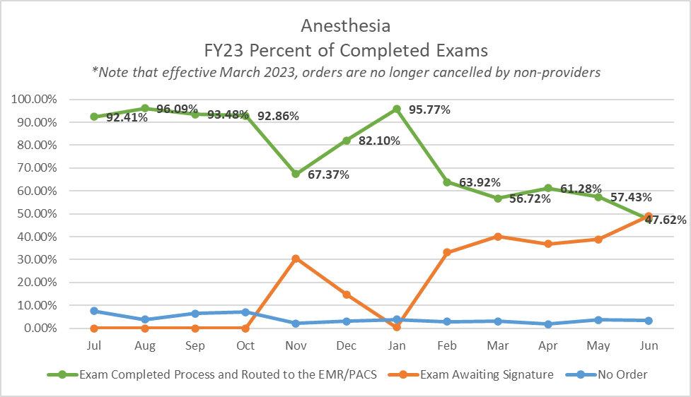

Slide 9
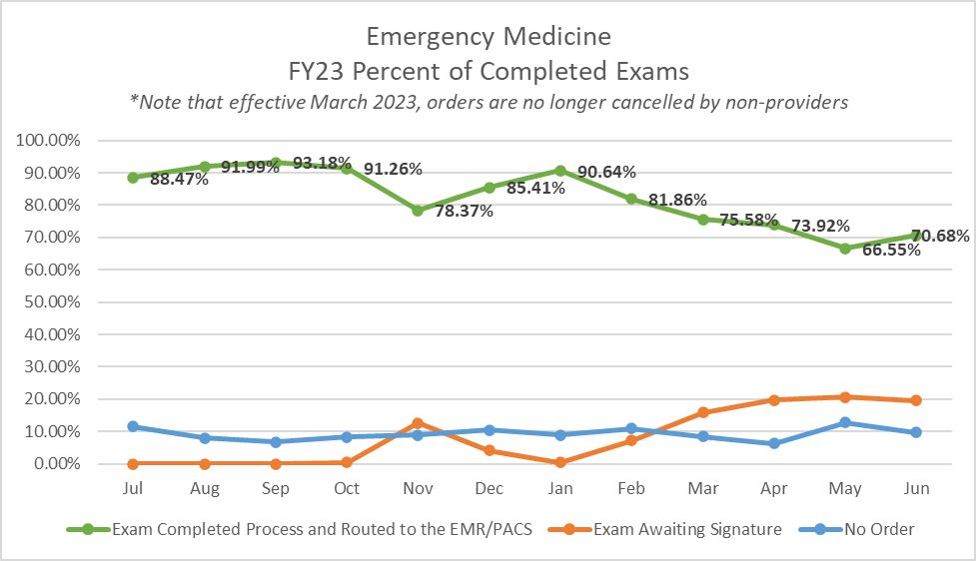

Slide 10
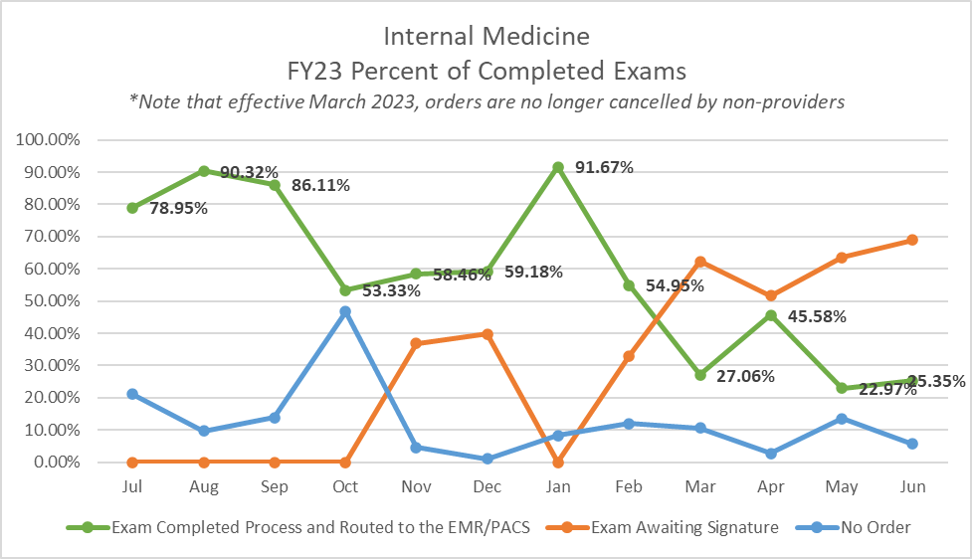

Slide 11
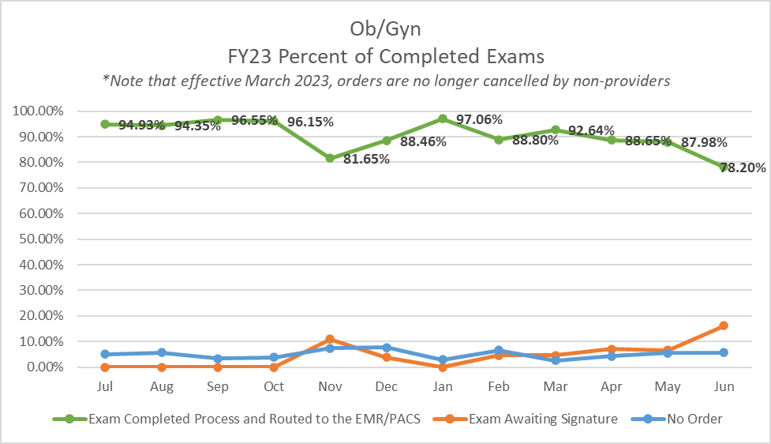

Slide 12
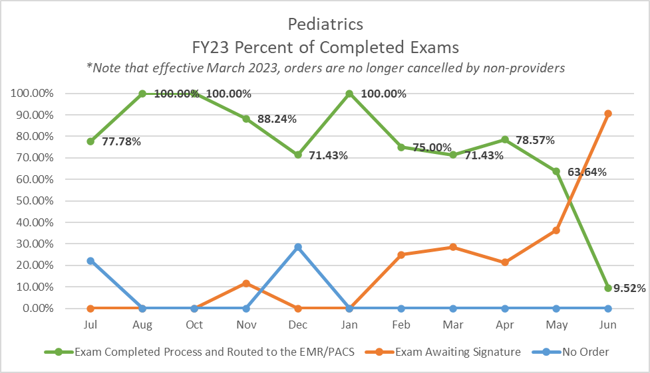

Slide 13
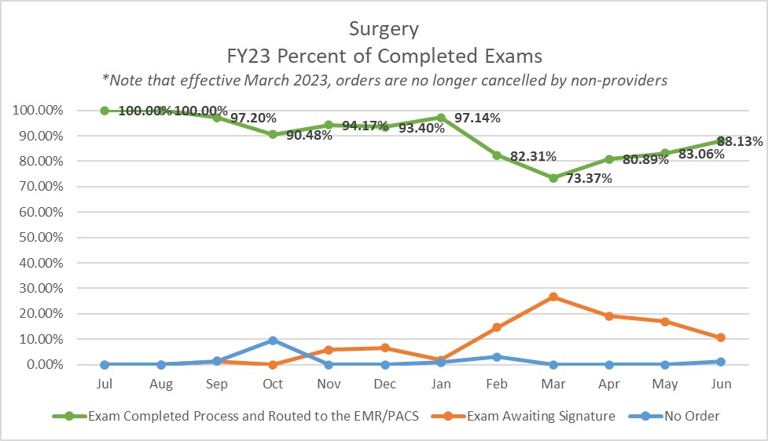

Slide 14
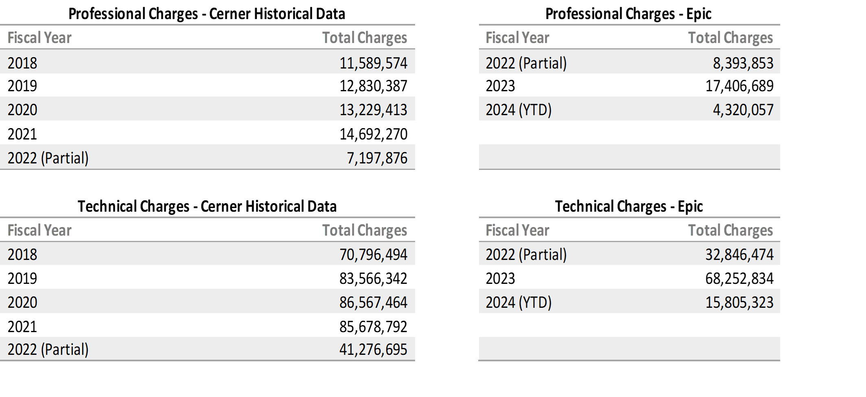
#3 – POCUS Data Review
Professional and Technical Revenue Capture Review CERNER (historical) and EPIC
NOTE:
AVG POCUS Facility Charge = $1,094.65
AVG POCUS Professional Charge = $276.52
Estimated Facility Reimbursement = $141.60
Estimated Professional Reimbursement = $35.40
Notes:
Total charges continue to trend up. However, still room for improvement.
Using the average charge data across all payers from 2019, 7.5k studies would have generated $8,232,862.65 in facility charges and $2,079,706.92 in provider charges. We are missing a significant number of studies that never enter Qpath because of old nonfunctioning equipment and compliance issues.
Next several slides provide details of technical and professional revenue capture by department.

Slide 15
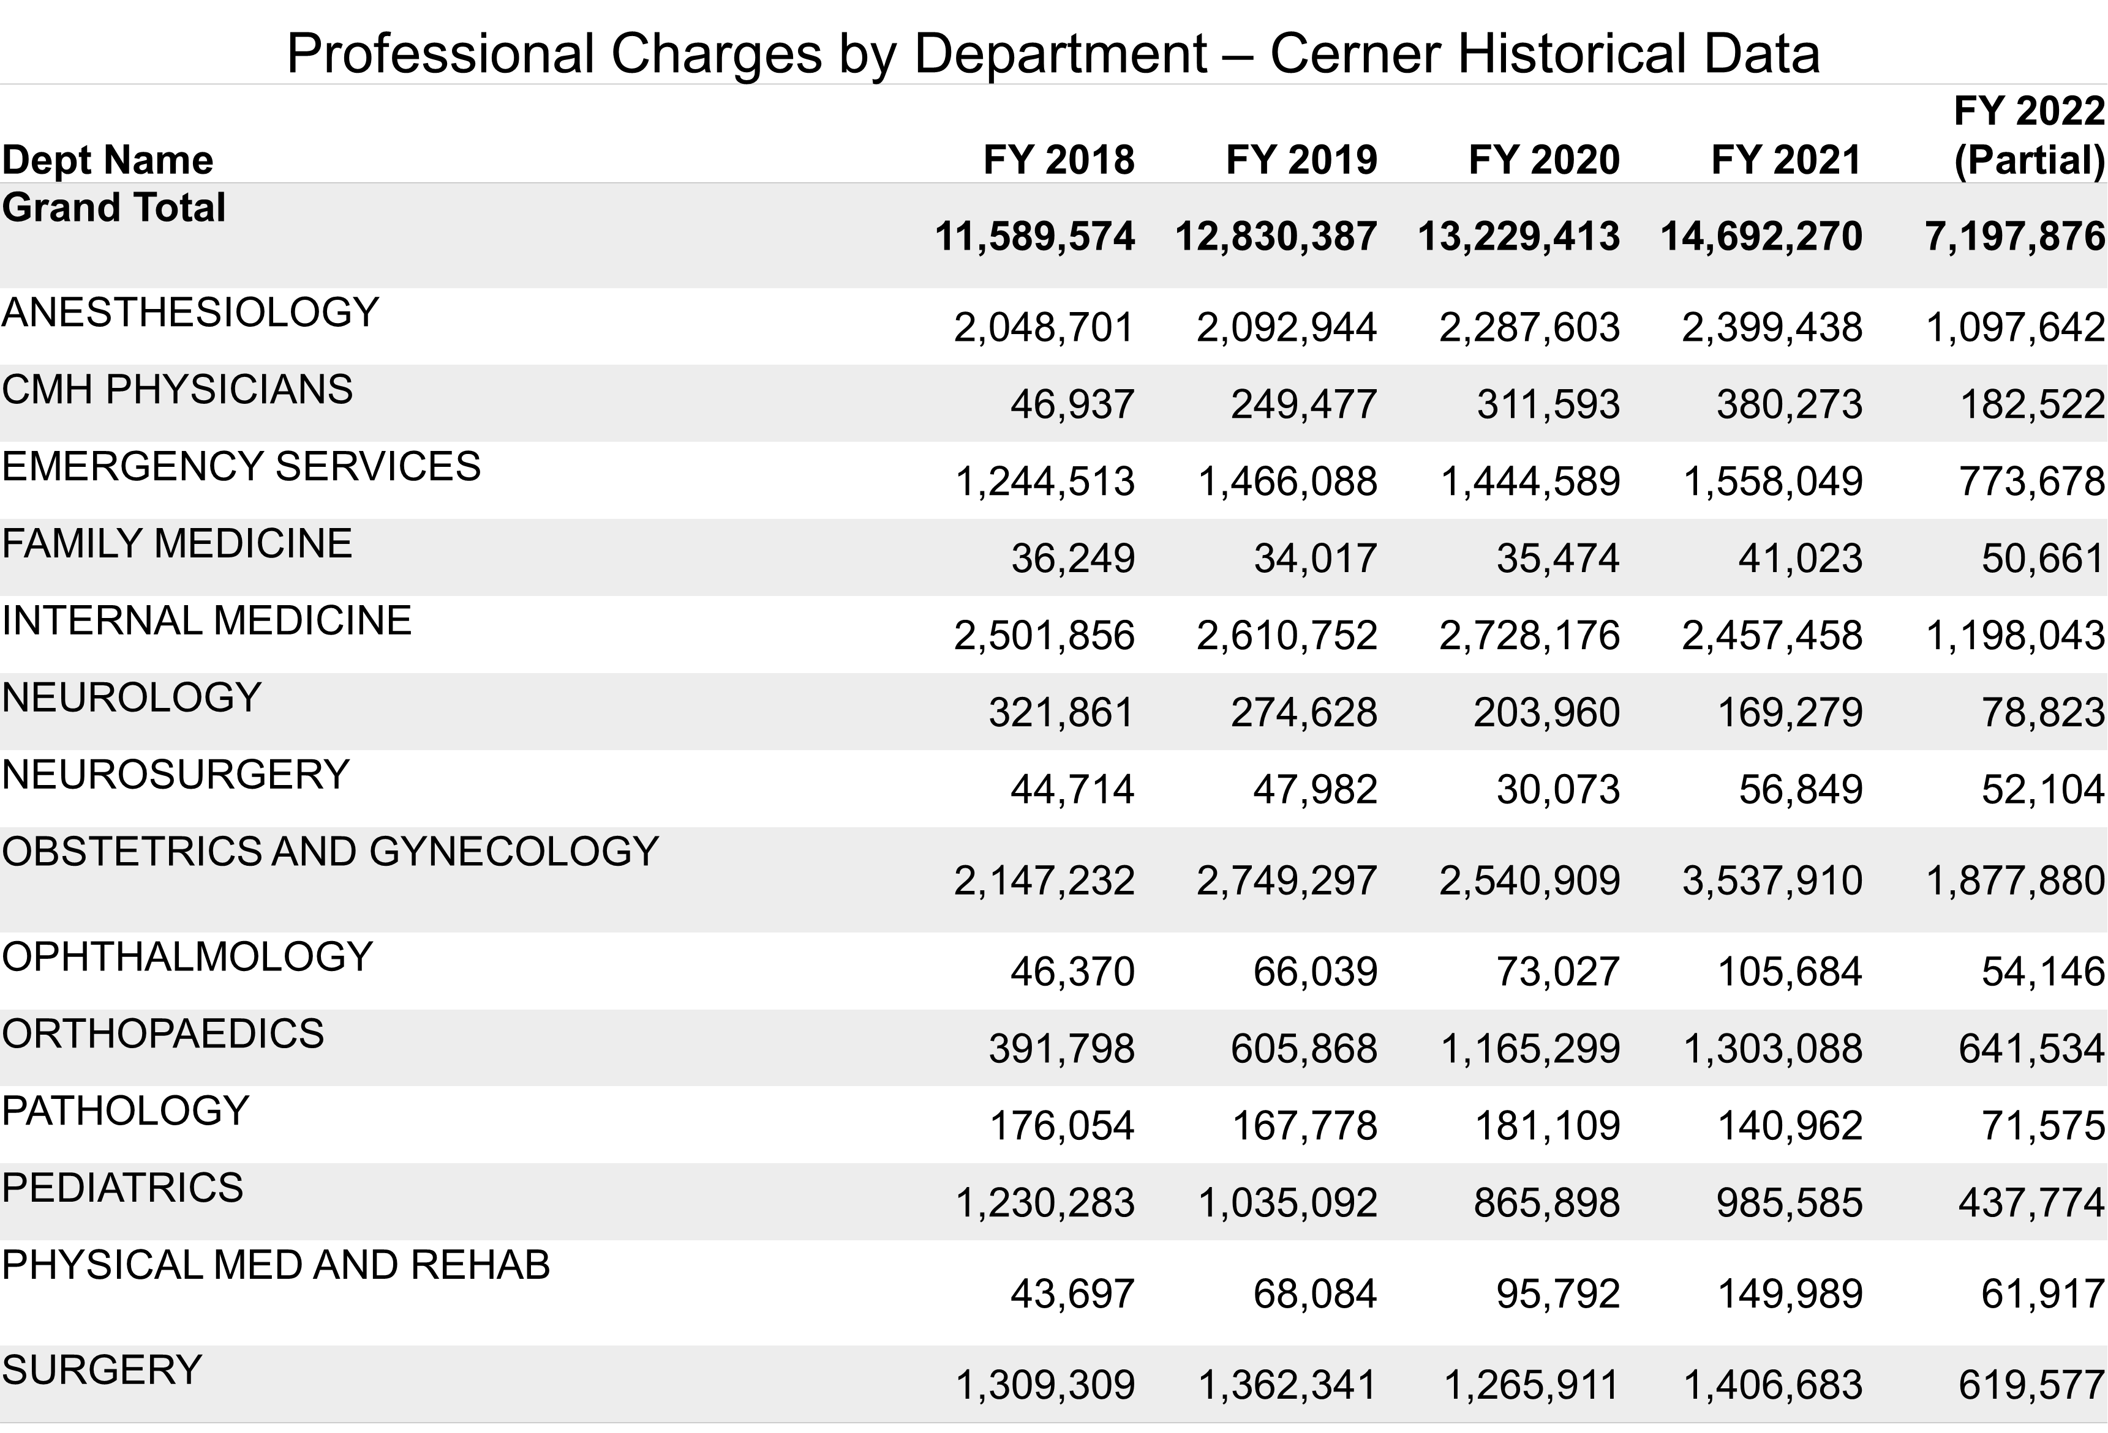

Slide 16
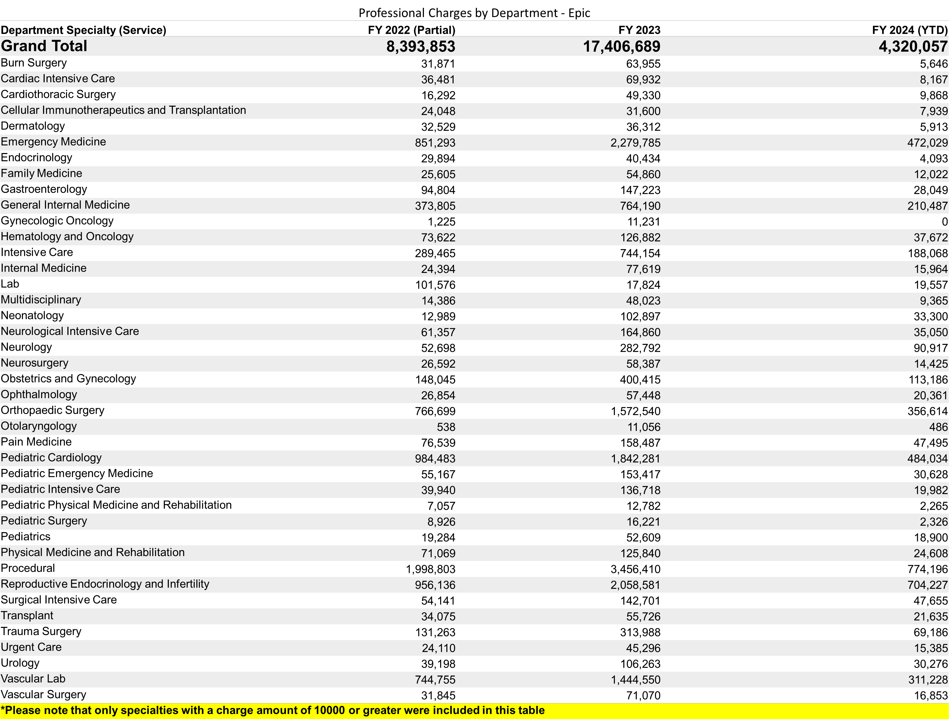

Slide 17
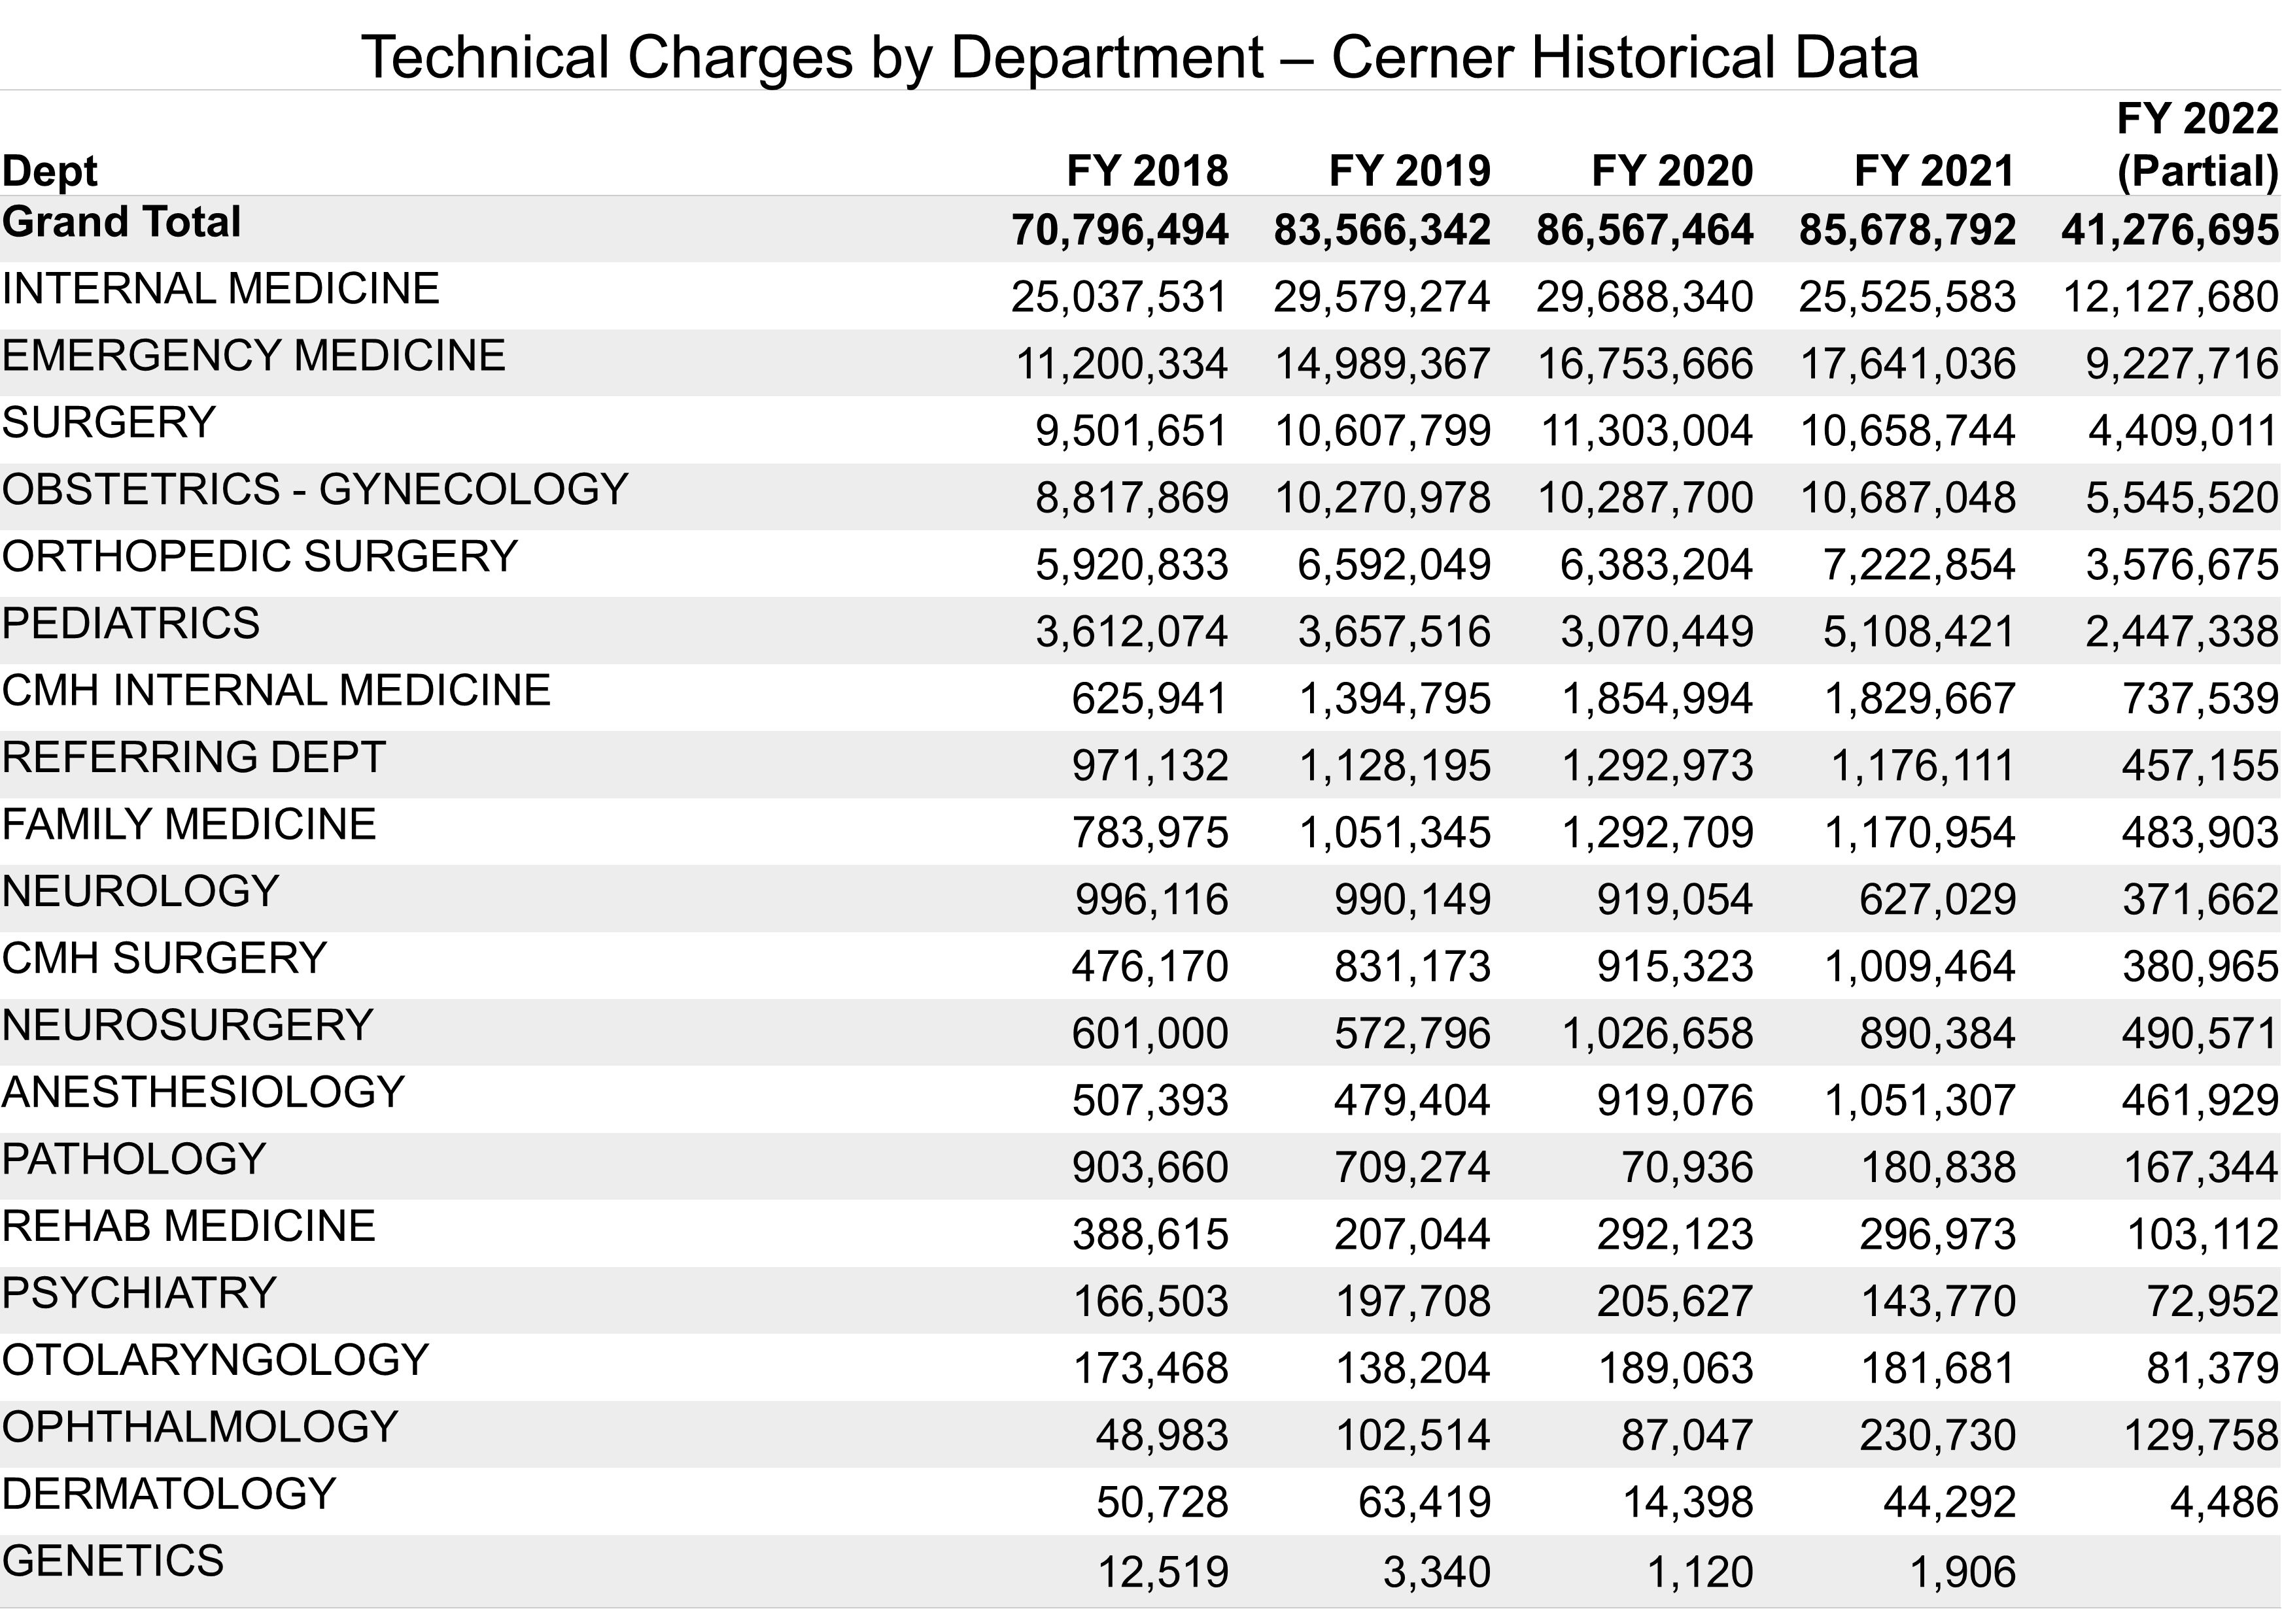

Slide 18
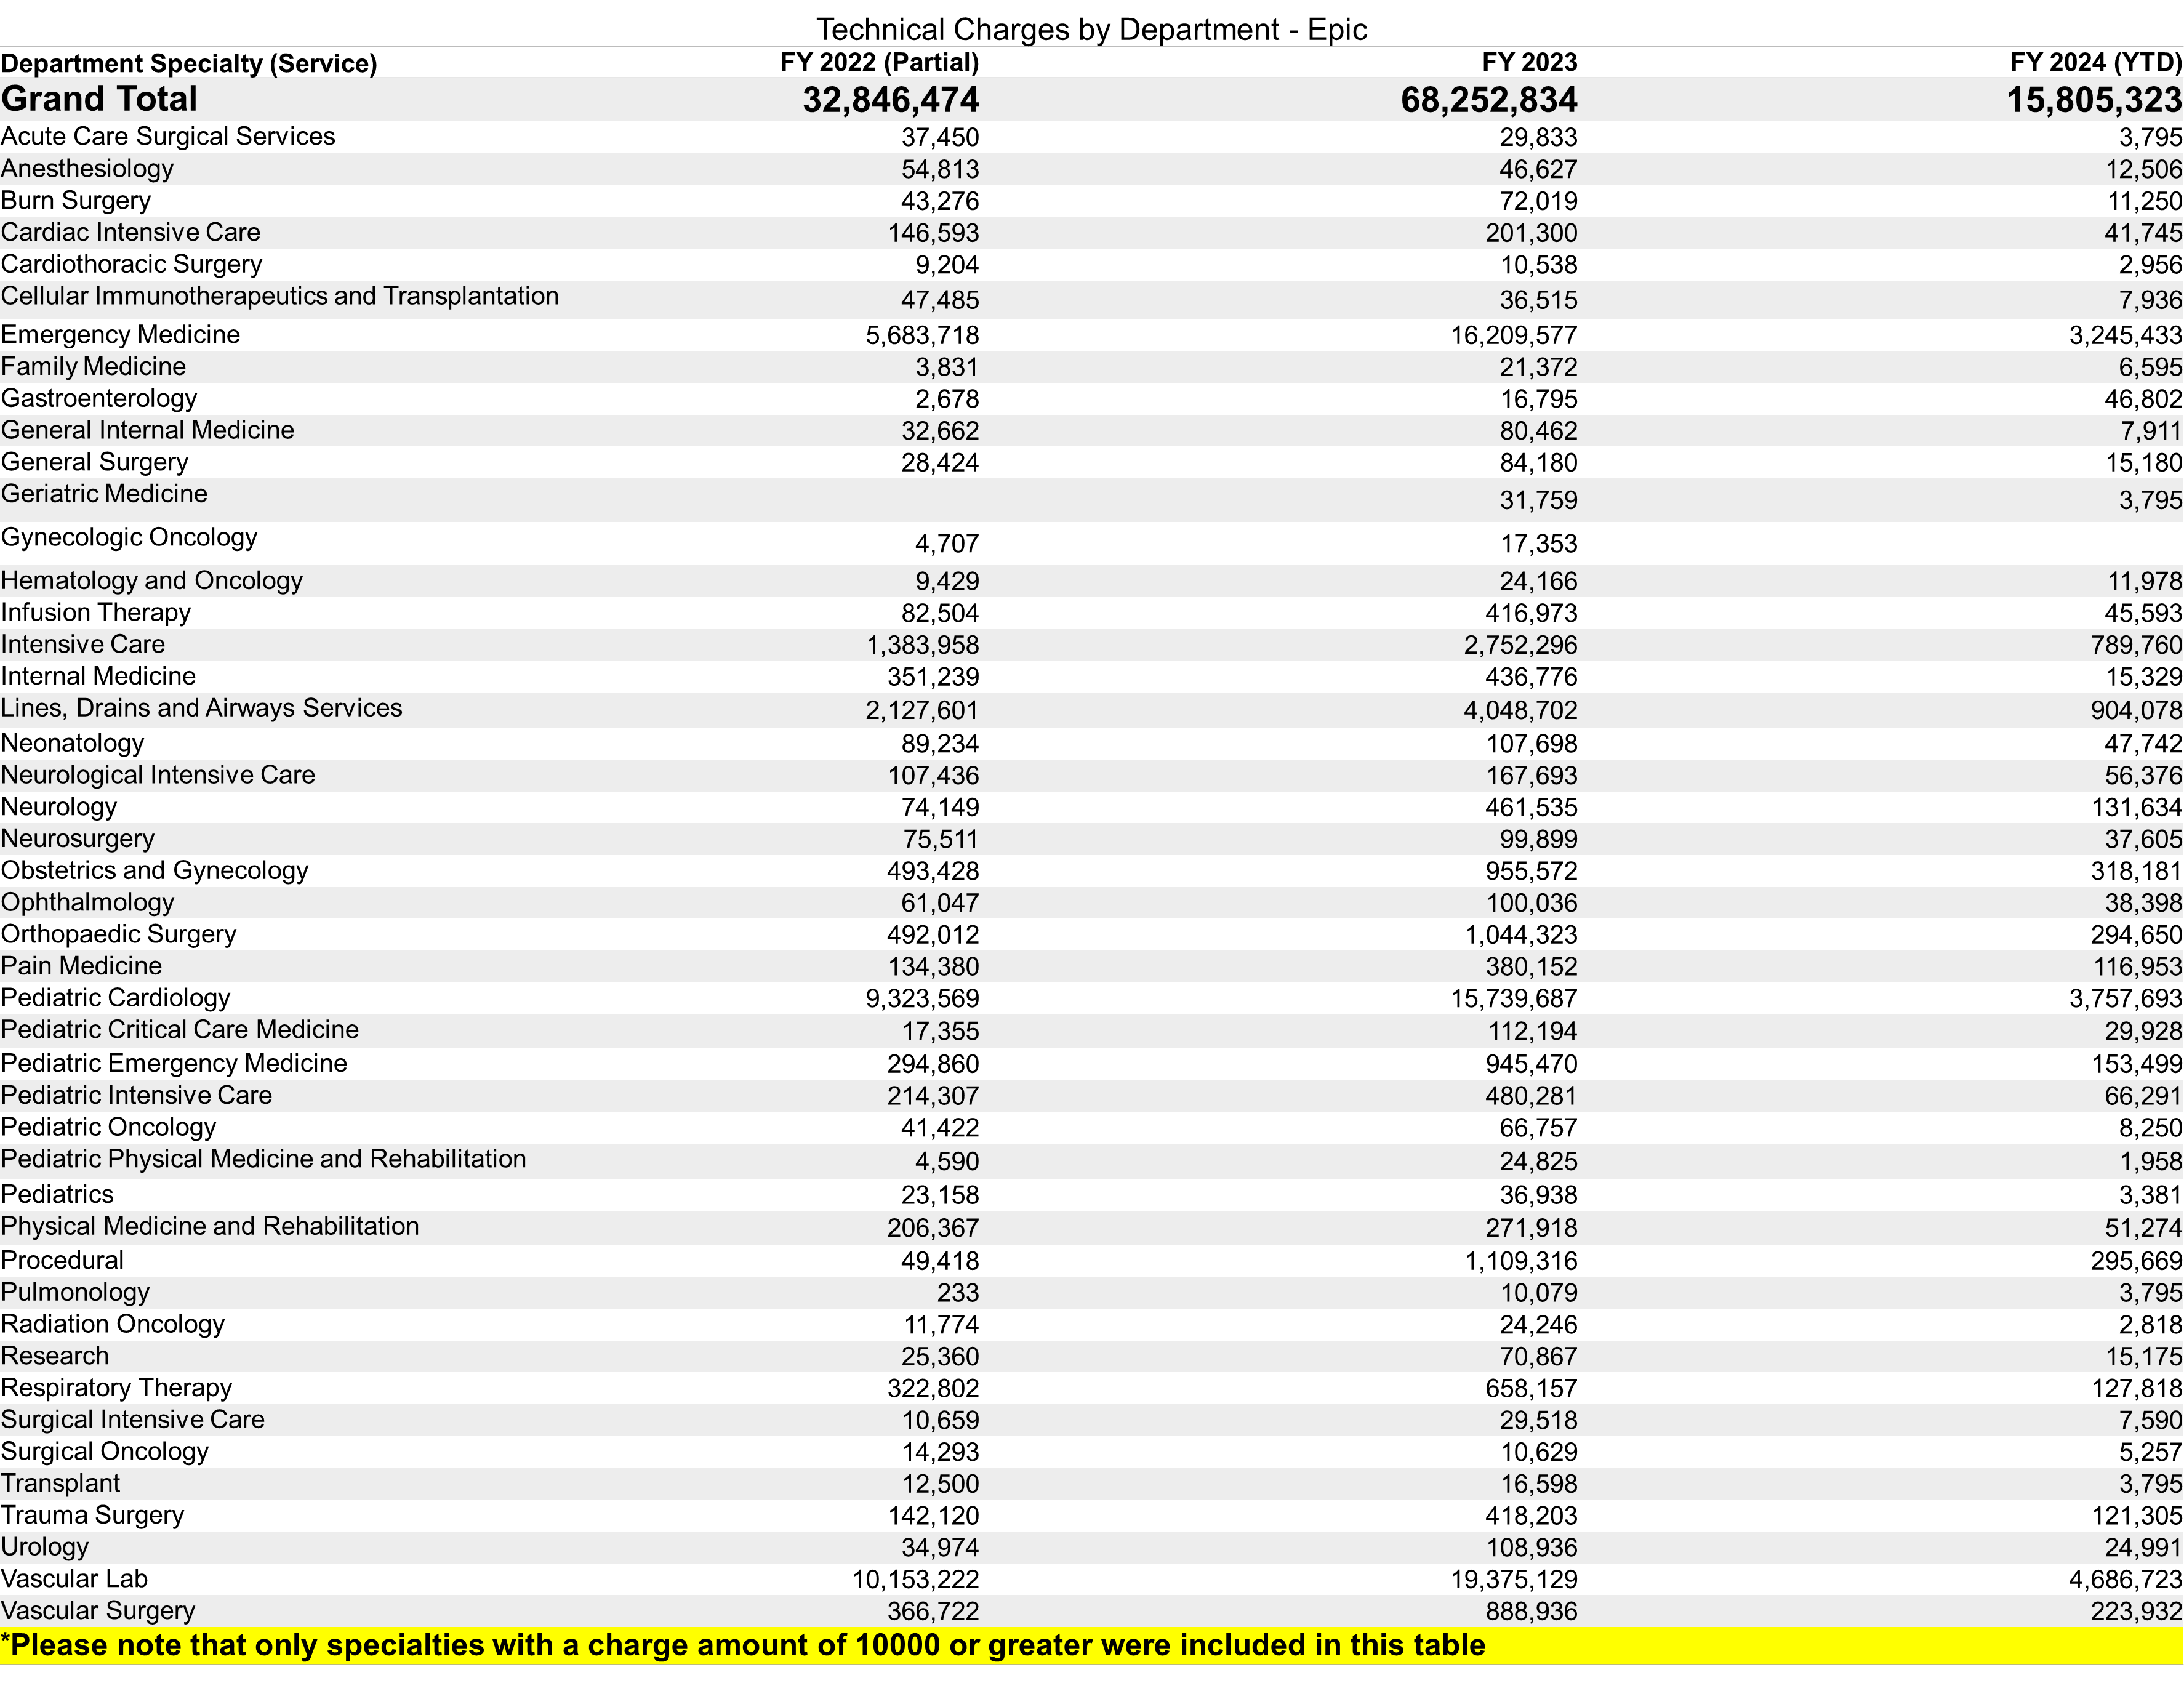

Slide 19
Next Steps
    Continue implementation of POCUS Business Plan: FY21 - FY25
      Replace US equipment (DICOM and wireless; end of life status)
    Diagnostic Sonography
      Continue to explore Ultrasound Imaging Educator support of Technologist education.
    POCUS Oversight
      Continue to work toward accurate revenue capture.
      Develop and implement POCUS image quality assurance program by department.
      Conduct clinical compliance observations and generate standardized reporting system for department/unit leadership.
    POCUS Scanning Program
      Explore opportunities to support POCUS scanning training.

Slide 20
Next Steps
    ESC Goals
        Met goals for FY23
        FY24 goals identified:
          Coding workflow for revenue capture
          Cloud migration.
          Diagnostic US: CE sessions, competency evaluation plan, image quality assessment plan, customized doppler education.
          POCUS quality assurance program
          US Probe replacement plan
          Scholarship opportunities
          US care and cleaning education
    Continue to refine metrics to measure outcomes with use of clinical ultrasound equipment
        QPath: users, image storage, and reporting by ISC Business Analyst.
        Accuracy in process: Order ->Image Storage ->Report ->Bill

Slide 21
Supporting Our Work
We’ve come a long way, but we still need your support!
QPath Use
      VCU Health physician leadership support of provider/APP use of QPath.
  2. POCUS machine procurement
      Purchase replacement and new POCUS machines.
3. Limited Bedside Ultrasound Order and Provider Privileges
      Encourage provider/APP use of order.
      Support provider completion of appropriate credentials for operation of POCUS equipment
      4. Accurate revenue data capture
      Encourage provider compliance with placing orders for studies and/or storing images in PACs. Data is based on current # of studies ordered.
      Encourage and support compliance with correct billing processes.
      Support QPath cloud server functionality.

Slide 22
Thank you
Questions!

Slide 23
Appendix

Slide 24
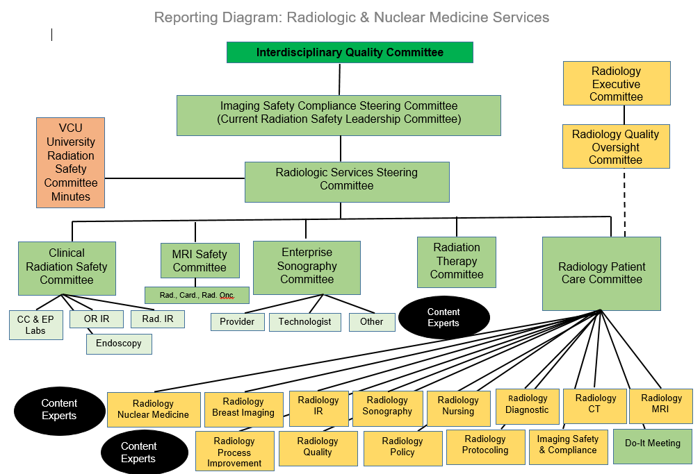

Slide 25
