Slide 1
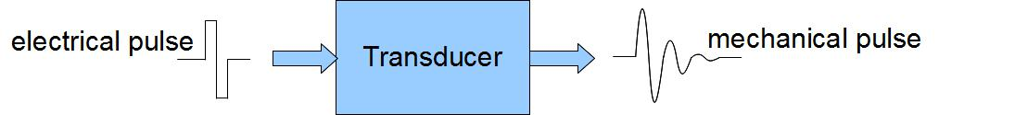
SPI

Slide 2
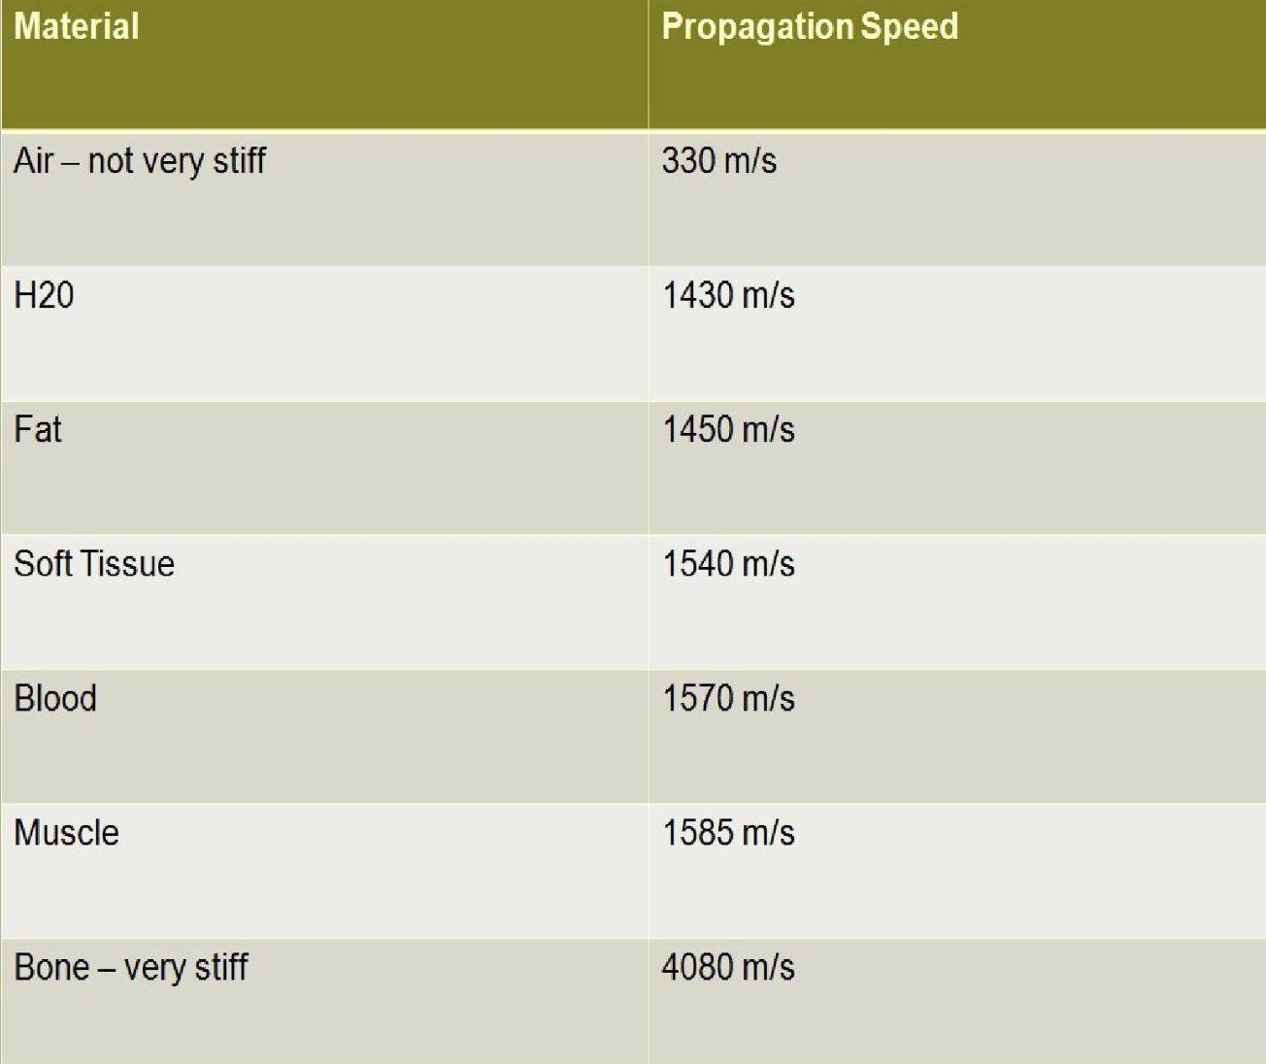
Speed is not constant

Slide 3
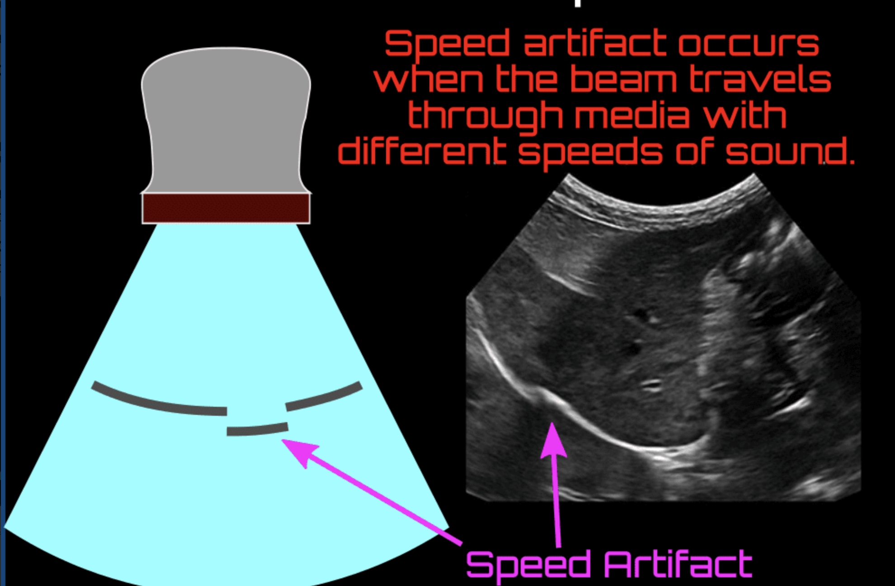
Speed displacement artifact

Slide 4
Beam width artifact
Ultrasound beam width artifact occurs when a reflective object located beyond the widened ultrasound beam, after the focal zone, creates false detectable echoes that are displayed as overlapping the structure of interest.
To understand this artifact, it is important to remember that the ultrasound beam is not uniform with depth, the main beam leaves the transducer with the same width as it, then narrows as it approaches the focal zone and widens again distal to this zone ¹.
Usually, it occurs when scanning an anechoic structure and some peripheral echoes are identified, i.e. gas bubbles in the duodenum simulating small gallstones and peripheric echoes in the bladder.
It is possible to avoid this artifact adjusting the focal zone to the depth level of interest and by placing the transducer at the center of the object being studied.

Slide 5
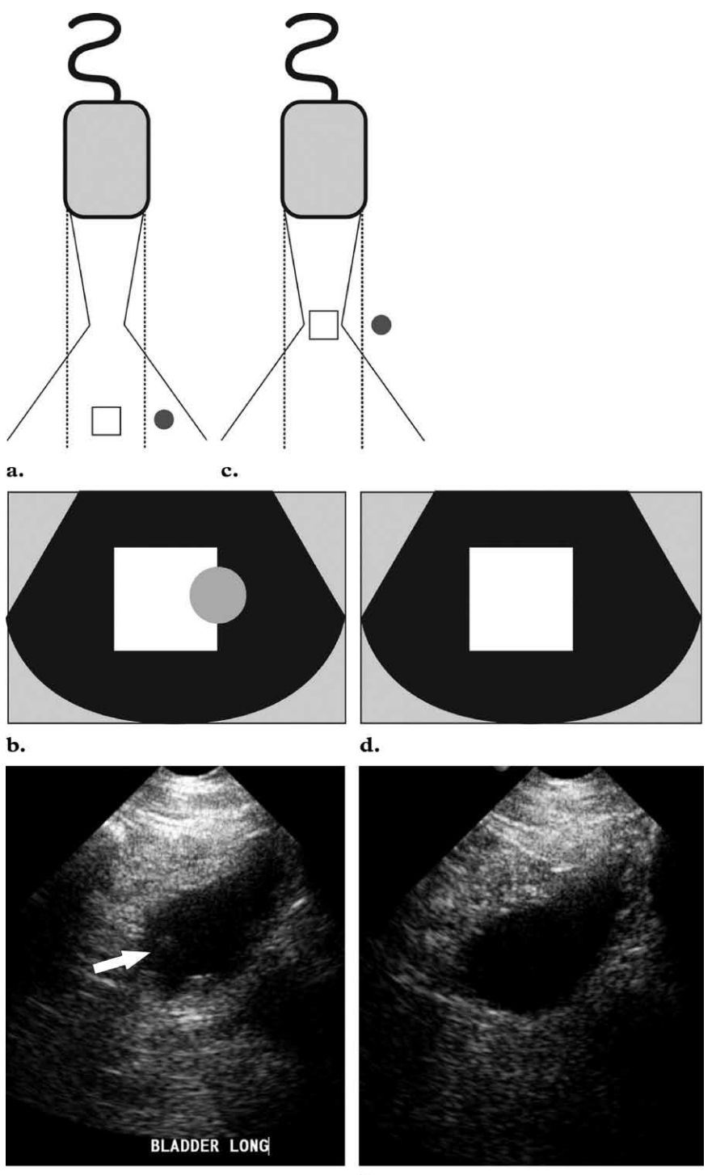

Slide 6
Spectral Broadening
Caused by turbulence in blood flow
Results in a "fill-in" of the area between a curve and the baseline due to varying velocity of reflectors in the sampling area
How to fix:
  Artifactual spectral broadening is dependent on the angle of insonation and will increase as the angle approaches 90
  Maintaining a proper orientation (<60°)
  use an appropriately sized sample volume

Slide 7
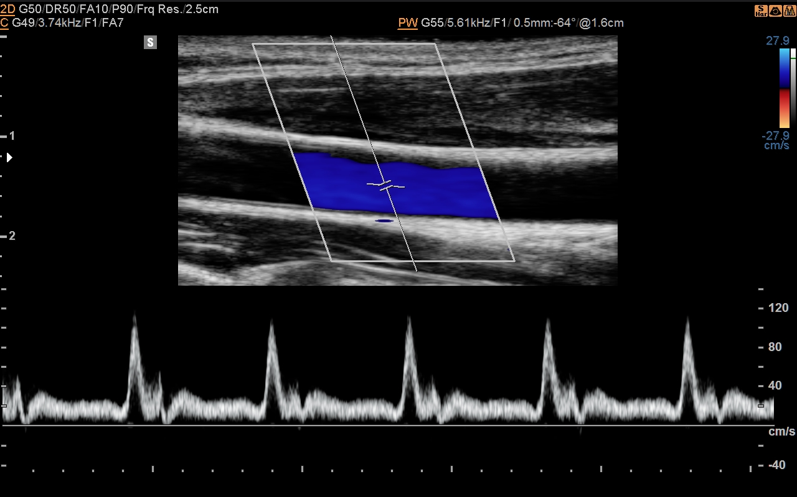
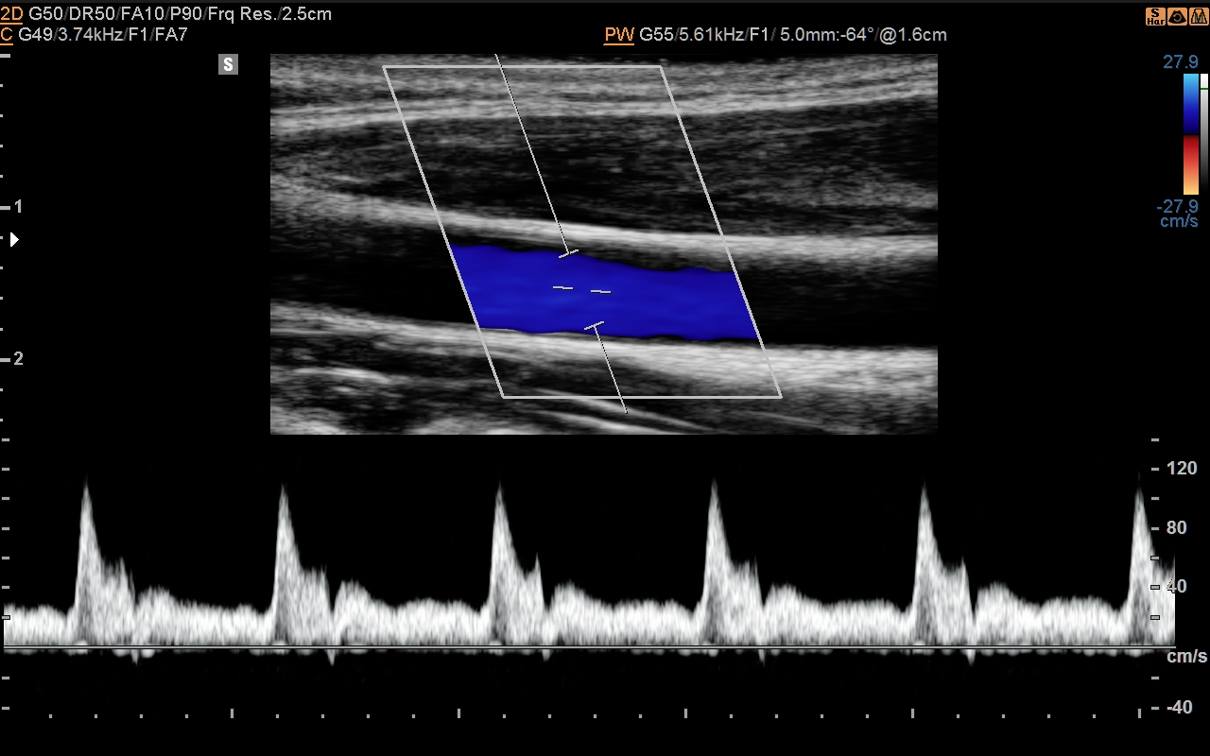
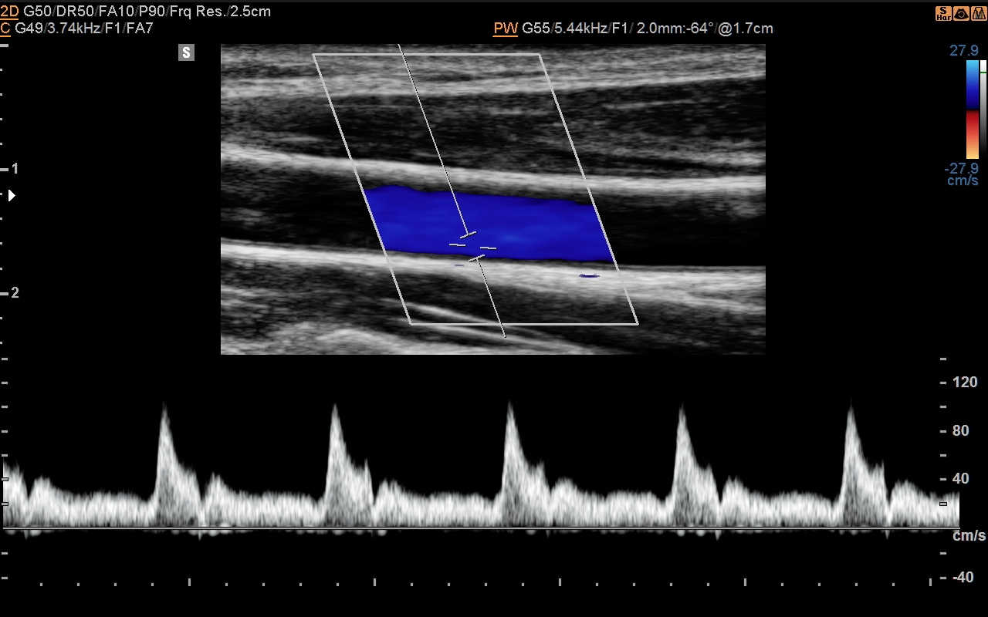

Slide 8
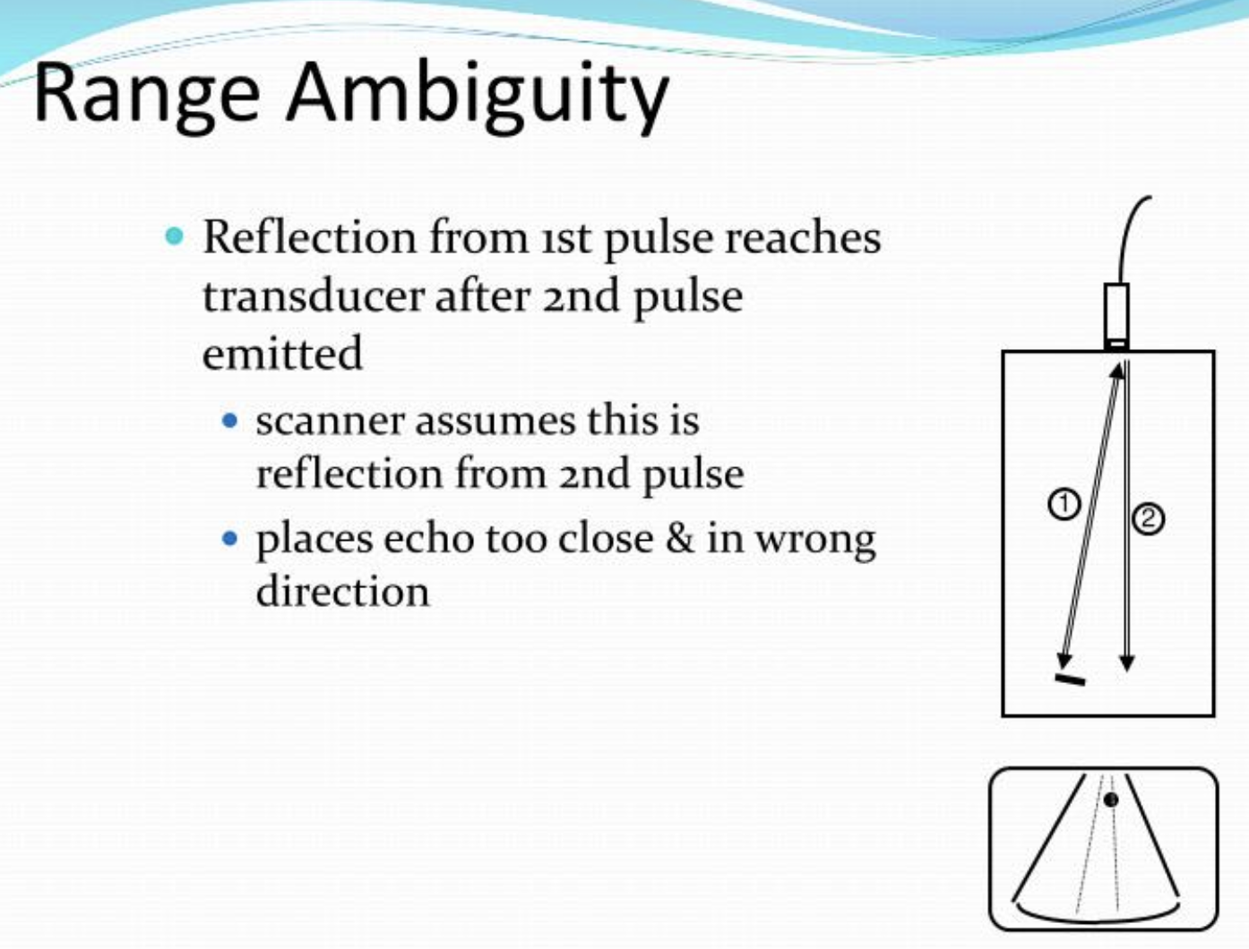

Slide 9
Two main parameters you need to know
Thermal Index
  Directly related to power output
  Color and spectral doppler increase output power, and thus increase TI
Mechanical Index
  Mechanical index is proportional to an ultrasound beam's peak negative pressure (or peak rarefaction pressure).
  It is also inversely proportional to the frequency of the beam. Therefore, higher frequencies have a lower mechanical index.

Slide 10
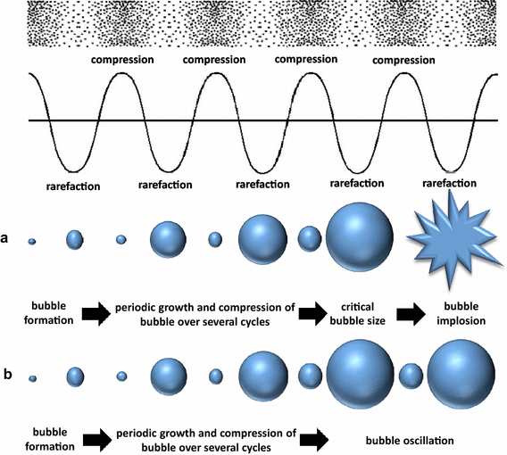

Slide 11
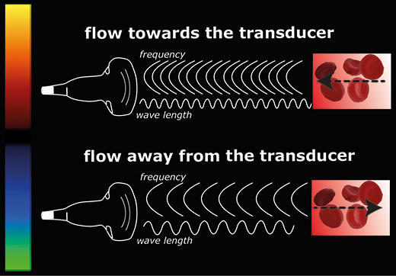
Doppler shift

Slide 12
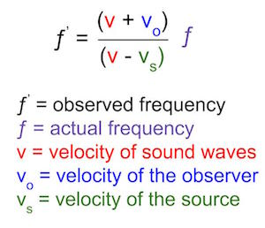
Doppler shift equation

Slide 13
Adjusted doppler equation
Adjusted (magnitude) Doppler equation
F = 2f_{o}(v/c)cos(Q)
where:
  F is Doppler frequency shift
  f_{o} is transmitted frequency from ultrasound probe
  v is the velocity of moving reflector
  c is the velocity of sound in the medium
  Q is the angle between ultrasound beam and axis of flow

Slide 14
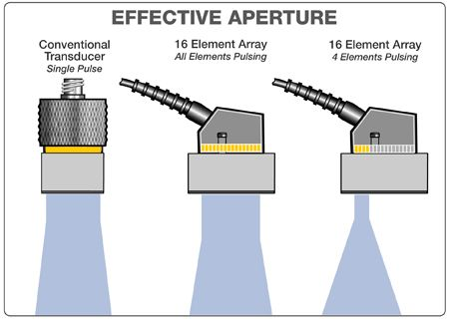
Beam steering

Slide 15
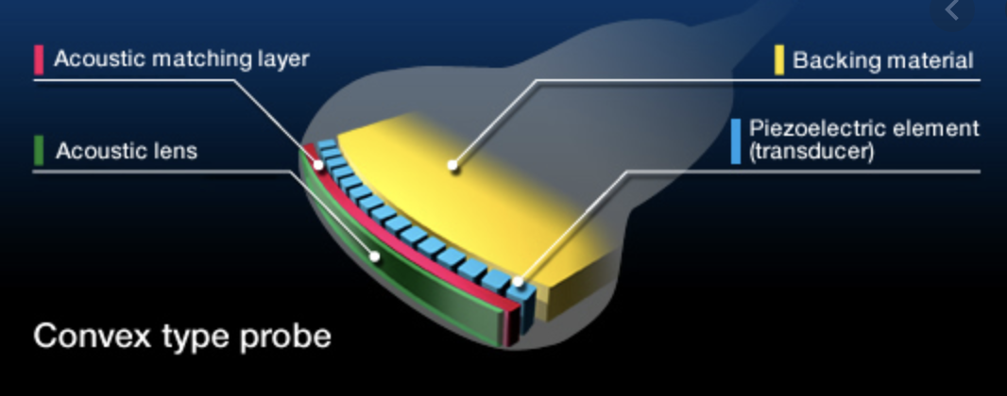

Slide 16
Tissue Harmonics
Ultrasound is sent out at the fundamental frequency – but it actually returns in integer multiples of this frequency
Filtering for only the harmonic waves decreases artifacts
The harmonic beam is very narrow, thus improving lateral resolution
Reduced slice thickeness – grating lobe artifact is removed

Slide 17
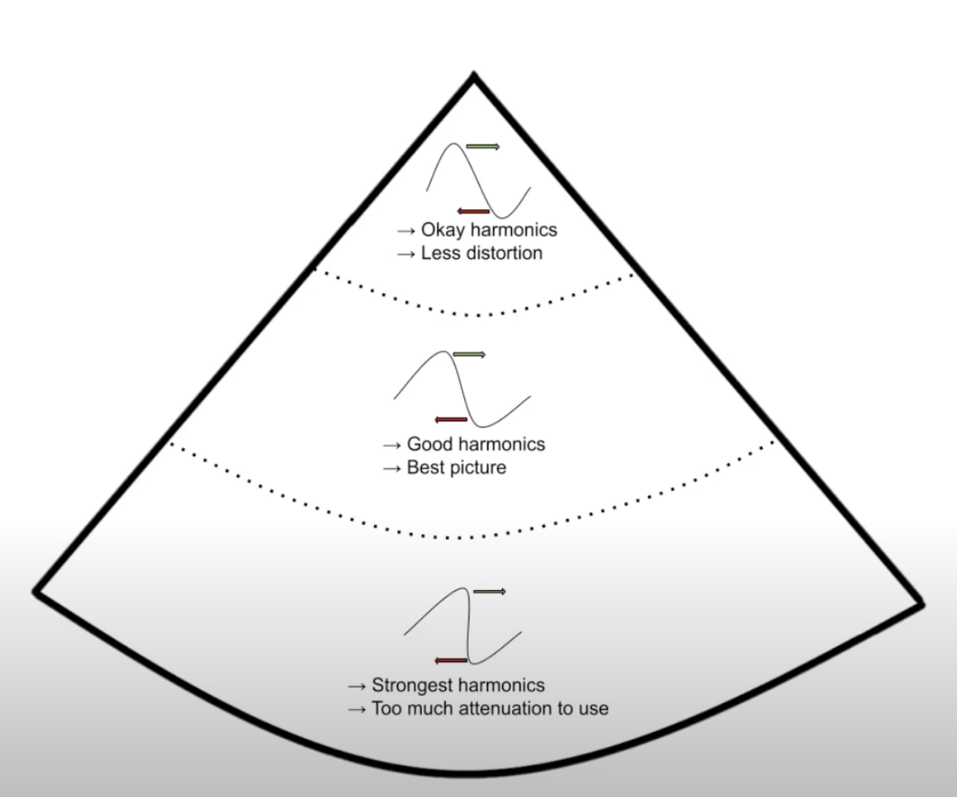
Tissue Harmonics

Slide 18
