Slide 1

^{4th} Annual!
SonoSlam
November 11, 2022
VCU Simulation Center

Slide 2
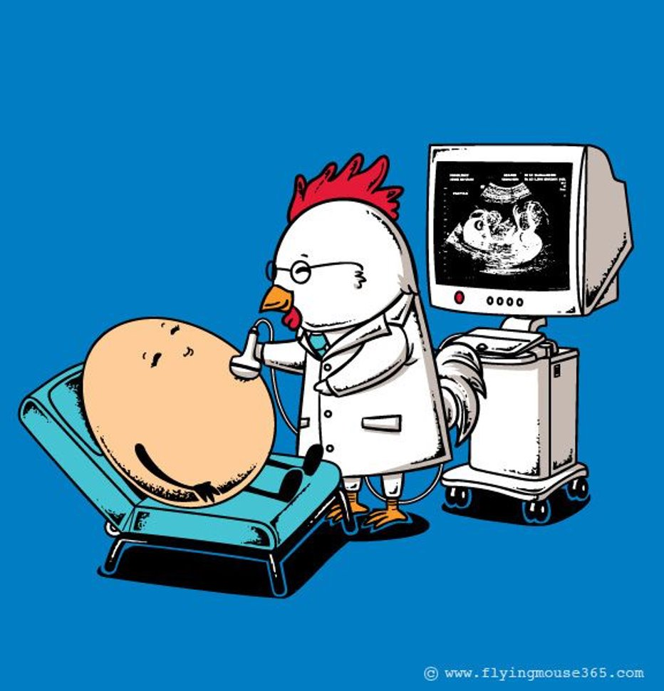
Introduction
Welcome to the 4th annual VCU School of Medicine SonoSlam
The goal of today is to allow you to practice ultrasound in a fun, interactive and collaborative fashion
The day will start with all teams in the same room answering quiz questions
Following this, you will rotate through the stations according to the handed out schedule
Wrap up and prizes will be back here in this room

Slide 3
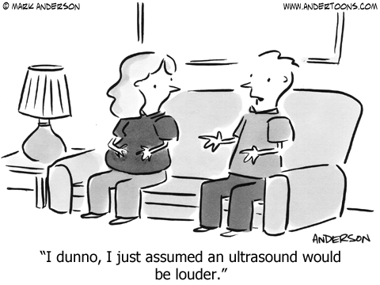
Rules for Quiz
All teams will compete with the opening quiz questions
Make sure you enter your team name into the Poll Everywhere app
Presentation is “USVCU”
You can change your answer, but only have 30 seconds to answer.
Do not yell out the answers

Slide 5
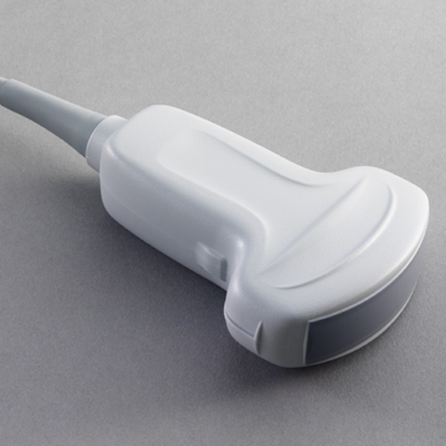
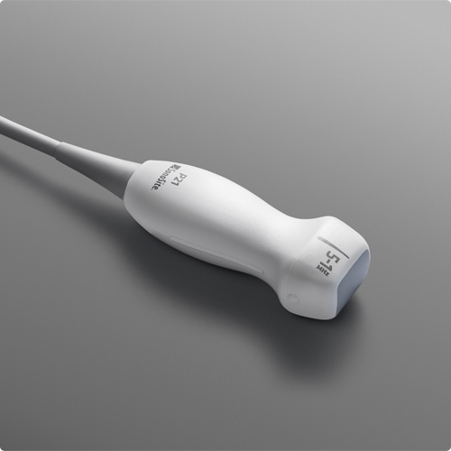
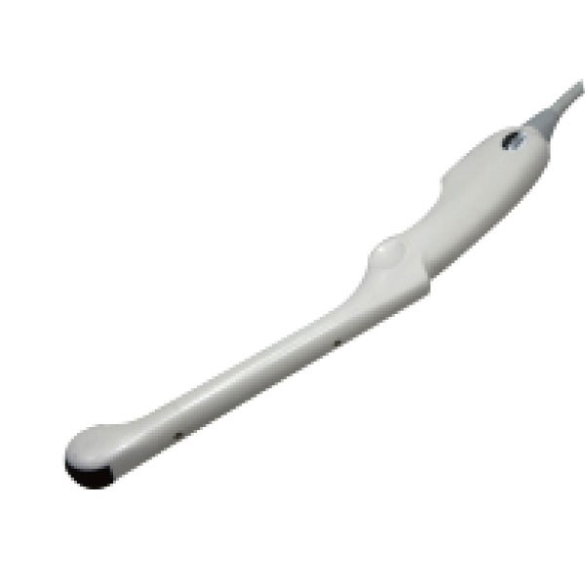
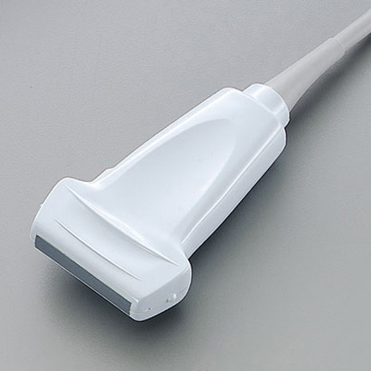
1) This probe utilizes electronic steering to get sound through tight spaces…
A
B
C
D

Slide 6
2) Increasing frequency helps improve what type of resolution?
a. Lateral
b. Axial
c. Temporal
d. Spatial

Slide 7
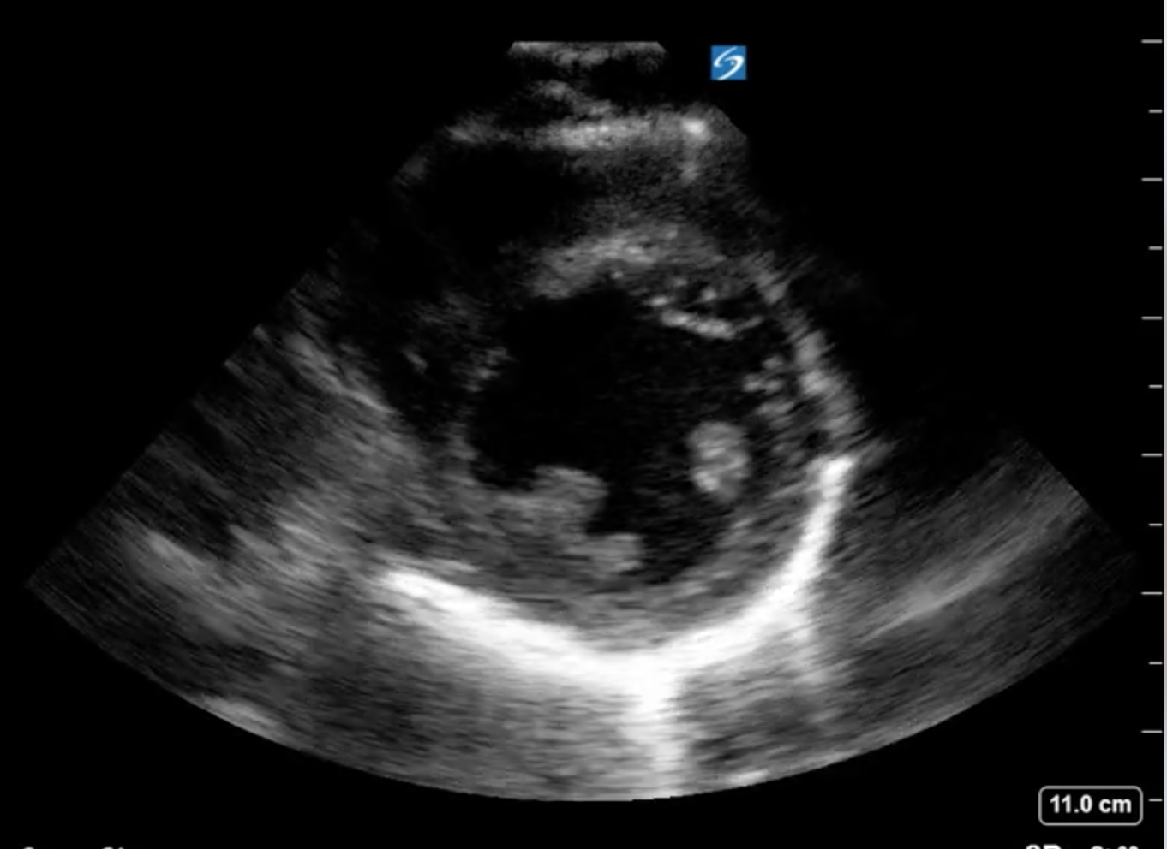
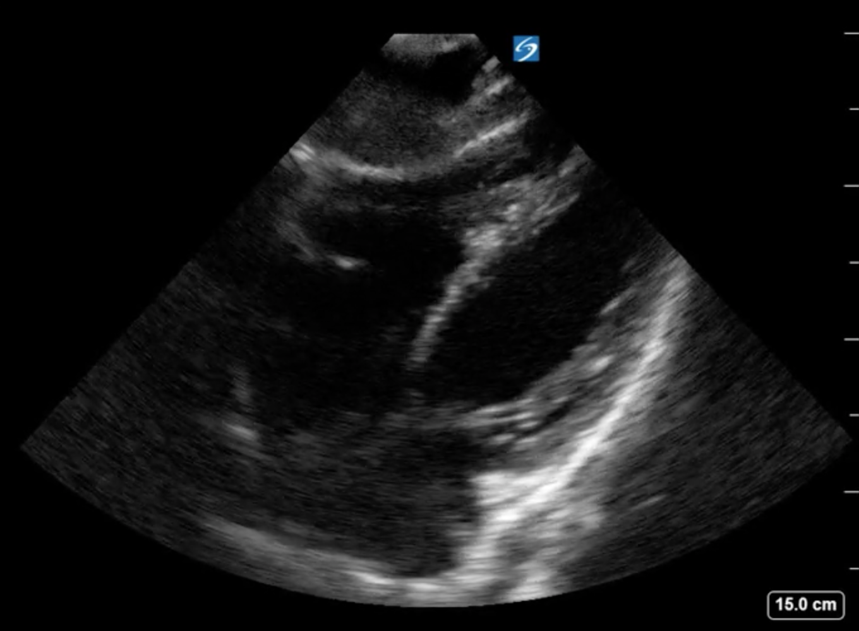
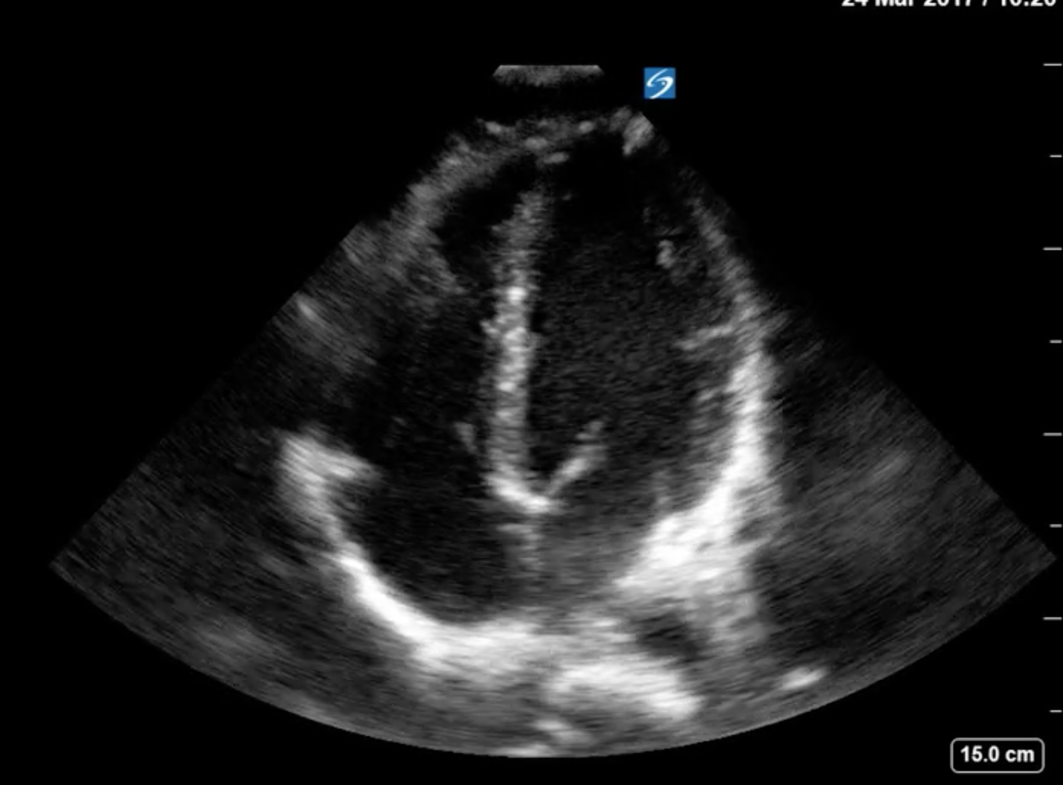
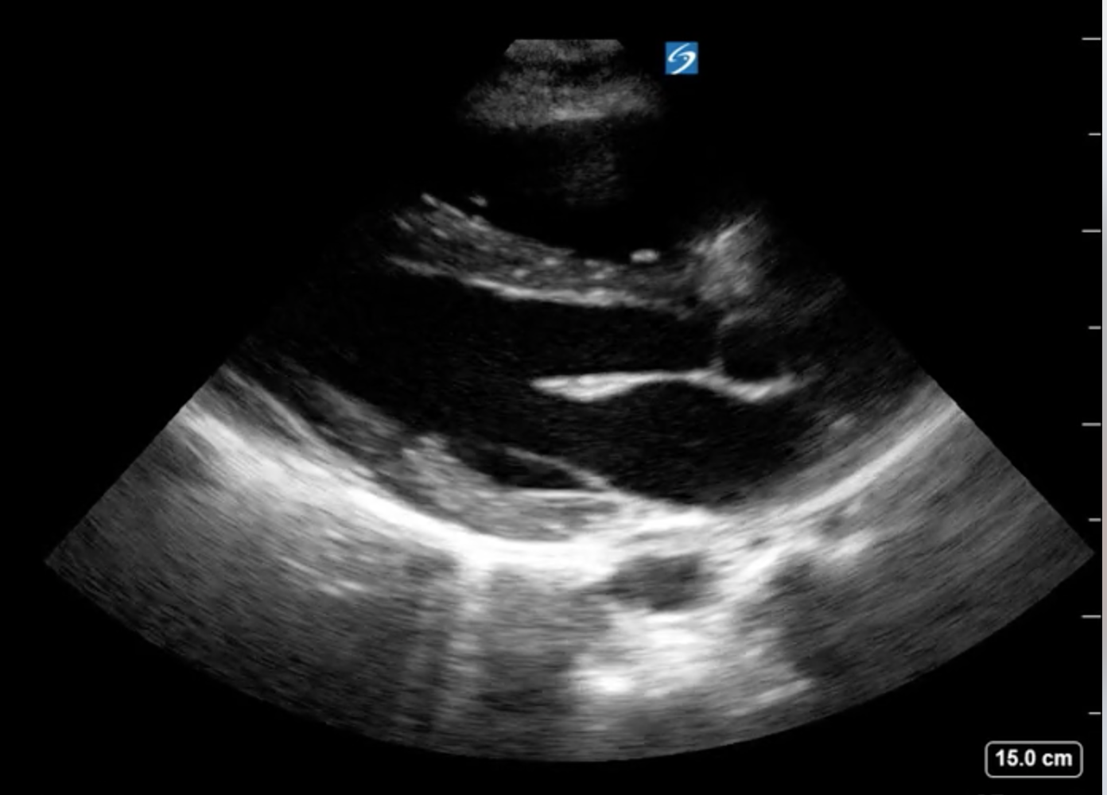
3) Which of the following is a subcostal image?
A
B
C
D

Slide 8
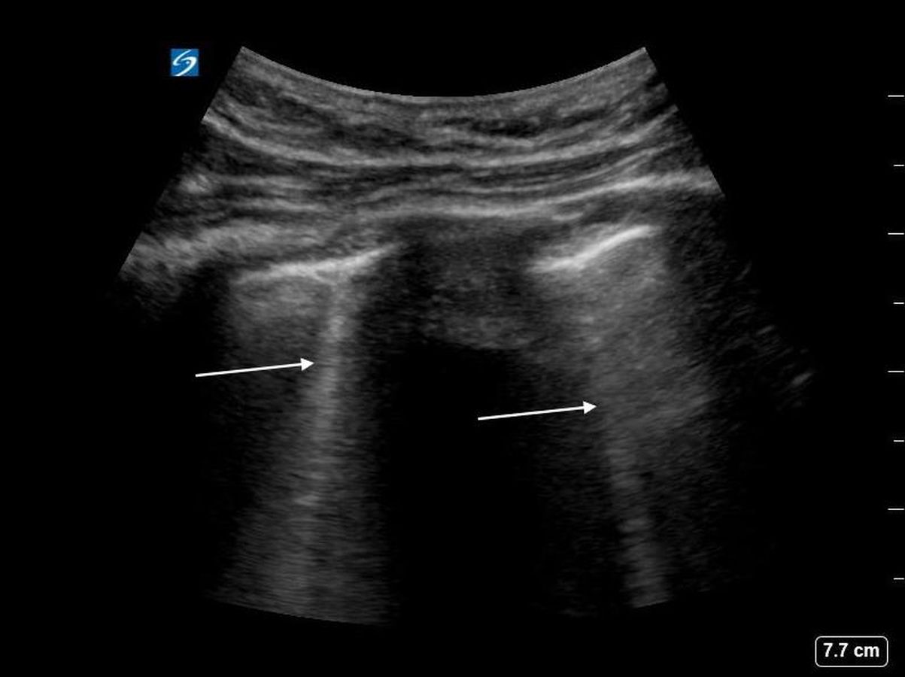
4) Write down the name of the artifact at the arrows:

Slide 9
5) Click on the descending aorta:

Slide 10
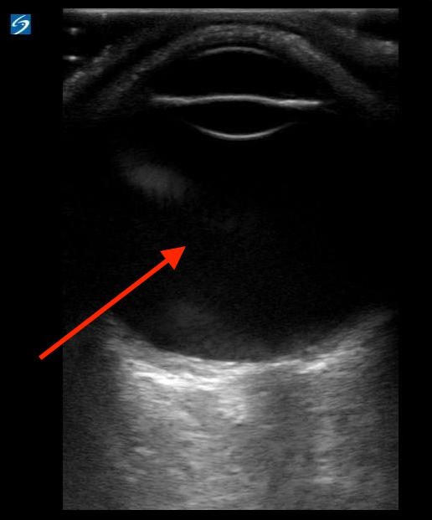
6) The arrow is pointing to which part of the eye?
A. Posterior chamber
B. Lens
C. Vitreous
D. Anterior chamber
E. Optic chamber

Slide 11
7) The standard convention for a sagittal plane image, is to have the marker dot pointed towards the patients _______________
A. Left side
B. Right side
C. Head
D. Feet

Slide 12
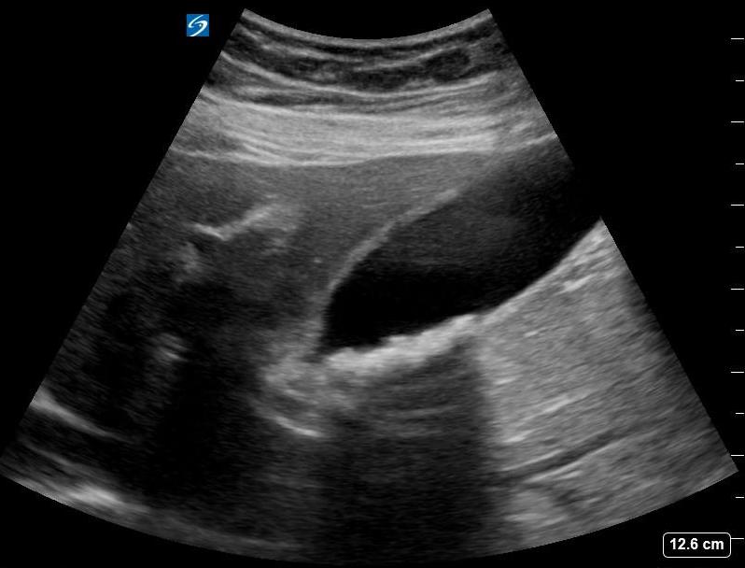
8) The correct diagnosis based on the image below is:
a. Cholecystitis
b. Choledocolithiasis
c. Cholecystectomy
d. Cholelithiasis

Slide 13
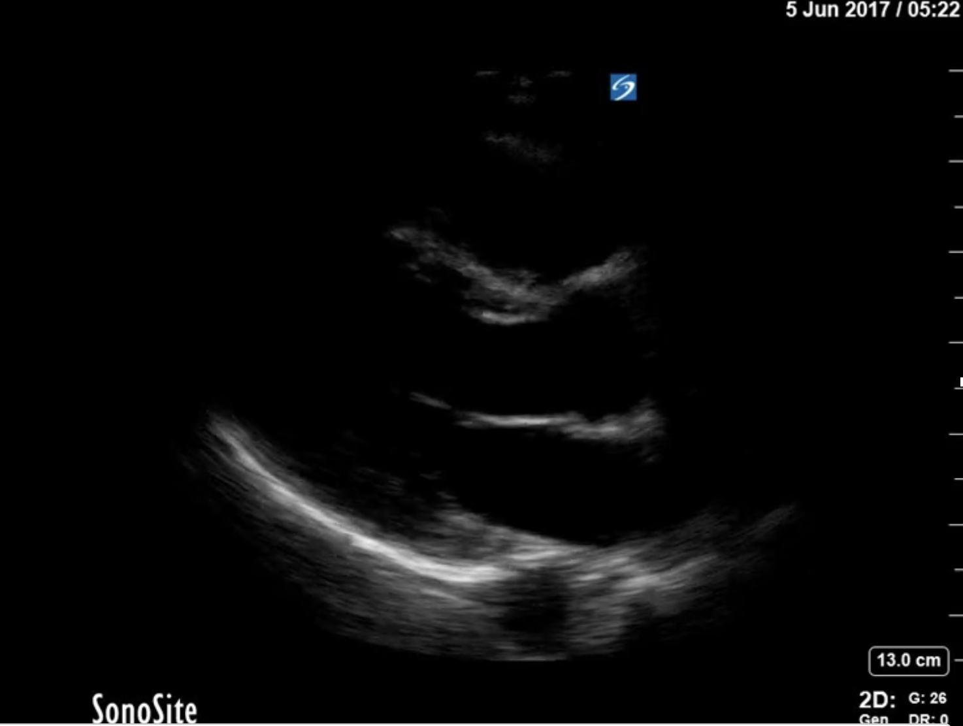
9) What is wrong with the following image?
a. Not enough gain
b. Wrong probe
c. Too much depth
d. Wrong plane

Slide 14
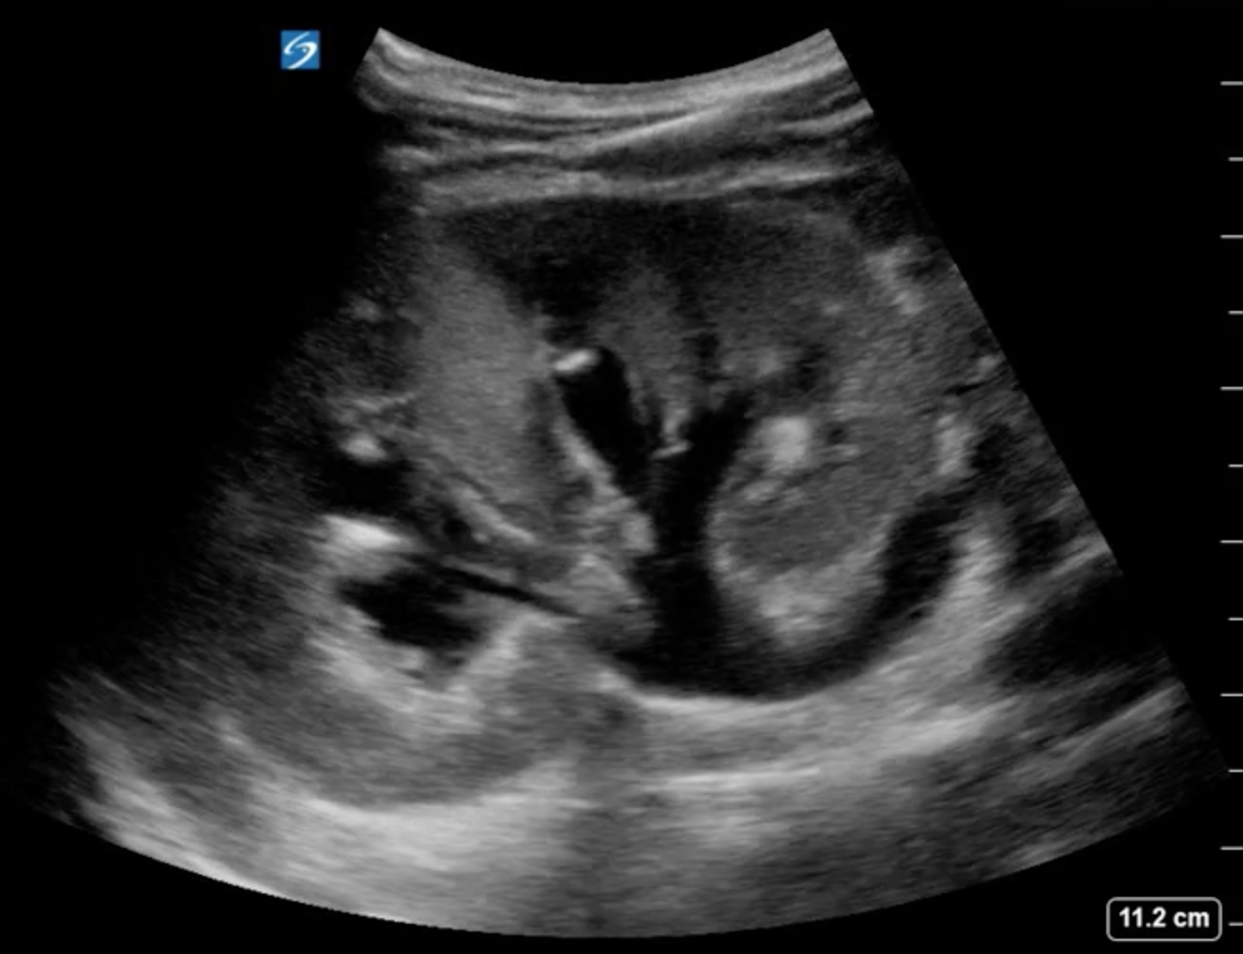
10) The most likely cause of the following pathology is?
a. Pyelonephritis
b. Ureteral Stone
c. Horseshoe kidney
d. Congenital defect

Slide 15
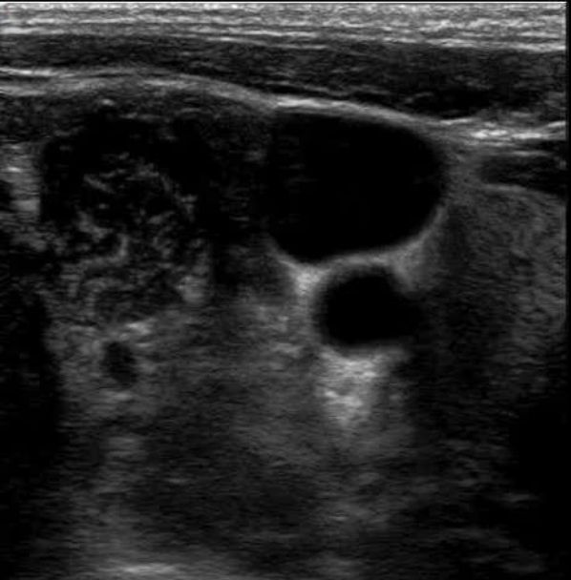
11) Your patient is septic and needs a central line, click on the appropriate place to put the catheter:

Slide 16
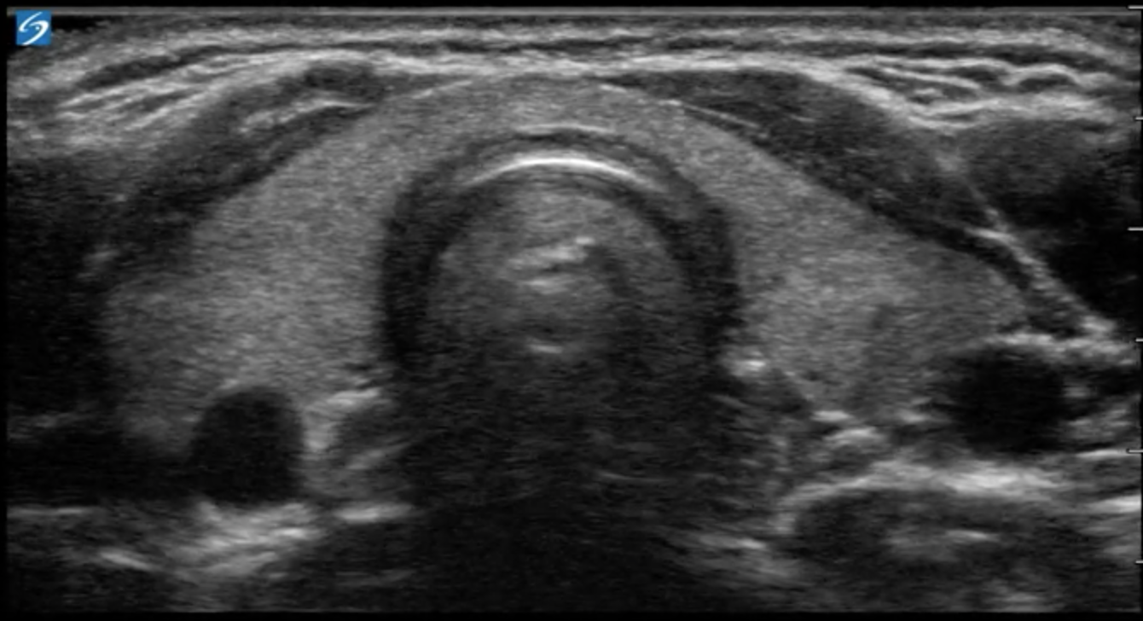
12) The arrow is pointing at which structure?
a. Trachea
b. Thyroid
c. SCM Muscle
Esophagus
Carotid artery

Slide 17
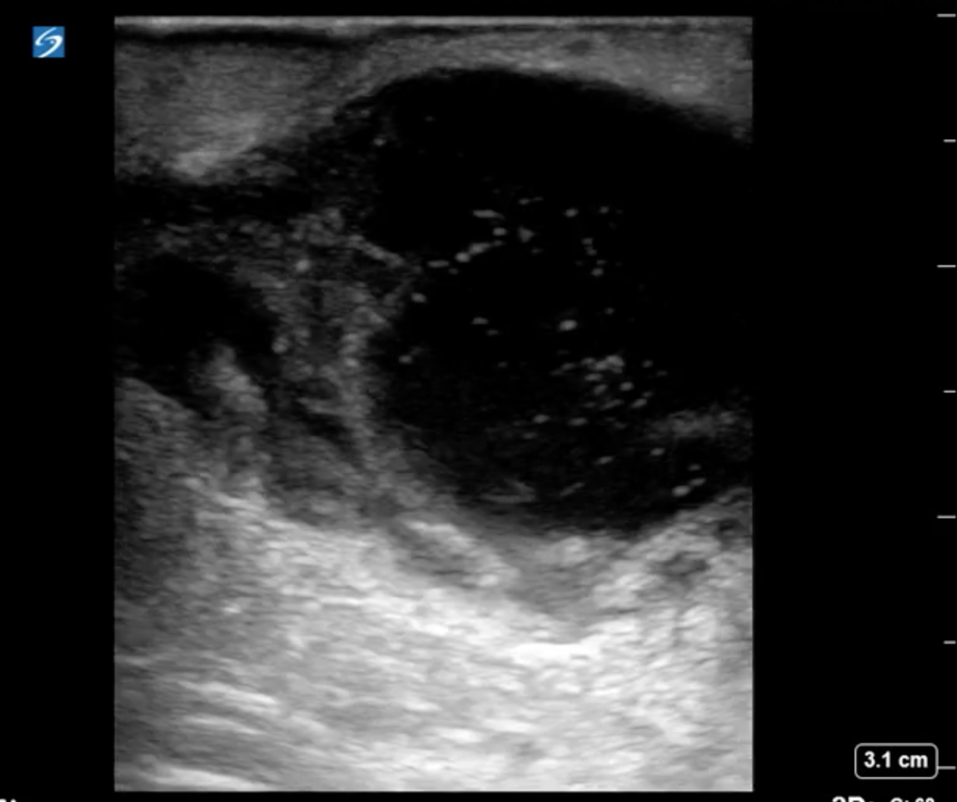
13) The following image of the soft tissue is most likely
a. Metallic foreign body
b. Tendon rupture
Tissue lipoma
Fluid filled abscess

Slide 18
END OF QUESTIONS

Slide 19
1) This probe utilizes electronic steering to get sound through tight spaces…
A
B
C
D
Image credit: Dye

Slide 20
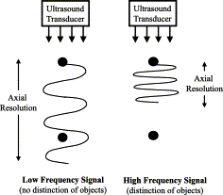
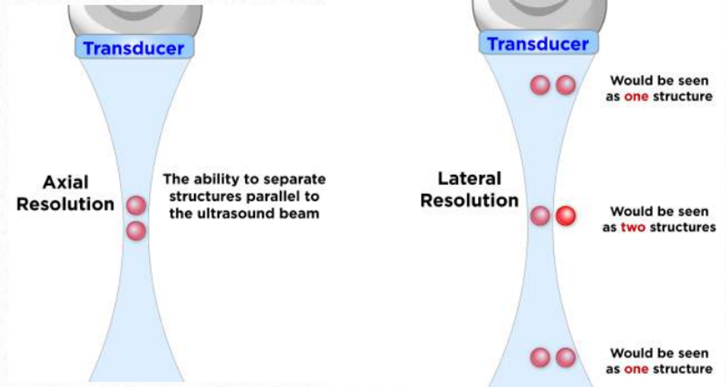
2) Increasing frequency helps improve what type of resolution?
a. Lateral
b. Axial
c. Temporal
d. Spatial

Slide 21
2) Which of the following is a subcostal image?
A
B
C
D

Slide 22
3) Write down the name of the artifact at the arrows:

Slide 23
4) Click on the descending aorta:

Slide 24
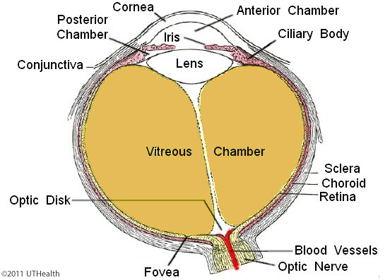
5) The arrow is pointing to the?
A. Posterior chamber
B. Lens
C. Vitreous
D. Anterior chamber
E. Optic chamber

Slide 25
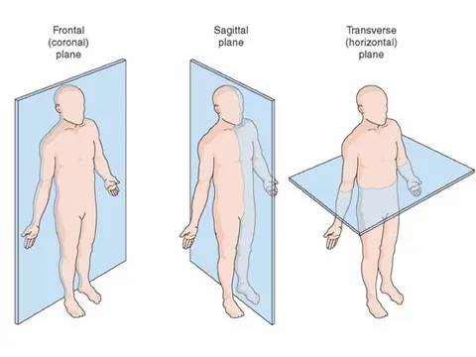
6) The standard convention for a sagittal plane image, is to have the marker dot pointed towards the patients _______________
A. Left side
B. Right side
C. Head
D. Feet

Slide 26
7) The correct diagnosis based on the image below is:
a. Cholecystitis
b. Choledocolithiasis
c. Cholecystectomy
d. Cholelithiasis

Slide 27
8) What is wrong with the following image?
a. Not enough gain
b. Wrong probe
c. Too much depth
d. Wrong plane

Slide 28
9) The most likely cause of the following pathology is?
a. Pyelonephritis
b. Ureteral Stone
c. Horseshoe kidney
d. Congenital defect

Slide 29
10) Your patient is septic and needs a central line, click on the appropriate place to put the catheter:

Slide 30
11) The arrow is pointing at which structure?
a. Trachea
b. Thyroid
c. SCM Muscle
Esophagus
Carotid artery

Slide 31
12) The following image of the soft tissue is most likely
a. Metallic foreign body
b. Tendon rupture
Tissue lipoma
Fluid filled abscess

Slide 32
4th Annual!
SonoSlam
Nov 11, 2022
VCU Simulation Center

Slide 33
SonoSlam REsults
BEST TEAM NAME

Slide 34
SonoSlam REsults
QUIZ BOWL:
FIRST Place:
Second Place:
Third Place:

Slide 35
SonoSlam REsults
OVERALL CHAMPIONS
3rd Place
2nd Place
1st Place

