Slide 1
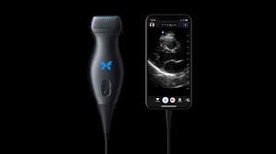
M3 Ultrasound Curriculum
How to use the butterfly

Slide 2
Check out
Butterfly checkout will be handled by the curriculum office (Kathy Naneyshvili)
Process will be the same as checking out other devices, requiring leaving a check in case of damage
There are lightning cable (apple) and usb-c (non apple) options available
Can check probe out for 1 week while on IM rotation

Slide 3
Check out
You will take the entire box which includes the charging cables and serial number on it
Must return in the same condition and in the box, just as when you received it
Please return the device charged so it is ready to go for the next user!

Slide 4

App
Download the Butterfly IQ app from the app store (apple) or google play (android)
You will receive email to your VCU account with invitation to create an account

Slide 5
How to Scan
Plug into your mobile device (iPad, iphone, android device)
Load up the app and sign in using the account you created

Slide 6
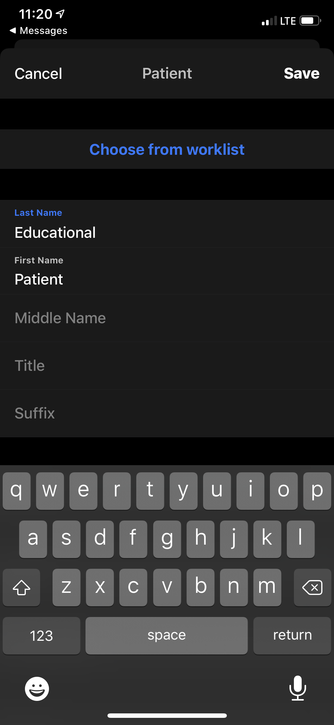
Set up patient info
Start a new study
Enter in Educational as the patient name
Do not enter any PHI, including MRN, birthdate, or name.

Slide 7
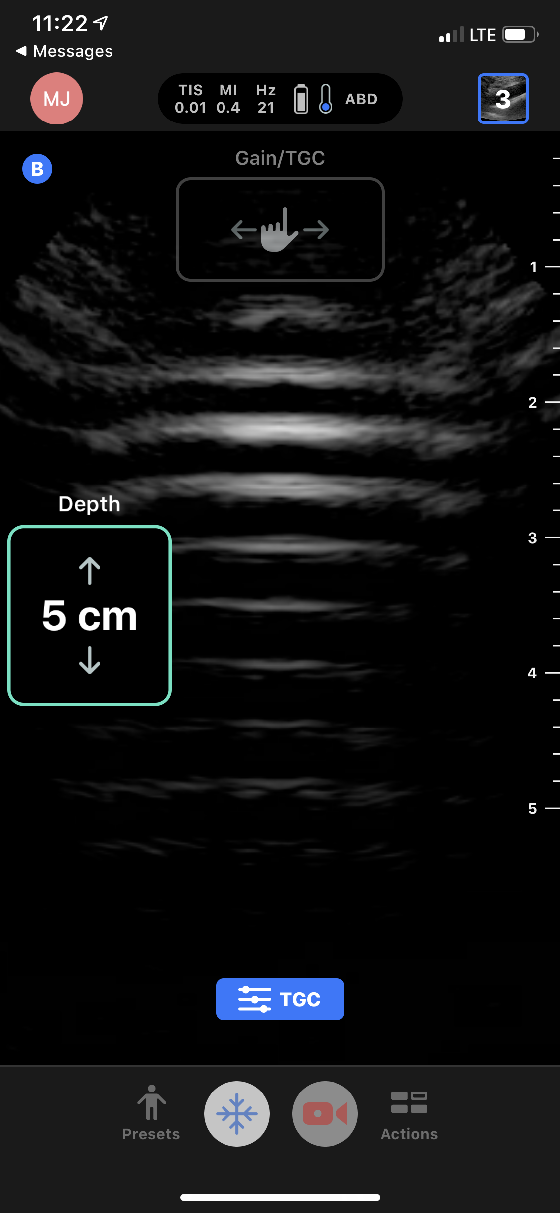
Basic controls
Depth
To adjust the depth slide your finger up or down for less or more depth

Slide 8
Basic controls
Gain
To adjust the gain, swipe your finger left for less gain, and right for more gain

Slide 9
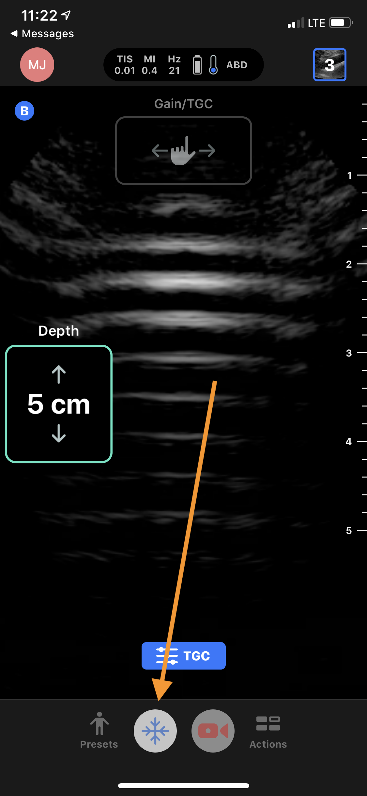
Basic controls
Freeze
To freeze and save a still image use the snowflake icon

Slide 10
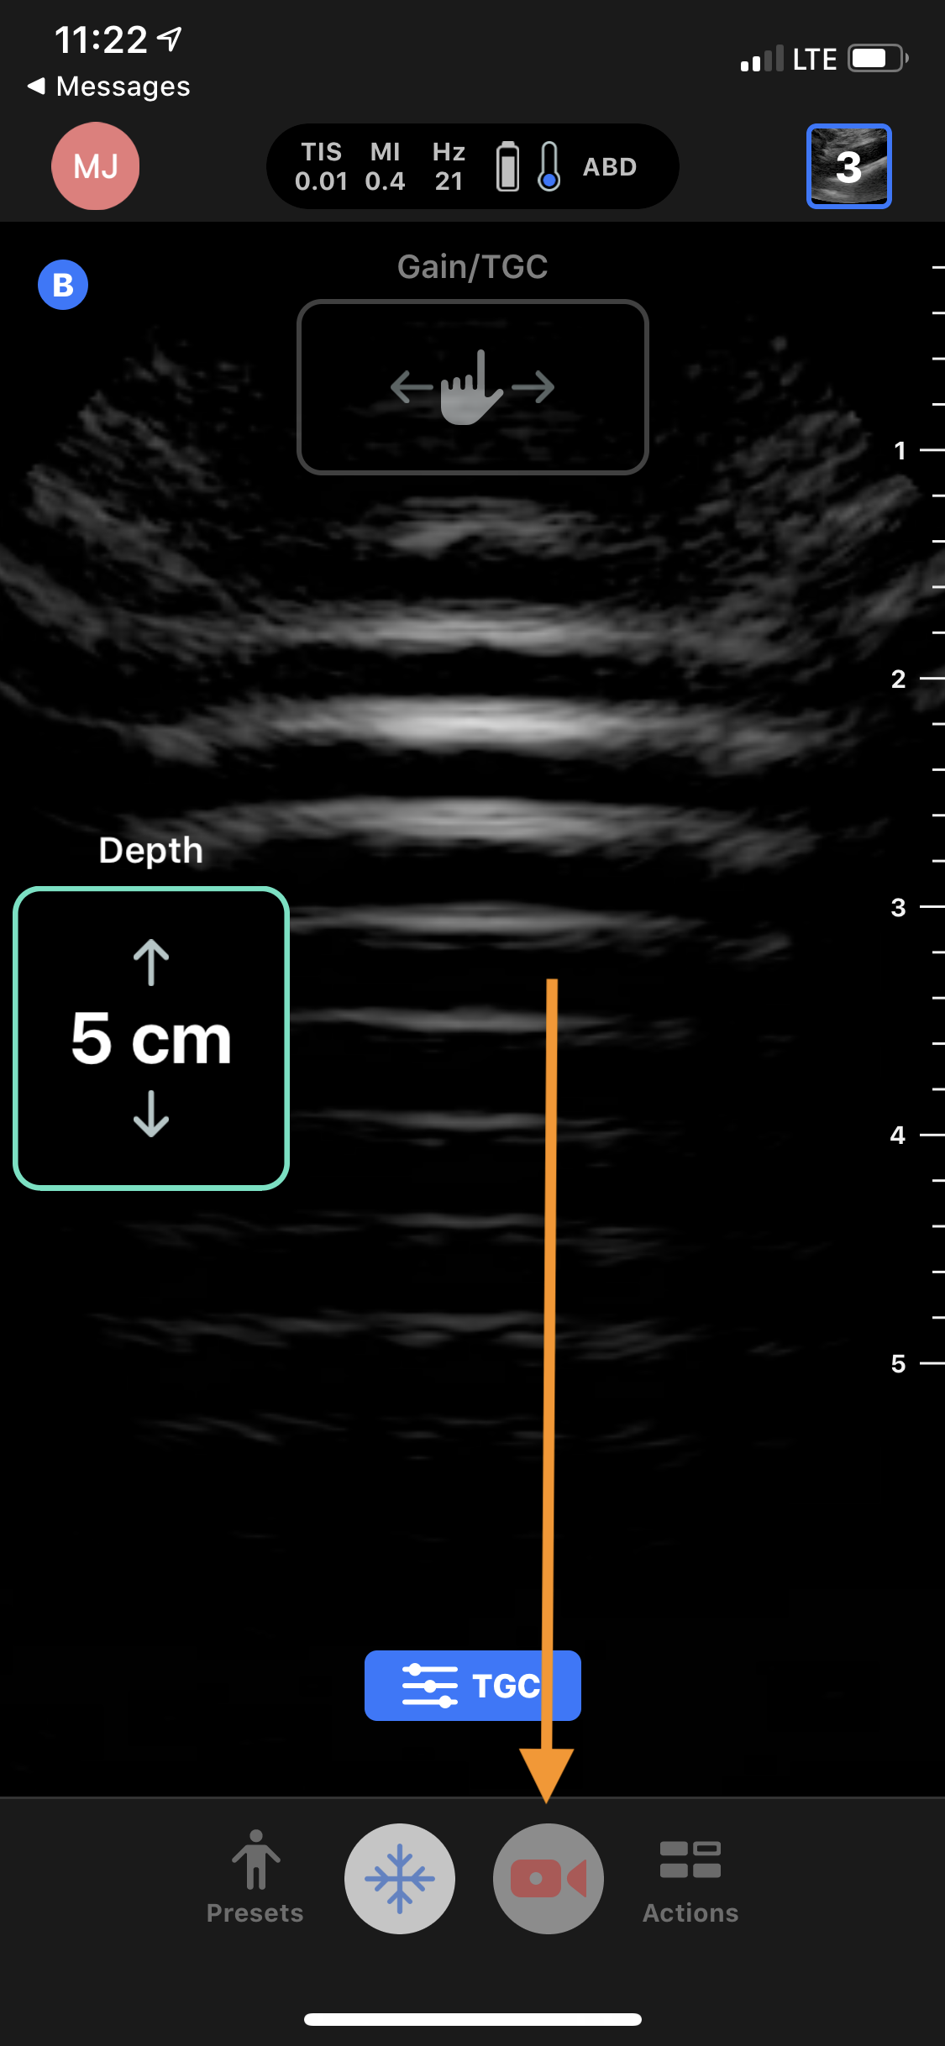
Basic controls
Save Video Clip
To record a prospective video clip, use the camera icon

Slide 11
Advanced controls
Please see user manual for additional controls
https://manual.butterflynetwork.com/butterfly-iq-user-manual_rev-aa-en.pdf

Slide 12
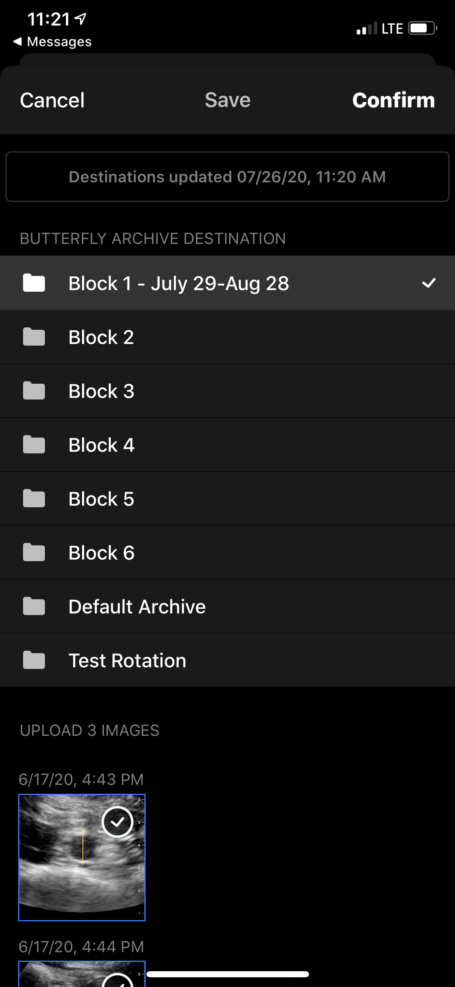
How to submit images
Please save images into the folder for your rotation
For M3, select the block you are on
For M4, Select the AI folder

Slide 13
Required scans
During your medicine rotation you will submit one of each of the following studies:
  Cardiac
  Thoracic
  Pulmonary
  DVT
Please see the attached power-point on what these views should look like
Additionally – built into the app are educational videos on how to obtain all of these studies

Slide 14
Feedback
Feedback will come directly back to the app – you should get a notification
You can log in and see comments/tips/instructions on each study that gets QA’d by a faculty member

Slide 15
Questions
Please email any of us with questions:
Jordan Tozer: Jordan.tozer@vcuhealth.org
Michael Joyce: john.joyce@vcuhealth.org
Sammy Pedram: Sammy.pedram@vcuhealth.org

