Slide 1

M3 ClinicaL US views

Slide 2
CARDIAC VIEWS

Slide 3
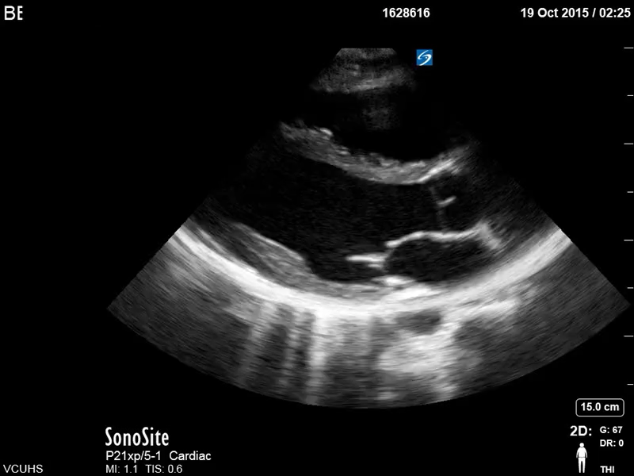
Notes:
PARASTERNAL LONG

Slide 4
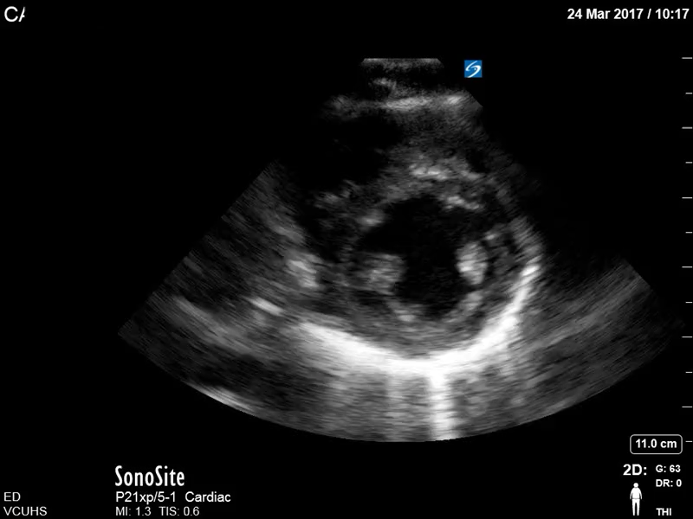
Notes:
PARASTERNAL SHORT

Slide 5
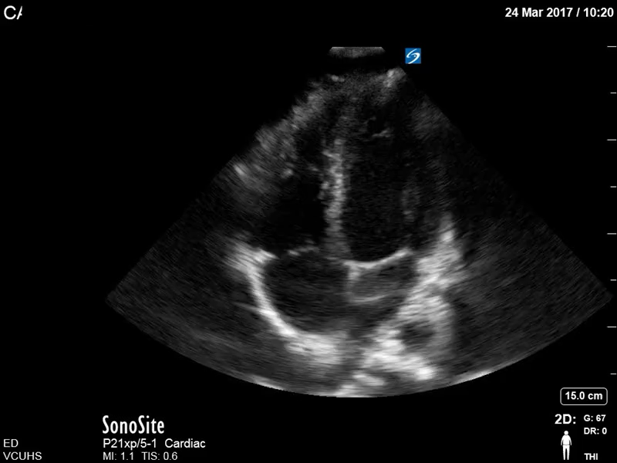

Slide 6
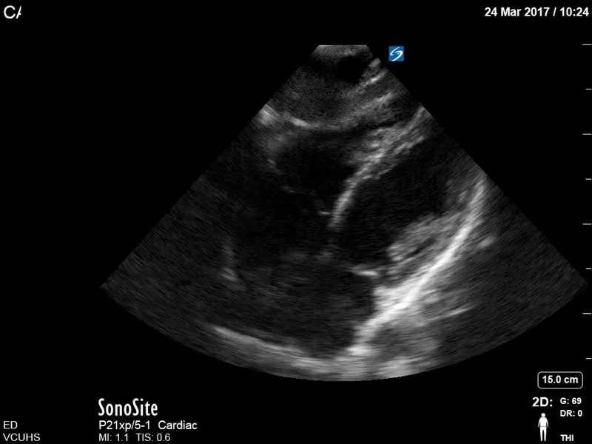
Notes:
SUBXIPHOID

Slide 7
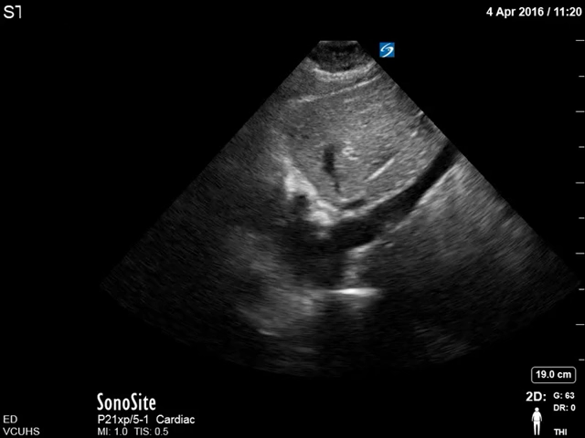
Notes:
IVC

Slide 8
PULMONARY VIEWS

Slide 9
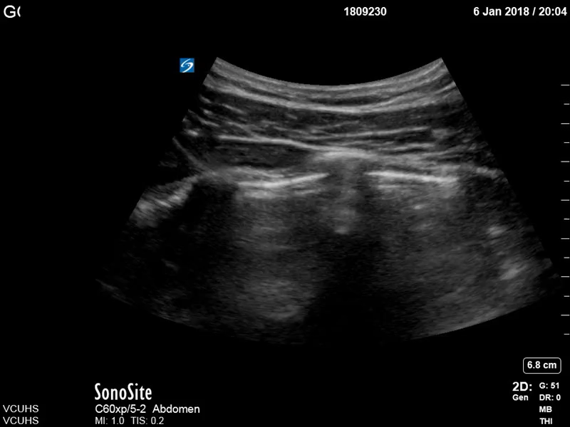
Notes:
NORMAL LUNG SLIDING

Slide 10
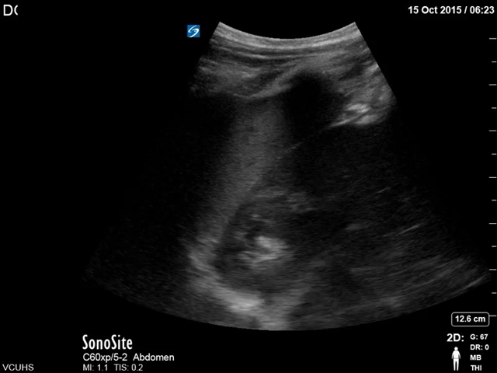
Notes:
RUQ VIEW TO SEE THE DIAPHRAGM AND DEPENDENT LUNG

Slide 11
AORTA

Slide 12
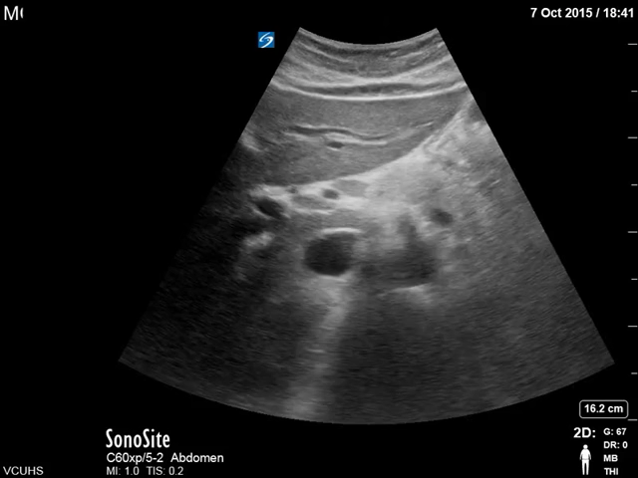
Notes:
PROXIMAL AORTA

Slide 13
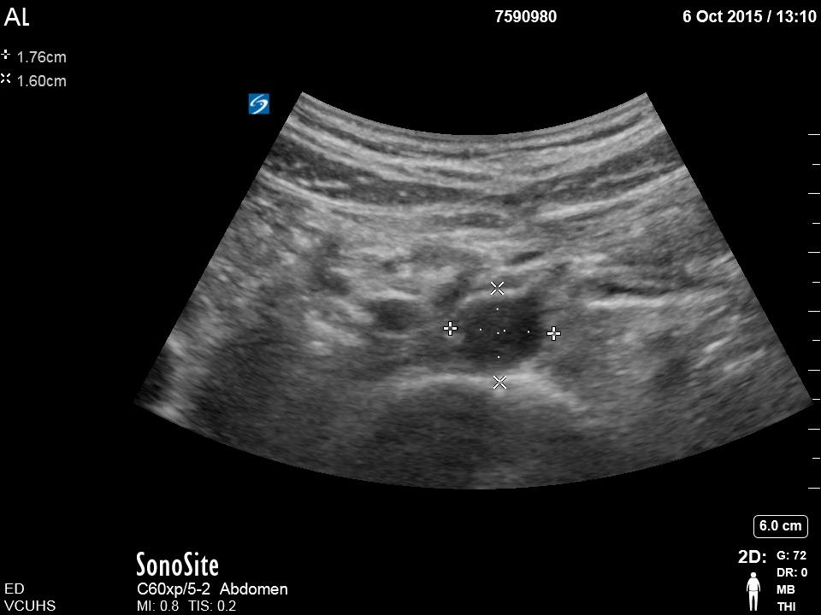
Notes:
AORTA MEASUREMENT

Slide 14
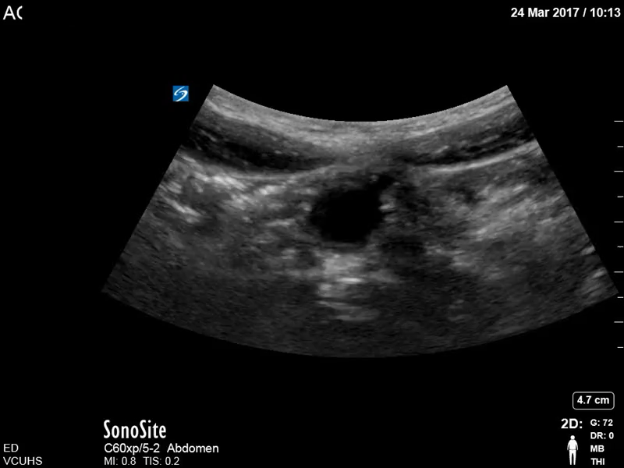
Notes:
AORTIC BIFURCATION

Slide 15
DVT

Slide 16
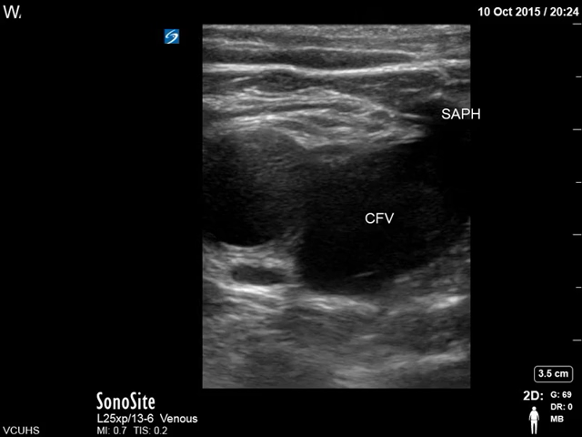
Notes:
PROXIMAL THIGH

Slide 17
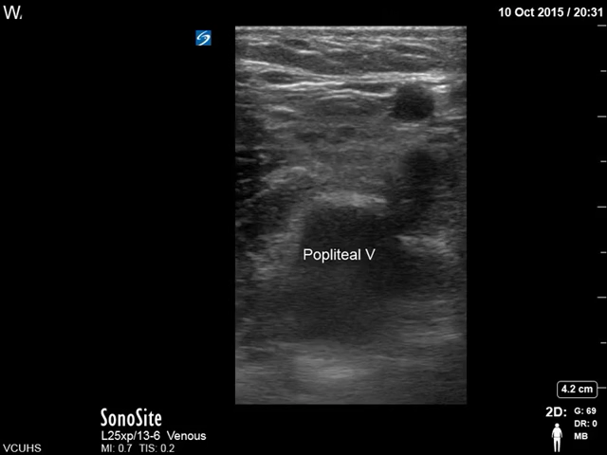
Notes:
POPLITEAL TRIFURCATION

Slide 18
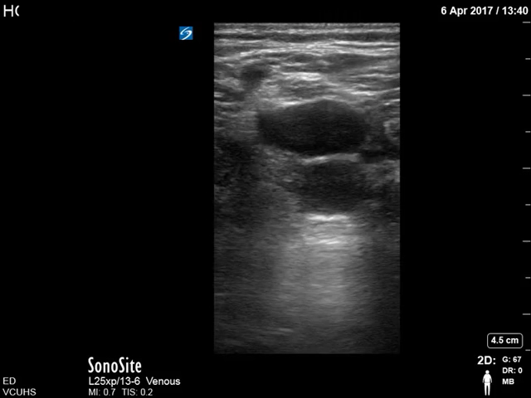
Notes:
POPLITEAL VEIN

